Slide 1

Hydrogen Gas Monitoring Serverless computing Project. PROFESSOR : VITTORIO SCARANO STUDENT : AYMEN BELFARHI
University of salerno
Computer science department
Speciality IOT
Notes:
© Copyright Showeet.com – Creative & Free PowerPoint Templates

Slide 2
THE PROBLEM
Detecting Hydrogen gas within the air and his concentration, is very important nowadays. Beceause humans are extremely harmful to hydrogen gas, which produces sparks when mixed with air. As a result, hydrogen gas must be monitored and measured on a regular basis to avoid these problems.
Notes:
© Copyright Showeet.com – Creative & Free PowerPoint Templates

Slide 3
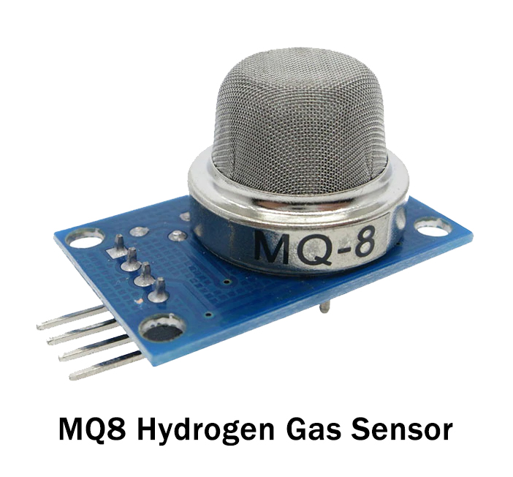
solution
However for this kind of detecting gas Methods, necessitate the use of a sensor.
The MQ8 sensor is the first in a series of MQ gas sensors that is specifically intended to detect hydrogen gas.
Photo credit: padrinan via Pixabay (Creative Commons Zero license)
Notes:
© Copyright Showeet.com – Creative & Free PowerPoint Templates

Slide 4
TOols Used
OVER VIEW ABOUT MQ8
The MQ8 sensor is a basic hydrogen gas
sensor that can detect hydrogen
concentrations in the air. As a result the MQ8 sensor can detect hydrogen gas concentrations ranging from 100 to 10000ppm. It is suitable for air quality monitoring applications due to its low cost.
Notes:
© Copyright Showeet.com – Creative & Free PowerPoint Templates

Slide 5
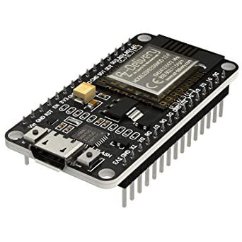

TOOLS USED
NodeMCU (Node MicroController Unit) is an open source software and hardware development environment that is built around a very inexpensive System-on-a-Chip (SoC) called the ESP8266.
NUCLIO is an open source and managed serverless platform used to minimize development and maintenance overhead and automate the deployment of data-science based applications.
Notes:
© Copyright Showeet.com – Creative & Free PowerPoint Templates

Slide 6


TOOLS USED
RabbitMQ is a messaging broker - an intermediary for messaging. It gives your applications a common platform to send and receive messages, and your messages a safe place to live until received.
The Arduino Integrated Development Environment is a cross-platform application that is written in functions from C and C++. It is used to write and upload programs to Arduino compatible boards such as NodeMCU.
Notes:
© Copyright Showeet.com – Creative & Free PowerPoint Templates

Slide 7


TOOLS USED
MQTIZER is a mobile MQTT client that can connect to any broker which shares the network with your phone, and to any broker on the cloud as well.
Docker is an open source containerization platform. It enables developers to package applications into containers—standardized executable components combining application source code with the operating system (OS) libraries and dependencies required to run that code in any environment.
Notes:
© Copyright Showeet.com – Creative & Free PowerPoint Templates

Slide 8
Libraries
ESP8266 is the library support for the ESP8266 chip to the Arduino environment. It lets us write sketches, using familiar Arduino functions and libraries, and run them directly on NODEMCU.
Pubsub Client a client library for MQTT messaging. MQTT is a lightweight messaging protocol ideal for small devices. This library allows you to send and receive MQTT messages.
Notes:
© Copyright Showeet.com – Creative & Free PowerPoint Templates

Slide 9
IMPLEMENTATION
RabitMQ
Arduino IDE
Ubuntu
Docker
Nuclio
The first step
was to install
Ubuntu on
a Virtual
Machine.
Second thing
Was to install
docker on
Ubuntu.
Third step was
by using Docker,
installing Nuclio
on Ubuntu.
Install RabitMQ
on Ubuntu
using Docker,
after Intaslling
Nuclio.
Downloading
Arduino on main operating System.
Notes:
© Copyright Showeet.com – Creative & Free PowerPoint Templates

Slide 10
IMPLEMENTATION
STEPS FOR IMPLEMENTATION:
Connecting Sensor with NodeMCu: Connect Mq8 sensor with NodeMcu using Jumper wire.
Uploading Code on Arduino: We have to install ESpwifi8266 and pubsubclient library after that we upload the code on NodeMcu.
Deploying Function On Nuclio: We have to deploy the given function on Nuclio by setting IP and triggers.
Queues RabitMQ: The function deployed on Nuclio will create Queues on RabitMQ.
MQTIZER: To display the data on SmartPhone we will set the RabbitMQ IP on the app and then it will generate the notifications of the CO2 AND VOC values on the SmartPhone.
Notes:
© Copyright Showeet.com – Creative & Free PowerPoint Templates

Slide 11
APPLICATIONS
Below are some of the applications for the MQ-8 gas sensor:
This sensor is used to measure the hydrogen concentration within the air.
It detects gas leakages within the industry.
The gas sensor is used in mines.
Used in AC & refrigerators.
Notes:
© Copyright Showeet.com – Creative & Free PowerPoint Templates

Slide 12
APPLICATIONS
As a result, the MQ8 Gas Sensor is extremely useful in detecting gas leaks using detecting equipment in homes, industries, public places, and so on. Because of the sensor's quick response time and high sensitivity, measurements must be taken as soon as possible.
Notes:
© Copyright Showeet.com – Creative & Free PowerPoint Templates

Slide 13
Thank you !
01
Notes:
© Copyright Showeet.com – Creative & Free PowerPoint Templates

