Slide 1

SUPERVIED LEARNING Decision Tree

Slide 2
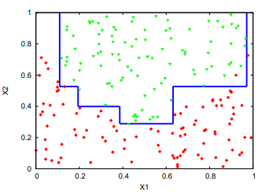
DEFINITIONS
Supervised learning : refers to the subset of machine learning methods which derive models in the form of input-output relationships
The goal of supervised learning is to identify a mapping from some input variables to some output variables on the sole basis of a given sample of joint observations of the values of these variables .
- Attributes or features
- Objects
- Learning sample.
For example : in medical domains patients marked in red are those suffering from some disease while patients marked in green are the healthy ones.
The goal could be to help a physician to predict the status of a new patient (the output) for which the test results are known (the inputs)

Slide 3

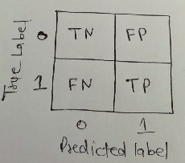
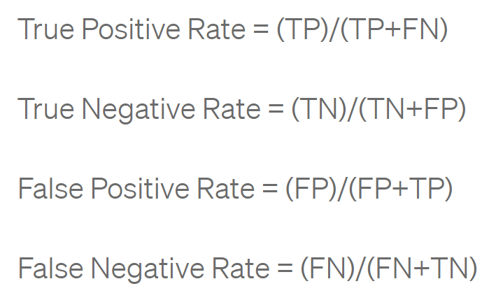
DEFINITIONS
The selection of algorithm for achieving good results is an important step. The algorithm evaluation is mostly judge by prediction accuracy
Confusion Matrix :
The most simple way to calculate the accuracy of any classification machine learning model
- True Positive Rate is called Recall
model is good at capturing positive instances
- False Positive Rate is called as Precision
when the model predicts a positive instance, it is likely to be correct

Slide 4
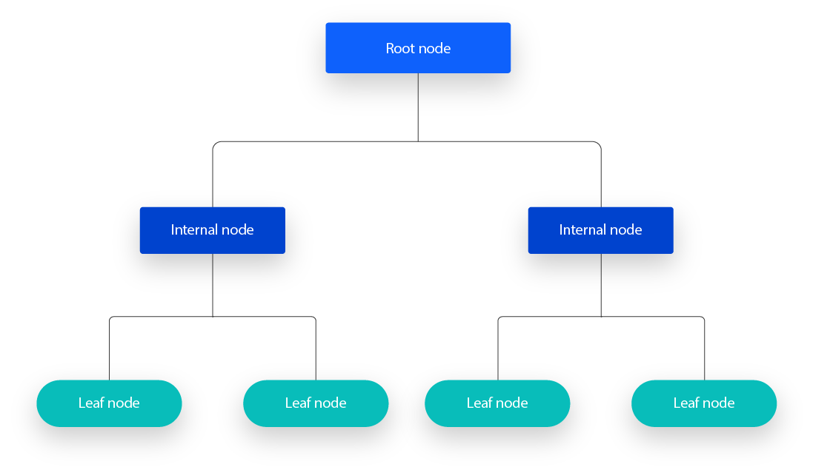
DEFINITIONS
DECISION TREES :
non-parametric supervised learning algorithm, which is utilized for both classification and regression tasks
Is currently one of the most important supervised learning algorithms for classification and prediction
classify instances by sorting them based on feature values, where each node in a decision tree represents a feature in an instance to be classified, and each branch represents a value that the node can assume (Class)

Slide 5



ALGORITHME
Types of Decision Trees
- ID3: created by Mr.Ross Quinlan, This algorithm leverages entropy and information gain (IG) as metrics to evaluate candidate splits.
- C4.5: This algorithm is considered a later iteration of ID3. It can use information gain or gain ratios to evaluate split points within the decision trees.
-CART: The term is an abbreviation for “classification and regression trees”, by Leo Breiman. This algorithm typically utilizes Gini impurity to identify the ideal attribute to split on.

Slide 6
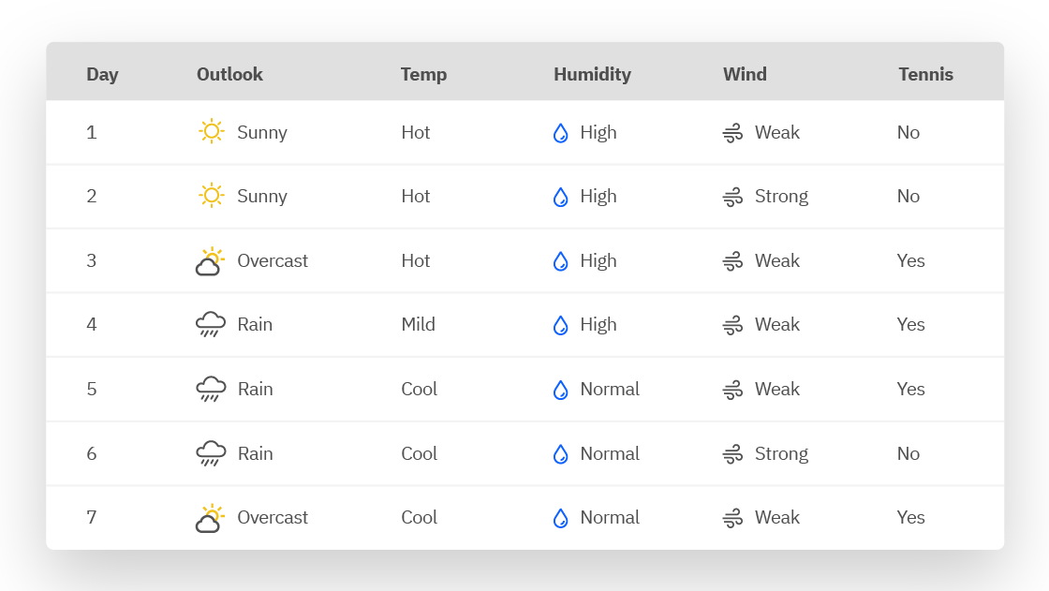
ALGORITHME : THEORY
1. Check for base cases
2. For each attribute “a” calculate
i. Normalized the information gain (IG) from splitting on attribute “a”.
3. Find the best “a”, attribute that has highest IG
4. Create a decision node: node that splits on best of “a”
5. Recurse on the sub-lists obtained by Splitting on a best and add those nodes as children of node
Example

Slide 7
ALGORITHME : PRACTICAL
LET’S GO
TO
THE LAB

Slide 8
CONCLUSION
ANY QUESTION ?

