Slide 1
Data Warehouse
I1 FSS
Aymen Ben Youssef , Med Ali Kechrida

Slide 2
Introduction
This project focuses on building a comprehensive data warehouse and an OLAP cube to analyze a dataset about used cars. Using the ETL methodology, the data was processed and transformed with Talend (as well as the python script method), including steps such as filtering, cleaning, and mapping, to prepare it for storage in a MySQL (SQL server) database.
The structured database serves as the foundation for a robust data warehouse, organizing information into dimensions and facts for analytical purposes.
Finally, Pentaho was utilized to create an OLAP cube, enabling multidimensional analysis and advanced reporting capabilities. This workflow demonstrates the seamless integration of ETL, data modeling, and business intelligence tools to derive actionable insights from raw data.

Slide 3
Conception
ID_brand
brand
Brand
Mileage
model
Price_Analitics
Price
Fueltype
Mileage
ID_Mileage
information
ID_information
Transmission
date
ID_date
year

Slide 4
Plan
02
03
ETL
01
Conclusion
Cube Olap

Slide 5
01
ETL

Slide 6
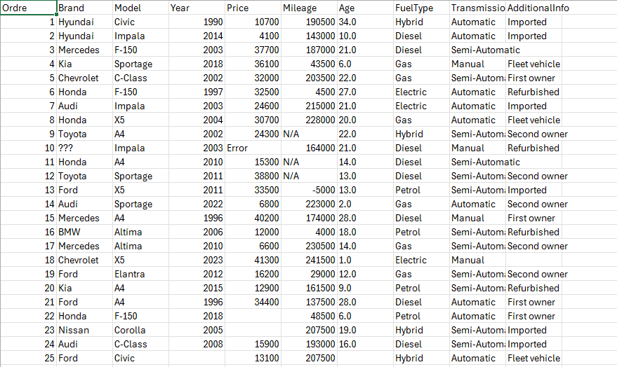
The dataset
We’ve used a csv file as data source for our datawarehouse project,
the dataset is about used cars to analyse the price of cars based on the brand ,year,mileage,etc…

Slide 7
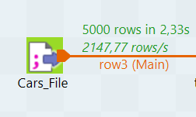
Extraction in Talend
Input :
Cars_File.csv
5000 rows
10 columns

Slide 8

Extraction in python
We used the pandas library to extract the data from the file used_cars.csv

Slide 9
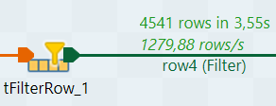
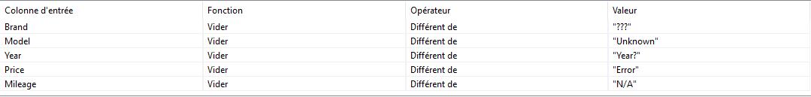
Transforme in Talend
tFilterRow_1:
We applied this filter to remove any rows containing illogical or invalid values.

Slide 10
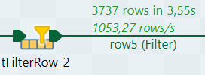
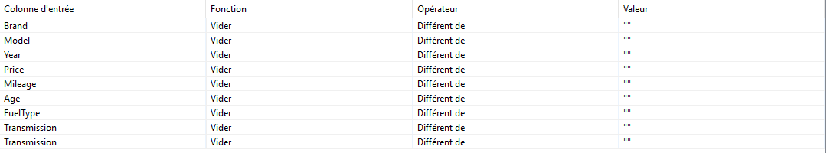
Transforme in Talend
tFilterRow_2:
We applied this filter to remove any rows containing a null value.

Slide 11
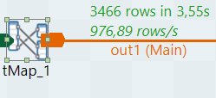
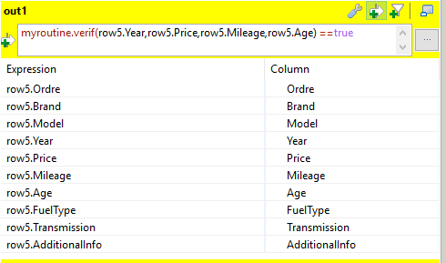
Transforme in Talend
Tmap_1:
We used in the first tMap the routine method to filter the data using a java code which is shown in next slide.

Slide 12
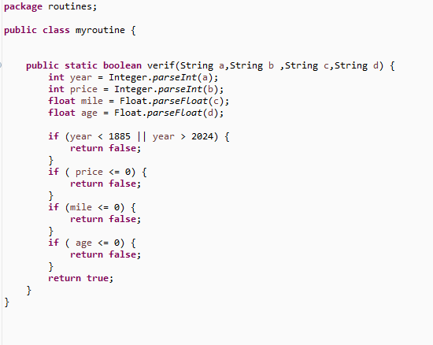
Transforme in Talend

Slide 13

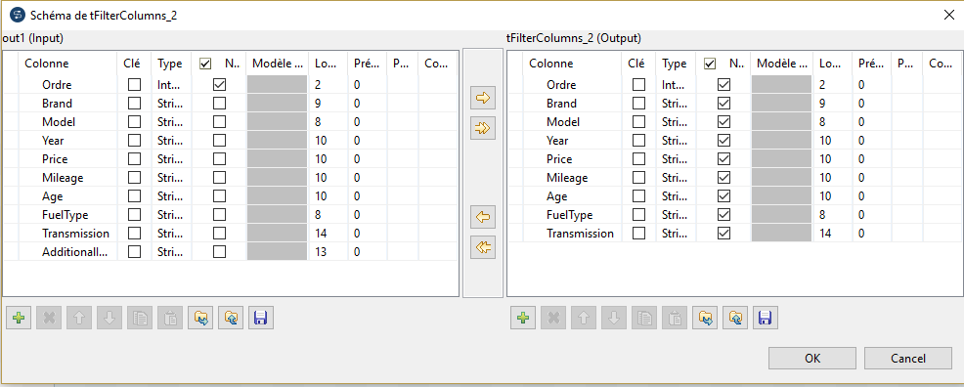
Transforme in Talend
tFilterColumns_1:
We used this filter to remove the column “additionnal information”.

Slide 14
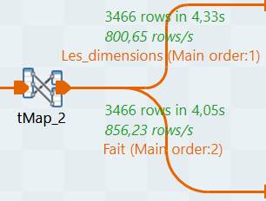
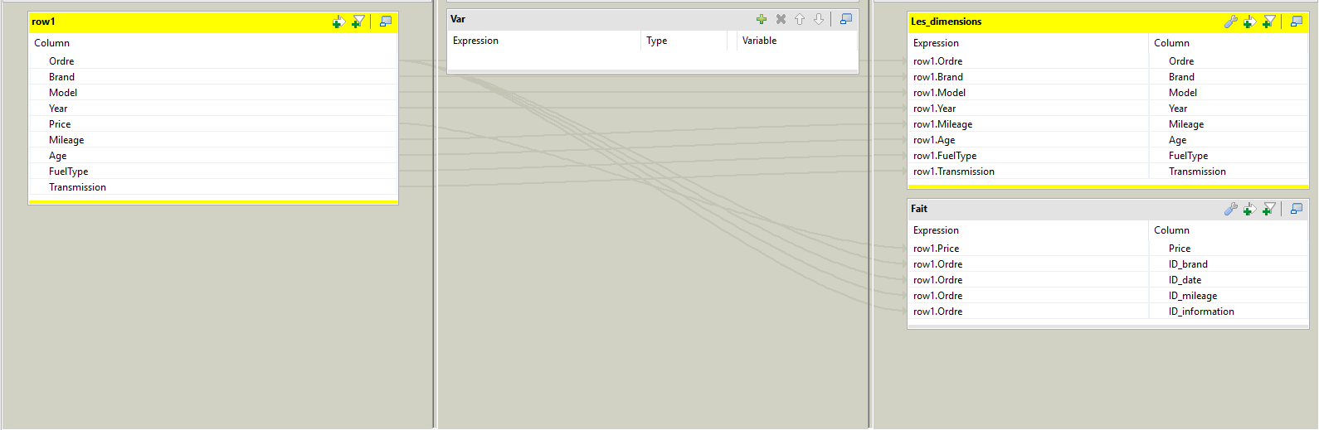
Transforme in Talend
tMap_2 :
We used this tMap to
devide the dataset
columns into dimensions
Columns and fact columns.

Slide 15
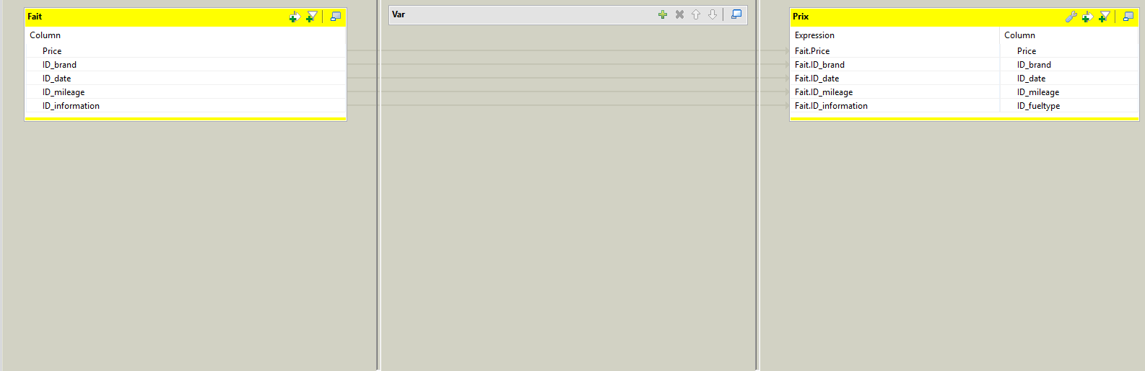
Transforme in Talend
tMap_3 :
We applied this tMap
to identify the fact name
As « Prix ».

Slide 16
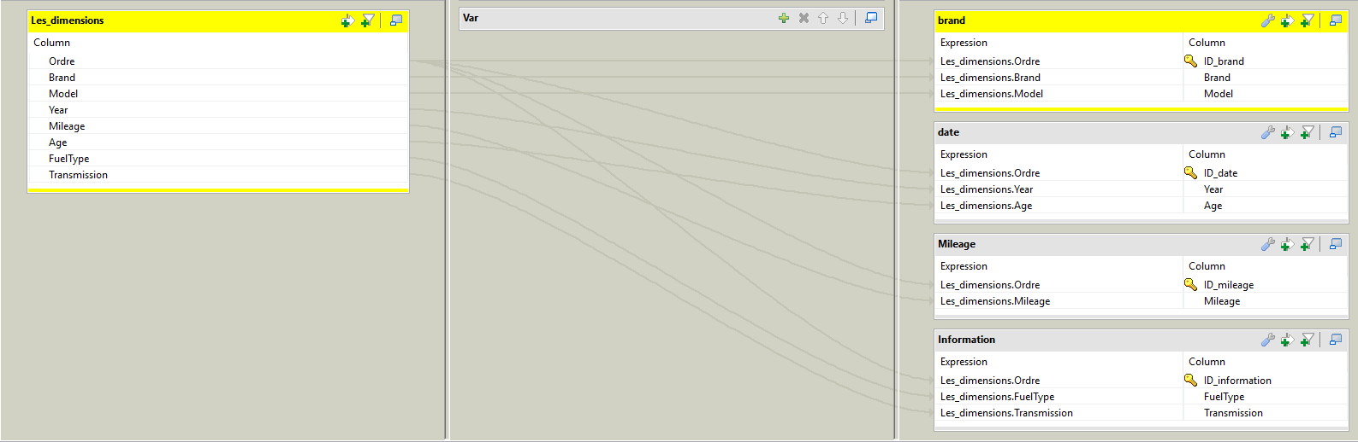
Transforme in Talend
tMap_4 :
This tMap create the
dimensions tables adding
the primary key to each one.

Slide 17
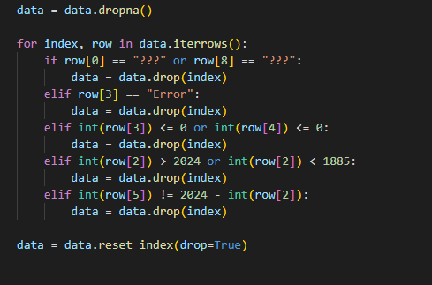
Transforme in Python
We used this python code to
filter any rows containing illogical
or invalid values.

Slide 18
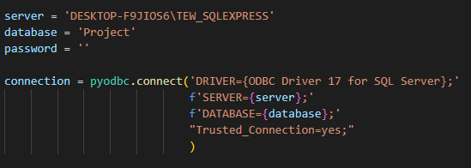
Transforme in Python
We connect to the
SQL server .

Slide 19
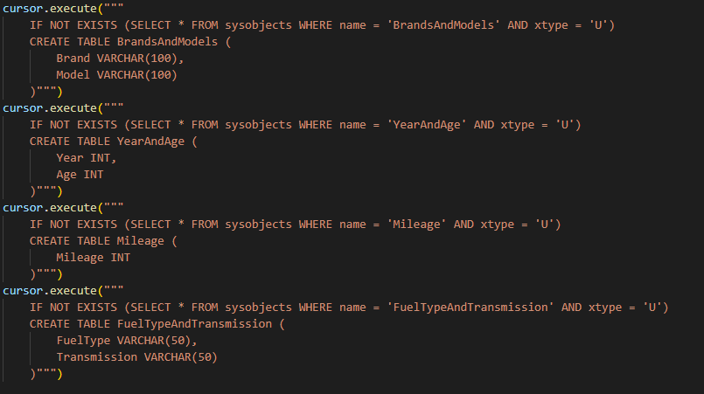
Transforme in Python
This code create the dimensions in the database .

Slide 20
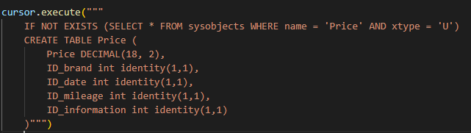
Transforme in Python
This one create the fact in the database .

Slide 21
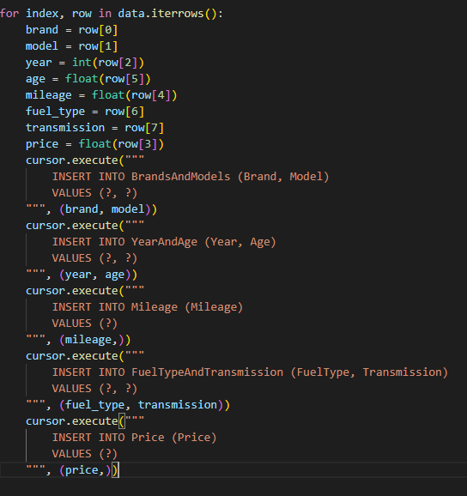
Load in python
Then we used this code to insert data into the database .

Slide 22
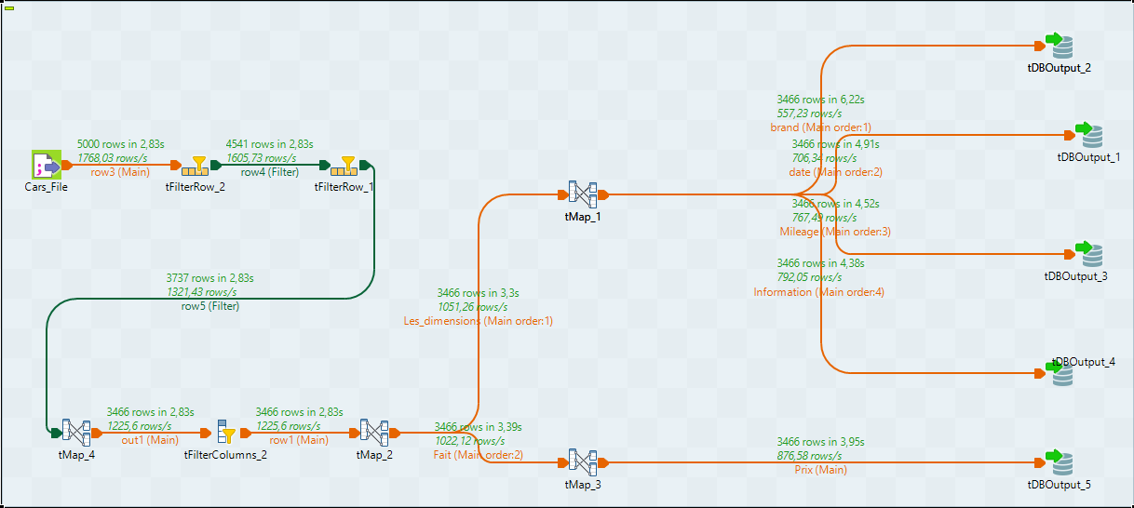
Load in Talend
We load the dimensions and fact into
5 tables in a database in Mysql server .

Slide 23
The final model

Slide 24
02
Cube Olap

Slide 25
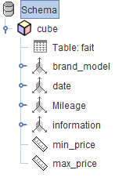
Schema
The OLAP cube schema includes the following:
Fact Table (fait): Stores the price of each car.
Dimensions:
Brand_Model : Details of vehicle brand and model.
Date: Information on year and age of the vehicle.
Mileage : Vehicle mileage details.
Information : Vehicle-specific details such as fuel type and transmission.

Slide 26
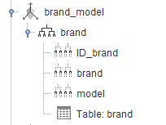
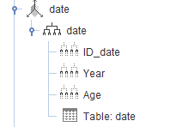

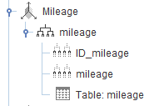
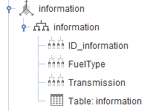
Schema

Slide 27
Analysis
Insights Derived from the Cube:
Brand-Level Insights: Identify which brands/models retain value over time.
Price Trends: Understand fluctuations in vehicle pricing by mileage or date.
Mileage Analysis: Correlation between mileage and pricing across different models.
Custom Information Queries: Analyze the price based on additional descriptive fields.

Slide 28
Use cases
Business Applications:
Dealerships: Optimize pricing strategies and predict market trends.
Consumers: Provide insights for buyers on vehicle value over time.
Market Analysts: Study trends in the automotive industry.

Slide 29
03
Conclusion

Slide 30
Conclusion
In conclusion, this project successfully demonstrates the power of a data
warehouse in analyzing the price of used cars, taking into account a wide
range of influencing factors. By leveraging Talend and Python for the ETL
process, data was efficiently extracted, transformed, and loaded into the
warehouse, ensuring data quality and consistency.
The integration of Pentaho for generating the cube has provided valuable
insights into the price trends and patterns of used cars, enabling better
decision-making for businesses and consumers.
Overall, the project highlights the potential of using advanced ETL tools
and BI technologies to uncover meaningful insights from complex datasets.

