Slide 1

Personal & Professional Project
Presented by
Aymen Nadi
Architecting the Future of Digital Trust: The Creative Engineer's Manifesto
Affiliation
ENSEEIHT / ENSIAS

Slide 2

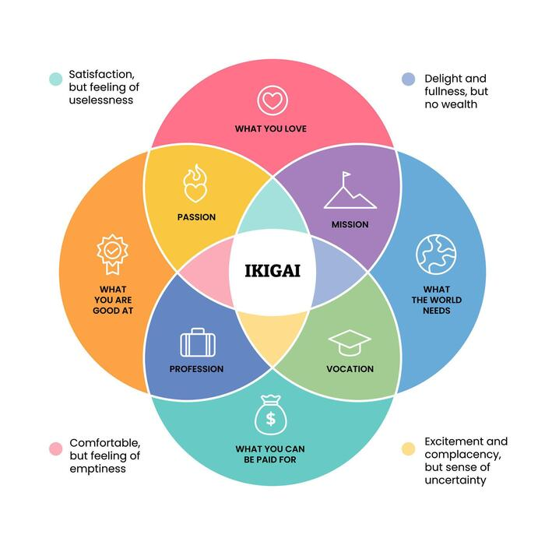
My IKIGAI: The Nexus of Purpose and Impact
The IKIGAI framework provides the blueprint for a sustainable and high-impact career, aligning personal drive with the critical needs of the cybersecurity landscape.
Dimension
Professional Alignment
Passion
Solving complex architectural challenges and automating security processes.
Expertise
Mastery of Cloud (AWS), DevSecOps methodologies, and Governance (GRC).
World's Need
Resilient digital infrastructures and automated compliance against evolving threats.
Vocation
Cloud Security Architect driving high-value, trust-by-design ecosystems.

Slide 3

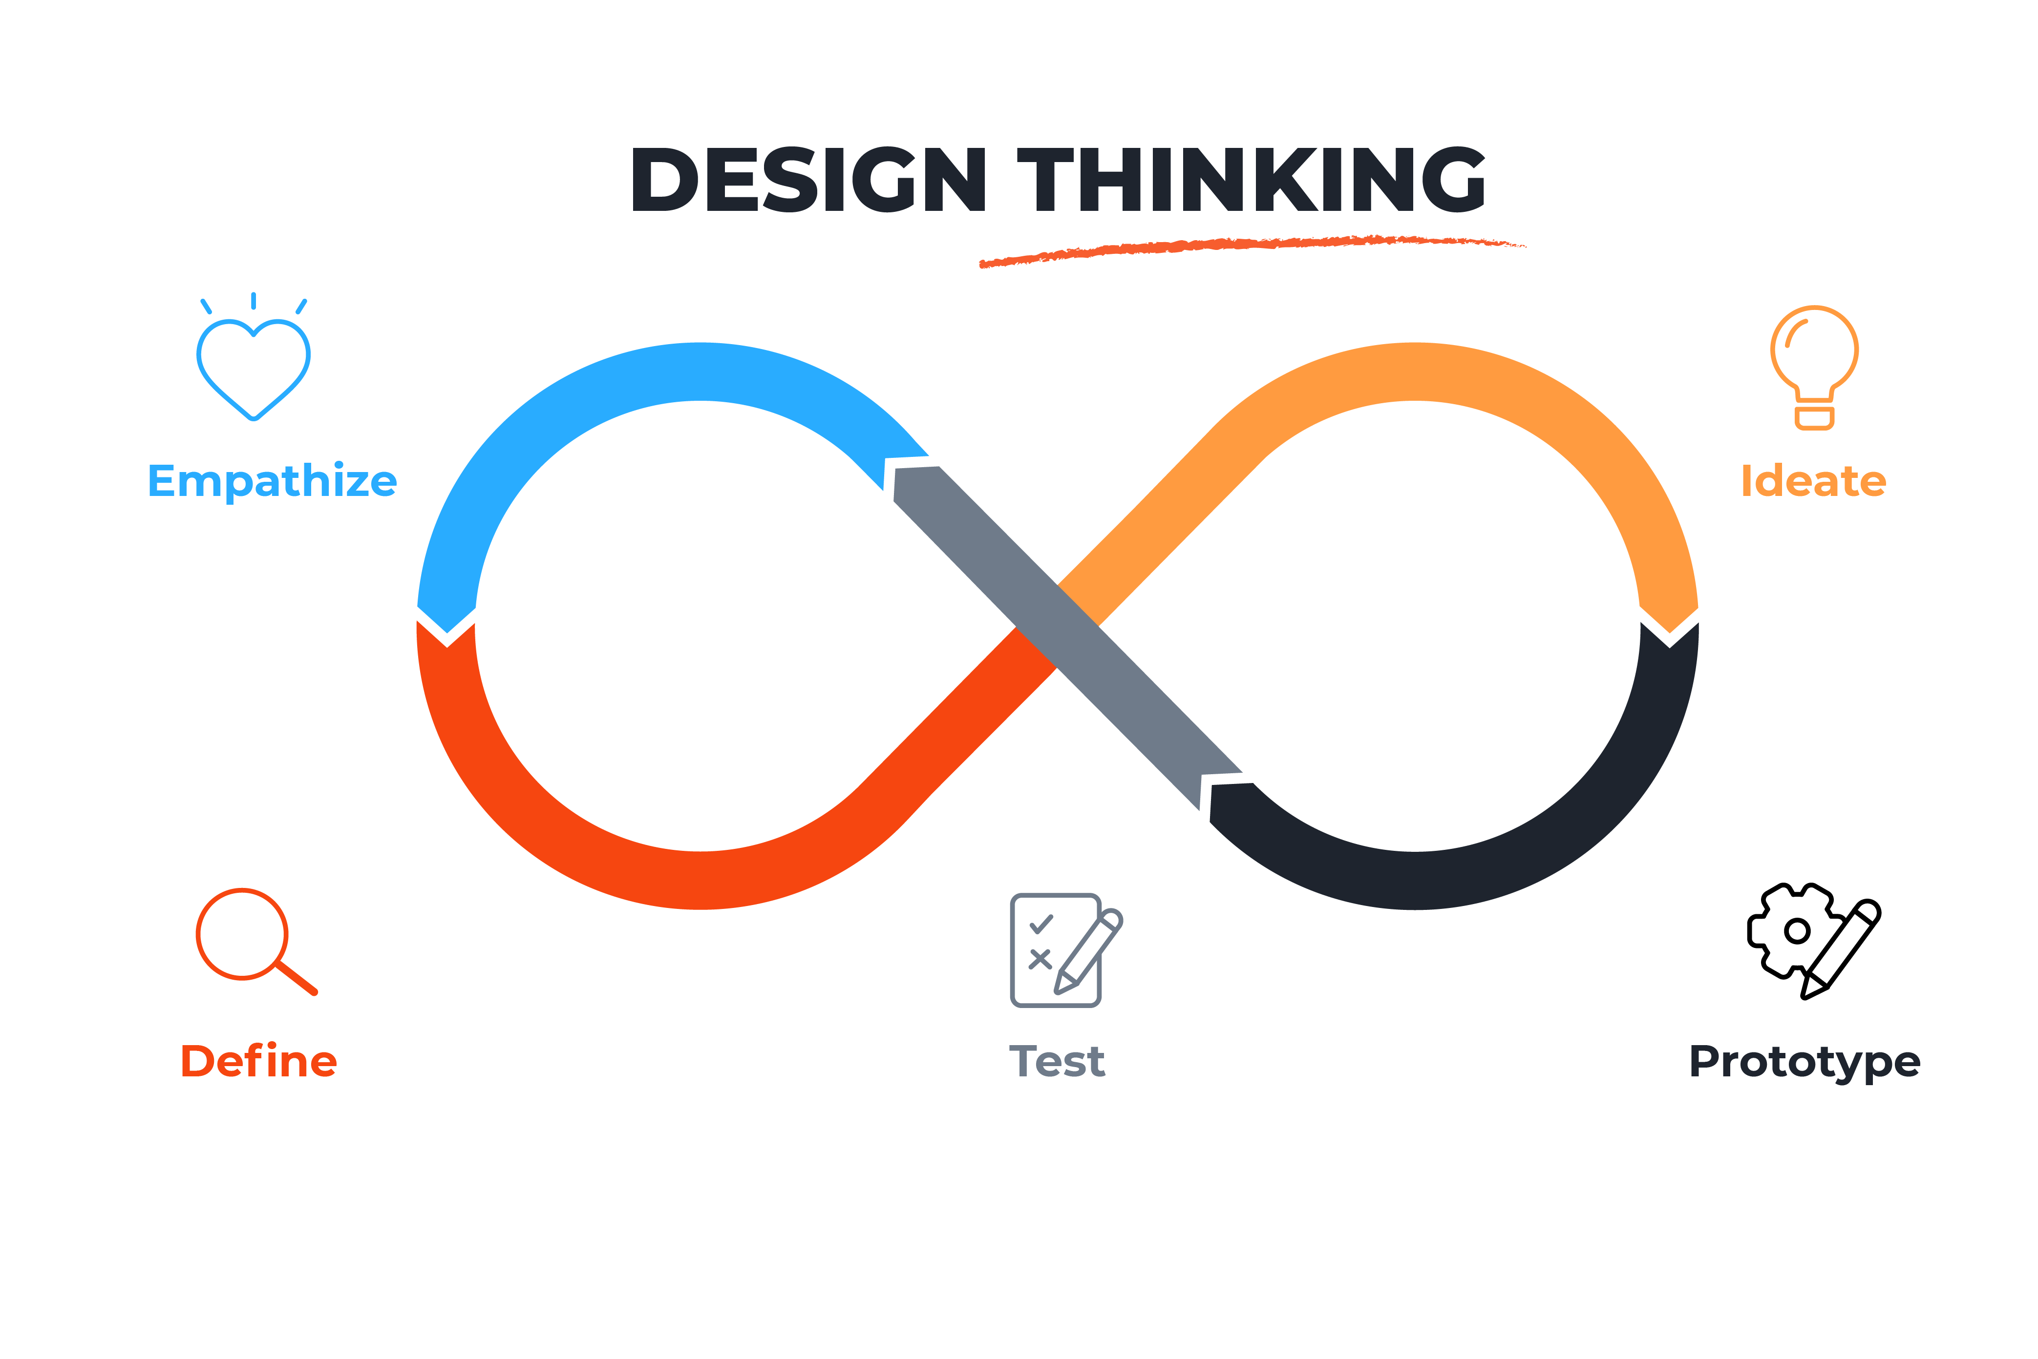
Design Thinking: The Iterative Career Blueprint
Empathize & Define
"Design Thinking is the strategy for building an agile and resilient career, not just a product."
Deep understanding of regulatory challenges (GDPR, NIS2) and defining the critical need for bridging technical implementation with governance strategy.
Ideate & Prototype
Exploring diverse career paths and validating them through certifications (AWS, CCNA) and hands-on projects (Secure CI/CD Pipeline).
Test & Iterate
Real-world application of skills during the OCP SAFI internship, refining my professional vision against industrial reality, applied GRC in large-scale industrial environment, implemented KRIs, .

Slide 4

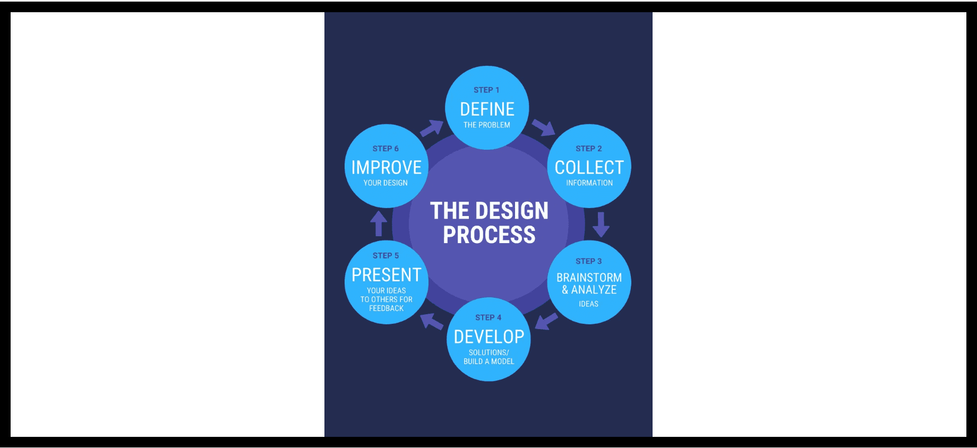
Odyssey Plan A: Cloud Security Architect
Years 1 - 2
Years 3 - 4
Year 5
Specialization
Technical Mastery
Strategic Leadership
Complete double degree (ENSEEIHT/ENSIAS) and take a solid foundations about systems and networks.
Cloud Security Engineer role, focusing on large-scale Zero Trust architecture deployment.
Transition to Senior Architect, leading international cloud security transformation projects.
Success Metric
AWS Security Specialty Certification and technical leadership on critical infrastructure projects.

Slide 5

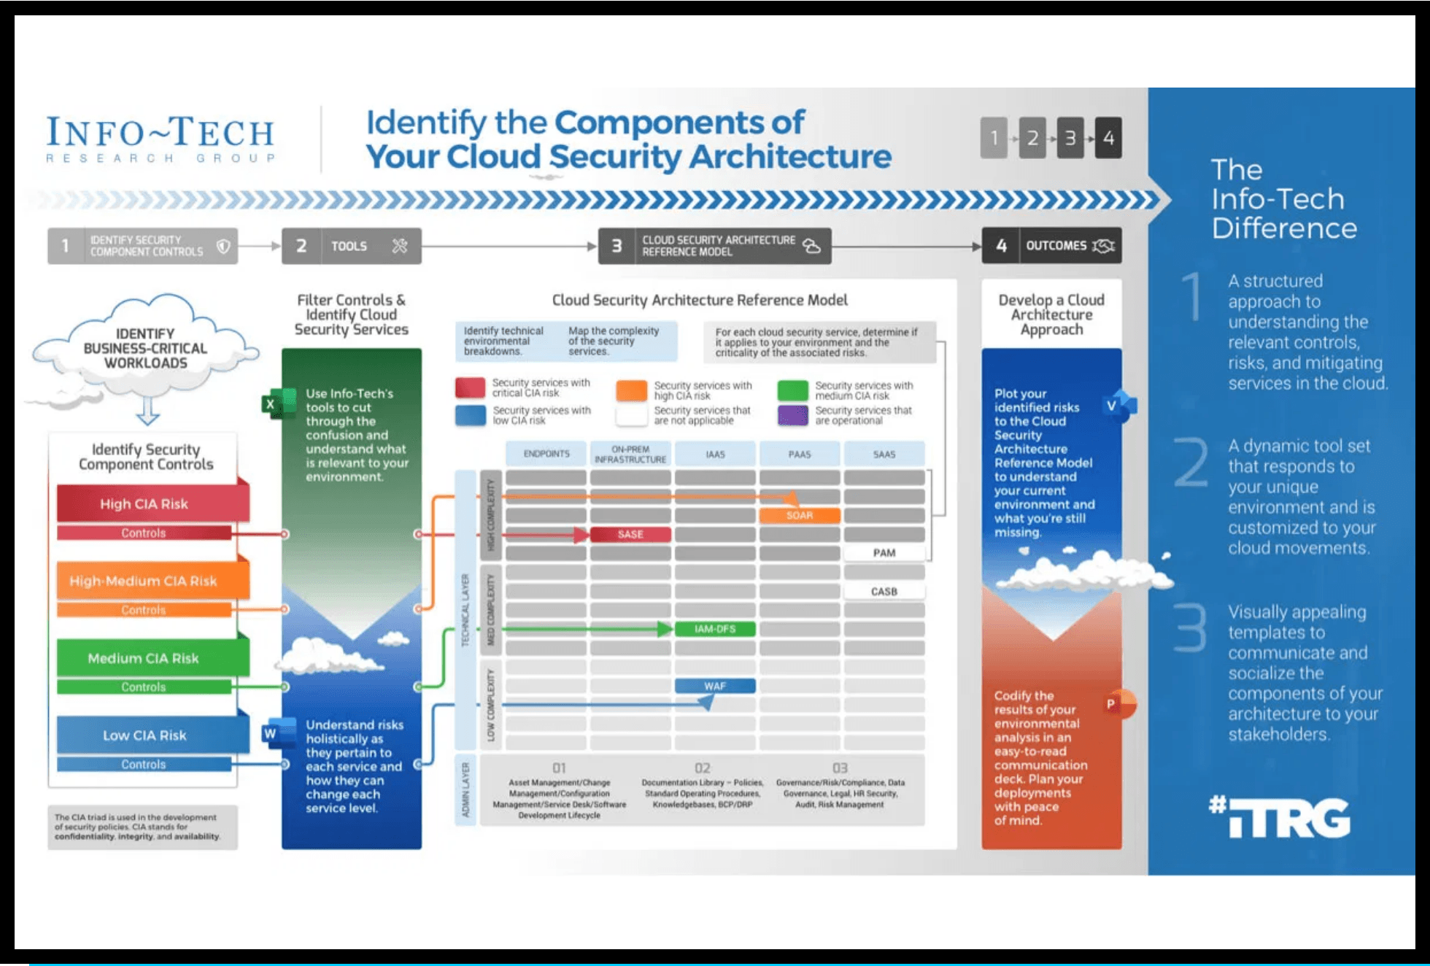
GRC & Cloud Compliance Specialist
Strategic Vision
Securing digital trust through risk mastery and automated compliance orchestration.
PLAN B
Compliance-as-Code
Transforming tedious manual audits into real-time monitoring systems for continuous security assurance.
Critical components of a compliant Cloud Security Architecture.
NIST & ISO 27001 Mastery
Targeting highly regulated sectors where data sovereignty and international standards are non-negotiable.
Strategic Advantage
Turning regulatory requirements into a competitive lever for organizational resilience and trust.

Slide 6

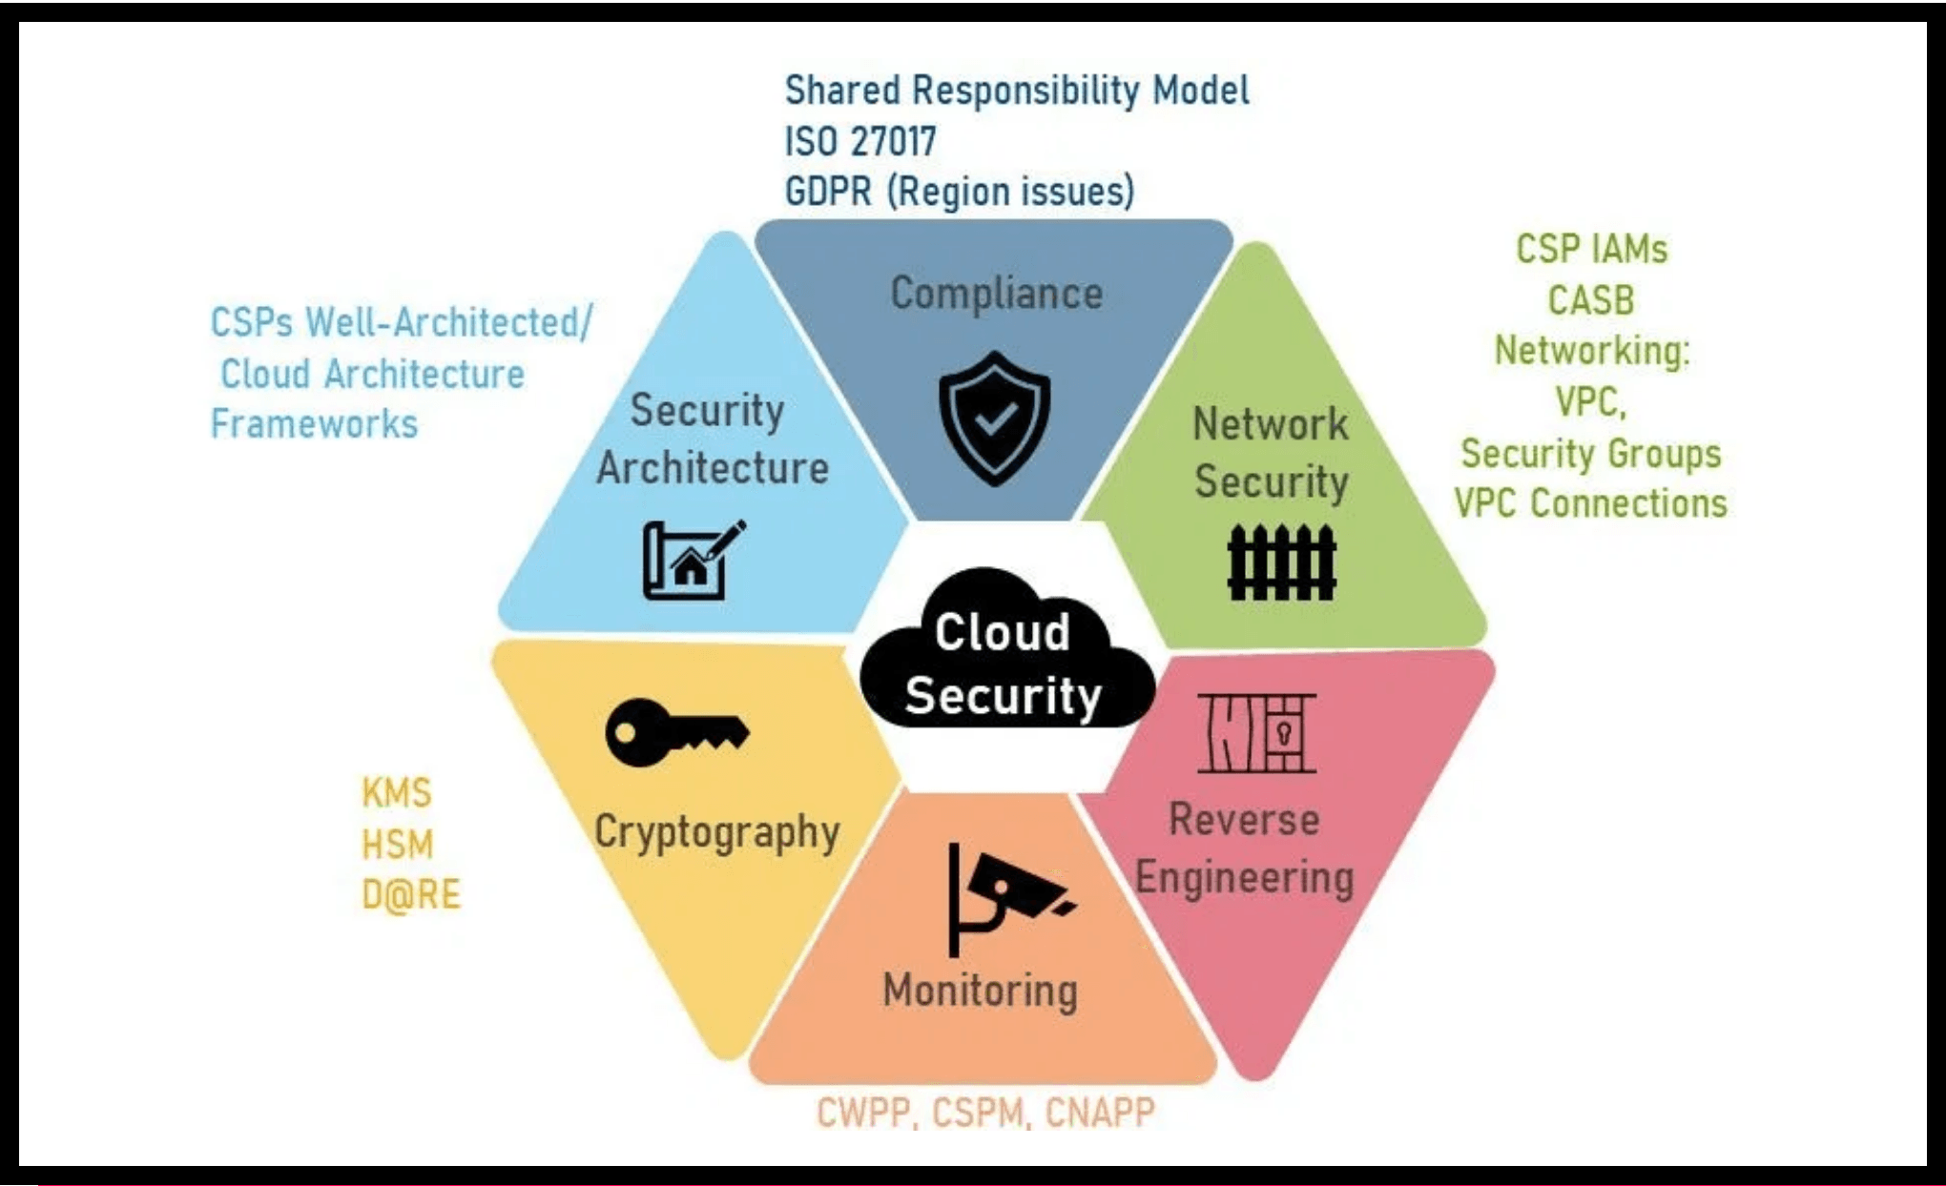
Odyssey Plan C: DevSecOps Innovation Lead
Future-Forward Vision
Pioneering security integration at the core of the software lifecycle through radical automation.
Integrating Compliance & Architecture into the DevSecOps Cycle
AI-Driven Detection
Exploring artificial intelligence to proactively identify emerging vulnerabilities within infrastructure code.
Security-First Culture
Championing a hybrid role that bridges development and security for seamless organizational agility.

Slide 7
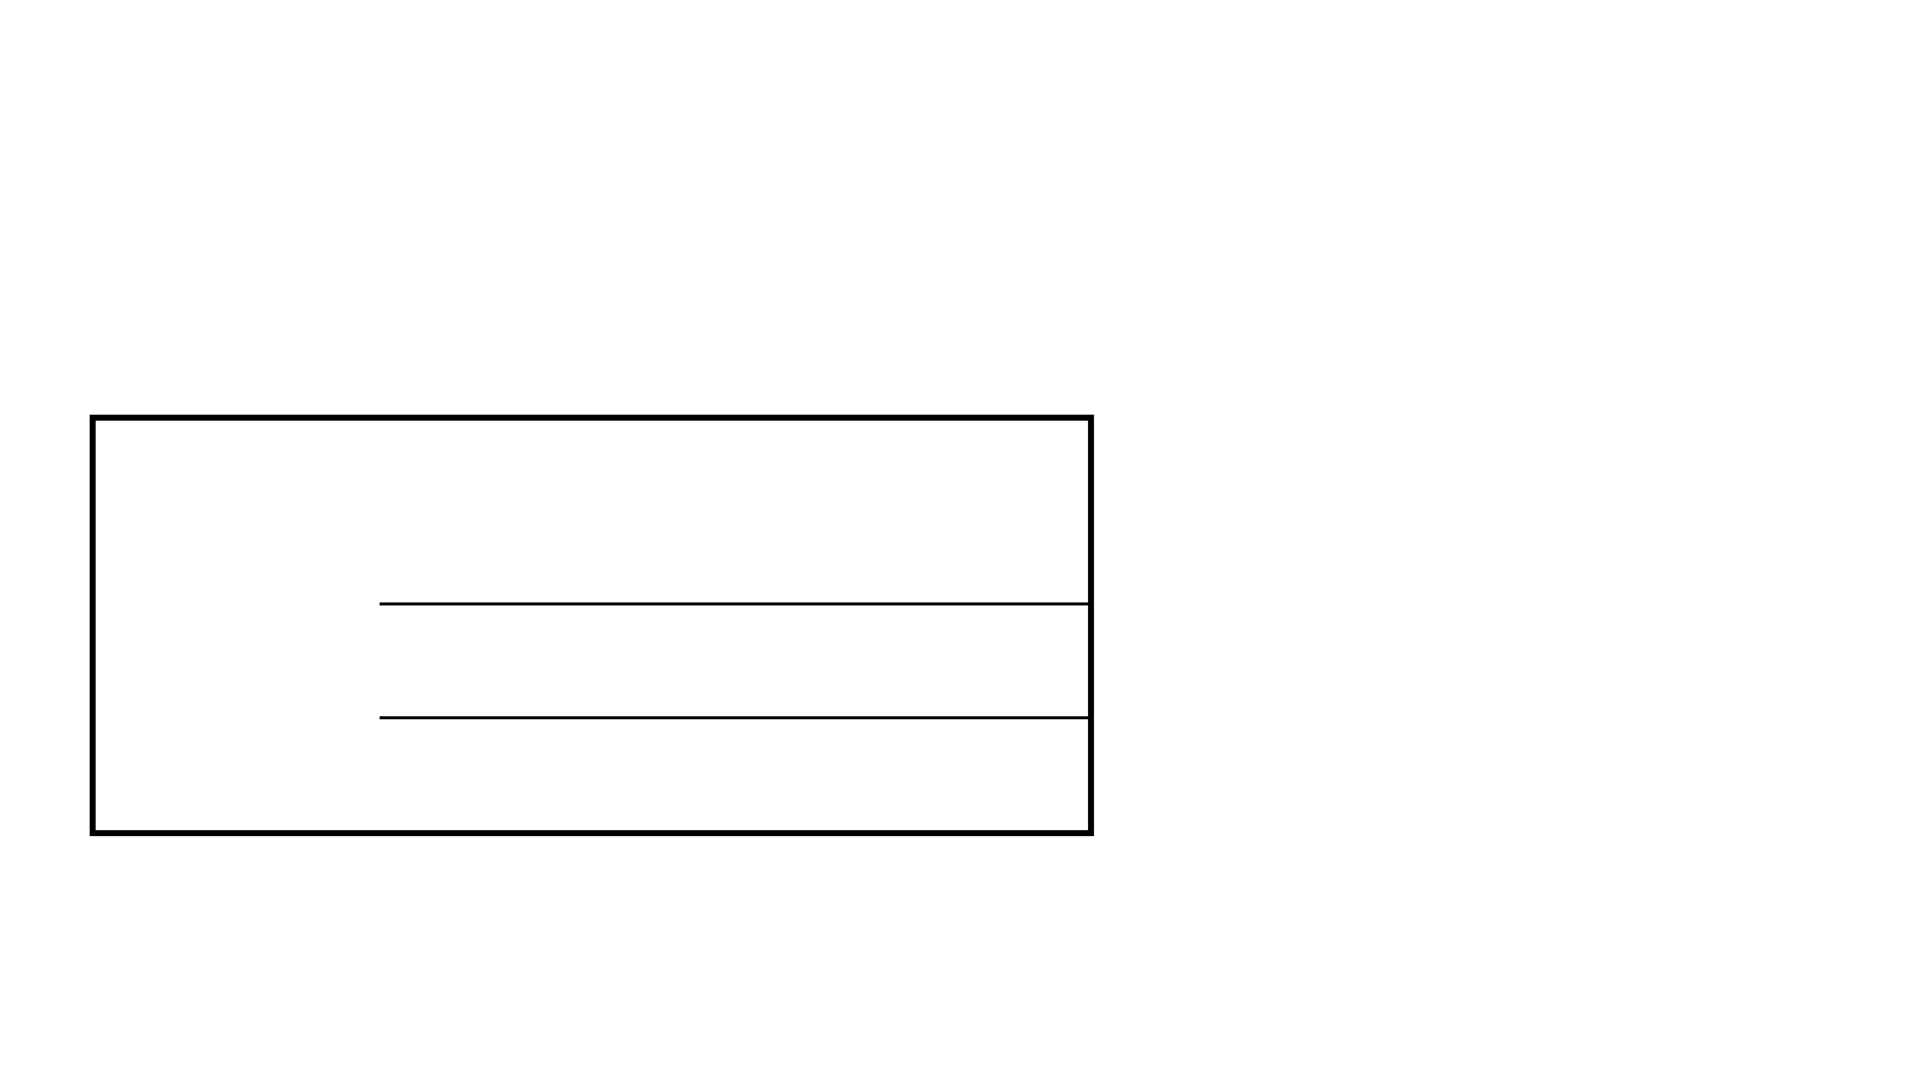
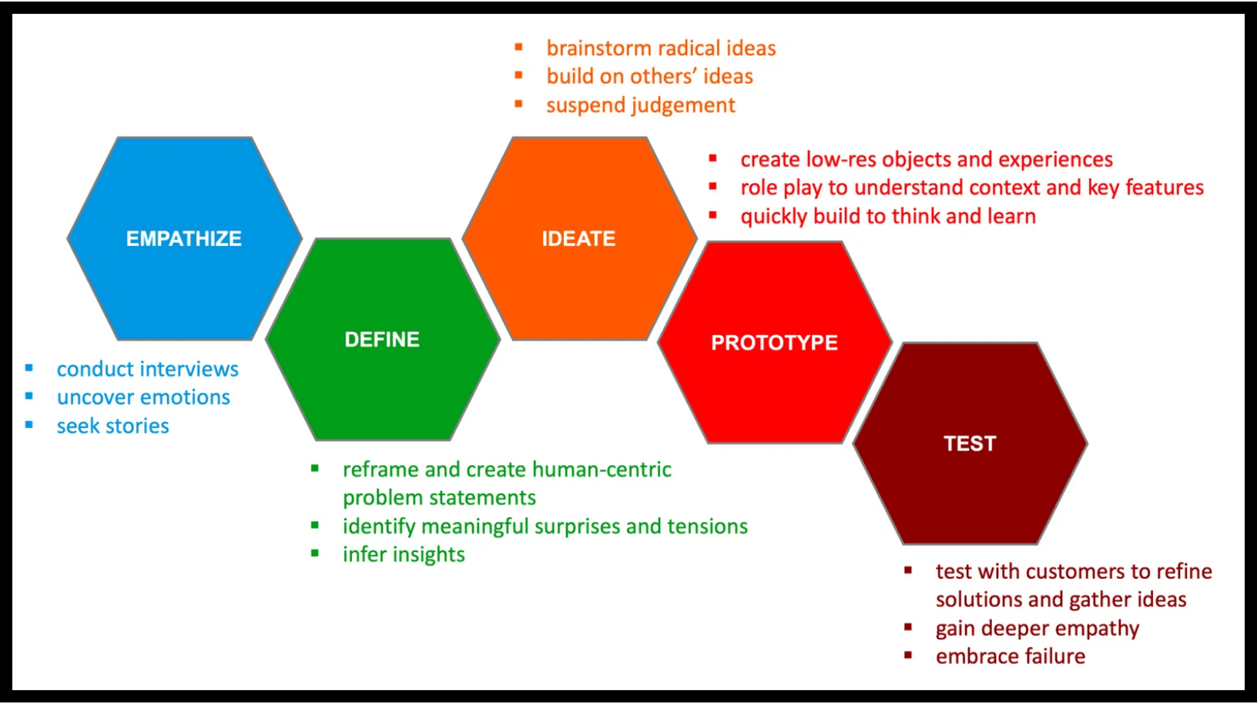
International Mobility Strategy
A strategic lever to gain a global perspective on security standards and exchange value with world industry leaders.
Strategic Goal
Target Region
Strategic Rationale
Creating a sustainable value bridge between international standards and local digital sovereignty needs.
North America
Immersion in the ecosystem of major Cloud Service Providers (CSPs) and radical innovation hubs.
Northern Europe
Mastery of the world's strictest security and data protection standards (NIS2, GDPR).
Value Exchange
Bringing a dual-engineer culture and high agency to global teams while gaining world-class expertise.

Slide 8

High Agency: Proactivity & Momentum
Certifications
Engagement
Self-Direction as a Growth Engine.
Active Pipeline
Community
AWS Solutions Architect
Tech Watch & Vulnerabilities
Cisco CCNA (Networks)
Web PenTester (HTB)
Bug Bounty & Open Source
Global Networking
The success of my Odyssey plans is underpinned by constant initiative, moving beyond the academic curriculum to build world-class field expertise.
Next Crucial Step
Securing a high-impact final internship in an international environment (Cloud Security / DevSecOps).

