Slide 1


*estimation, for external realization
Manage, understand and predict store turnover
Dataset: Rossman Stores @Kaggle
Team Names: BOIVIN Jolyanne, BOUCHER Axel, DE BROGLIE Aymon, GRIGNARD Jeremy, KARTHIGESU Dinojan, NAULET Antoine
BUSINESS PROBLEM
DATA DRIVEN SOLUTION
CUSTOMER SEGMENT
Predict the daily stores turnover, that is for a given date predict the amount of sales for each store..
Predicting the stores turnover serves several objectives and provide valuable insight for the sales team or the marketing team. For example, if we do more marketing during specific days with high turnover, like black friday, we will probably sell more.
Moreover, introspection of our results will help identifying the factors driving sales which can help optimizing our investments.
Analyze past results of different stores and implement a Machine Learning algorithm to predict daily sales
Optimization of the process in the Sales department
KEY METRICS
ADDITIONAL DATA
Daily sales by store
Maybe some data about concurrents store
Geographical data about stores to highlight any dependencies between the location of the store and the sales.
COST STRUCTURE ~ 75k€*
BENEFITS
Activities
Data retrieval, homogenization and cleaning (Data analyst: 1day)
Data analysis for historical maintenance costs knowledge (Data analyst: 10d)
Dataset building (Data scientist: 20d, Business expert: 2d)
Machine Learning model construction (Data scientist: 30d)
Minimum viable app development (Developer: 10d, Data scientist: 3d)
IT Resources
Data science environment : Big Data Frameworks (distributed engines to process Big Data)
Hadoop, spark
Skills
Data Analyst : 1 FTE for 1.5 month
Data Scientist : 1 FTE for 2.5 month
Developer : 1 FTE for 0.5 month
Increase sales
Better marketing and welcome well client
We could optimize productivity in function of predicted sales

Slide 2
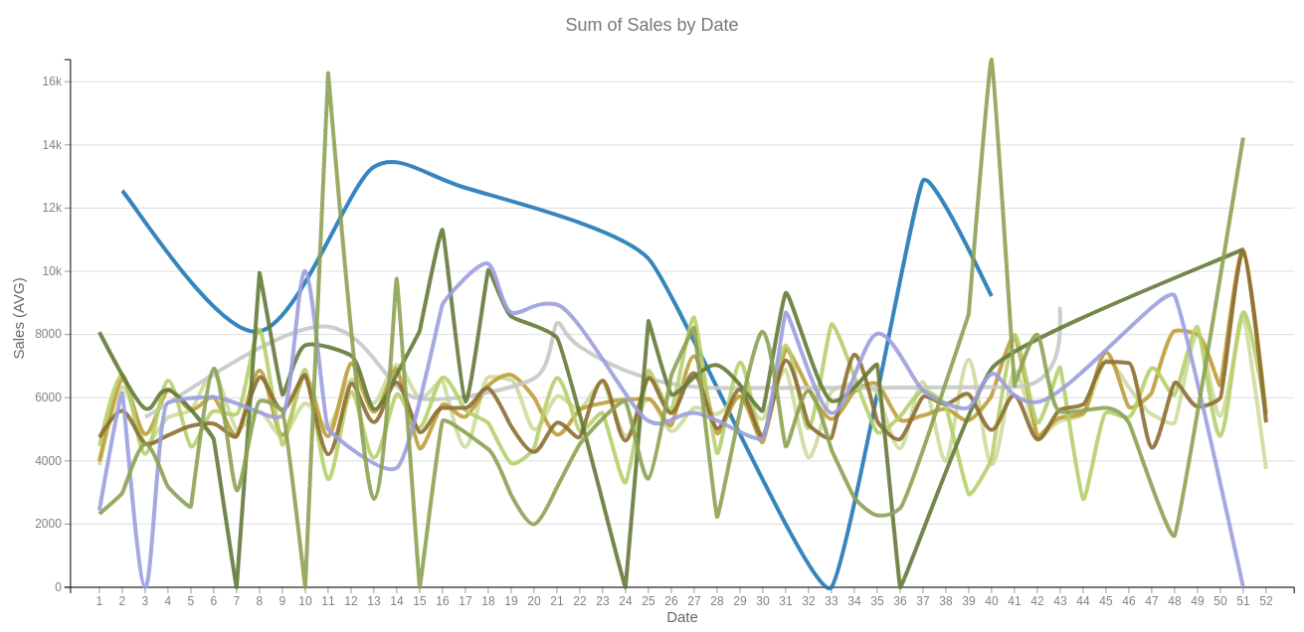
You have all the informations !!!
But it seems not so clear for some of you…
Lets try to highlight some insights
Notes:
Beaucoup d’info, peu d’insights

Slide 3
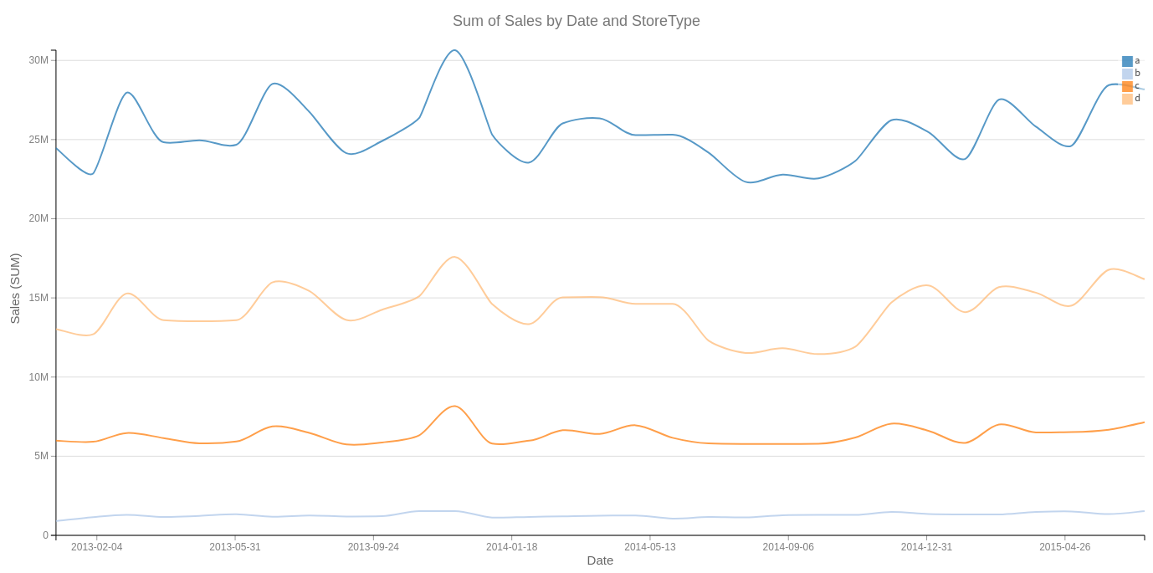
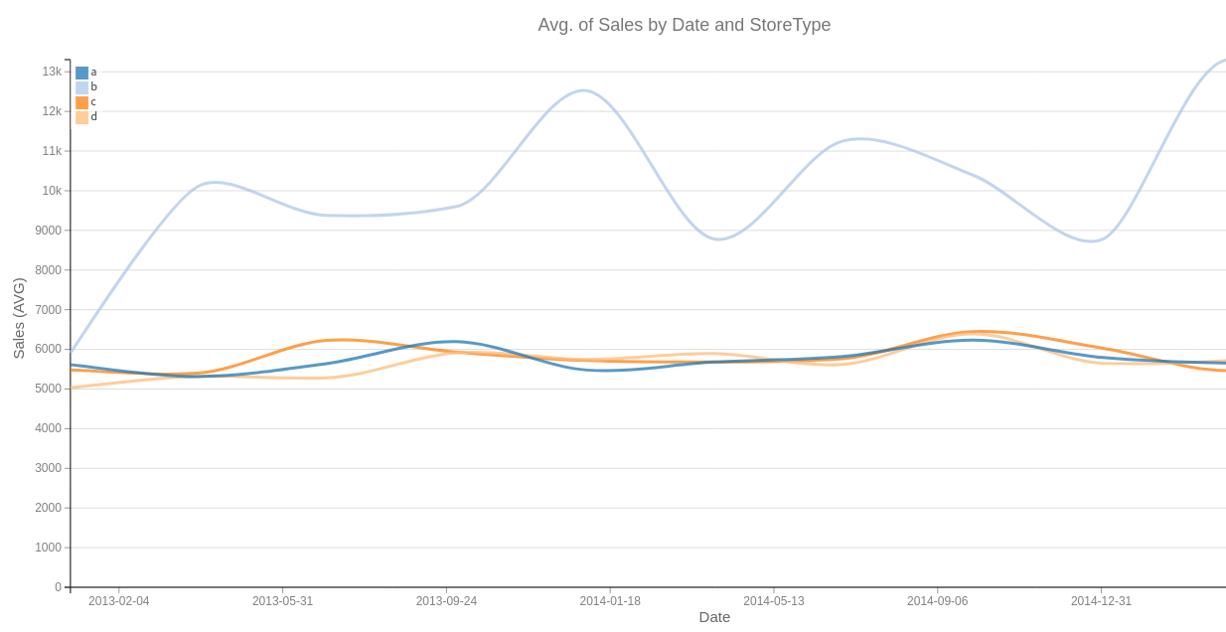
Facts | Analysis | Conclusion
Global sum of sales is stable to decreasing | The current strategy leads to stale growth, however there seems to be opportunities regarding stores of type b | Sales strategy could be reviewed.
Type b is more profitable and seems to progress
Notes:
Une entreprise qui ne progresse pas est déjà en train de disparaitre.
Une adaptation est nécessaire car il n’y a plus de croissance.

Slide 4
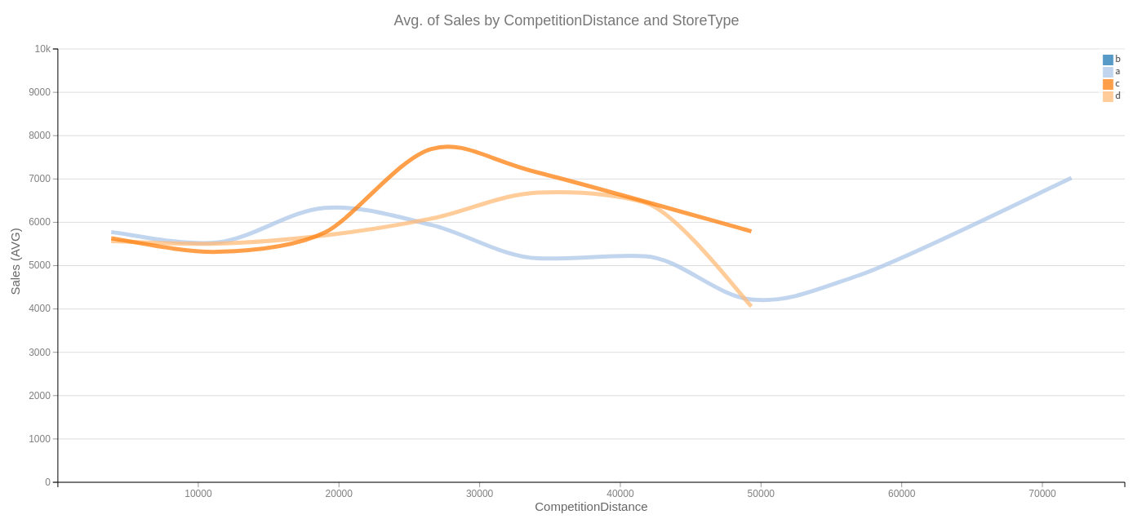
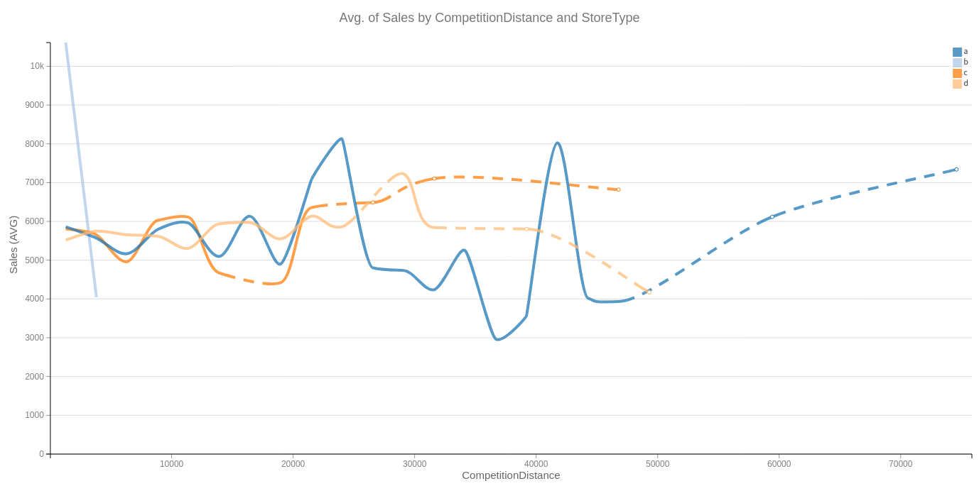
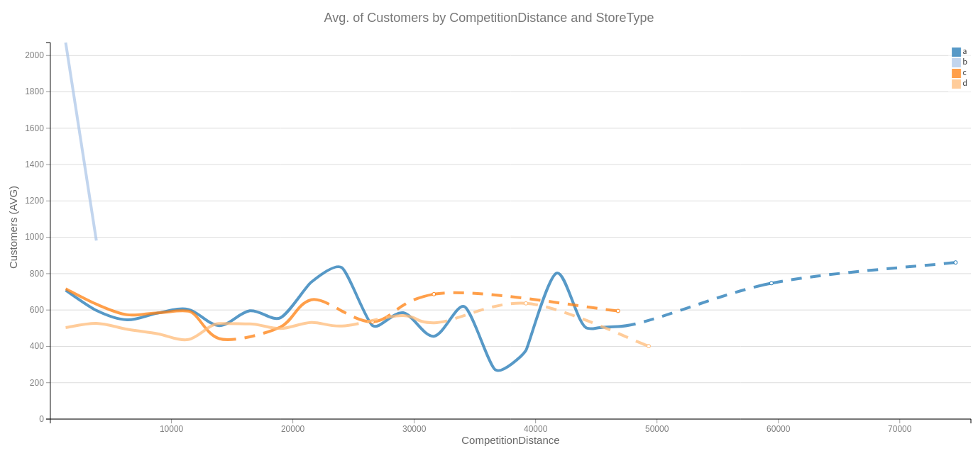
Facts | Analysis | Conclusion
Distance has a limited influence | No need to create new stores. | Rather than creating new shops, better to improve the existing ones
Distance has a similar influence with all store types
Notes:
La distance de compétition ne permet pas de faire un break. Il faut évoluer à isopérimètre d implantation.

Slide 5
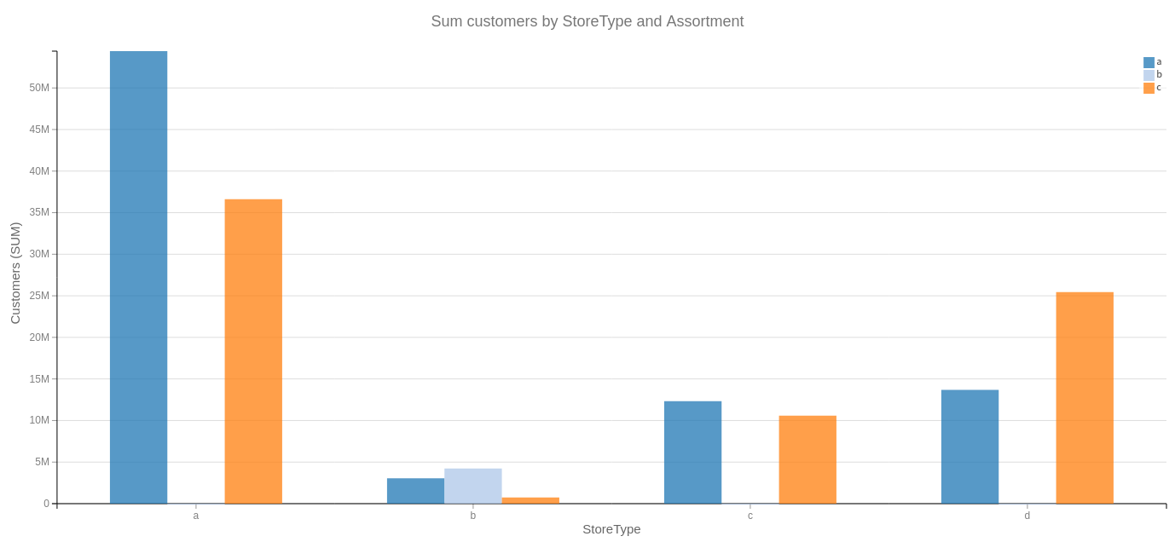
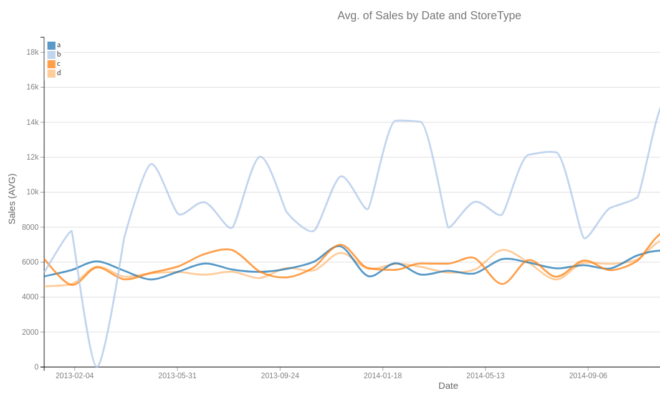
Facts | Analysis | Conclusion
Only type b stores have type b assortments | Assortment b could deprecate type c (this assumption should be confirmed) | Assortment b could be tried in store type a and c but result on type d are more incertain
Stores d have different product ratio than the rest | Stores d seem to have a different assortment logic than others
Notes:
La physionomie des ventes A et C est commune avec le B pour les produits A et C mais le D a un ratio inverse. Introduire du B ne devrait pas bouleversé A et C mais l’effet sur D est plus incertain .
Ratio A/C pour les magasion a,b,c,d 0.7 ; 0.3 ; 0.8 ; 2. Le type d est clairement dans une autre logique de produit que les 3 premiers;

Slide 6
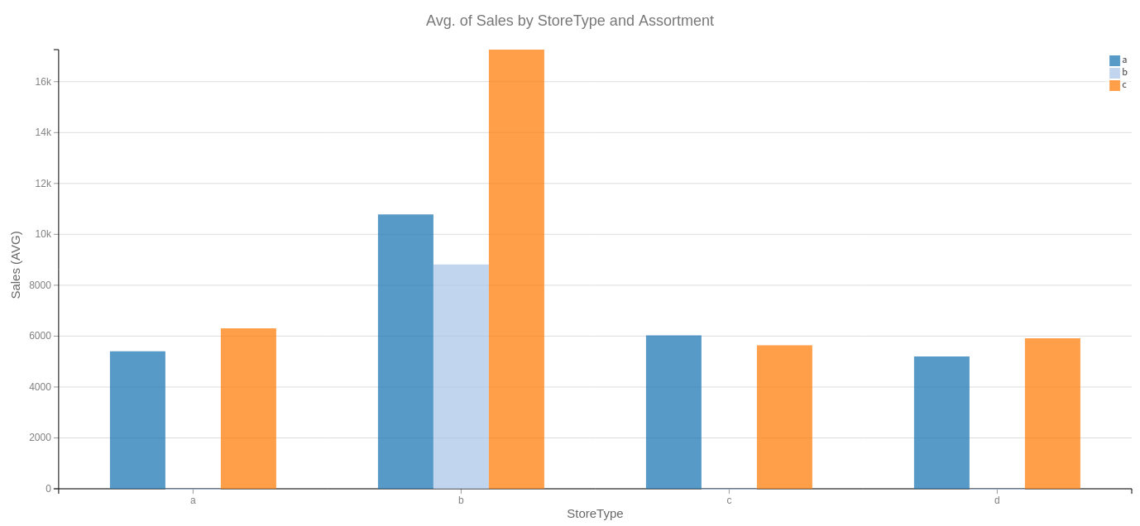
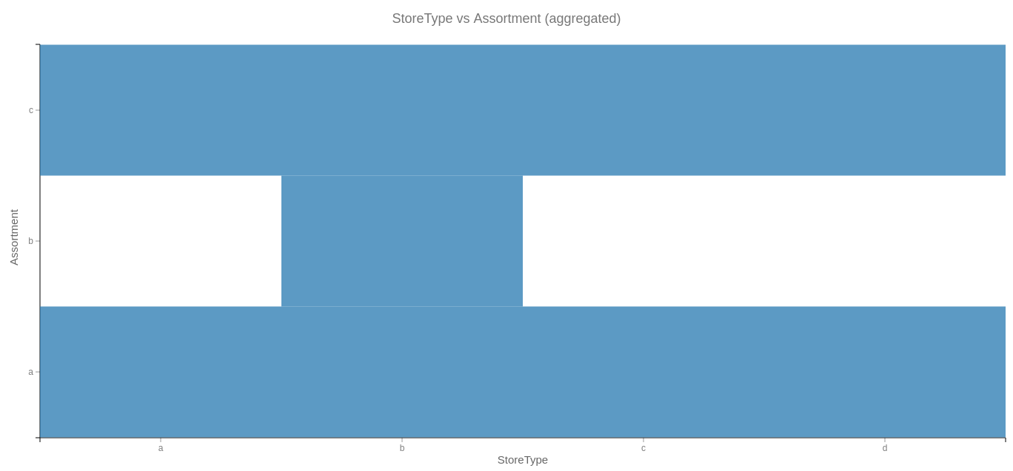
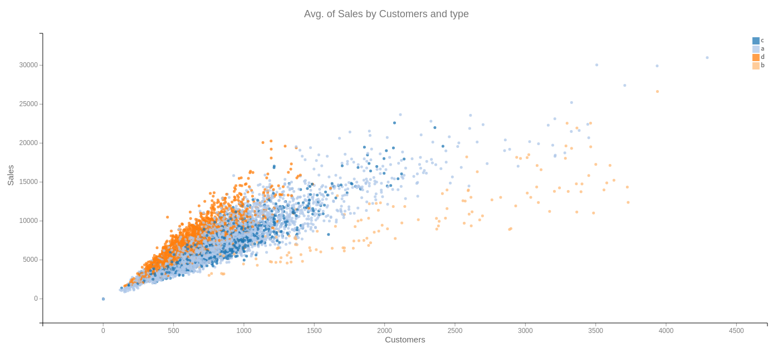
Facts | Analysis | Conclusion
Presence of type b increases sales of type c (invalidate last assumption) | Assortment b could improve the whole sales Success of store type b could be linked to the assortment type b Type b attracts more customers | Deploy type b assortment in every store could improve sales
Sales by customer is highest in type d
Notes:
La spécificité des magasin b est d’avoir un assortment b qui tire vers le haut les ventes en quantité car ces magasin attirent bcp plus de client. Meme si relativement ces clients consomment moins en ventes totales ils dépensent plus.

Slide 7
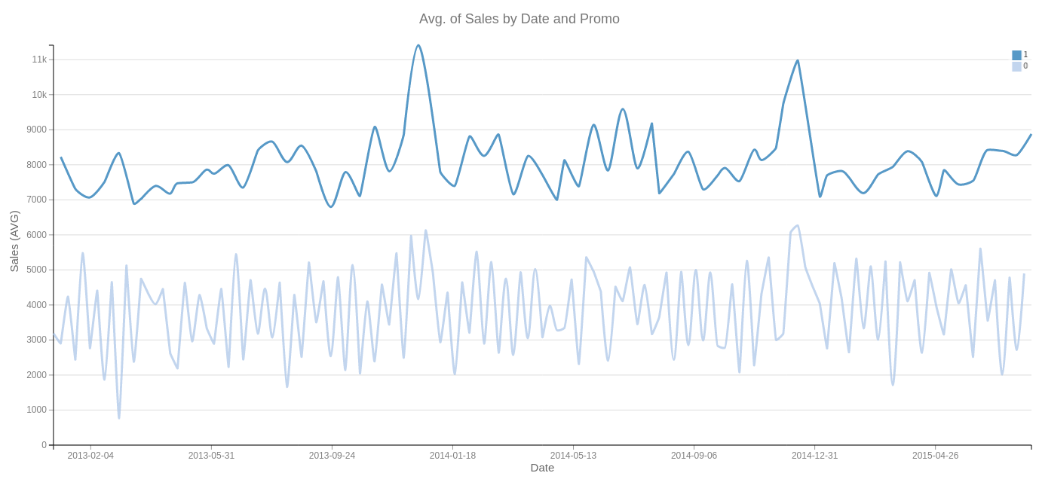
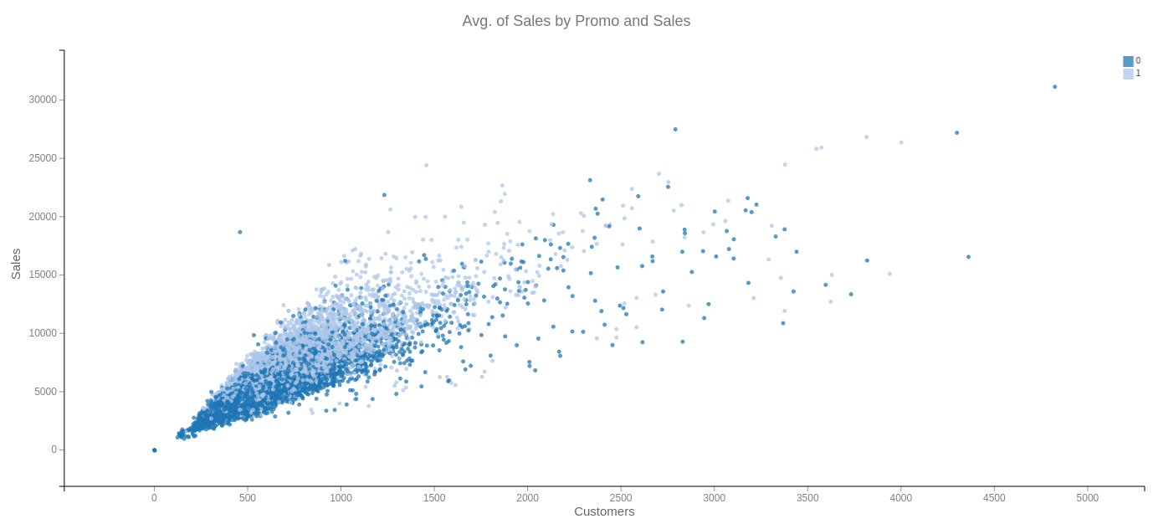
Facts | Analysis | Conclusion
Promotions double sales | Promotions increase consumer affluence and consumer spending | Promotions always increase sales Deployment of type b assortments should be supported by large promotions.
Average of sale by customer is higher during promotion
Notes:
Jeremy:
Conclusion: Promotion always increase the sales (comparison 0/1).
Promotion are subject to periodic effect only for the end of the year (november, december)

Slide 8
Stale growth
Promotions are always efficient
A new strategy of sale to reinforce sales growing could be based on the deployment of assortment of type b in every store supported by large promotions
One store type is atypical and efficient:
Store type b
Assortment b has a positive effect on whole sales
Success could come from assortment b
Notes:
Absence de croissance
Identification d’un cas de réussite
Analyse des facteurs de réussite
Etude des effets connexes du facteur
Capacité à déployer la best practice
Conclusion stratégique

Slide 9
What about machine learning?
Estimate the benefits to convince COMEX
Estimate the most influential shops which should be targeted first
A new strategy of sale to reinforce sales growing could be based on the deployment of assortment of type b in every store supported by large promotions
Define the best model: tempo of changes
Select the best promotion (slot and product)
Notes:
Pour aller plus loin que l’intuition : utiliser le machine learning
Modèle de gain espéré
Synchromatrice du changement
Ciblage marketing
Prototypage de la stratégie

