Slide 1
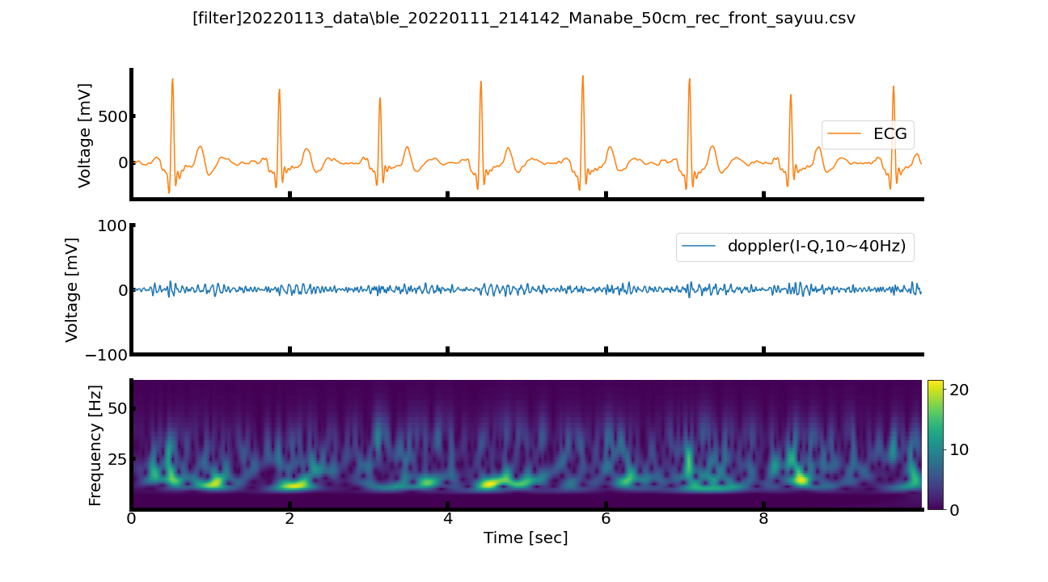
.\20220113_data\ble_20220111_214142_Manabe_50cm_rec_front_sayuu_filtered.png

Slide 2
.\20220113_data\ble_20220111_214142_Manabe_50cm_rec_front_sayuu_sma5.png

Slide 3
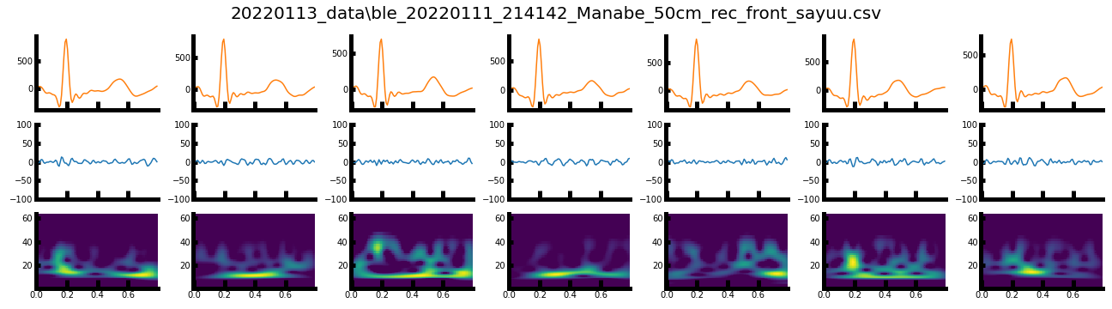
.\20220113_data\ble_20220111_214142_Manabe_50cm_rec_front_sayuu_split.png

Slide 4
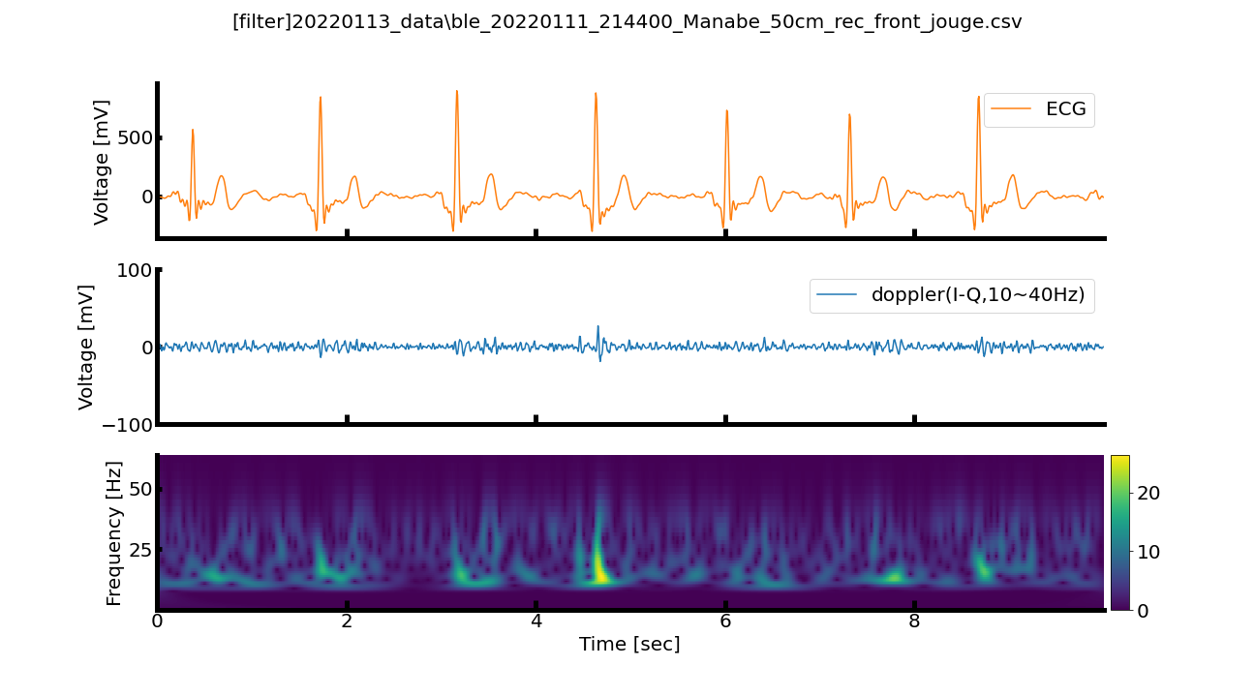
.\20220113_data\ble_20220111_214400_Manabe_50cm_rec_front_jouge_filtered.png

Slide 5
.\20220113_data\ble_20220111_214400_Manabe_50cm_rec_front_jouge_sma5.png

Slide 6
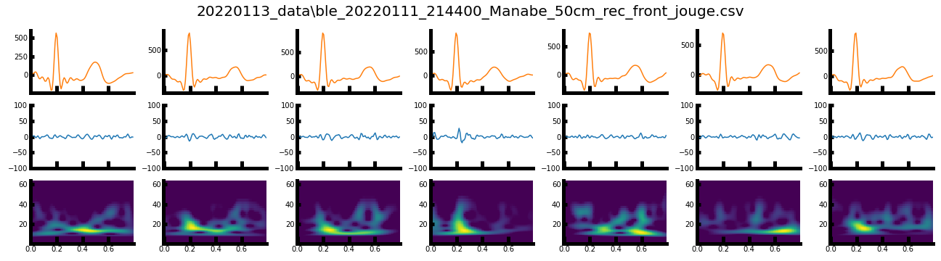
.\20220113_data\ble_20220111_214400_Manabe_50cm_rec_front_jouge_split.png

Slide 7
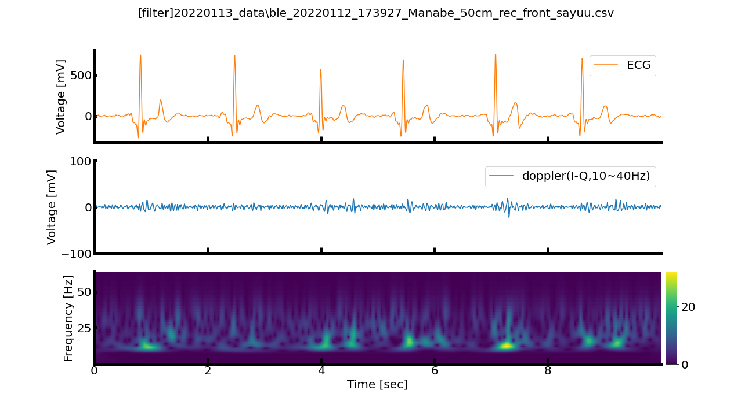
.\20220113_data\ble_20220112_173927_Manabe_50cm_rec_front_sayuu_filtered.png

Slide 8
.\20220113_data\ble_20220112_173927_Manabe_50cm_rec_front_sayuu_sma5.png

Slide 9
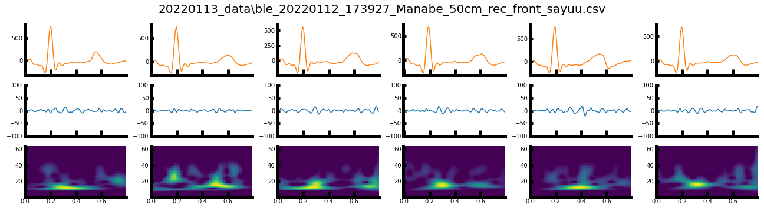
.\20220113_data\ble_20220112_173927_Manabe_50cm_rec_front_sayuu_split.png

Slide 10
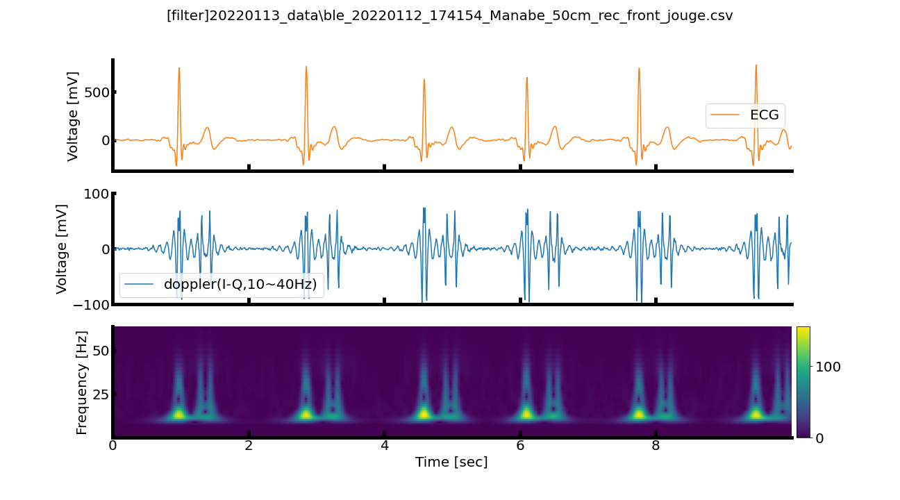
.\20220113_data\ble_20220112_174154_Manabe_50cm_rec_front_jouge_filtered.png

Slide 11
.\20220113_data\ble_20220112_174154_Manabe_50cm_rec_front_jouge_sma5.png

Slide 12
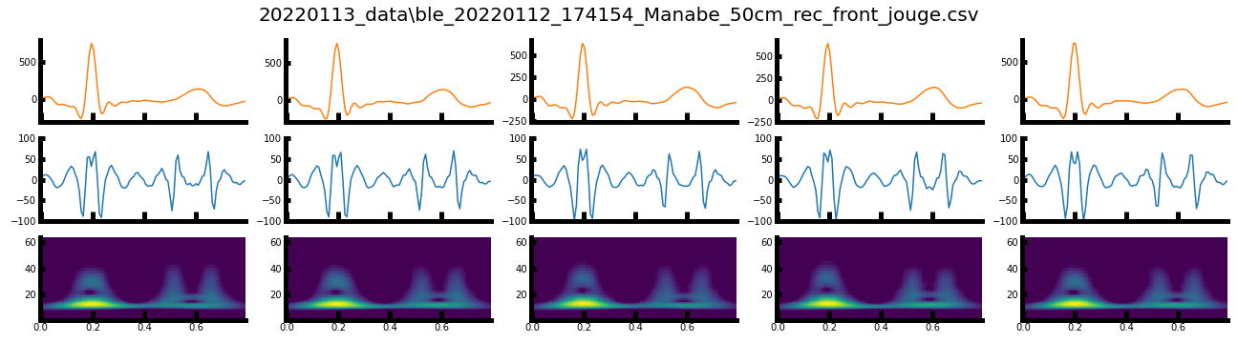
.\20220113_data\ble_20220112_174154_Manabe_50cm_rec_front_jouge_split.png

Slide 13

.\20220113_data\ble_20220112_174406_Manabe_50cm_rec_front_sayuu_filtered.png

Slide 14
.\20220113_data\ble_20220112_174406_Manabe_50cm_rec_front_sayuu_sma5.png

Slide 15
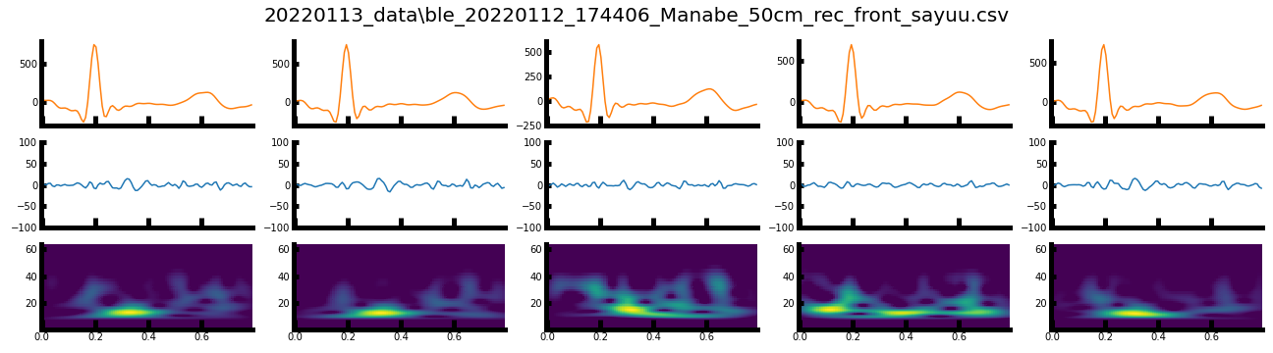
.\20220113_data\ble_20220112_174406_Manabe_50cm_rec_front_sayuu_split.png

Slide 16
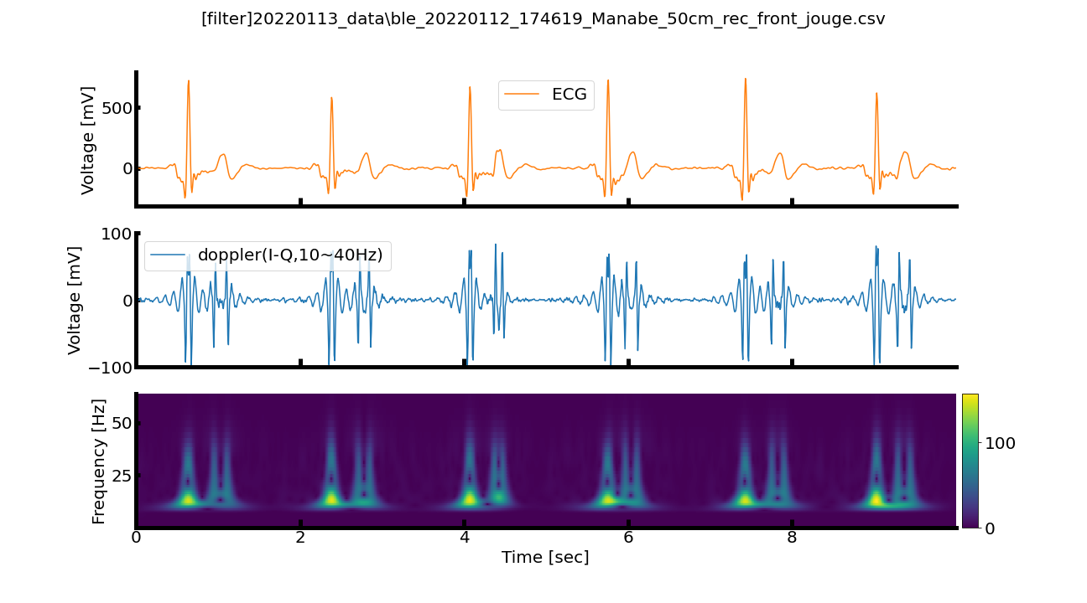
.\20220113_data\ble_20220112_174619_Manabe_50cm_rec_front_jouge_filtered.png

Slide 17
.\20220113_data\ble_20220112_174619_Manabe_50cm_rec_front_jouge_sma5.png

Slide 18
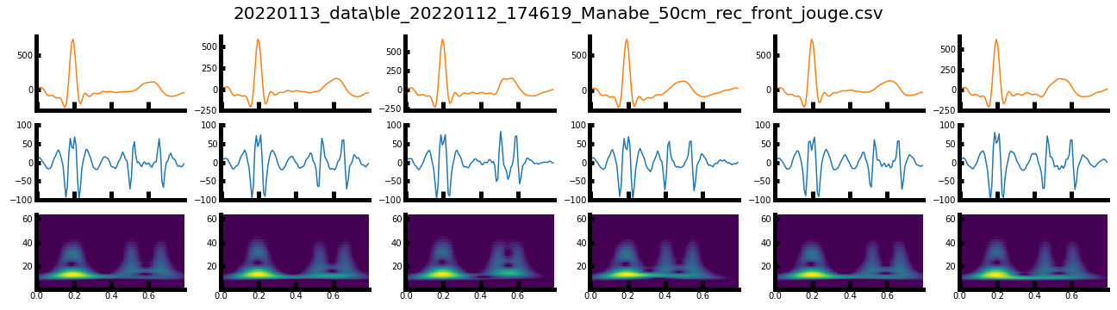
.\20220113_data\ble_20220112_174619_Manabe_50cm_rec_front_jouge_split.png

