Slide 1
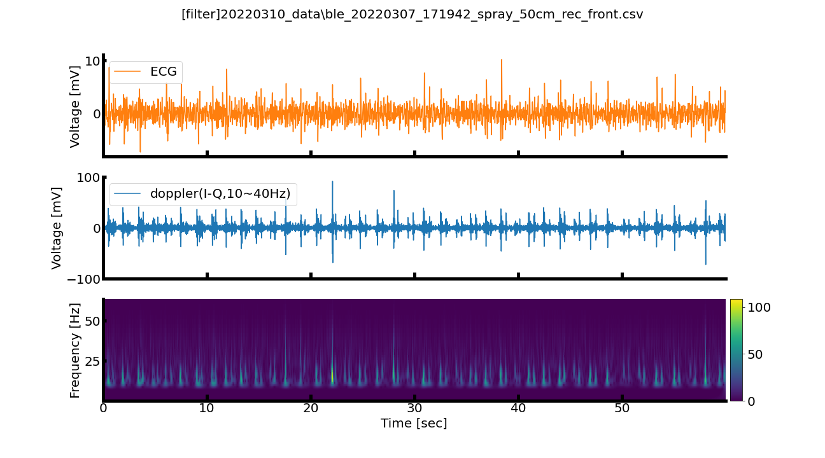
.\20220310_data\ble_20220307_171942_spray_50cm_rec_front_filtered.png

Slide 2
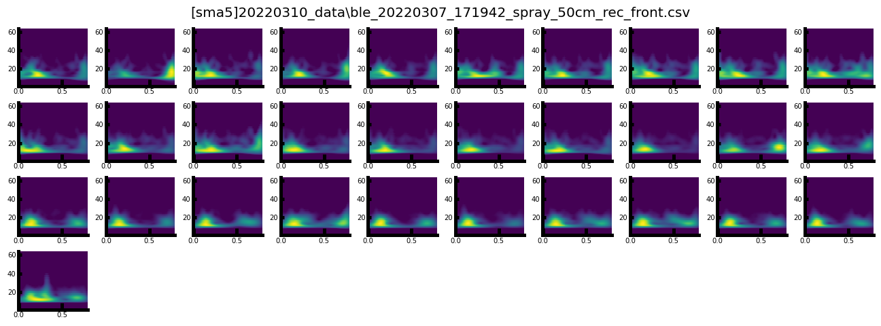
.\20220310_data\ble_20220307_171942_spray_50cm_rec_front_sma5.png

Slide 3
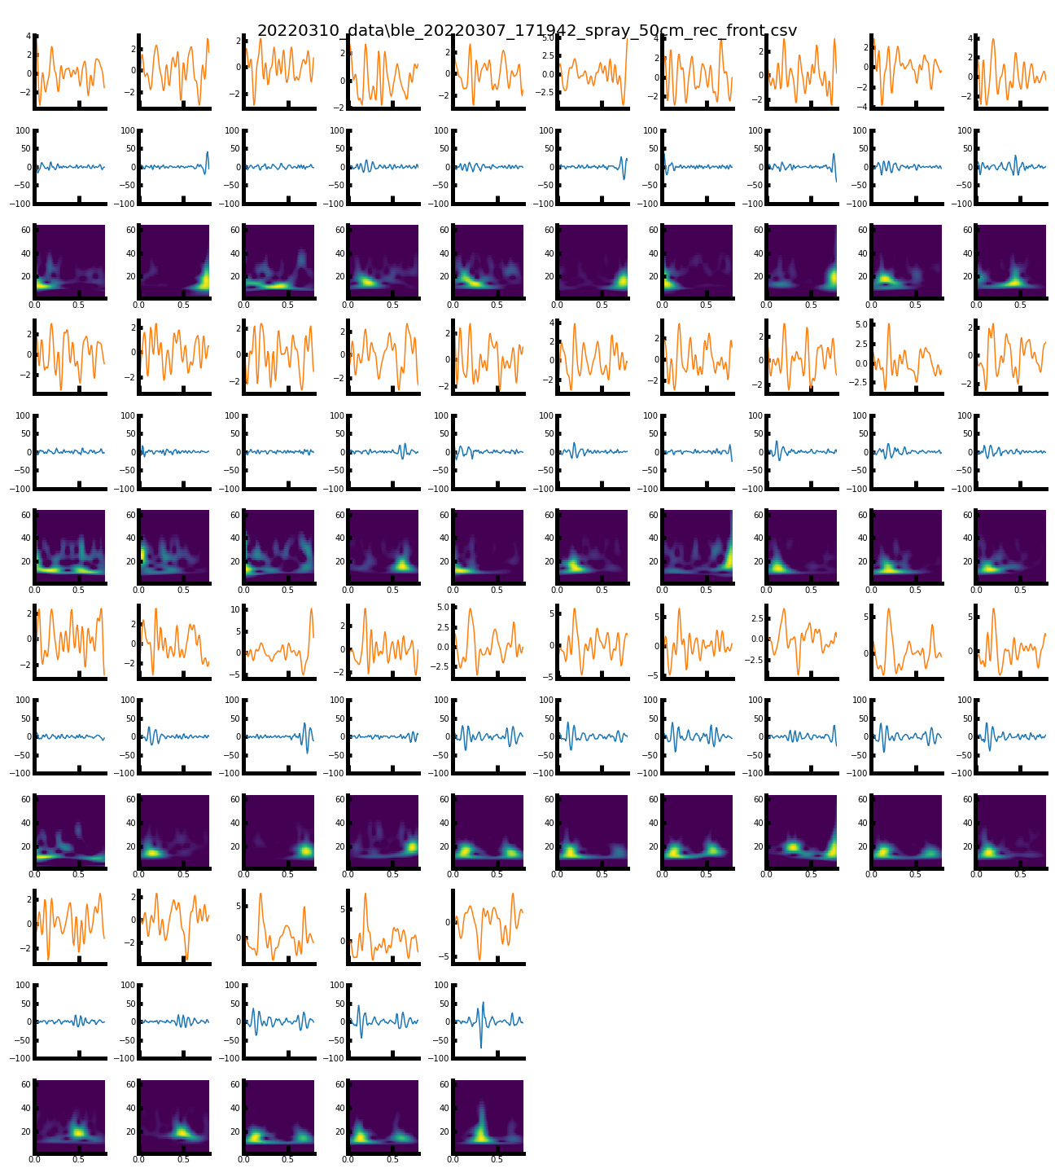
.\20220310_data\ble_20220307_171942_spray_50cm_rec_front_split.png

Slide 4
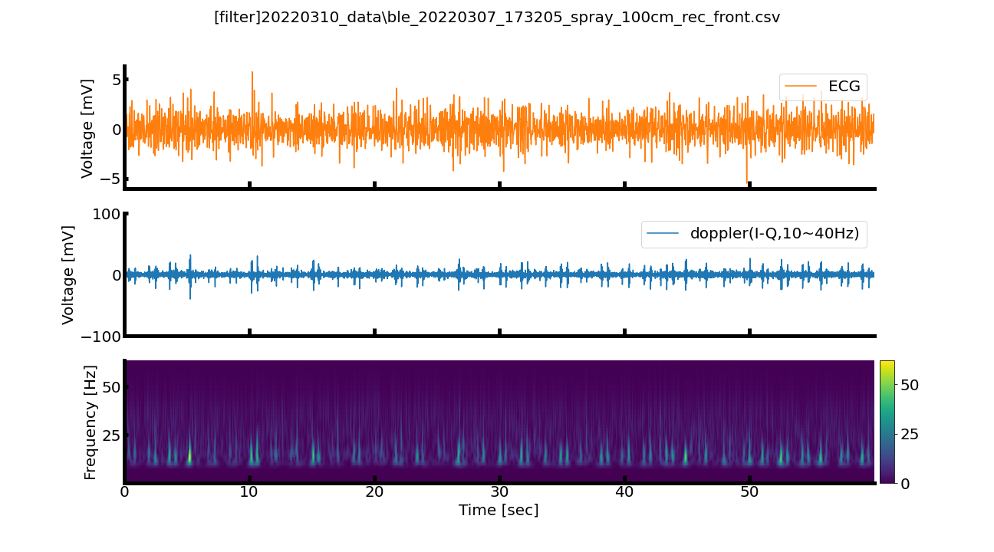
.\20220310_data\ble_20220307_173205_spray_100cm_rec_front_filtered.png

Slide 5
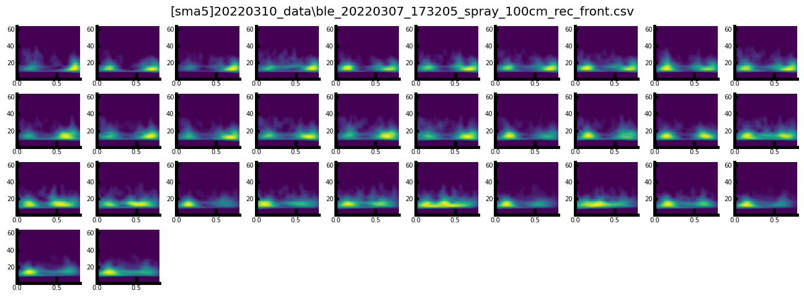
.\20220310_data\ble_20220307_173205_spray_100cm_rec_front_sma5.png

Slide 6
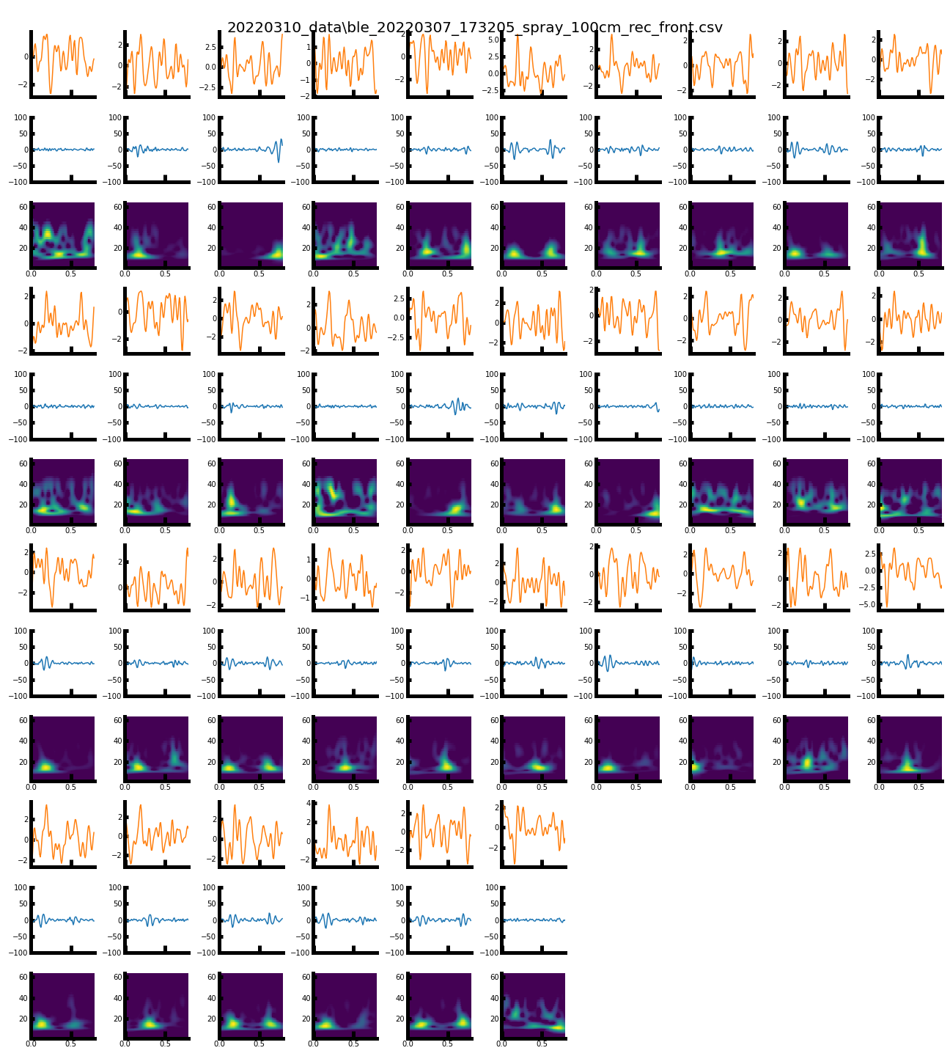
.\20220310_data\ble_20220307_173205_spray_100cm_rec_front_split.png

Slide 7
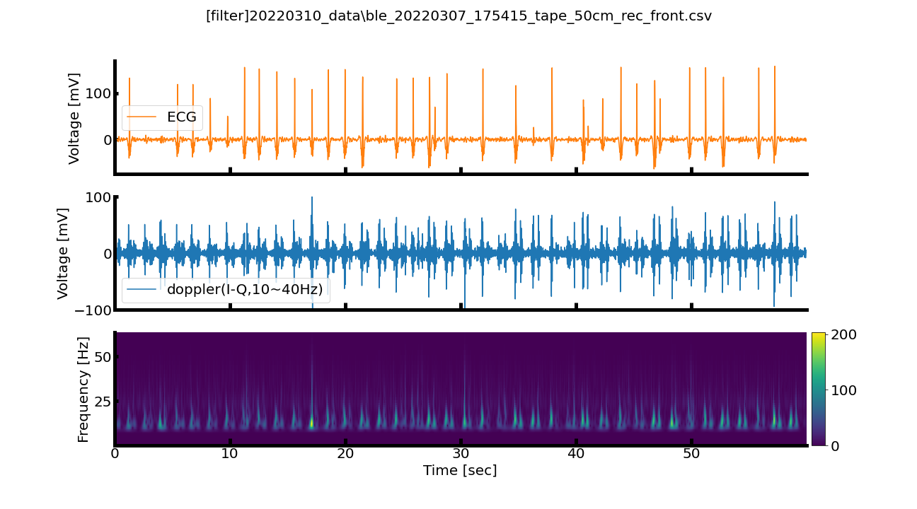
.\20220310_data\ble_20220307_175415_tape_50cm_rec_front_filtered.png

Slide 8
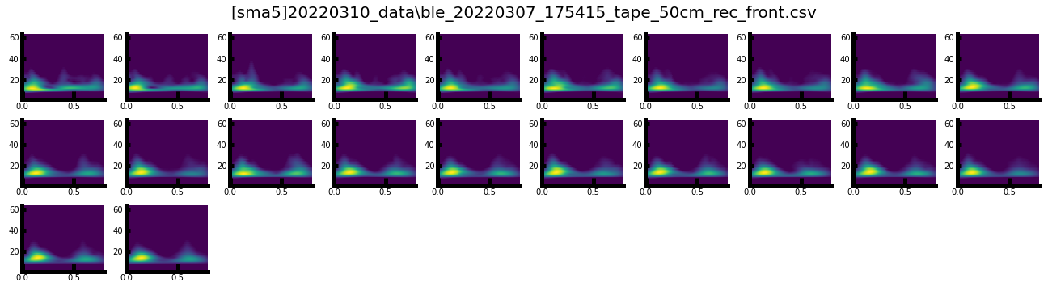
.\20220310_data\ble_20220307_175415_tape_50cm_rec_front_sma5.png

Slide 9
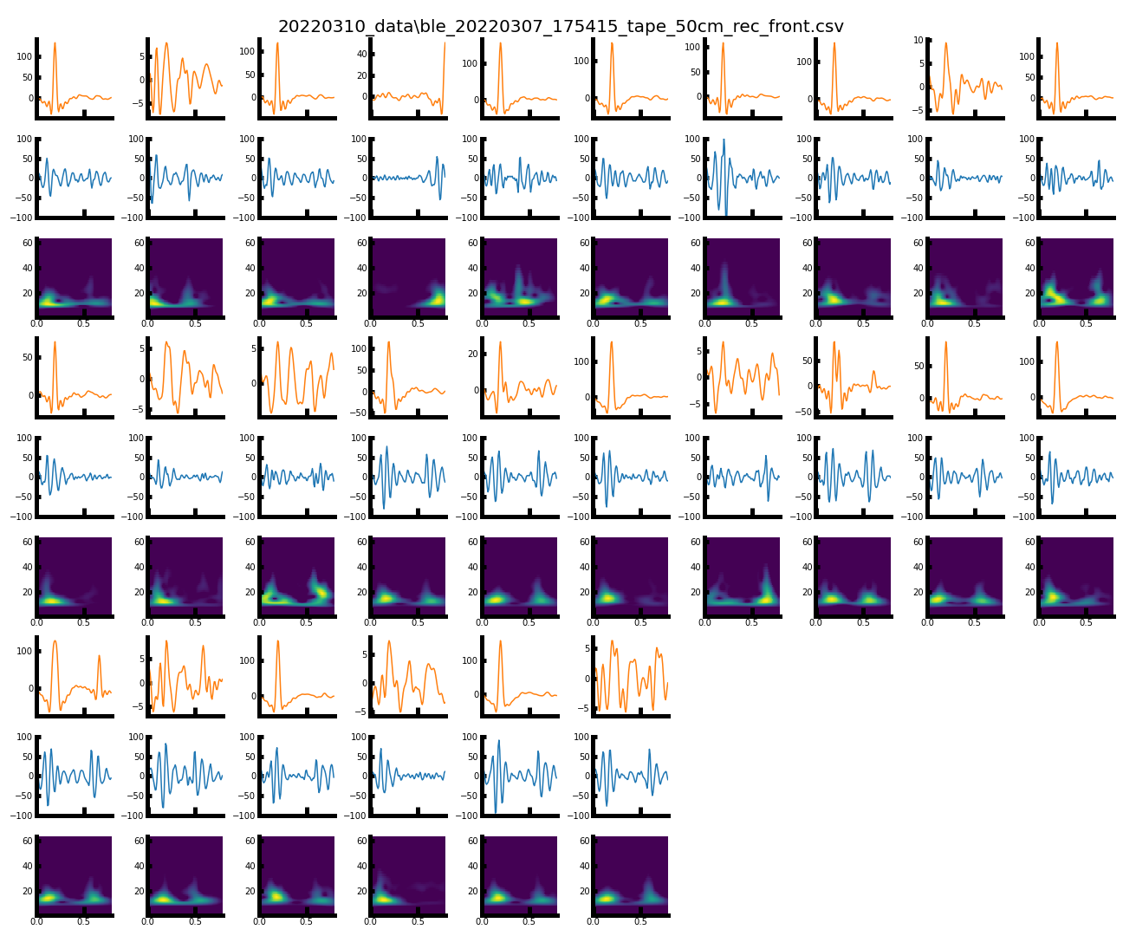
.\20220310_data\ble_20220307_175415_tape_50cm_rec_front_split.png

Slide 10
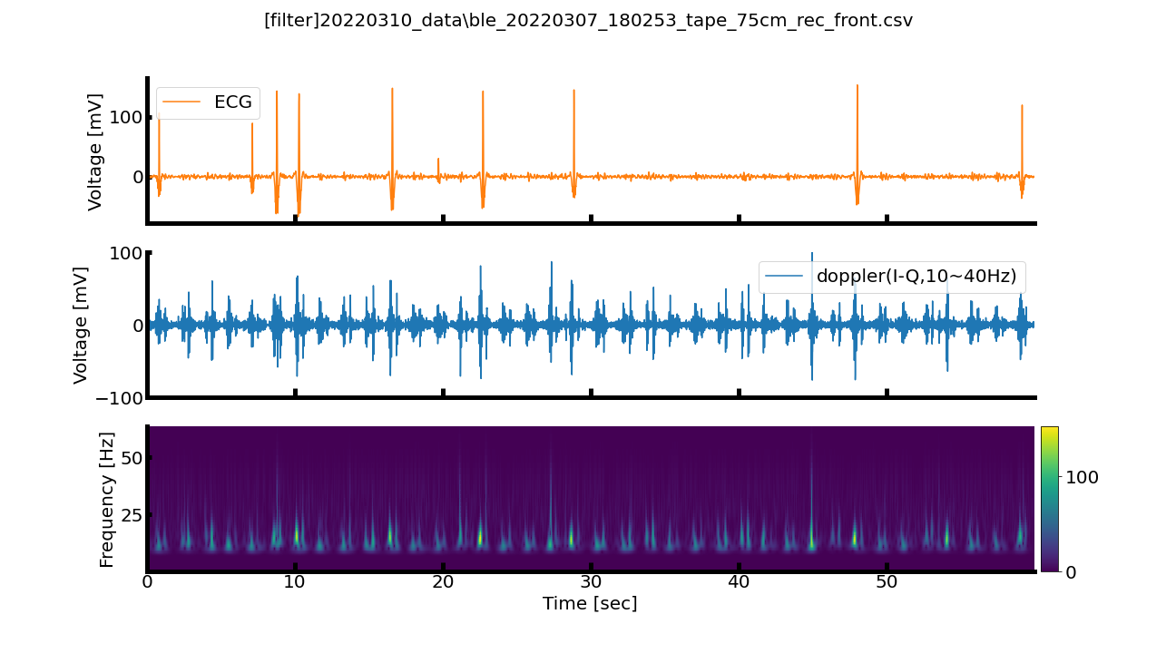
.\20220310_data\ble_20220307_180253_tape_75cm_rec_front_filtered.png

Slide 11
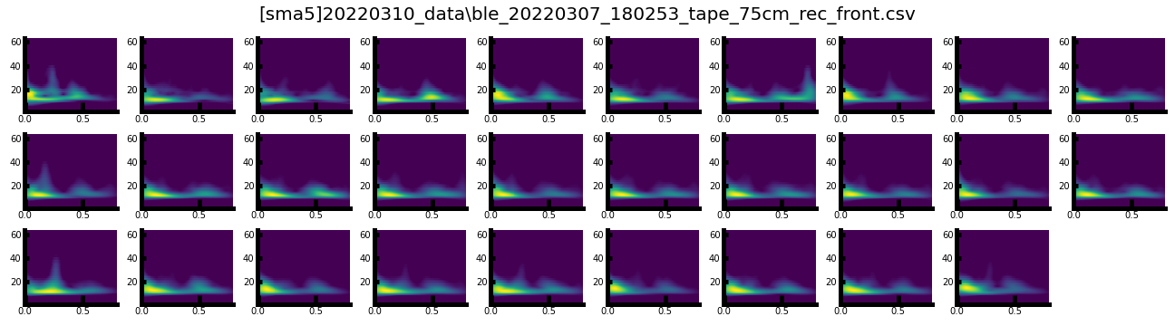
.\20220310_data\ble_20220307_180253_tape_75cm_rec_front_sma5.png

Slide 12
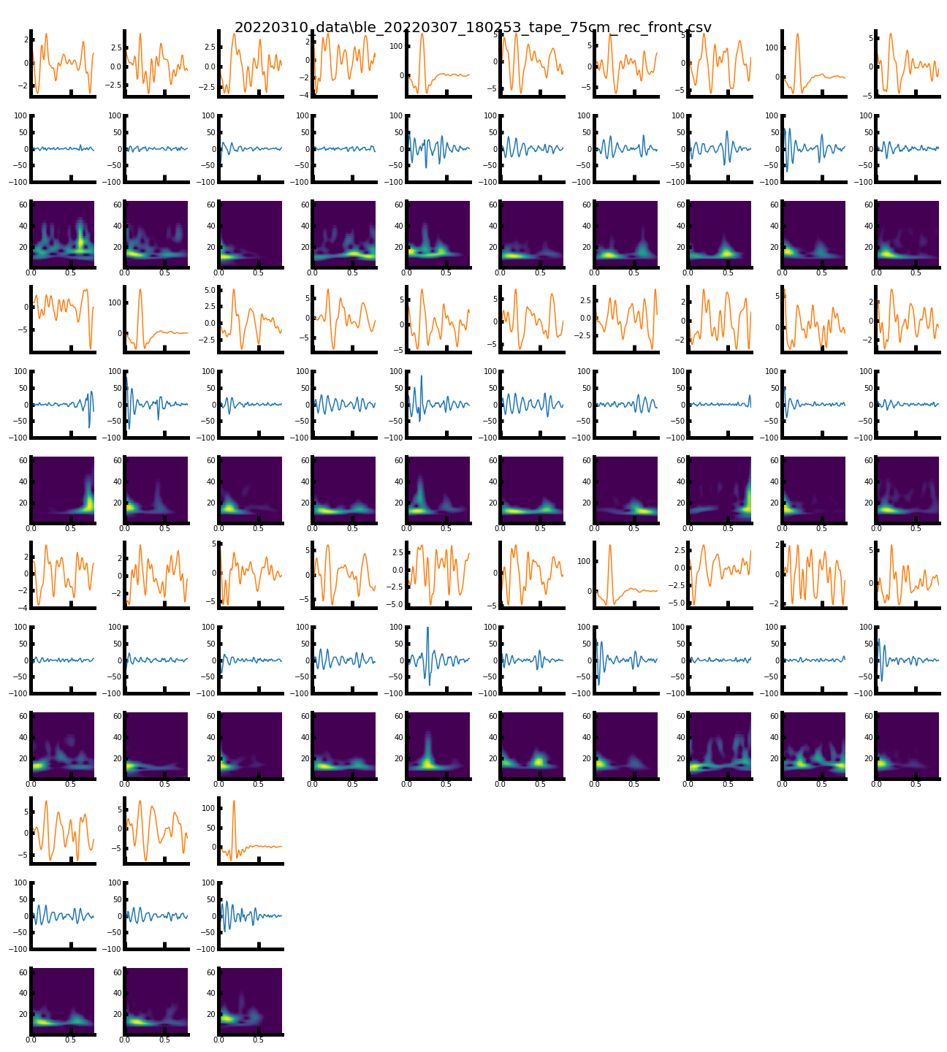
.\20220310_data\ble_20220307_180253_tape_75cm_rec_front_split.png

Slide 13
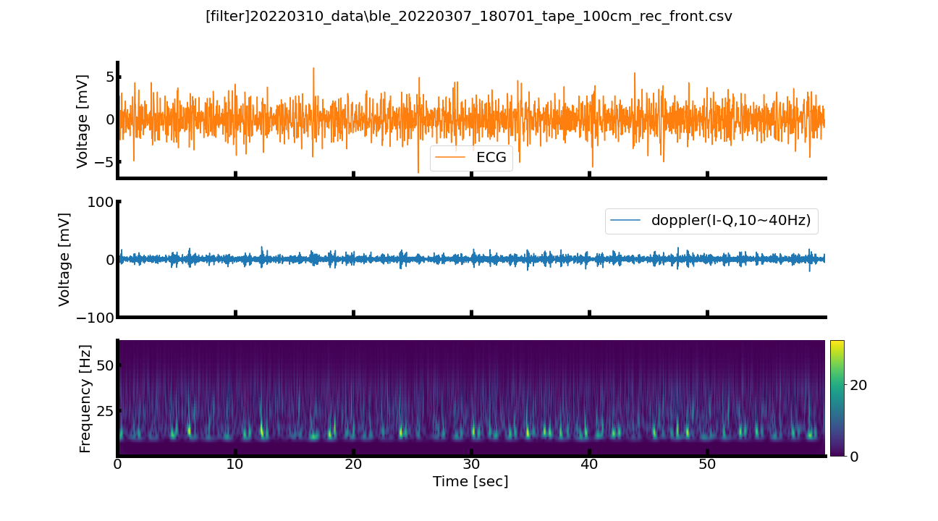
.\20220310_data\ble_20220307_180701_tape_100cm_rec_front_filtered.png

Slide 14
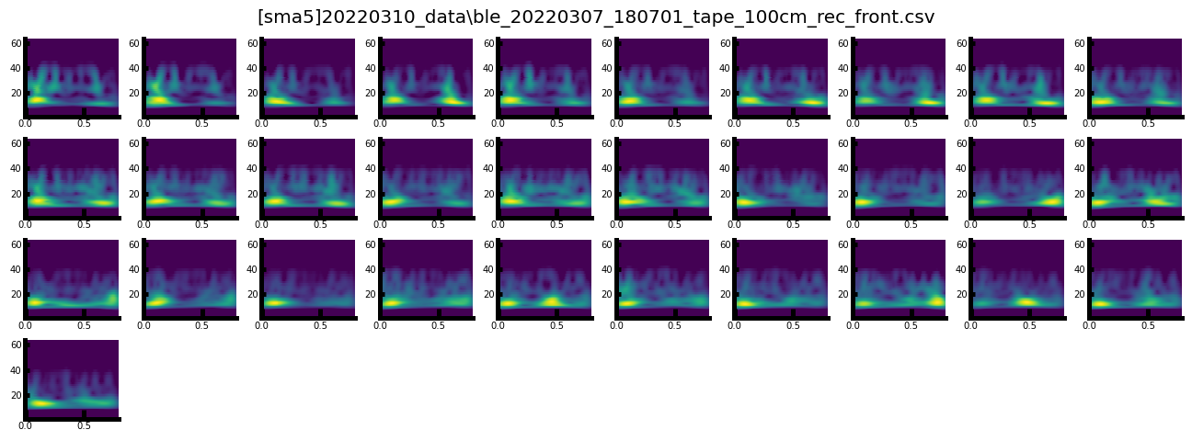
.\20220310_data\ble_20220307_180701_tape_100cm_rec_front_sma5.png

Slide 15
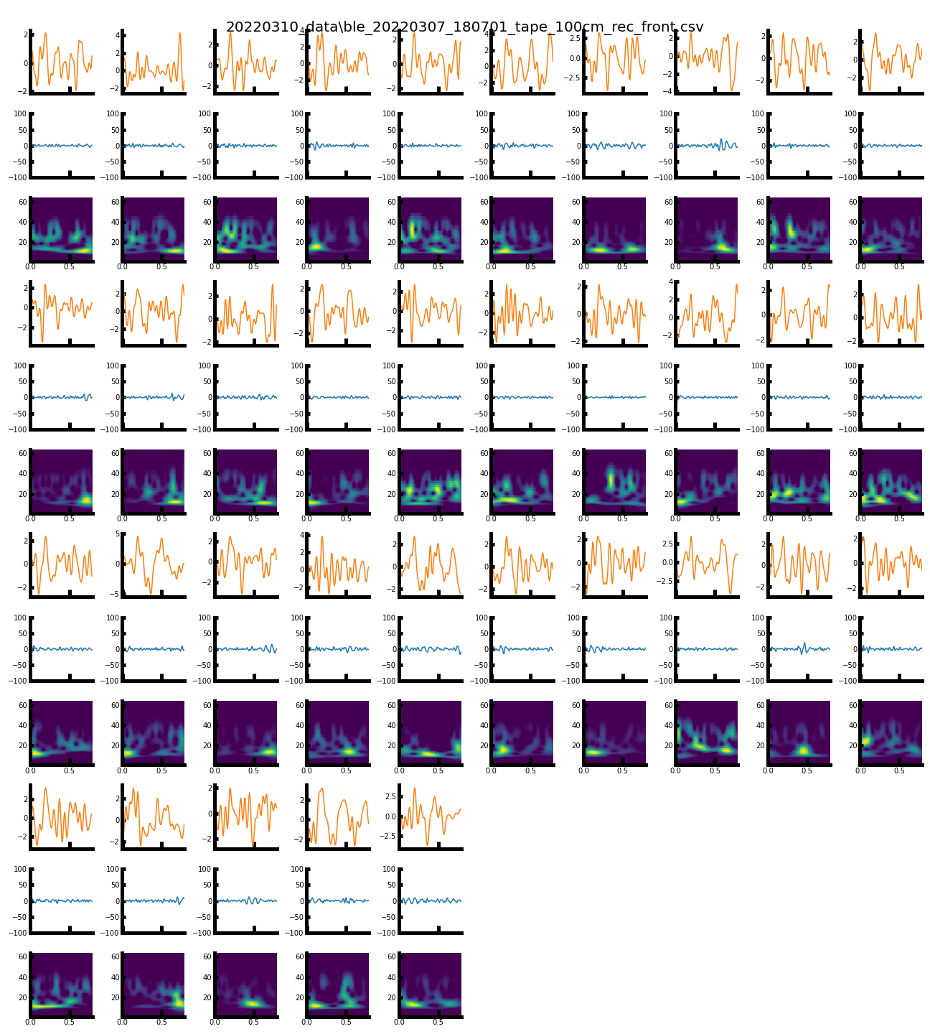
.\20220310_data\ble_20220307_180701_tape_100cm_rec_front_split.png

