Slide 1

Teacher Login
Student login
Online Test
Username: :
Password:
Saranya
root
login

Slide 2


Saranya(Teacher Name)
Account
logout
Dashboard
Subjects
ES204 Physics
CS850 Maths
CS850 Maths

Slide 3
Saranya(Teacher Name)
Account
logout
Dashboard
This will remove the
subject from teacher
Subjects
ES204 Physics
CS850 Maths
CS850 Maths

Slide 4
Saranya(Teacher Name)
Account
logout
Dashboard
This will remove the
subject from teacher
Subjects
ES204 Physics
CS850 Maths
This will add a subject
CS850 Maths

Slide 5
Lead to home
Saranya(Teacher Name)
Account
logout
Dashboard
This will remove the
subject from teacher
Subjects
ES204 Physics
CS850 Maths
This will add a subject
CS850 Maths

Slide 6
Lead to home
Saranya(Teacher Name)
Account
logout
Dashboard
This will remove the
subject from teacher
Subjects
ES204 Physics
I click here
CS850 Maths
This will add a subject
CS850 Maths

Slide 7
Saranya(Teacher Name) Subject: Maths
Account
logout
Dashboard
Question Bank
Exam Section

Slide 8
Saranya(Teacher Name) Subject: Maths
Account
logout
Dashboard
I click here
Question Bank
Exam Section

Slide 9

Saranya(Teacher Name) Subject: Maths
Account
logout
Dashboard
Chapters
18
Integration
34
Differentiation
14
Limit

Slide 10
Saranya(Teacher Name) Subject: Maths
Account
logout
Dashboard
This will delete the chapter
Chapters
18
Integration
34
Differentiation
14
Limit

Slide 11
Saranya(Teacher Name) Subject: Maths
Account
logout
Dashboard
This will delete the chapter
Chapters
18
Integration
34
Differentiation
This will modify
the chapter name
14
Limit

Slide 12
Saranya(Teacher Name) Subject: Maths
Account
logout
Dashboard
This will delete the chapter
Chapters
18
Integration
34
Differentiation
This will modify
the chapter name
This will add a chapter
14
Limit

Slide 13
Saranya(Teacher Name) Subject: Maths
Account
logout
Dashboard
This denotes the number of questions
This will delete the chapter
Chapters
18
Integration
34
Differentiation
This will modify
the chapter name
This will add a chapter
14
Limit

Slide 14
Saranya(Teacher Name) Subject: Maths
Lead to subject page
Account
logout
Dashboard
This denotes the number of questions
This will delete the chapter
Chapters
18
Integration
34
Differentiation
This will modify
the chapter name
This will add a chapter
14
Limit

Slide 15
Lead to home
Lead to subject page
Saranya(Teacher Name) Subject: Maths
Account
logout
Dashboard
This denotes the number of questions
This will delete the chapter
Chapters
18
Integration
34
Differentiation
This will modify
the chapter name
This will add a chapter
14
Limit

Slide 16
Lead to home
Lead to subject page
Saranya(Teacher Name) Subject: Maths
Account
logout
Dashboard
Suppose
I click on this card
This denotes the number of questions
This will delete the chapter
Chapters
18
Integration
34
Differentiation
This will modify
the chapter name
This will add a chapter
14
Limit

Slide 17




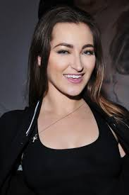
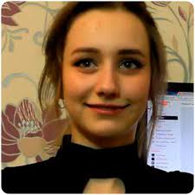
Saranya(Teacher Name) Subject: Maths
Account
logout
Dashboard
This is a question. Questions will be shown in NETFLIX style
Chapter
Integration
18
correct
Option 1
Option 2
Option 3
Option 4

Slide 18
Saranya(Teacher Name) Subject: Maths
Account
logout
Dashboard
This is a question. Questions will be shown in NETFLIX style
Chapter
Integration
18
This will add a question
correct
Option 1
Option 2
Option 3
Option 4

Slide 19
Saranya(Teacher Name) Subject: Maths
Account
logout
Dashboard
This is a question. Questions will be shown in NETFLIX style
This denotes number of questions
Chapter
Integration
18
This will add a question
correct
Option 1
Option 2
Option 3
Option 4

Slide 20
Saranya(Teacher Name) Subject: Maths
Account
logout
Dashboard
This is a question. Questions will be shown in NETFLIX style
This denotes number of questions
Chapter
Integration
This modifies the question
18
This will add a question
correct
Option 1
Option 2
Option 3
Option 4

Slide 21
Saranya(Teacher Name) Subject: Maths
Account
logout
Dashboard
This is a question. Questions will be shown in NETFLIX style
This denotes number of questions
Chapter
Integration
This modifies the question
18
This will add a question
correct
Option 1
Option 2
This deletes the question
Option 3
Option 4

Slide 22
Saranya(Teacher Name) Subject: Maths
Account
logout
Dashboard
This is a question. Questions will be shown in NETFLIX style
This denotes number of questions
Chapter
Integration
This modifies the option
This modifies the question
18
This will add a question
correct
Option 1
Option 2
This deletes the question
Option 3
Option 4

Slide 23
Saranya(Teacher Name) Subject: Maths
This previews the question
Account
logout
Dashboard
This is a question. Questions will be shown in NETFLIX style
This denotes number of questions
Chapter
Integration
This modifies the option
This modifies the question
18
This will add a question
correct
Option 1
Option 2
This deletes the question
Option 3
Option 4

Slide 24
Saranya(Teacher Name) Subject: Maths
Account
logout
Dashboard
This is a question. Questions will be shown in NETFLIX style
I choose to add a question
Chapter
Integration
18
correct
Option 1
Option 2
Option 3
Option 4

Slide 25

Question Workspace
Question
Write Your Question Here. You can use equations and images

Slide 26
Question Workspace
Question
Write Your Question Here. You can use equations and images
I click here

Slide 27
Question Workspace
Correct Option
Write Your Correct Option Here. You can use equations and images

Slide 28
Question Workspace
Correct Option
Write Your Correct Option Here. You can use equations and images
I click here

Slide 29
Question Workspace
Incorrect Option1
Write Your Incorrect Option 1 Here. You can use equations and images

Slide 30
Question Workspace
Incorrect Option1
Write Your Incorrect Option 1 Here. You can use equations and images
I click here

Slide 31
Question Workspace
Incorrect Option2
Write Your Incorrect Option 2 Here. You can use equations and images

Slide 32
Question Workspace
Incorrect Option2
Write Your Incorrect Option 2 Here. You can use equations and images
I click here

Slide 33

Question Workspace
Incorrect Option3
Write Your Incorrect Option 3 Here. You can use equations and images

Slide 34
Question Workspace
Incorrect Option3
Write Your Incorrect Option 3 Here. You can use equations and images
I click here

Slide 35
Saranya(Teacher Name) Subject: Maths
Account
logout
Dashboard
This is a question. Questions will be shown in NETFLIX style
Chapter
Integration
19
correct
Option 1
Option 2
Option 3
Option 4

Slide 36
Saranya(Teacher Name) Subject: Maths
Account
logout
Dashboard
This is a question. Questions will be shown in NETFLIX style
Chapter
Integration
This will act similarly as add button
19
correct
Option 1
Option 2
Option 3
Option 4

Slide 37
Saranya(Teacher Name) Subject: Maths
Account
logout
Dashboard
This is a question. Questions will be shown in NETFLIX style
Chapter
Integration
This will act similarly as add button
19
correct
Option 1
Suppose I click here
Option 2
Option 3
Option 4

Slide 38
Edit Option
Write Your Option Here. You can use equations and images

Slide 39
Edit Option
Write Your Option Here. You can use equations and images
I click here

Slide 40

Saranya(Teacher Name) Subject: Maths
Account
logout
Dashboard
This is a question. Questions will be shown in NETFLIX style
Chapter
Integration
19
correct
Option 1
Option 2
Option 3
Option 4

Slide 41

Saranya(Teacher Name) Subject: Maths
Account
logout
Dashboard
This is a question. Questions will be shown in NETFLIX style
Chapter
Integration
I select this option
19
correct
And I select this option
Option 1
Option 2
Option 3
Option 4

Slide 42
Saranya(Teacher Name) Subject: Maths
Account
logout
Dashboard
This is a question. Questions will be shown in NETFLIX style
Chapter
Integration
I select this option
19
This will swap two options
correct
And I select this option
Option 1
Option 2
Option 3
Option 4

Slide 43
Lead to subject page
Saranya(Teacher Name) Subject: Maths
Account
logout
Dashboard
This is a question. Questions will be shown in NETFLIX style
Chapter
Integration
19
correct
Option 4
Option 2
Option 3
Option 1

Slide 44
Lead to subject page
Saranya(Teacher Name) Subject: Maths
Account
logout
Dashboard
This is a question. Questions will be shown in NETFLIX style
Lead to chapter page
Chapter
Integration
19
correct
Option 4
Option 2
Option 3
Option 1

Slide 45
Lead to home
Lead to subject page
Saranya(Teacher Name) Subject: Maths
Account
logout
Dashboard
This is a question. Questions will be shown in NETFLIX style
Lead to chapter page
Chapter
Integration
19
correct
Option 4
Option 2
Option 3
Option 1

Slide 46
Lead to home
Lead to subject page
Saranya(Teacher Name) Subject: Maths
Account
logout
Dashboard
I click here
This is a question. Questions will be shown in NETFLIX style
Lead to chapter page
Chapter
Integration
19
correct
Option 4
Option 2
Option 3
Option 1

Slide 47
Saranya(Teacher Name)
Account
logout
Dashboard
Subjects
ES204 Physics
CS850 Maths
CS850 Maths

Slide 48
Saranya(Teacher Name)
Account
logout
Dashboard
Subjects
ES204 Physics
I click here
CS850 Maths
CS850 Maths

Slide 49
Saranya(Teacher Name) Subject: Maths
Account
logout
Dashboard
Question Bank
Exam Section

Slide 50
Saranya(Teacher Name) Subject: Maths
Account
logout
Dashboard
Question Bank
I click here
Exam Section

Slide 51
Saranya(Teacher Name) Subject: Maths
Account
logout
Dashboard
Test Dashboard
View Result

Slide 52
Saranya(Teacher Name) Subject: Maths
Account
logout
Dashboard
I click here
Test Dashboard
View Result

Slide 53
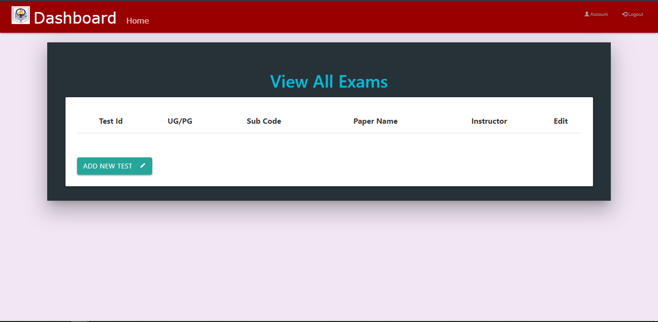
I click here

Slide 54
Saranya(Teacher Name)
Account
logout
Dashboard
Auto Generated
Date
Test ID:
6
Given
Test Name:
Given By Teacher
Test Description:
Subject
Given By Teacher.
Dropdown
Cancel
Next

Slide 55
Saranya(Teacher Name)
Account
logout
Dashboard
Auto Generated
Date
Test ID:
6
Given
Test Name:
Given By Teacher
Test Description:
Subject
Given By Teacher.
Dropdown
I click here
Cancel
Next

Slide 56

Saranya(Teacher Name) Subject: Maths
Account
logout
Dashboard
Question selected
0

Slide 57
Saranya(Teacher Name) Subject: Maths
Account
logout
Dashboard
Question selected
0
This is to add questions

Slide 58
Saranya(Teacher Name) Subject: Maths
Account
logout
Dashboard
Question selected
0
Me click here

Slide 59

Chapters
18
Integration
34
Differentiation
14
Limit

Slide 60
Chapters
18
Integration
34
Differentiation
14
This is a back button leads to page in slide 56
Limit

Slide 61
me click here
Chapters
18
Integration
34
Differentiation
14
This is a back button leads to page in slide 56
Limit

Slide 62

This is a question. Questions will be shown in NETFLIX style
correct
Option 1
Option 2
Option 3
Option 4

Slide 63
This is a question. Questions will be shown in NETFLIX style
correct
Option 1
Option 2
Option 3
Option 4
This is a back button leads to page in slide 59

Slide 64
This is a question. Questions will be shown in NETFLIX style
me click here
correct
Option 1
Option 2
Option 3
Option 4
This is a back button leads to page in slide 59

Slide 65

Eta blur korlam bujhli toh
This is a question. Questions will be shown in NETFLIX style
correct
Option 1
Option 2
Option 3
Option 4

Slide 66
This is a question. Questions will be shown in NETFLIX style
me click here
correct
Option 1
Option 2
Option 3
Option 4

Slide 67
This is a question. Questions will be shown in NETFLIX style
correct
Option 1
Option 2
Option 3
Option 4

Slide 68
This is a question. Questions will be shown in NETFLIX style
me click here
correct
Option 1
Option 2
Option 3
Option 4

Slide 69
This is a question. Questions will be shown in NETFLIX style
correct
Option 1
Option 2
Option 3
Option 4

Slide 70
This is a question. Questions will be shown in NETFLIX style
correct
Option 1
Option 2
Option 3
Option 4
me click here

Slide 71
Chapters
18
Integration
34
Differentiation
14
Limit

Slide 72
Chapters
18
Integration
34
Differentiation
14
Limit
me click here

Slide 73
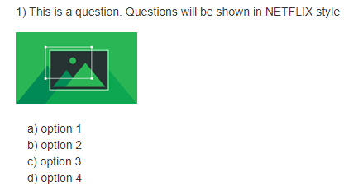
Saranya(Teacher Name) Subject: Maths
Account
logout
Dashboard
Chapter
Integration
Question selected
1

Slide 74
Saranya(Teacher Name) Subject: Maths
Account
logout
Dashboard
Chapter
Integration
Question selected
1
me click here

Slide 75
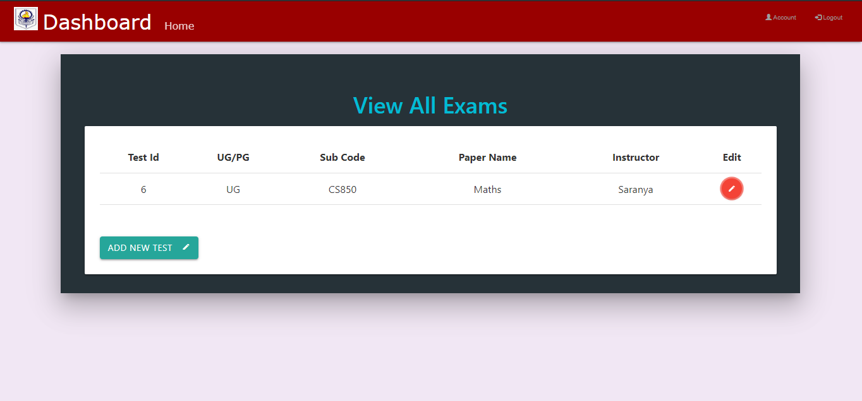
Here all the exams made by a teacher will be shown including past examinations. Examinations which has not submitted to COE will be editable. Rest will be non editable. Please give a back button here. Me click a back button which does not exist like our Tech Club

Slide 76
Saranya(Teacher Name) Subject: Maths
Account
logout
Dashboard
Test Dashboard
I click here
View Result

Slide 77
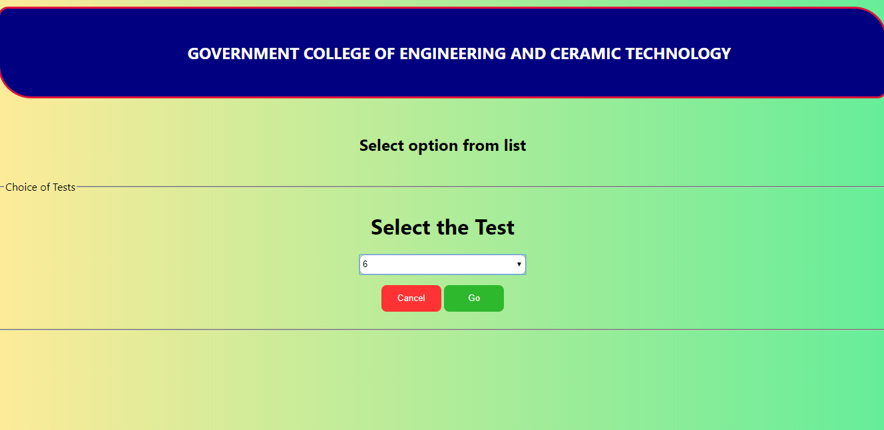
Beautify this page and also show test name with test id.

Slide 78
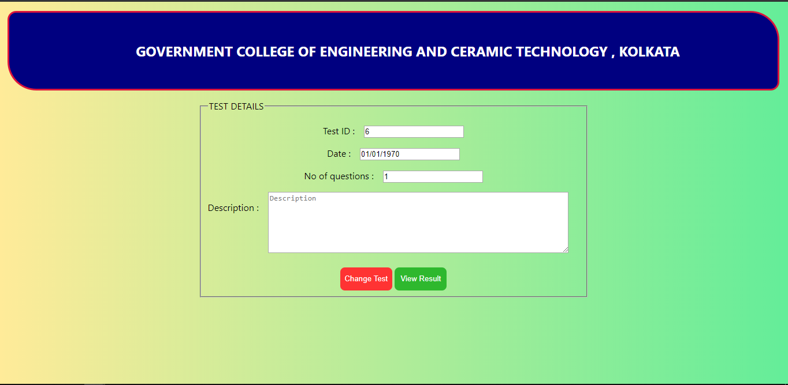
Beautify . Otherwise this page looks good. Show the test name.

Slide 79
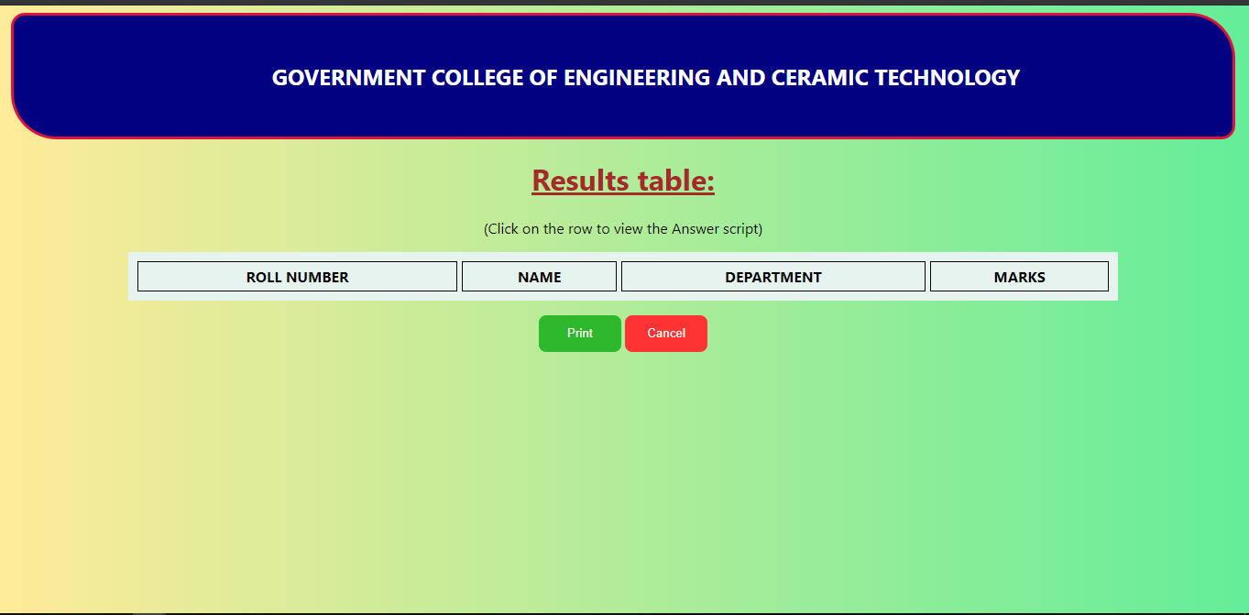
Beautify. Otherwise this page looks good.

Slide 80
Create smain.html again

Slide 81
masterlanding.html
(skip)
COE login
(skip)
Teacher Login
(skip)
Student Login (recreate)
Everything Skip
intro.php
(skip)
Everything New
workpg
(recommended)
Submit Answer
(skip)

