Slide 1
LOCATING COFFEE SHOP IN LOS ANGELES THROUGH DATA ANALYSIS
Aynaz Mirzazada

Slide 2
Objectives
Coffee shop targeting the university students in the ages of 19 - 27
Quiet place to study and be productive
Targeted location is California, targeted city Los Angeles
Finding out the city with the highest youth population and highest number of education facilities

Slide 3
Data acquisition
California Census Data is used from the Los Angeles Open Data Portal
Los Angeles Education Facilities data from Los Angeles Open Data Portal
Los Angeles geographical coordinates data from LA City Geohub
Foursquare API for geolocation from Foursquare Developer

Slide 4
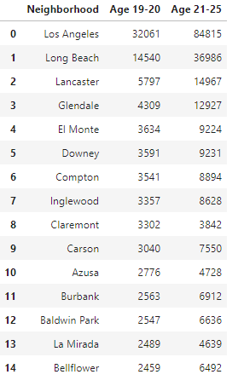
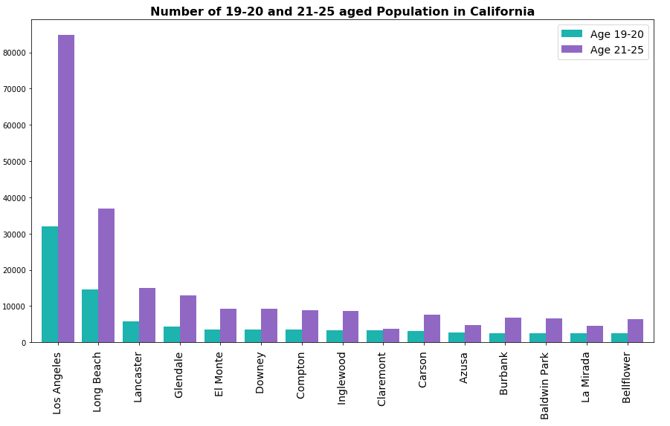
Number of Young Age Groups

Slide 5
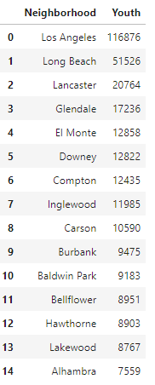
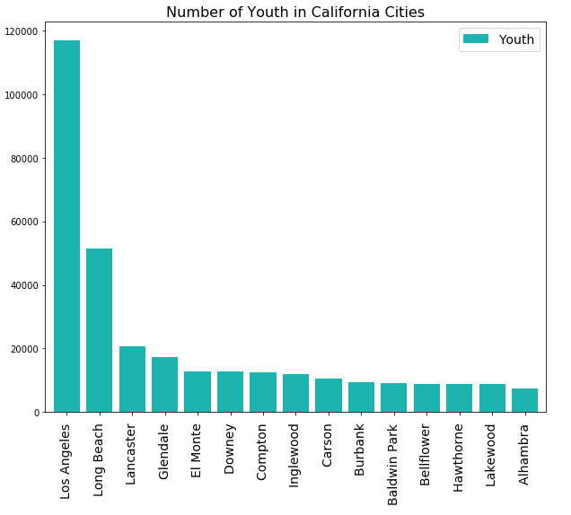
The Highest Youth Population in LA

Slide 6
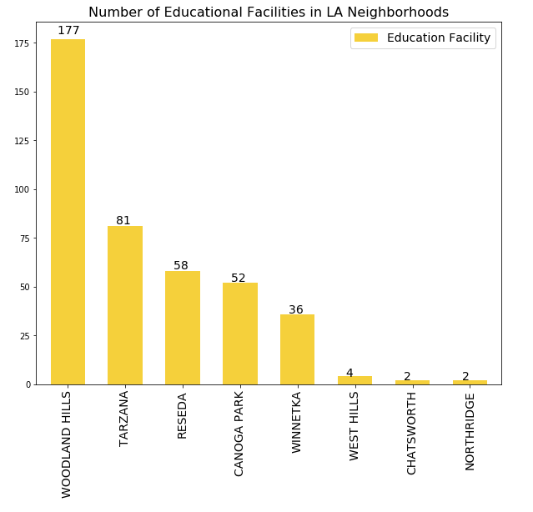
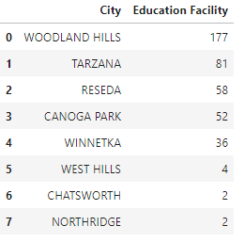
Location for Education Facilities in LA
Woodland Hills, Los Angeles is the neighborhood with the highest number of educational facilities in Los Angeles.

Slide 7
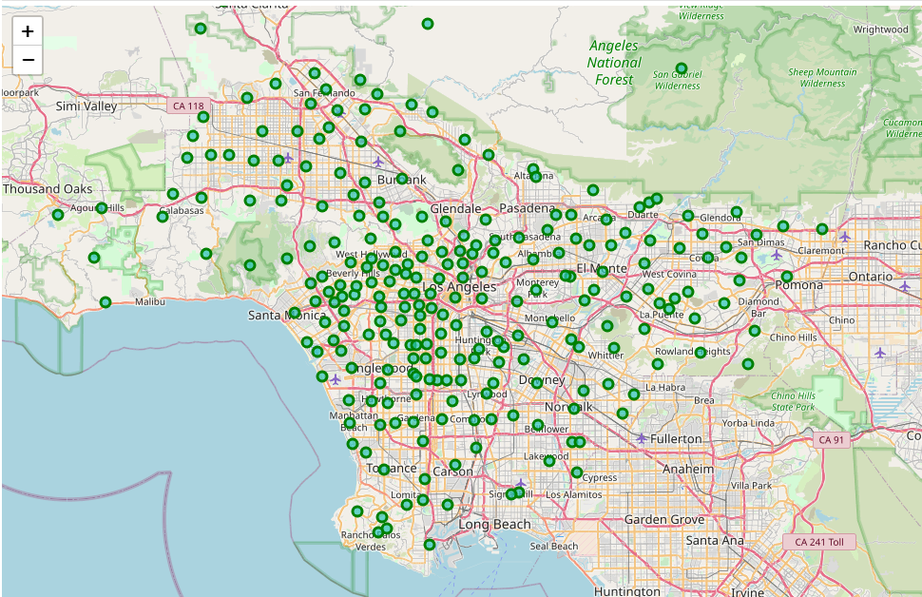
Los Angeles Mapping

Slide 8
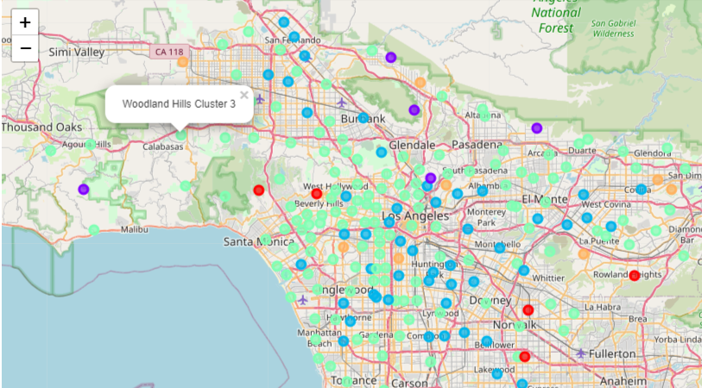
Result after k-means clustering
K=5 means clustering
Woodland Hills is in the Cluster 3
Highest youth population in California
Densest location for educational facilities
No any common coffee shop in top 10
No heavy competition

Slide 9
Business perspectives
This research can be used for businesses with similar target audiences
Location can be chosen far from highway closer to city center, for easier transportation
Cluster 3 is especially diverse for its common venues which is an opportunity for many visitors.

Slide 10
Thanks for attention!
Coursera Capstone Data Science Project “The Battle of Neighborhoods”
July, 2020
Aynaz Mirzazada

