Slide 1
UVSIM
By: Anthony, Andie, Brandon

Slide 2
Early Design
Client
UVU
Project Purpose
Machine language learning tool
BasicML Interpreter

Slide 3
BasicML
100 Word Memory
Accumulator
Signed 4-digit Words
First 2 digits determine instruction
Last 2 digits determine address

Slide 4
Users and Use Cases
Students - Learning machine language
BasicML program writing, loading, running, and saving functionality
Useful error messages for learning
Teachers
Loading and running student-made BasicML programs
Writing example BasicML programs

Slide 5
SRS - Functional Requirements
BasicML Requirements
Signed 4-digit words
100 Registers
1 Accumulator
Error Checking
GUI with visible memory state
Program reset functionality

Slide 6
SRS - Instructions
I/O functions - READ, WRITE
Memory management functions - LOAD, STORE
Arithmetic functions - ADD, SUBTRACT, MULTIPLY, DIVIDE
Branching functions - BRANCH, BRANCHNEG, BRANCHZERO
Halting function - HALT

Slide 7
SRS - Nonfunctional
Modularity
Designed with modular structure to enable efficient updates
Universal Support
UVSim can run on most modern computers and operating systems
Speed
Valid BasicML programs can begin running within 2 seconds of being loaded

Slide 8
Later Requirements
BasicML
Signed 6-word program support
250-word memory size
Legacy Support

Slide 9
Features - High Level
Modular Architecture
BasicML Program Execution
Interactive GUI
File & Editor Integration
Input/Output Management
Customizable Themes
Error Checking

Slide 10
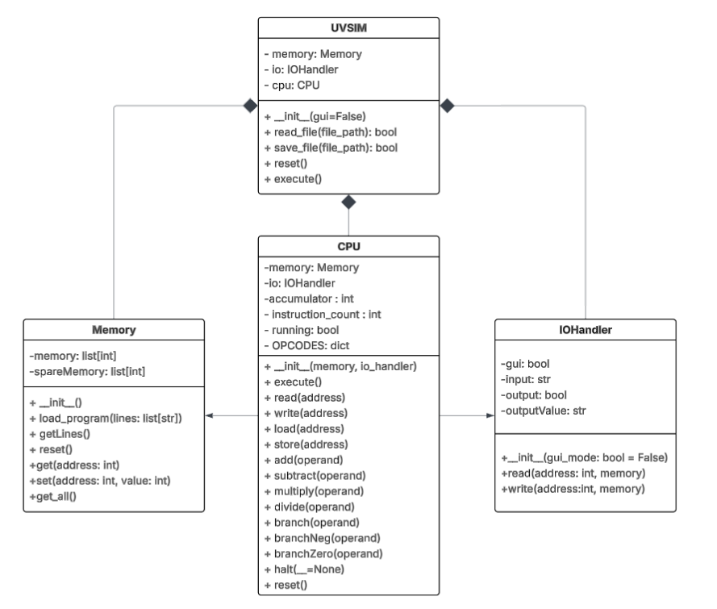
Model Class Responsibilities
UVSIM is the main model and holds the CPU, Memory, and IOHandler
CPU: executes instructions, controls the program flow
Memory: stores and gets program data
IOHandler: gets GUI and Console input/output

Slide 11
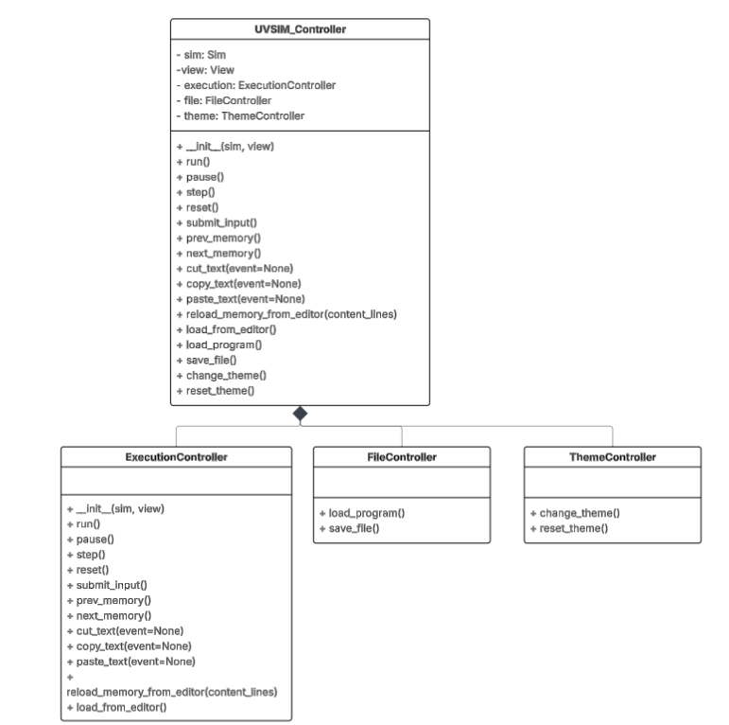
Controller Class Responsibilities
UVSIM_Controller: Handles the central logic
ExecutionController: Handles the functions required to run, reset, halt execution of the program
FileController: Handles the file loading and saving aspect of the program
Theme Controller: Manages the setting and resetting of theme

Slide 12
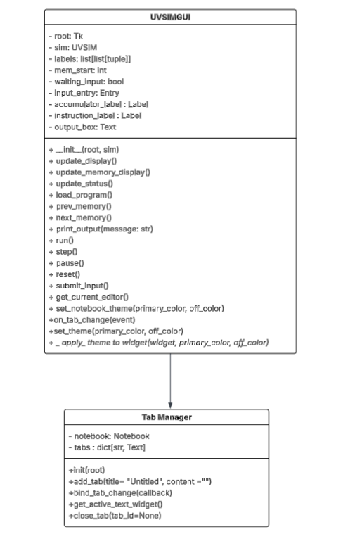
View Class Responsibilities
UVSIMGUI: Sets up the main window for the GUI
Uses Tkinter for layout
TabManager: Manages the notebook and output for the different tabs
The GUI works with the Controller classes to show the current model state.

Slide 13
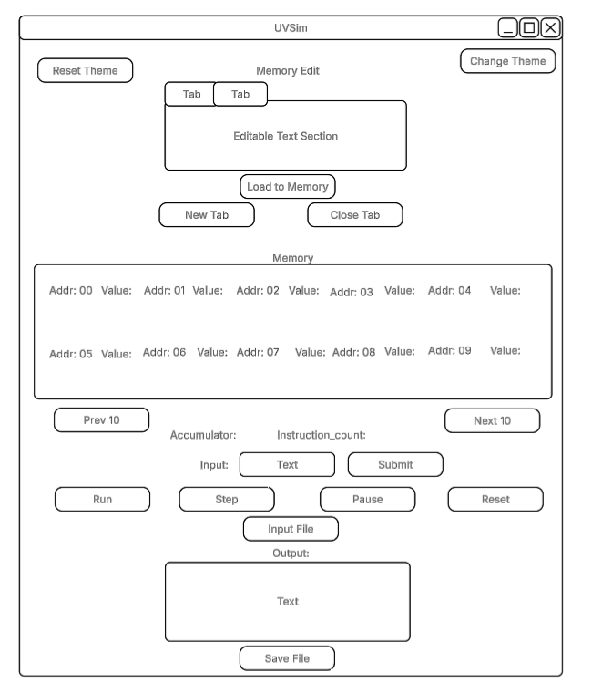
WireFrame

Slide 14
Design Principles
Model View Controller Architecture
Separation of Concerns
Single Responsibility Principle
Don’t Repeat Yourself (DRY)
Open/Closed
Encapsulation

Slide 15
Design Patterns
The UVSim_Controller class follows the Facade Pattern:
It serves as a interface to a set of subsystems
The GUI only needs to interact with the UVSim_Controller, not all the subsystems
UVSIMGUI class uses Observer Pattern (Partially)
The GUI observes state changes in memory and updates the view.
It isn’t a formal Observer implementation, but it tries to do the same thing.

Slide 16
Organization
Modular and organized folder structure
Used Github for version control and collaboration
Used issues on Zenhub to help track progress and assign tasks
Testing done through Unittest
UVSim-Project
Src
Model
View
Controller
Documentation
Images
Sprint_Meetings
SRSProposals
Tests

Slide 17
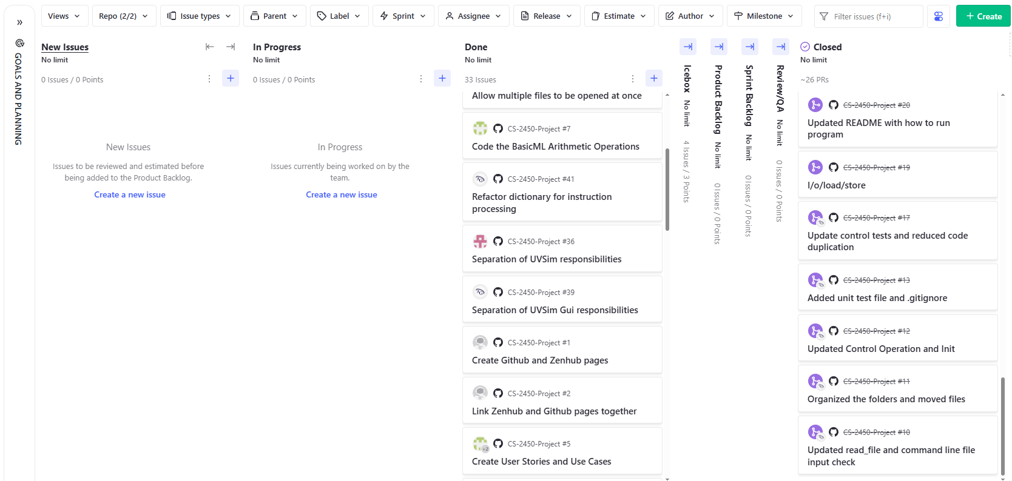
Zenhub Board

Slide 18
Robustness in UVSim
Input Validation
Strict checks for signed numbers (+/- followed by digits)
Rejects mixed word lengths (all instructions must be 4 or 6 digits)
Error Handling
Division by zero: Pauses execution with clear error
Invalid opcodes: Halts with descriptive message
Memory Safety
Bounds checking on memory access
Separate memory and spareMemory for resets
Modular

Slide 19
Robustness cont.
Current Limitations:
No thread safety (assumes single-threaded GUI)
Limited error recovery (halts on most errors)
Proposed Improvements:
Add logging for debugging
Implement memory protection flags
Extend unit test coverage

Slide 20
Testing
Framework: unittest
Over 60 unit tests covering:
CPU valid/invalid instructions (ADD, SUBTRACT, BRANCH, etc.)
Memory operations loading and format validation
GUI interactions (tk.Text, tab management, input validation)
Controller logic (reset, pause, memory reload)
Run with:
PYTHONPATH=./src python -m unittest discover -s tests

Slide 21
Sample tests
Instruction Execution:
test_branch_instruction_count()
test_divide_zero() : raises ZeroDivisionError
Loading:
test_valid_4digit_program()
test_invalid_missing_sign() : properly fails
Controller Logic:
test_pause_stops_execution()
test_reset_clears_state_and_resets_cpu()
GUI Integration:
test_set_theme_applies_color()
test_print_output() — verifies text is displayed in output box

