Slide 1
Smart Tracker Reports

Slide 2
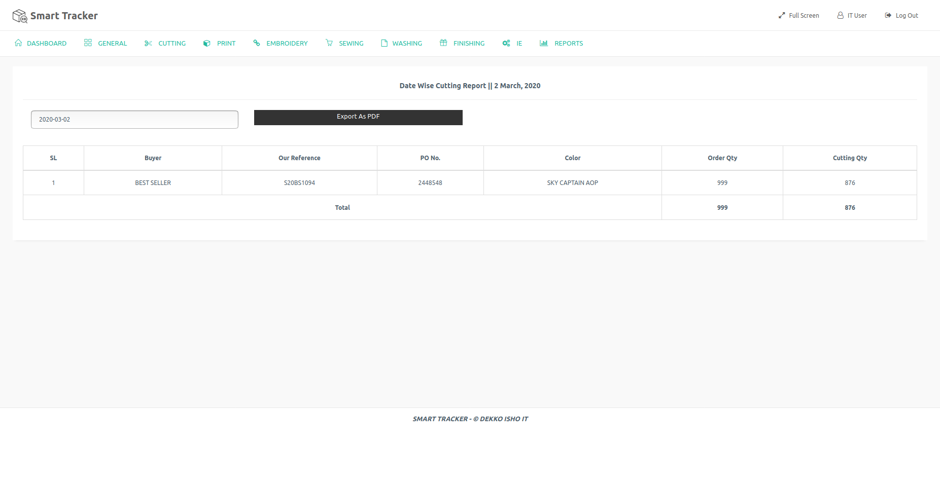
Day Wise Cutting Report

