Slide 1
Design and implementation of a weather measurement system
Ayomide Ajayi
Embedded Systems Lecturer: Prof. Lajos Harasztosi
26/11/2023

Slide 2
OVERVIEW
Design an autonomous weather monitoring system that sends temperature and humidity data to the cloud to be accessible from anywhere in the world.
Components used: DHT22 - Temperature and Humidity sensor
Battery – Power supply
Resistors – two 1k Ohms resistors
Tact switch
2 LEDs – WiFi indicator and Power indicator
Node MCU – ESP8266 microcontroller

Slide 3
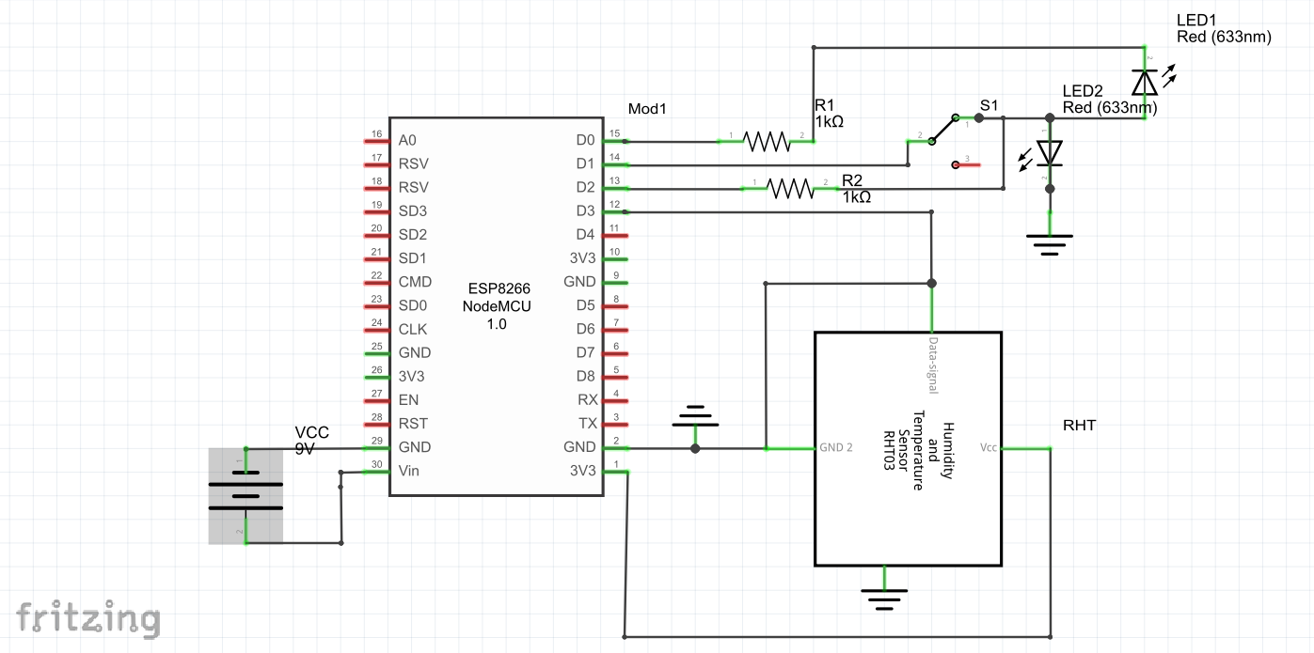
SCHEMATIC DIAGRAM

Slide 4
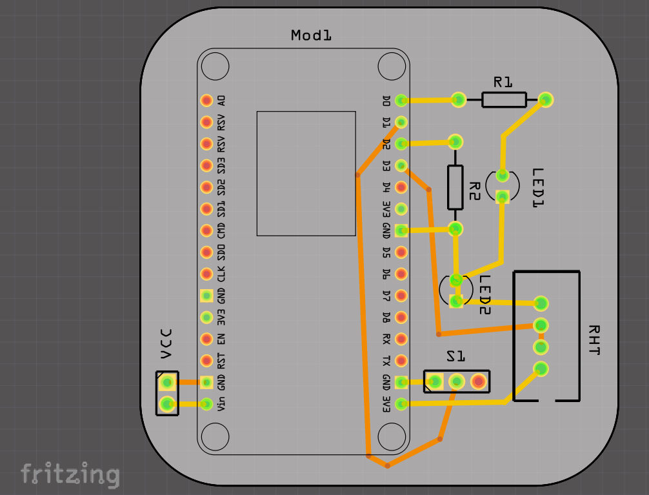
PRINTED CIRCUIT BOARD DESIGN

Slide 5
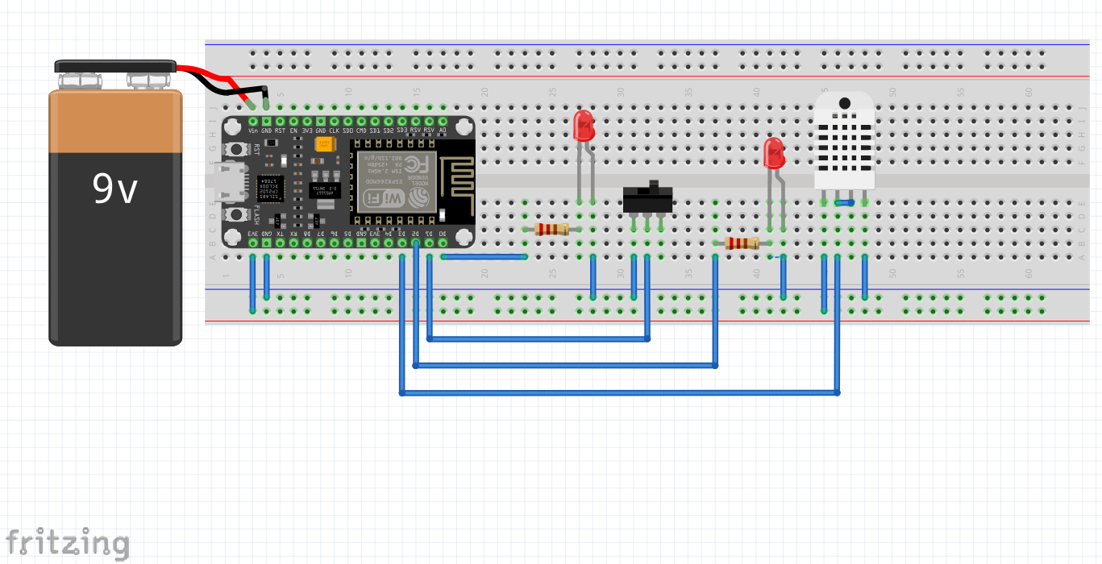
BREADBOARD CIRCUIT LAYOUT

Slide 6
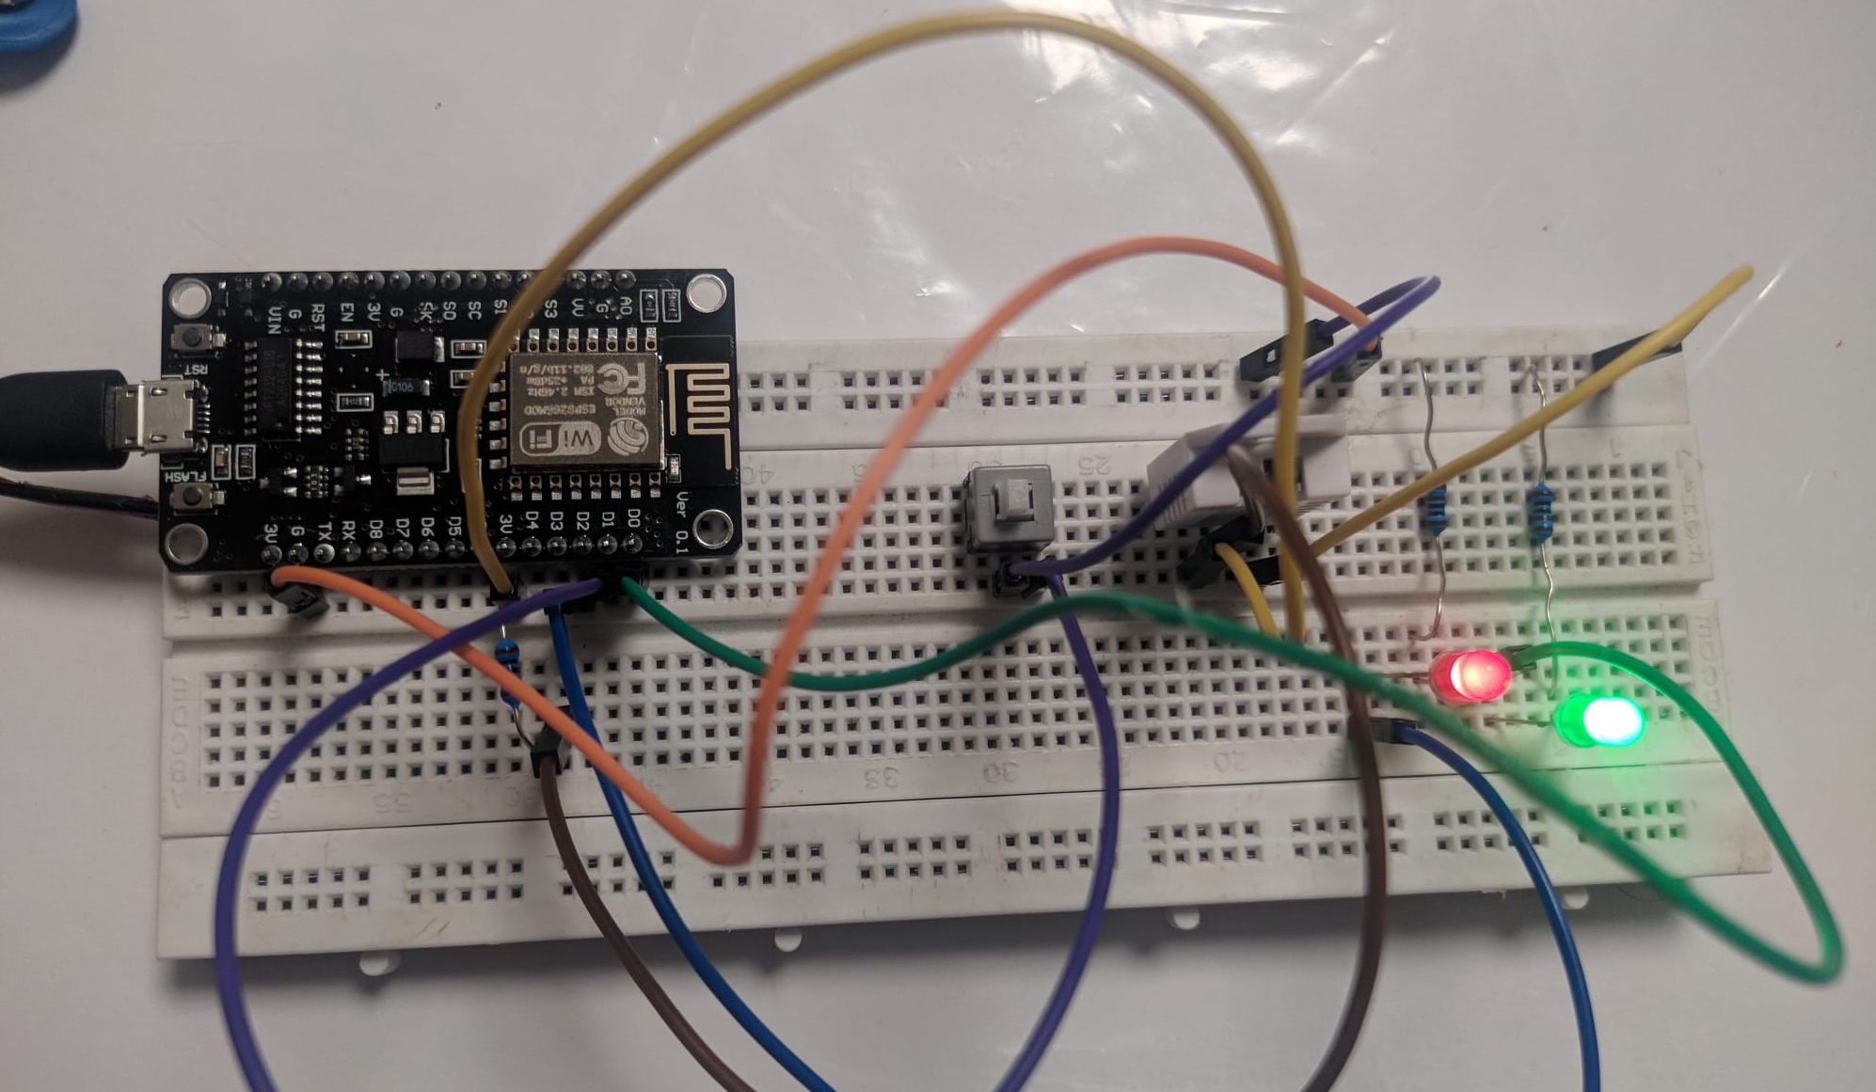
CIRCUIT AT WORK

Slide 7
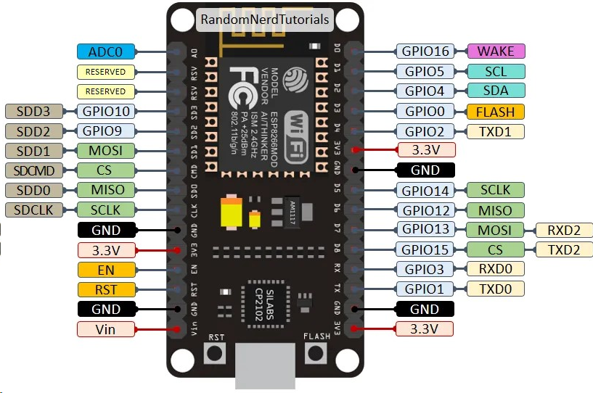
Pinout Diagram of ESP8266 NodeMCU V2

Slide 8
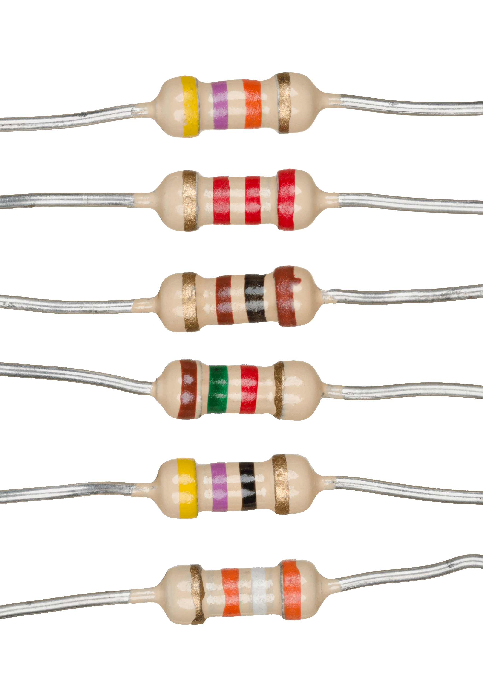
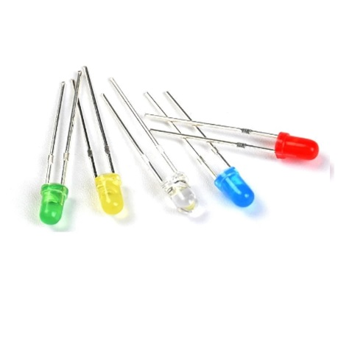
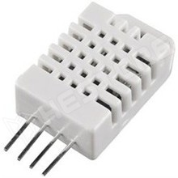
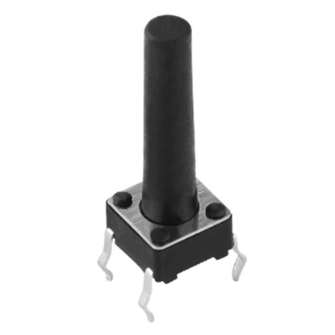

Other components used in the project
Resistors
LEDs
DHT22 Temperature and Humidity Sensor
Battery
Switch

Slide 9
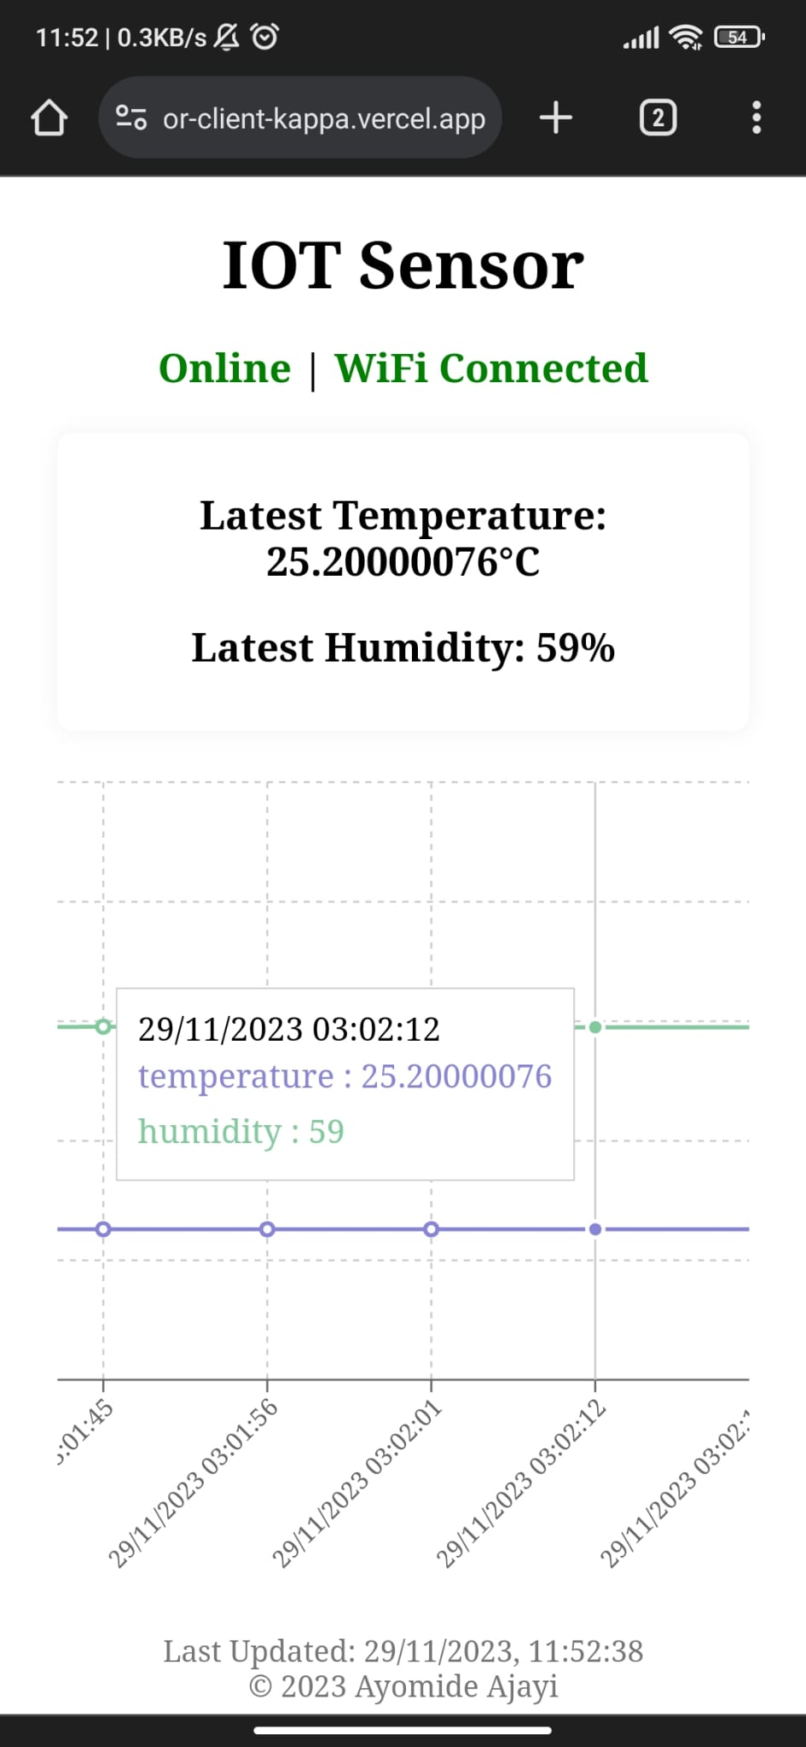
Web APP view on mobile phone
https://sensor-client-kappa.vercel.app/

Slide 10
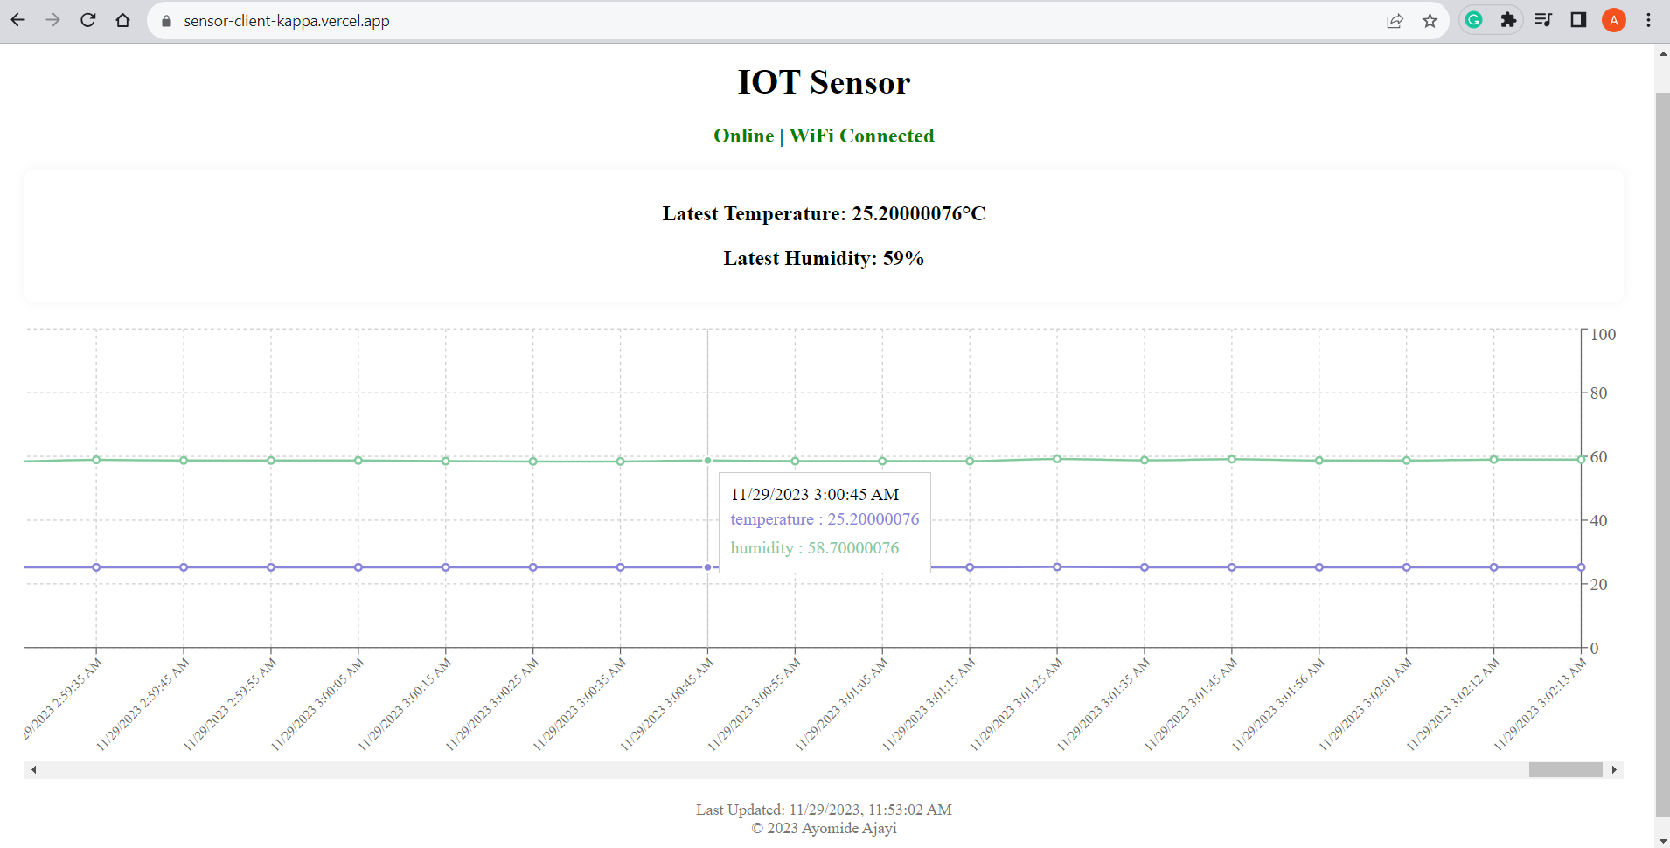
WEB app on pc with AN extended chart view
https://sensor-client-kappa.vercel.app/

Slide 11
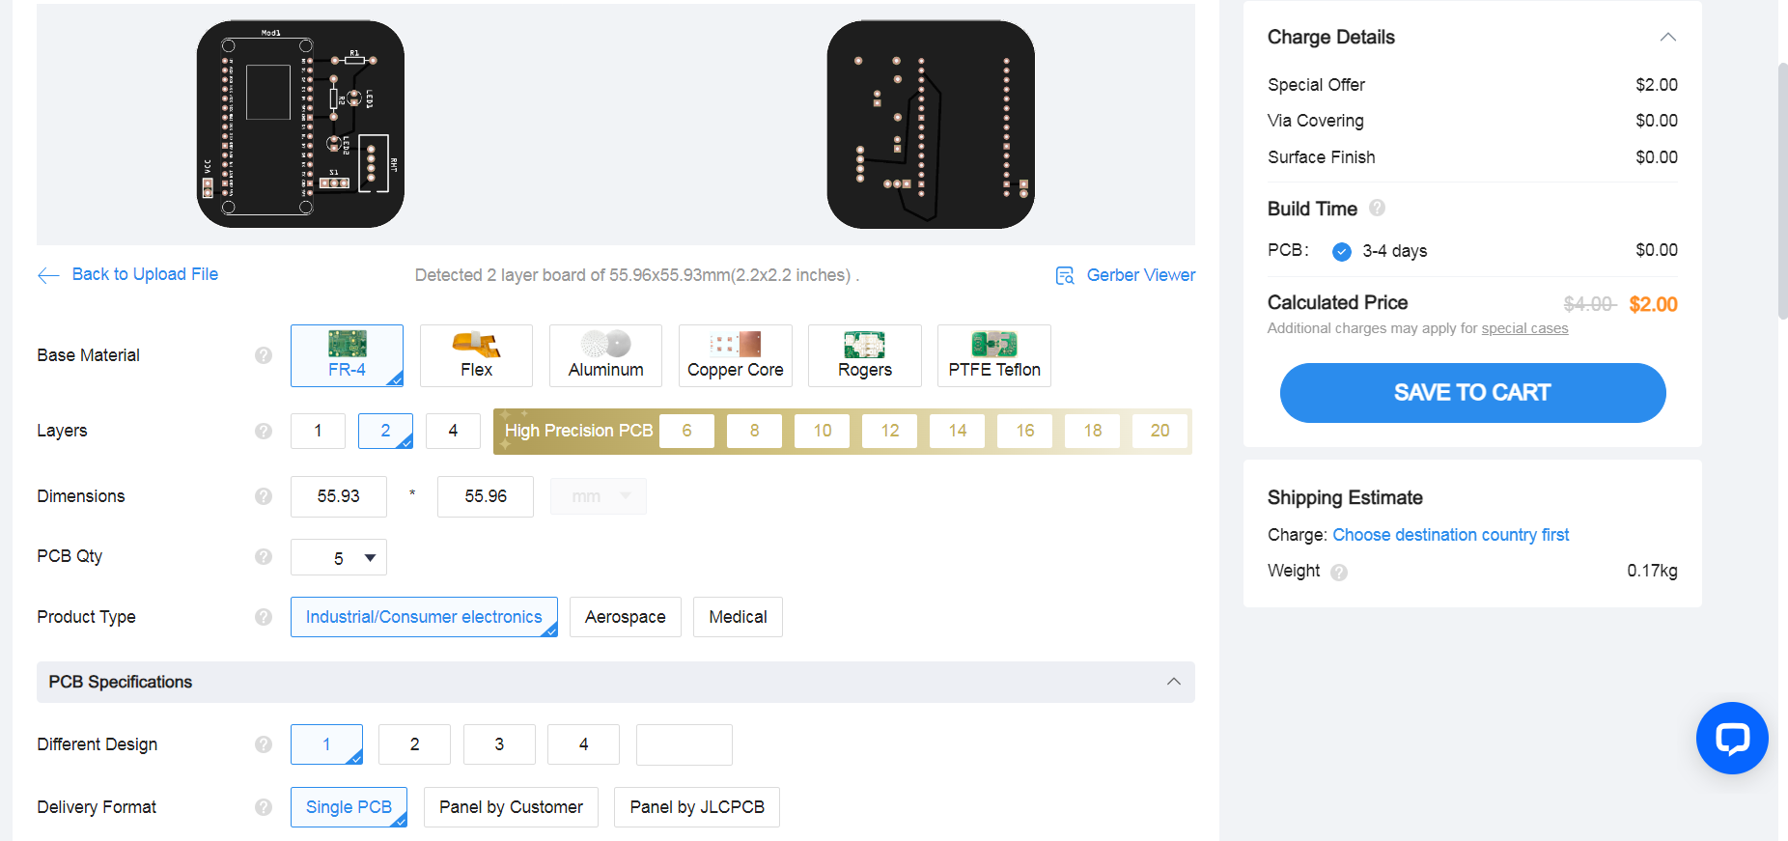
JLCPCB PCB ordering process using gerber file

Slide 12
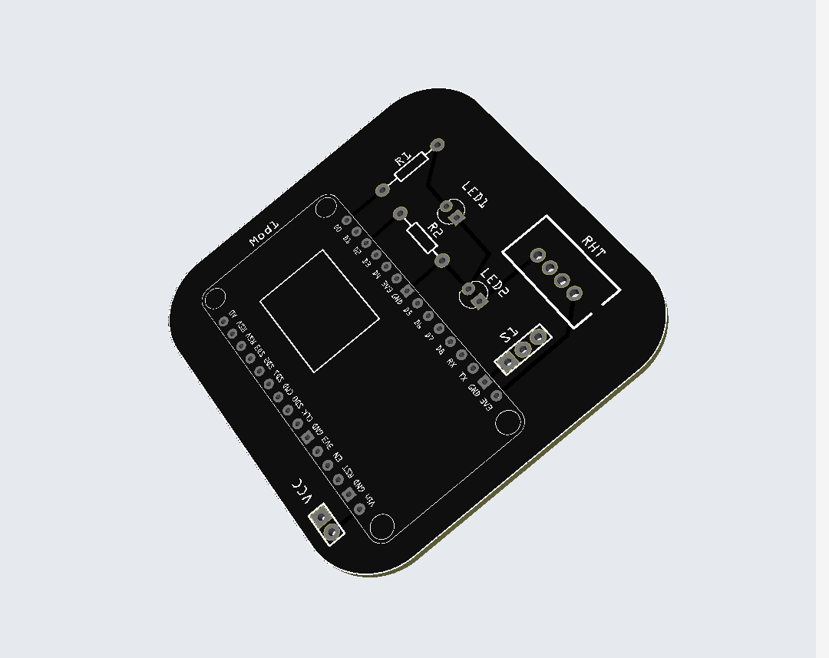
3d view of the 2-layer pcb on jlcpcb

Slide 13
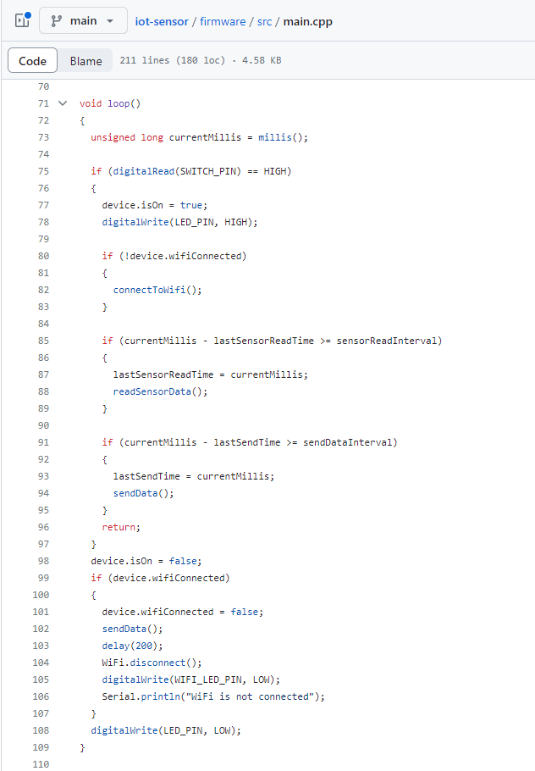
Firmware script
https://github.com/ayo-ajayi/iot-sensor

Slide 14
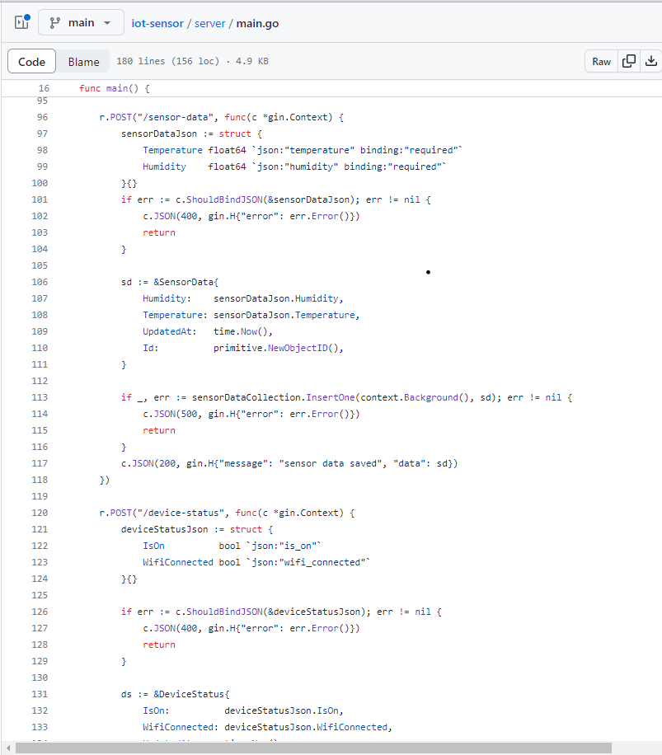
server script
https://github.com/ayo-ajayi/iot-sensor

Slide 15
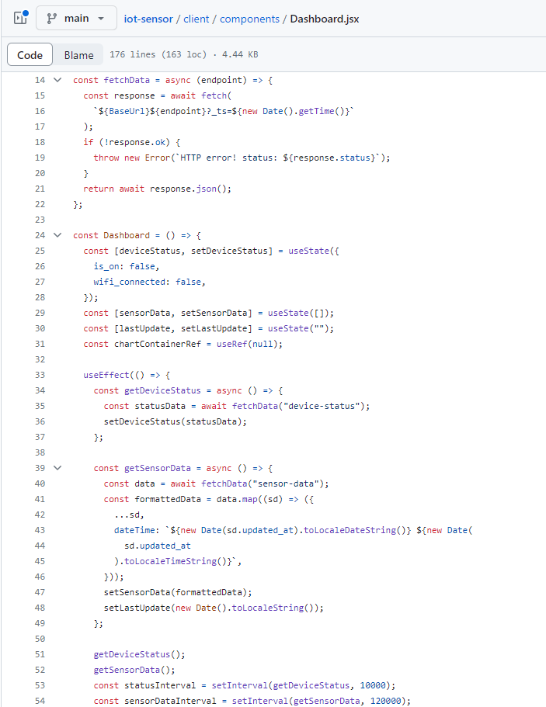
Web app script
https://github.com/ayo-ajayi/iot-sensor

Slide 16
Software used for project:
PlatformIO [C++] – Microcontroller programming
Golang – Server Development
ReactJS – Client/Web Interface
MongoDB – Database for storing data
Fritzing – PCB Design

Slide 17
THANK YOU
ajayiayomide247@gmail.com

