Slide 1
Design and implementation of a weather measurement system
Ayomide Ajayi
Embedded Systems Lecturer: Prof. Lajos Harasztosi
Electrical Engineering, UniDeb
26/11/2023

Slide 2
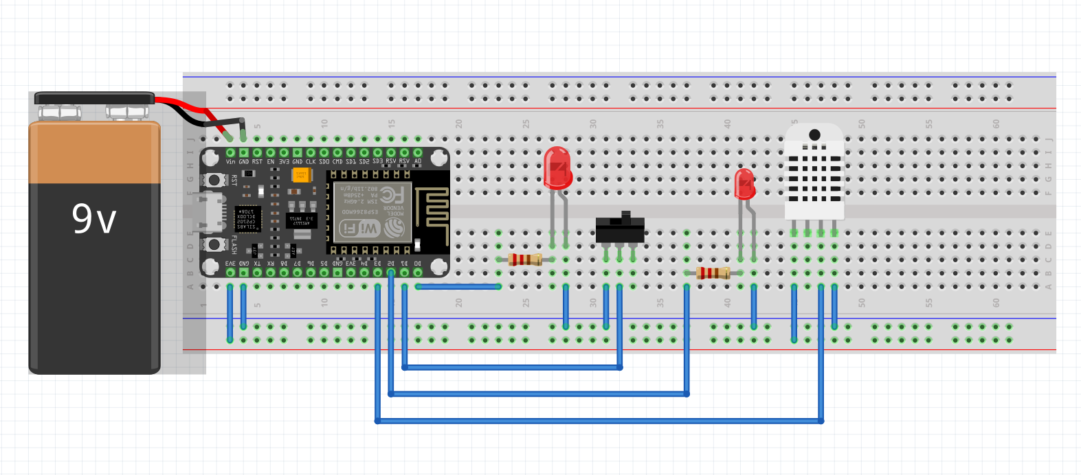

Slide 3
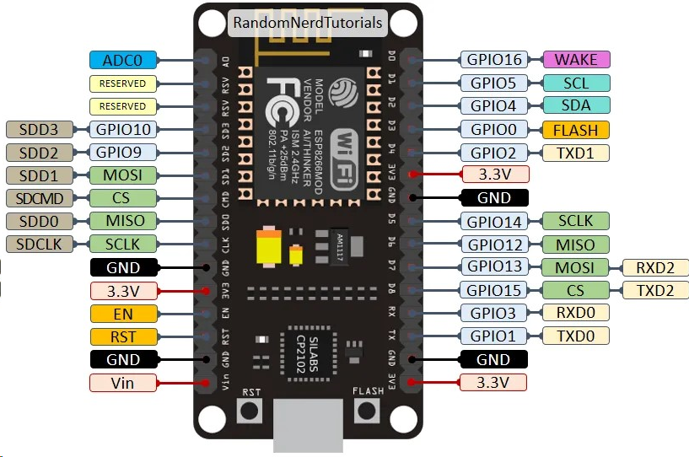
Pinout Diagram of ESP8266 NodeMCU V2

Slide 4
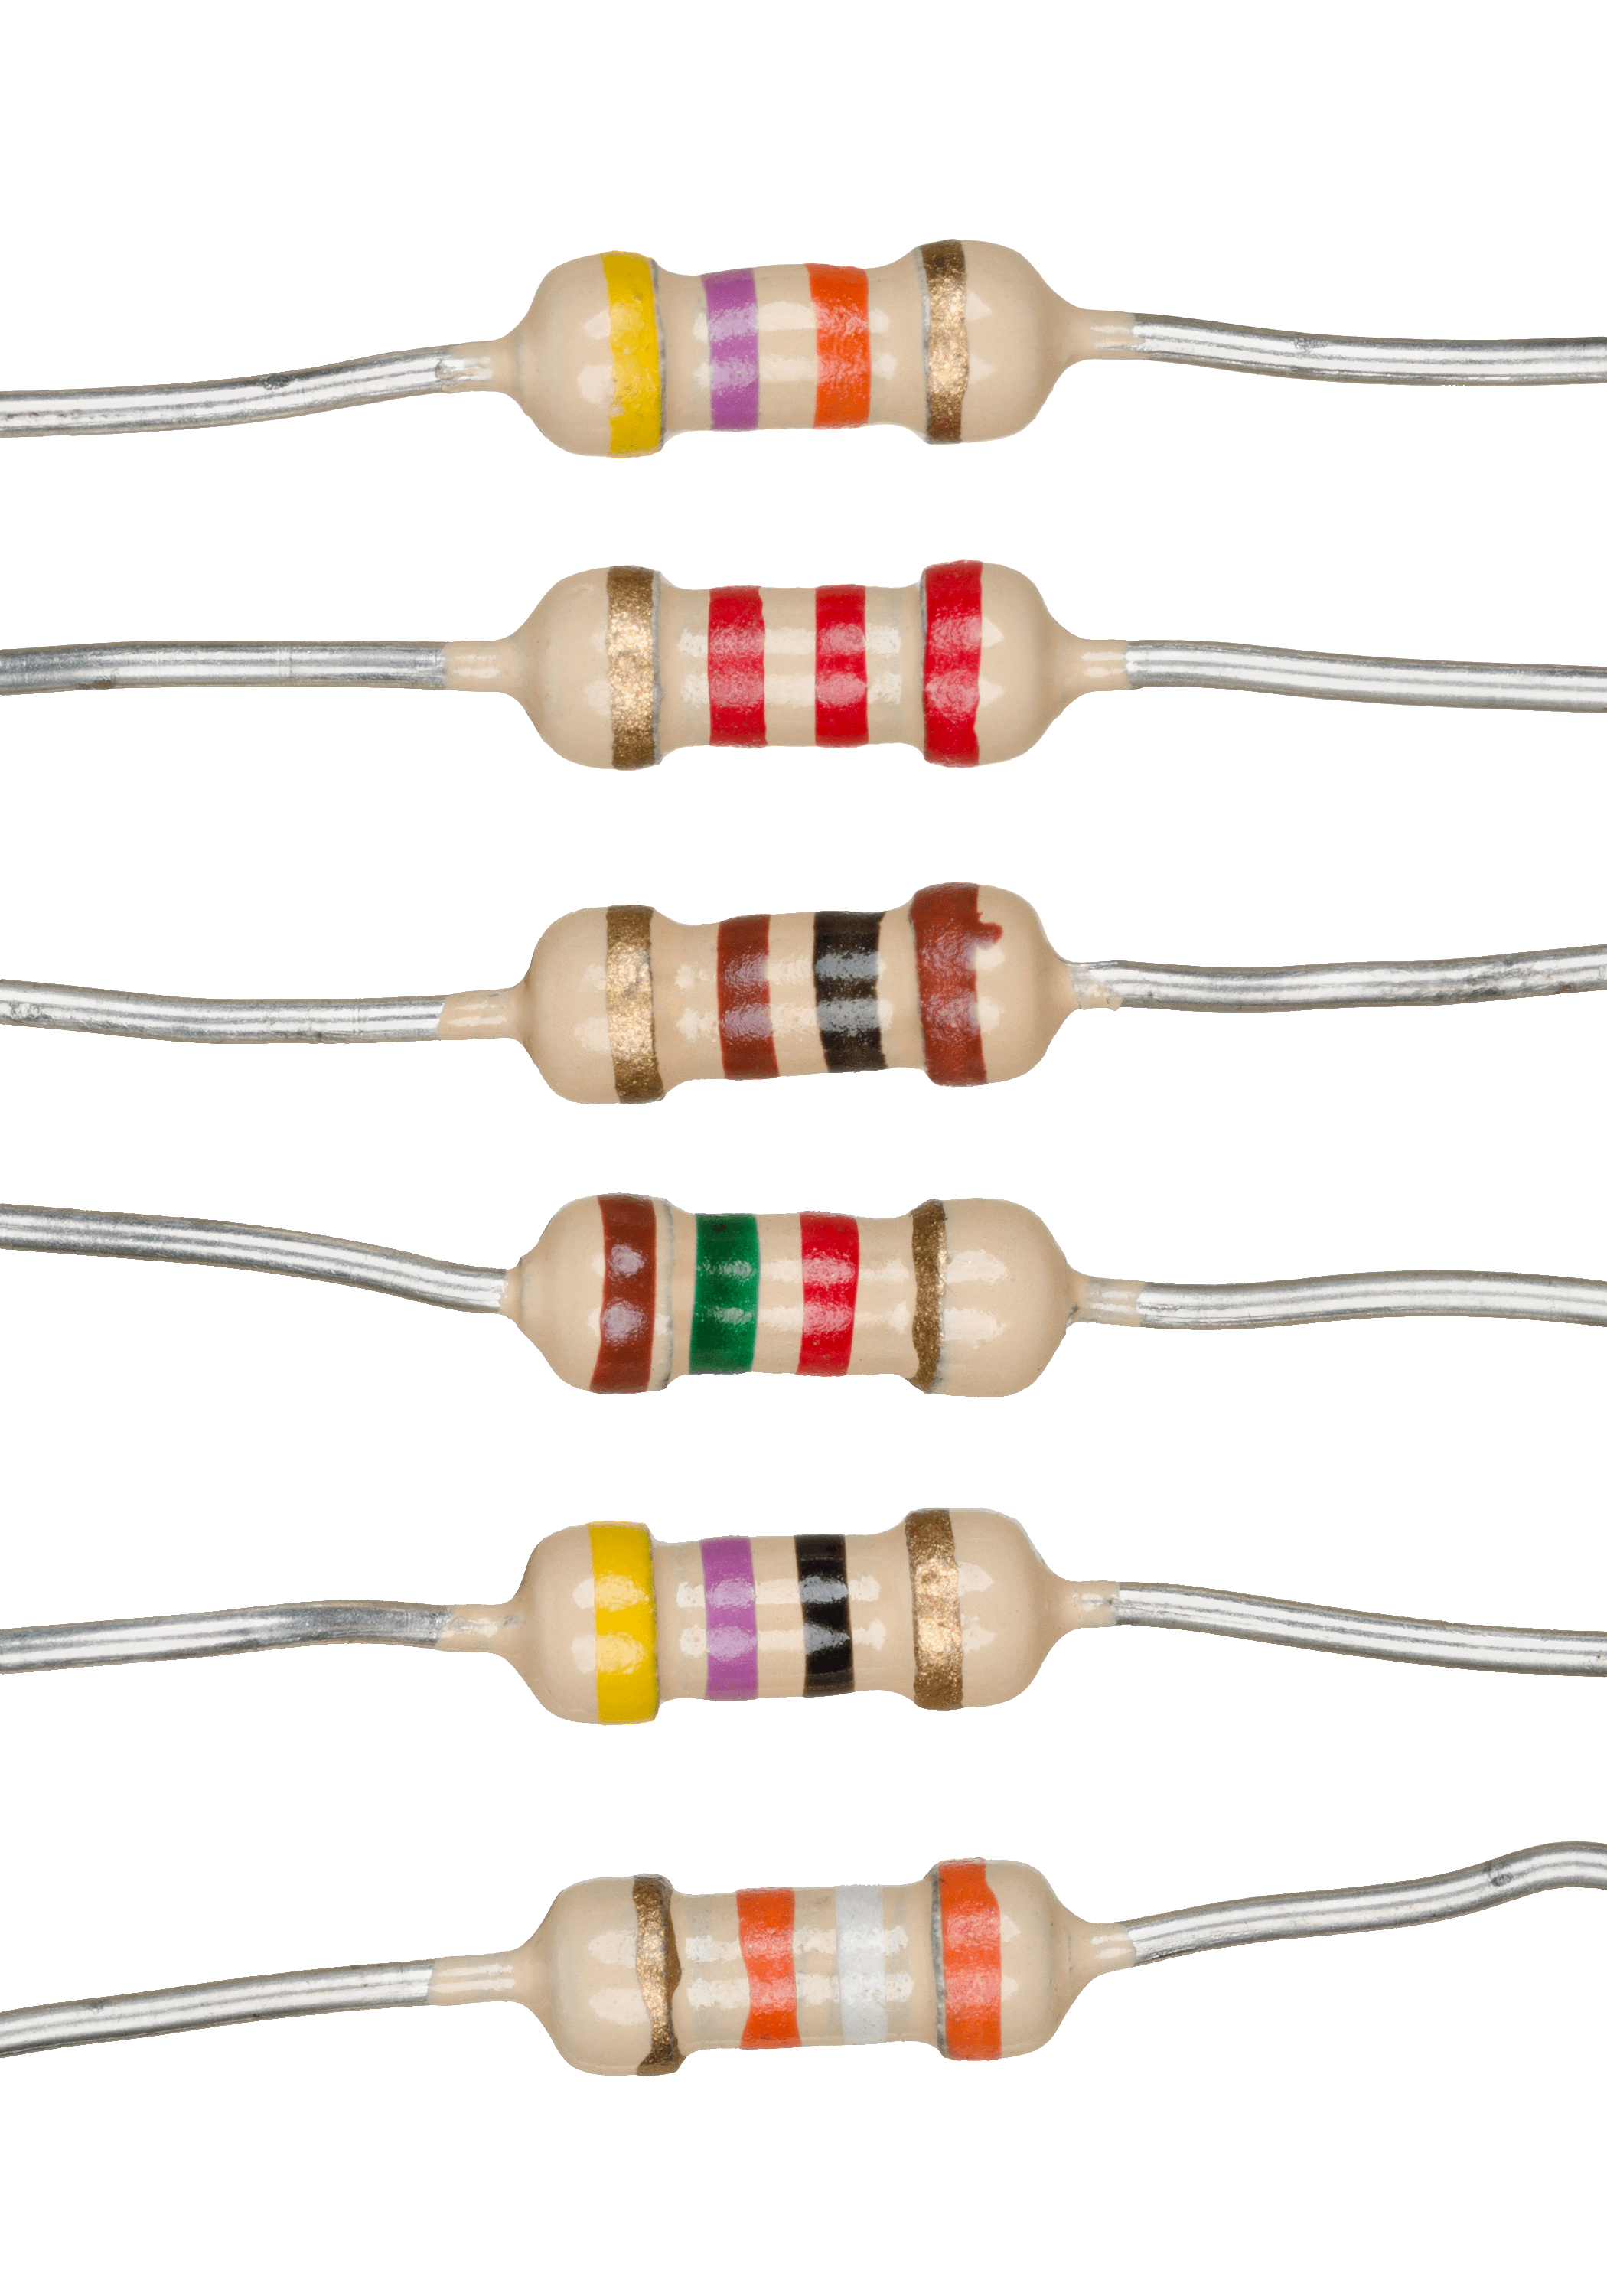
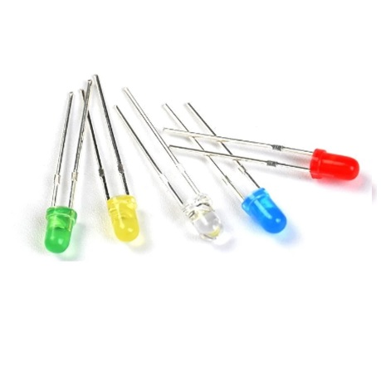
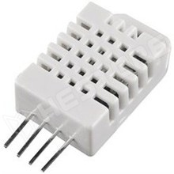
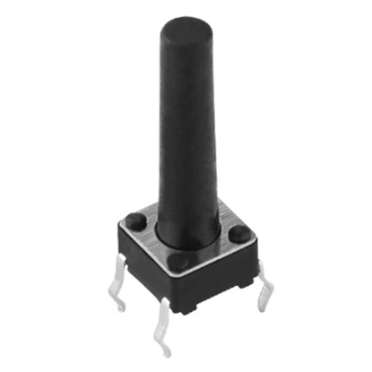

Other components used in the project
Resistors
LEDs
DHT22 Temperature and Humidity Sensor
Battery
Switch

Slide 5
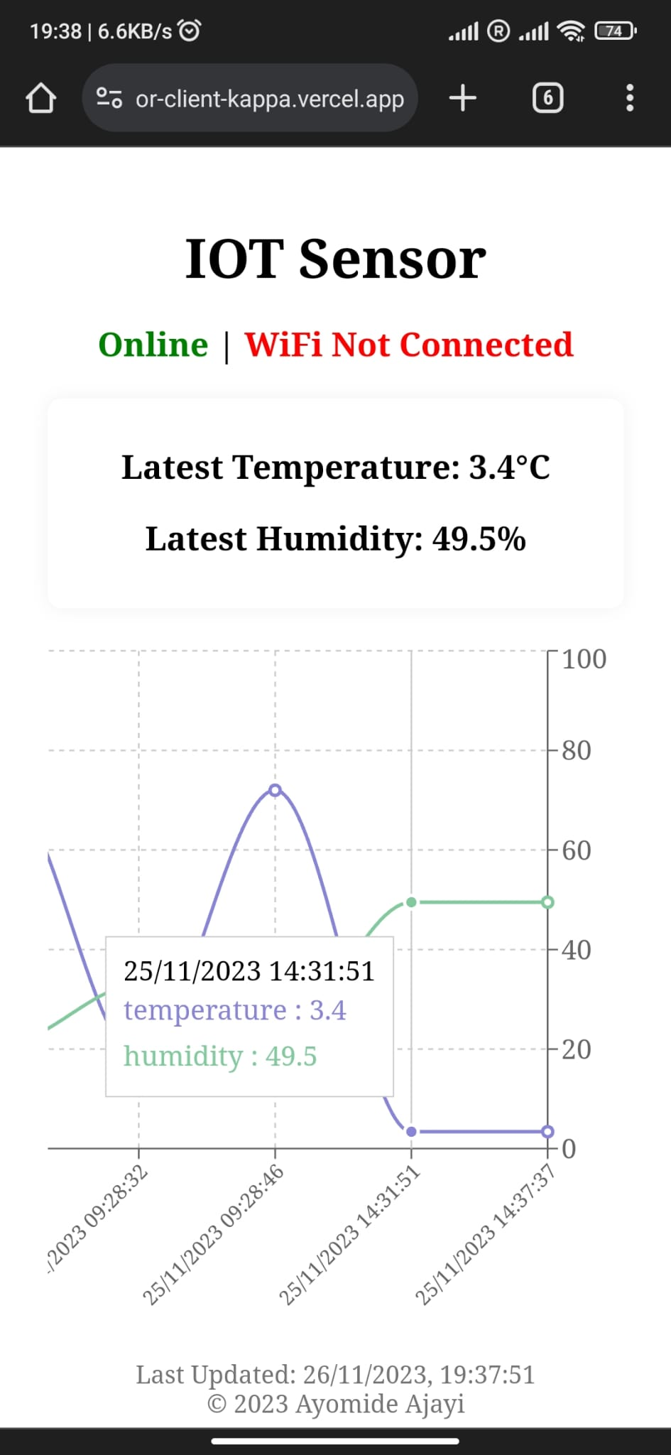
Web APP view on mobile phone
https://sensor-client-kappa.vercel.app/

Slide 6
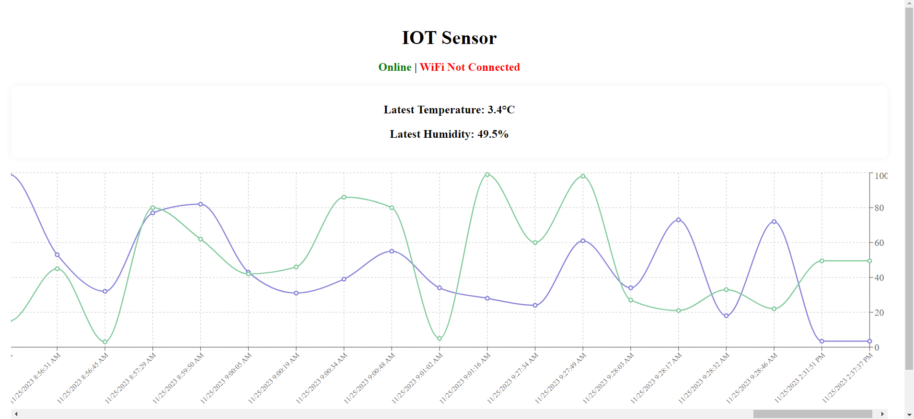
WEB app on pc with AN extended chart view
https://sensor-client-kappa.vercel.app/

Slide 7
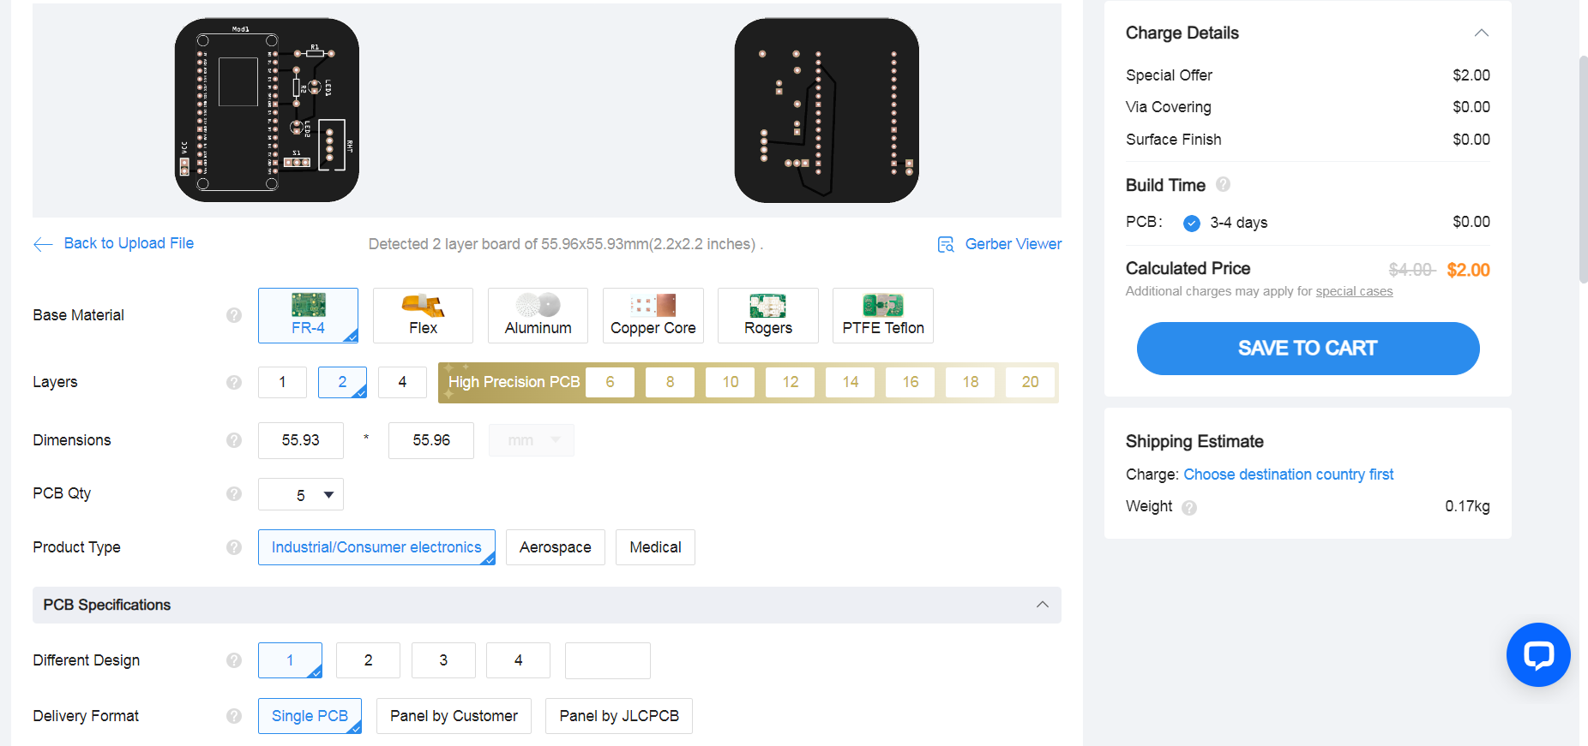
JLCPCB PCB ordering process using gerber file

Slide 8
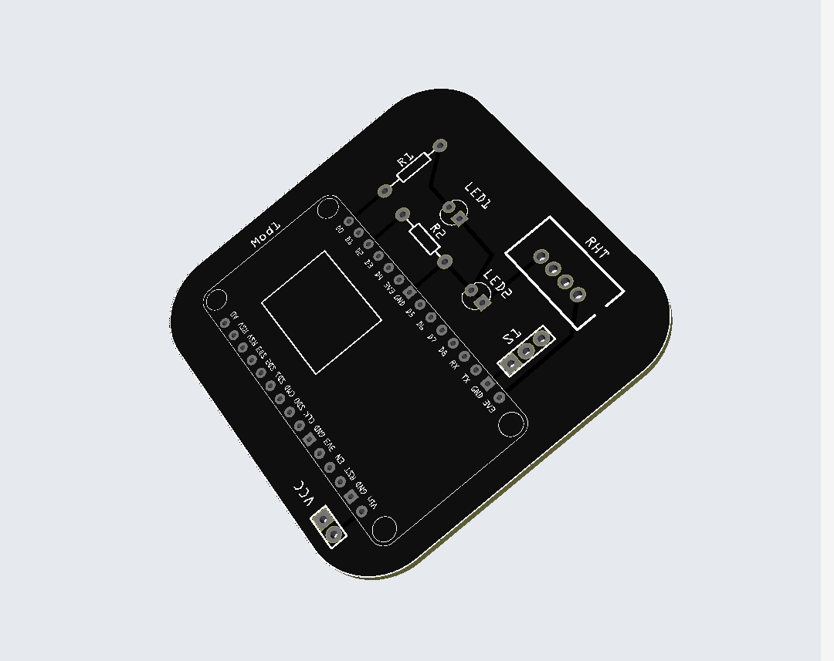
3d view of the 2-layer pcb on jlcpcb

Slide 9
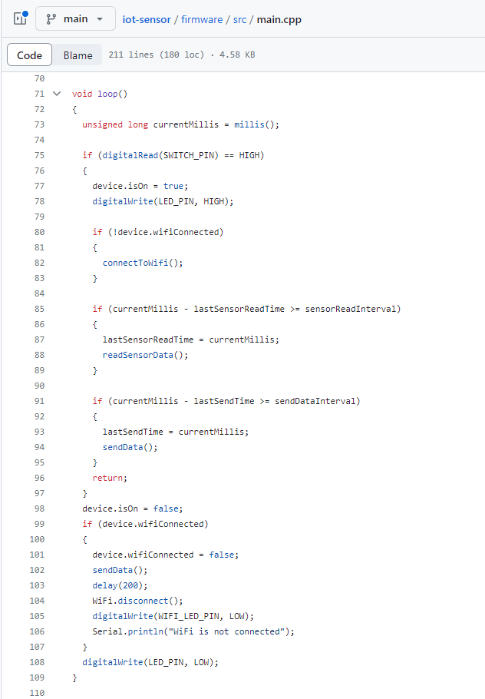
Firmware script
https://github.com/ayo-ajayi/iot-sensor

Slide 10
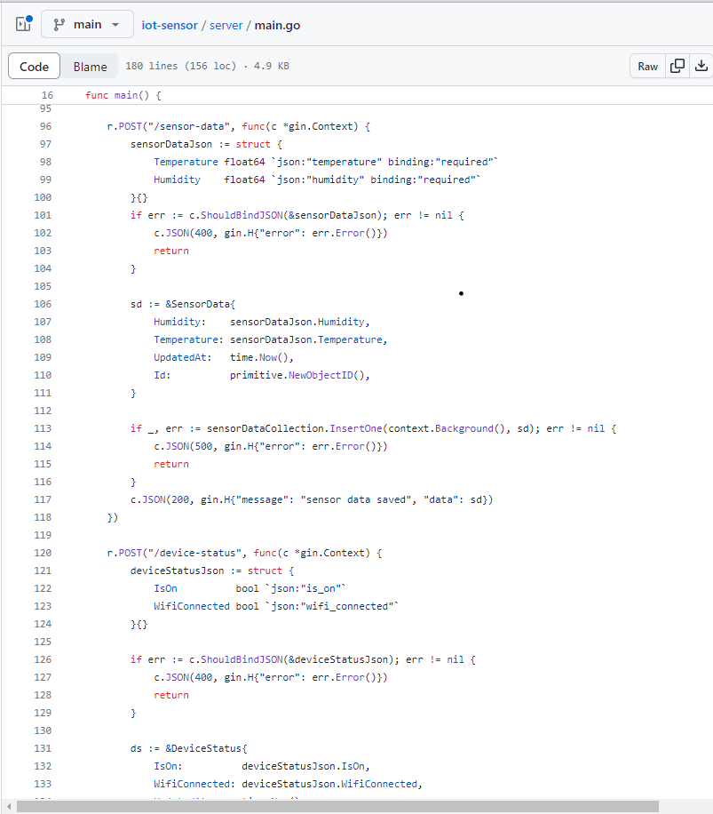
server script
https://github.com/ayo-ajayi/iot-sensor

Slide 11
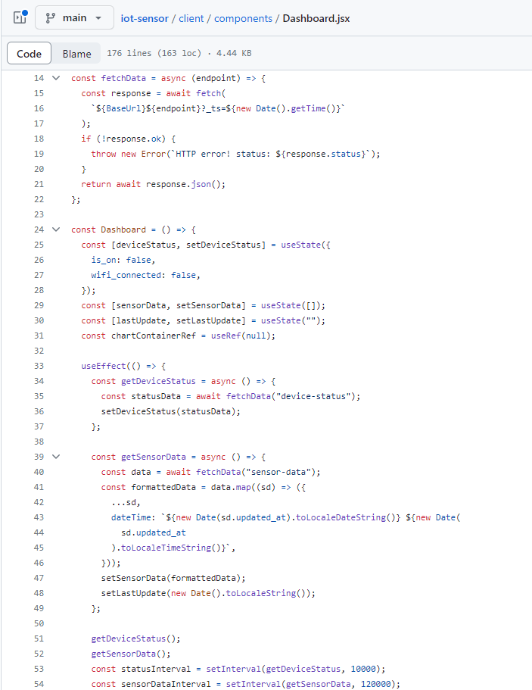
Web app script
https://github.com/ayo-ajayi/iot-sensor

Slide 12
Software used for project:
PlatformIO [C++] – Microcontroller programming
Golang – Server Development
ReactJS – Client/Web Interface
MongoDB – Database for storing data
Fritzing – PCB Design

Slide 13
THANK YOU
ajayiayomide247@gmail.com

