Slide 1
Low power modes of Microcontrollers
Ayomide Ajayi

Slide 2
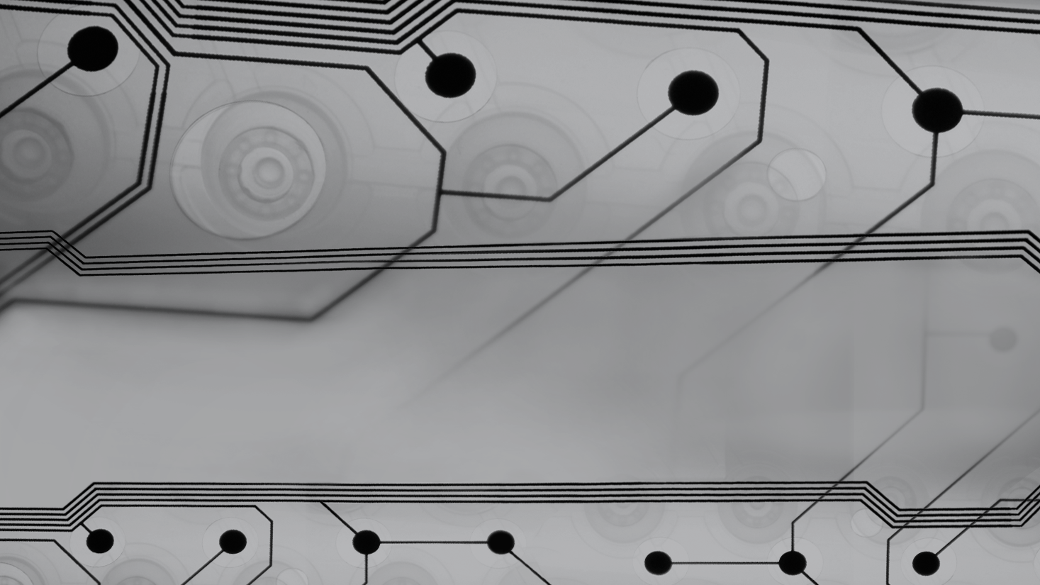
What are Microcontrollers?
Compact, self-contained computers embedded in everything from kitchen appliances, cars to wearables
Tirelessly performing specific tasks.
Designed to be efficient — consumes minimal power.

Slide 3
Why is minimal energy consumption necessary?
Battery Life Extension
Eco-Friendly Operation
Heat Management
Reliability in Critical Systems
Cost-Effectiveness
Notes:
Battery Life Extension: reduces charging frequency and battery replacement
Eco-Friendly Operation: reduced energy that ensures environmental sustainability & decreased carbon footprint…important to investors
Heat Management: excessive heat degrades performance & reliability – causing shorter lifespan
Reliability in Critical Systems: ensures availability in medical life-support systems or safety equipment through reliable power usage profile
Cost-Effectiveness: reduces cumulative energy bills for IoT devices

Slide 4
Common Power Saving Techniques
Energy-Efficient Architecture
Subthreshold Operation
On-Chip Sensors
Power-Optimized Firmware (Code)
Low-Power Modes (Sleep Modes)
Notes:
Energy-Efficient Architecture: using components that operate on the least amount of power required
Subthreshold Operation: modern MCUs can operate at voltages below traditional transistor voltages, at the cost of performance
On-Chip Sensors: some MCUs have sensors that monitor their temperature and adjust power usage
Power-Optimized Firmware: understanding time-complexity of code. Use C pointers in place of copying large structs.
Use local variables over global variables. Local variables are in CPU while global variables are in RAM. CPU accesses local vars faster.
Use function calls instead of repeating code.

Slide 5
Low-power modes
Low-power modes are special operating modes that reduce the power consumption of the microcontroller by changing the clock source, frequency, and voltage and by disabling some or all of the CPU, peripherals, and memory.
Notes:
Specialized operational states designed to conserve energy when the full functionality of the microcontroller is not required.
MCUs have multiple power modes, allowing them to shut down unnecessary components when they are not needed.
MCUs have different low-power modes, depending on the architecture and manufacturer.

Slide 6
TI MSP430FR58xx, MSP430FR59xx, and MSP430FR6xx Family
Active Mode
Low Power Mode :
LPM0
LPM1
LPM2
LPM3
LPM4
LPM3.5 & LMP4.5
Notes:
LPM0 - Both CPU and MCLK are disabled. SMCLK and ACLK remain active. Peripherals which use SMCLK and ACLK also remain active.
LPM1 - Both CPU and MCLK are disabled. DCO (digitally controlled oscillator) is disabled. SMCLK is not available if it is sourced from DCO. ACLK remains active.
LPM2 - CPU, MCLK, SMCLK and DCO are disabled, ACLK remains active
LPM3 - CPU, MCLK, SMCLK, DCO are disabled, ACLK remain active.
LPM4 - All the clocks including ACLK are disabled in this mode. The controller can only be wakened from this mode by an external interrupt. This mode consumes the least power compared to all other modes.
MSP430x5xxx and higher order series have LPM3.5 and LPM 4.5. When the controller is entered into any one of those modes, the voltage regulator of the Power Management Module (PMM) is disabled. All the RAM, register and IO contents are lost, the I/O pin states are locked upon LPMx.5 entry. Wakeup from LPM4.5 is possible by the power sequence, an RST event, RTC or from specific I/O.

Slide 7
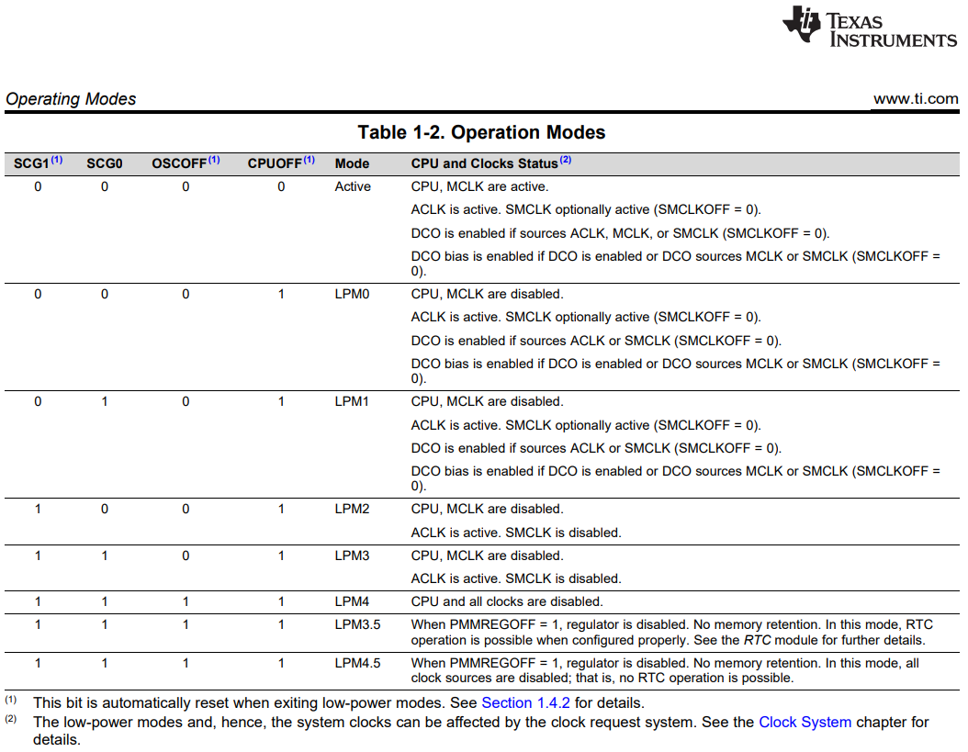
TI MSP430FR58xx, MSP430FR59xx, and MSP430FR6xx Family
Notes:
LPM0 - Both CPU and MCLK are disabled. SMCLK and ACLK remain active. Peripherals which use SMCLK and ACLK also remain active.
LPM1 - Both CPU and MCLK are disabled. DCO (digitally controlled oscillator) is disabled. SMCLK is not available if it is sourced from DCO. ACLK remains active.
LPM2 - CPU, MCLK, SMCLK and DCO are disabled, ACLK remains active
LPM3 - CPU, MCLK, SMCLK, DCO are disabled, ACLK remain active.
LPM4 - All the clocks including ACLK are disabled in this mode. The controller can only be wakened from this mode by an external interrupt. This mode consumes the least power compared to all other modes.
MSP430x5xxx and higher order series have LPM3.5 and LPM 4.5. When the controller is entered into any one of those modes, the voltage regulator of the Power Management Module (PMM) is disabled. All the RAM, register and IO contents are lost, the I/O pin states are locked upon LPMx.5 entry. Wakeup from LPM4.5 is possible by the power sequence, an RST event, RTC or from specific I/O.
CPU(Central Processing Unit)
It performs basic arithmetic, logic, control, and I/O operations.
Its power consumption is directly related to its clock speed; reducing the clock speed can save power.
MCLK(Master Clock)
The main clock signal that drives CPU and the system.
In low-power modes, it can be slowed down or turned off to save power.
ACLK(Auxiliary Master Clock)
Can be sourced from low-frequency oscillators like watch crystal.
Useful for operation when CPU is off
ACLK is used to drive low-power peripherals, e.g., Watchdog timer, Low-energy communication interfaces, etc
SMCLK(Subsystem Master Clock)
Drives peripherals that need frequency less than MCLK but higher than ACLK.
SMCLK drives intermediate-speed peripherals, e.g., Timer Modules for PWM, UART (Universal Async. Receiver/Transmitter) for serial communication, and SPI(Serial Peripheral Interface) buses for external communication.
DCO(Digitally Controlled Oscillator)
Generates a stable clock signal over temperature and voltage changes that can be adjusted digitally in software.
Clock speed can be fine-tuned for power saving or performance.
Can be source for MCLK and SMCLK and indirectly affects peripherals that rely on these clocks.
RTC(Real Time Clock)
Crucial for apps that need to be triggered at specific intervals, such as data logging functions.
Used to maintain an accurate clock or wake the MCU at specific intervals

Slide 8
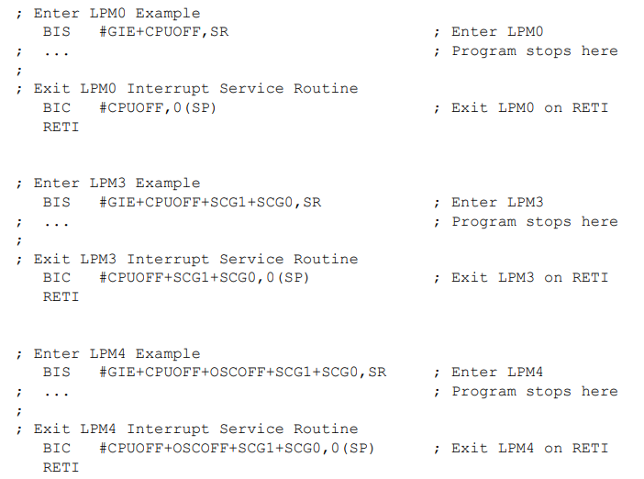
Entering and Exiting Low-Power Modes LPM0 Through LPM4
Notes:
RETI – Return from Interrupt
BIS – Bit Set
BIC – Bit Clear
GIE – Global Interrupt Enable

Slide 9
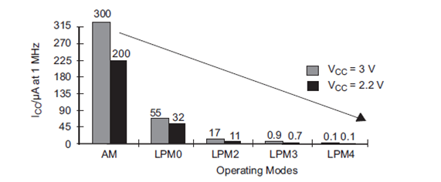
Power consumption in various modes of the MSP430 Family
Notes:
CPU
MCLK - Master clock
ACLK – Auxiliary clock
SMCLK - Subsystem master clock
DCO - Digitally controlled oscillator
RTC – Real time clock

Slide 10
STM32L476xx - Ultra-low-power ARM Cortex-M4
Run mode – operating mode after a system or power reset
Sleep mode
Low-power run mode
Low-power sleep mode
Stop mode
Standby
Shutdown
Power consumption decreases, performance decreases, wake-up time increases, and the number of wake-up sources decreases.
Notes:
Best compromises between low-power consumption, short start-up time, and available peripherals and wakeup sources.
As we go down, power consumption decreases, performance decreases, wake-up time increases, and wake-up sources decrease.
Sleep mode: CPU is stopped. All peripherals operate and can wake up CPU when an interrupt/event occurs—shortest wakeup time.
Low-power run mode: Vcore supplied by low-power regulator to minimize the regulator’s operating current. CPU frequency is limited to 2MHz. It is not stopped.
Low-power sleep mode: The mode is entered from the low-power mode. Only CPU clock is stopped. System reverts to low-power run mode when wakeup is triggered by an event or interrupt. It is a combination of low-power mode & sleep mode.
Stop mode: Lowest power consumption while retaining the content of SRAM and registers. RTC can remain active.
Standby mode: Used to achieve the lowest power consumption with BOR. The state of each I/O can be selected by software. Does not preserve SRAM or Registers.
BOR –Brown out reset protects MCU when supply voltage goes below required value.
Shutdown mode: The internal regulator is switched off so that the Vcore domain is powered off. BOR is not available as there is no voltage to monitor.
MSI and PLL are also switched off.
MSI – Multispeed internal oscillator
PLL – controls the speed of a signal to match a reference. It is used to maintain a consistent and precise frequency.

Slide 11
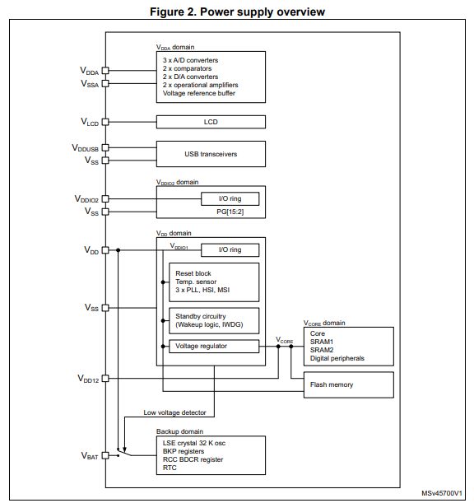
STM32L476xx - Power supply
Notes:
Sleep mode: CPU is stopped. All peripherals operate and can wake up CPU when an interrupt/event occurs
Low-power mode: Vcore supplied by low-power regulator to minimize the regulator’s operating current. CPU frequency is limited to 2MHz
Low-power sleep mode: The mode is entered from the low-power mode. Only CPU clock is stopped. System reverts to low-power run mode when wakeup is triggered by an event or interrupt.
Stop mode: Lowest power consumption while retaining the content of SRAM and registers. RTC can remain active.
Standby mode: Used to achieve the lowest power consumption with BOR. The state of each I/O can be selected by software
BOR –Brown out reset protects MCU when supply voltage goes below required value.
Shutdown mode: The internal regulator is switched off so that the Vcore domain is powered off. BOR is not available as there is no voltage to monitor.
MSI and PLL are also switched off.
MSI – Multispeed internal oscillator
PLL – controls the speed of a signal to match a reference. It is used to maintain a consistent and precise frequency.

Slide 12
Conclusion
Key aspects that typically change in low-power modes:
Clock Gating
Peripheral Shutdown
Reduced Clock Speed
Voltage Scaling
Standby/Idle States
Power-Down Modes
Notes:
Key aspects that typically change in low-power modes:
Clock Gating: Disabling the clocks to certain parts of the MCU, such as the CPU or peripherals, stops them from operating, thus reducing power consumption.
Peripheral Shutdown: Turning off various peripherals that are not needed.
Reduced Clock Speed: Operating the microcontroller at a lower frequency can reduce the power consumed by the CPU and other clock-dependent subsystems.
Voltage Scaling: Lowering the supply voltage to the MCU can significantly reduce power consumption as power is proportional to the square of the voltage.
Standby/Idle States: Entering states where the MCU retains its state but uses less power, ready to resume full operation quickly when required.
Power-Down Modes: MCUs can enter a state where almost all operations are shut down, including the core logic, and only a few essential functions, like the real-time clock, remain active.

Slide 13
References
LinkedIn - https://www.linkedin.com/advice/3/how-do-you-use-low-power-modes-idle-mode-pic-microcontrollers
Circuit Digest - https://circuitdigest.com/article/implementing-low-power-consumption-in-microcontrollers
GPT4 - https://chat.openai.com
TI - MSP430FR58xx, MSP430FR59xx, and MSP430FR6xx Family User's Guide (Rev. P)
Learn Controllers - https://learncontrollers.blogspot.com/2018/02/low-power-modes-of-msp430.html
ST - https://www.st.com/resource/en/datasheet/stm32l476je.pdf

Slide 14
Thank you
E ṣé
Köszönöm
Merci
Shukran
Dhan'yabāda
Na gode
Spasibo
Obrigado
Bayarlalaa
Ndatenda
Daalụ

