Slide 1

PHOTONIC CHIPS (PICs)
Ayomide Ajayi
Electrical Engineering
University of Debrecen, Hungary
10th May, 2024

Slide 2
Introduction
1. Integrated Photonics
History of Integrated Photonics
2. How Photonic ICs work
3. PICs by fabrication platforms
4. Superiority of Photonic Chips
5. Challenges facing Photonic Chips
Programmable Photonic Chips
6. The Market for PICs
PIC Market Trends
7. Future Outlook
8. Conclusion
9. References
10. Q&A

Slide 3
Integrated Photonics
Integrated Photonics (IP) is a branch of photonics in which multiple photonic functions and waveguides are fabricated on the surface of a flat substrate made from either Indium Phosphide (InP), Silicon Nitride (SiN), or Silicon Photonics (SiPh).
Photonic integrated circuits can process and transmit light similarly to how electronic integrated circuits conduct electrical signals, easing bandwidth and signal fidelity.

Slide 4
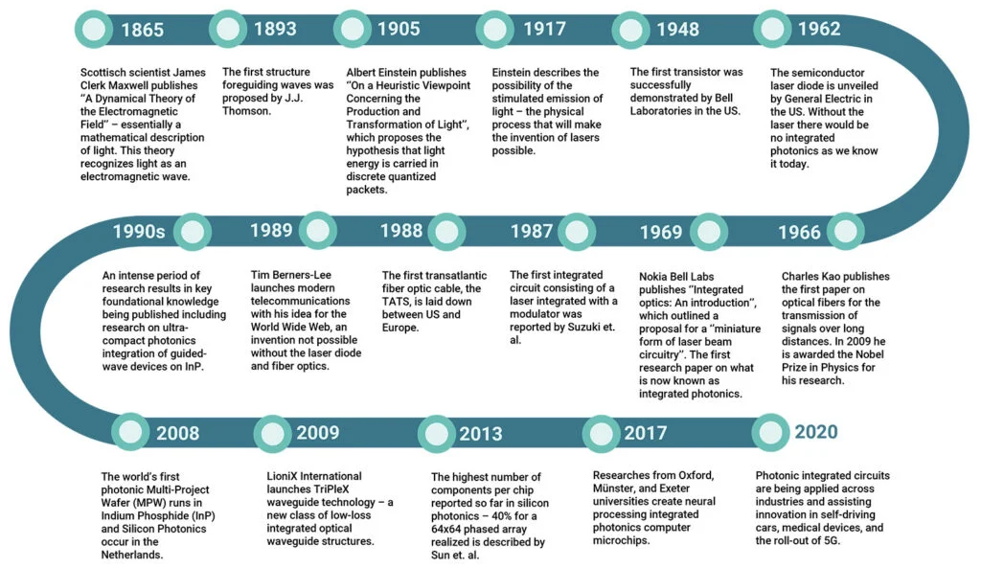
HISTORY OF INTEGRATED PHOTONICS
Source: https://www.photondelta.com/

Slide 5
How Photonic ICs work
An IC is a chip containing (electronic) components that form a functional circuit, such as those in phones, PCs, and other devices
Photonic chips also called Photonic ICs or PICs utilize light (photons) instead of electrical currents (electrons) to perform electronic functions such as transmitting and processing data.

Slide 6
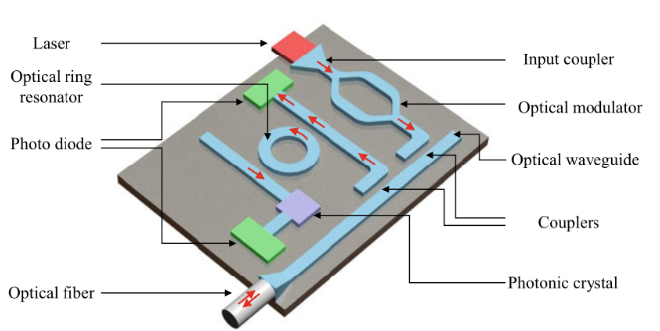
How Photonic ICs work
Source: https://www.ovaga.com/
Notes:
1. Laser: Emits a coherent light source used to power the photonic circuit.
2. Optical Ring Resonator: A component that uses total internal reflection to confine light in a circular path, enhancing specific optical wavelengths.
3. Photo Diode: A sensor that converts light into an electrical signal, detecting the intensity and presence of light.
4. Optical Fiber: Transports light signals with minimal loss over long distances, used for communications and sensing.
5. Input Coupler: A device that efficiently directs light from an external source into the chip's waveguides.
6. Optical Modulator: Alters the properties of light (such as amplitude, phase, or polarization) to encode information.
7. Optical Waveguide: Structures that guide light along predetermined paths on the chip.
8. Couplers: Devices that split or combine light signals within the photonic circuit.
9. Photonic Crystal: Manipulates light at the nano-scale, creating band gaps to control the flow of light within the circuit.

Slide 7
How Photonic ICs work
1. Laser: Emits a coherent light source used to power the photonic circuit.
2. Optical Ring Resonator: A component that uses total internal reflection to confine light in a circular path, enhancing specific optical wavelengths.
3. Photo Diode: A sensor that converts light into an electrical signal, detecting the intensity and presence of light.
4. Optical Fiber: Transports light signals with minimal loss over long distances, used for communications and sensing.
5. Input Coupler: A device that efficiently directs light from an external source into the chip's waveguides.
6. Optical Modulator: Alters the properties of light (such as amplitude, phase, or polarization) to encode information.
7. Optical Waveguide: Structures that guide light along predetermined paths on the chip.
8. Couplers: Devices that split or combine light signals within the photonic circuit.
9. Photonic Crystal: Manipulates light at the nano-scale, creating band gaps to control the flow of light within the circuit.
Notes:
1. Laser: Emits a coherent light source used to power the photonic circuit.
2. Optical Ring Resonator: A component that uses total internal reflection to confine light in a circular path, enhancing specific optical wavelengths.
3. Photo Diode: A sensor that converts light into an electrical signal, detecting the intensity and presence of light.
4. Optical Fiber: Transports light signals with minimal loss over long distances, used for communications and sensing.
5. Input Coupler: A device that efficiently directs light from an external source into the chip's waveguides.
6. Optical Modulator: Alters the properties of light (such as amplitude, phase, or polarization) to encode information.
7. Optical Waveguide: Structures that guide light along predetermined paths on the chip.
8. Couplers: Devices that split or combine light signals within the photonic circuit.
9. Photonic Crystal: Manipulates light at the nano-scale, creating band gaps to control the flow of light within the circuit.

Slide 8
How Photonic ICs work
Photonic chips manage information via the flow of photons through optical components like waveguides, which act similarly to electrical wires, and lasers, which drive the components, similar to turning on a switch to inject electricity into electronic components.
This allows for a more efficient transfer of data with minimal loss of energy and no heat production.
This technology, rooted in the invention of the laser and advancements in fiber optics, promises faster speeds, higher efficiency, and reduced thermal output compared to traditional electronic chips.

Slide 9
PICs by fabrication platforms
Indium Phosphide (InP) PICs: have active laser generation, amplification, control, and detection. Ideal component for communication and sensing applications.
Silicon Nitride (SiN) PICs: vast spectral range and ultra low-loss waveguide. Highly suited to detectors, spectrometers, biosensors, and quantum computers. Lowest propagation losses reported in SiN is 0.1 dB/cm down to 0.1 dB/m.
Silicon Photonics (SiPh) PICs: provide low losses for passive components like waveguides. Used in very tiny photonic circuits. Compatible with existing electronic fabrication.

Slide 10
Superiority of Photonic Chips
Photonic chips offer greater miniaturization capabilities, enhanced transmission speeds, and significantly lower heat generation.
Ideal for applications requiring high bandwidth and energy efficiency, such as in data centers and high-performance computing platforms.
Electrons move relatively slowly in hardware, colliding with other particles and generating heat, while photons flow without losing energy, generating no heat at all. This is good for sustainable computing.

Slide 11
Challenges facing Photonic Chips
Photonic chips face challenges such as high production costs, integration complexities with existing technologies, and a need for specialized manufacturing processes.
The photonics ecosystem is not as mature as that of electronics. The fabricated chips do not always work as intended, especially first iterations.
Today, PICs are mostly used by companies who can afford the production processes.
One possible solution is to lower the barrier of entry into the field and introduce programmability into photonic circuits. FPGAs have been crucial for innovation in consumer electronics.

Slide 12
Programmable Photonic Chips
To make the paths of light on the chip configurable, we need to incorporate hundreds of thousands of optical gates that can be controlled by tunable phase shifters.
These phase shifters can induce tiny delays into the various paths of light , which then leads to interference of the optical waves and cause the optical signal to change paths.
MORPHIC project
MORPHIC is an EU-funded project aimed at advancing PIC technology by developing programmable silicon photonic circuits using advanced waveguide Micro-Electro-Mechanical Systems (MEMS) technology. MEMS are small mechanical actuators that can change the distance between two waveguides.

Slide 13
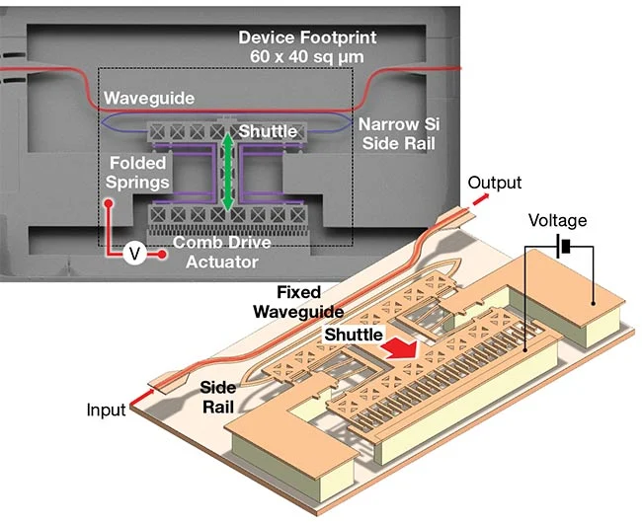
Waveguide: A pathway that directs the flow of light within the photonic chip.
Shuttle: A movable component that adjusts its position to change the light path or its properties.
Folded Springs: Elastic structures that support the shuttle and enable precise movement.
Comb-Drive Actuator: An electrostatic actuator that moves the shuttle by applying voltage to interlocking comb-like structures.
Fixed Waveguide: A stationary waveguide that, together with the shuttle, forms an adjustable optical path.
Side Rail: Structural support that ensures stable and controlled movement of the shuttle.
A MEMS optical phase shifter.
Source: KTH Royal Institute of Technology and Ghent University/imec

Slide 14
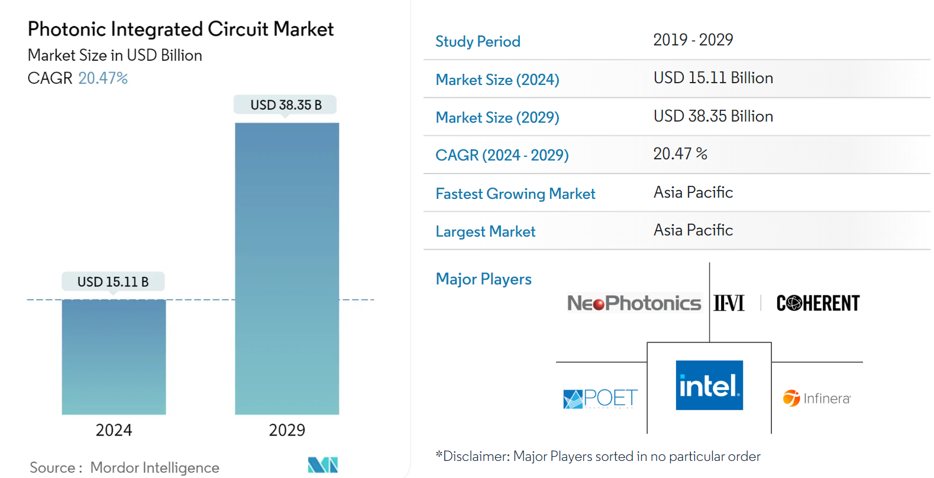
The Market for PICs
The adoption of photonic chips is rapidly growing, driven by their superior capabilities and the increasing demand for faster data processing and communication technologies. Key sectors include telecommunications, computing, healthcare, and automotive industries.
Notes:
CAGR - Compound annual growth rate

Slide 15
PIC Market Trends
Growing applications in Telecoms and Data Centers to drive market
North America to Hold Major Market Share
According to Cloudscene, The US holds the highest number of data centers globally, almost 2,700 (33% of the world’s).
In Dec 2022, OpenLight unveiled an 800 G DR8 photonic integrated circuit to advance the global data center interconnect industry.

Slide 16
PIC Market Trends
May 2023: ANELLO Photonics announced a partnership with NVIDIA Inception to nurture start-ups that radically change industries with advances in technology.
In order to produce low noise and low drift optical sensors, ANELLO's photonic gyroscope integrated circuit technology is used
August 2022: DustPhotonics announced a partnership with MaxLinear in order to demonstrate exceptional overall system performance in silicon photonics chipset with integrated lasers directly driven from a DSP without using an external driver chip.

Slide 17
Future Outlook
The future of photonics looks promising with potential breakthroughs in quantum computing, optical sensing, and AI. The ongoing development and refinement of photonic chips will play a crucial role in the next wave of technological innovations.
Information acquisition: LIDAR and optical sensing will form new application scenarios in the fields of AI, automatic driving and IoT.
Information transmission: application scenarios represented by 5G, optical communication, quantum communication, etc. have been formed, and the industry scale is huge.

Slide 18
Future Outlook
Information processing: application scenarios such as photonic computing and quantum computing have been formed, which will substantially improve computer performance in the future.
Information storage: 5D laser memory, optical transceiver modules, etc. will form new application scenarios such as cloud computing and big data centers.
Information display: new information display application scenarios such as VR, AR and microLED will be formed.

Slide 19
Conclusion
Photonic chips represent a transformative technology in the field of integrated circuits, offering a leap forward in terms of efficiency, speed, and miniaturization. As technology evolves, PICs are set to play a crucial role in the future of computing and telecoms.

Slide 20
References
https://www.photonics.com/Articles/Programmable_Photonic_Chips_Adapt_PICs_to/a68811
https://www.synopsys.com/glossary/what-is-a-photonic-integrated-circuit.html
https://interestingengineering.com/innovation/worlds-first-photonic-chip
https://www.nanotrun.com/article/has-the-era-of-photon-computing-arrived-what-does-the-photonic-chip-bring-to-us-i00354i1.html
Mordor Intelligence Research & Advisory. (2023, November). Photonic Integrated Circuit Market Size & Share Analysis - Growth Trends & Forecasts (2024 - 2029). Mordor Intelligence. Retrieved May 10, 2024, from https://www.mordorintelligence.com/industry-reports/hybrid-photonic-integrated-circuit-market

Slide 21
Q&A

Slide 22
Thank you
E ṣé
Köszönöm
Merci
Shukran
Dhan'yabāda
Na gode
Spasibo
Obrigado
Bayarlalaa
Teşekkürler
Daalụ

