Slide 1
QUANTUM DOTS
Ayomide Ajayi
Electrical Engineering
University of Debrecen, Hungary
25th May, 2024

Slide 2
Introduction to Quantum Dots
Quantum dots (QDs) are semiconductor nanoparticles or nanocrystals that exhibit size and composition-dependent optical and electronic properties. QDs are ultrasmall, typically in the size range between 1.5 and 10.0 nm (10 – 50 atoms). QDs exhibit size-unique optical properties due to changes in band gap energy caused by quantum confinement effects.
QDs exhibit fluorescence, wherein the nanocrystals can produce distinctive colors determined by the size of the particles.
Due to their small size, the electrons in these particles are confined in a small space (quantum box) and there is quantization of the energy levels according to Pauli’s exclusion principle. The discrete, quantized energy levels of quantum particles relate them more closely to atoms than bulk materials and have resulted in them being nicknamed ‘artificial atoms’.

Slide 3
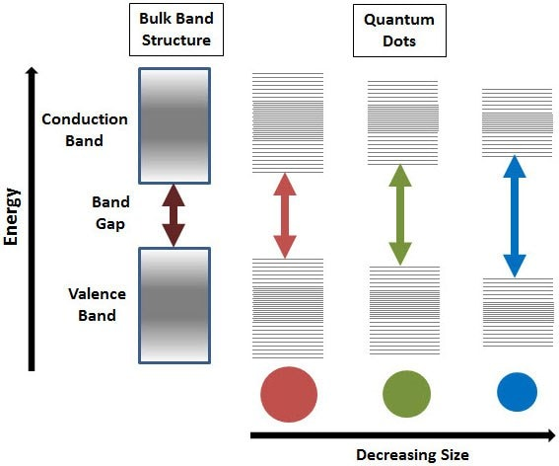
Splitting of energy levels in quantum dots due to the quantum confinement effect, semiconductor band gap increases with decrease in size of the nanocrystal.

Slide 4
Quantum Dots in Nanotechnology
Quantum Dots are a cornerstone in the field of nanotechnology, offering precise control over their optical and electronic properties due to their quantum mechanical nature.
They can be engineered to specific sizes, allowing them to emit and absorb light at various wavelengths, which is crucial for applications ranging from photovoltaics to quantum computing.
In nanotechnology, their small size and high surface area make them ideal for use in sensors and other devices that require high sensitivity and specificity.
Researchers are also exploring quantum dots for targeted drug delivery systems, leveraging their ability to attach to certain biological cells and emit light for easy tracking. Additionally, their unique properties are pushing the boundaries of traditional electronics, leading to the development of ultra-thin, flexible electronic displays.

Slide 5
Physical and Chemical properties
The semiconductor nature of quantum dots allows them to confine electrons, holes, or excitons in three spatial dimensions, leading to unique optical and electrical properties, such as size-tunable light emission.
The quantum dots’ physical size, typically between 2 to 10 nanometers, directly influences their colour output through quantum confinement effects, where smaller dots emit shorter wavelengths like blue, and larger ones emit longer wavelengths such as red.
Chemically, quantum dots are generally composed of elements from groups II-VI, III-V, or IV-VI on the periodic table, with common compositions including cadmium selenide (CdSe) or indium arsenide (InAs).
Stability, solubility, and toxicity are significant chemical properties that impact their applications.

Slide 6
Synthesis Techniques
The synthesis of quantum dots can be achieved through various techniques, each influencing their size, shape, consistency, and optical properties.
Colloidal synthesis: is one of the most common methods, involving the chemical reaction of precursors in a solution, often at high temperatures, which allows for tight control over the size and composition of the quantum dots produced. This method is favoured for producing high-quality quantum dots suitable for optical applications due to the precise control it offers over the particles' characteristics.

Slide 7
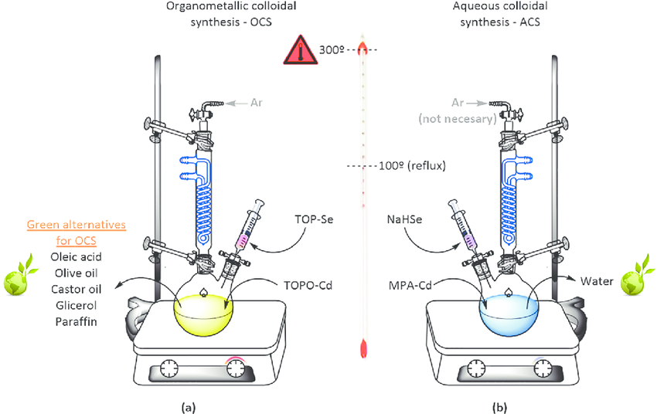
Synthesis Techniques
Source: “Green” Quantum Dots: Basics, Green Synthesis, and Nanotechnological Applications
DOI: 10.5772/62327

Slide 8
Synthesis Techniques
Hot-injection synthesis: introduces precursors into a hot surfactant solution, quickly forming quantum dots. This method is particularly useful for achieving uniform sizes and shapes, which are critical for applications requiring consistent optical properties.
Vapor deposition techniques: are also used, particularly for applications requiring the quantum dots to be part of a solid matrix. These methods involve the deposition of materials onto a substrate in a vacuum, allowing for the integration of quantum dots into larger semiconductor structures.
Microbial and green synthesis: are emerging as environmentally friendly alternatives, using biological organisms or plant extracts to reduce metal salts into quantum dots, avoiding the use of harmful chemicals.
Room Temperature synthesis

Slide 9
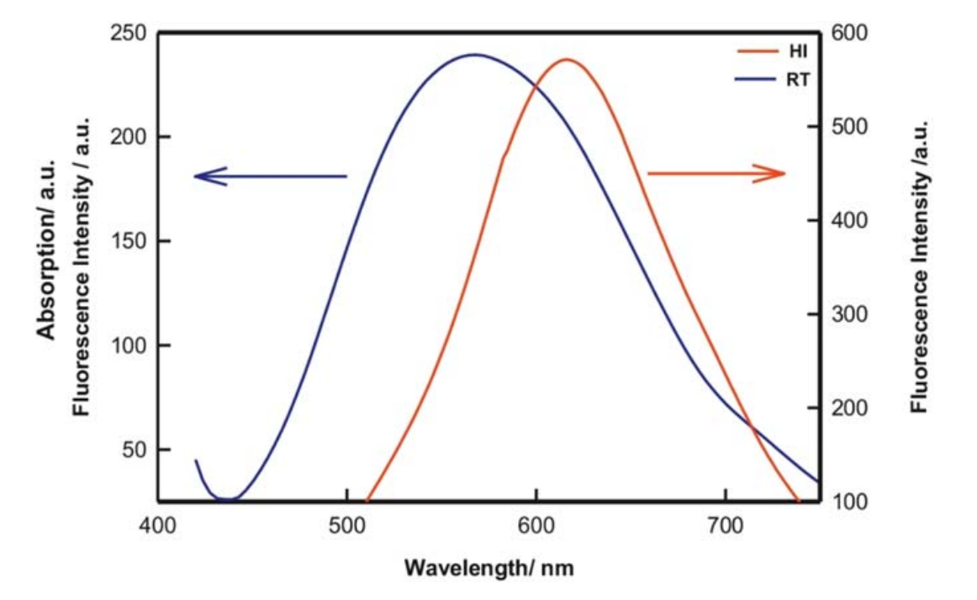
Synthesis Techniques
Fluorescence spectra of the Quantum dot samples obtained from Hot Injection and Room Temperature (RT) synthesis. Source: https://iopscience.iop.org/article/10.1088/2053-1591/acda17/pdf

Slide 10
Applications in Nanoelectronics
Enhanced Device Performance: Quantum dots improve charge carrier mobility in transistors, enhancing the performance of nanoelectronic devices.
Quantum Dot Transistors: Utilization in the development of quantum dot field-effect transistors (QD-FETs), offering higher sensitivity and faster switching times compared to conventional FETs.
Flexible Electronics: Quantum dots are integral to creating flexible electronic displays and sensors, providing vibrant colour displays and high responsiveness under mechanical stress.

Slide 11
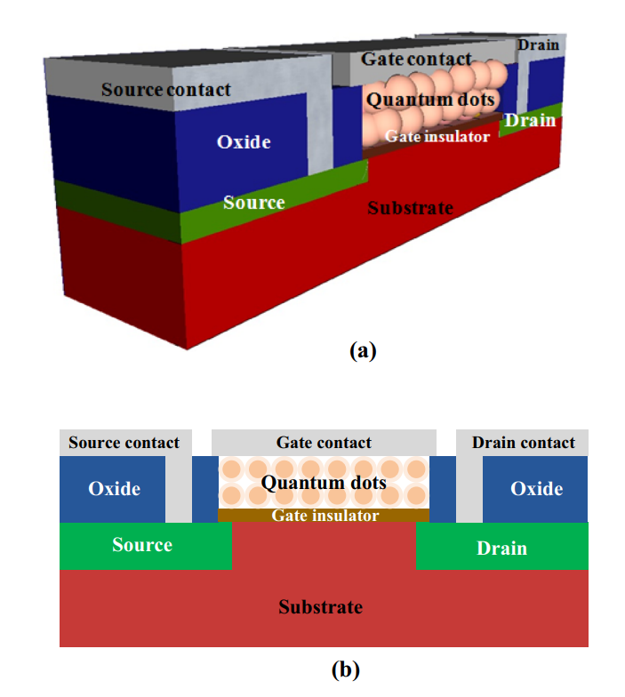
Quantum Dot Gate-FET
Device structure
Cross sectional schematic
Source: Application of quantum dot gate FETs (QDGFETs) in ternary logic image inversion
https://link.springer.com/article/10.1007/s10470-015-0673-1

Slide 12
Applications in Nanoelectronics
Optoelectronic Devices: Application in optoelectronic devices such as quantum dot lasers and photodetectors, which benefit from the tunable optical properties of quantum dots for increased efficiency and specificity in light emission and detection.
Quantum Computing: Quantum dots are pivotal in the development of quantum computing technologies, where they can act as qubits for storing and processing information at the quantum level.

Slide 13
Environmental and Safety Considerations
Environmental and safety considerations are critical in quantum dot technology, particularly given the widespread use and potential health and ecological impacts of these materials.
Quantum dots often contain heavy metals which pose significant toxicity risks to both human health and the environment if not properly managed.
The potential for these materials to leach into water sources or accumulate in the food chain raises concerns about their long-term ecological impact.
Studies have shown that quantum dots can be toxic to cells and organisms, depending on their composition, surface chemistry, and exposure levels. This toxicity can affect cellular processes and DNA, leading to cytotoxicity, genotoxicity, and potentially causing other harmful effects.

Slide 14
Environmental and Safety Considerations
Regulatory frameworks are being developed and refined to manage the production, use, and disposal of quantum dots to mitigate these risks. Innovations in quantum dot synthesis, such as the development of cadmium-free and biocompatible quantum dots, are also being pursued to reduce environmental and health hazards.
Incorporating life cycle analysis and green chemistry principles into the development and application of quantum dots is crucial. These measures ensure safer production processes and help reduce the environmental footprint while maintaining the functionality and benefits of quantum dots in various applications.

Slide 15
Conclusion
Quantum dots are revolutionary nanomaterials that enhance nanotechnology and electronics with their unique, tunable properties. As research progresses, safe and sustainable use remains essential. Their potential continues to grow, promising significant advancements across multiple fields.

Slide 16
References
Tyler Maxwell, Maria Gabriela Nogueira Campos, Stephen Smith, Mitsushita Doomra, Zon Thwin, Swadeshmukul Santra,
Chapter 15 - Quantum Dots (https://doi.org/10.1016/B978-0-12-816662-8.00015-1)
https://www.sigmaaldrich.com/HU/en/technical-documents/technical-article/materials-science-and-engineering/biosensors-and-imaging/quantum-dots
Chapter Four - Nanotechnology in wastewater treatment (https://doi.org/10.1016/bs.coac.2021.11.002)
Application of quantum dot gate FETs (QDGFETs) in ternary logic image inversion (https://link.springer.com/article/10.1007/s10470-015-0673-1 )
https://www.sigmaaldrich.com/HU/en/technical-documents/technical-article/materials-science-and-engineering/biosensors-and-imaging/quantum-dots
Quantum dots: an overview of synthesis,properties, and applications (https://iopscience.iop.org/article/10.1088/2053-1591/acda17/pdf)
“Green” Quantum Dots: Basics, Green Synthesis, and Nanotechnological Applications (http://dx.doi.org/10.5772/62327)

Slide 17
Thank you
E ṣé
Köszönöm
Merci
Shukran
Dhan'yabāda
Na gode
Spasibo
Obrigado
Bayarlalaa
Teşekkürler
Daalụ

