Slide 1
Practical Project Management & Prof Development
A.V.A Chatbot
By:
Ayodamola Ajibola
Jia Ren Goh
Alex Moreton
Khawla Elmasalati

Slide 2
Presentation outlines
Introduction
Project Aims and Objectives
Existing Alternatives
Development Approach
Results
Limitations and Future Work
Conclusion
Live Demo

Slide 3
Introduction
Project Aims and Objectives
What an AI is
Why we developed a chatbot
What should do
Existing Alternatives
Social issues
Development Approach
Programming Language
Data handling
Business Functionality
Growth
Environmental implication
Benefits of a chatbot

Slide 4
project’s aims and objectives
Ava should be able to start and continue conversations
Ava should be able to respond based on keyword detection
The code for Ava should showcase proper understand of object-orientated programming
Ava should support simple profile creation
Ava should utilize a database to store and access useful data
Cross-platform compatibility for Ava should be maximized

Slide 5
Project Aims and Objectives continued
Ava should be kept updated and maintained
Ava should be able to make use of text to speech systems
Restrictions should be put in place on users to prevent unacceptable behaviour
Multiple access levels should be put in place to prevent unauthorised access to data

Slide 6
Functional Requirements
Rules and boundaries – what Ava can ‘learn’ should be limited to ensure that it both fits well into its role and does not hinder the user.
Human language – Ava should be able to understand what the user is saying, despite the difficulties of understanding human language in use.
Different levels of users – Ava should be set up with different levels of users with different levels of access, to prevent access to sensitive data

Slide 7
Non-Functional Requirements
Dynamic answers – Ava should have a variety of different answers to possible questions to avoid repetition
Services – Ava should be able to provide simple external services to users with appropriate prompting
Interface – Ava should have a clean and simple interface to aid understanding.
Availability – Ava should be able to work across different platforms
Recoverability – Ava should be able to recover past conversations and other useful data

Slide 8
existing alternatives

Slide 9
development approach
Agile development
Java
Learner Class
Data mining
Google APIs

Slide 10
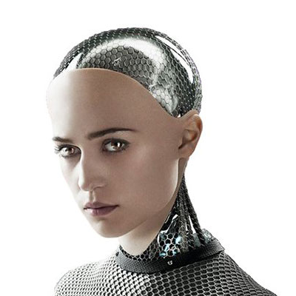
Results

Slide 11
limitations and ideas for future work as a minimum
Turning Test – Imitating human features doesn’t make it human
Data mining on social media
Future implementation
Bespoke developments for businesses

Slide 12
Conclusion
A.I is Essential in human growth
What does the future hold?
Earth may be dying but we’re, interstellar beings
How current issues can be solved,
Turning test/ is this a human or a chatbot?
Misinformed idea of a dystopia,
What we learnt
Improvements to be made
Passionate about A.I and expanding on machine learning

Slide 13
Live Demo

Slide 14
References

Slide 15
Any Questions?
Questions
Ava could answer some (probably when finished)
Questions to Ask

