Slide 1
ALGORITHM CONCEPTS AND REPRESENTATION

Slide 2
Algorithm
An algorithm is a procedure consisting of a finite set of steps which specify a finite sequence of operations that provides the solution to a problem.
An algorithm is composed of a sequence of actions, each organized in steps.
Hence, an algorithm is a step-by-step procedure to solve a given problem.

Slide 3
Example of an algorithm
An algorithm for daily activities can have the following steps:
Wake up in the morning
Pray
Brush your teeth
Take your bath
Eat
Go to class

Slide 4
Algorithm and Program
What is the difference between an Algorithm and a Program?
Algorithm is the mathematical step-by-step procedure while a Program is the implementation of the algorithm in a particular programming language.
Algorithm is a method for solving any instance of the problem such that for a given particular input, the algorithm produces the desired result. A program, on the other hand, is an algorithm that has been encoded into some programming language.

Slide 5
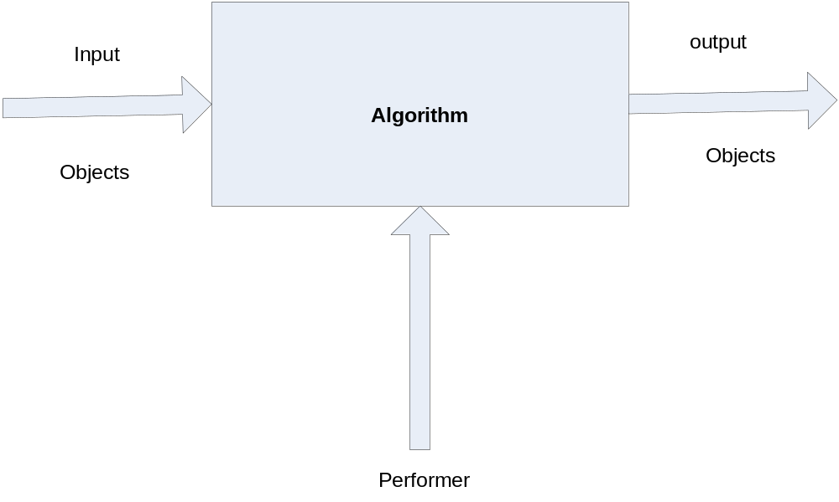
The relationship between algorithm, input, output and performer

Slide 6
Example of an Algorithm
Algorithm to Add two numbers
Step 1: Start
Step 2: Read the values of A and B
Step 3: Add the two numbers together
Step 4: Store the result in Sum
Step 5: Display the content of Sum
Step 6: Stop

Slide 7
Example 2:
Design an algorithm to add these test scores: 26, 49, 98, 87, 62, 75 and obtain the Average score
1.Start
2. Sum = 0
3. Input 26, 49, 98, 87, 62, 75
4. Sum = 26+49+98+87+62+75
5. Average = Sum/6
6. Output Average
7. Stop

Slide 8
Properties of Algorithm
Correctness
Correctness is the property reflecting the extent to which the algorithm is able to reach a solution without errors.
Efficiency
The efficiency of an algorithm is the property that regards the rapidity by which a solution is reached.
Generality
This means that it must solve every instance of the problem. For example, a program that computes the area of a rectangle should work on all possible dimensions of the rectangle.

Slide 9
Effectiveness
This means that an algorithm must provide the correct answer to the problem.
Comprehensible
Finally the algorithm must be comprehensible by the one who performs it.
It must describe in all details, the actions and the entities necessary for the resolution of a problem.

Slide 10
Algorithm Analysis
In computer science, the analysis of algorithms is the determination of the amount of computing resources (such as time and space) necessary to execute them. We want to be able to consider two algorithms and say that one is better than the other because it is more efficient in its use of those resources or perhaps because it simply uses fewer.
It is important to consider the amount of space or memory an algorithm requires to solve the problem. The amount of space required by a problem solution is typically dictated by the problem instance itself.

Slide 11
Algorithm Analysis
We can analyze algorithms based on the amount of time required to execute them. This measure is sometimes referred to as the “execution time” or “running time” of the algorithm.
Algorithms can be described in terms of :
Time efficiency
Space efficiency
Algorithm efficiency is often calculated for three broad cases of inputs by:
Best case - when the resources usage is at least
Average case - when the resources usage is average
Worst case - when the resources usage is at most

Slide 12
Algorithm Analysis
In real-time computing, the worst-case execution time is often of particular concern since it is important to know how much time might be needed in the worst case to guarantee that the algorithm will always finish on time.
Average performance and worst-case performance are the most used in algorithm analysis. Less widely found is best-case performance, but it does have uses: for example, where the best cases of individual tasks are known, they can be used to improve the accuracy of an overall worst-case analysis.

Slide 13
Essential Elements of a Good Representation
1. Show the Logic.
Your algorithm representation should focus on the logic of the problem, and not the logic of the eventual implementation. More specifically, the upper levels of your representation should, to the degree possible, be devoid of implementation details - these should be relegated to the lower levels of the representation.
2. Reveal the Flow
Most problems, especially if they are intended to be solved with the aid of a computer program, involve flow control.
3. Be Expandable and Collapsible
Our algorithm representation should be flexible and allow us to readily collapse it so as to show less detail and focus on the more abstract elements of the algorithm or to expand it so as to get as detailed as necessary in order to actually implement the solution.

Slide 14
Essential Elements of a Good Representation
4. Aid in Implementation
At the end of the day, the goal is usually to actually implement a solution to the problem being solved. If our method of representing our algorithm does not lend itself to an orderly implementation of that algorithm, then our method is seriously flawed. Conversely, if our method of representation lends itself to a systematic implementation of the algorithm, then our method is extremely useful.
By "systematic implementation" we mean that we should be able to take our represented algorithm and break it into easily identifiable fragments each of which can be readily translated into one of the structures, such as a while() loop or an if()/else block, available to us in our chosen implementation scheme be it a C program, an assembly language routine, an electronic circuit, or a physical mechanism.

Slide 15
TOOLS FOR REPRESENTING ALGORITHMS
Two tools for representing algorithms are:
Pseudocode
Flowchart
Pseudocode: Pseudocode is one of the tools that can be used to write a preliminary plan that can be developed into a computer program.
Pseudocode is a generic way of describing an algorithm without use of any specific programming language syntax.
It is, as the name suggests, pseudo code —it cannot be executed on a real computer, but it models and resembles real programming code.

Slide 16
Pseudocode
Pseudo code is an English language constructs modelled to look like statements available in most programming languages. It has some basic and peculiar attributes. They are:
Steps are presented in a structured manner (numbered, indented, and so on)
No fixed syntax for most operations is required
Less ambiguous and more readable than natural language
Emphasis is on process, not notation
Well-understood forms which allow logical reasoning about algorithm behaviour
It can be easily translated into a programming language.

Slide 17
Pseudo code Format
Action Keywords: There are three basic actions that can be carried out.
The SET, GET, and PUT keywords are used for these actions.
SET:
This is an action keyword that denotes performing some operation that changes a value in memory.
PUT:
This is an action keyword that denotes an output operation, generally to the screen
GET:
This is an action keyword that denotes in input operation, generally from the keyboard.

Slide 18
Example: Pseudocode for computing miles per litre
STEP | OPERATIONS
1 | GET VALUES OF LITRES USED, STARTING MILEAGE, ENDING MILEAGE
2 | SET VALUE OF DISTANCE DRIVEN (ENDING MILEAGE-STARTING MILEAGE
3 | SET VALUE OF AVERAGE MILES PER LITRE TO(DISTANCE DRIVEN – LITRES USED)
4 | PRINT THE VALUE OF AVERAGE MILES PER LITRE
5 | STOP

Slide 19
TOOLS FOR REPRESENTING ALGORITHMS
Flowchart: Flowchart is a tool for showing the steps involved in a process.
Flowchart is a graphical means of representing an algorithm.
A flowchart is a diagram made up of boxes, diamonds and other shapes, connected by arrows.
Each shape represents a step in the process, and the arrows show the order in which they occur.
Flowchart combines symbols and flow-lines, to show figuratively the operation of an algorithm.

Slide 20
Basic Flowchart Shapes
.
T F
ENTRY
EXIT
Q?
TASK
I/O

Slide 21
Basic Flowchart Shapes
Sphere - Entry/Exit Point
The sphere indicates the entry and exit point for the program or for the current segment of the program. The entry point has exactly one arrow leaving it and the exit point has exactly one arrow entering it. Execution of the program - or of that segment of the program - always starts at the entry point and finishes at the exit point.
Rectangle - Task
The rectangle represents a task that is to be performed. The key point is that it also has a single entry point and a single exit point.

Slide 22
Basic Flowchart Shapes
Parallelogram - Input/Output
The parallelogram is used to indicate that some form of input/output operation is occurring.
Diamond - Decision Point
The diamond represents a decision point within the program. A question is asked and depending on the resulting answer, different paths are taken. Therefore a diamond has a single entry point but more than one exit point. Usually, there are two exit points - one that is taken if the answer to the question is "true" and another that is taken if the answer to the question is "false".

Slide 23
Basic Flowchart Shapes
Connector: A small, labelled, circular flow chart shape used to indicate a jump in the process flow. Connectors are generally used in complex or multi-sheet diagrams.

Slide 24
General Rules for flowcharting
1. All boxes of the flowchart are connected with Arrows. (Not lines)
2. Flowchart symbols have an entry point on the top of the symbol with no other entry points. The exit point for all flowchart symbols is on the bottom except for the Decision symbol.
3. The Decision symbol has two exit points; these can be on the sides or the bottom and one side.
4. Generally a flowchart will flow from top to bottom.

Slide 25
Advantages of Using Flowcharts:
Communication: Flowcharts are better way of communicating the logic of a system to all concerned.
Effective analysis: With the help of flowchart, problem can be analysed in more effective way.
Proper documentation: Program flowcharts serve as a good program documentation, which is needed for various purposes.
Efficient Coding: The flowcharts act as a guide or blueprint during the systems analysis and program development phase. Proper Debugging: The flowchart helps in debugging process.
Efficient Program Maintenance: The maintenance of operating program becomes easy with the help of flowchart. It helps the programmer to put efforts more efficiently on that part.

Slide 26
Limitations of Using Flowcharts:
Although a flowchart is a very useful tool, there are a few limitations in using flowcharts which are listed below:
Complex logic: Sometimes, the program logic is quite complicated. In that case, flowchart becomes complex and clumsy.
Alterations and Modifications: If alterations are required the flowchart may require re-drawing completely.
Reproduction: As the flowchart symbols cannot be typed, reproduction of flowchart becomes a problem. The essentials of what is done can easily be lost in the technical details of how it is done.

Slide 27
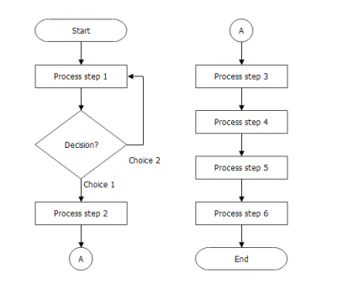
Samples of flowchart

Slide 28
Control Structures of Algorithm
What kind of control structures are necessary to describe
algorithm?
Sequence, Selection and Iteration (Repetition)
Sequence: The first type of control structures is called the sequence structure. This structure is the most elementary structure. The sequence structure is a case where the steps in an algorithm are constructed in such a way that, no condition step is required.
For example, suppose you are required to design an algorithm for finding the average of six numbers, and the sum of the numbers is given.

Slide 29
Control Structures of Algorithm
The algorithm will be as follows:
Start
Input Sum
Set Average = Sum / 6
Output Average
Stop
2. Selection Structure: The selection structure also known as decision structure is a case in the algorithm where one has to make a choice of two alternatives by making a decision depending on a given condition.

Slide 30
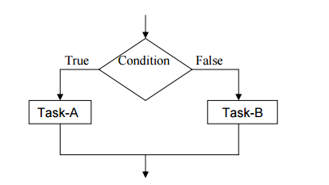
Control Structures of Algorithm
A selection structure takes the form:
If condition is true
Then do task A
else
Do Task-B
This structure can be illustrated in a flowchart as follows:

Slide 31
Control Structures of Algorithm
The selection requires the following:
• Choose alternative actions as a result of testing a logical condition
• Produce code to test a sequence of logical tests
In making choices, IF statement is used together with logical operators to test for true or false.
The logical operators used are:
= is equal to <= is less than or equal
> is greater than <> is not equal to
< is less than
>= is greater than or equal

Slide 32
Control Structures of Algorithm
3. Iteration or Repetition structures: The iteration structure can be implemented using
• Repeat Until Loop • The While Loop • The For Loop
Any program instruction that repeats some statement or sequence of statements a number of times is called an iteration or a loop. The commands used to create iterations or loops are all based on logical tests.

Slide 33
Control Structures of Algorithm
• Repeat Until Loop
The syntax is
REPEAT
A statement or block of statements
UNTIL
a true condition
For example, A program repeatedly asking for an entry of a number in the range 1 to 100 until a valid number is entered.
REPEAT
Output “Enter a number between 1 and 100”
UNTIL
number < 1 OR number > 100
•

Slide 34
Control Structures of Algorithm
The While Loop
The second type of iteration. This type of conditional loop tests for terminating condition at the beginning of the loop. In this case no action is performed at all if the first test causes the terminating condition to evaluate as false.
The syntax is:
WHILE (a condition is true)
A statement or block of statements
ENDWHILE

Slide 35
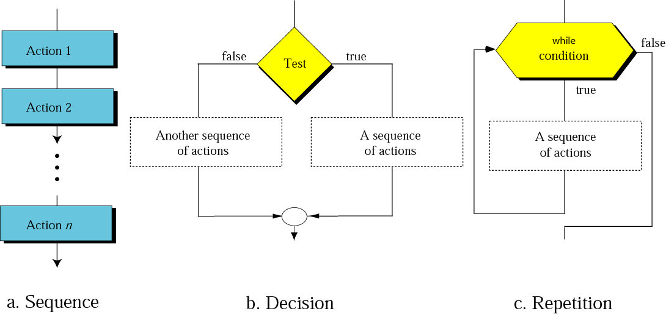
Control Structures of Algorithm

Slide 36
Control Structures of Algorithm
• The For Loop: The third type of iteration. This, in its simplest form, uses an initialisation of the variable as a starting point, a stop condition depending on the value of the variable. The variable is incremented on each iteration until it reaches the required value.
The syntax is:
FOR (starting state, stopping condition, increment) Statements
ENDFOR
For example:
FOR (n = 1, n <= 4, n + 1)
Output “loop”, n
ENDFOR

Slide 37
Control Structures of Algorithm
The fragment of code will produce the output
Loop 1
Loop 2
Loop 3
Loop 4
In the example, n is usually referred as the loop variable, or counter, or index of the loop.
Example : Write an algorithm to calculate the sum and average of a series of numbers.

Slide 38
Control Structures of Algorithm
Algorithm
1. Start
2. Sum = 0
3. FOR (n = 1, n <= count, n + 1)
4. Sum = Sum + n
5. ENDFOR
6. Average = Sum / count
7. Output Average
8. Stop

Slide 39
Control Structures of Algorithm
Example: Design an algorithm and the corresponding flowchart for finding the sum of n numbers.
Algorithm
1. Start
2. Sum = 0
3. Input n
4. For(I = 1, n, I+1)
5. Input a number
6. Sum = Sum + number
7. ENDFOR
8. Output Sum
9. Stop

