Slide 1
CSC 301 Lecture Notes
First Semester 2018/2019
STRUCTURED PROGRAMMING USING PYTHON
by
ABORISADE D.O.

Slide 2
INTRODUCTION
Structured programming is a programming approach where a program is modularized for the purpose of clarity, efficiency and modification.
This is mostly achieved in structured programming through the use of program flow constructs such as selection statements; if ….statements, for…statements, do….while, and block structures.
Structured programming approach is one where a problem is solved by dividing the problem into modules and solutions proffered to those modules, so that the solutions could be in turn combined to serve as the solution to the overall problem.

Slide 3
INTRODUCTION
Features of Structured programming approach
Breaking of problems into smaller modules or procedures or functions.
Absence of GOTO statements
Structured programs are usually composed of If , For, Do While statements
Availability of expanded set of operators like bit manipulation, shift and part word operators in addition to logical, relational, arithmetic and comparison operators.
Examples of Structured programming languages include C Language, Pascal, ALGOL, PL1, ADA

Slide 4
INTRODUCTION-Python
Python a programing language created by Guido van Rossum is a structured programming language.
It has a simple syntax, hence, it is extremely easy to get started.
It is an example of a Free/Libré and Open Source Software (FLOSS). In simple terms, you can freely distribute copies of this software, read its source code, make changes to it, and use pieces of it in new free programs.
Python is an interpreted language where there is no need to compile python source code to object but rather to byte code. This means that when python programs are written, programmer does not have to bother about the low-level details such as managing the memory used by his program.
Python is a ported programming language. This shows that python programs can work on any platform without change to the program.

Slide 5
INTRODUCTION-Python
Python also allows part of code written in C/C++ to be used in python.
Programmers can embed python code in C/C++ as a script language.
Python has huge standard library to make development of cryptography, databases, GUI (Graphics User Interface), and HTML files possible.

Slide 6
APPLICATION AREAS
ATIFICIAL INTELLIGENCE
NEURAL NETWORK
MACHINE LEARNING
DATA SCIENCE
GAMING

Slide 7
WRITING Python PROGRAMS
Python programs could be written and tested using
interactive interpreter prompt.
(ii) use of source file in code editor.
The standard procedure however, is to use a code editor (like Pycham or Vim) to create the program as a file to be stored for later use.
Programming with Python Interpreter Prompt
Open your operating system prompt (e.g. command prompt in Windows)
Navigate to the python working directory
Type “python” and press Enter key to see “ >>>”
Type command statement such as print(“Good to see my first python Code”) and press enter key

Slide 8
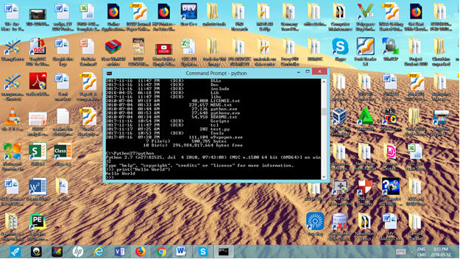
WRITING Python PROGRAMS

Slide 9
Programming in Python with Code Editor
The standard procedure is to save and run a Python program is as follows:
Open the installed text editor i.e PyCharm
Click on Create new Project
Select Pure Python and Change untitled to helloworld (in front of for the location of the project).
Click the Create button.
Right-click on the helloworld in the sidebar and select New -> Python File
When prompted to type the name, type hello
After an empty file is opened, type code statement (i.e print(“Welcome to my first code”)).
Right-click on the code statement and click on Run 'hello'

Slide 10
Structure of a Python program
A typical Python program structure is made up;
statements for invoking library files, function/modules definition, comments blocks of statements.
The idea of whitespace and indentation is also very important in the structure of a python program. Use of whitespace at the beginning of the line is called indentation and very important in python programming structure.
Leading whitespace at the beginning of the logical line is used to determine the indentation level of the logical line, which in turn is used to determine the grouping of statements.
In python, statements in the same block must have the same indentation.
Indentation that is not right would give rise to errors in a program.

Slide 11
Python Program-Example
A program to illustrate the wrong use of whitespaces and indentation.
x = 10
# Program to illustrate indentation error
print(“What is your name”)
print(“Asking my name is an ERROR”)
Output:
Error message:
File "wrongspace.py", line 3 print(“What is your name”) ^IndentationError: unexpected indent

Slide 12
Literal constant, String, Variables and Identifiers
Literal constant is a character or collection of characters that do not change in a program. Examples of literal constants are 7, 10.5. When literal constant is in form of alphabet, they are called string literals. Examples of string literals are ‘Computer Science’ and “Federal University of Agriculture, Abeokuta”.
Variables are data names or identifiers that hold different values in the life of a program. In python, some rules are used to guide the formulation of variables (or identifiers). These include:

Slide 13
Variables and Identifiers contd…
An identifier or variable must start with a letter of the alphabet (uppercase ASCII or lowercase ASCII or Unicode character) or an underscore (_).
Identifiers must not be a python reserved word like print, str, e.t.c
The rest of the identifier name can consist of letters (uppercase ASCII or lowercase ASCII or Unicode character), underscores (_) or digits (0-9).
Identifier must include space or special character.
Identifier names are case-sensitive. e.g. firstname and firstName are not the same.

Slide 14
Variables and Identifiers contd…
Examples of valid identifier include j, average, total, my_salary, sum, abc.
Examples of invalid identifier names are 7name, my salary, print, and >abc_c3.
Reserved Words
are keywords reserved for the exclusive use of the compiler.
e.g print, ASCCII, str, if, else, e.t.c

Slide 15
Input and Output
It is very common to write programs where user would interact with the system by supplying input values and print output.
This can be achieved using functions such as: input ( ), print( ) functions. We can also use str (string) class, rjust method. Another method of dealing with input/output is through files. In programming, files must be created, read, and written (using create read, write).
Example: Write a python program that would allow user to enter name, firstscore, secondscore, thirdscore, totalscore, and averagescore using input ( ) and print ( )

Slide 16
Input and Output
# program to find average of three numbers
name=raw_input("Enter your Name:")
firstscore = int(input("Input the First number: "))
secondscore= int(input("Input the Second number: "))
thirdscore=int(input("Input the Third number: "))
totalscore= firstscore+secondscore+thirdscore
average=totalscore/3
print("The Student name is:", name)
print("The Average Score is:", average)

Slide 17
Input and Output
counter = 100 # An integer assignment
miles = 1000.0 # A floating point
name = "John" # A string
print counter
print miles
print name

Slide 18
Data types in Python
Data types refers to the different forms of data that can be assigned to variables (or identifiers) in python. These include strings, numbers, and objects.
Strings: Sequence of characters
Numbers: Integers, Floating point(1.79e308 1.79e+308), complex numbers
Bolean:True or False
Objects: bytes, list, dict, tuple

Slide 20


Slide 34
COMPUTER SOFTWARE
Computer software is basic ally a program, which allows the hardware components to operate effectively as well as provide very many useful services. Computer Manufacturers and certain software specialist usually write software. Programs are sequences of instructions given to a computer to enable it solve a particular problem or accomplish a given assignment. Some of these programs are permanently stored in the computer. They automatically
start up the computer when it is switched on. On completion of the initial process of start-up, they will transfer control to the operating system, which is the manager of the computer resources. The rest of these programs that are for the external use are loaded to the memory of the system from the secondary storage medium like hard/floppy disk after the system boot-up.

Slide 35
SOFTWARE
System Software :are the collection of programs usually supplied by the manufacturer of the computer. These programs protect the user from the enormous complexity of the computer system, and enable the computer to be use d to maximum effect by a wide variety of people, many of whom will know very little about the inner workings of computers. Without systems software a modern digital computer would be virtually impossible to use.
Operating systems
If a computer system is viewed as a set of resources, comprising elements of both hardware and software, then it is the job of the collection of programs known as the
operating system to manage these resources as efficiently as possible.

Slide 36
SOFTWARE
In so doing, the operating system acts as a buffer between the user and the complexities of the computer itself. One way of regarding the operating system is to think of it as a program which allows the user to deal with a simplified computer, but without losing any of the computational power of the machine. In this way the computer system becomes a virtual system, its enormous complexity hidden and controlled by the operating system and through which the user communicates with the real system.

Slide 37
SOFTWARE
System Services: Often a manufacturer will provide a number of programs designed specifically for program or application development. Some examples of such aids are as follows. Language Translators (Processors)
These are computer programs designed to convert high-level language programs into
machine code, that is, into a form directly usable by a computer. Common types of
language processors are Assembler, Compilers and Interpreters. Assembler: This is a translator that convert program written in Assembly language to machine code and vice-versa.
Compiler: This is a translator that convert program written in High Level Language to machine code and vice-versa, and the translation in done all at once.

Slide 38
SOFTWARE
Languages translated by Compiler are COBOL, FORTRAN, C++ etc.
Interpreter: This is a translator that convert program written in High Level language to machine code and vice-versa, but the translator is done line by line. Example of language translated by Interpreter is BASIC.
Utility Programs
As part of the systems software provided with a computer system there are a number
of utility programs specifically designed to aid program development and testing.

Slide 39
SOFTWARE
USER APPLICATIONS SOFTWARE
Applications software refers to programs that have some direct value to an organization, and will normally include those programs for which the computer system was specifically purchased. Application Software are grouped into User Program and Commercially produced applications software. User Programs : are written by people within the organization for specific needs, which cannot be satisfied by other sources of software. These program writers may be
professional programmers employed by the organization, or other casual users with programming expertise.

Slide 40
ALGORITHMS
An algorithm is a step by step procedure for solving a problem. e.g
Step 1: State the problem clearly
Step 2: Describe the input/output information
Step 3: Work the problem by hand, give example
Step 4: Develop a solution (Algorithm Development)
  and Convert it to a program (C program)
Step 5: Test the solution with a variety of data

Slide 41
FLOWCHART
A flowchart is a diagrammatic representation of step by step procedure for solving a problem. Flowchart and pseudocode are ways of representing algorithm.

Slide 42
PSEUDOCODE
A pseudocode is the step by step procedure with an syntaxes and keywords of an intended programming language for solving a problem.

Slide 43
FACTS ABOUT C
General purpose programming language.
Closely related to UNIX
Often referred as a system programming language as useful for writing compilers and operating systems.

Slide 44
Brief History of C
Developed by Dennis Ritchie at AT&T, early 70s, for DEC PDP-11
Unix written in, closely associated with, C
Family of languages:
  BCPL, Martin Richards
  B (typeless), Ken Thompson, 1970
  C, Dennis Ritchie, Bell Labs, early 70s
  C++, Bjarne Stroustrup, Bell Labs, 80s
  Java, James Gosling Sun, 1995
  C#, Microsoft, recently
C++, Java, C# conserve (much) C syntax

Slide 45
General Structure of a C program
Simple C programs have the form
directives
int main(void)
{
statements
}

Slide 46
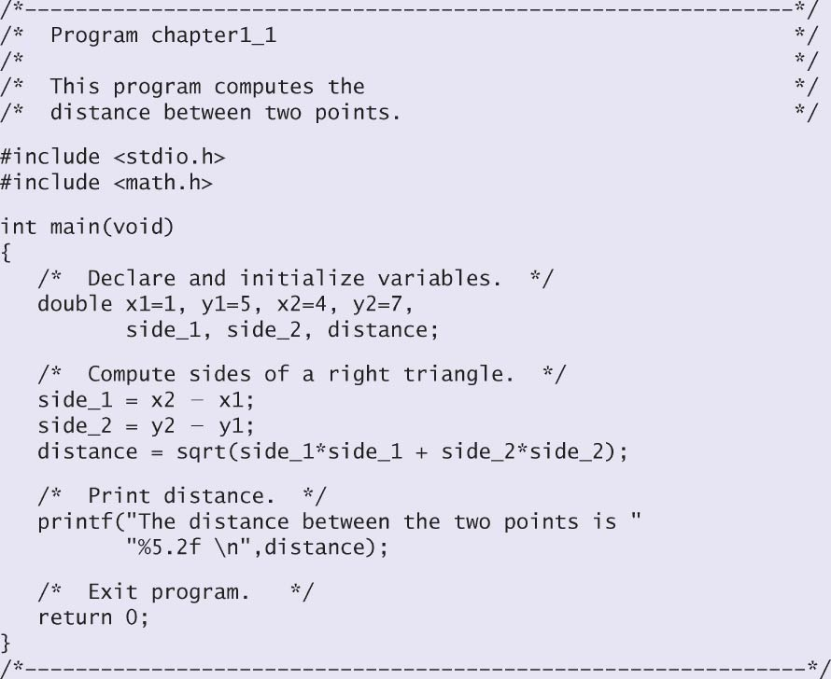
A sample C Program

