Slide 1
Sports Match Outcome Prediction Modeling
Shahana Ayobi
Client: BeDedicated

Slide 2
Content
Introduction
Performance Metrics
Datasets
Data Processing and Engineering Pipeline
Data Analysis
Modeling
Variable Importance Plots
Model Limitations
Recommendations
Conclusion

Slide 3
Introduction
The global sports betting market is expected to reach $155 billion by 2024 according a report by Forbes,
Build a model that accurately predicts the match outcomes for the 20 English Premier League teams across three seasons.
Give the bookkeepers a competitive advantage in the betting industry and they will be able to provide more balanced odds
This project aims to answer: What are the main predictors influencing football match outcome?
Response variable: three class variable with value 1 for home team winning, 0.5 for draw, and 0 for away team winning
Predictors considered: home and away team expected goals, team total market value, home and away team attacking strength, audience attendance, B365 betting odds, and time of the match.

Slide 4
Performance Metrics
Why accuracy?
Measures the overall correctness of the model's predictions.
Tells the percentage of correct predictions the model made across all three classes (home team winning, draw, away team winning).
Tell how well the model is performing in terms of predicting the correct outcome.
Formula
Accuracy = (True Positives + True Negatives) / (True Positives + False Positives + True Negatives + False Negatives)

Slide 5
Datasets
Football.co.uk
Includes variables such as location of the team, betting odds by different betting providers, and match scores
Total of 106 variables, and 380 rows.
FRref
Includes information on form of the team and expected goals
Contains a total of 14 variables and 380 rows
Downloaded using filters: Clubs > Premier League > Scores and Fixtures
Transfermarkt
Contains Information on team average and total market values
Includes total of 6 variables and 20 rows for each season

Slide 6
Data Processing and Engineering Pipeline
•Dropping empty rows
•Removing symbols and abbreviations
•Ensuring measurement uniformity
Day | Date | Home | xG
Sun | 2/14/21 | Everton | 0.3
Mon | 2/15/21 | West Ham | 1.9
Mon | 2/15/21 | Chelsea | 2.2
Wed | 2/17/21 | Burnley | 0.9
Wed | 2/17/21 | Everton | 1
Fri | 2/19/21 | Wolves | 0.6
Team | Squad | AvgAge | AvgMV | TotalMVH
Manchester City | 39 | 24.3 | €25.74m | €1.00bn
Liverpool FC | 49 | 24 | €18.75m | €918.90m
Chelsea FC | 44 | 25.1 | €20.78m | €914.50m
Manchester United | 43 | 25.5 | €17.89m | €769.15m
Tottenham Hotspur | 45 | 23.5 | €15.32m | €689.35m
Arsenal FC | 41 | 23.4 | €14.95m | €613.05m
Leicester City | 40 | 25.1 | €13.16m | €526.55m
Aston Villa | 44 | 24.2 | €11.09m | €487.75m
Everton FC | 42 | 25.5 | €11.41m | €479.05m

Slide 7
Data Processing and Engineering Pipeline
Standardizing team names by using fuzzy matching technique
Stats | XG scores | Market values
Man United | Manchester Utd | Manchester United
Man City | Manchester City | Manchester City
Factoring FTR to get match outcome (response variable)
Calculating attack strength variable by dividing a team's average number of goals by the league's average
Generating time category variable
Creating a flag variable for attendance

Slide 8
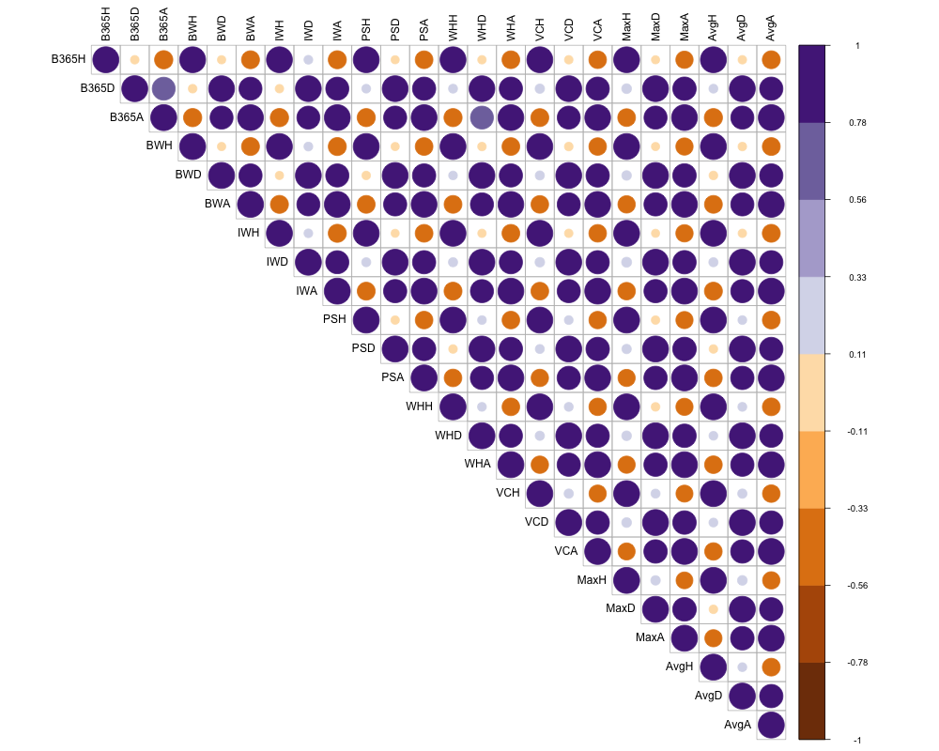
Data Analysis
8 online bookmakers are almost perfectly correlated with each other
Bookmakers aim to set similar odds to minimize their risk and ensure balanced betting
Benchmark predictions
An overall home team advantage with a probability of 42% considering all three seasons
Season | Home Win Prob | Draw Prob | Away Win Prob
2019/2020 | 0.4526 | 0.2421 | 0.3053
2020/2021 | 0.3789 | 0.2184 | 0.4026
2021/2022 | 0.4289 | 0.2316 | 0.3395
Overall | 0.4202 | 0.2307 | 0.3491

Slide 9
Modeling
Data is split into two parts by 20% to 80% ratio to to avoid over fitting
The train data contains the first 912 matches and the rest 228 is included in the test
Models | Predictors
M1 M2 | attendance + attendance flag M1 + home expected goals + away expected goals + home total market values + away total market values + home attack strength + away attack strength + Bet365 odds + time category
Multinomial Logistic Regression
Used for predicting categorical outcomes with more than two categories
Provides interpretable coefficients and can handle multiclass classification problems.
Avoids bias by modeling the relationships that considers all classes simultaneously.

Slide 10
Modeling
Random Forest
Ensemble learning method combining multiple decision trees to make predictions
Less prone to overfitting handling bias by aggregating predictions from multiple trees.
Gradient Boosting Model (GBM)
Boosting algorithm that sequentially builds an ensemble of weak prediction models
Addresses bias by iteratively building models focused on correcting the mistakes of previous models.
Model | Accuracy Train | Accuracy Test
Multinomial Logit | 0.4145 | 0.4386
Random Forest | 0.4178 | 0.4342
GBM | 0.4638 | 0.4956
Multinomial Logit Complex | 0.5866 | 0.6404
Random Forest Complex | 0.6502 | 0.5921
GBM Complex | 0.6656 | 0.5746

Slide 11
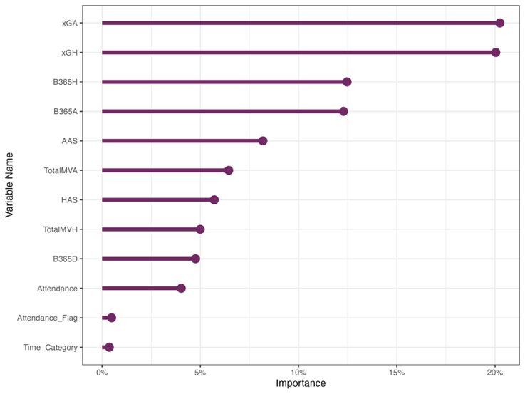
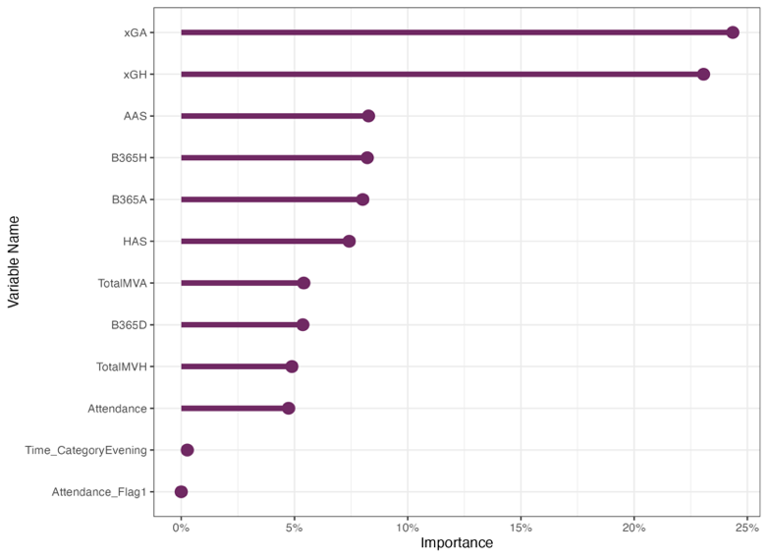
Variable Importance Plots
Predictors xGA and xGH explain more than 40% of model performance
Attacking strength, betting odds, market values, audience attendance, and time of the match also have significant impact.

Slide 12
Predicted Odds
The predicted odds from the model were compared to the odds provided by the B365 bookmaker, showing comparable results for home odds but some discrepancies in the odds for the away team.
Date | HomeTeam | AwayTeam | B365H | B365D | B365A | Home Odds | Draw Odds | Away Odds
11/12/2021 | Chelsea | Leeds | 1.25 | 5.75 | 12 | 1.39 | 7.84 | 6.44
11/12/2021 | Liverpool | Aston Villa | 1.2 | 7 | 13 | 1.22 | 6.8 | 32.16
11/12/2021 | Norwich City | Manchester United | 7 | 4.5 | 1.45 | 7.39 | 5.02 | 1.5
12/12/2021 | Burnley | West Ham | 3.6 | 3.6 | 2 | 3.73 | 2.64 | 2.83
12/12/2021 | Leicester City | Newcastle | 1.66 | 4.1 | 4.75 | 1.27 | 5.58 | 30.58
12/12/2021 | Crystal Palace | Everton | 2.3 | 3.2 | 3.3 | 1.77 | 3.37 | 7.24

Slide 13
Model Limitations
Data quality and processing issues
Time constraint
Influence of unforeseen circumstances and external factors
Limited generalizability to other leagues
Market dynamics and model-bookmaker discrepancies

Slide 14
Recommendations
Leverage Natural Language Processing (NLP) or Fuzzy matching techniques to automate standardization
Include additional data to capture relevant impact of unforeseen circumstances; weather data, injury reports, referee statistics, or other factors that can impact match outcomes.
Conduct comparative analysis to investigate the generalizability of the models to other leagues
Identify league-specific predictors such as team formation, historical performance, or league characteristics.

Slide 15
Conclusion
Developed precise prediction models for English Premier League match outcomes.
Utilized predictors such as expected goals, market values, attack strength, attendance, and betting odds.
Evaluated multinomial logistic regression, random forest, and GBM models.
Multinomial logistic regression achieved the highest accuracy of 64% on the test dataset.
Models offer valuable insights to betting providers for attracting customers and ensuring balanced odds.
Received reasonably comparable odds for home team
Recommended further research and refinement for enhanced accuracy and performance.

Slide 16
Thank You! Questions?

