Slide 1
Employee Risk Attrition Assessment
Proof-of-Concept
BY
ANIBABA AYODEJI TEMILOLUWA

Slide 2
Following data science methodology; 1.Business/Project understanding
We have to answer these questions;
What is the problem we are trying to solve?
What is the goal?
We have to define the goal and objective of the goal.
The problem:- employee attrition problem in CompanyX
The Goal/Objective:- The company wants to understand what factors contributed most to employee turnover, What type of employees are leaving and to determine which employees are prone to leave next.

Slide 3
2. Analytic Approach
What approach can we use to answer the question
Predictive model
Descriptive model
Classification Model
Predictive Model:- determines the probabilities of an approach
Descriptive Model:- shows Relationship within the dataset
Classification Model:- requires a yes or no answer.

Slide 4
3. Data Requirement
What is the kind of data needed?
What is required data needed to consider for data processing and collection
Our data= problemcase.csv

Slide 5
4. Data Collection
There Is a good understanding of what we are working with right now
Importing the dataset
Importing modules for manipulation and visualization
Check to see if there are any missing values in our data set
Check the type of our features
Eliminate Redundant Data after thorough revision have been carried out;

Slide 6
5. Data Understanding
Descriptive statistics are done(Histograms, charts etc.)
Data Quality(Assessing)
There is no missing values in our dataset
All statistical overview has been done.
Renaming certain columns for better readability
The dataset contains 10 columns and 14999 observations
Iterative data collection and understanding
Looks like about 76% of employees stayed and 24% of employees left.

Slide 7
6. Data Preparation
cleansing the data of dirt or imperfection
Transforming the data by getting it into a state that is workable
Convert variables dept and salary into categorical variables
Knowing the who?, what?, when?, where?, how?, and why?.
Formatting and Feature engineering using Machine Learning
Text analysis by paying attention to details in the data
Satisfaction:- There is a huge spike for employees with low satisfaction and high satisfaction.
Evaluation:- There is a bimodal distribution of employees for low evaluations (less than 0.6) and high evaluations (more than 0.8)
AverageMonthlyHours:- There is another bimodal distribution of employees with lower and higher average monthly hours (less than 150 hours & more than 250 hours)
The evaluation and average monthly hour graphs both share a similar distribution.
Employees with lower average monthly hours were evaluated less and vice versa.
If you look back at the correlation matrix, the high correlation between evaluation and AverageMonthlyHours does support this finding.

Slide 8
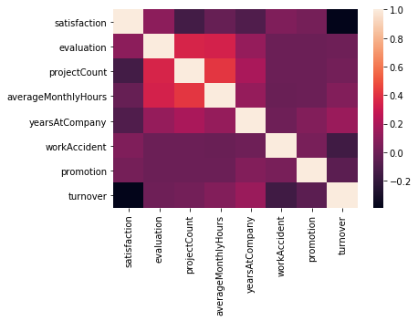
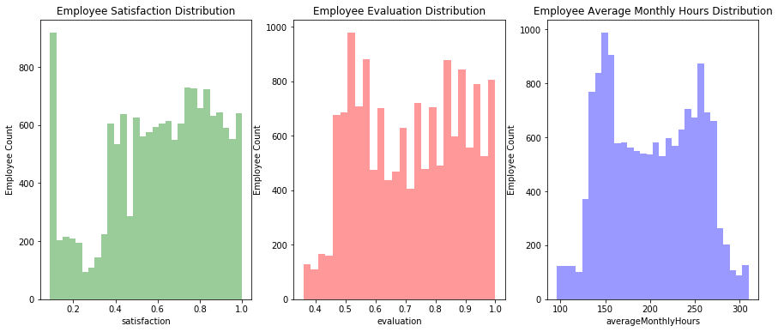
From the heatmap, there is a positive(+) correlation between projectCount, averageMonthlyHours, and evaluation. Which could mean that the employees who spent more hours and did more projects were evaluated highly. For the negative(-) relationships, turnover and satisfaction are highly correlated. I'm assuming that people tend to leave a company more when they are less satisfied.

Slide 9
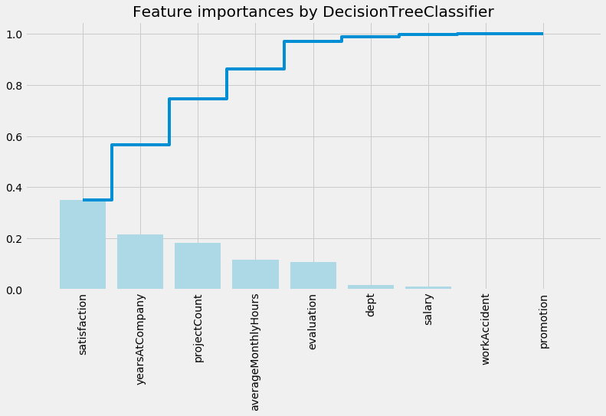
7. Modelling
Sample to check if more data is needed or it is good enough
split dataset into train and test set
Application of models to know the accurate one for the project at hand
Decided on the Decision Tree Model because it had a better Accuracy score compared to logistic regression model
The end goal(well defining solution) will determine the model to use in answering the initial question(problem statement)
We got the important features from this model that are determinants to solving this problem.

Slide 10
8. Evaluation
Iteration with modelling
Assessing the Quality of the model
Does it answer the question or it needs to be adjusted or changed( if logistic regression don’t work we adjust or use decision tree etc.)

Slide 11
By correlations and comparisons done on Tableau and results from python analysis
Employees generally left when they are underworked (less than 150hr/month or 6hr/day)
Employees generally left when they are overworked (more than 250hr/month or 10hr/day)
Employees with either really high or low evaluations should be taken into consideration for high turnover rate
Employees with low to medium salaries are the bulk of employee turnover
Employees that had 2,6, or 7 project count was at risk of leaving the company
Employee satisfaction is the highest indicator for employee turnover.
Employee that had 4 and 5 years at Company should be taken into consideration for high turnover rate
Employee satisfaction, years at Company, and evaluation were the three biggest factors in determining turnover.

Slide 12
9. Deployment
Getting the stakeholders familiar with the used method and tool
Roll out for testing
Maybe develop a training with IT developers

Slide 13
10. Feedback
Feedback from the users of this model(companyX) whether to make adjustments or just refine and forward after a period of time
Real time use
redeployment

Slide 14
THANK YOU

