Slide 1
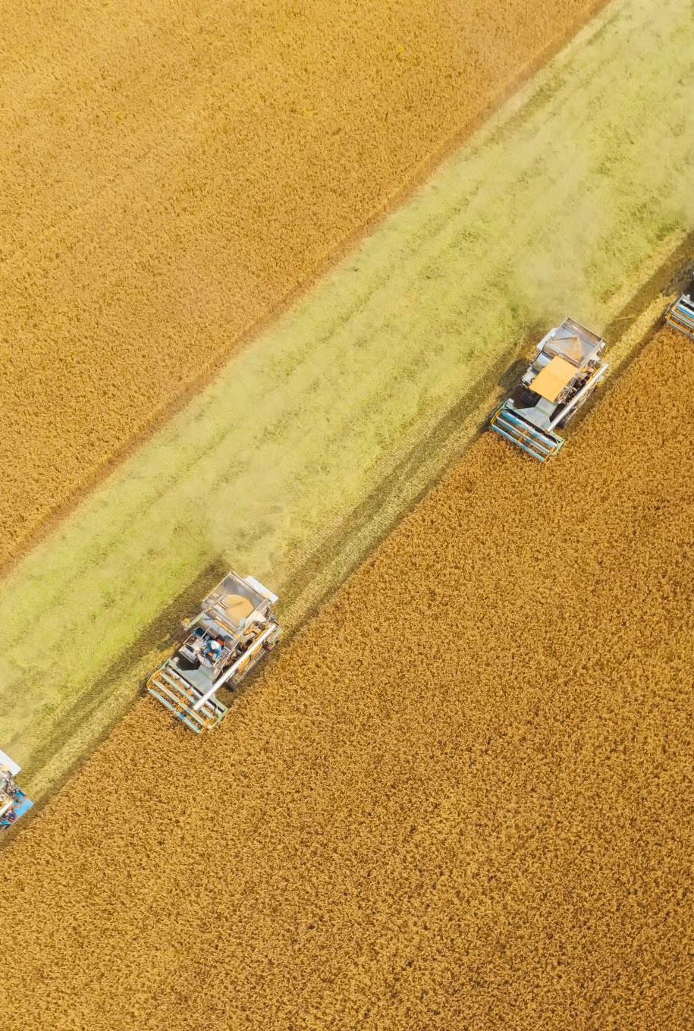
A Multivariate Linear Model for Agricultural Data of Iowa for Corn, Soybeans, and Wheat
By: Ayodeji Williams
Mentor: Dr. Zephyrinus Okonkwo
Department of Mathematics, Computer Science and Physics
Albany State University (ASU)
ASU 2026 Undergraduate Research Symposium
April 17, 2026

Slide 2
Introduction/background
A multivariate linear model is statistical method of prediction that is used to conduct analysis of covariance between multiple dependent variables(outcomes) concurrently as a linear combination of the predictor variables.
Multiple Independent and Dependent Variables
Models a vector of responses capturing the relationships between outcomes of the predictors with the goal of understanding how factors impact multiple outcomes simultaniously.

Slide 3
Intro & background cont’d
A Multivariate Linear Model follows:
Y=Xβ+ε or Y=XB+E
Y is an n x 1 vector of the dependent variables
X is the n x p + 1 matrix that represents the design matrix of the independent variables
Β(beata) is a p + 1 x 1 vector and it is the coefficient or parameters to be estimated
Ε(epsilon) is an n x 1 vector and it is the error terms
Purpose: Allows the compact solving of linear regressions with multiple predictors

Slide 4
Intro Cont’d Solving for predictors
Ordinary Least Squares (OLS)
Top Estimate Coefficients
B=(X^{T}X)⁻¹X^{T}Y
X: Design Matrix
X^{T}: Transpose of the Design Matrix
1 | 1 | 1 | 1 | 1
X11 | X21 | X31 | X41 | X51
X12 | X22 | X32 | X42 | X52
X13 | X23 | X33 | X43 | X53
X14 | X24 | X34 | X44 | X54
1
1
1
1
1
X11 | X12 | X13 | X14
X21 | X22 | X23 | X24
X31 | X32 | X33 | X34
X41 | X42 | X43 | X44
X51 | X52 | X53 | X54
(X^{T}X) Multiplication of both matrices which only exist if there is no multicollinearity (full column rank)
(X^{T}X)⁻¹ The inverse of that matrix

Slide 5
Introduction/Background cont’d Abstract: Application of the Concept
This project investigates the joint relationship between Corn, Soybeans, and wheat yield in Iowa.
Particularly climatic variables such as precipitation, alongside anthropogenic factors like fertilizer(Nitrogen) use
To fill the gaps that already exist in the univariate models.
We took data from the USDA NASS from 2020 to 2025, with a focus on soil quality, considering the covariance between corn, soybeans, and wheat yields.
The model follows the form Y=XB+E
Y is the multi-crop yield matrix,
X as the matrix for environmental predictors
E the error terms associated.

Slide 6
Iowa as an agricultural powerhouse and The “powerful Tag Team” of Corn and Soybean
The “dynamic duo” started off as horse forage crop, and with time became the predominant grain crop because of various historical and biological factors.
Agronomical Synergy: Soybeans are classified as legumes with the natural ability to improve nitrogen in the soil, due to this, corns will require less nitrogen fertilization, which reduces costs for farmers
The rotation of these two crops on a farm provides pest and disease control, resulting in better health for crops and higher yields.
Residue Management: the adaptability of soybeans, they can thrive regardless of the heavy corn residue
They also use the same machinery.

Slide 7
Corn & soybean cont’d yield from 2020-2025 (Six-Year period)

Slide 8
Wheat production in iowa
In search of data, we found that the production of Wheat has decreased and is practically non-existent in Iowa. The latest data on USDA NASS was in 2018.
Farmers in Iowa were surveyed in the Iowa Farm and Rural life Poll in 2025 (Gordon Arbuckle Jr., 2025)
The survey revealed the financial challenges that farmers face that causes this crop production dynamic (Corn & Soybeans)
“Rising input cost and profit margins”, input costs like seed and chemicals tends to increase when “profit margins are higher” 88% of them agreed that these profit margins on corn and soybeans are lost to land rent and input costs, therefore “underscoring persistent financial pressures in row crop production.”
Uncertainty and Risk in the economy, 85% of famers agreed or strongly agreed that “the boom-bust cycles of commodity production are hard on farmers”
69% feel sometimes like they have minimal control over profitability,
67% agreed that heavy reliance on the financial risk of the heavy reliance on corn and soybeans,
60% felt “overly dependent on purchased inputs.”
To conduct our analysis and model the data regardless of the lack of recent data, we used the most recent six-year time period which is from 2013-2018

Slide 9
Six Year time Series of wheat yields in iowa 2013-2018

Slide 10
Note
It is important to note that, there is a multitude of missing data, we try our best to conduct our analysis, data modeling and prediction with the best information available.

Slide 11
Variable in our model
X₁(Precipitation): Total Rainfall Critical Window (April-August)
X₂(Temperature): Average daytime temperature of “Growing Degree Days”
X₃(Nitrogen Fertilizer): Total pounds applied per acare in Iowa

Slide 12
Precipitaion Data in relation to corn & Soybeans

Slide 13
Temperature data in relation Corn & Soybeans

Slide 14
Nitrogen (Fertilizer) use for corn & soybeans

Slide 15
Quick Note
Due to missing data
Wheat yield data for the Iowa in the following slides was estimated using regional Soft Red Winter
Wheat averages from USDA NASS Small Grains Summaries, as state-level data for Iowa is
frequently suppressed due to low harvested acreage.
The "Regional Representative" Proxy: The Soft Red Winter Wheat (SRW) average for the "Corn Belt" region.

Slide 16
The outcome(Multi-Crop yield) Matrix (Y) 2020-2025
Corn(Y_{C})
Soybean(Y_{S})
Wheat(Y_{W})
54 | 231 | 19
63 | 267 | 49
58.5 | 258.5 | 52
58 | 259 | 63
60 | 271 | 68
63.5 | 273.5 | 58

Slide 17
Predictor Matrix (environmental predictors) (x) 2020-2025
Precipitation (X_{P})
Temperature (X_{T})
Nitrogen (X_{N})
49.2 | 28.92 | 131
50 | 31.06 | 146
47.5 | 27.25 | 124
50.6 | 26.82 | 134
51.5 | 36.95 | 140
49.7 | 33.59 | 172
6x3
Due to Soybeans not requiring nitrogen(therefore=0) and the lack of data for wheat (N/A) within that time period, we will use only the nitrogen data for corn.

Slide 18
Computing Y: The revenue 2020-2025
Corn(Y_{C})
Soybean(Y_{S})
Wheat(Y_{W})
Revenue
54 | 231 | 19
63 | 267 | 49
58.5 | 258.5 | 52
58 | 259 | 63
60 | 271 | 68
63.5 | 273.5 | 58
1369.72
2402.77
2564.01
2217.46
Y=
Prices
$3.81 | $11.1 | $5.05 | $3.81
$5.9 | $13.1 | $7.63 | $5.9
$6.4 | $14.1 | $8.83 | $6.4
$5.5 | $12 | $6.96 | $5.5
$5.5 | $10 | $6.72 | $5.5
$4.3 | $10.5 | $5.1 | $4.3

Slide 19
Finding B (Coefficients) B=(X^{T}X)⁻¹X^{t}y
1 | 1 | 1 | 1 | 1 | 1
49.2 | 50 | 47.5 | 50.6 | 51.5 | 49.7
28.92 | 31.06 | 27.25 | 26.82 | 36.95 | 33.59
131 | 146 | 124 | 134 | 140 | 172
X^{T}=
Multiplied
49.2 | 28.92 | 131
50 | 31.06 | 146
47.5 | 27.25 | 124
50.6 | 26.82 | 134
51.5 | 36.95 | 140
49.7 | 33.59 | 172
6 | 298.5 | 184.59 | 847
298.5 | 14859.59 | 9199.679 | 42174
184.59 | 9199.679 | 5756.556 | 26246.64
847 | 42174 | 26246.64 | 120993
1
1
1
1
1
1
(X^{T}X)=
X=
345.8576 | -7.55298 | 1.43352 | -0.0994
-7.55298 | 0.17343 | -0.03818 | 0.000705
1.43352 | -0.03818 | 0.027396 | -0.00267
-0.0994 | 0.000705 | -0.00267 | 0.001038
(X^{T}X)⁻¹=

Slide 20
Finding B (Coefficients) Cont’d B=(X^{T}X)⁻¹X^{t}y
345.8576 | -7.55298 | 1.43352 | -0.0994
-7.55298 | 0.17343 | -0.03818 | 0.000705
1.43352 | -0.03818 | 0.027396 | -0.00267
-0.0994 | 0.000705 | -0.00267 | 0.001038
(X^{T}X)⁻¹=
2.68655 | -1.77913 | 13.82846 | -11.1962
-0.03211 | 0.0355 | -0.26811 | 0.292985
-0.0024 | -0.01437 | 0.035443 | -0.12139
-0.00601 | 0.004404 | -0.01001 | 0.003695
Multiply
(X^{T}X)⁻¹X^{T}=
1 | 1 | 1 | 1 | 1 | 1
49.2 | 50 | 47.5 | 50.6 | 51.5 | 49.7
28.92 | 31.06 | 27.25 | 26.82 | 36.95 | 33.59
131 | 146 | 124 | 134 | 140 | 172
X^{T}=

Slide 21
Finding B (Coefficients) Cont’d B=(X^{T}X)⁻¹X^{t}y
2.68655 | -1.77913 | 13.82846 | -11.1962
-0.03211 | 0.0355 | -0.26811 | 0.292985
-0.0024 | -0.01437 | 0.035443 | -0.12139
-0.00601 | 0.004404 | -0.01001 | 0.003695
(X^{T}X)⁻¹X^{T}=
Multiply
1369.72
2402.77
2564.01
2239.98
2217.46
1865.55
3612.275
-19.1548
9.985724
-6.06813
Y =
(X^{T}X)⁻¹X^{T}Y=

Slide 22
The coefficient B
B=3612.275-19.1548X₁+9.985724X₂-6.06813X₃
Point of Intersection

Slide 23
Finding E The Error
E = Y – Ŷ
Y: Actual
Ŷ : Predicted
Soybeans
Y Ŷ E
Corn
Y Ŷ E
Wheat
Y Ŷ E
-2577.689481
-2426.66476
-2612.17923
-2589.690231
-2358.230219
-2211.435914
231 | 2754.6895
267 | 2630.6648
258.5 | 2812.1792
259 | 2790.6902
271 | 2569.2302
273.5 | 2421.4359
-2700.689
-2567.665
-2753.679
-2732.69
-2509.23
-2357.936
19 | 2754.6895
49 | 2630.6648
52 | 2812.1792
63 | 2790.6902
68 | 2569.2302
58 | 2421.4359
-2735.6895
-2581.6648
-2760.1792
-2727.6902
-2501.2302
-2363.4359
54 | 2754.6895
63 | 2630.6648
58.5 | 2812.1792
58 | 2790.6902
60 | 2569.2302
63.5 | 2421.4359

Slide 24
Error Matrix
-2577.689481 | -2700.689 | -2735.6895
-2426.66476 | -2567.665 | -2581.6648
-2612.17923 | -2753.679 | -2760.1792
-2589.690231 | -2732.69 | -2727.6902
-2358.230219 | -2509.23 | -2501.2302
-2211.435914 | -2357.936 | -2363.4359
E=

Slide 25
Our Model Y=XB+E
2754.6895 | -2700.689 | -2735.6895
2630.6648 | -2567.665 | -2581.6648
2812.1792 | -2753.679 | -2760.1792
2790.6902 | -2732.69 | -2727.6902
2569.2302 | -2509.23 | -2501.2302
2421.4359 | -2357.936 | -2363.4359
49.2 | 28.92 | 131
50 | 31.06 | 146
47.5 | 27.25 | 124
50.6 | 26.82 | 134
51.5 | 36.95 | 140
49.7 | 33.59 | 172
3612.275
-19.1548
9.985724
-6.06813
1
1
1
1
1
1
Y=
+

Slide 26
Error covariance analysis
Conclusion of Error
We see that the error is intense, the predicted far exceeded the actual(yield)
This can lead us to conclude that, the three variables or predictors (precipitation, temperature, and nitrogen) should in theory positively influence yield.

Slide 27
Conclusion: The reality of the matter The lurking (confounding) variables
As mentioned previously, the survey reveals that there are financial and economical reasons that affects the yield of these crops, these are the lurking or confounding variables.
They caused distortion in the data.
The environmental factors alone does not determine the yield of crops

Slide 28
References
Alexopoulos, E. C. (2010). Introduction to multivariate regression analysis. Hippokratia,14(Suppl 1), 23–28. https://pmc.ncbi.nlm.nih.gov/articles/PMC3049417/
Birchmier, K. (2026, March 29). Why corn and soybeans form a powerful tag team. Farm Progress. https://www.farmprogress.com/crops/why-corn-and-soybeans-form-a-powerful-tag-team
Orngard, S. (2023, October 23). A wealth of winter wheat. Practical Farmers of Iowa. https://practicalfarmers.org/2023/10/a-wealth-of-winter-wheat/
White, J. (2026, April 8). Diversifying the Corn Belt - Brownfield Ag News. Brownfield Ag News. https://www.brownfieldagnews.com/news/diversifying-the-corn-belt/
Gordon Arbuckle Jr., J. (2025). Farmers Challenged by Persistent “Cost-Price Squeeze” Dynamics. News. https://www.extension.iastate.edu/news/farmers-challenged-persistent-cost-price-squeeze-dynamics

Slide 29
Acknowledgments
Center for Transformational Student Experiences (CTSE)
Dr. Zephyrinus Okonkwo, Department of Mathematics, Computer Science and Physics

Slide 30
Questions?

Slide 31
The End

