Slide 1


Data Storage
Databases II (COMPSCI 4411/9538)
Instructor: Mostafa Milani
Progress Update

Slide 2
Adaptive Confidence Based Prototype Aggregation for Federated Prototype Learning on Non-IID Data

Slide 3
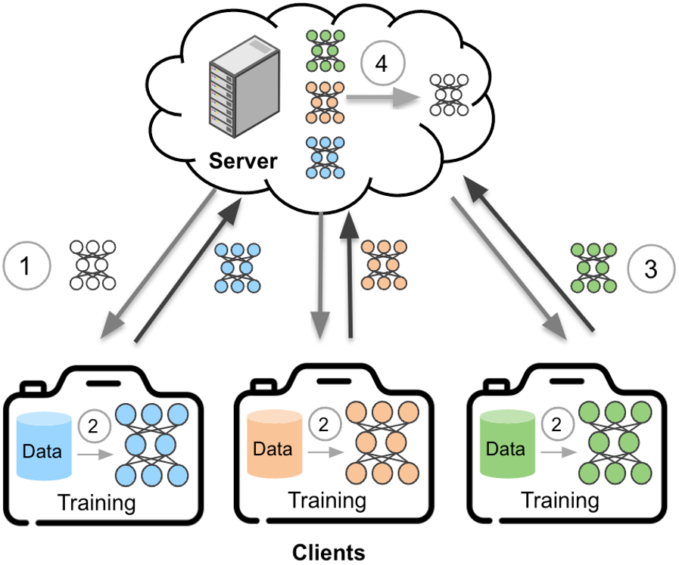
Introduction
Federated Learning Overview:
A distributed learning paradigm that enables clients to collaboratively train a global model while keeping data local.
Challenges in FL:
Client datasets often vary in distribution.
This leads to biased updates, slower convergence, and reduced accuracy.
Model heterogeneity
Global model will not generalize well for all local distribution
Source: https://ai.sony/blog/Recent-Breakthroughs-Tackle-Challenges-in-Federated-Learning/
https://ai.sony/blog/Recent-Breakthroughs-Tackle-Challenges-in-Federated-Learning/

Slide 4
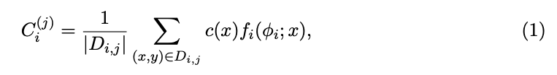
Prototype Learning in FL
Concept:
Uses class prototypes (mean embeddings) to represent data distributions in each client.
These prototypes act as representatives of each class, capturing the essential features of the local data.

Slide 5
Prototype Learning in FL
Advantages:
Prototypes help generalize better to unseen data.
Prototypes enable robust communication between clients and server without requiring model gradients.

Slide 6
Related works
[1] FedAvg(Federated Averaging)
Introduced to aggregate gradients across clients.
Poor performance on Non-IID data.
Does not consider the quality or reliability of updates.
[2] FedProto (Federated Prototype Learning)
Uses prototypes for each class to reduce communication costs.
Treats all prototypes equally, without accounting for reliability or confidence.
[3] FedProc: Prototypical Contrastive Federated Learning on Non-IID data
FedProc combines prototypical learning with a contrastive learning objective to enhance prototype quality.
Treats all prototypes equally, without accounting for reliability or confidence.
[1] McMahan et al., “Communication-Efficient Learning of Deep Networks from Decentralized Data,” AISTATS, 2017.
[2] Tan et al., "FedProto: Federated Prototype Learning Across Heterogeneous Clients," NeurIPS Workshop, 2021.
[3] Zhang et al., “FedProc: Prototypical Contrastive Federated Learning on Non-IID Data,” CIKM, 2022.

Slide 7
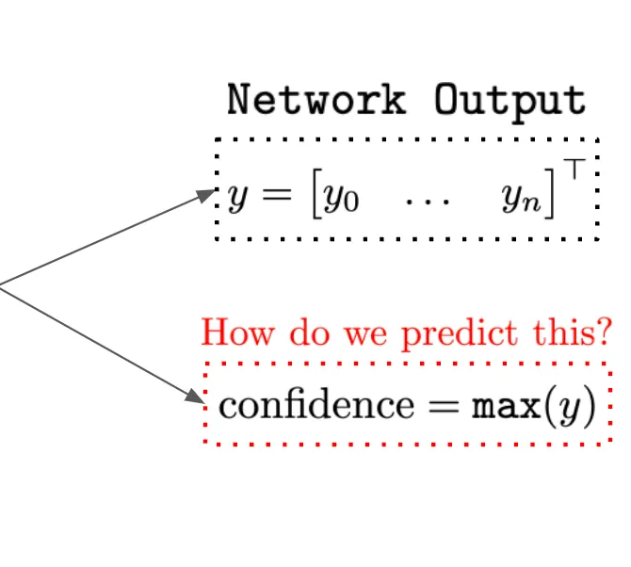
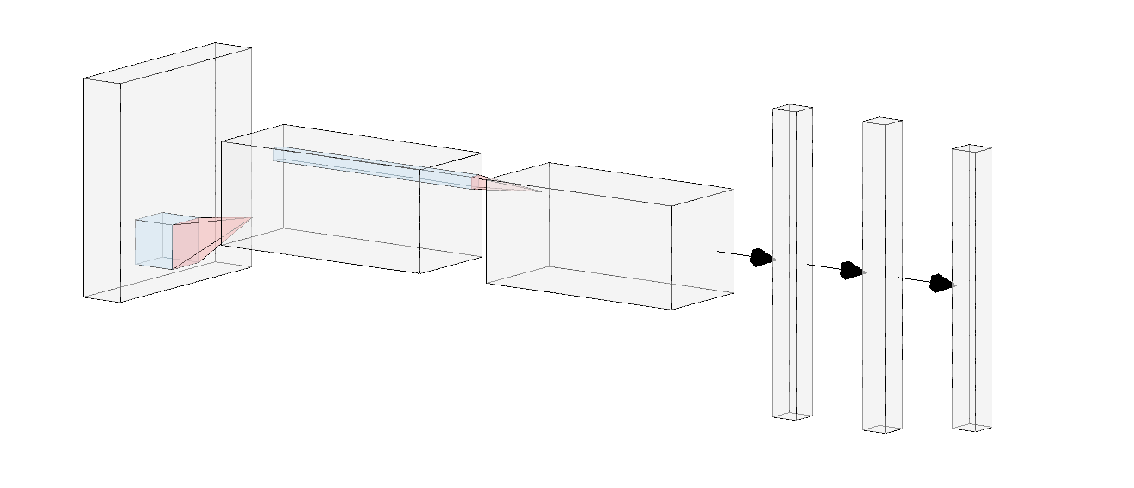

Confidence based prototype learning
Key idea
The quality and reliability of local prototypes vary across clients due to local data distributions.
Model Confidence as a Metric:
Confidence scores measure the reliability of predictions, ensuring that higher-quality prototypes have a greater influence on global updates.
Embedding
Embedding layers
Decision layers
Notes:
\

Slide 8
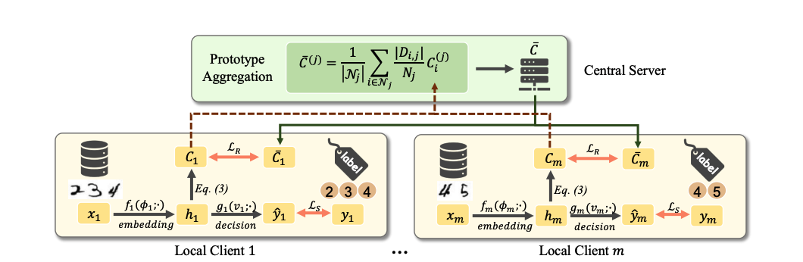


Proposed Approach - confFedproto
https://arxiv.org/abs/2105.00243

Slide 9
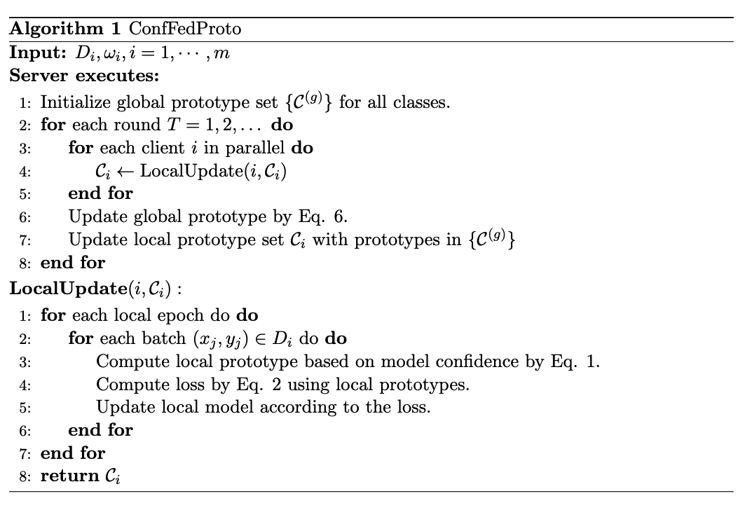
ConfFedproto Algorithm

Slide 10
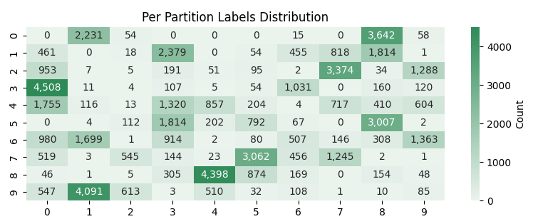
Methodology
Datasets used:
MNIST - CIFAR-10 - EMNIST
Non-iid data generation
Class label
clients
CIFAR 10 non-iid distribution; with Dirichlet(α=0.3)

Slide 11
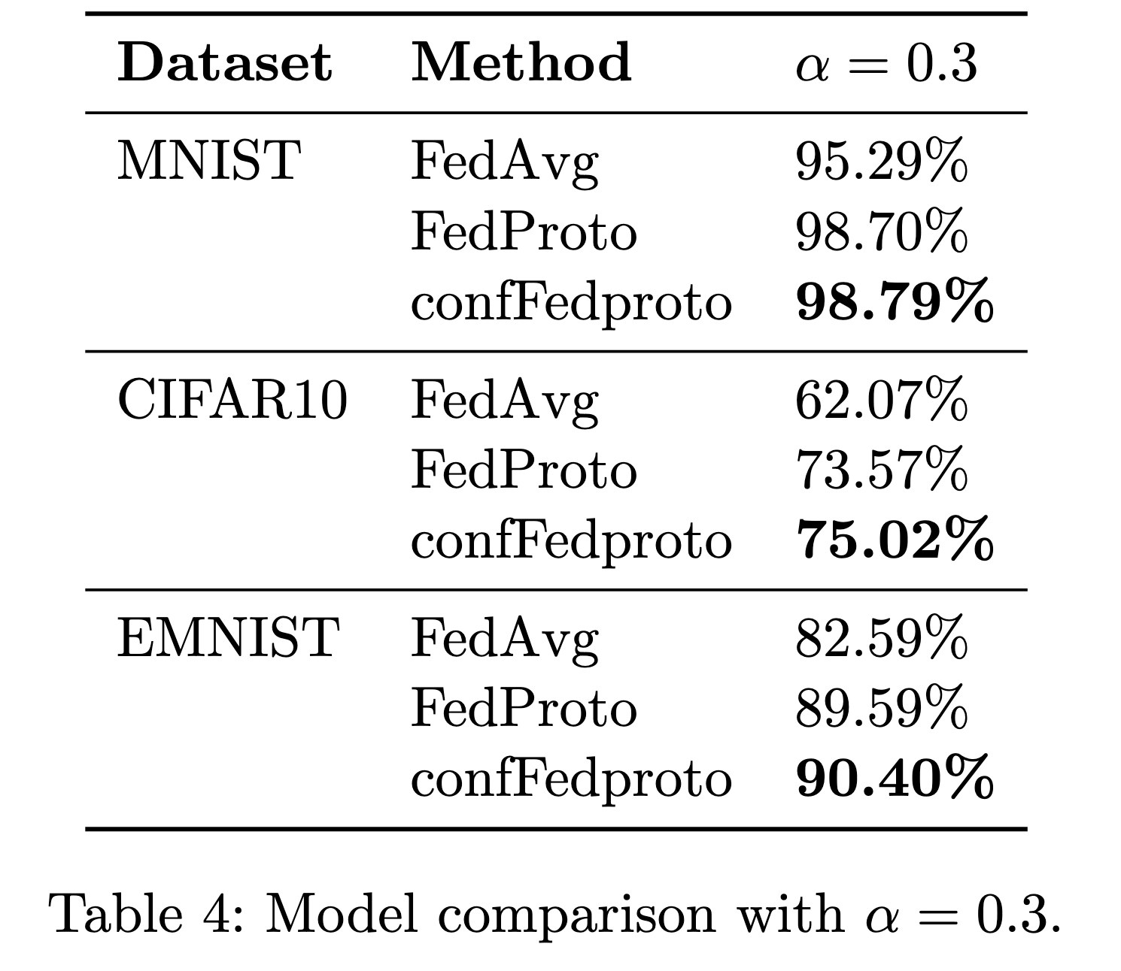
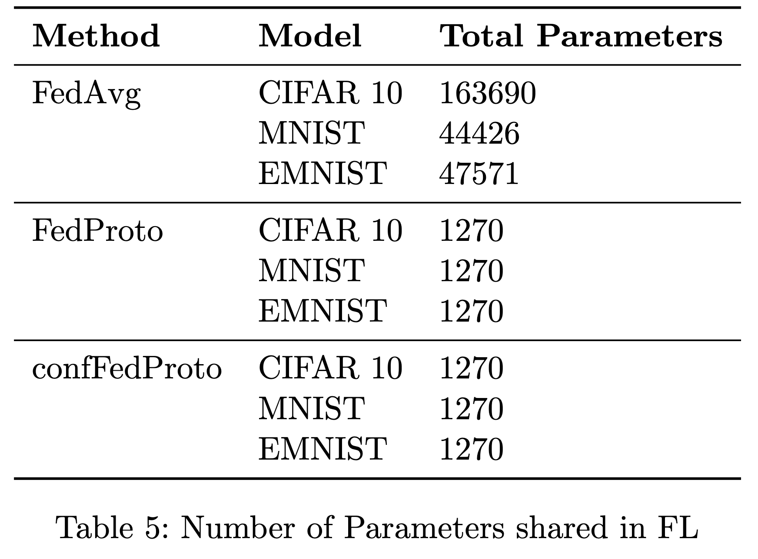
Results

Slide 12
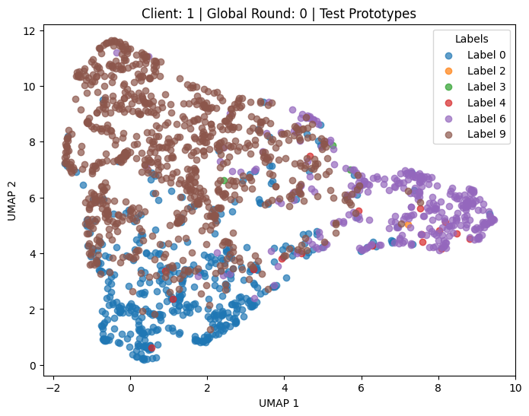
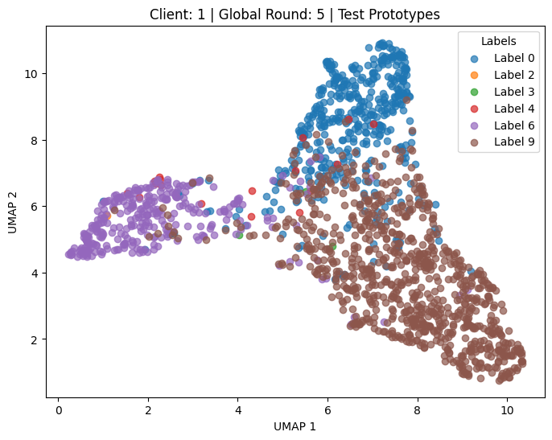
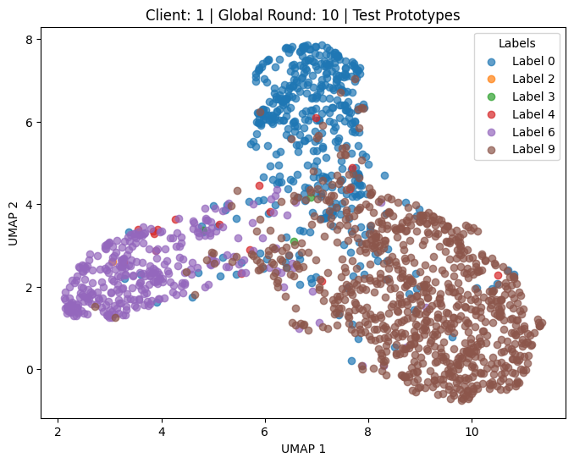
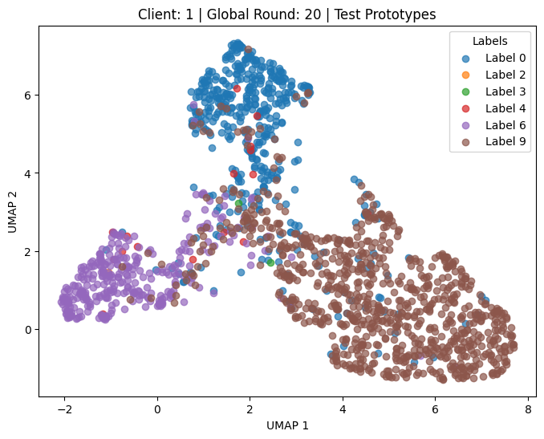
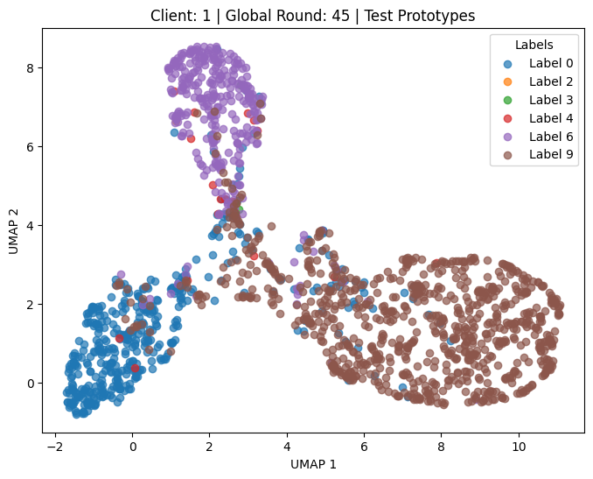
Prototype Visualization

Slide 13
Future Works
Enhance scalability for larger datasets and more clients.
More experiment with different Dirichlet - α parameters

