Slide 1
SignalR
Alexander Yonchev

Slide 2
What problem is SignalR solving?

Slide 3
Connection types

Slide 4
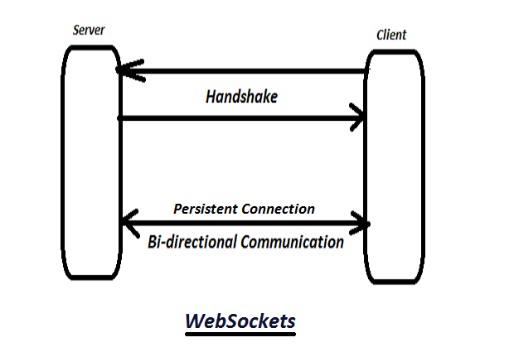
WebSockets

Slide 5
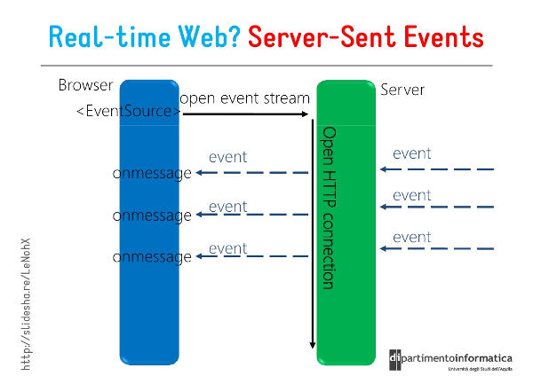
Server-Sent Events

Slide 6
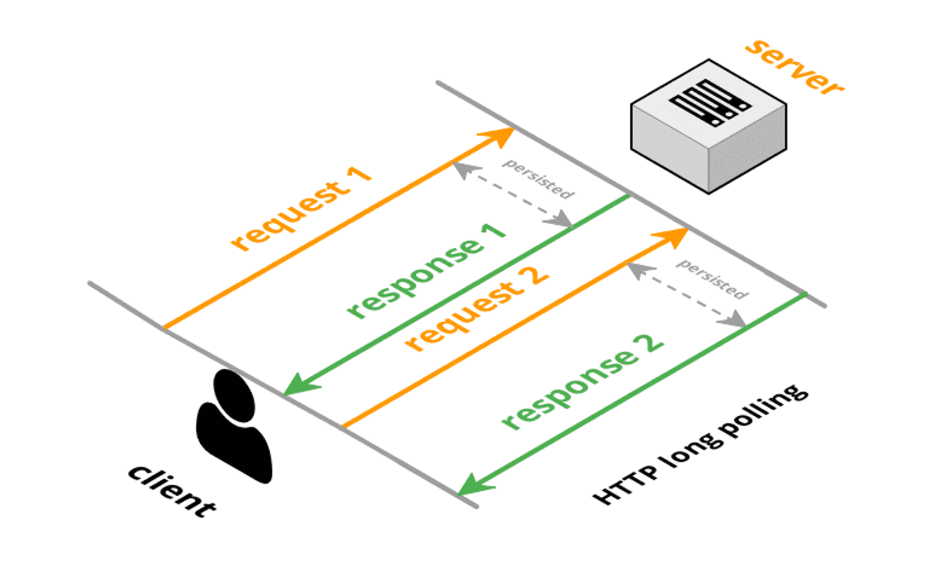
Long Polling

Slide 7
Demo - Modern Chat

Slide 8
Core features
Starting the connection
Events on the server
Events on the client
Notifying all clients
Notifying groups
Notifying users
Strongly typed hubs
Authorization
Hub life cycle events

Slide 9
Thank you for your time!

