Slide 1
Check In Easy
Presenter - Ayon Kar
Top picks for you

Slide 2
The app will allow the users to search for events happening nearby and book tickets for those events for an incredible engaging
User can sign up and sign in to create, search and book events
User will be able to search for events randomly
User will be able to search for events based on category
User will be able to book tickets for those events
User can look for direction from current location to event location using MapKit
Use of Auto Layout to make it responsive for all iOS devices
Used Eventbrite APIs to fetch the data and show it to the user
Database : CoreData

Slide 3

Home Screen

Slide 4

Event Detail Screen

Slide 5
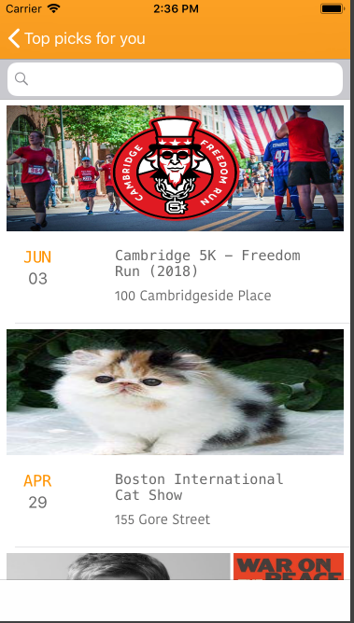
Search Screen

Slide 6
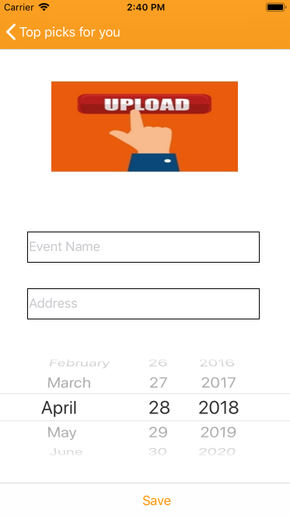
Create Event

Slide 7
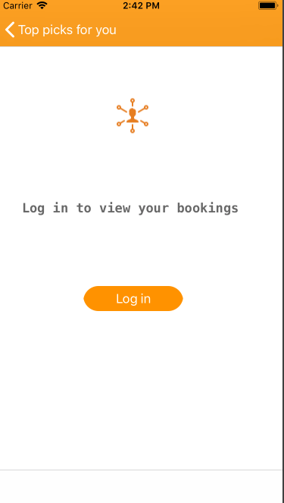
Without Login you cannot create/book event

Slide 8
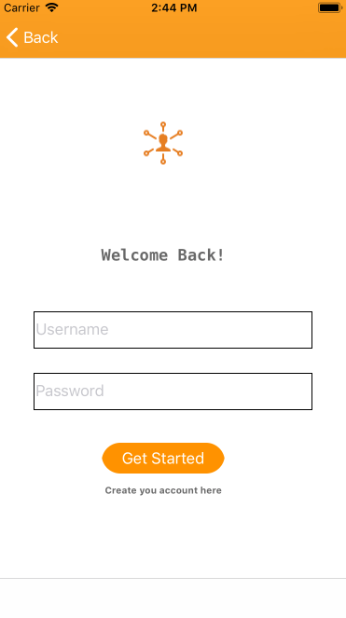
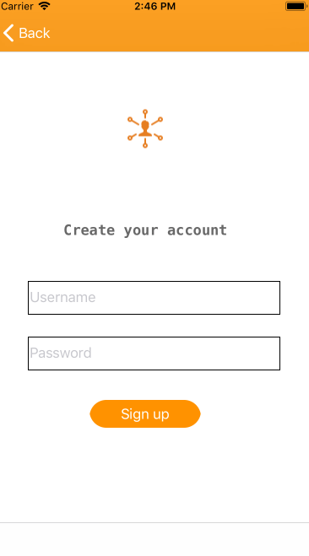
Sign In screen
Sign Up screen

Slide 9
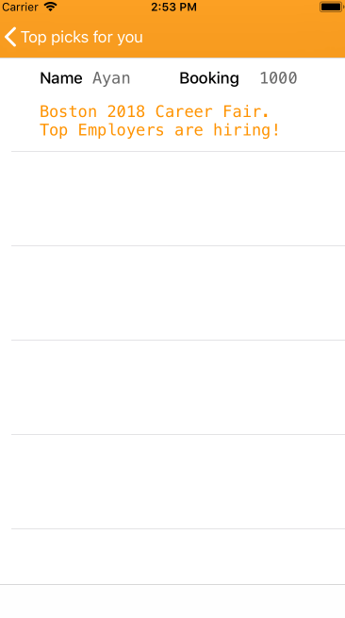
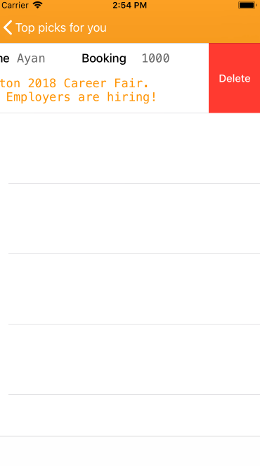
Booking Screen
Delete Booking Screen

Slide 10
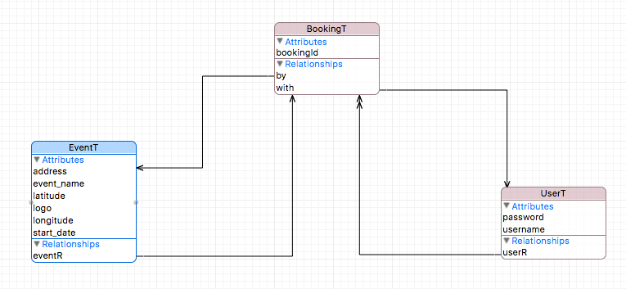
Object Model

