Slide 1
Storyboard of ‘Terra Trek’

Slide 2
Agenda:
Review of apps
Our user profile
Targets
Results
Goal
Company Retract

Slide 3

“Terra Trek“ Helps and procceses us to make a good trip.For those we connected An agent and customer each other. Our motto, ”Travelling is pleasant.”

Slide 4
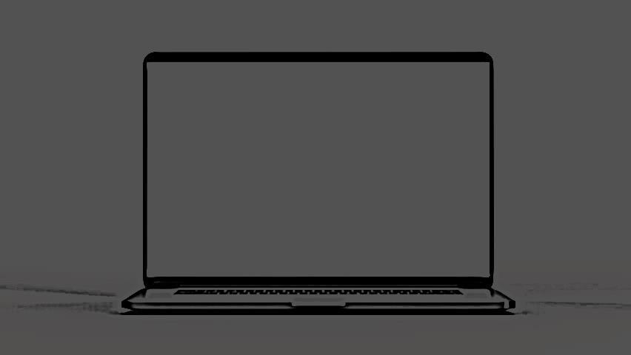
User profile:
1.Two types of user profile will have been created;
Agent
Tourist
Agent
Tourist

Slide 5
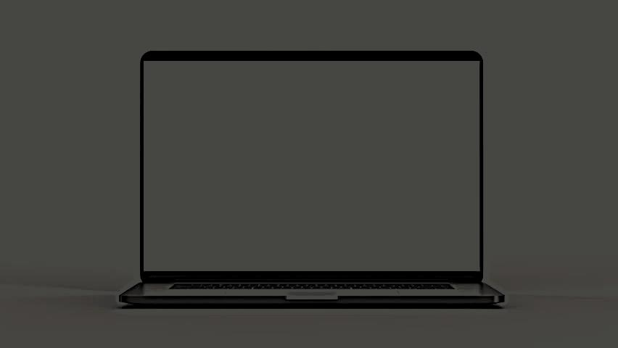
Targets: We serve the best of ours to make a good trip. And also make a good communication medium of agent and tourist.
Agent
Tourist

Slide 6
Result:
Then , it will be more affective to found the guideline of tour.
Agent can find their clients
Tourist can easily find the place
They will be knowing and understanding the whole system of travelling service.
Tourist can make a budget trip.
They can take their whole travel story by an album.
They will get a good guideline to make their trip good .

Slide 7


Our pleasure is tourist satisfaction.
By giving Security By giving disciplined service By giving the information&pre-structure

Slide 8
Company Retraction:
1. For security system must be represent the identity. 2.Impact of any natural crisis pandemic our system possibly can off. 3.In there no payment or dealing issue with the company.Its verify to agent and tourist.

