Slide 1
Home Page

Slide 2
Home
Profile
Poll
Announcements
Tournament
Drawer

Slide 3
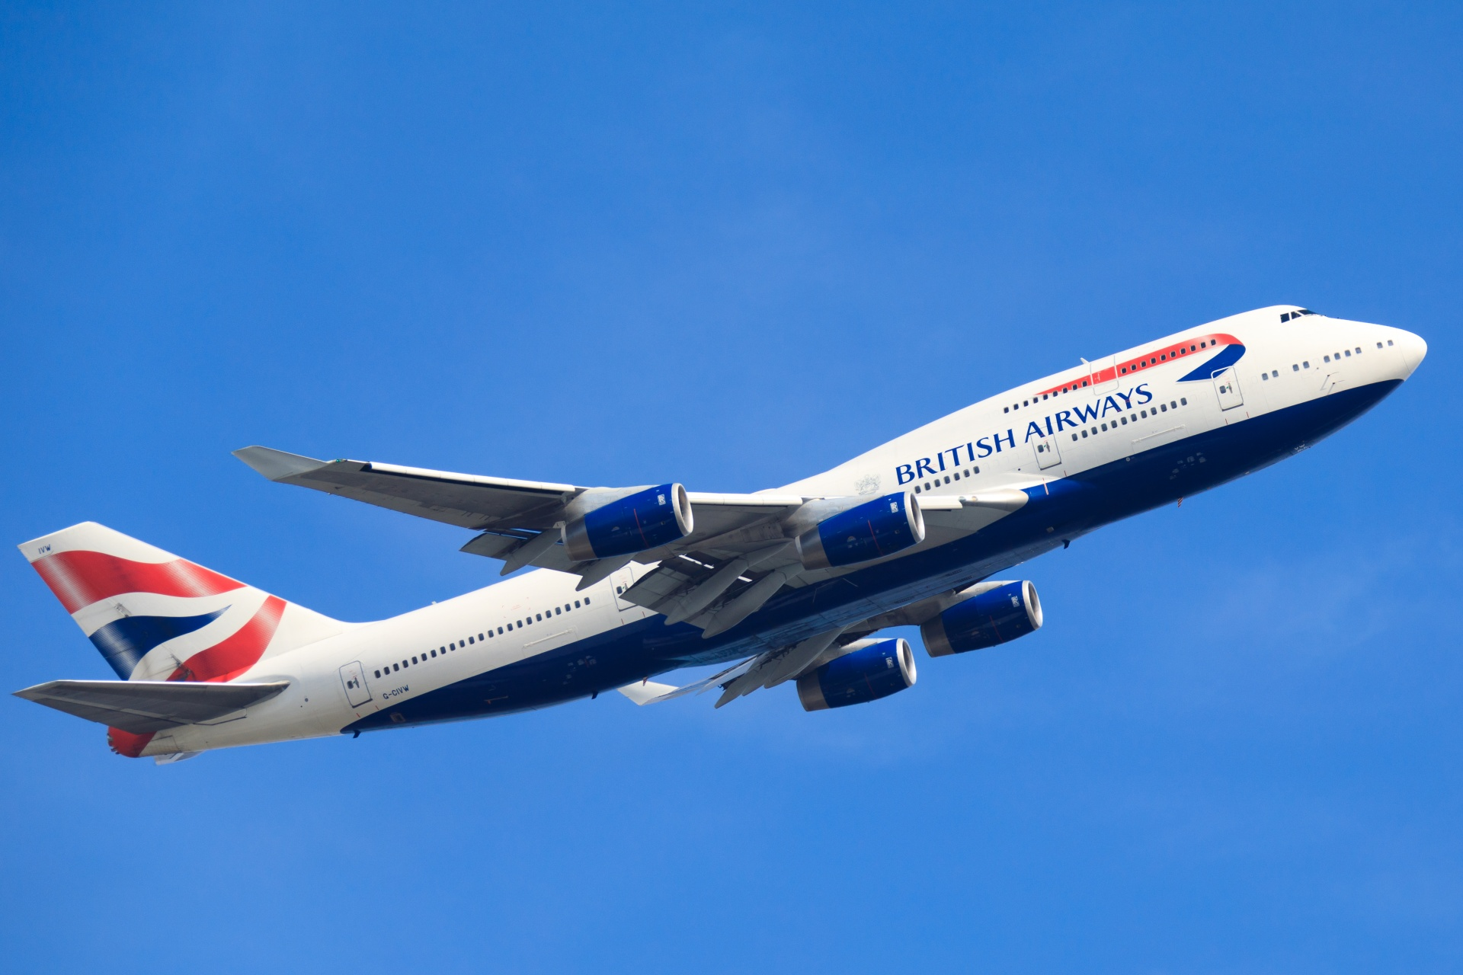
Practice matches of tournament in announcements section
Players inside main drawer menu as playera always play
Images
Fixture
Players
Rules
Teams
Score
Tournament Page(Scrollable)

Slide 4
Practice matches of tournament in announcements section
Players inside main drawer menu as playera always play
Images
Fixture
Players
Rules
Teams
Score
Tournament Page(Scrollable)

Slide 5
League Day 1
Sami
Sohel
Shajal
Zahed
Nafis
Rashed
Rezwan
Shahin
Practice matches of tournament in announcements section
Moinul
Mona
Mashu
Rupom
Manar
Omar
Polin
Munna
League Day 1, ASC, 425 Woodward St | League Day 1, ASC, 425 Woodward St
CVB1 | Sohel v Shajal | 9 am - 9:25 am
CVB1 | Sohel v Shajal | 9 am - 9:25 am
CVB1 | Sohel v Shajal | 9 am - 9:25 am
CVB1 | Sohel v Shajal | 9 am - 9:25 am
CVB1 | Sohel v Shajal | 9 am - 9:25 am
Images
Fixture
Players
Rules
Teams
Score
Tournament Page(Scrollable)

Slide 6

Practice matches of tournament in announcements section
Ayon
Ayon
Ayon
Ayon
Ayon
Ayon
Ayon
Ayon
Images
Fixture
Players
Rules
Teams
Score
Tournament Page(Scrollable)

Slide 7
2022 Austin-Bangladeshi Volleyball Tournament Rules
The rules of play for the tournament will be governed by the following: Players will participate in the tournament in the spirit of sportsmanship and will conduct themselves in the best manner possible.
Communication:
Games will be refereed by volunteer and/or paid tournament officials. All calls by the officials are final. No arguing. It’s for fun! In no circumstances, players are allowed to taunt, abuse, or hit the referees of the game. Such player(s) will be immediately thrown out of the game.
Draft:
1. Each captain will rank the other 15 captains (except himself) starting from Rank 1 (most skillful), 2,3, …,15 (least skillful). An average ranking will develop for each captain out of the ranking numbers assigned. The lowest average number will be the No. 1 captain and highest average number will be the No. 16 captain. The
Practice matches of tournament in announcements section
Ayon
Ayon
Images
Fixture
Players
Rules
Teams
Score
Tournament Page(Scrollable)

Slide 8
Practice matches of tournament in announcements section
Ayon
Ayon
Only headshots in team pictures. If click on images, go to profile.
Ayon
Ayon
Ayon
Ayon
Ayon
Ayon
Images
Fixture
Players
Rules
Teams
Score
Tournament Page(Scrollable)

Slide 9
League Games Day 1
Group 1 Games
ASC Woodward, Saturday, 10/29: Winning Game Point: 1, Losing Game Point: 0
Sami | 25-23 | Shajal
Sami | 25-23 | Shajal
Sami | 25-23 | Shajal
Sami | 25-23 | Shajal
Practice matches of tournament in announcements section
Group 2 Games
ASC Woodward, Saturday, 10/29: Winning Game Point: 1, Losing Game Point: 0
Sami | 25-23 | Shajal
Sami | 25-23 | Shajal
Sami | 25-23 | Shajal
Sami | 25-23 | Shajal
Ayon
Ayon
Images
Fixture
Players
Rules
Teams
Score
Tournament Page(Scrollable)

