Slide 1

Multivariate Disease Progression Modelling with Longitudinal Ordinal Data
St John’s Research Institute : Journal Club
Pierre-Emmanuel Poulet, Stanley Durrleman
Division of Biostatistics and Epidemiology

Slide 2
Contents
Introduction
Disease progression models
Challenges
Goal
Related work
Method
Generic frame-work
Logistic curves model
Ordinal model
Estimation
Data Analysis
Simulation study
Application to Parkinson’s disease data

Slide 3
Introduction
Disease progression models are statistical models that describe and predict disease progression at the population or individual level.
Disease progresses on average
Forecast Progression
Range of disease trajectories across patients
Stratify Patients

Slide 4
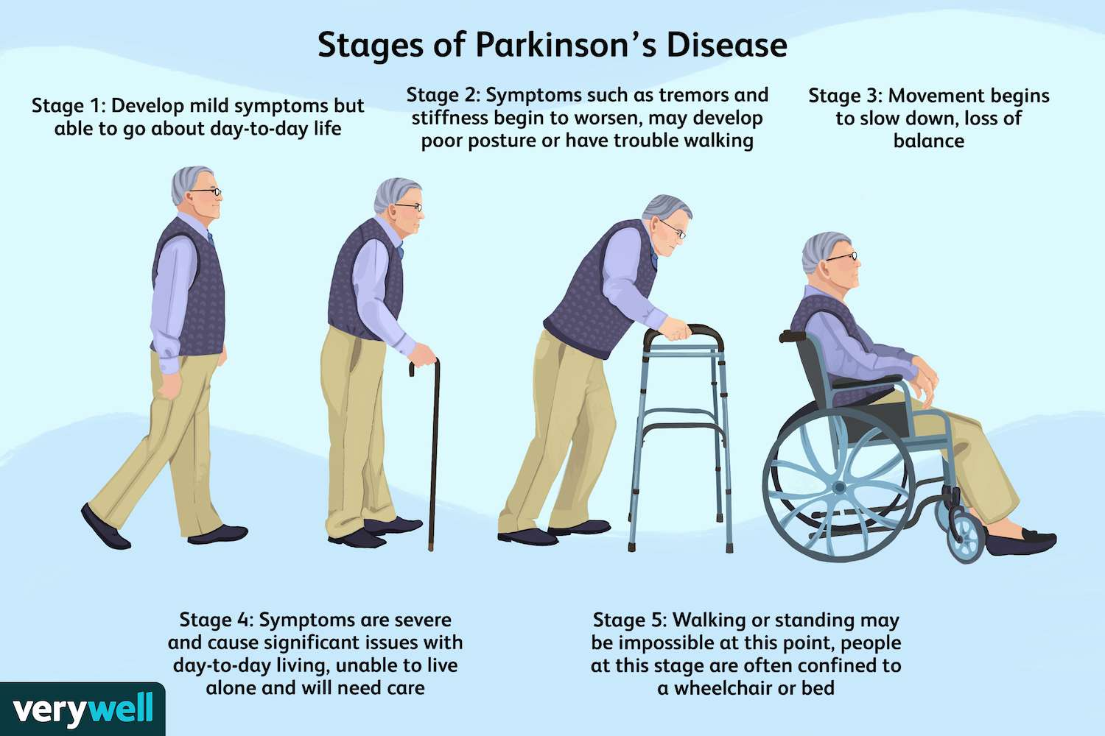
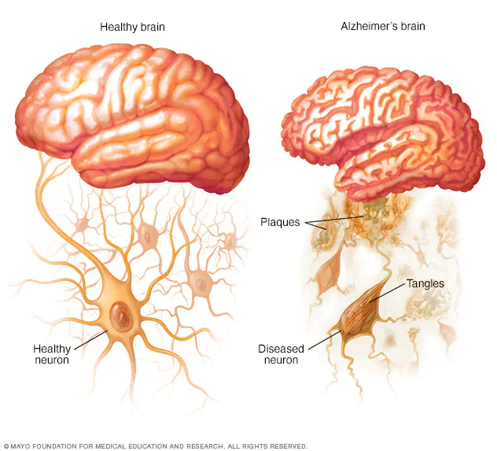
Challenges
Disease modeling should link a patient's age at diagnosis with a specific disease stage on a normalized timeline.
Aggregated scores with time warp functions for Alzheimer’s or Parkinson’s (ADA-scale, The Movement Disorder Society-Sponsored Revision of the Unified Parkinson's Disease Rating Scale (MDS-UPDRS) )
Trade off between interpretability and flexibility

Slide 5
Goal
Disease course mapping (DCM) is a disease modelling technique disentangles two sources of variability in a longitudinal data
Changes in the dynamics of the disease progression
Varying values for each item at a given disease stage
Extend the approach to binary or categorical variables
Disease timeline
Multivariate
Inter-patient variability (individual parameters)

Slide 6
Related work
Models | Disadvantages
SuStaIn (Subtype and Stage Inference) | Not multivariate
Linear mixed effect model | Diseases are mostly non-linear
Non linear mixed effect model | Multivariate extensions are very diverse Fine grained models based on imaging Dynamical models relying on differential equations
Disease course mapping (geometric mixed effect framework) | Continuous variables
IRT models for longitudinal data | Very few latent parameters (1 per individual)
Multidimensional IRT models for longitudinal data | Have not been applied to disease progression modelling

Slide 7
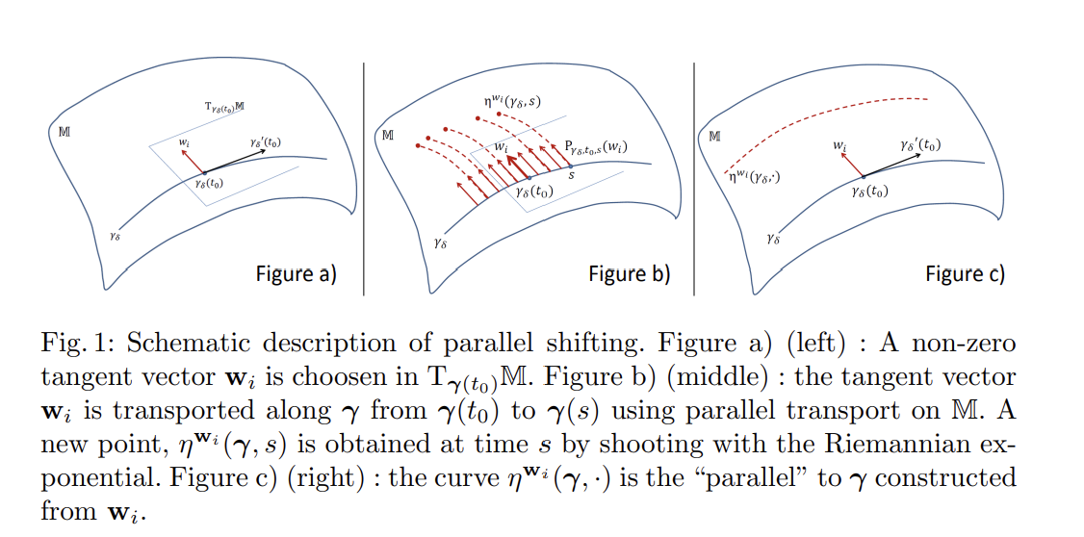
Method
The model discussed here is a disease course mapping model based on a geometric mixed-effect framework.
Geometric models constitute a flexible approach to describe complex non-linear multidimensional data while providing interpretable parameters, which is crucial for clinical acceptation.

Slide 8
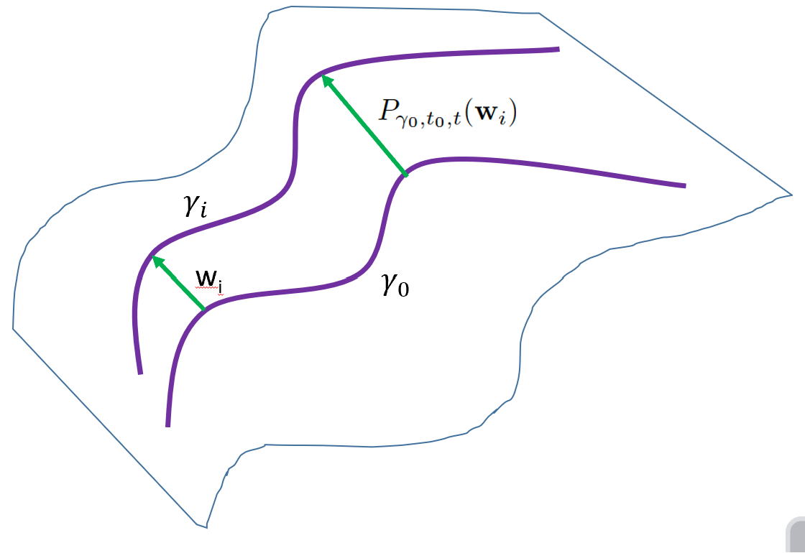
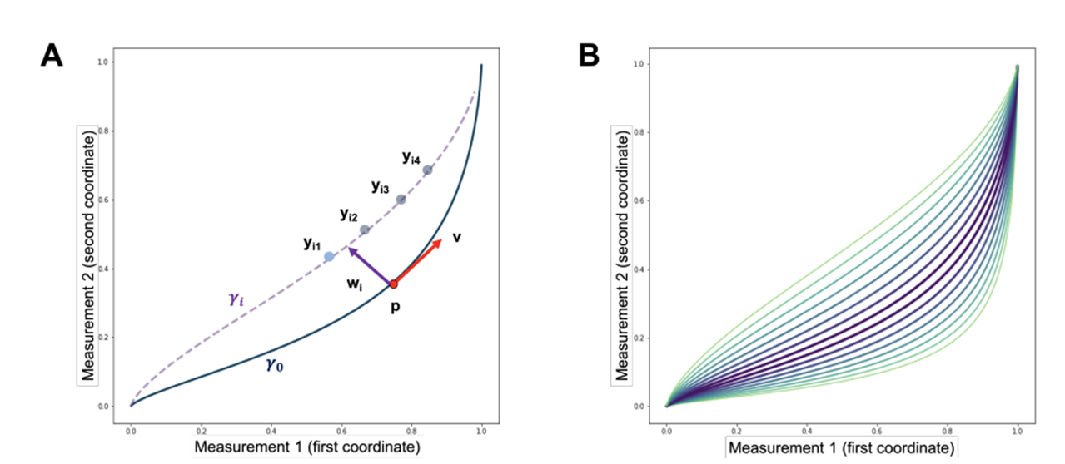
The term manifold represents an abstract mathematical space where the neighborhood of every point resembles Euclidean space.
A smooth manifold is a type of manifold equipped with an additional structure that allows for smooth, differentiable functions to be defined on it.
The Riemannian manifold can also be defined as smooth manifolds with Riemannian metrics that define the shortest distance (otherwise called geodesics) from one point to another.
Geodesics are crucial in understanding the geometry and curvature of the manifold.
In this setting, the observations lie on a Riemannian manifold and individual trajectories are described by a bundle of parallel curves around a geodesic curve which can be thought of as a population average trajectory.

Slide 9
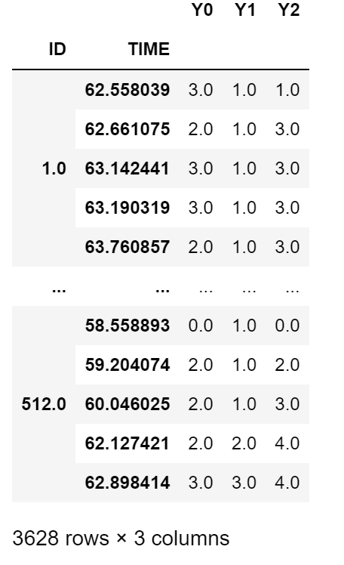
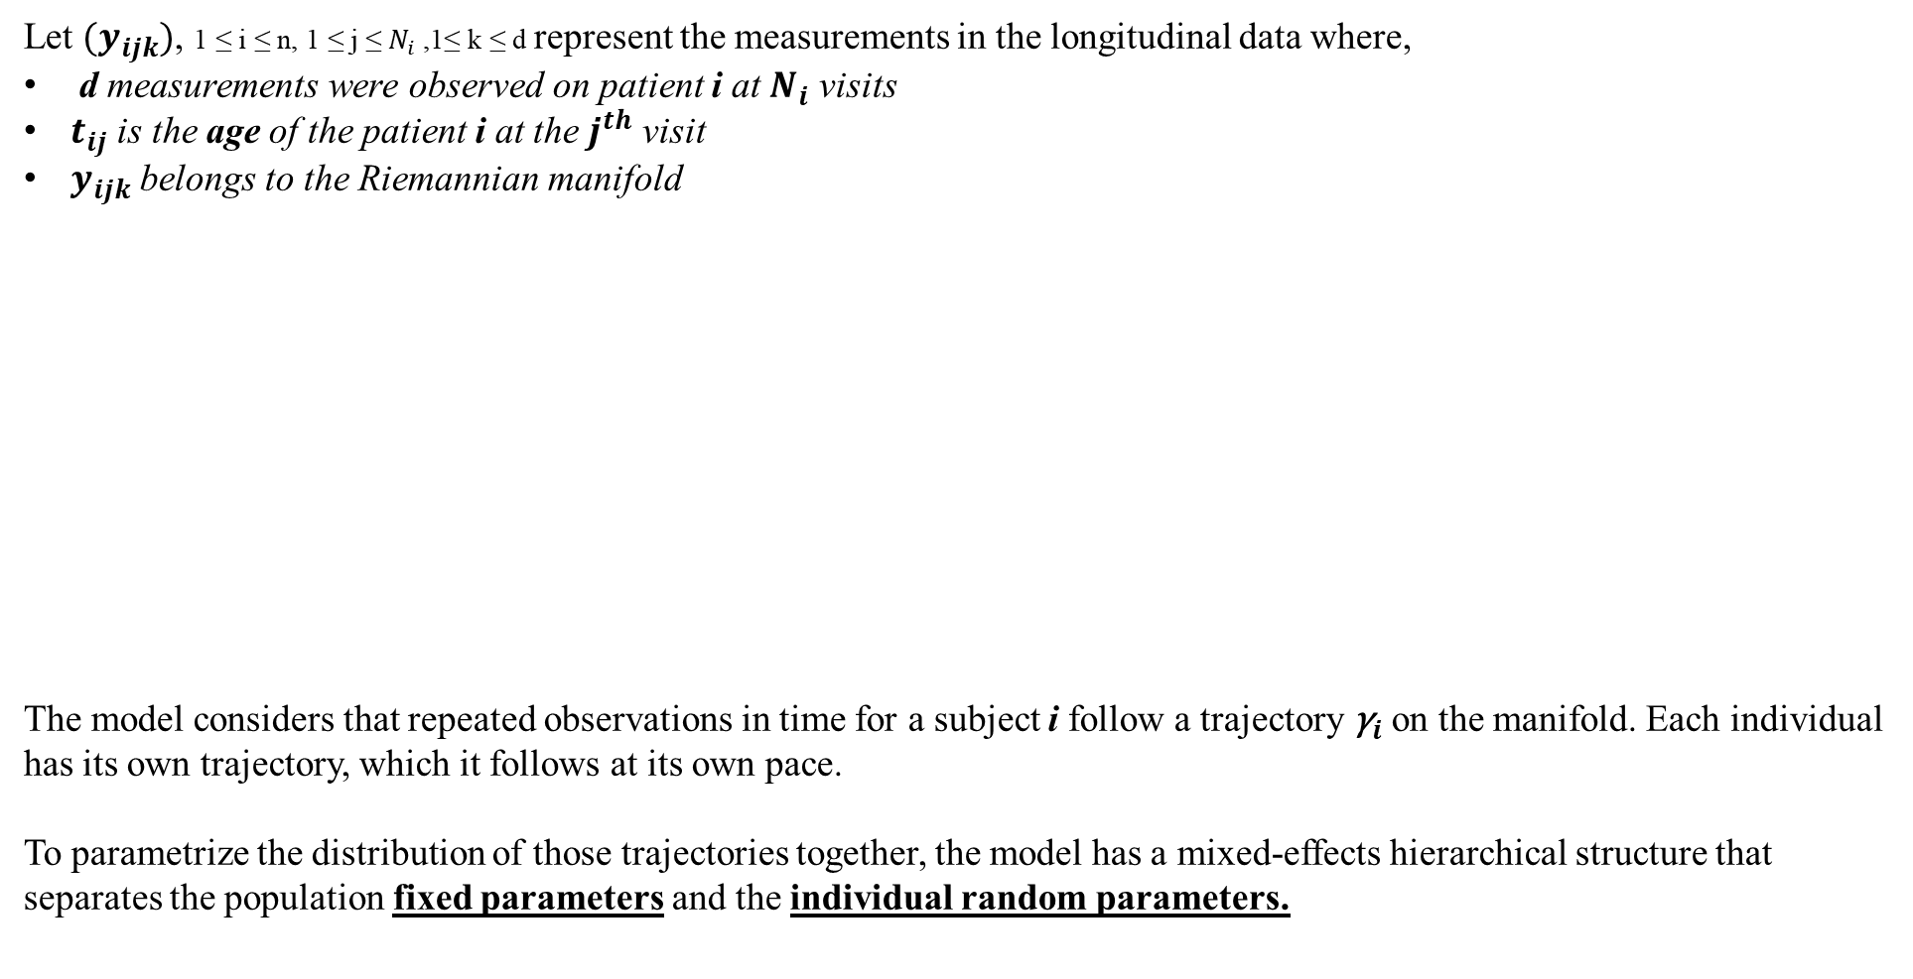
Generic framework (Continuous case)
Let ${(y}_{ijk})$, 1 ≤ i ≤ n, 1 ≤ j ≤ $N_{i}$ ,1≤ k ≤ d represent the measurements in the longitudinal data where,
d measurements were observed on patient i at $N_{i}$ visits
$t_{ij}$ is the age of the patient i at the $j^{th}$ visit
$y_{ijk}$ belongs to the Riemannian manifold
The model considers that repeated observations in time for a subject i follow a trajectory ${\text{γ}}_{i}$ on the manifold. Each individual has its own trajectory, which it follows at its own pace.
To parametrize the distribution of those trajectories together, the model has a mixed-effects hierarchical structure that separates the population fixed parameters and the individual random parameters.

Slide 10
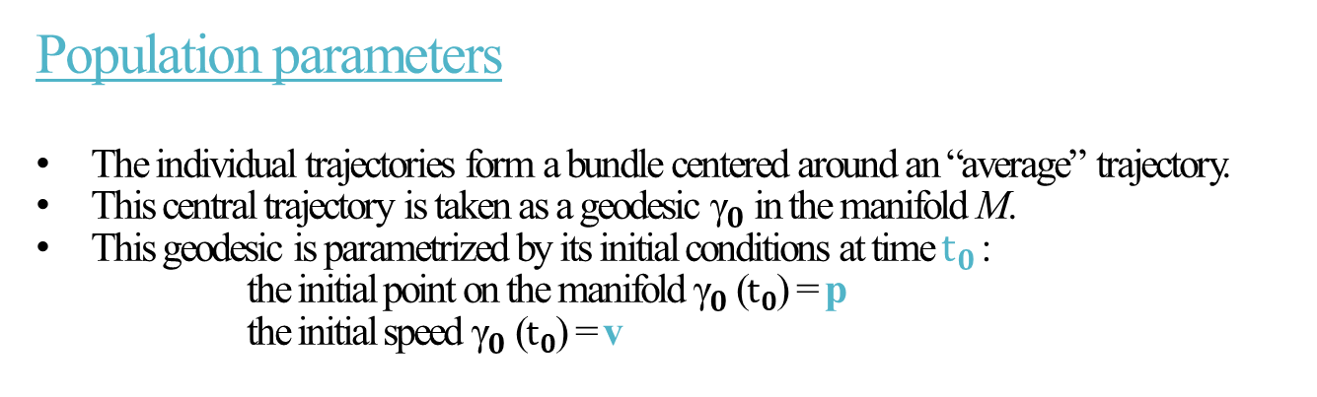
Population parameters
The individual trajectories form a bundle centered around an “average” trajectory.
This central trajectory is taken as a geodesic ${\text{γ}}_{0}$ in the manifold M.
This geodesic is parametrized by its initial conditions at time ${\text{t}}_{0}$:
the initial point on the manifold ${\text{γ}}_{0}$ (${\text{t}}_{0}$) = p
the initial speed ${\text{γ}}_{0}$ (${\text{t}}_{0}$) = v

Slide 11
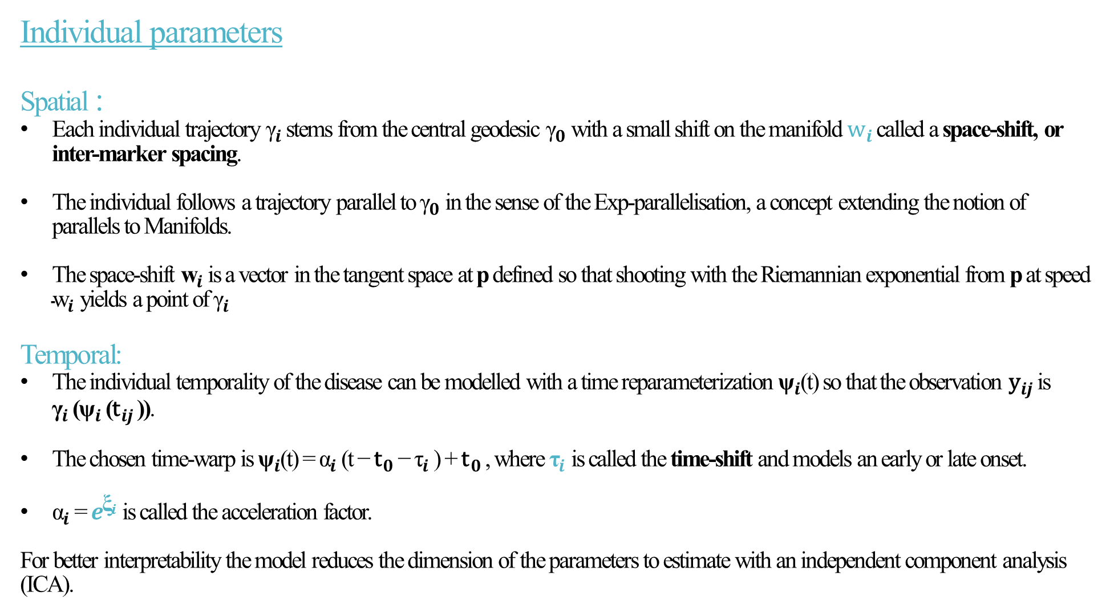
Individual parameters
Spatial :
Each individual trajectory ${\text{γ}}_{i}$ stems from the central geodesic ${\text{γ}}_{0}$ with a small shift on the manifold ${\text{w}}_{i}$ called a space-shift, or inter-marker spacing.
The individual follows a trajectory parallel to ${\text{γ}}_{0}$ in the sense of the Exp-parallelisation, a concept extending the notion of parallels to Manifolds.
The space-shift ${\text{w}}_{i}$ is a vector in the tangent space at p defined so that shooting with the Riemannian exponential from p at speed ${\text{w}}_{i}$ yields a point of ${\text{γ}}_{i}$
Temporal:
The individual temporality of the disease can be modelled with a time reparameterization ${\text{ψ}}_{i}$(t) so that the observation ${\text{y}}_{ij}$ is ${\text{γ}}_{i}$ (${\text{ψ}}_{i}$ (${\text{t}}_{ij}$ )).
The chosen time-warp is ${\text{ψ}}_{i}$(t) = ${\text{α}}_{i}$(t − ${\text{t}}_{0}$ − ${\text{τ}}_{i}$) + ${\text{t}}_{0}$ , where ${\text{τ}}_{i}$ is called the time-shift and models an early or late onset.
${\text{α}}_{i}$= $e^{{\text{ξ}}_{i}}$ is called the acceleration factor.
For better interpretability the model reduces the dimension of the parameters to estimate with an independent component analysis
(ICA).

Slide 12
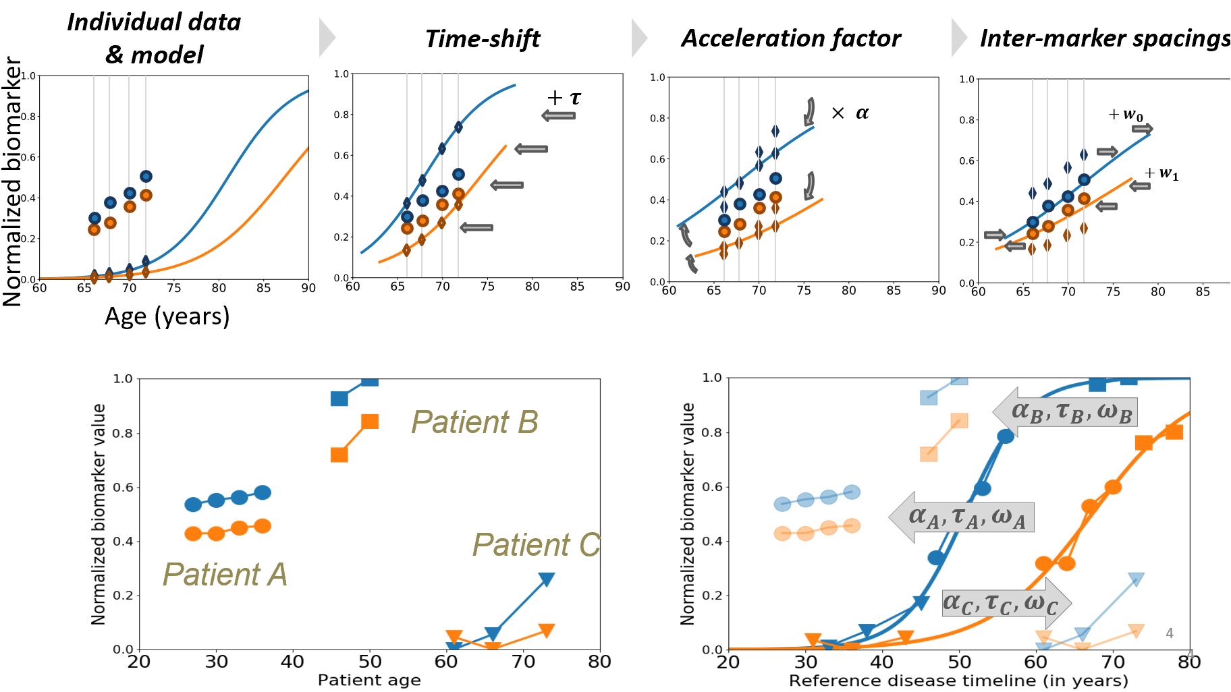

Slide 13
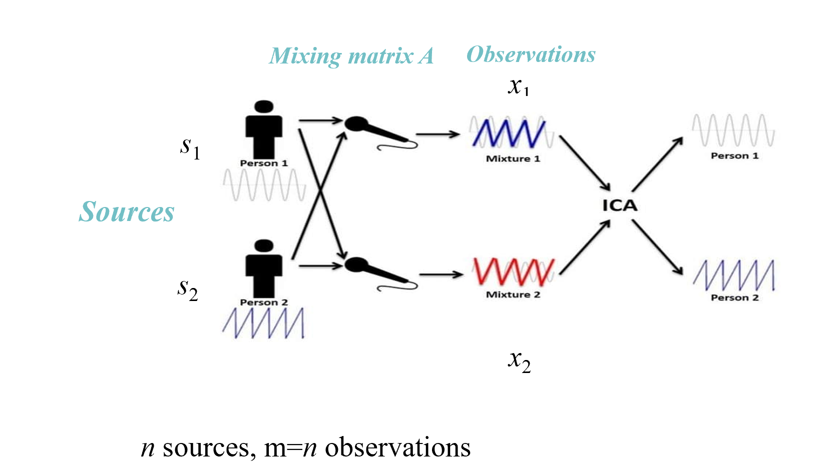
Independent Component Analysis
Independent component analysis (ICA) is a method for finding underlying factors or components from multivariate (multi-dimensional) statistical data.
What distinguishes ICA from other methods is that it looks for components that are both statistically independent, and non-gaussian.
Cocktail Party Problem

Slide 14
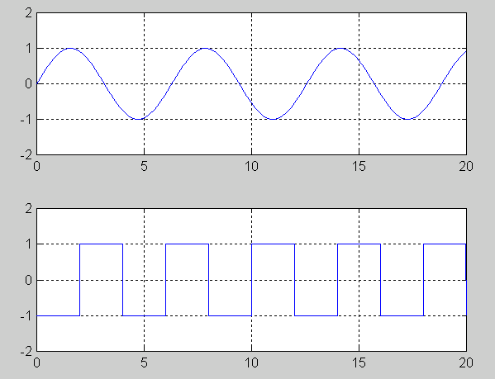
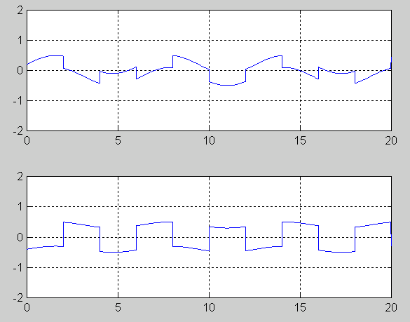
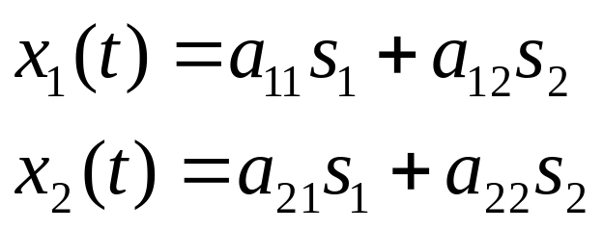
Motivation
Two Independent Sources
Mixture at two Mics
a_{ij} ... Depend on the distances of the microphones from the speakers
x = As

Slide 15
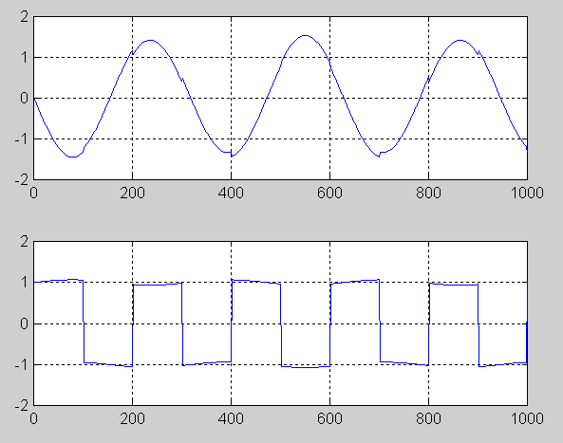
Motivation
Get the Independent Signals out of the Mixture

Slide 16
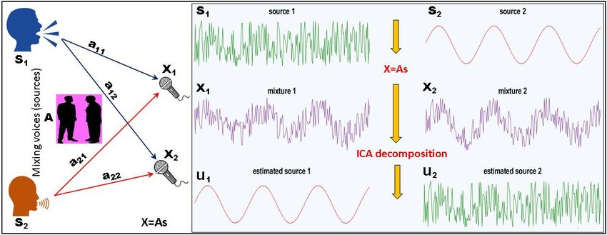
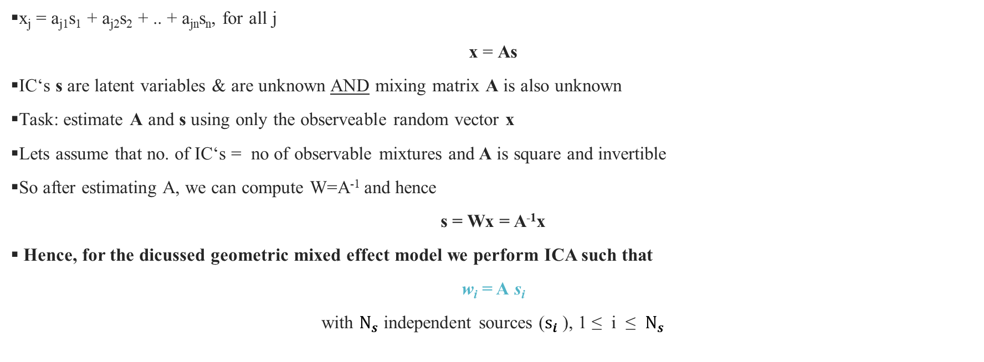
x_{j} = a_{j1}s₁ + a_{j2}s₂ + .. + a_{jn}s_{n}, for all j
x = As
IC‘s s are latent variables & are unknown AND mixing matrix A is also unknown
Task: estimate A and s using only the observeable random vector x
Lets assume that no. of IC‘s = no of observable mixtures and A is square and invertible
So after estimating A, we can compute W=A⁻¹ and hence
s = Wx = A⁻¹x
Hence, for the dicussed geometric mixed effect model we perform ICA such that
w_{i} = A s_{i}
with ${\text{N}}_{s}$ independent sources (${\text{s}}_{i}$), 1 ≤ i ≤ ${\text{N}}_{s}$

Slide 17


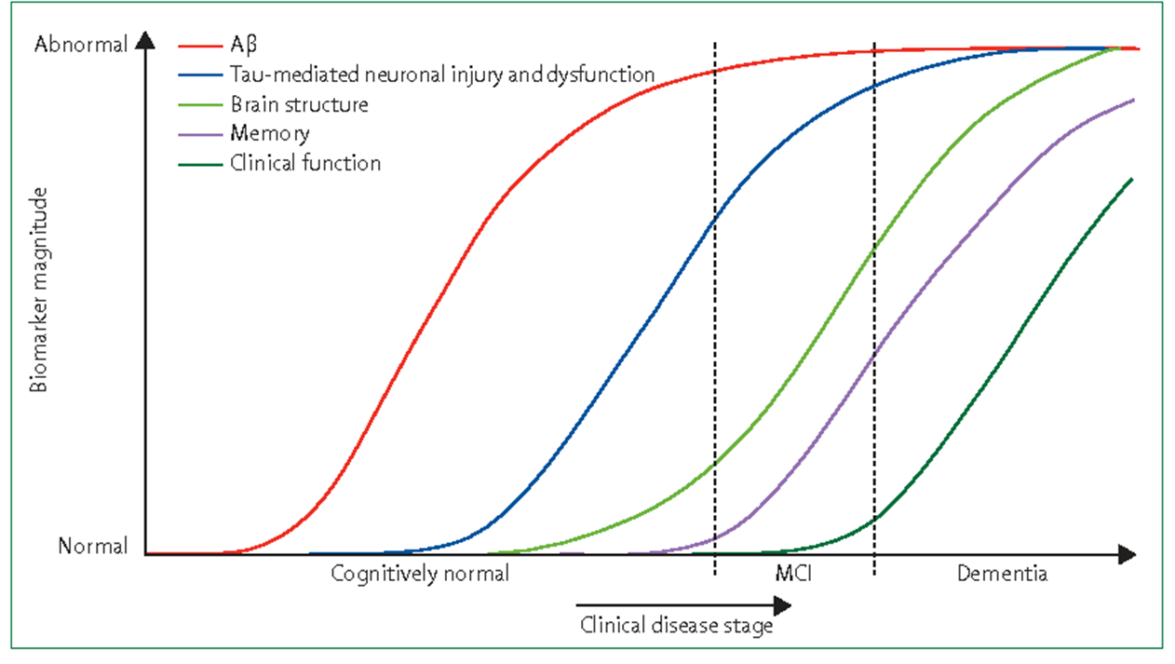
Logistic Curves Model
The disease course mapping model is a generic framework, and we can apply it to different types of observations by choosing the adequate manifold.
Model binary observations using a logit model.
The manifold whose geodesics are logistic curves.
The Riemanninan manifold used in that case is set to be the product manifold of d times (0, 1) equipped with the metric where
The logistic curves is common in most neurodegenerative diseases.

Slide 18
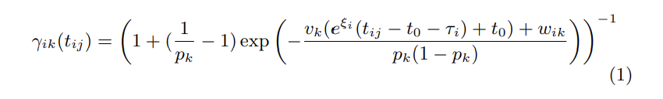
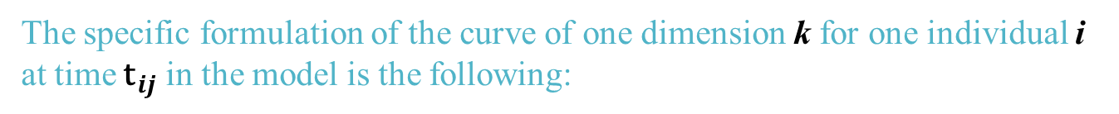
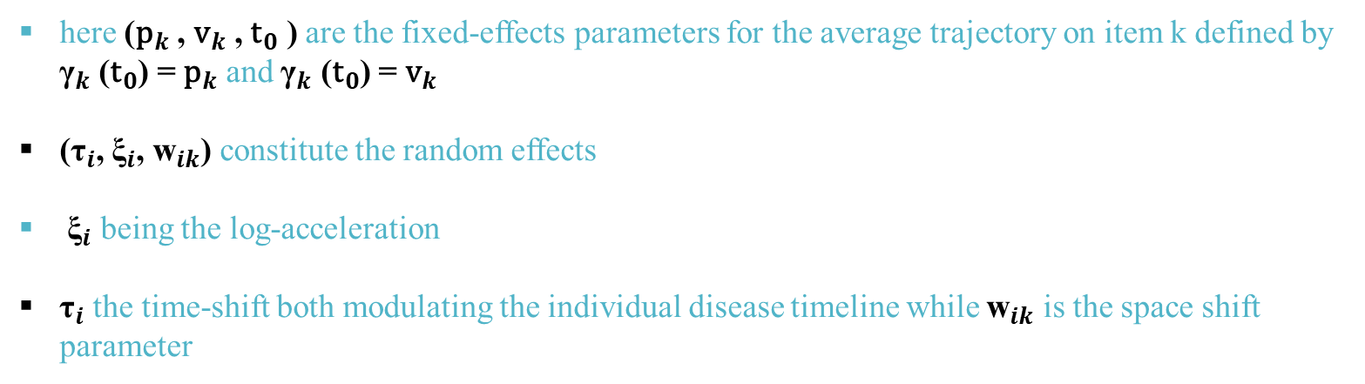
The specific formulation of the curve of one dimension k for one individual i at time ${\text{t}}_{ij}$ in the model is the following:
here (${\text{p}}_{k}$ , ${\text{v}}_{k}$ , ${\text{t}}_{0}$ ) are the fixed-effects parameters for the average trajectory on item k defined by ${\text{γ}}_{k}$ (${\text{t}}_{0}$) = ${\text{p}}_{k}$ and ${\text{γ}}_{k}$ (${\text{t}}_{0}$) = ${\text{v}}_{k}$
(${\text{τ}}_{i}$, ${\text{ξ}}_{i}$, ${\text{w}}_{ik}$) constitute the random effects
${\text{ξ}}_{i}$ being the log-acceleration
${\text{τ}}_{i}$ the time-shift both modulating the individual disease timeline while ${\text{w}}_{ik}$ is the space shift parameter

Slide 19
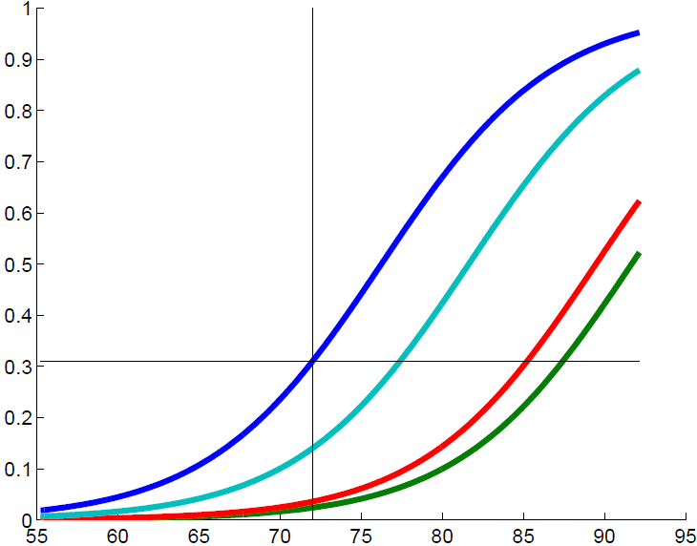
Model of cognitive decline in Alzheimer’s disease
The average trajectory of data changes

Slide 20
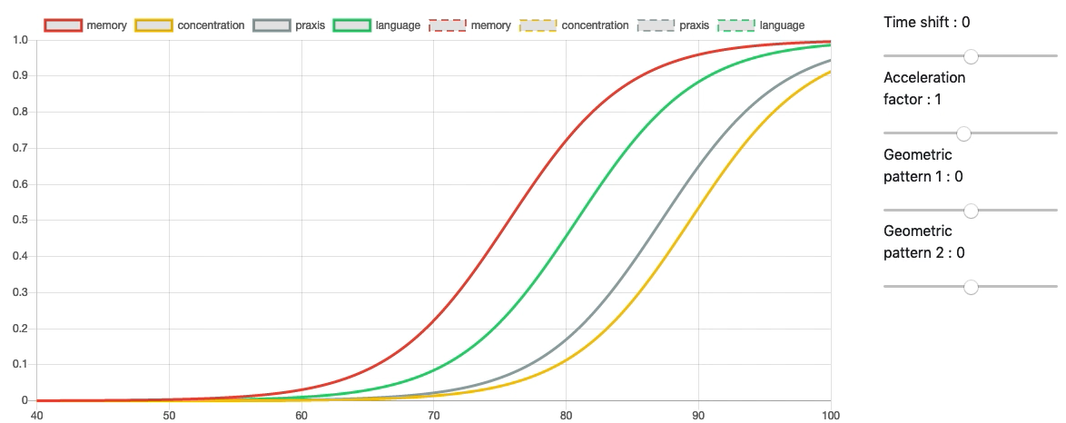
adjusting for:
age at onset
pace of progression
disease presentation, i.e.
timing of symptom onset
appearance of image data
We learn the distribution of parameters generating disease trajectories

Slide 21
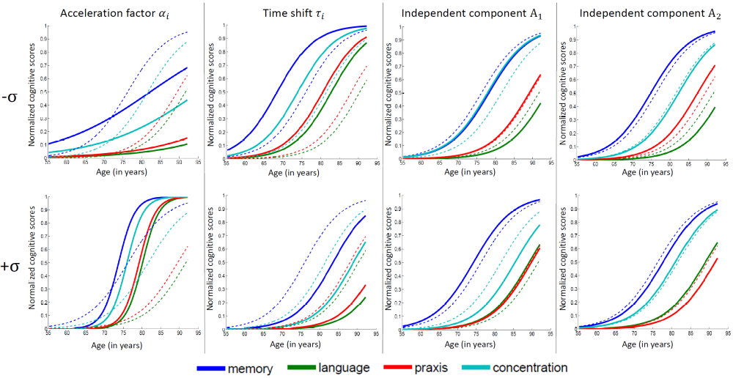
Distinguish fast vs. slow progressers
Distinguish early vs. late onset individuals

Slide 22
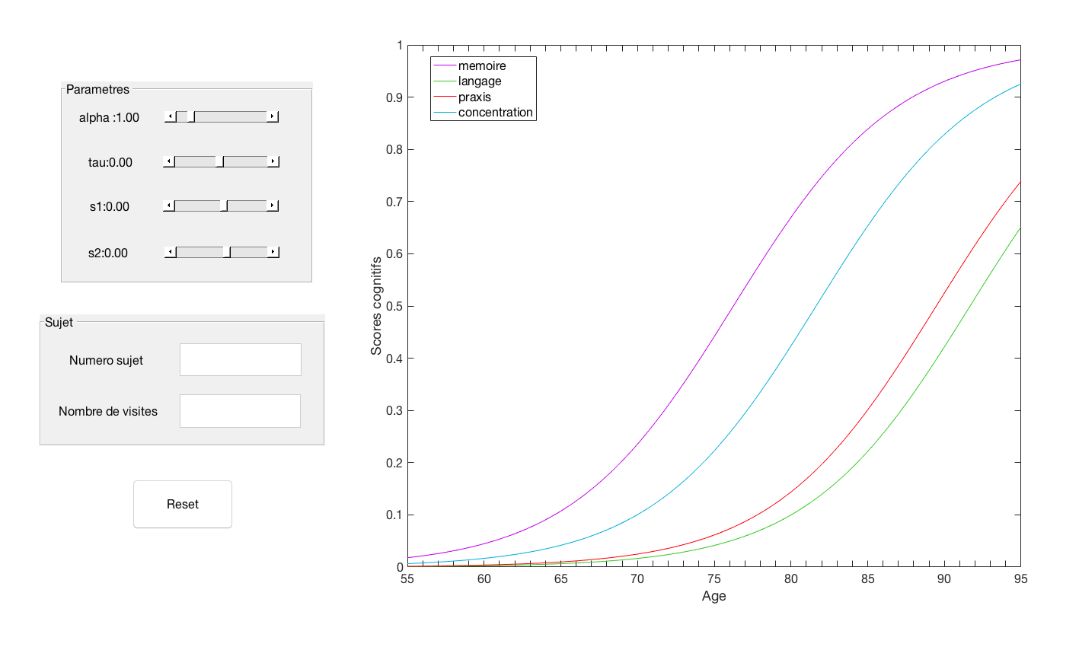
Step 0 (off-line):
The model was trained on observational longitudinal data set.
22

Slide 23
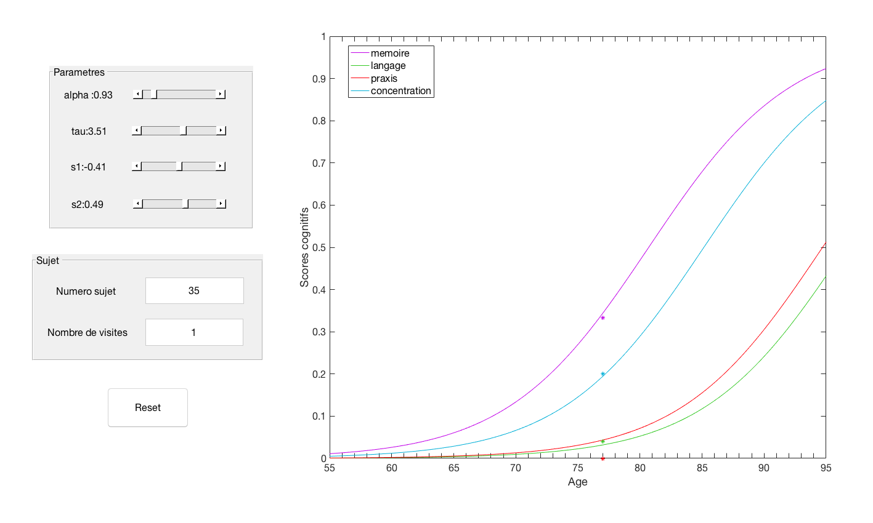
Step 1:
A new patient comes in.
We report the endpoints of the patient at his corresponding age.
We adjust the model parmeters to predict a progression curve of the patient.
23

Slide 24
Step 2:
We forecast the endpoint values at follow-up visits
We measure the discrepancy with the true hidden measurement
24

Slide 25
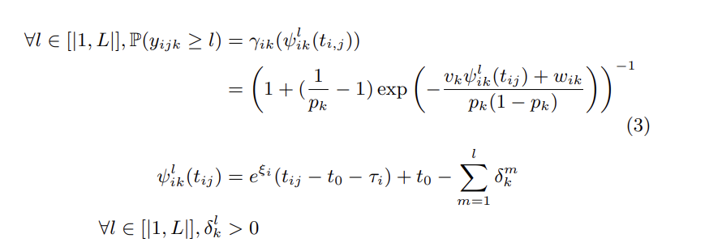
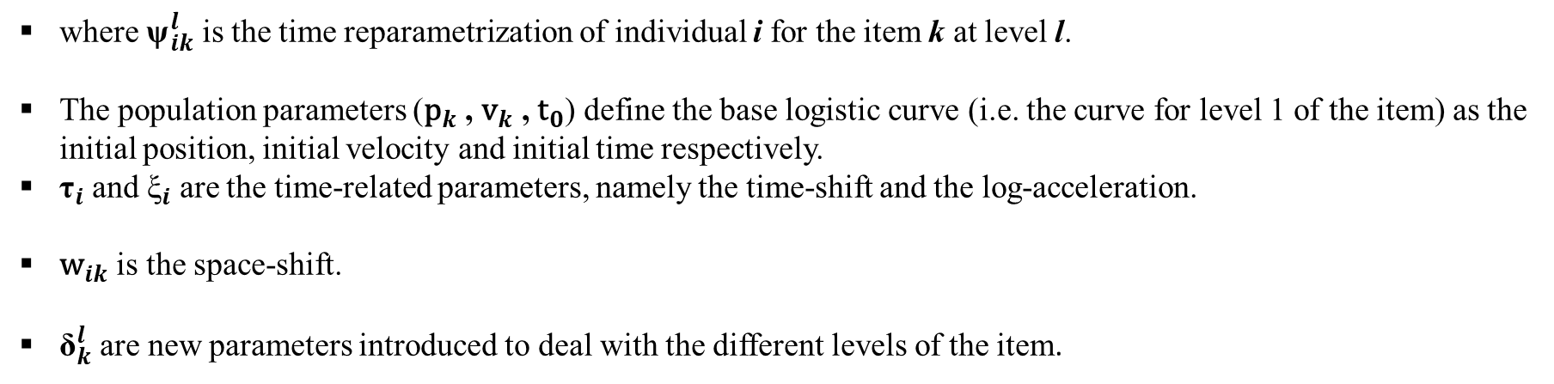
Ordinal Model
Assume the measurements lie on a discontinuous space with ordered values.
Without loss of generality, we assume these values are integers between 0 and L included.
Assume that the model values belonging to the manifold (which is continuous) describe a form of probability (here through the cumulative distribution function).
where ${\text{ψ}}_{ik}^{l}$ is the time reparametrization of individual i for the item k at level l.
The population parameters (${\text{p}}_{k}$ , ${\text{v}}_{k}$ , ${\text{t}}_{0}$) define the base logistic curve (i.e. the curve for level 1 of the item) as the initial position, initial velocity and initial time respectively.
${\text{τ}}_{i}$ and ${\text{ξ}}_{i}$ are the time-related parameters, namely the time-shift and the log-acceleration.
${\text{w}}_{ik}$ is the space-shift.
${\text{δ}}_{k}^{l}$ are new parameters introduced to deal with the different levels of the item.

Slide 26
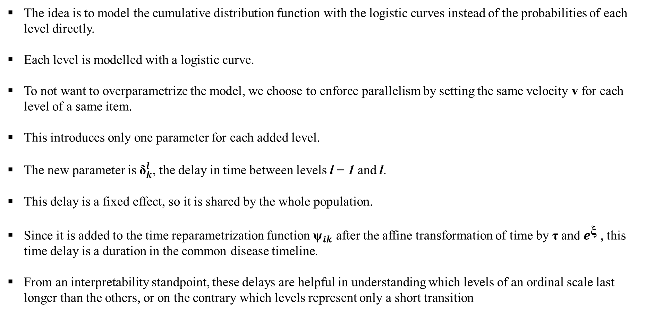
The idea is to model the cumulative distribution function with the logistic curves instead of the probabilities of each level directly.
Each level is modelled with a logistic curve.
To not want to overparametrize the model, we choose to enforce parallelism by setting the same velocity v for each level of a same item.
This introduces only one parameter for each added level.
The new parameter is ${\text{δ}}_{k}^{l}$, the delay in time between levels l − 1 and l.
This delay is a fixed effect, so it is shared by the whole population.
Since it is added to the time reparametrization function ${\text{ψ}}_{ik}$ after the affine transformation of time by $\text{τ}$ and $e^{\text{ξ}}$ , this time delay is a duration in the common disease timeline.
From an interpretability standpoint, these delays are helpful in understanding which levels of an ordinal scale last longer than the others, or on the contrary which levels represent only a short transition

Slide 27
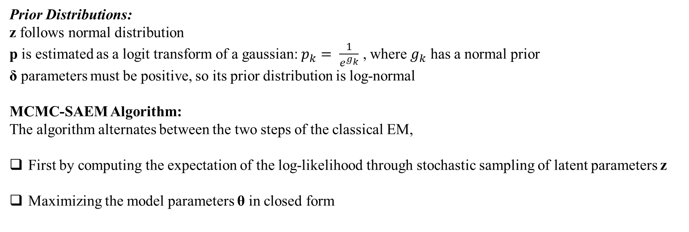
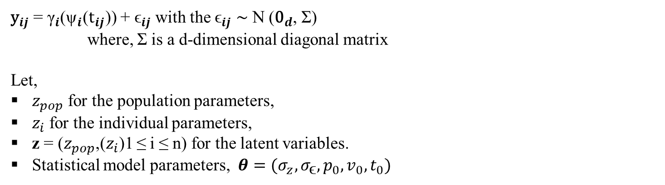
Estimation
${\text{y}}_{ij}$ = ${\text{γ}}_{i}$(${\text{ψ}}_{i}$(${\text{t}}_{ij}$)) + ${\text{ϵ}}_{ij}$ with the ${\text{ϵ}}_{ij}$ ∼ N (${\text{0}}_{d}$, Σ)
where, Σ is a d-dimensional diagonal matrix
Let,
$z_{pop}$ for the population parameters,
$z_{i}$ for the individual parameters,
z = ($z_{pop}$,($z_{i}$)1 ≤ i ≤ n) for the latent variables.
Statistical model parameters, $θ=(σ_{z},σ_{\text{ϵ}},p_{0},v_{0},t_{0})$
Prior Distributions:
z follows normal distribution
p is estimated as a logit transform of a gaussian: $p_{k}= \frac{1}{e^{g_{k}}}$ , where $g_{k}$ has a normal prior
δ parameters must be positive, so its prior distribution is log-normal
MCMC-SAEM Algorithm:
The algorithm alternates between the two steps of the classical EM,
First by computing the expectation of the log-likelihood through stochastic sampling of latent parameters z
Maximizing the model parameters θ in closed form

Slide 28
Data Analysis
Simulation study
Objectives:
How modelling items leads to a finer-grained description of the disease progression, as compared to modelling aggregated scores.
In particular, to show that a model based on item response exhibits patients clusters that were not visible with a continuous model.
Compare how the ordinal model fares as opposed to the logistic curves model.
To show that the flexibility introduced with the δ parameters allows to learn a step function which is less rigid than an imposed template such as a logistic curve.

Slide 29
Data
Data with d = 3 dimensions
ICA decomposition with at least 2 sources.
Each item has L = 4 levels, which sums into an aggregated score ranging from 0 to 12.
Each individual has at least two visits.
Each of the timepoint is sampled with a gaussian distribution around the middle of the disease progression curve, with a time window calibrated to span about 5 years of follow-up for each subject.

Slide 30
Model Type | Description
Model 1 : | DCM continuous case Fit a disease mapping course model with logistic curves with observations considered as continuous with a gaussian noise. The model is three dimensional with two sources
Model 2 : | DCM ordinal case Fit a disease mapping course model with logistic curves with observations considered as ordinal. The model is three dimensional with two sources
Model 3 : | DCM univariate continuous model on the aggregated score Fit a single logistic curve model on the sum of the three items The model is one-dimensional without sources
Model 4 : | DCM univariate ordinal model on the aggregated score

Slide 31
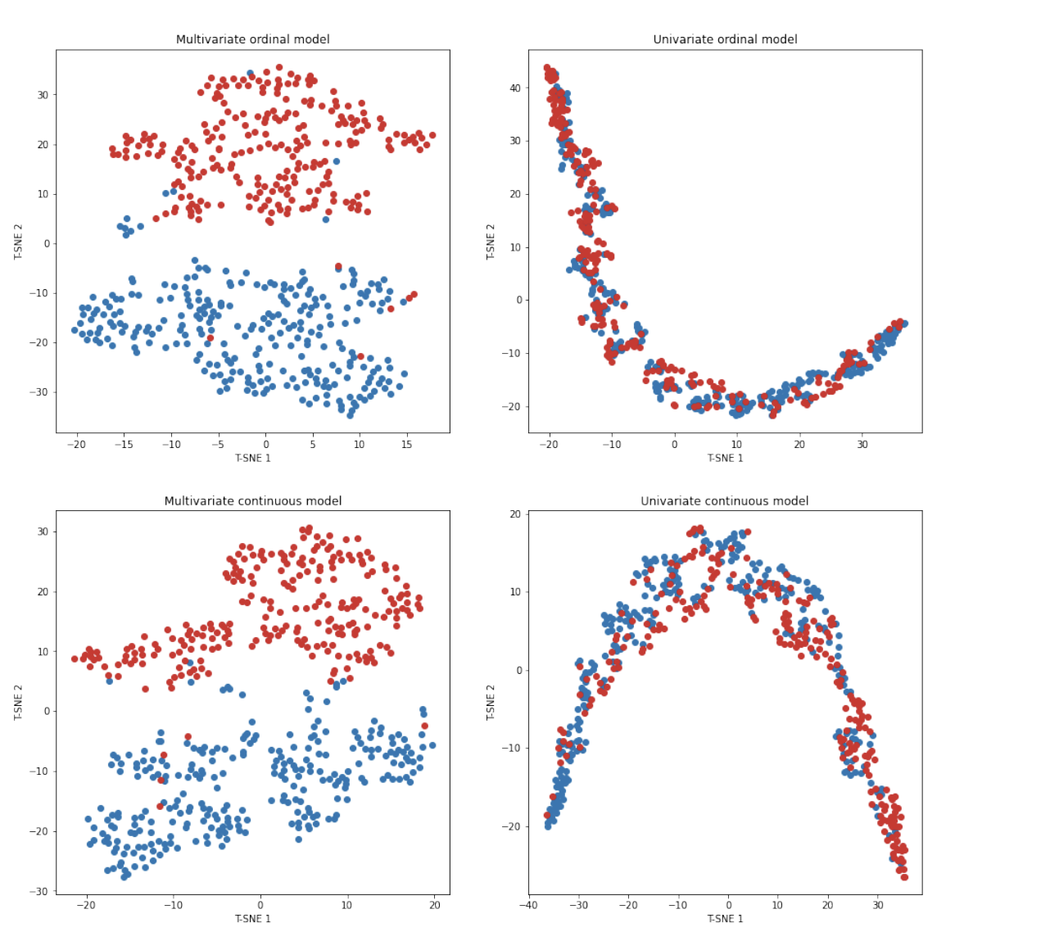
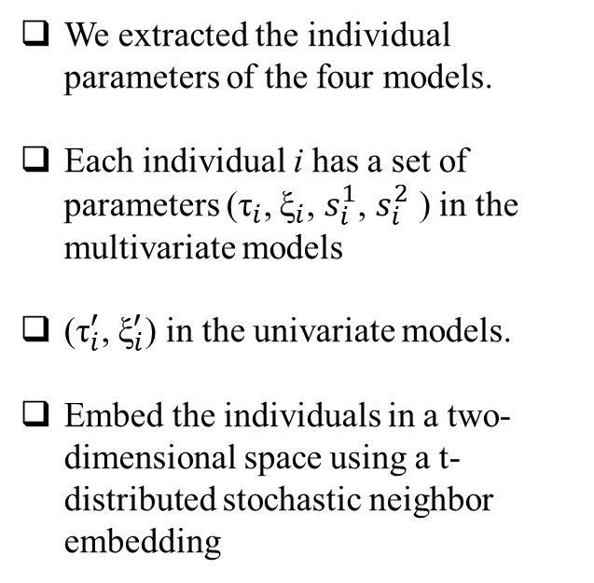
Modelling items leads to a finer-grained description of the disease progression
We extracted the individual parameters of the four models.
Each individual i has a set of parameters (${\text{τ}}_{i}$, ${\text{ξ}}_{i}$, $s_{i}^{1}$, $s_{i}^{2}$ ) in the multivariate models
(${\text{τ}}_{i}^{′}$, ${\text{ξ}}_{i}^{′}$) in the univariate models.
Embed the individuals in a two-dimensional space using a t-distributed stochastic neighbor embedding

Slide 32
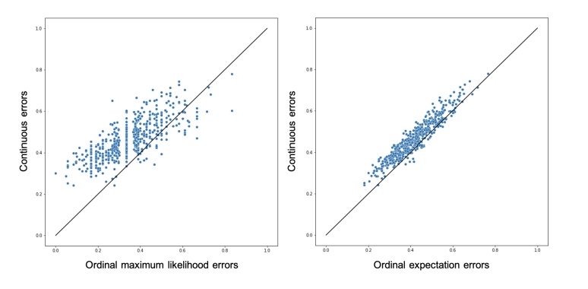
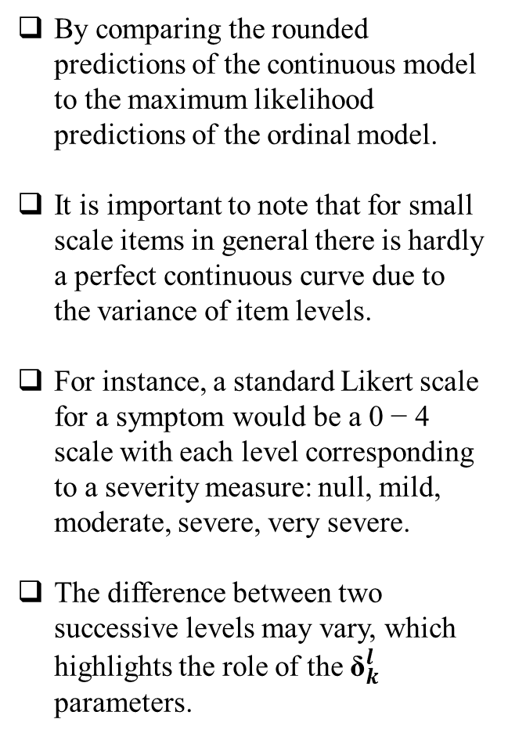
By comparing the rounded predictions of the continuous model to the maximum likelihood predictions of the ordinal model.
It is important to note that for small scale items in general there is hardly a perfect continuous curve due to the variance of item levels.
For instance, a standard Likert scale for a symptom would be a 0 − 4 scale with each level corresponding to a severity measure: null, mild, moderate, severe, very severe.
The difference between two successive levels may vary, which highlights the role of the ${\text{δ}}_{k}^{l}$ parameters.

Slide 33
Application to Parkinson’s disease data
Data
Data used in the preparation of this article were obtained from the Parkinson’s Progression Markers Initiative (PPMI) database
The cohort includes mainly Parkinson’s disease (PD) patients within two years of their diagnosis.
Selected all PD diagnosed patients with at least 2 visits in the study in order to have a longitudinal history for the training set, which left 900 subjects for a total of 7918 visits.
From the wide range of biomarkers and clinical assessments, chose to focus on the MDS-UPDRS score (excluding Part IV).
It is composed of 59 items divided in 3 sections:
Each item is rated on a Likert scale (0: Normal, 1: Slight, 2: Mild, 3: Moderate, 4: Severe)
Sections | Descriptions
non-motor aspects of experiences of daily living (I) | which is filled half by the clinician and half by the patient in a self-report questionnaire
motor aspects of experiences of daily living (II) | which is a form only filled by the patient;
motor examination (III) | by the clinician

Slide 34
Qualitative Experiment: a description of the MDS-UPDRS
In PPMI, items with non-zero values often come as groups, which suggest that several items capture a similar biological phenomenon.
Aim to disentangle these trends with the ICA on the space-shifts.
Calibrated an ordinal DCM model on the 900 subjects using their whole set of 59 items.
Due to the very high number of dimensions, chose 8 as the number of sources to reduce the dimension of individual parameters and prevent overfitting
The ICA enforces correlations within the space-shifts due to the relation w_{i} = As_{i}, with A being rectangular
The correlations across individuals resulting from these space-shifts values, can be seen as a time delay in the progression of each item compared to the population average trajectory
Performed hierarchical clustering in order to isolate groups of highly correlated items

Slide 35
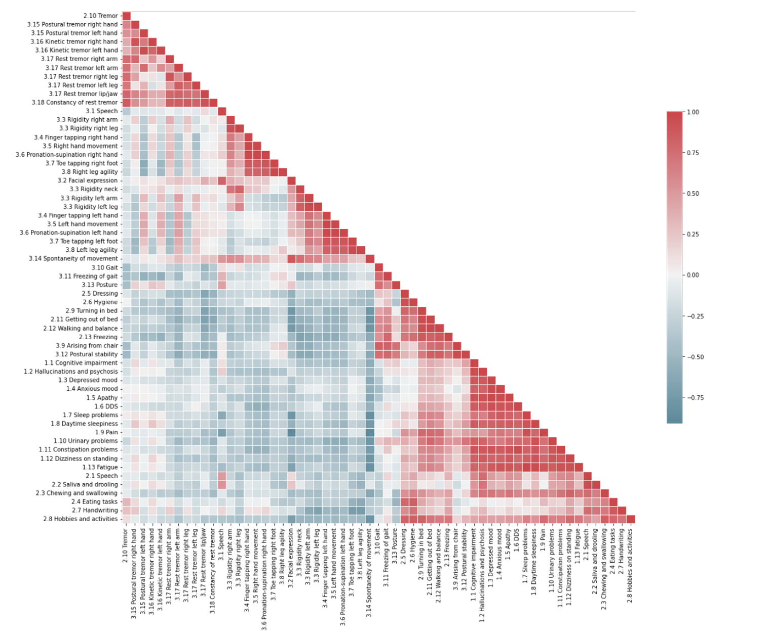
Cluster 1 : Tremors
Cluster 2 : Right
Cluster 3 : Left
Cluster 4 : Daily life
Cluster 5 : non motor aspects

Slide 36
Sources | Description
Source 1 | Left body delay
Source 2 | Right body delay
Source 3 | Motor Source
Source 4 | Left body and rigidity combined progression
Source 5 | Patient’s self-report effect
Source 6 | Brain-first source
Source 7 | Gait and balance source
Source 8 | Cognitive source

Slide 37
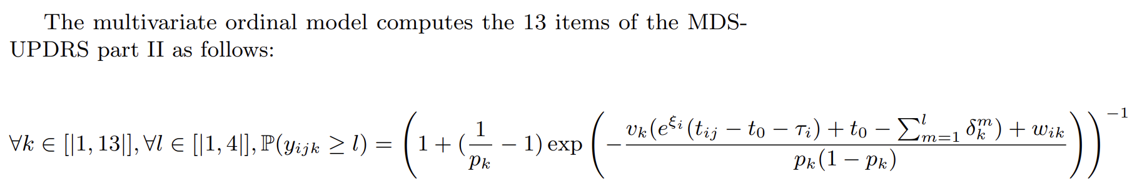
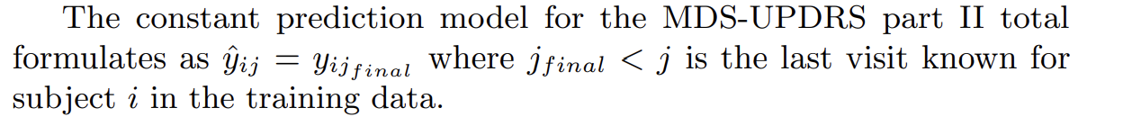
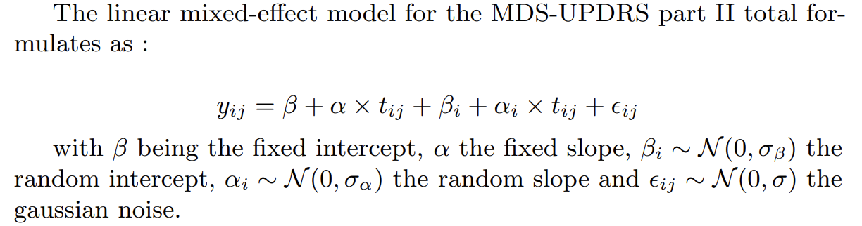
Quantitative results: prediction task
Ordinal multivariate
Baseline constant model
Linear mixed effect

Slide 38
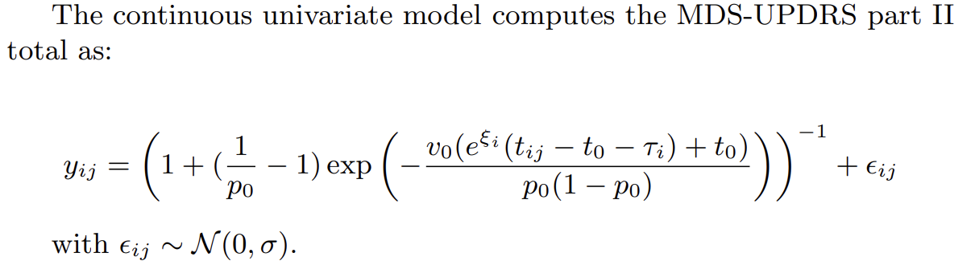
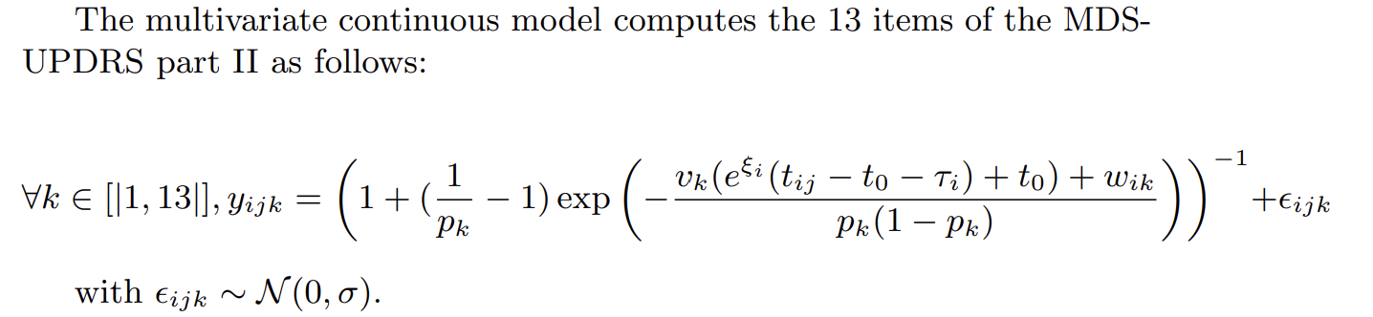
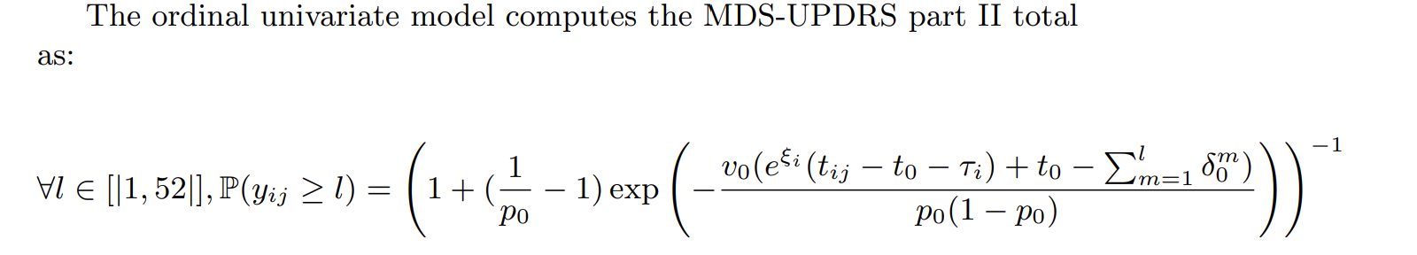
Continuous univariate
Continuous multivariate
Ordinal univariate

Slide 39
A training dataset is utilized to calibrate or train
To learn the fixed effects for mixed-effect models or DCM
The models are used to predict outcomes for patients in a separate test set.
For each patient in the test set, a set of their past visits is considered.
From this set, some visits are randomly selected, including a visit in the future for which the prediction is desired.
The random effects of the models, which capture individual patient variations, are learned based on the past visits of each patient.
With the personalized model that incorporates both fixed and random effects, the model computes the expected value at the desired future visit's timepoint for that specific patient.
To assess the accuracy and generalization performance of the predictive models, a repeated 8-fold cross-validation technique is employed.
Cross-validation involves partitioning the dataset into multiple subsets (in this case, 8 subsets) for training and testing in a way that each subset serves as both a testing set and a training set in different iterations.
This process is repeated multiple times (hence "repeated" cross-validation) to ensure robustness in the evaluation of the models.
The models' prediction errors are measured and assessed during this cross-validation process to determine their performance.
Training
Prediction
Cross- Validation

Slide 40
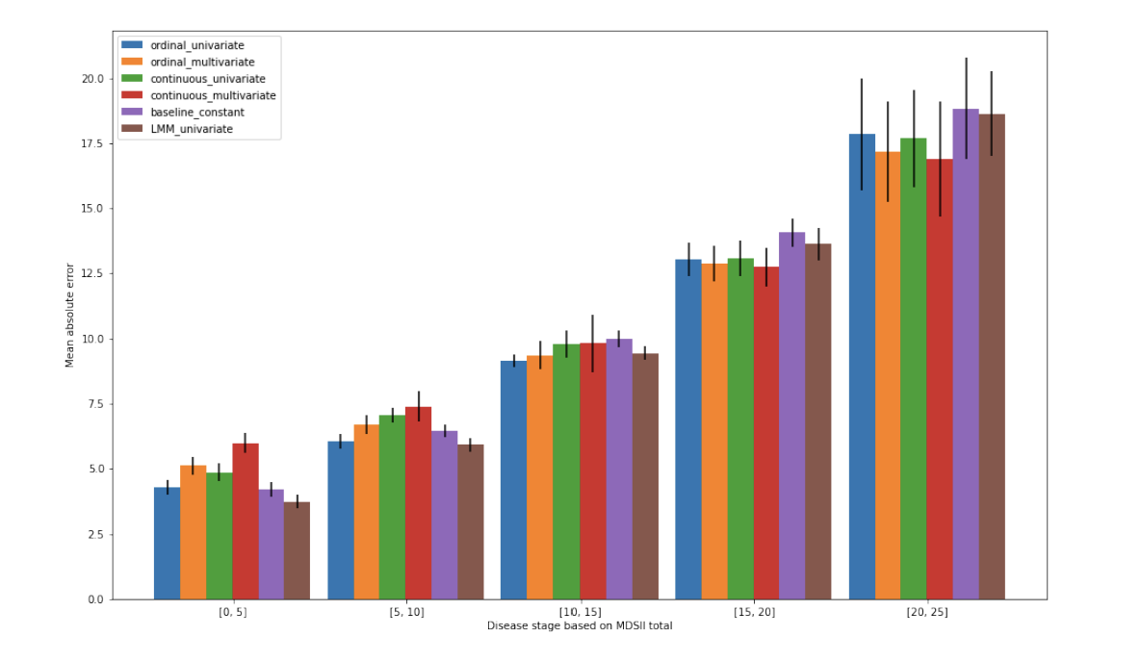
Constant prediction and linear mixed models perform well in the early stages of the disease when patient scores are low, reflecting slow progression.
Simple models (linear and constant) become less effective as patient scores increase, indicating their inability to capture disease progression accurately.
Ordinal models exhibit a similar trend, with better performance in higher disease stages, outperforming continuous models in the early stages due to the flexibility of step parameters.
In later disease stages, continuous models catch up with ordinal models in performance, attributed to sparser data at these stages, emphasizing the role of shape priors.
Over the long term, ordinal models benefit from their low granularity for better prediction at low levels when changes are small, but their performance becomes more mixed at higher disease stages due to data limitations.
Comparing univariate and multivariate models, univariate models are better at capturing early disease progression, while multivariate models excel as disease progression accelerates in later stages.

Slide 41
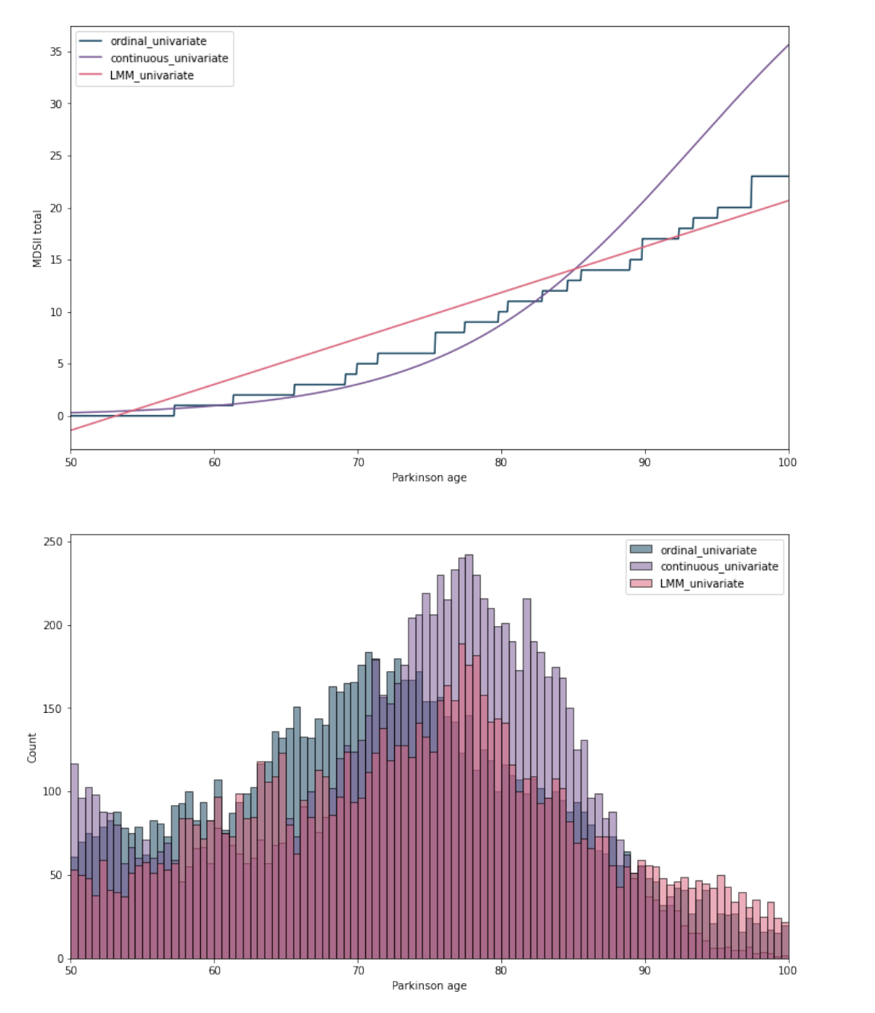
The average disease progression as learned by univariate mixed-effect models.
Spaghetti plots with individual trajectories.
The figure illustrates that the logistic and ordinal models provide similar descriptions of the aggregate score until age 85.
After age 85, the logistic model assumes the score will reach a value of 1, which is unlikely in practice, leading to a slower progression in the ordinal model.
The logistic model anticipates faster disease progression after 85 years old.
In contrast, the linear mixed-effect model tends to underestimate the rate of change at this stage.
The shape of the step function is mainly influenced by the δ values learned, making it more flexible.

Slide 42




Python : Leaspy
II. Personalize
III. Impute & Predict
Predicted data
Test data
Individual
parameters
IV. Application: cofactor analysis
V. Data Simulation
I. Fit
Leaspy model
Train data
Simulated data

Slide 43
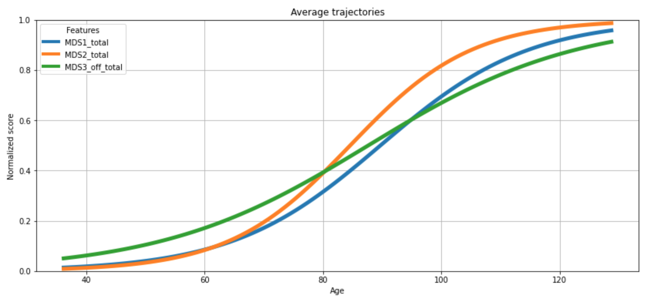
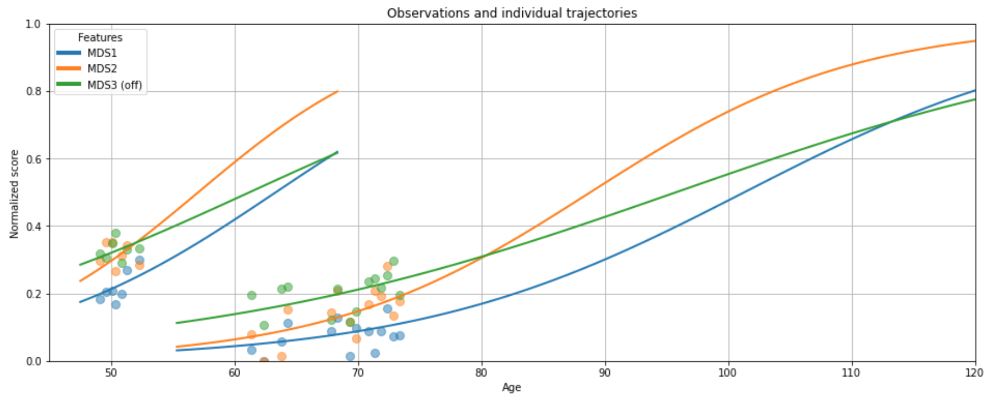
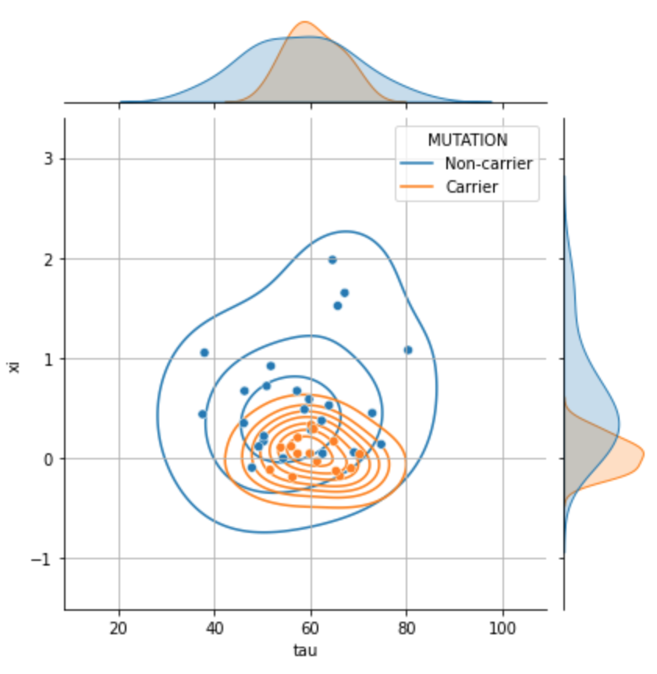
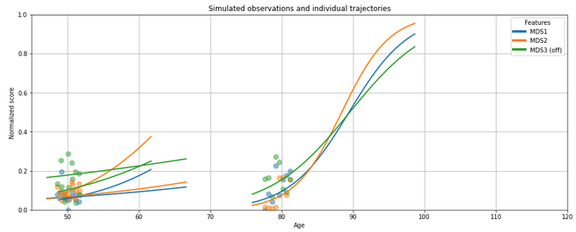
Leaspy model can be an helpful tool to
Get disease timeline with population disease progression
Predict individual disease progression
Extract interpretable information
Simulate data

Slide 44
Conclusion
Leveraging small ordinal scale items instead of aggregated scores for analysis.
Extension of a non-linear mixed-effect model to handle ordinal data.
Application of this approach to understand cognitive decline in Parkinson's disease using MDS-UPDRS.
Potential for extending this method to other cognitive scales in neurodegenerative diseases.
Ordinal models provide finer predictions for early disease stages with slower evolution.
Importance of using multivariate data for prediction in later disease stages with larger rating score changes.
Future applications for extracting information from specific items and building composite scores.
Limitations of ordinal method when data has few values for certain levels, particularly with high values in MDS UPDRS II.
Computational cost associated with the additional parameters in the ordinal DCM.
Recommendation of using the method for items rated on short scales like Likert scales.

Slide 45
THANK YOU !

