Slide 1

Loan predictor
Process Automation
Ayoola

Slide 2
Problem statement
a microfinance bank offering a very arractive loan product is seeking help in improving its process, as they’ve seen a lot of applicants flood their website to fill out the loan application process. Based on the number of applications they receive daily, they see over 75% of applicant are not eligible for this product making the workload of the staff more than they can handle, with little result…

Slide 3
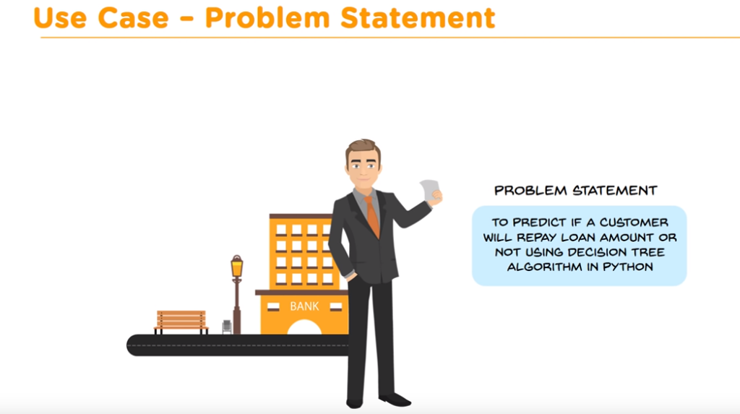
The bank has reach out to a senior data analyst to help come up with a solution that would help reduce the burden of sifting through piles of unqualified loans help improve efficiency

Slide 4
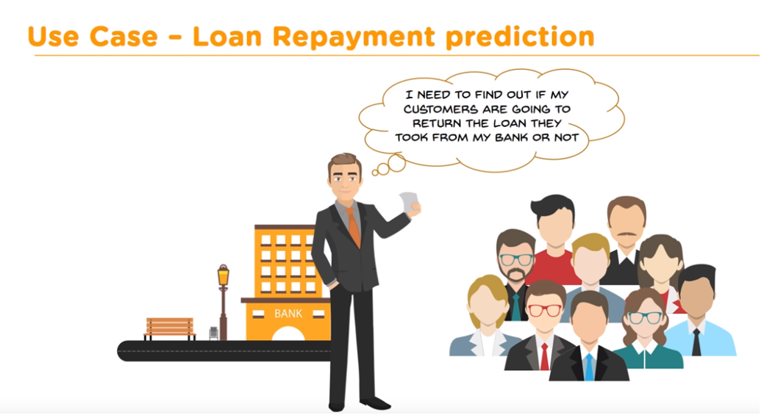
The senior data analyst decides she can use historical data on approved loans, the bank had previously offered to build a trained model to determine if a new applicants would be an eligible recipient of the new loan product. Using her knowledge of machine learning, and computer programming skills she is able to build a LOAN REPAYMENT CALCULATOR

Slide 5
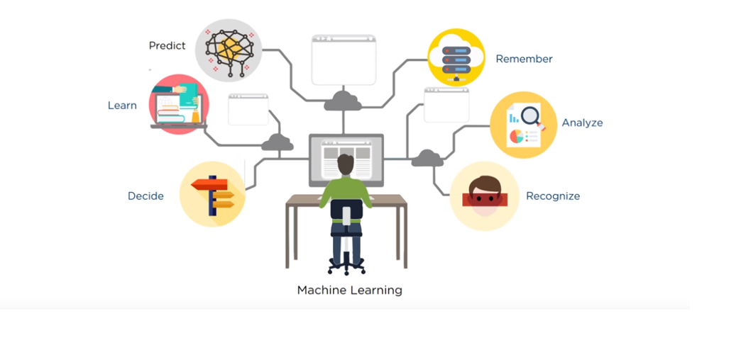
Machine Learning to the rescue!!!

Slide 6
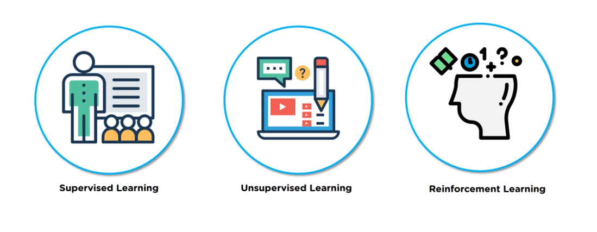
Business Problem Solved!!!

Slide 7
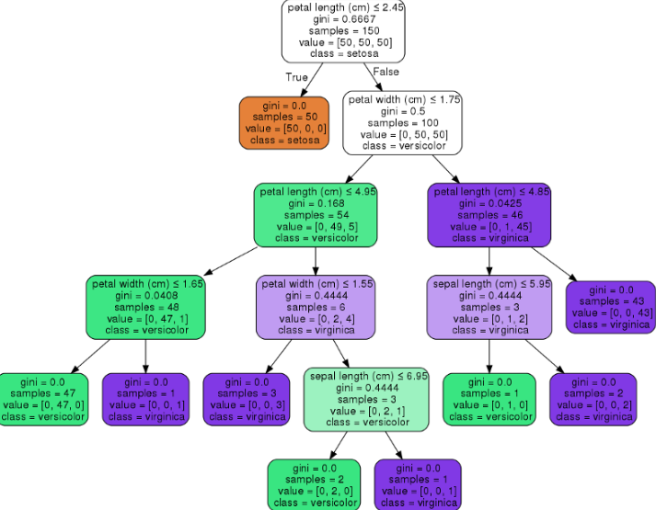

Decision tree Classifier

Slide 8
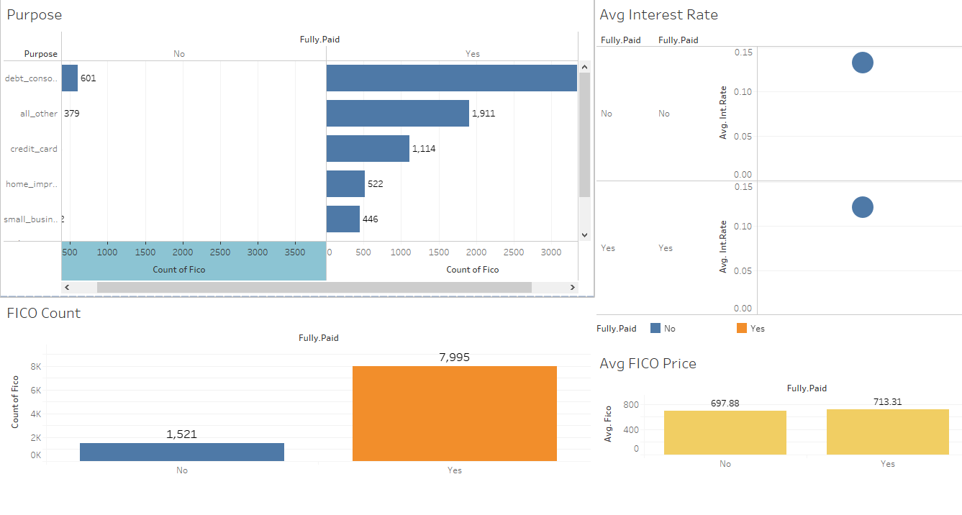
Data review

Slide 9
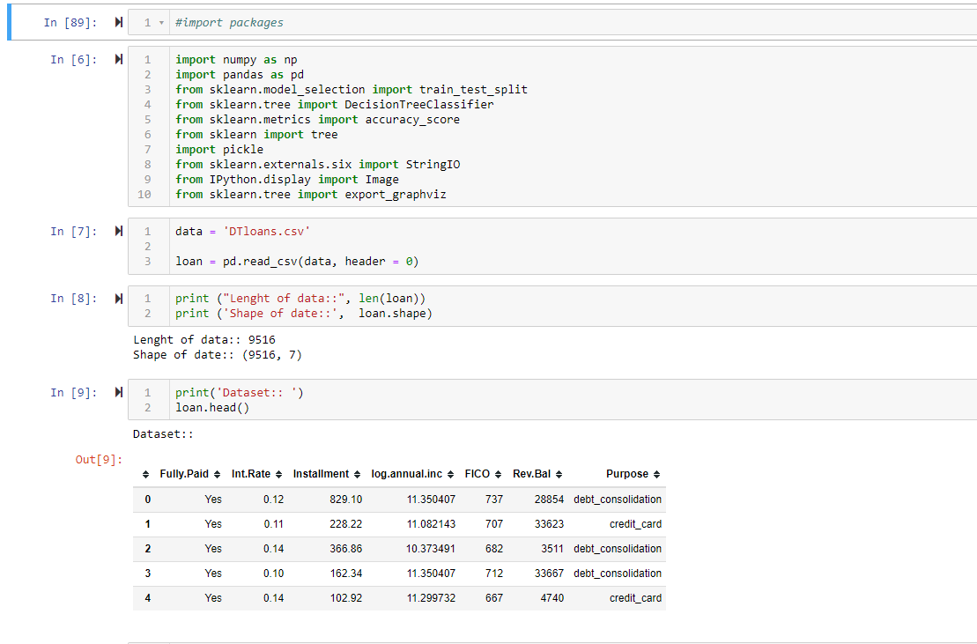
Snapshot of python code!!!

Slide 10
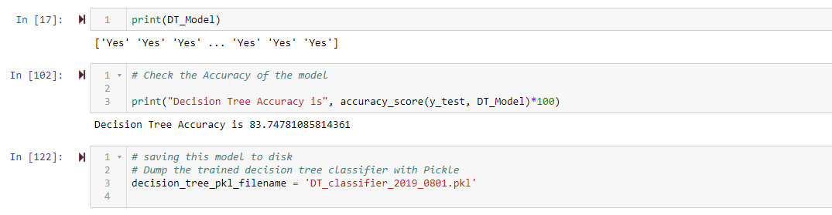
Accuracy rate of 84%...whew!!!!

Slide 11
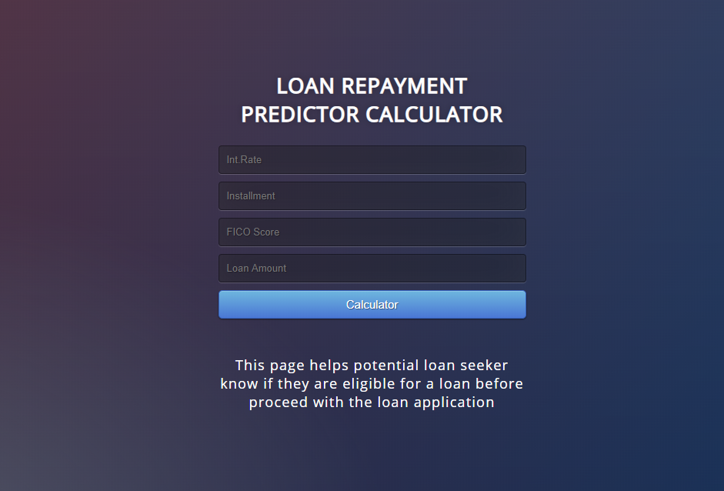
Loan Repayment Calculator!!!

Slide 12
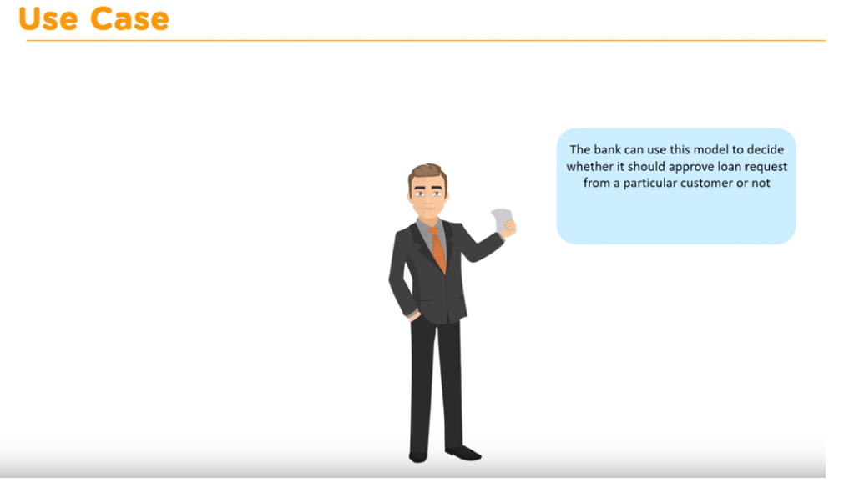
Business Problem Solved!!!

