Slide 1
CSC 374/407: Computer Systems II
Lecture 1
Joseph Phillips
De Paul University
2014 July 18
Copyright © 2011 Joseph Phillips
All rights reserved

Slide 2


Reading
Bryant & O'Hallaron “Computer Systems, 2nd Ed.”
  Chapter 5.1-5.6, 5.10-5.15
Hoover “System Programming”
  Chapter 1

Slide 3
Topics
Review: Pointers and objects
About machine-independent optimization
Using registers instead of RAM
Code motion
Common expression computation
Reduction in strength
Limitations
Profiling
“So, how do I actually program knowing this?”

Slide 4
But first . . let's learn some C:

Slide 5
A little C (Output)
Output in C with printf() (“print-formatted”)
  printf("template",expr1,...exprn)
Constant formatting:
  printf("\tI just print \"hello\".\n");
  What do these mean? \t \" \n
Substitution formatting:
  int i=1;printf("%d %d %d Go!\n",3,1+1,i);
  %d = decimal integer
  %x %X = hexadecimal integer
  %c = single char
  %s = C-string (i.e. pointer to char: char*)
  %f %g = double or floating point
  %p = An address (e.g. a pointer's value)

Slide 6
A little more C (Input):
Almost always should get any input as string
  Convert string to integer or float
#include <stdio.h>
#define LINE_LEN 10
. . .
char line[LINE_LEN];
printf("Please enter a number: ");
fgets(line,LINE_LEN,stdin);
int i = strtol(line,NULL,10);
float f = strtod(line,NULL);
printf("i = %d, f = %g\n",i,f);

Slide 7
About strtol() and strtod()
strtol
(const char* text,
char** endPtr,
int base)
(STRing TO Long)
strtod
(const char* text,
char** endPtr)
(STRing TO Double)
text: pointer to text to convert
endPtr: address of pointer to receive just beyond last char converted (or NULL if you don't care)
base: Base (2-36) to use. Or 0, in which case it uses the same rules as C int constants.

Slide 8
strtol() example
#include <stdlib.h>
#include <stdio.h>
#define TEXT_LEN 64
int main ()
{ char text[TEXT_LEN];
char* cPtr;
while (1)
{
printf("Please enter a number: ");
fgets(text,TEXT_LEN,stdin);
int i = strtol(text,&cPtr,0); //We're using base 0
if (cPtr == text)
printf("Phooey!\n");
else
printf("dec:\t%d\n"
"hex:\t%X\n",i,i);
}
return(EXIT_SUCCESS);
}

Slide 9
strtol() example (cont'd)
$ ./strtol
Please enter a number: 20 // Ordinary decimal
dec: 20
hex: 14
Please enter a number: 020 // Leading 0 => octal
dec: 16
hex: 10
Please enter a number: 0x20 // Leading 0x => hex
dec: 32
hex: 20
Please enter a number: twenty // No digit => ERROR!
Phooey!
Please enter a number:

Slide 10

You knew this was coming: addresses and pointers! (1)
What is an address?
  It is where in memory some object starts.
  All objects in memory have unique starting addresses
  In general you do not specify addresses, the OS/compiler/running system specify them for you.
Getting addresses:
  SomeType var;
  . . .
  &var // Returns address of var
  SomeType array[ARRAY_LEN];
  . . .
  array // Returns addr of array[0]
  &array[0] // Same addr as 'array'
  malloc(16); // Returns addr of 16 bytes on heap
  "string const" // Returns addr where
  // "string const" starts

Slide 11
You knew this was coming: addresses and pointers! (2)
Pointers are variables that store addresses
  In general, they can store the address of (ie. “point to”) which ever object they want
Declaring pointers: Type* typePtr
int* intPtr;
char* charPtr;
SomeType* someTypePtr;

Slide 12
You knew this was coming: addresses and pointers! (3)
Putting it together:
int i = 10;
int* intPtr1 = &i;
int* intPtr2 = intPtr1;
const char* charPtr = "string const";
char buffer[100];
charPtr = buffer;
charPtr = (char*)malloc(10);
free(buffer);

Slide 13
YOUR TURN!
Consider sscanf():
  int sscanf
  (const char* source,
  const char* format
  <,addr1>
  <,addr2>
  ...)
Reads values from source into addr1, addr2, using printf-like specifiers in format.
Returns num. items read
Which one sets i=10, j=20, and n=2?
int i,j,n;
n = int sscanf(
"10 20",
"%d %d",
*i,*j)
n = int sscanf(
"10 20",
"%d %d",
&i,&j)
Neither

Slide 14
Dereferencing: 1
Dereferencing means “follow the pointer to the object”:
Done with *objectPtr
Important! Two different stars! (*)
// * after type declares ptr var
int i = 10;
int* intPtr = &i;
// * before ptr var dereferences
printf("i=%d\n",*intPtr);

Slide 15
Your turn!
Write a program with two variables:
  Integer i.
  Pointer to i called iPtr.
Give the program a for loop that counts from 0 to 9 using the value stored in i but that never refers to i except to initialize iPtr.

Slide 16
Dereferencing: 2
Use arrow (->) to access struct or class member:
class XYCoord
{int x; int y;
public:
XYCoord(int nX,int nY){x=nX; y=nY;}
int getX() const { return(x); }
int getY() const { return(y); }
};
. . .
XYCoord* pPtr = new XYCoord(1,2);
printf("%d,%d\n",
pPtr->getX(),pPtr->getY());
delete(pPtr);

Slide 17
Your turn!
Write a method print() for the class on the previous slide
Call your method using the pointer ptr
These are equivalent:
// Do method() of pointed-to obj
ptr->method();
// Get pointed-to obj then do method()
(*ptr).method();

Slide 18
Arrays and pointers
Arrays are actually addresses:
  Address of their first item
  Can be used:
    to assign values to other pointers
    to test their values against other pointers
  Their position cannot be changed by ++, etc.
Pointers can also be accessed like arrays:
Can dereference with:
  *ptr or ptr[0]
  ptr->method() or (*ptr).method() or ptr[0].method()

Slide 19
Your turn!
// Example
int intArray[5] = {10,20,30,40,50};
int* intPtr = intArray;
// What will this print?
printf("%p %p\n",intArray,intPtr);
(*intPtr) *= 10;
// What will this print?
printf("%d\n",intArray[0]);

Slide 20
Const pointers
const SomeType* ptr;
Same promise as const references:
  “I, the programmer, promise not to change the pointed to object”
  Compiler will yell at you if:
    You break that promise:
      const int* cIntPtr = &i;
      (*cIntPtr)++; // Illegal!
    You pass it to something that does not maintain that promise:
      const int* cIntPtr = &i;
      int* intPtr = cIntPtr; // Illegal!
  You may, however, point at different objects:
      const int* cIntPtr = &i;
      cIntPtr = &j; // Okay

Slide 21
Your turn!
Happy compiler :) or sad compiler :( ?
void compilerPisserOffer(const int* ciPtr)
{
int* iPtr = ciPtr; // Happy or sad?
int array[5] = {1,2,3,4,5};
ciPtr = array; // Happy or sad?
ciPtr++; // Happy or sad?
(*ciPtr)++: // Happy or sad?
}

Slide 22
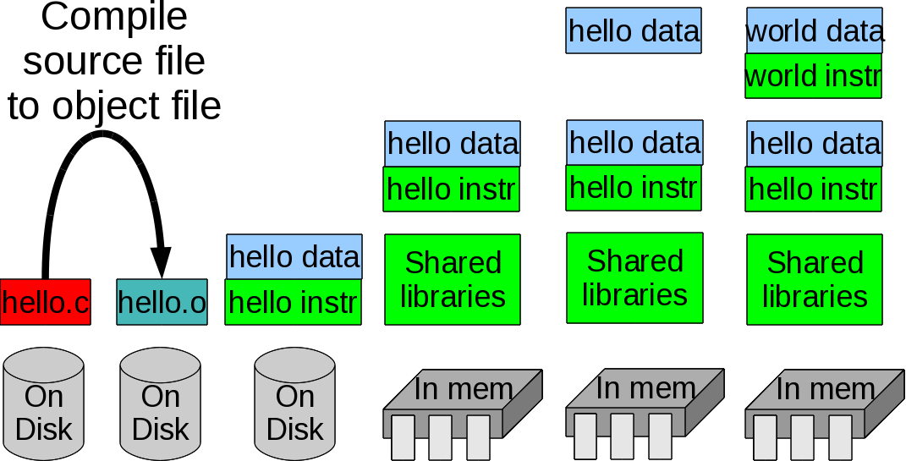
Today's topic (in time)
How to compile to create efficient programs:

Slide 23
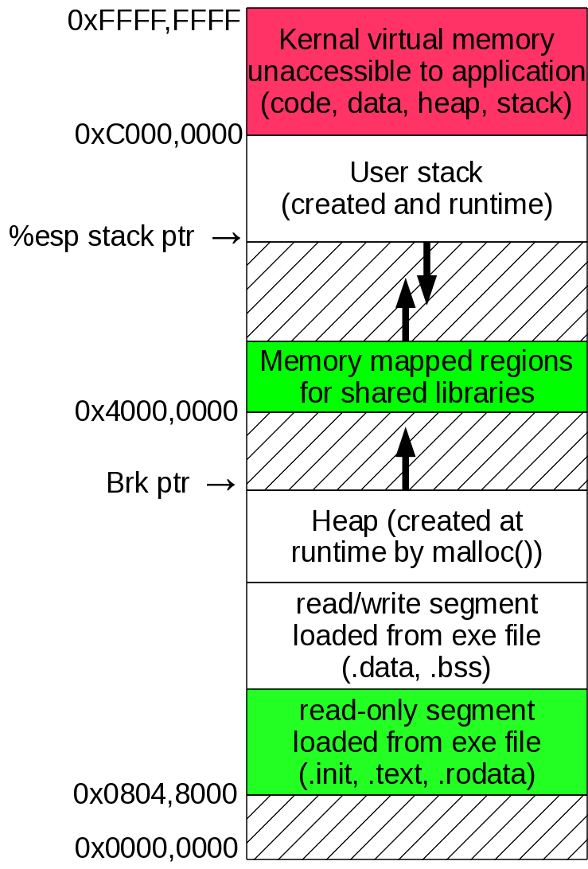
Today's topic (in space)
Efficient code for a program to run

Slide 24
Speed it up!
Q: Why do we just love computers? (They don't have any common sense after all)
A1: Because they don't get bored
A2: Because they are accurate
A3: Because they're fast baby!

Slide 25
Speed it up! (2)
What goes into making an algorithm fast?
  Algorithm and data-structure choice
  Don't do O(N) linear search in a linked list, Ninny!
  Do O(lg N) binary search in a balanced tree instead
  This is important, it's why we harass you with a basic and an advanced course in data structures and algorithms
  Implementing the algorithm and data structure
  The compiler has to change it into assembly language
  That's the aim of this lecture!

Slide 26
Speed it up! (3)
We will study machine independent optimizations
  Make sense to do no matter what your CPU
What can we do?
  Use our registers efficiently
    It takes time to load/store data
  Re-order code
    Don't do the same thing multiple times if don't have to
  Get rid of obviously inefficient things

Slide 27
Speed it up! (4)
Watch out! Good optimizations:
  Don't change the programmer's data-structure behind his/her back (Why not?)
  Don't change the programmer's algorithm behind his/her back (Why not?)
  Watch out for memory aliasing:
int i = 10;
int* iPtr = &i;
(*iPtr)++;
printf("i is still 10, right? %d\n",i);
  Don't assume too much about what other fncs do

Slide 28
Speed it up! (5)
Our approach:
  Only make code equivalent to what the programmer wrote (even “optimizing” their bugs)
    When the compiler spots something that looks like a bug what should it do?
  Optimize functions individually
  Don't make any assumptions about inputs
Four main tools:
  Store in registers, not RAM.
  Code motion: move code so it isn't being done so many times (e.g. loops)
  Compute common expressions once
  Reduction in strength: Use a cheaper operator.

Slide 29
Using Registers
Without optimization most
variables are kept in RAM
(e.g. the stack)
int counter (int limit)
{ int sum = 0;
int i;
for (i = 0; i <= limit; i++)
sum += i;
return(sum);
}
<+0>: push %ebp
<+1>: mov %esp,%ebp
<+3>: sub $0x10,%esp
<+6>: movl $0x0,-0x4(%ebp) sum=0
<+13>: movl $0x0,-0x8(%ebp) i=0
<+20>: jmp <counter+32>
<+22>: mov -0x8(%ebp),%eax
<+25>: add %eax,-0x4(%ebp) sum+=i
<+28>: addl $0x1,-0x8(%ebp) i++
<+32>: mov -0x8(%ebp),%eax
<+35>: cmp 0x8(%ebp),%eax i<=limit?
<+38>: jle <counter+22>
<+40>: mov -0x4(%ebp),%eax
<+43>: leave
<+44>: ret

Slide 30
Using Registers (2)
int counter (int limit)
{ int sum = 0;
int i;
for (i = 0; i <= limit; i++)
sum += i;
return(sum);
}
With optimization some
variables are kept in
registers
<+0>: mov 0x4(%esp),%ecx ecx = limit
<+4>: xor %eax,%eax eax=sum=0
<+6>: test %ecx,%ecx limit==0?
<+8>: js <counter+25> // jmp to ret
<+10>: xor %edx,%edx edx=i=0
<+12>: lea 0x0(%esi,%eiz,1),%esi
<+16>: add %edx,%eax sum+=i
<+18>: add $0x1,%edx i++
<+21>: cmp %edx,%ecx i<=limit
<+23>: jge <counter+16>
<+25>: repz ret // optimized return

Slide 31
Code motion
Move code so not doing redundant calculations
  Might introduce temporary variables to hold results
for (i = 0; i < n; i++)
for (j = 0; j < n; j++)
a[i*n + j] = b[j]
for (i = 0; i < n; i++)
{
int in = i*n;
for (j = 0; j < n; j++)
a[in + j] = b[j]
}

Slide 32
Your turn!
Please optimize using code motion:
for (i = 0; i < n; i++)
for (j = 0; j < n; j++)
for (k = 0; k < j; k++)
a[i*n + i*j - k] = b[k*7];

Slide 33
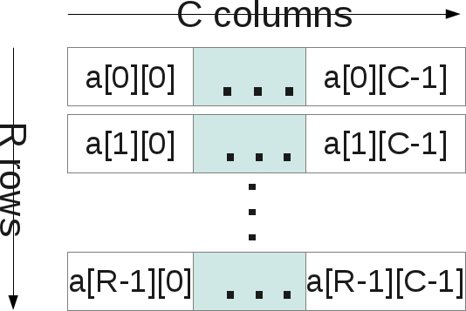
Compute common expressions once
Our example will use 2-D arrays
So let's see how 2-D arrays are laid out in memory

Slide 34
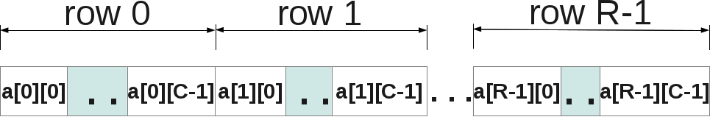
Compute common expressions once
2-D arrays are actually laid out in memory as very long 1-D arrays
&array2D[i][j] == &array1D[i*NumCols + j]

Slide 35
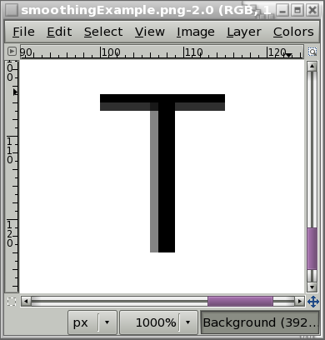

Compute common expressions once
Now, consider the following:
  Actually done in image processing (e.g. blurring)
above = array[n*(i-1)+j];
below = array[n*(i+1)+j];
left = array[i*n+j-1];
right = array[i*n+j+1];
aver = (above+below+
right+left )/4;

Slide 36
Compute common expressions once, cont'd
Don't compute what's common more than once:
  They all share i*n+j in various guises:
inPj = i*n+j;
above = array[inPj - n];
below = array[inPj + n];
left = array[inPj - 1];
right = array[inPj + 1];
aver = (above+below+right+left )/4;

Slide 37
Your turn!
Optimize:
above = array[(n*n)*(i+1)+j*n +k];
below = array[(n*n)*(i-1)+j*n +k];
left = array[i*n*n +n*(j-1)+k];
right = array[i*n*n +n*(j+1)+k];
front = array[i*n*n +j*n +k-1];
back = array[i*n*n +j*n +k+1];
aver = (above+below+
right+front+
back+left)/6;

Slide 38
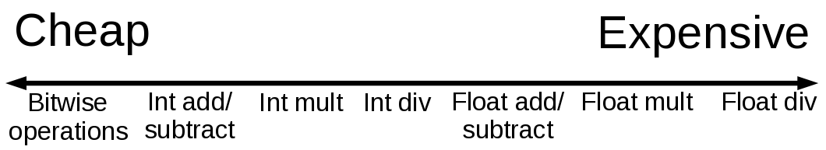
Reduction in strength
Change from expensive operation to cheaper
What's expensive?
  Depends on CPU
Generally:

Slide 39
Reduction in strength
It makes sense to do:
  << instead of multiplying by powers of 2
  >> instead of dividing by powers of 2
  Additions instead of multiplications
Not so important now, but “i*10” used to be done as:
int result = i << 2; // i*4
int result += i; // i*5
int result = result << 1; // i*10
Rather do 2 shifts and addition than 1 multiply

Slide 40
Reduction in strength, ex
unsigned int num=strtol(line,0,0);
//call 0x8048360 <strtol@plt>
//mov %eax,0xfffffff0(%ebp)
unsigned int numDiv4 = num / 4;
//mov 0xfffffff0(%ebp),%eax
//shr $0x2,%eax
//mov %eax,0xfffffff4(%ebp)
unsigned int numMul4 = num * 4;
//mov 0xfffffff0(%ebp),%eax
//shl $0x2,%eax
//mov %eax,0xfffffff8(%ebp)

Slide 41
Reduction in strength, ex 2
Trickier dance if dealing with signed numbers:
int num = strtol(line,0,0);
//call 0x8048360 <strtol@plt>
//mov %eax,0xfffffff0(%ebp)
int numDiv4 = n / 4;
//mov 0xfffffff0(%ebp),%edx
//mov %edx,%eax
//sar $0x1f,%eax
//shr $0x1e,%eax
//add %edx,%eax
//sar $0x2,%eax
//mov %eax,0xfffffff4(%ebp)

Slide 42
Your turn!
Compute the following without using imult or idiv:
  i*3
  i*12
  i*20
  i*31
Is it practical to compute i*j without imult?

Slide 43
Code motion + reduction in strength
It makes sense to do:
  Repeated adding to a temp var instead of repeated multiplying the same num by 0, 1, 2, 3, etc.
  Repeated subtracting from temp var instead of repeated multiplying the same num by 9, 8, 7, etc.
  Uses temporary variable to accumulate sum
  Also, can use pointers to march thru arrays

Slide 44
Code motion + reduction in strength, cont'd
CM: Move code out of inner loop(s)
RiS: Change repeated multiplies to repeated adds
for (i = 0; i < n; i++)
for (j = 0; j < n; j++)
a[i*n + j] = b[j]
int in = 0;
for (i = 0; i < n; i++)
{
for (j = 0; j < n; j++)
a[in + j] = b[j]
in += n;
}

Slide 45
Your turn!
Remember me?
  Optimize me again, getting rid of as many expen$ive multiplies as you can . . .
for (i = 0; i < n; i++)
for (j = 0; j < n; j++)
for (k = 0; k < j; k++)
a[i*n + i*j - k] = b[k*7];

Slide 46
A real world example:
for (i = 0; i < n; i++)
for (j = 0; j < n; j++)
a[n*i + j] = b[j];
free(b);
free(a);
return(0);
}
#include <stdlib.h>
int main ()
{
int i;
int j;
int n = 100;
int* a = (int*)
calloc(n*n,sizeof(int));
int* b = (int*)
calloc( n,sizeof(int));

Slide 47
Optimize O0 (none)
<main+72>: movl $0x0,0xffffffe8(%ebp) i = 0
<main+79>: jmp <main+137>
<main+81>: movl $0x0,0xffffffec(%ebp) j = 0
<main+88>: jmp <main+125>
<main+90>: mov 0xfffffff0(%ebp),%eax eax = n
<main+93>: imul 0xffffffe8(%ebp),%eax eax = n*i
<main+97>: add 0xffffffec(%ebp),%eax eax = n*i + j
<main+100>: shl $0x2,%eax eax = (n*i + j)*4
<main+103>: mov %eax,%edx edx = eax
<main+105>: add 0xfffffff4(%ebp),%edx edx = a+(n*i+j)*4
<main+108>: mov 0xffffffec(%ebp),%eax eax = j
<main+111>: shl $0x2,%eax eax = j * 4
<main+114>: add 0xfffffff8(%ebp),%eax eax = b + j * 4
<main+117>: mov (%eax),%eax eax = mem[b+j*4]
<main+119>: mov %eax,(%edx) mem[a+(n*i+j)*4]=eax
<main+121>: addl $0x1,0xffffffec(%ebp) j++
<main+125>: mov 0xffffffec(%ebp),%eax eax = j
<main+128>: cmp 0xfffffff0(%ebp),%eax j < n
<main+131>: jl <main+90> ?
<main+133>: addl $0x1,0xffffffe8(%ebp) i++
<main+137>: mov 0xffffffe8(%ebp),%eax eax = i
<main+140>: cmp 0xfffffff0(%ebp),%eax i < n
<main+143>: jl <main+81> ?

Slide 48
Optimize O1 (First level)
<main+42>: mov %eax,0xffffffec(%ebp) a = calloc(10000,4)
<main+45>: movl $0x4,0x4(%esp) push 4
<main+53>: movl $0x64,(%esp) push 100
<main+60>: call 0x8048388 <calloc@plt>
<main+65>: mov %eax,%ebx ebx = (b =calloc(100,4))
<main+67>: mov 0xffffffec(%ebp),%esi esi = a
<main+70>: jmp <main+105>
<main+72>: mov 0xfffffffc(%ebx,%edx,4),%eax
eax = mem[b + 4*(j+1) - 4]
<main+76>: mov %eax,(%ecx) *a = eax
<main+78>: add $0x1,%edx (j+1)++
<main+81>: add $0x4,%ecx a++
<main+84>: cmp $0x65,%edx (j+1) != 101
<main+87>: jne <main+72> ?
<main+89>: add $0x190,%esi esi += 400
<main+95>: lea 0x9c40(%edi),%eax eax = a + 40,000
<main+101>: cmp %eax,%esi eax == esi
<main+103>: je <main+114> ?
<main+105>: mov %esi,%ecx ecx = a
<main+107>: mov $0x1,%edx edx = (j+1) = 1
<main+112>: jmp <main+72>
<main+114>: mov %ebx,(%esp)

Slide 49
Limitations
Harder for compiler to optimize across function calls
  Even though you would want to!
Example:
  Is this efficient?
void stupidUppercase (char* string)
{
int i;
for (i = 0; i < strlen(string); i++)
string[i] = toupper(string[i]);
}

Slide 50
Limitations, cont'd
Analysis
  Let N be the actual length of string.
  The loop goes from 0 . . (N-1), so N-times.
  During each time, strlen(string) is called.
  strlen(string) also has to go over the N characters of string.
  Each strlen(string) costs at least N operations, there are N calls to strlen(string), therefore there are at least N*N operations (we call it O(N²) )

Slide 51
Limitations, cont'd
Enough silliness! Optimize that sucker!
  Simple enough . . .
void smartUppercase (char* string)
{
int i;
int length = strlen(string);
for (i = 0; i < length; i++)
string[i] = toupper(string[i]);
}

Slide 52
Not so fast, bucko!
You (as the compiler) have committed a mortal sin . . .
You have changed the algorithm!
  Old: O(N²), New: O(N)
  Why is this so bad?
So, if the compiler can not be relied upon to do this type of optimization whose responsibility is it?

Slide 53
Limitations, example
Consider an abstract data-type called vector with the following interface:
class Vector
{
int length;
int* dataPtr;
public:
Vector (int len)
{ length=len; dataPtr = new int[len];}
int getLength () { return(length); }
int* getDataPtr() { return(dataPtr); }
int getElement (int i, int* dest)
{ if (i<0||i>=length) return(0);
*dest = dataPtr[i];
return(1); }
};

Slide 54
Limitations, example:
Say we want to sum all elements in vector
  Original code:
int sum (Vector* vPtr)
{
int eleVal;
int s = 0;
for (int i = 0; i < vPtr->getLength(); i++)
{
vPtr->getElement(i,&eleVal);
s += eleVal;
}
return s;
}

Slide 55
Limitations, example, cont'd:
Well, don't call getLength() all those times:
  Code motion:
int sum (Vector* vPtr)
{
int eleVal;
int s = 0;
int length = vPtr->getLength();
for (int i = 0; i < length; i++)
{
vPtr->getElement(i,&eleVal);
s += eleVal;
}
return s;
}

Slide 56
Limitations, example, cont'd:
Don't call getElement() all those times:
  Reduction in strength:
int sum (Vector* vPtr)
{
int eleVal;
int s = 0;
int length = vPtr->getLength();
int* iPtr = vPtr->getDataPtr();
for (int i = 0; i < length; i++)
{
eleVal = *(iPtr+i);
s += eleVal;
}
return s;
}

Slide 57
Limitations, example, cont'd:
Eliminate obvious inefficiency:
int sum (Vector* vPtr)
{
int s = 0;
int length = vPtr->getLength();
int* iPtr = vPtr->getDataPtr();
for (int i = 0; i < length; i++)
s += *(iPtr+i);
return s;
}

Slide 58
There you have it: optimized!
But at what cost!
  Look at this! Is this good software engineering?
    Is it good object-oriented design?
  What is fundamentally a better solution?
int sum (Vector* vPtr)
{
int s = 0;
int length = vPtr->getLength();
int* iPtr = vPtr->getDataPtr();
for (int i = 0; i < length; i++)
s += *(iPtr+i);
return s;
}

Slide 59
Another problem: aliasing!
Two different expressions refer to same memory:
Example 1:
int i = 10;
int* iPtr = &i;
(*iPtr)++; i—;
Example 2:
vPtr->getElement(2,&eleVal1);
eleVal2 = *(vPtr->getDataPtr() + 2);

Slide 60
You control the optimizing:
For gnu compilers for Linux (gcc and g++):
  -O0 (No optimization)
    Best for debugging because there's a better correlation between assembly language code and source code
    This is the default
  -O1 (Optimize)
    Takes more compiler time
  -O2 (Optimize even more)
    Takes even more compiler time but does almost all that do not involve a space-speed tradeoff
  -O3 (Optimize even more!)
    Takes even more
  -Os (Optimize for size)

Slide 61
Profiling
Just how fast is it?
  Link with -pg flag: inserts code that times fncs
  Running program creates file gmon.out w/timing info
  Unix tool gprof <program> uses gmon.out to display timing info for fncs in <program>.
  Example: testGprof is a bubblesort of 10,000 ints:
    Two nested loops (therefore O(N²))
    Inner loop exchanges pairs (O(1) time)
    Outer loop does inner loop while at least one pair exchanged

Slide 62
Profiling, cont'd
[jphillips@localhost lecture1]$ gprof testGprof
Flat profile:
Each sample counts as 0.01 seconds.
% cumulative self self total
time seconds seconds calls ns/call ns/call name
78.80 0.51 0.51 __libc_csu_init
21.63 0.65 0.14 24883341 5.65 5.65 main
% the percentage of the total running time of the
time program used by this function.
cumulative a running sum of the number of seconds accounted
seconds for by this function and those listed above it.
self the number of seconds accounted for by this
seconds function alone. This is the major sort for this
listing.
calls the number of times this function was invoked, if
this function is profiled, else blank.

Slide 63
“So, how do I actually program knowing all this?”
It's up to you to optimize across function calls
Compilers have limited ability to detect common expressions, do that yourself too
Compilers are reasonably good at reduction in strength, therefore write for clarity to other programmers!
Use local vars and accumulate within loops to tell compiler not to worry about aliasing
When in doubt look at the assembly (“Eeww!”) or profile to see who the big time hogs are

Slide 64
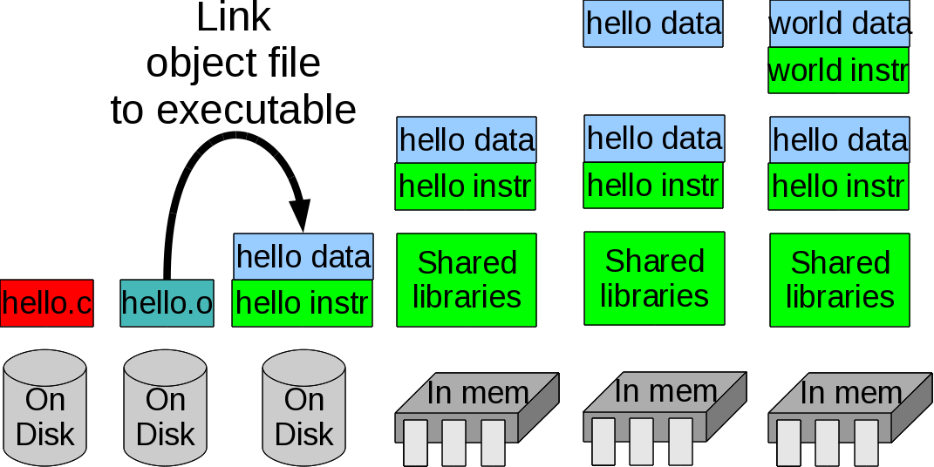
Next time: Linking!

