Slide 1
CSC 374/407: Computer Systems II
Lecture 2
Joseph Phillips
De Paul University
2014 April 8
Copyright © 2011 Joseph Phillips
All rights reserved

Slide 2


Reading
Bryant & O'Hallaron “Computer Systems, 2nd Ed.”
  Chapter 7: Linking
Hoover “System Programming”
  Program Management 6
  Libraries 8.1-8.3, 8.6, 8.7

Slide 3
Topics
Linkers
ELF
Dynamic Linking

Slide 4
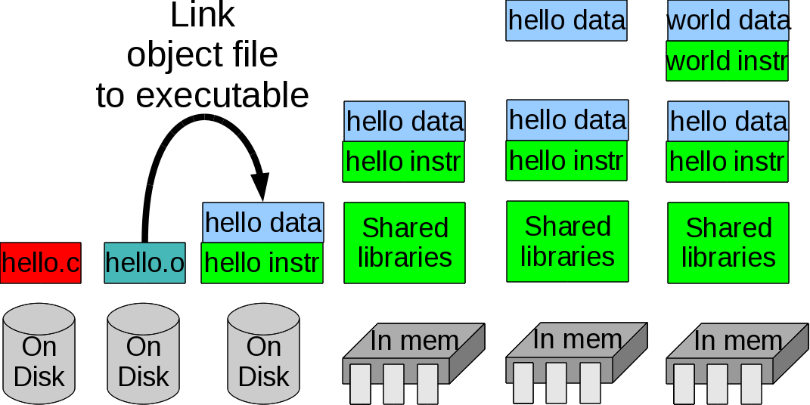
Today's topic (in time)
Linking object files into executable files

Slide 5
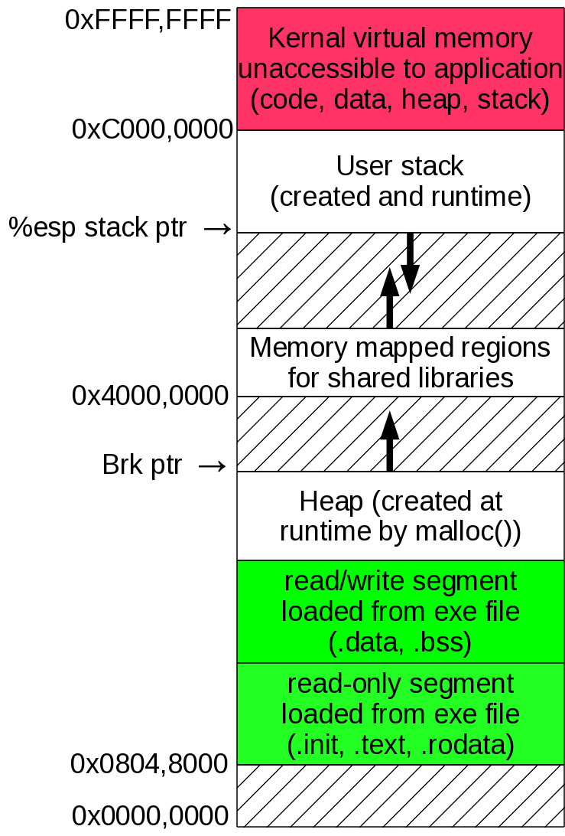
Today's topic (in space)
Parts of the program the compiler actually has to create

Slide 6
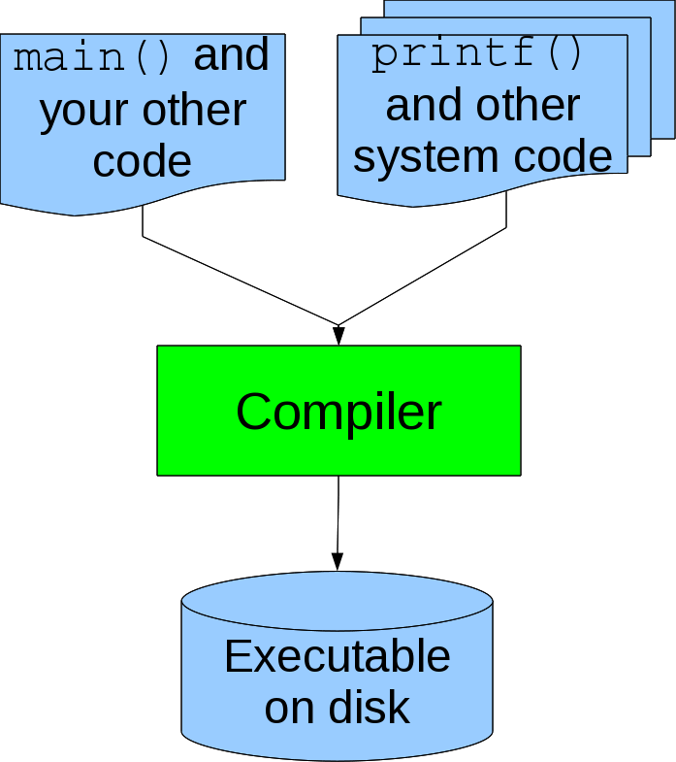
How would you write a compiler?
The direct approach:
One program to compile everything:
  Everything includes your code (naturally!)
  Everything includes standard library code too (hmm?)

Slide 7
What?!? Re-compiling library code again and again?!?
Sounds like a bad idea because
  It's a waste of time: mostly it doesn't change.
  So much for hiding implementation: When given easy-access to the source code some folks just can't stop themselves from trying to “optimize” their own code after seeing how the standard library code actually works. Even worse they can start to muck with it . . .
So, let's give them the library code in a post-compiled but pre-integrated into a program . . .

Slide 8
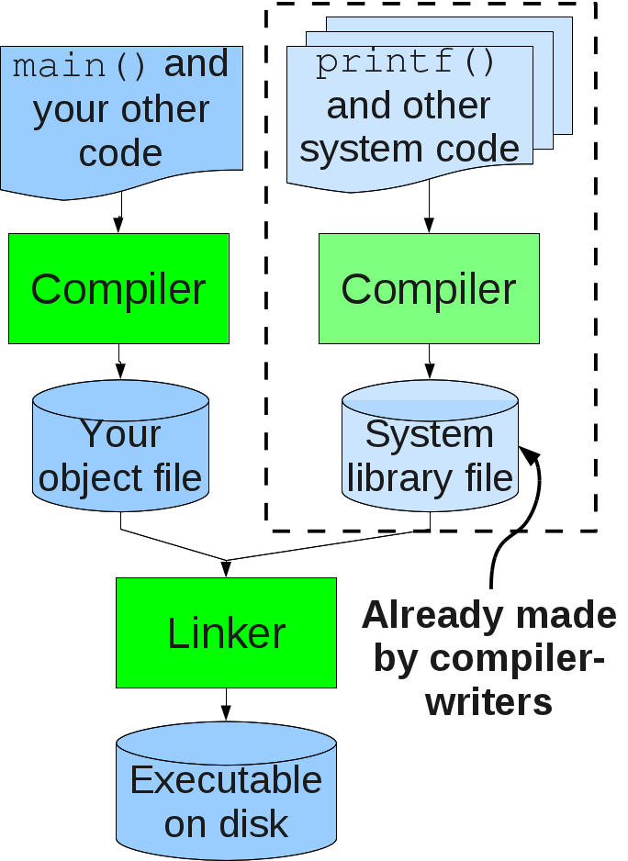
Enter the linker!
Compile standard code into libraries.
Distribute libraries to user-programmers
Programmers compile their own code to object files
Linkers combine object files + libraries into executable files

Slide 9
Linkers give you . . .
Modularity
  You can write your program as small files can compile them individually
  You can use the libraries of others or build your own
Efficiency
  Time: No need to re-compile everything if change one small file
  Space: Can incorporate from libraries only code that's actually used

Slide 10
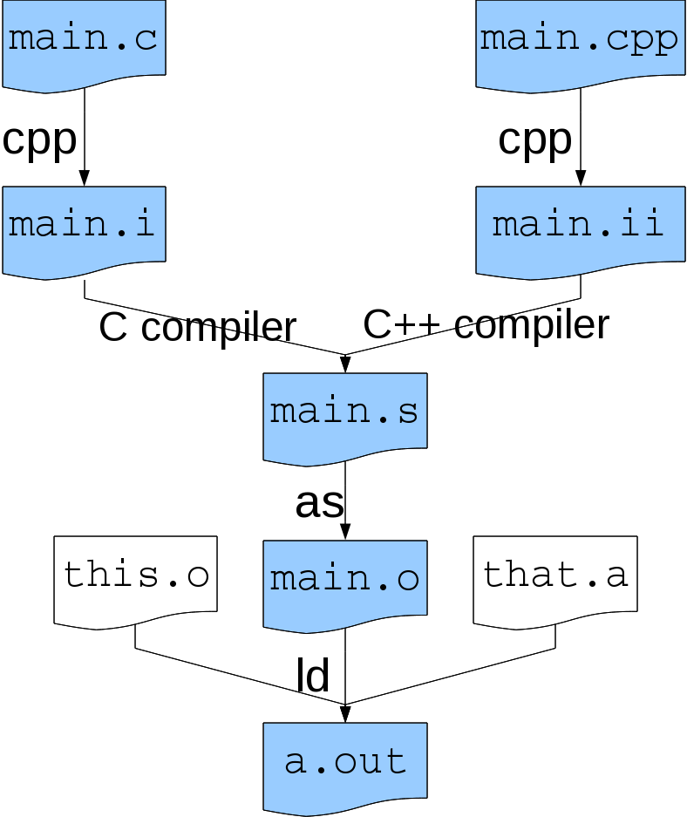
There's a linker under the hood?
You “But all I have to say is gcc main.c”
Prof Joe “Yes, 'cuz it does a number of things behind your back:”
  cpp: the C preprocessor
  The C/C++ compiler proper
  as: the assembler
  ld: the linker

Slide 11

Let's try!
You can tell gcc and g++ to stop along the way:
  gcc -E test.c # stop after preprocessing
    Output is post-processed C code to stdout
  gcc -S test.c # stop after compiling
    Output is assembly code in test.s
  gcc -c test.c # stop after assembling
    Output is object file test.o
  gcc test.c # Go all the way baby!
    Output is executable file a.out

Slide 12
How do Linkers Spend Their Time?
To merge object files they must:
  Resolve “external references:”
extern int externallyDefinedVar;
extern int externallyDefinedFunc(int);
int locallyDefinedGlobalVar;
int main ()
{
. . .
externallyDefinedVar=externallyDefinedFnc(5);
}
  Move all symbols from several object files to distinct places in executable
  Update symbol locations
  “Symbol” means either named code or data

Slide 13
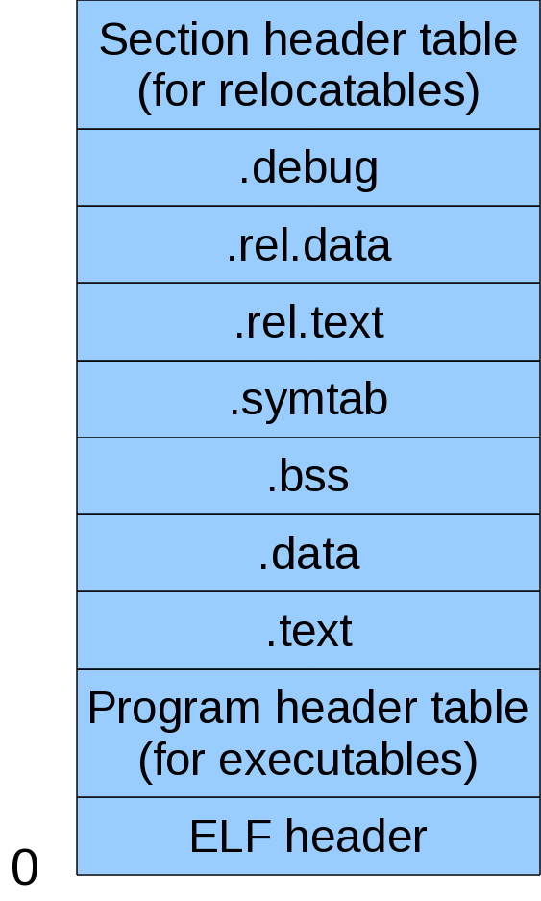
Executable and Link Format (ELF)
Assembler, Linker and Program Loader all need one format to describe object files and executables
ELF derived from AT&T Unix System V and BSD
Unifies description of:
  Relocatable object files (.o)
  Executables
  Shared object files (.so)

Slide 14
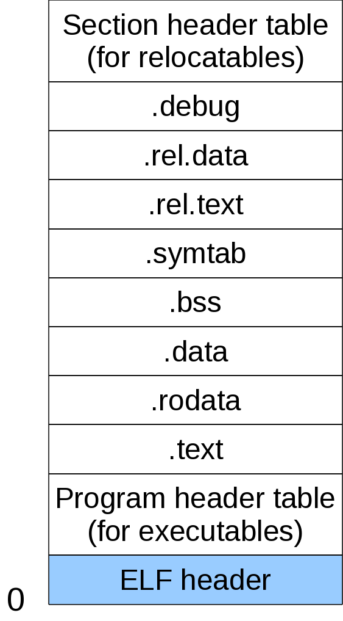
What's in an ELF?
ELF header:
  “Magic number” (Am I for Intel 386? Sparc Solaris? Something else?)
    Important for shared disk systems
  Byte ordering
    Big or little endian?
  Type
    .o? Executable? .so?

Slide 15
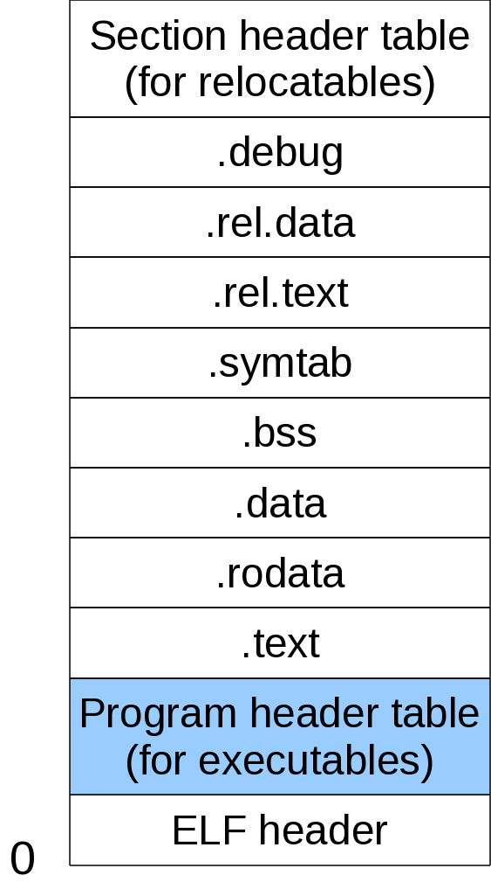
What's in an ELF?
Program header:
  OS-specific info like
    Page size
    Virtual address mem segments
    Segment sizes

Slide 16
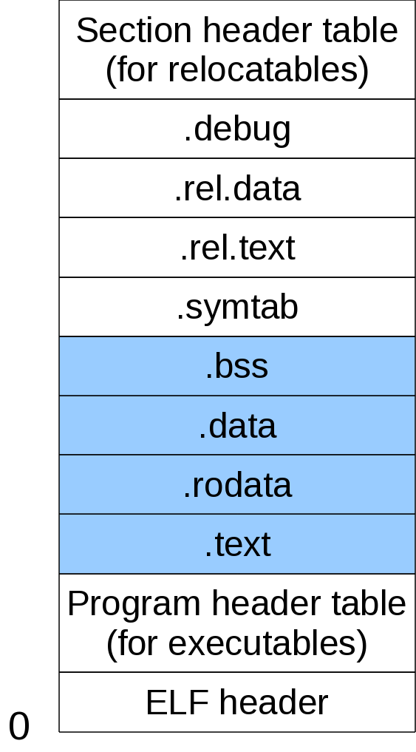
What's in an ELF?
.text
  Code (functions)
.rodata
  Read-Only consts (e.g. strings)
.data
  Global and static vars initialized to other than 0
.bss
  Global and static vars that start out 0
  (Why not in .data?)

Slide 17
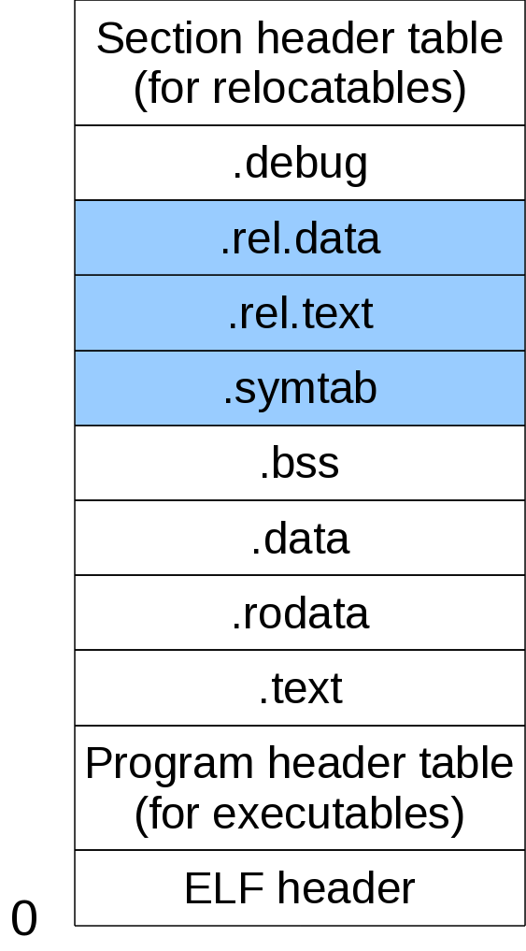
What's in an ELF?
.symtab
  Symbol table holds names and locations of functions, variables and sections
.rel.text
  Relocatable info for .text (which .text addresses need to be changed and how)
.rel.data
  Ditto for .data

Slide 18
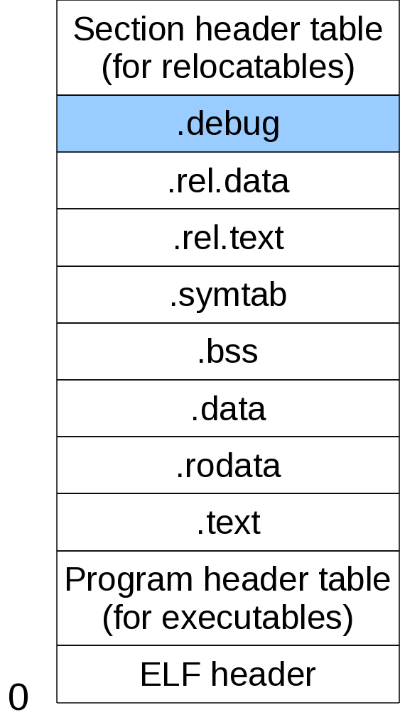
What's in an ELF?
.debug
  Information for gdb debugger
  Generated when compile with -g option

Slide 19
Don't be shy, let's look in an ELF
/* Sample program hello.c */
#include <stdlib.h>
#include <stdio.h>
int OS_EVERYTHING_OKAY = 0;
void helloWorld ()
{
puts("Hello world!");
}
int main ()
{
helloWorld();
return(OS_EVERYTHING_OKAY);
}
[jphillips@localhost lecture2]$ gcc -c hello.c # makes hello.o
[jphillips@localhost lecture2]$ gcc hello.c -o hello

Slide 20
Peering inside an ELF
readelf -h <file>
  Prints header info of .o .so and execs
[jphillips@localhost lecture2]$ readelf -h hello
ELF Header:
Magic: 7f 45 4c 46 01 01 01 00 00 00 00 00 00 00 00 00
Class: ELF32
Data: 2's complement, little endian
Version: 1 (current)
OS/ABI: UNIX - System V
ABI Version: 0
Type: EXEC (Executable file)
Machine: Intel 80386
Version: 0x1
Entry point address: 0x80483b0
Start of program headers: 52 (bytes into file)
Start of section headers: 2480 (bytes into file)
Flags: 0x0
Size of this header: 52 (bytes)
Size of program headers: 32 (bytes)
Number of program headers: 8
Size of section headers: 40 (bytes)
Number of section headers: 30
Section header string table index: 27

Slide 21
Peering inside an ELF
readelf -S <file>
  Prints info on sections
[jphillips@localhost lecture2]$ readelf -S hello
There are 30 section headers, starting at offset 0x9b0:
Section Headers:
[Nr] Name Type Addr Off Size ES Flg Lk Inf Al
[ 0] NULL 00000000 000000 000000 00 0 0 0
. . . .
[20] .jcr PROGBITS 08049694 000694 000004 00 WA 0 0 4
[21] .dynamic DYNAMIC 08049698 000698 0000e0 08 WA 6 0 4
[22] .got PROGBITS 08049778 000778 000004 04 WA 0 0 4
[23] .got.plt PROGBITS 0804977c 00077c 00001c 04 WA 0 0 4
[24] .data PROGBITS 08049798 000798 000008 00 WA 0 0 4
[25] .bss NOBITS 080497a0 0007a0 000008 00 WA 0 0 4
[26] .comment PROGBITS 00000000 0007a0 000114 00 0 0 1
[27] .shstrtab STRTAB 00000000 0008b4 0000fc 00 0 0 1
[28] .symtab SYMTAB 00000000 000e60 000450 10 29 46 4
[29] .strtab STRTAB 00000000 0012b0 000250 00 0 0 1
Key to Flags:
W (write), A (alloc), X (execute), M (merge), S (strings)
I (info), L (link order), G (group), x (unknown)
O (extra OS processing required) o (OS specific), p (processor specific)

Slide 22
Peering inside an ELF
readelf -s <file>
  Prints symbol table
[jphillips@localhost lecture2]$ readelf -s hello
Symbol table '.dynsym' contains 7 entries:
Num: Value Size Type Bind Vis Ndx Name
0: 00000000 0 NOTYPE LOCAL DEFAULT UND
1: 00000000 0 NOTYPE WEAK DEFAULT UND __gmon_start__
2: 00000000 0 NOTYPE WEAK DEFAULT UND _Jv_RegisterClasses
3: 00000000 438 FUNC GLOBAL DEFAULT UND __libc_start_main@GLIBC_2.0 (2)
4: 00000000 399 FUNC GLOBAL DEFAULT UND puts@GLIBC_2.0 (2)
5: 08048394 1020 FUNC GLOBAL DEFAULT UND __gxx_personality_v0@CXXABI_1.3 (3)
6: 08048588 4 OBJECT GLOBAL DEFAULT 15 _IO_stdin_used
Symbol table '.symtab' contains 69 entries:
Num: Value Size Type Bind Vis Ndx Name
0: 00000000 0 NOTYPE LOCAL DEFAULT UND
1: 08048134 0 SECTION LOCAL DEFAULT 1
2: 08048148 0 SECTION LOCAL DEFAULT 2
. . .

Slide 23
Peering inside an ELF
objdump -d -j <section> <file>
  Disassembles (“-d”) of <section> (“-j”) of <file>
[jphillips@localhost lecture2]$ objdump -d -j .text hello.o
hello.o: file format elf32-i386
Disassembly of section .text:
00000000 <helloWorld>:
0: 55 push %ebp
1: 89 e5 mov %esp,%ebp
3: 83 ec 08 sub $0x8,%esp
6: c7 04 24 00 00 00 00 movl $0x0,(%esp)
d: e8 fc ff ff ff call e <helloWorld+0xe>
12: c9 leave
13: c3 ret
00000014 <main>:
14: 8d 4c 24 04 lea 0x4(%esp),%ecx
18: 83 e4 f0 and $0xfffffff0,%esp
1b: ff 71 fc pushl -0x4(%ecx)
1e: 55 push %ebp
1f: 89 e5 mov %esp,%ebp
21: 51 push %ecx
22: 83 ec 04 sub $0x4,%esp
. . .

Slide 24
Peering inside an ELF
objdump -s -j <section> <file>
  Shows full hexadecimal contents (“-s”) of <section> (“-j”) of <file>
[jphillips@cdmlinux Lecture2]$ objdump -s -j .rodata hello.o
hello.o: file format elf32-i386
Contents of section .rodata:
0000 48656c6c 6f20776f 726c6421 00 Hello world!.

Slide 25
Now we know all about ELFs,
Put the linker to work!
/* one.c */
#include <stdlib.h>
#include <stdio.h>
int start = 0;
int stop = 100;
extern int sum ();
int main ()
{
printf("Sum from %d to %d is %d\n",
start,stop,sum()
);
return(EXIT_SUCCESS);
}
Which one.o section has:
  main()?
  stop?
  start?
  The string "Sum from %d to %d is %d\n"?
  How can we show this?

Slide 26
Now we know all about ELFs,
Put the linker to work!
Which two.o section has:
  sum()?
  addrOfStop?
  i and total?
    Think carefully!
  How can we show this?
/* two.c */
extern int start;
extern int stop;
int *addrOfStop = &stop;
int sum ()
{
int i;
int total = 0;
for (i = start; i <= *addrOfStop; i++)
total += i;
return(total);
}

Slide 27
Linking to make an executable
[jphillips@localhost]$ g++ -c one.c
[jphillips@localhost]$ g++ -c two.c
[jphillips@localhost]$ g++ -o oneTwo one.o two.o
Where in oneTwo are:
  start and stop? What are their values?
  addrOfStop? What is it's value?
  main() and sum()?

Slide 28
Your turn!
Write a program separated into three files:
  first.c: Has two characters (begin and end) and main() which calls enterBeginEnd() and printFromBeginToEnd().
  second.c: Has enterBeginEnd(), which asks for a first character (begin), and then asks for a second character (end). It must ensure end has greater or equal ASCII value.
    HINT: char array[SIZE]; printf("Enter..."); fgets(array,SIZE,stdin); begin = array[0];
  third.c: Has printFromBeginToEnd() which prints out the characters from begin to end and their ASCII values in decimal. (Use a simple for-loop)

Slide 29
Resolving references
The linker works for its money
  It puts the all the .text's together, all the .data's together, etc.
  It fills in the addresses of pointers, function calls, etc.
I wonder how we should refer to jmp and call addresses?
  Absolute addresses?
  Relative addresses?

Slide 30
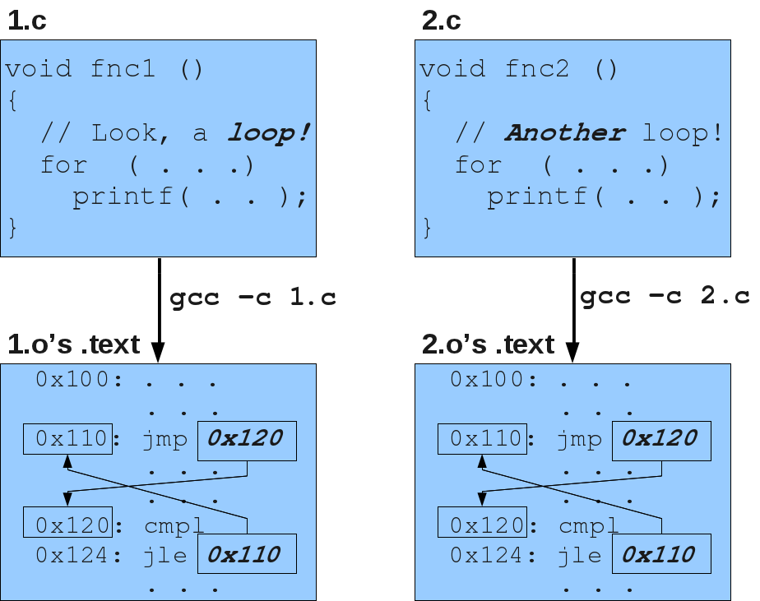
Absolute addressing: compiling
Hardcode addresses in jmp & call

Slide 31
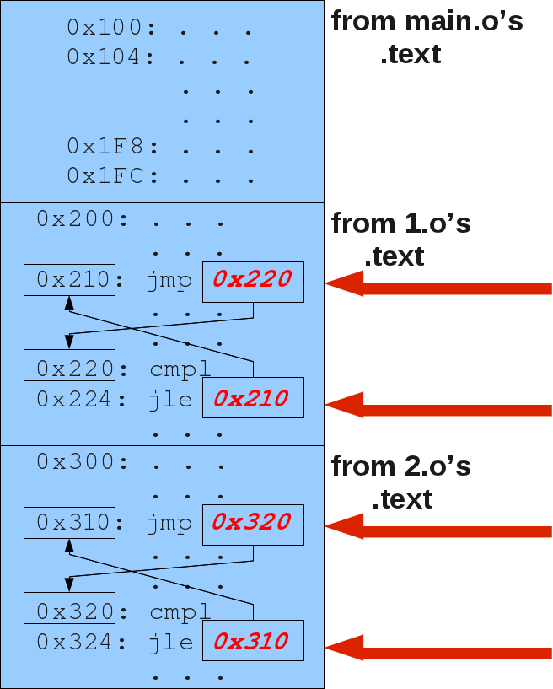

Absolute addressing: linking
Uh oh!
  The linker now has lots of work to clean change the addresses of all jmps and calls, even within same source .texts!
Sad linker!

Slide 32

Relative addressing: compiling
Tell offset (what to add to eip) in jmp & call

Slide 33
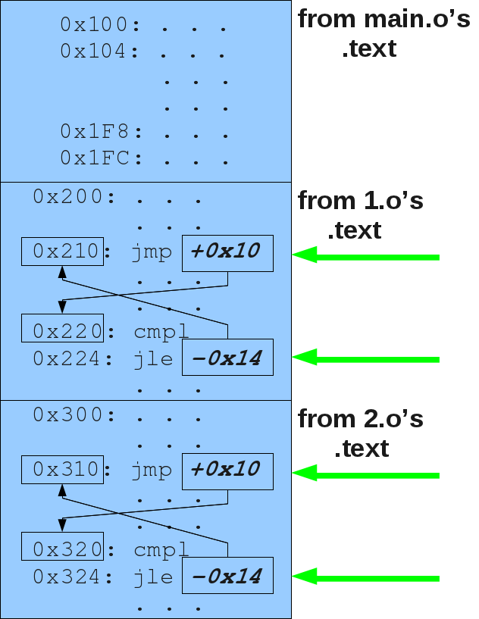

Relative addressing: linking
Easy street!
  The linker has nothing to do within same source .texts!
Happy linker!

Slide 34
Consider jmps in this loop:
#include <stdlib.h>
#include <stdio.h>
int main ()
{
int i;
for (i = 0; i < 10; i++)
printf("%d ",i);
printf("\n");
return(EXIT_SUCCESS);
}

Slide 35
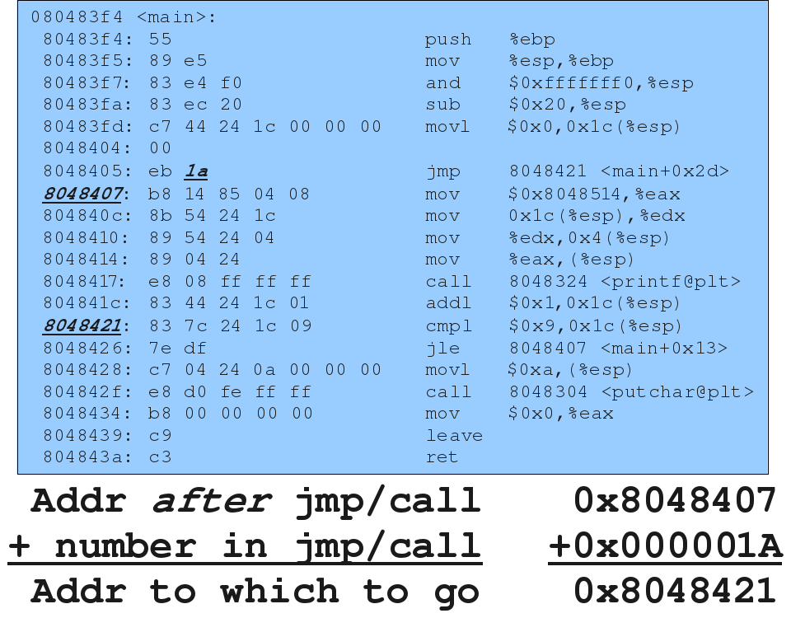
Relative jumps, example 1:

Slide 36
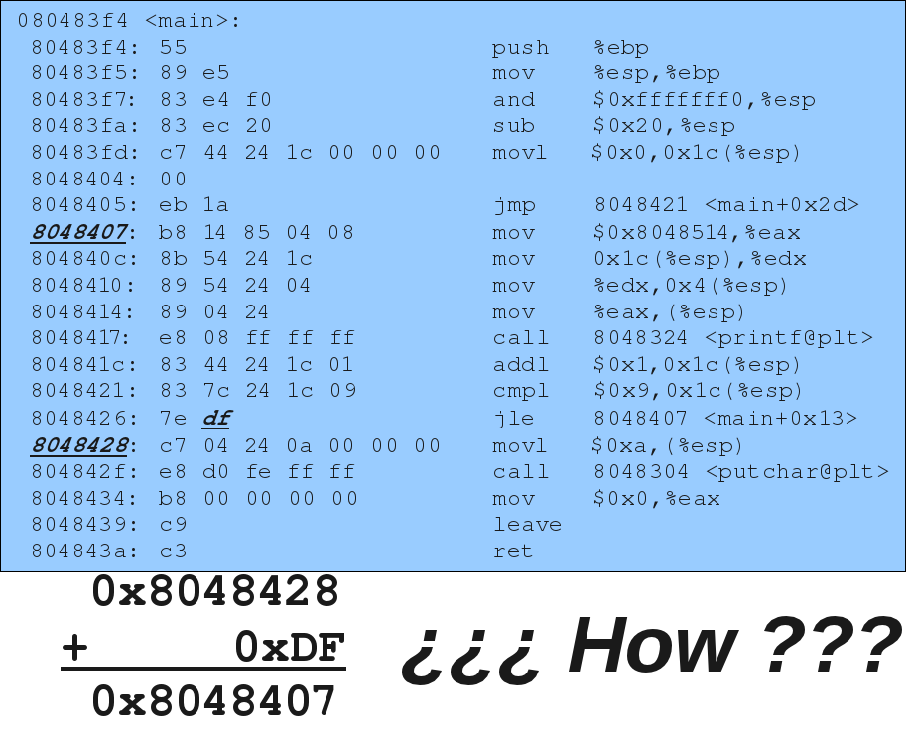
You explain this one:

Slide 37
Try explain the
math behind a call
in program you just
wrote

Slide 38
Strong and weak symbols
Strong symbols
  Initialized global vars
  Functions
Weak symbols:
  Uninitialized global vars
Rules:
  Only one strong symbol
  Weak symbols over ridden by strong
  If all weak linker can choose arbitrarily
// Strong
int initialized = 0;
// Weak
int unInit;
// Strong
int someFnc()
{
return(strong+weak);
}

Slide 39
Happy Linker :) or
Sad Linker :( ?
/* 1.c */
int var;
int someFnc()
{
. . .
}
/* 2.c */
int someFnc()
{
. . .
}

Slide 40
Happy Linker :) or
Sad Linker :( ?
/* 1.c */
int var;
int someFnc1()
{
. . .
}
/* 2.c */
int var;
int someFnc2()
{
. . .
}

Slide 41
Happy Linker :) or
Sad Linker :( ?
/* 1.c */
int var1;
int var2;
int someFnc1()
{
. . .
}
/* 2.c */
double var1;
int someFnc2()
{
. . .
}

Slide 42
Happy Linker :) or
Sad Linker :( ?
/* 1.c */
int var1 = 10;
int someFnc1()
{
. . .
}
/* 2.c */
double var1;
int someFnc2()
{
. . .
}

Slide 43
Don't take MY word for it . . .
// weakIntVar.c
#include <stdlib.h>
#include <stdio.h>
#define TEXT_LEN 16
extern void varAsFloat ();
int var;
void varAsInt ()
{
char text[TEXT_LEN];
printf("var(int) = %d, enter INT: ",
var);
fgets(text,TEXT_LEN,stdin);
var = strtol(text,NULL,10);
printf("var(int) = %d\n",var);
}
int main ()
{
while (1)
{
varAsInt();
varAsFloat();
}
return(EXIT_SUCCESS);
}
// weakFloatVar.c
#include <stdlib.h>
#include <stdio.h>
#define TEXT_LEN 16
float var;
void varAsFloat ()
{
char text[TEXT_LEN];
printf("var(float)=%g, enter FLOAT: ",
var);
fgets(text,TEXT_LEN,stdin);
var = strtod(text,NULL);
printf("var(float)=%g\n",var);
}

Slide 44
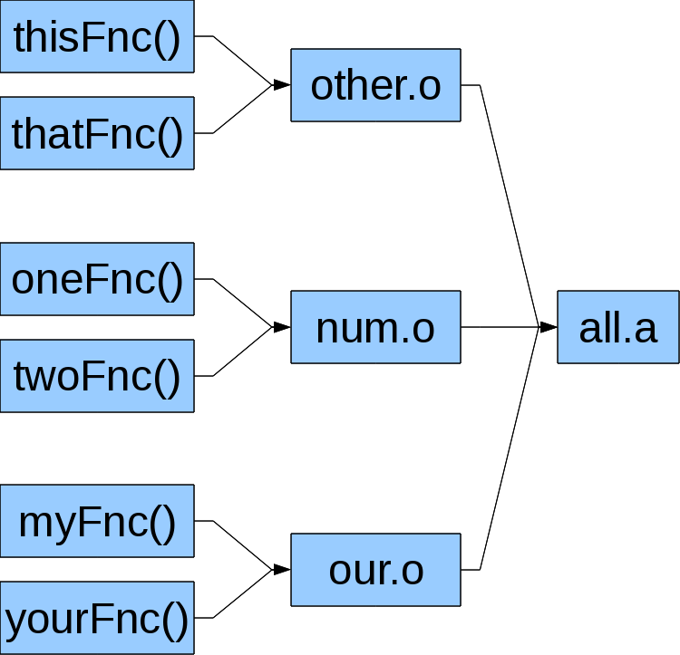
Static libraries (.a for “archives”)
Link related object files
  General C functionality /usr/lib/libc.a
  Math-related (sin(), cos(), etc.) /usr/lib/libm.a
  Cryptography /usr/lib/libcrypt.a
  Also for strings, graphics, etc.

Slide 45
Static libraries (.a for “archives”)
What's in them? Find out:
$ ar t /usr/lib/libcrypt.a
crypt-entry.o
md5-crypt.o
md5.o
sha256-crypt.o
sha256.o
sha512-crypt.o
sha512.o
crypt.o
crypt_util.o
How to make them?
$ ar rs all.a other.o num.o our.o
How to use them?
$ gcc -o myExecutable main.o -lm

Slide 46
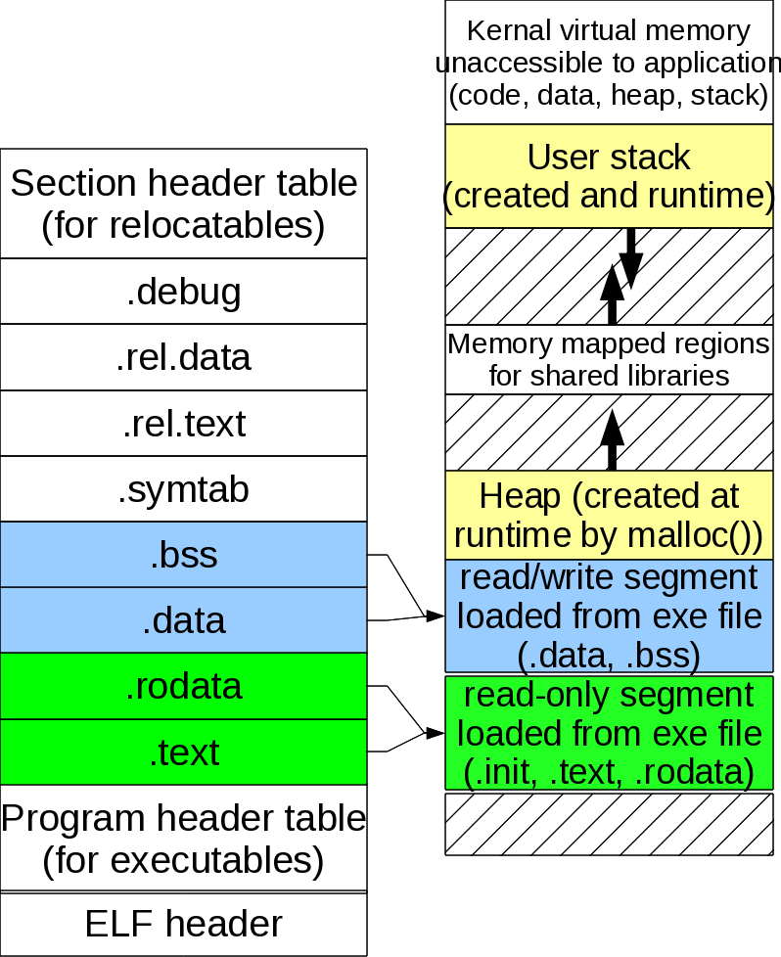
Got an executable? Load it!
.text to execute-only code pages
.rodata to read-only data pages
.data to read-write data pages
.bss expanded to 0-initialized data pages
Construct stack and heap pages

Slide 47
Hey! Aren't we wasting memory?
Almost any program written in C includes libc.a code for printf(), fgets(), etc.
  Wastes disk-space (many executables with same code)
  (Even worse) wastes memory (memory, of course, is faster and more scarce)

Slide 48
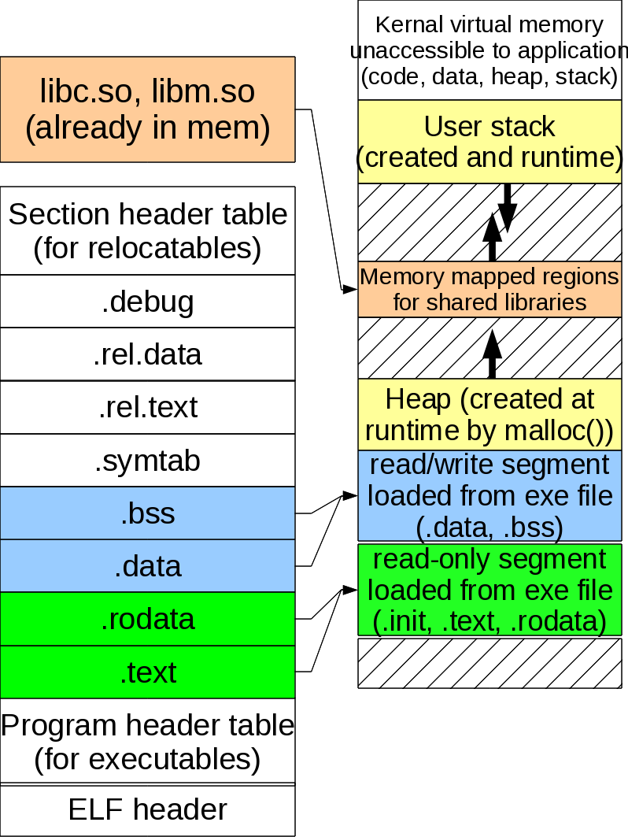
Solution: Dynamically Shared Libs
gcc -c myFile.c
gcc -o myFile.o -lspecial
When loading to execute, dynamically link with libc.so, libm.so, etc.

Slide 49
Don't dynamic linking?
Use -static flag to link libc.a instead of dynamically link with libc.so.
But it will cost you though:
[jphillips@local]$ gcc -c hello.c
[jphillips@local]$ gcc -o hello hello.o
[jphillips@local]$ gcc -static -o helloStatic hello.c
[jphillips@local]$ ls -l hello helloStatic
-rwxrwxr-x 1 4990 2011-01-11 07:03 hello
-rwxrwxr-x 1 546491 2011-01-11 07:03 helloStatic

Slide 50
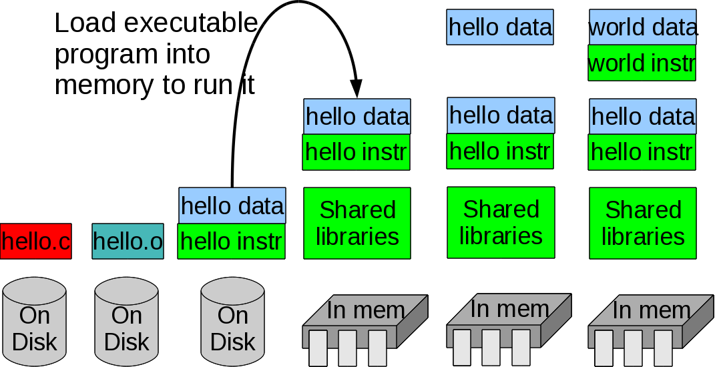
Next time: Loading and executing!

