Slide 1
CSC 374/407: Computer Systems II
Lecture 4
Joseph Phillips
De Paul University
2014 February 2
Copyright © 2011 Joseph Phillips
All rights reserved

Slide 2


Reading
Bryant & O'Hallaron “Computer Systems, 2nd Ed.”
  Chapter 8: Exception Control Flow
Hoover “System Programming”
  System Calls 7.1-7.4

Slide 3
Topics
Signals
setjmp() and longjmp()

Slide 4
Remember the shell . . .
Let's re-write our simple shell program from last time.
We may use:
  fork()
  execl(char* path, char* arg0, char* arg1, . . .)
  wait(int* statusPtr)
  waitpid(pid_t pid, int* statusPtr, int flag)

Slide 5
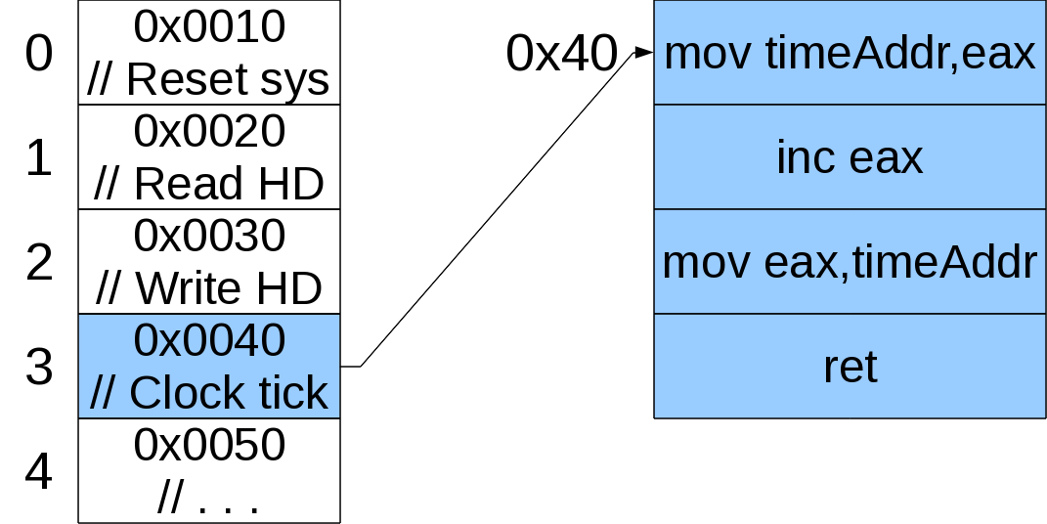
Remember: One interrupt vector table for whole computer

Slide 6
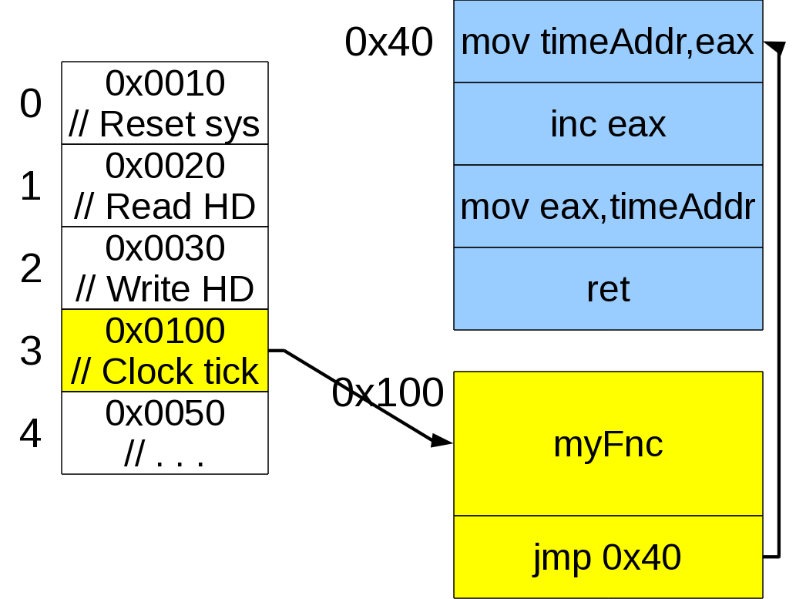
Remember how to do something periodically?

Slide 7
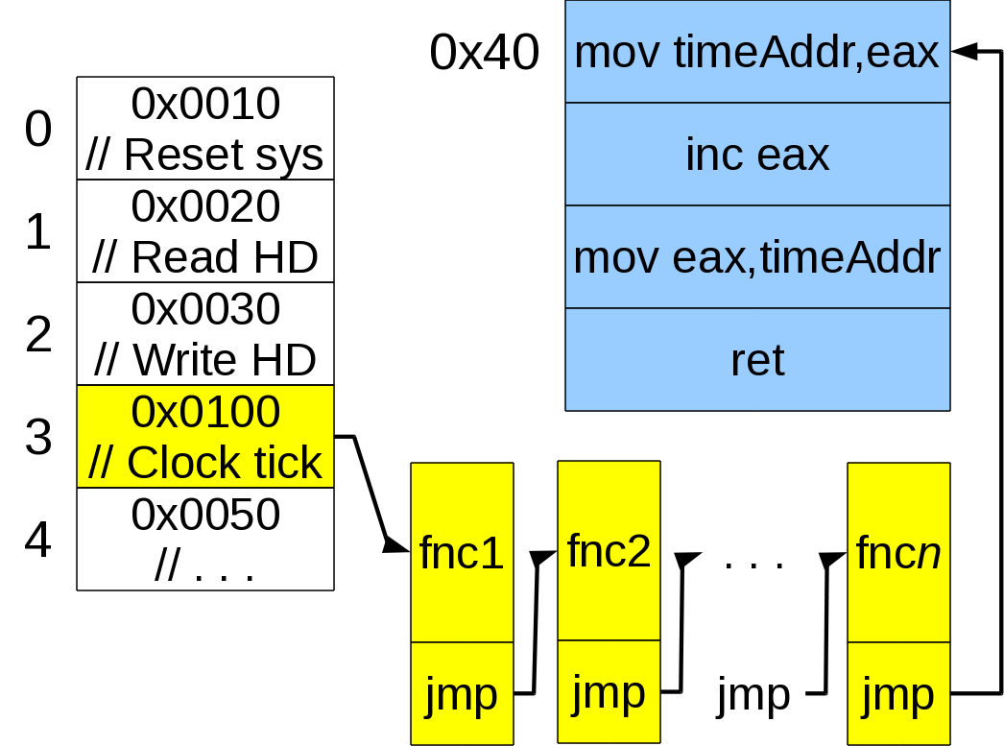
Is this technique efficient when there are many things to schedule?

Slide 8
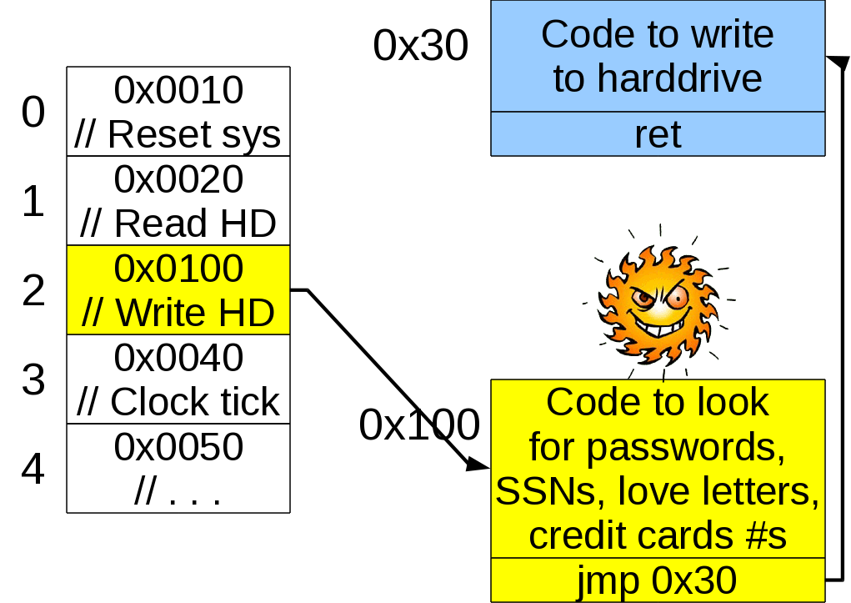
Is this technique secure?

Slide 9
Signals: a better idea
The whole computer still has its interrupt table
  Nobody can mess with it except OS and ROM BIOS
Each process has its own “personal” interrupt table
It's “interrupts” include
  You set the alarm and went to sleep(), now it's Time to wake up!
  Hey! One of your children just finished!
  Close things down and finish, or less politely . . .
  Die now!

Slide 10
List of signals (Linux i386) (1)
The default actions are:
  Term: terminate the process
  Core: terminate the process and dump the core
  Ign: ignore the signal
  Stop: stop the process
Signal Value Action Comment
-------------------------------------
SIGHUP 1 Term Hangup detected on controlling
terminal or death of controlling
process.
SIGINT 2 Term Interrupt from keyboard (Ctrl-C)
SIGQUIT 3 Core Quit from keyboard
SIGILL 4 Core Illegal Instruction
SIGABRT 6 Core Abort signal from abort(3)
SIGFPE 8 Core Floating point exception
SIGKILL 9 Term Kill signal

Slide 11
List of signals (Linux i386) (2)
Signal Value Action Comment
-------------------------------------
SIGSEGV 11 Core Invalid memory reference
SIGPIPE 13 Term Broken pipe: write to pipe with no
readers
SIGALRM 14 Term Timer signal from alarm(2)
SIGTERM 15 Term Termination signal
SIGUSR1 10 Term User-defined signal 1
SIGUSR2 12 Term User-defined signal 2
SIGCHLD 17 Ign Child stopped or terminated
SIGCONT 18 Continue if stopped
SIGSTOP 19 Stop Stop process
SIGTSTP 20 Stop Stop typed at tty
SIGTTIN 21 Stop tty input for background process
SIGTTOU 22 Stop tty output for background process

Slide 12
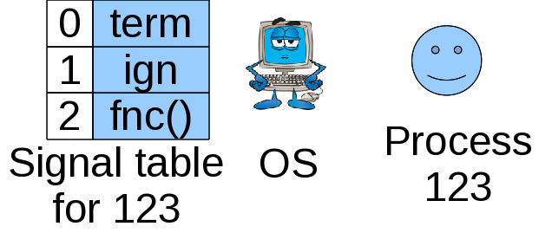
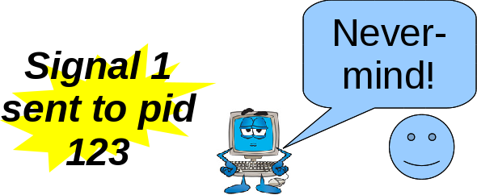
How OS handles signals (1)
Each process has its own signal table:
Some signals may be ignored or handled specially

Slide 13
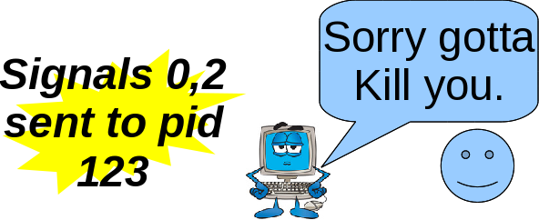
How OS handles signals (2)
Question: What happens if multiple signals of different number arrive around same time?
Answer: The lowest numbered signal takes precedence

Slide 14
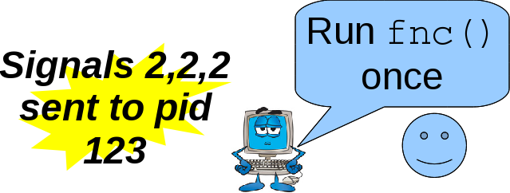
How OS handles signals (3)
Question: What happens if multiple signals of same number are pending?
Answer: Because they are not buffered, any called routine will only be called once and should be clever enough to handle any number of waiting cases.

Slide 15
A look at those actions
Signals so serious that can't be trapped, ignored:
  SIGSTOP: Stop that! (Restartable with SIGCONT)
  SIGKILL: Die now! Punk!
Other serious signals include:
  SIGILL: Illegal instruction (how could this happen?)
  SIGSEGV: Illegal memory reference (how could this happen?)
Other signals are less serious
  SIGCHLD: A child has finished (Hey, wouldn't wait() or waitpid() always catch this for us?)
  SIGINT: Ctrl-C
  SIGHUP: Controlling terminal hung-up (disconnected)

Slide 16
What does all this mean for me?
You the applications programmer get (some) control over your process' personal “interrupt table”
  Default action for this!
  Ignore that!
  Do it my way for the other!

Slide 17
sigaction()
(1) Defining a simple action
#include <signal.h>
int sigaction (int signum,
const struct sigaction* act,
struct sigaction* oldact);
Where:
struct sigaction
{
void (*sa_handler)(int); // Simple handler
void (*sa_sigaction)(int, siginfo_t*, void*);
// Funkier sig handler
sigset_t sa_mask; // Sigs to allow in handler
int sa_flags;//
void (*sa_restorer)(void);
};

Slide 18
Doing it! (1)
#include <signal.h>
void simpleHandle (int signalNum)
{
// Handling code here
}
int main ()
{
// Set up struct to specify the new action.
struct sigaction act;
memset(&act,'\0',sizeof(struct sigaction));
sigemptyset(&act.sa_mask);
act.sa_flags = 0;
. . .

Slide 19
Doing it! (2)
act.sa_handler = SIG_DFL;//Handle by default
sigaction(SIGINT,&act,NULL);
act.sa_handler = SIG_IGN;// Ignore SIGINT
sigaction(SIGINT,&act,NULL);
act.sa_handler = simpleHandler;
// Handle with simpleHandler()
sigaction(SIGINT,&act,NULL);
. . .
}

Slide 20
Your turn!
Write a program that
Prints “You can't stop me! Ngyeah-ngyeah, ngyeah-ngyeah!”
Pauses for 2 seconds
Goes back to 1.
Indefinitely, and that cannot be stopped by Ctrl-C.
(Question: Uh-oh, how can we stop it?)

Slide 21
Sending signals to processes (1)
Oh no! The program from the previous slide is still running!
  Ctrl-C can't stop it!
If we could send SIGKILL (9) we could stop it, but how?
$ kill -9 <processId>
  Question: How do we figure out the PID?
Forgive the bloodthirsty name, it should be called “sendSignal”

Slide 22
Sending signals to processes (2)
Process groups
  Each process belongs to a process group
  By default it's its parents group
  Can find out group pid_t getpgrp() in unistd.h.
  Can change group to one's own process id (or that of another process) int setpgid (pid_t pid, pid_t pgid)
  Can send signal to all processes in group by making process number negative
$ kill -9 -<processGroupId>

Slide 23
Back to the actions!
Some actions are un-ignorable and un-handle-able:
  QUESTION: Name 2 or 3 which you think are.
  QUESTION: Why?
Handlers should have form void someName (int sigNum)
  QUESTION: Why is the return type void?
  QUESTION: Why does it take the signal number as the sole parameter?

Slide 24
Your turn again!
Same as before, except this time each time the user does press Ctrl-C it randomly prints one of the following:
  “Ouch!”
  “Stop that!”
  “That hurts!”
  “Mercy!”
HINT: Use switch (rand() %4) { .. } to jump to cases 0 to 3 randomly

Slide 25
Sending signals to processes (3)
Application programs can signal each other too!
#include <sys/types.h>
#include <signal.h>
int kill (pid_t procToSignal, int sigToSend);
Again, forgive the bloodthirsty name, it should be called “sendSignal()”

Slide 26
Back to the shell
Our shell program waited for child process to finish.
Revise it so that it may have multiple children (ie. one of the children can run in the “background”)
The background child process can finish at any time. (When it does SIGCHLD is sent to the parent, but by default this signal is ignored.)
Reap the child so it doesn't remain a zombie too long.
HINT: use:
action.sa_flags =
SA_NOCLDSTOP// No SIGCHLD on stop(pause) or resume
|SA_RESTART; // If interrupted in sys call then
// restart sys call after sig handler

Slide 27
Back to the shell (2)
If multiple children finish around the same time will the different SIGCHLD signals be queued?
How can we revise our previous program to leave no zombies?
  HINT: wait() quits if there is nothing for to wait.

Slide 28
sigaction()
(2) Defining more complex actions
#include <signal.h>
int sigaction (int signum,
const struct sigaction* act,
struct sigaction* oldact);
Where:
struct sigaction
{
void (*sa_handler)(int); // Simple handler
void (*sa_sigaction)(int, siginfo_t*, void*);
// Funkier sig handler
sigset_t sa_mask; // Sigs to allow in handler
int sa_flags;//
void (*sa_restorer)(void);
};

Slide 29
Look at all the goodies in siginfo_t (1)
siginfo_t
{
int si_signo; // Signal number
int si_errno; // An errno value
int si_code; // Signal code
int si_trapno; // Trap number that caused
// hardware-generated signal
// (unused on most archs.)
pid_t si_pid; // Sending process ID
uid_t si_uid; // User ID of sending proc
int si_status; // Exit value or signal
clock_t si_utime; // User time consumed
clock_t si_stime; // System time consumed
sigval_t si_value; // Signal value
int si_int; // POSIX.1b signal
void *si_ptr; // POSIX.1b signal
. . .

Slide 30
Look at all the goodies in siginfo_t (2)
. . .
int si_overrun; // Timer overrun count;
// POSIX.1b timers
int si_timerid; // Timer ID;
// POSIX.1b timers
void *si_addr; // Mem loc that caused fault
long si_band; // Band event (was int in
// glibc 2.3.2 and earlier)
int si_fd; // File descriptor
short si_addr_lsb; // Least sign. bit of addr.
// (since kernel 2.6.32)
}

Slide 31
sigaction() (Example 2a)
/* More advanced sig handlers take */
/* tell which process sent the signal */
#include <signal.h>
#include <string.h>
#include <stdio.h>
void signal_handler
(int sig, siginfo_t* infoPtr, void* dataPtr)
{
printf("signal:[%d], pid:[%d], uid:[%d]\n",
sig,
infoPtr->si_pid,
infoPtr->si_uid );
// dataPtr is not used so much
}

Slide 32
sigaction() (Example 2b)
int main (int argc, char *argv[])
{
struct sigaction sa;
memset(&sa,'\0',sizeof(struct sigaction));
sigemptyset(&sa.sa_mask );
sa.sa_flags= SA_SIGINFO //Install sa_sigaction
// (as opposed to
// sa_handler)
| SA_RESTART;//If interrupted in
// sys call then
// restart sys call
// after signal handler
sa.sa_sigaction = signal_handler;
sigaction(SIGINT, &sa, NULL);

Slide 33
sigaction() (Example 2c)
int i;
for (i = 0; i < 60; i++)
{
printf("%2d of 60\n",i);
sleep (1);
}
return(EXIT_SUCCESS);
}

Slide 34
Our turn!
Write a program that forks a process.
The child process should print its PID.
The child should also install a SIGINT handler.
When the child receives SIGINT it is being tickled.
The parent enters a loop:
(1) wait for user to press enter
(2) send SIGINT to child
Child enters sleep(1) loop.
When the parent tickles the child says
“Hee hee, that tickles!”
When any other process tickles the child says “Keep your hands to yourself, MISTER!”

Slide 35
sigaction()
(3) Seeing what already is being done
#include <signal.h>
int sigaction (int signum,
const struct sigaction* act,
struct sigaction* oldact);
Where:
struct sigaction
{
void (*sa_handler)(int), // Simple handler
void (*sa_sigaction)(int, siginfo_t*, void*);
// Funkier sig handler
sigset_t sa_mask; // Sigs to allow in handler
int sa_flags;//
void (*sa_restorer)(void);
};

Slide 36
sigaction() Continued!
Install SIGINT handler if not already ignoring:
int main ()
{
struct sigaction newAction, oldAction;
//Define ctrlCHandler that wont block other sigs
newAction.sa_handler = ctrlCHandler;
sigemptyset (&newAction.sa_mask);
newAction.sa_flags = 0;
// See what is currently done for SIGINT
sigaction (SIGINT, NULL, &oldAction);
// Install new handler if not currently ignoring
if (oldAction.sa_handler != SIG_IGN)
sigaction (SIGINT, &newAction, NULL);
. . .

Slide 37
sigaction()
But wait! There's more!
Way more detail!
See $ man sigaction

Slide 38

SIGALRM
#include <unistd.h>
unsigned int alarm(unsigned int secs);
If secs>0 then tells OS “Send SIGALRM to me secs seconds in the future”
If secs==0 then tells OS “Clear any alarms I may have set”
Either case returns number seconds until next (now cleared) alarm, or 0 if there were none.

Slide 39
Your turn!
Write a program that:
(1) Let's the user type in how many seconds they want to wait until an alarm goes off
(2) Continually prints “Tick-tock” until the alarm goes off. Then it prints “Ding-ding” and stops.
(3) If the user press Ctrl-C then it prints how many seconds are left and waits for the user to press Enter. Then it goes back to (2).

Slide 40
setjmp() and longjmp()
Old school C way of doing error recovery
int setjmp(jmp_buf j)
  Memorize both position in code (%eip) and position on stack (%esp) inside buffer j.
  First time it's called returns 0 (so you know this is the installation case).
void longjmp(jmp_buf j, int i)
  Uh-oh! We have a hard-to-recover-from error!
  Set %eax to i, jump back to “safe” state described in j.

Slide 41
Use
jmp_buf j; // Put in global context
int main()
{
if (setjmp(j) != 0)
{
// Handle error
}
attemptToDoSomethingErrorProne();
}
void attemptToDoSomethingErrorProne()
{
if (haveMessedUp == 1)
longjmp(j,1);
}

Slide 42
Abuse
/* Question: Will this behave properly? */
jmp_buf j; // Put in global context
int main()
{
foo();
bar();
}
void foo () void bar ()
{ {
if (setjmp(j) != 0) if (haveMessedUp==1)
{ longjmp(j,1);
// Handle error }
}
}

Slide 43
Bottom line on setjmp() and longjmp()
If you use them be sure you longjmp() to a function that is still on the stack.
Question: What modern error-trapping technique is in C++, Java, etc. that makes this C construct not necessary?

Slide 44
Next time: Threads!

