Slide 1
CSC 374/407: Computer Systems II
Lecture 6
Joseph Phillips
De Paul University
2014 July 19
Copyright © 2012-2014 Joseph Phillips
All rights reserved

Slide 2



Reading
Bryant & O'Hallaron “Computer Systems, 2nd Ed.”
  Chapter 9.1-9.8: Virtual Memory
  Chapter 9.9: Dynamic Memory Allocation
Hoover “System Programming”
  Chap 4: Pointers and Structures
    Especially: 4.2.3: Dynamic Memory Allocation

Slide 3
Topics
The heap
  Heap Motivation
  Heap Programming at C level (glibc)
    malloc(), free(), calloc() and realloc()
    How not to abuse the heap
  Heap Programming at OS level (Linux)
    getrlimit(), setrlimit(), brk(), sbrk()
C-Strings
  Buffer overflow attacks
  Preventing buffer overflow attacks
Linux virtual memory and paging

Slide 4
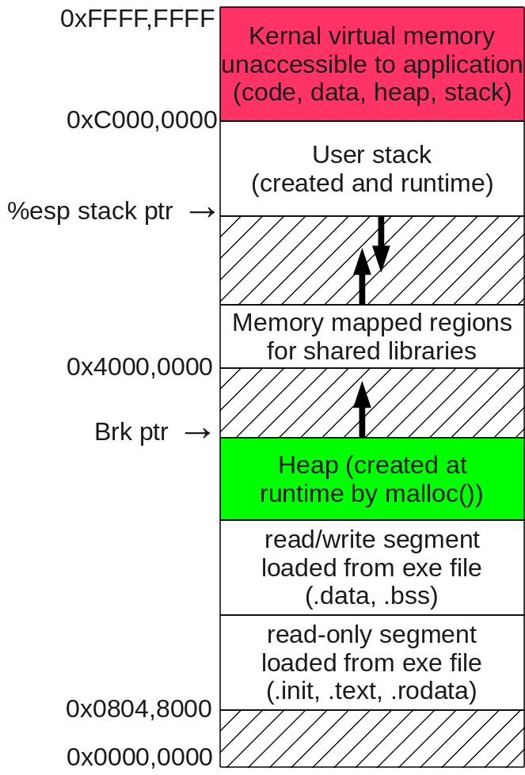
Today's topic (in space)
Runtime heap

Slide 5
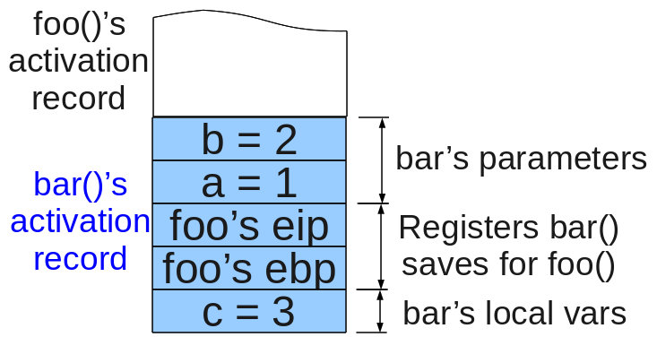
We all know that local vars live on the stack
int bar (int a, int b)
{
int c = a + b;
return(c);
}
int foo ()
{
int x = bar(1,2);
. . .

Slide 6
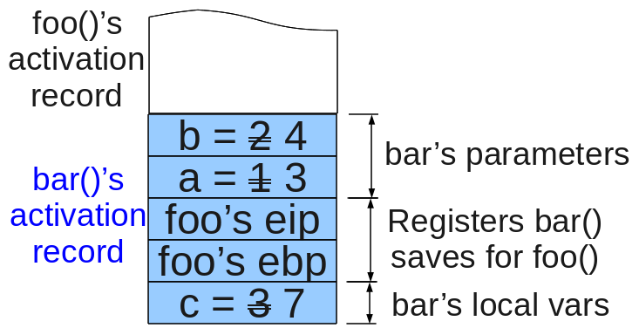
And we all know that the stack gets overwritten by subsequent function calls
int bar (int a, int b)
{
int c = a + b;
return(c);
}
int foo ()
{
int x = bar(1,2);
x = bar(3,4);
. . .

Slide 7
Question?
But what if you
want your object to
persist?

Slide 8
Answer!
MyClass* bar()
{
return new MyClass(1,2);
}
void foo()
{
MyClass ptr;
ptr = bar();
. . .
delete(ptr);
Put it
on the heap!

Slide 9
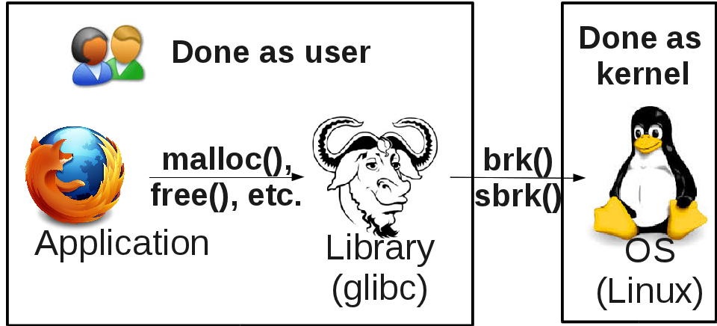
Two “folks” we have to ask for heap memory:

Slide 10

First: Ordinary C heap programming (glibc)

Slide 11
Heap Programming
void* malloc(size_t numBytes)
  Allocate numBytes bytes from heap and return pointer (allocates in page table, not necessarily main memory!)
  Returns NULL if error like not enough space.
  Returned pointer should be cast to a more specific type before using:
int* intPtr = (int*)malloc(sizeof(int));
char* charPtr = (char*)malloc(strlen(sourcePtr)+1);
void free (void* ptr)
  Return memory back to system

Slide 12
malloc() and free() example
#include <stdlib.h>
#include <stdio.h>
int main ()
{
int* iPtr;
iPtr = (int*)malloc(sizeof(int));
*iPtr = 14;
printf("iPtr = %p, *iPtr = %d\n",
iPtr,*iPtr
);
free(iPtr); // Very important!
return(EXIT_SUCCESS);
}

Slide 13
realloc() and calloc()
void* calloc(size_t nmemb, size_t size);
  Allocates an array of nmemb members, each of size bytes.
  Initializes memory to byte all 0’s
  (Some claim this wastes time.)
void* realloc(void *ptr, size_t size);
  “Re-allocates” by extending memory allocated at pointer, or by (1) getting size bytes, (2) copying from ptr into new memory, and (3) free()-ing old memory

Slide 14
realloc() and calloc() example
#include <stdlib.h>
#include <stdio.h>
#define NUM_ELE 4
int main ()
{
int* iPtr;
int* iPtr2;
int i;
iPtr = (int*)calloc(NUM_ELE,sizeof(int));
iPtr2 = (int*)calloc(NUM_ELE,sizeof(int));
for (i = 0; i < NUM_ELE; i++)
{ // Any other ways to access?
iPtr[i] = i*10;
}

Slide 15
realloc() and calloc(), contd
for (i = 0; i < NUM_ELE; i++)
printf("%3d is at %p\n",
*(iPtr+i),(iPtr+i)
);
printf("Uh-oh, not enough space!\n");
iPtr=(int*)realloc(iPtr,4*NUM_ELE*sizeof(int));
for (i = 0; i < 4*NUM_ELE; i++)
printf("%3d is at %p\n",
*(iPtr+i),(iPtr+i)
);
free(iPtr2); // Very important!
free(iPtr); // Very important!
return(EXIT_SUCCESS);
}

Slide 16
realloc() and calloc(), contd
[instructor@localhost Lecture06]$ ./reallocAndCalloc1
0 is at 0x84f2008
10 is at 0x84f200c
20 is at 0x84f2010
30 is at 0x84f2014
Uh-oh, not enough space!
0 is at 0x84f2038
10 is at 0x84f203c
20 is at 0x84f2040
30 is at 0x84f2044
0 is at 0x84f2048
0 is at 0x84f204c
0 is at 0x84f2050
0 is at 0x84f2054
0 is at 0x84f2058
0 is at 0x84f205c
0 is at 0x84f2060
0 is at 0x84f2064
0 is at 0x84f2068
0 is at 0x84f206c
0 is at 0x84f2070
0 is at 0x84f2074

Slide 17
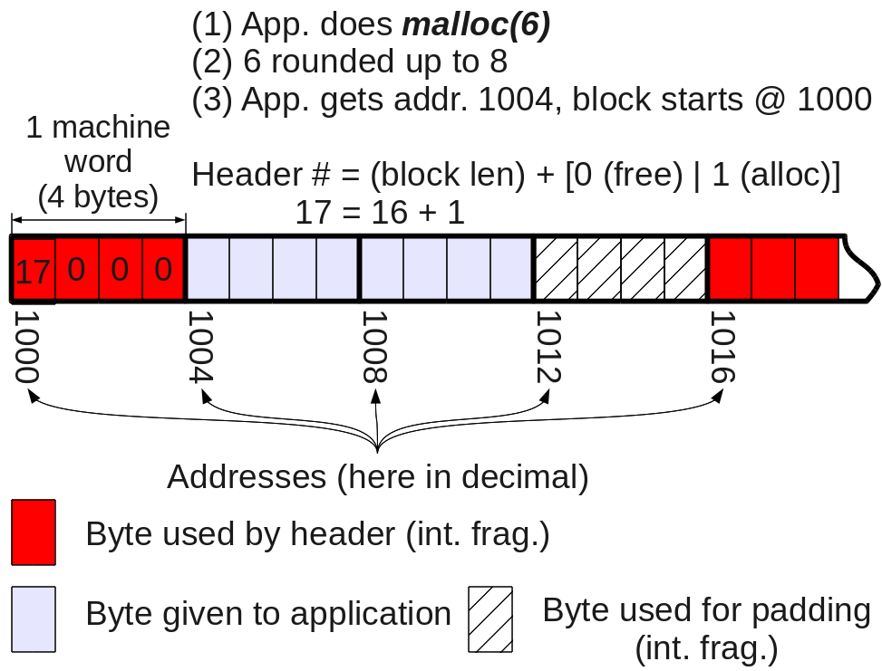
Datastructure for heap management

Slide 18
Algorithm for heap management
How do we keep track of malloc()s and free()s in heap?
Desireable algorithms should:
  Be efficient (maximize space for app. data)
    Minimize internal fragmentation (space used in allocated block for bookkeeping and padding)
    Minimize external fragmentation (unused space between allocated blocks)
  Be fast!
  Be robust (detect app errors)
  Be sensitive to spatial locality (put similar sized items “close” to each other)
  Be thread safe

Slide 19
Your turn!
Question 1:
  Why do you think it changed addresses between the calloc() and the realloc()?
  Can you test that hypothesis?
Question 2:
  Do you think the newly allocated space is guaranteed to by initialized to 0?
  Can you test that hypothesis?

Slide 20

A Rogue's Gallery of the All-Time WORST memory offenses
Twirl your mustaches and
enter at your own risk!

Slide 21
How NOT to use the heap: Memory leak
// Very subtly wrong. What are the symptoms?
#include <stdlib.h>
#include <stdio.h>
int main ()
{
int* iPtr;
iPtr = (int*)malloc(sizeof(int));
*iPtr = 14;
printf("iPtr = %p, *iPtr = %d\n",
iPtr,*iPtr
);
return(EXIT_SUCCESS);
}

Slide 22
How NOT to use the heap:
Double free
#include <stdlib.h>
#include <stdio.h>
int main ()
{
int* iPtr;
iPtr = (int*)malloc(sizeof(int));
*iPtr = 14;
printf("iPtr = %p, *iPtr = %d\n",
iPtr,*iPtr
);
free(iPtr);
free(iPtr);
return(EXIT_SUCCESS);
}

Slide 23
How NOT to use the heap:
Wild-write 1
#include <stdlib.h>
#include <stdio.h>
int main ()
{
int* iPtr;
iPtr = (int*)malloc(sizeof(int));
*(iPtr-1) = 14;
printf("iPtr = %p, *iPtr = %d\n",
iPtr,*iPtr
);
free(iPtr);
return(EXIT_SUCCESS);
}

Slide 24
How NOT to use the heap:
Freed memory access
#include <stdlib.h>
#include <stdio.h>
int main ()
{
int* iPtr;
iPtr = (int*)malloc(sizeof(int));
*iPtr = 14;
printf("iPtr = %p, *iPtr = %d\n",
iPtr,*iPtr
);
free(iPtr);
(*iPtr)++; // Not yet finished
return(EXIT_SUCCESS);
}

Slide 25
How NOT to use the heap:
Uninitialized mem access
#include <stdlib.h>
#include <stdio.h>
int main ()
{
int* iPtr;
*iPtr = 14;
printf("iPtr = %p, *iPtr = %d\n",
iPtr,*iPtr
);
return(EXIT_SUCCESS);
}

Slide 26
This is how glibc complains:
*** glibc detected *** wildwrite: munmap_chunk(): invalid pointer: 0x08f71008 ***
======= Backtrace: =========
/lib/libc.so.6[0x49b8b9f2]
/lib/libc.so.6[0x49b8bc6b]
wildwrite[0x8048524]
/lib/libc.so.6(__libc_start_main+0xf3)[0x49b2c6b3]
wildwrite[0x8048441]
======= Memory map: ========
08048000-08049000 r-xp 00000000 fd:03 397997
./wildwrite
08049000-0804a000 rw-p 00000000 fd:03 397997
./wildwrite
08f71000-08f92000 rw-p 00000000 00:00 0 [heap]
. . .

Slide 27
And this is how Linux complains:
Segmentation fault (core dumped)

Slide 28
Your turn!
Fix the following function that should copy a string into memory allocated from the heap:
char* naughtyCopy (const char* fromP)
{
char* toP;
for ( ; *fromP != ’\0’; fromP++, toP++)
*toP = *fromP;
free(fromP);
return(toP);
}

Slide 29

Second: OS's heap interface

Slide 30
OS's heap tools
A process can put limits on how big it's heap is allowed to grow
  getrlimit(), setrlimit()
  Soft-limit: limits how much heap (or stack, CPU, etc.) a process is allowed to use
    Any process can set
  YOUR TURN: Why would a process want to do this?
  Hard-limit: limits the soft limit
    Only privileged processes may set
A process can get heap pages directly from OS:
  brk(), sbrk()

Slide 31
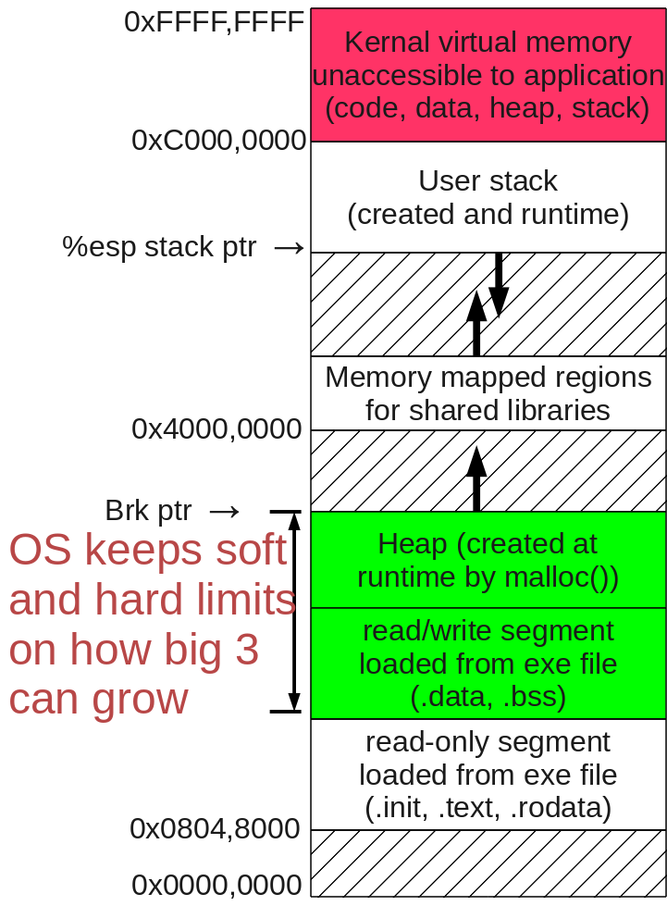
OS’s view of heap
#include <stdlib.h>
#include <stdio.h>
#include <sys/resource.h>
#include <errno.h>
int main ()
{
struct rlimit resouceLimit;
if ( getrlimit(RLIMIT_DATA, &resouceLimit) ) {
perror("getrlimit(RLIMIT_DATA) failed");
return(EXIT_FAILURE);
}
printf("Process' combined max Data,"
" ROData and heap sizes:\n");
printf("Soft:\t");
if (resouceLimit.rlim_cur == RLIM_INFINITY)
puts("(Unlimited)");
else
printf("%lu\n",resouceLimit.rlim_cur);
printf("Hard:\t");
if (resouceLimit.rlim_max == RLIM_INFINITY)
puts("(Unlimited)");
else
printf("%lu\n",resouceLimit.rlim_max);
return(EXIT_SUCCESS);
}

Slide 32
OS’s view of heap, cont’d
#include <unistd.h>
int brk(void *endDataSeg);
  sets end of data segment when
    (1) value is reasonable,
    (2) system has memory,
    (3) process doesn’t exceed max data size
void *sbrk(intptr_t inc);
  increments data space by inc bytes
  Not a system call, it is just a C library wrapper.
  sbrk(0) finds current ptr value.
WARNING: YOU ARE malloc() and free()!
  Manually do what GNU C Library (glibc) does for you

Slide 33
Check this out!
A program that recursively
  Prints the current value of the brk pointer.
  Asks (in hexadecimal) how many bytes to allocate
  Allocates those bytes
  Prints the difference between the brk pointer and the end of the allocated block
  Recursively goes back to (1)
Useful stuff:
  strtol("FF",NULL,16) returns integer 0xFF

Slide 34
moveBrkPtr3.c
#include <stdlib.h>
#include <stdio.h>
#include <unistd.h>
#include <errno.h>
#include <string.h>
#define TEXT_LEN 10
void doIt ()
{
char text[TEXT_LEN];
printf("sbrk is now "
" %010p\n",
sbrk(0)
);
printf("How much mem IN HEXADECIMAL "
"do you want (0-8000,0=quit)? "
);
fgets(text,TEXT_LEN,stdin);
int size = strtol(text,NULL,16);
if (size <= 0)
return;
void* ptr = malloc(size);
if (errno == ENOMEM)
{
printf("Out of memory, Boss!\n");
return;
}
printf("You just got addresses:"
" %010p - %010p.\n",
ptr,ptr+(size-1)
);
printf("sbrk- blockEnd: %010p -"
" %010p = %010p\n",
sbrk(0),
ptr+(size-1),
sbrk(0)-(ptr+(size-1))
);

Slide 35
moveBrkPtr3.c, cont'd
doIt();
printf("Now freeing %p\n",ptr);
free(ptr);
}
int main ()
{
doIt();
return(EXIT_SUCCESS);
}

Slide 36
Using moveBrkPtr2.c
$ ./moveBrkPtr2
sbrk is now 0x0957e000
How much mem IN HEXADECIMAL do you want (0-8000, 0=quit)? 8000
You just got addresses: 0x0957e008 - 0x09586007.
sbrk- blockEnd: 0x095a7000 - 0x09586007 = 0x00020ff9
sbrk is now 0x095a7000 <= 1st malloc
How much mem IN HEXADECIMAL do you want (0-8000, 0=quit)? 8000
You just got addresses: 0x09586010 - 0x0958e00f.
sbrk- blockEnd: 0x095a7000 - 0x0958e00f = 0x00018ff1
sbrk is now 0x095a7000
How much mem IN HEXADECIMAL do you want (0-8000, 0=quit)? 8000
You just got addresses: 0x0958e018 - 0x09596017.
sbrk- blockEnd: 0x095a7000 - 0x09596017 = 0x00010fe9
sbrk is now 0x095a7000

Slide 37
Using moveBrkPtr2.c
You just got addresses: 0x0958e018 - 0x09596017.
sbrk- blockEnd: 0x095a7000 - 0x09596017 = 0x00010fe9
sbrk is now 0x095a7000
How much mem IN HEXADECIMAL do you want (0-8000, 0=quit)? 8000
You just got addresses: 0x09596020 - 0x0959e01f.
sbrk- blockEnd: 0x095a7000 - 0x0959e01f = 0x00008fe1
sbrk is now 0x095a7000
How much mem IN HEXADECIMAL do you want (0-8000, 0=quit)? 8000
You just got addresses: 0x0959e028 - 0x095a6027.
sbrk- blockEnd: 0x095a7000 - 0x095a6027 = 0x00000fd9 <= too small
sbrk is now 0x095a7000
How much mem IN HEXADECIMAL do you want (0-8000, 0=quit)? 8000
You just got addresses: 0x095a6030 - 0x095ae02f.
sbrk- blockEnd: 0x095cf000 - 0x095ae02f = 0x00020fd1
sbrk is now 0x095cf000 <=sbrk changed
How much mem IN HEXADECIMAL do you want (0-8000, 0=quit)? 0

Slide 38
Buffer overflow attacks
Buffer overflow:
Very common type of attack
Exploits weakness in design of C with respect to:
  implementation of arrays
  Function calls
  How values are saved in system stack
So we'll have to review a wee bit of how function calls work . . .

Slide 39
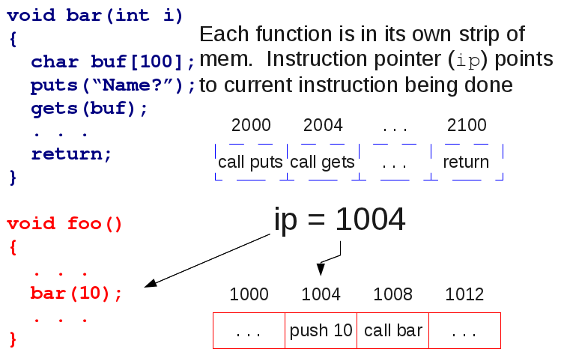
Buffer overflow attack (1)

Slide 40
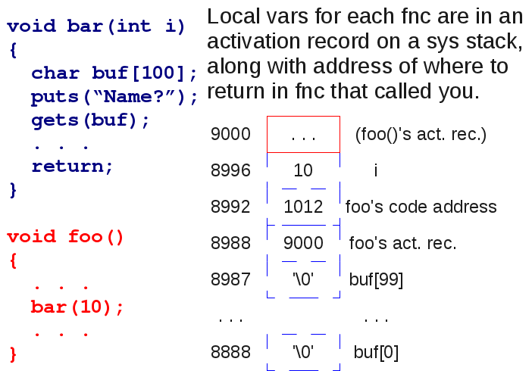
Buffer overflow attack (2)

Slide 41
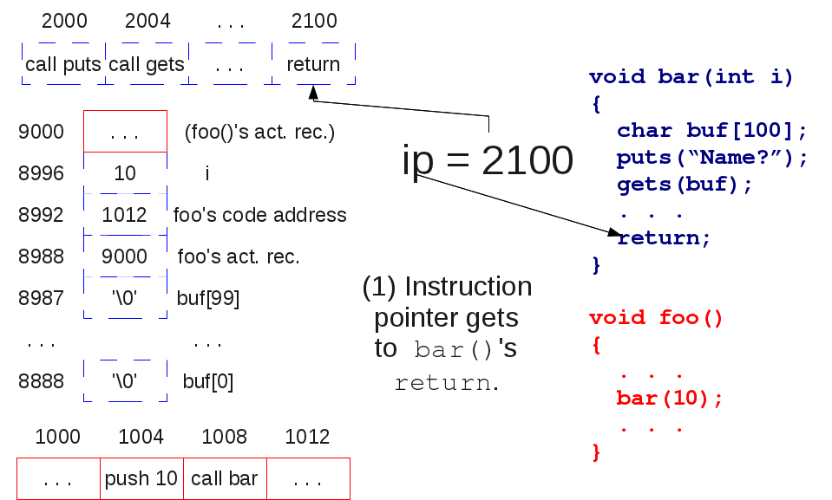
Buffer overflow attack (3)

Slide 42
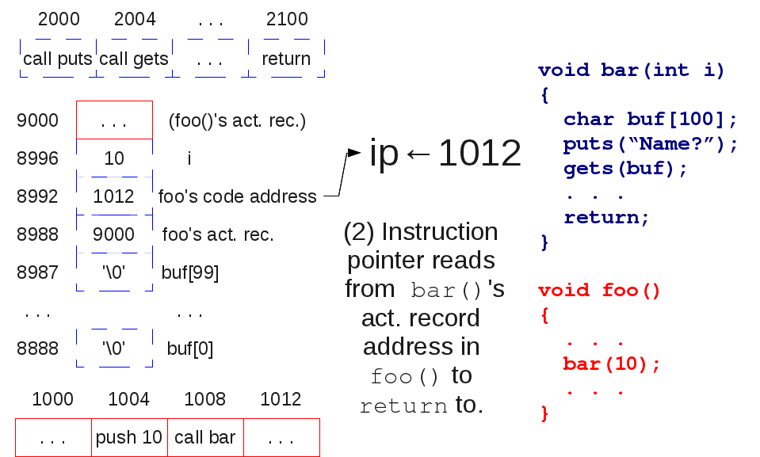
Buffer overflow attack (4)

Slide 43
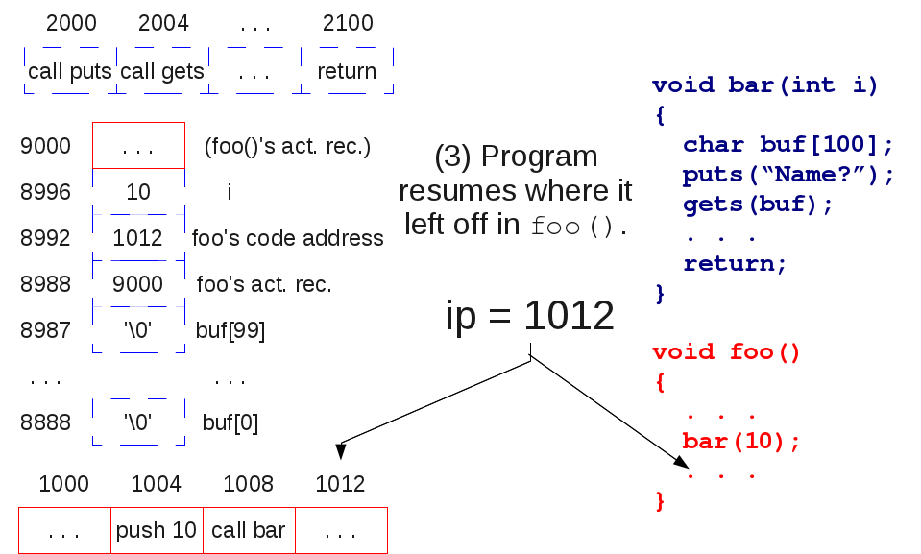
Buffer overflow attack (5)

Slide 44
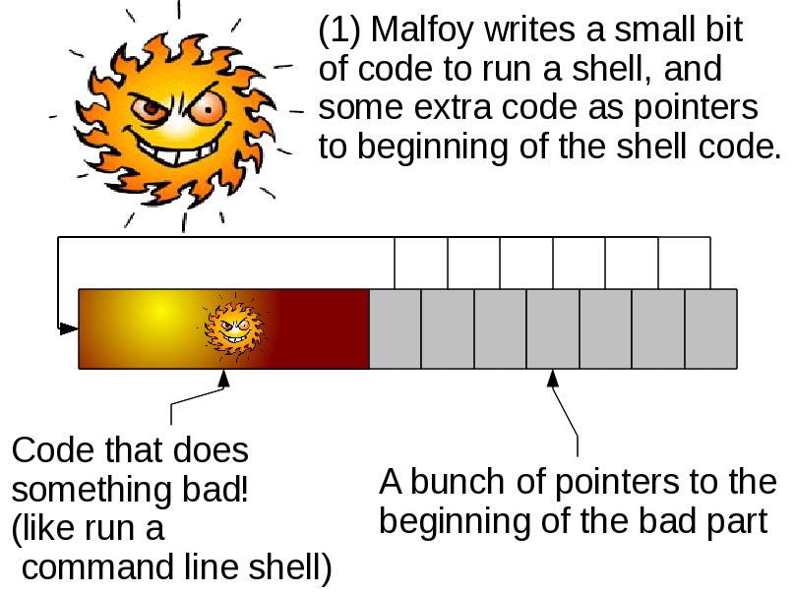
Buffer overflow attack (6)

Slide 45
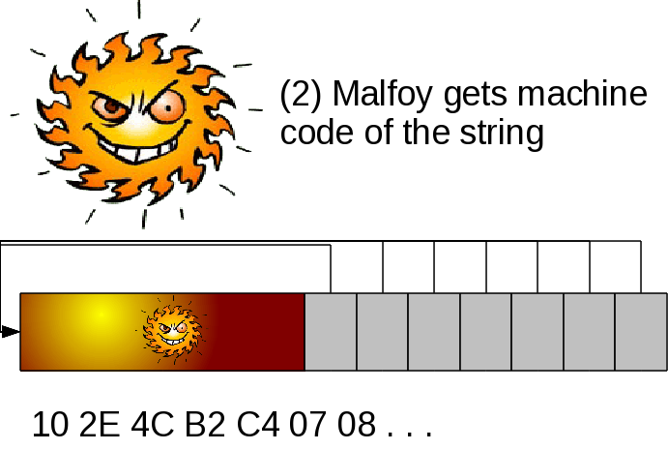
Buffer overflow attack (7)

Slide 46
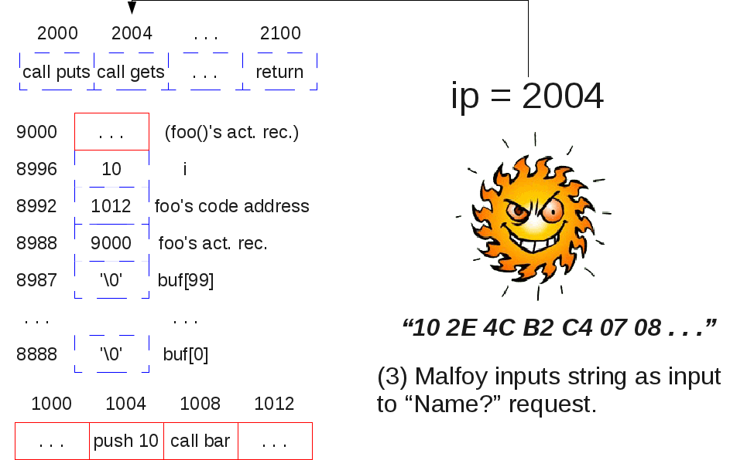
Buffer overflow attack (8)

Slide 47
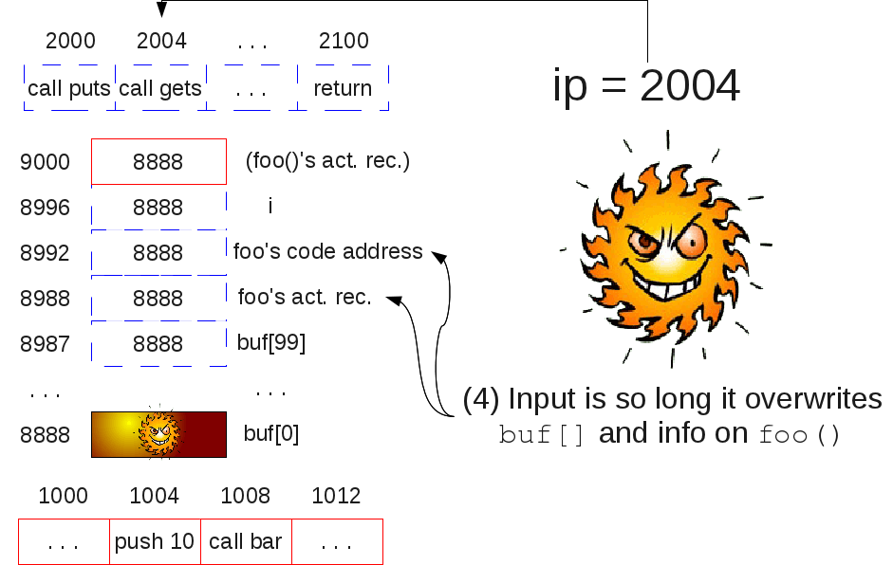
Buffer overflow attack (9)

Slide 48
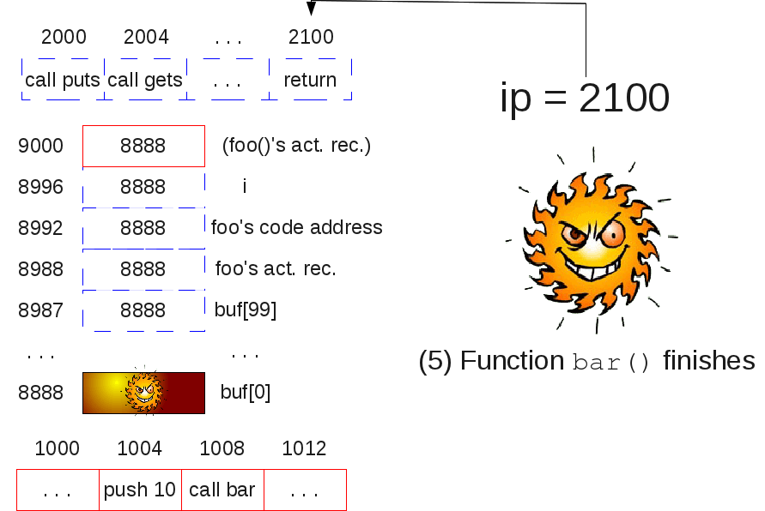
Buffer overflow attack (10)

Slide 49
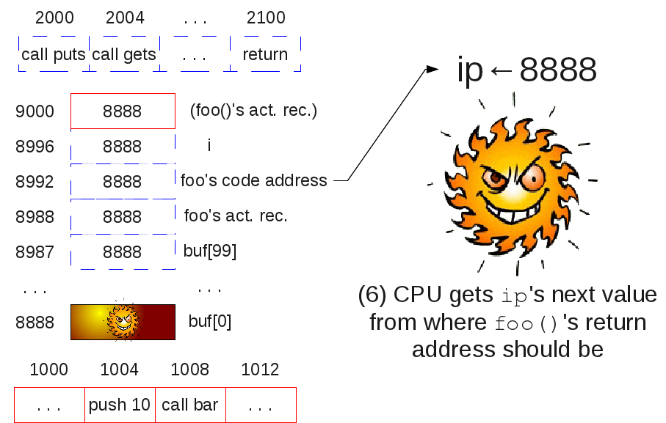
Buffer overflow attack (11)

Slide 50
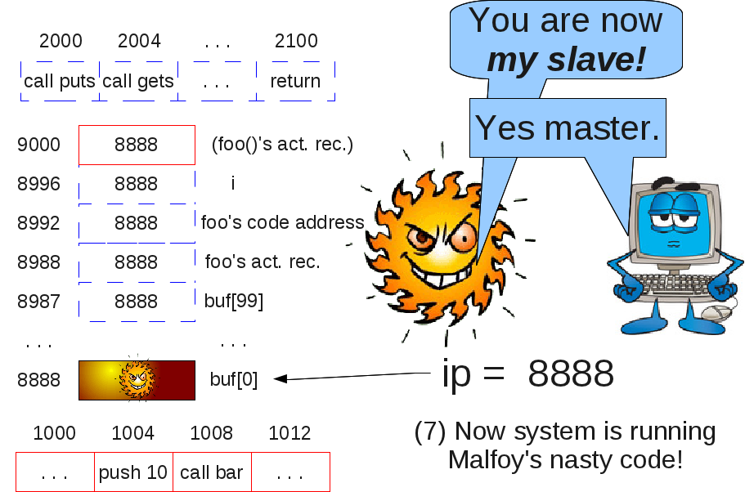
Buffer overflow attack (12)

Slide 51
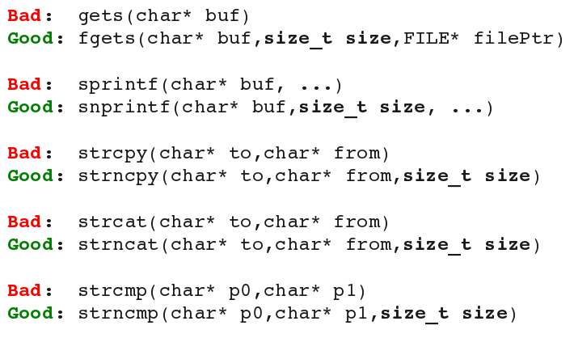
Preventing Buffer Overflow
Solution #1: Use C++ string objects.
  const char* string::c_str();
  Returns C-string representation of C++ string
Solution #2: Use safe C-string fncs

Slide 52
Preventing Buffer Overflow, cont'd
strncpy(char* to, const char* from, size_t size) will copy size bytes without copying '\0' if no '\0' is present in from.
strncat(char* to, const char* from, size_t size) will copy up to size bytes from from and will always copy or add '\0'. Thus, it could write up to size+1 bytes.

Slide 53
Your turn! Fix this program!
#include <stdlib.h>
#include <stdio.h>
#include <string.h>
#define STRING_LEN 20 /*Assumed char array len */
#define NUMBER_LEN 3
void enterName(char* nPtr)
{ printf("Your name: ");
gets(nPtr);
}
void enterAge(int* agePtr)
{ char numberText[NUMBER_LEN];
printf("Your age: ");
gets(numberText);
*agePtr=strtol(numberText,0,0);
}

Slide 54
Your turn! Fix this (cont’d)
void enterFavoriteColor (const char* itemNamePtr,
char* entryPtr)
{ printf("Fav. color for %s.",itemNamePtr);
gets(entryPtr);
}
void printInfo (char* nameP, int y,
char* carCP,char* houseCP)
{
char text[STRING_LEN];
sprintf(text,"%s who’s %d yrs old",nameP,y);
printf ("%s likes car color %s",text,carCP);
if(strcmp(carCP,houseCP) == 0)
puts("They like same color for houses");
else
printf("They like house color %s",houseCP);
}

Slide 55
Your turn! Fix this (cont’d)
int main ()
{
char name[STRING_LEN];
int age;
char carColor[STRING_LEN];
char houseColor[STRING_LEN];
enterName(name);
enterAge(&age);
enterFavoriteColor("car",carColor);
enterFavoriteColor("house",houseColor);
printInfo(name,age,carColor,houseColor);
return(EXIT_SUCCESS);
}

Slide 56
Your turn again!
Revise the naughtyCopy() to copy at most size_t n chars.
char* naughtyCopy(const char* fromP, size_t n)
{
char* toP;
for ( ; *fromP != ’\0’; fromP++, toP++)
*toP = *fromP;
free(fromP);
return(toP);
}

Slide 57
Virtual Memory and Paging
Advantages of virtual memory
  Access to more memory than just Dynamic RAM (“DRAM”)
  Easier memory management, let's processes share pages
  Increased protection for a process' memory: either a process has access to a page or it does not.

Slide 58
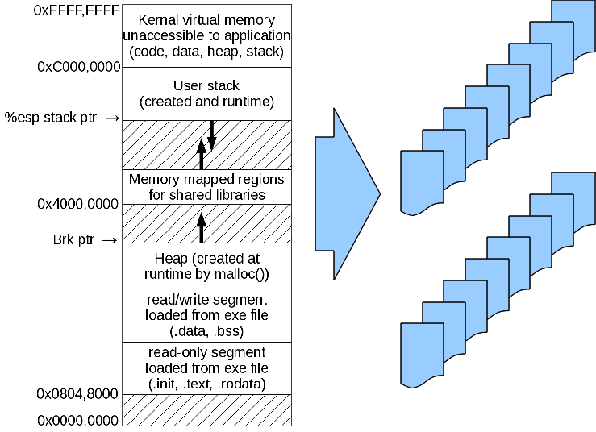
What is virtual memory? (1)
Each process' memory divided into pages.
Pages 4 kb each.

Slide 59
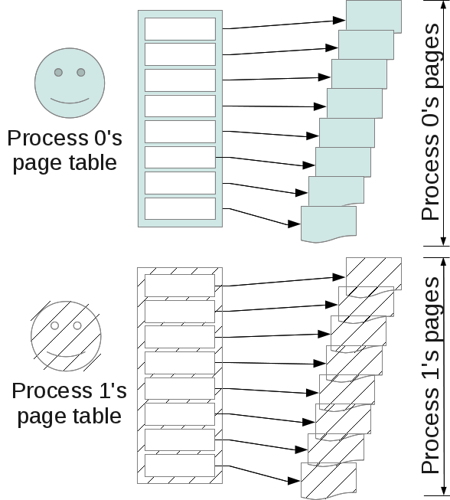
What is virtual memory? (2)
Each process' page table tells which pages it owns.

Slide 60
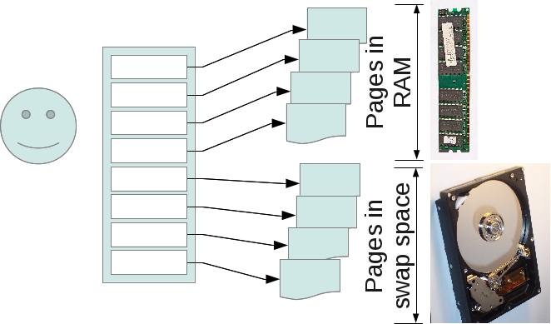
What is virtual memory? (3)
Not everyone's pages fit in memory at same time.
Processes own virtual pages, implemented either:
  as physical pages (in RAM: FAST!)
  as swap space (on the harddrive: SLOW!)

Slide 61
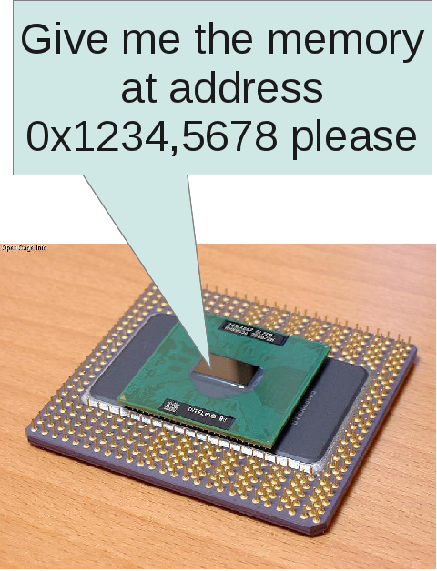
The CPU thinks in terms of virtual addresses
Your program knows virtual addresses in virtual memory
They have to be translated into addresses in physical memory

Slide 62
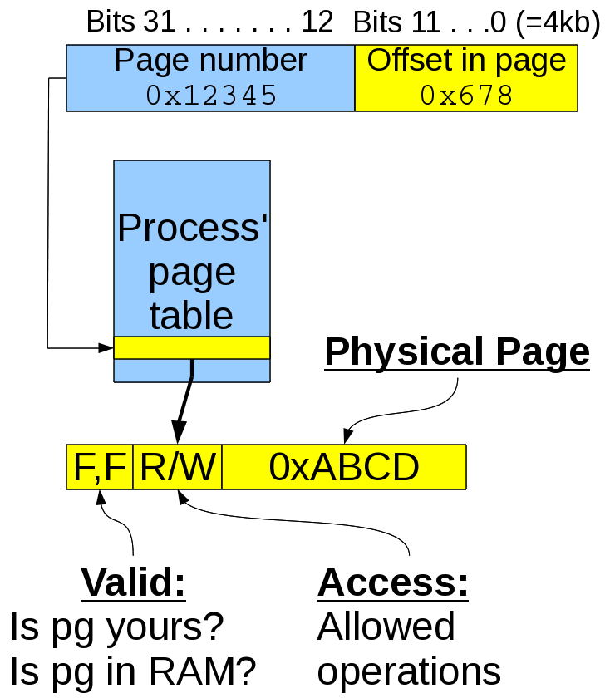
Translating Virtual to Physical Addresses (32 bits) (1)
Each process has a page table.
High bits 12..31 tell the virtual page num.
Low bits 0..11 tell the offset within page.
Page table tells page's
  Validity
  Allowed access
  Physical page (or location on disk)

Slide 63
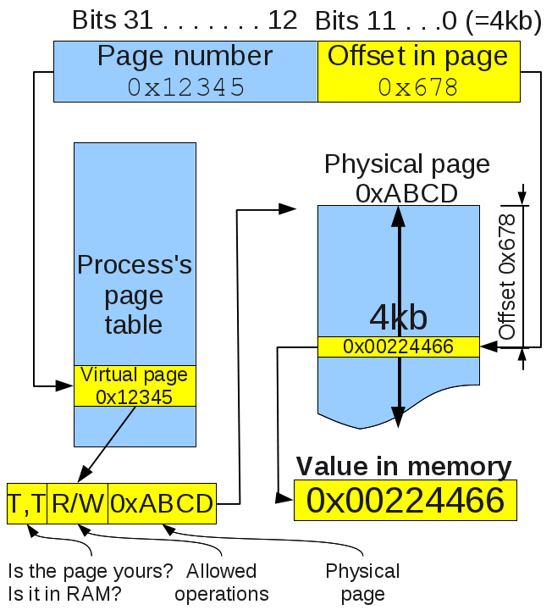
Virtual Memory Operation 1
Case 1: If:
Page belongs to process, AND
Page is in memory
then go to mem[physicalPage + offset]

Slide 64
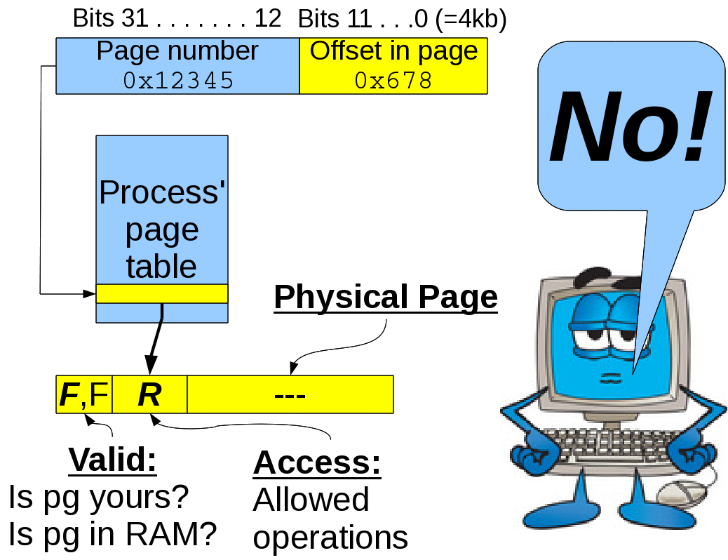
Virtual Memory Operation 2
Case 2: You don't own the page, or try to write to read-only page

Slide 65
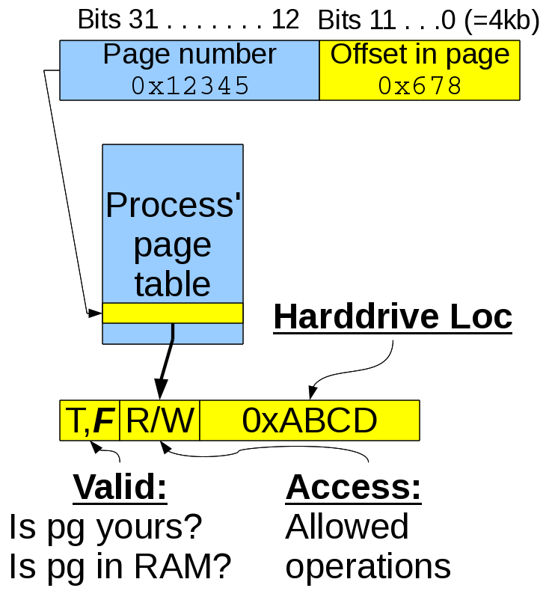
Virtual Memory Operation 3
Case 3: Page is yours but not in RAM.
Have to load from hard drive.

Slide 66
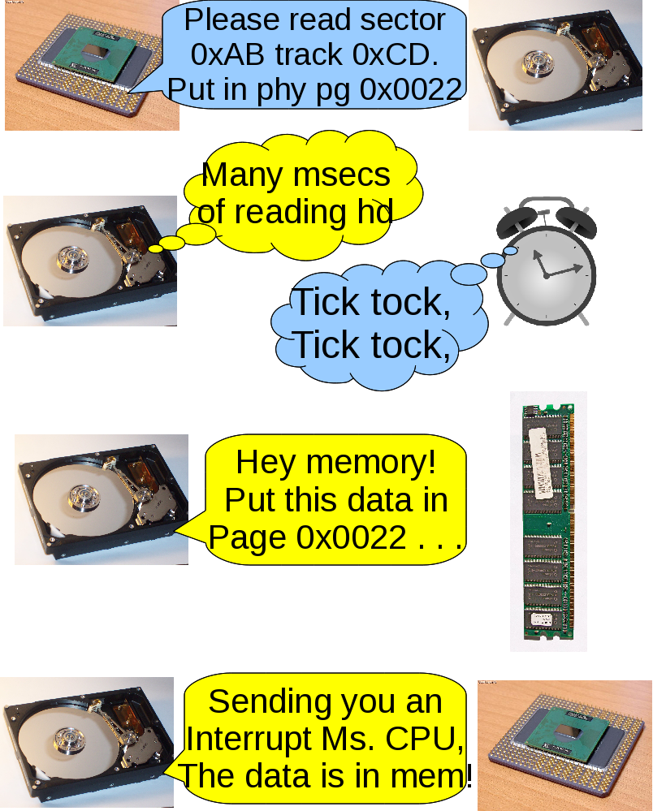
Virtual Memory Operation 3, cont'd
Case 3: Page is yours but not in RAM.
Harddrive (and network card, and flash drive, and DVD, etc.) writes data directly to RAM. Interrupts CPU when done.

Slide 67
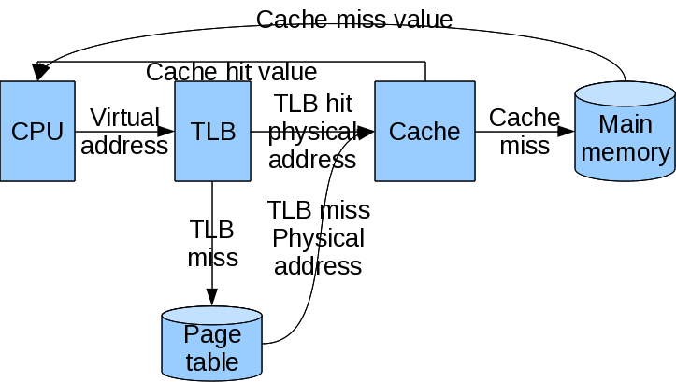
Virtual Memory Operation 1
(more detail)
Case 1: Page is yours and is in RAM. Go to cache (or RAM) and get it!
Problem: Page table could be huge!
Solution: TLB (Translation Lookaside Buffer) is a hardware cache of page table

Slide 68
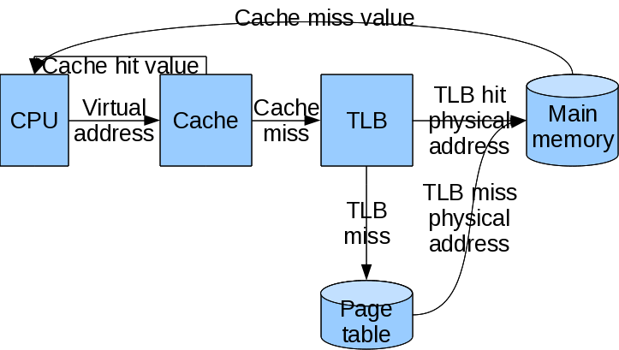
Your turn!
You could put the cache before the TLB. Caching virtual addresses would be faster for CPU. Why is caching physical addresses still preferred? Hint: There's more than 1 process.

Slide 69
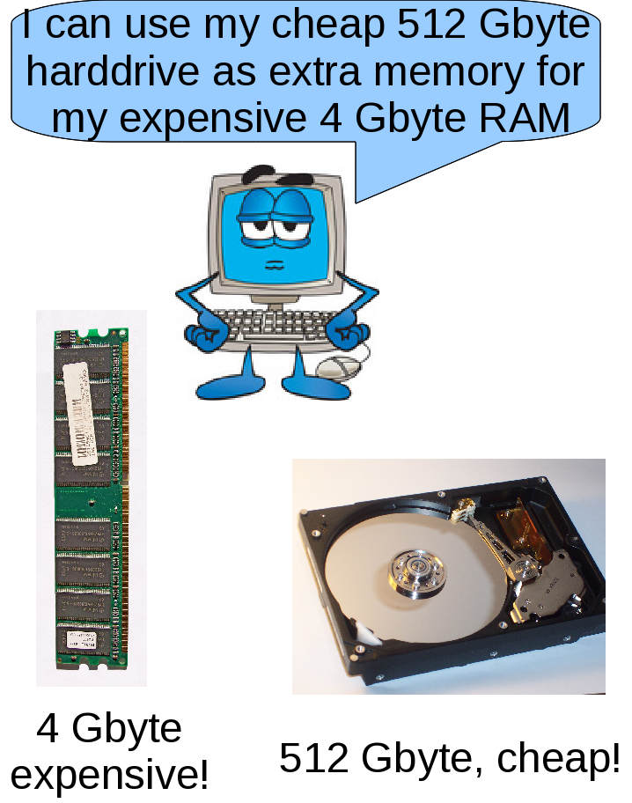
Advantage #1 of Paging Sys
Ability to use harddrive as memory, not just file storage.
Question: Nothing is free! What did we sacrifice?

Slide 70
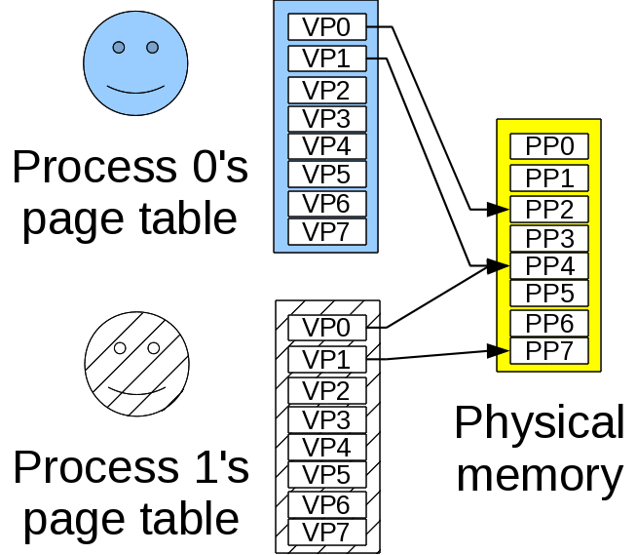
Advantage #2 of Paging Sys
Ability of processes to share pages, and flexibility for OS about where virtual pages are in phys mem.
Question: Which segment pages can be safely shared?

Slide 71
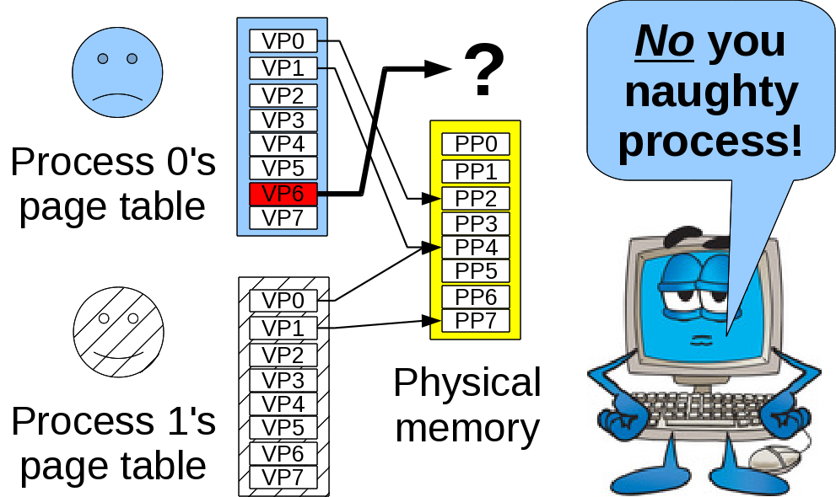
Advantage #3 of Paging Sys
Ability to protect processes from each other.
Question: What must the OS do when process makes illegal memory access?

Slide 72
Effective main memory use
Stay on the same page!

Slide 73
Your turn!
Which has better spatial locality?
// Option 1:
int sum=0;
for (int i=0; i<NUM_ROW; i++)
for (int j=0; j<NUM_COLS; j++)
sum+=array[i][j];
// Option 2:
int sum=0;
for (int j=0; j<NUM_COLS; j++)
for (int i=0; i<NUM_ROW; i++)
sum+=array[i][j];

Slide 74
Next time:
Input/Output!

