Slide 1
CSC 374/407: Computer Systems II
Lecture 8
Joseph Phillips
De Paul University
2014 August 14
Copyright © 2012-14 Joseph Phillips
All rights reserved

Slide 2

Reading
Bryant & O'Hallaron “Computer Systems, 2nd Ed.”
  Chapter 10 (except 10.4): System Level I/O
  Chapter 11: Networking Programming
Hoover “System Programming”
  Chapter 5: Input/Output

Slide 3
Topics
Unix Filesystem Design: A Process' Prospective
Unix Filesystem Design: A Systemwide Prospective
Low-level C Input-Output
Socket communication and the client/server model
Server-side socket programming
Client-side socket programming

Slide 4
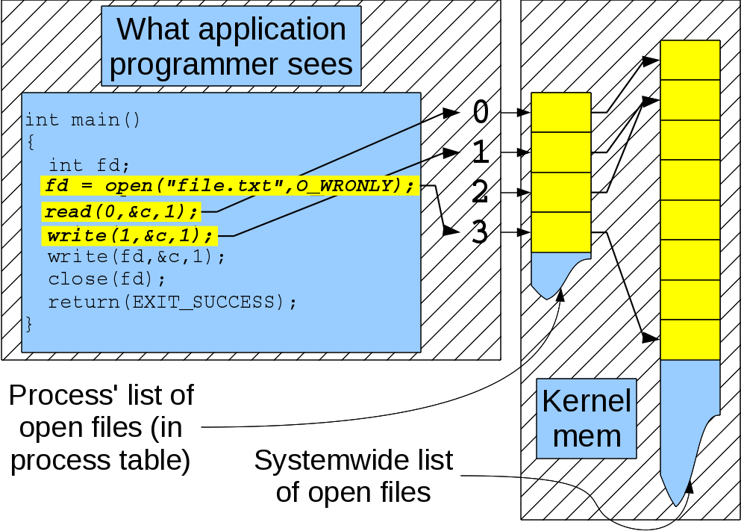
Unix Filesystem Design:
A Process' Prospective

Slide 5
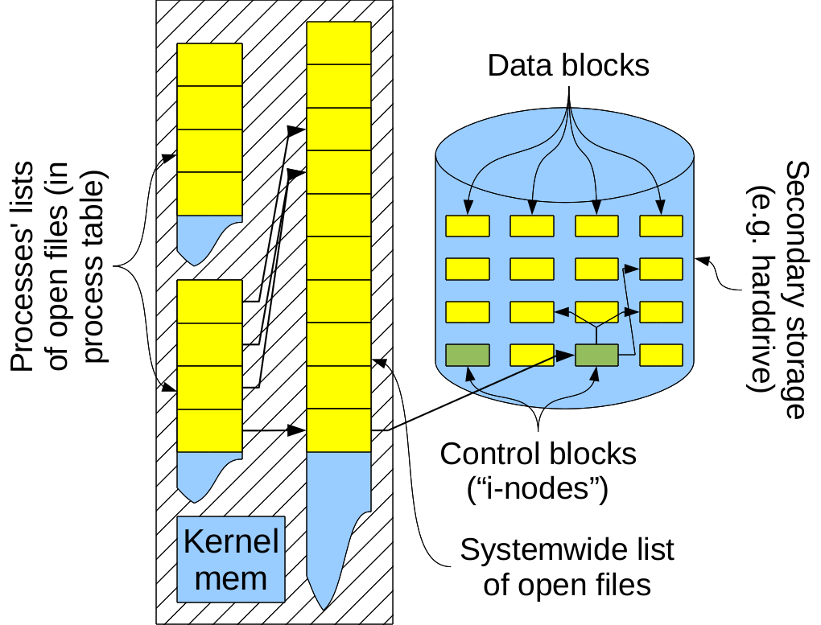
Unix Filesystem Design:
A Systemwide Prospective

Slide 6
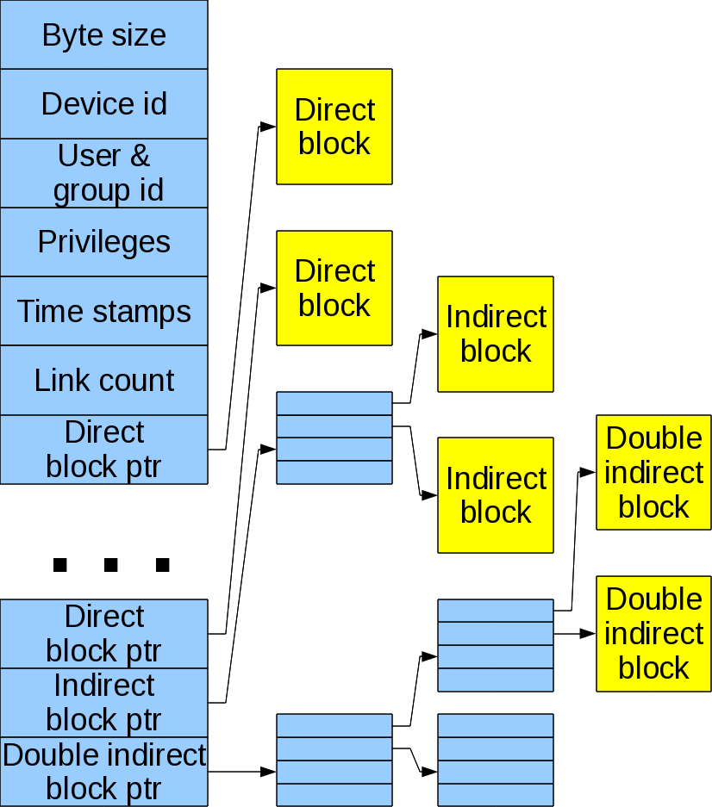
What's an “I-Node”?
Tells a files:
  Size in bytes
  Access times (last read, last written, last its status was modified)
  User and group ID
  Device ID
  Access privileges
  Link count (num different names/directories)
  Pointers

Slide 7
Low level C Input-Output
File descriptors are indices into process' file table
  0: Standard input (stdin)
  1: Standard output (stdout)
  2: Standard error (stderr)
Useful commands include:
int open(const char* path, int how, int permission)
int close(int fd)
int read(int fd, char* bufferPtr, size_t bufferSize)
int write(int fd, char* bufferPtr, size_t numBytes)
int dup(int fd);
int pipe(int** );

Slide 8
open()
int open(const char* path, int how, int permission)
  Returns file descriptor (index into process' file array)
  File path given by path.

Slide 9
open()
int open(const char* path, int how, int permission)
  Integer how is bitwise or-ing of one of:
    O_RDONLY: Open for reading only.
    O_WRONLY: Open for writing only.
    O_RDWR: Open for reading and writing.
  And perhaps one or more of:
    O_CREAT: Create file if doesn't already exist
    O_TRUNC: If exist truncate its length to 0 (even if not open for writing)
    O_EXCL: If O_CREAT is also set fail if file exists.
    O_APPEND: Write to end of file.

Slide 10
open(), cont'd
int open(const char* path, int flags, int permission)
  Commonly specified in octal: “0” + d2*8² + d1*8¹ + d0*8⁰
    0x10: leading “0x” mean “hexadecimal”
    020: leading “0” mean “octal”
  Digits: 04 = read, 02 = write, 01 = execute permission
  Place: 64s pos. = user, 8s pos. = group, 1s pos. other
  Permissions are the bitwise or-ing (|) of permissions for read/write/execute for user/group/other
000 (0) | 001 (1) | 002 (2) | 003 (3) | 004 (4) | 005 (5) | 006 (6) | 007 (7)
010 (8) | 011 (9) | 012 (10) | 013 (11) | 014 (12) | 015 (13) | 016 (14) | 017 (15)
??? (?) | ??? (?) | ??? (?) | ??? (?) | ??? (?) | ??? (?) | ??? (?) | ??? (?)

Slide 11
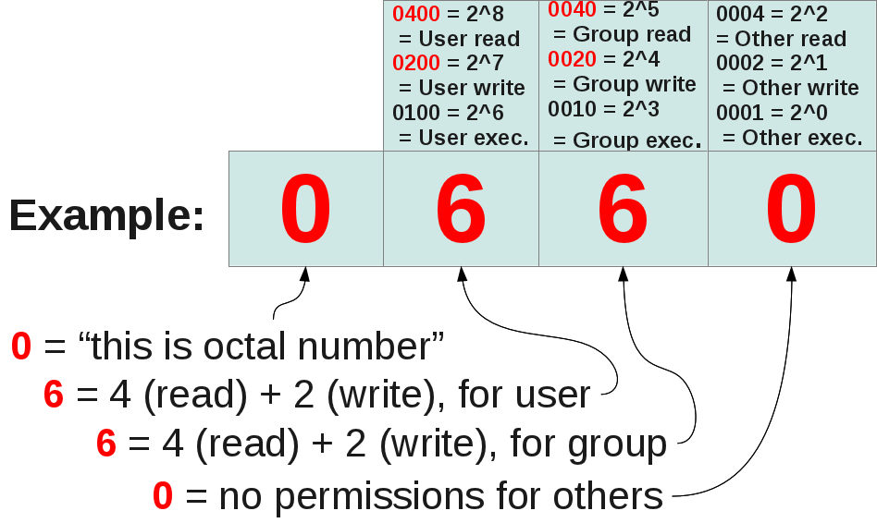
open(), cont'd

Slide 12
YOUR TURN
(1) What is the octal code for:
user: read, write;
group: read-only;
other: read-only
(2) What does octal code 0750 allow the
user, group and everyone else
to do?

Slide 13
close()
int close (int fd)
  Closes fd.
  Returns 0 on success or -1 otherwise.
  Does not flush file.

Slide 14
Your turn!
You are going to open a process' first file after standard input (0), standard output (1) and standard error (2). The file descriptor is an index in a table. What is its integer value?
#include <stdlib.h>
#include <stdio.h>
#include <sys/stat.h>
#include <fcntl.h>
int main ()
{
int fd = open("bubu.txt",O_WRONLY|O_CREAT|O_APPEND,0660);
printf("fd = %d\n",fd);
close(fd);
return(EXIT_SUCCESS);
}

Slide 15
write()
int write(int fd, char* bufferPtr, size_t numBytes)
  Writes numBytes pointed to by bufferSize to fd.
  Returns number of bytes written, or -1 on error.

Slide 16
write() example
#include <stdlib.h>
#include <stdio.h>
#include <sys/stat.h>
#include <fcntl.h>
int main ()
{
int fd = open("bubu.txt",O_WRONLY|O_CREAT|O_APPEND,0660);
write(fd,"Bubu!\n",6);
close(fd);
system("ls -l ./bubu.txt");
return(EXIT_SUCCESS);
}

Slide 17
read()
int read(int fd, char* bufferPtr, size_t bufferSize)
  Reads up to bufferSize bytes from fd and puts them into bufferPtr.
  Returns number of bytes read from file, either
    0 (“No more left!”),
    bufferSize (“Here's a whole buffer full!”),
    somewhere inbetween (“Here's all that's left”), or,
    -1 (“Error!”)

Slide 18
read() example
#include <stdlib.h>
#include <stdio.h>
#include <sys/stat.h>
#include <fcntl.h>
#define BUFFER_SIZE 256
int main ()
{
char buffer[BUFFER_SIZE];
int fd = open("bubu.txt",O_RDONLY,0660);
read(fd,buffer,BUFFER_SIZE);
printf("%s",buffer);
close(fd);
return(EXIT_SUCCESS);
}

Slide 19
Your turn!
Write your own simple version of the Unix littleCopy file copying command. I'll get you started:
#include <stdlib.h>
#include <stdio.h>
#include <ctype.h>
#include <sys/stat.h>
#include <fcntl.h>
#include <string.h>
#define BUFFER_SIZE 256
/* Continued on next slide */

Slide 20
Your turn!
/* From previous slide */
int main (int argc, const char* argv[])
{
const char* fromFileCPtr;
const char* toFileCPtr;
if (argc < 3)
{
fprintf(stderr,
"Usage: littleCopy <fromFile> <toFile>\n"
);
return(EXIT_FAILURE);
}
fromFileCPtr = argv[1];
toFileCPtr = argv[2];
/* YOUR CODE HERE */
return(EXIT_SUCCESS);
}

Slide 21
Your turn, again!
/* Write a program that counts the number of occurrences
of a character given on the command line. */
int main (int argc, const char* argv[])
{
const char charToCount;
const char* fileCPtr;
if (argc < 3)
{
fprintf(stderr,
"Usage: charCount <char> <file>\n"
);
return(EXIT_FAILURE);
}
charToCount = *argv[1];
fileCPtr = argv[2];
/* YOUR CODE HERE */
return(EXIT_SUCCESS);
}

Slide 22
And your turn, yet again!
Revise the previous program to
count the number of lines in a file.

Slide 23
What happens if mother and child write to same file?
#include <stdlib.h>
#include <stdio.h>
#include <ctype.h>
#include <sys/stat.h>
#include <fcntl.h>
#include <string.h>
#define FILENAME "bubu.txt"
int main ()
{
const char* wordsPtr;
int i;
int numBytes;
int pid;
int fd =
open(FILENAME,
O_WRONLY|O_CREAT|O_TRUNC,
0660);
if (fd < 0)
{
fprintf(stderr,
"Sorry, I can't make "
"the output file %s\n",
FILENAME);
return(EXIT_FAILURE);
}
pid = fork();
if (pid < 0)
{
fprintf(stderr,
"Too many processes ace!\n"
);
return(EXIT_FAILURE);
}

Slide 24
What happens if mother and child write to same file?
else
if (pid == 0)
wordsPtr =
"Baby says \"Gaga Gugu!\"\n";
else
wordsPtr =
"Mama says \"Poor baby!\"\n";
numBytes = strlen(wordsPtr);
for (i = 0; i < 4; i++)
{
sleep(1);
write(fd,wordsPtr,
numBytes);
printf(wordsPtr);
}
if (pid > 0)
{
sleep(2);
close(fd);
}
return(EXIT_SUCCESS);
}

Slide 25
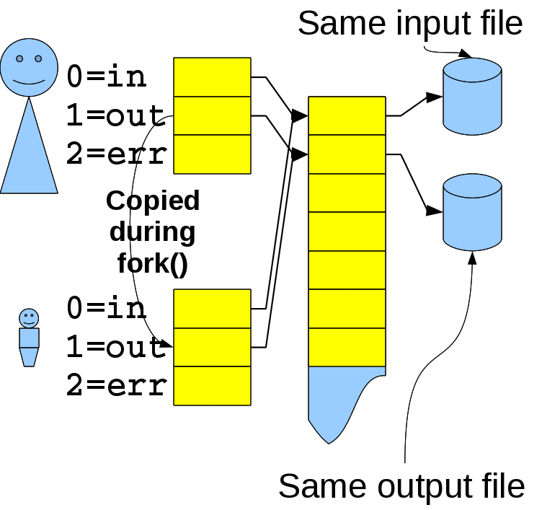
What's going on?

Slide 26
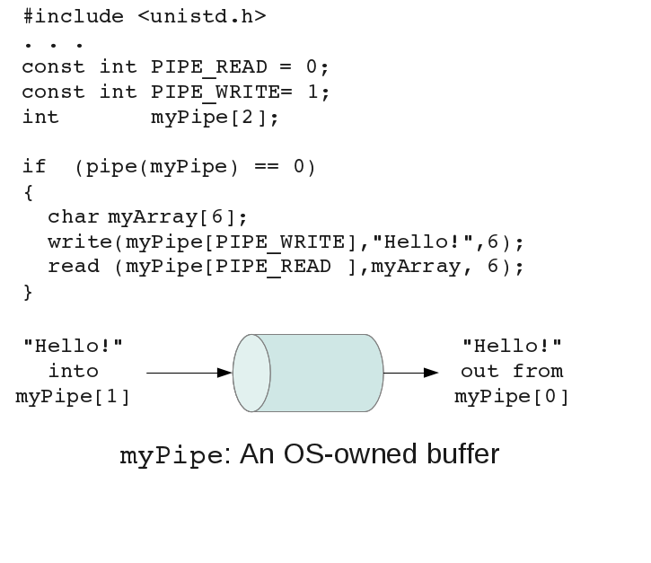
Hey! Maybe we can use this for interprocess communication!

Slide 27
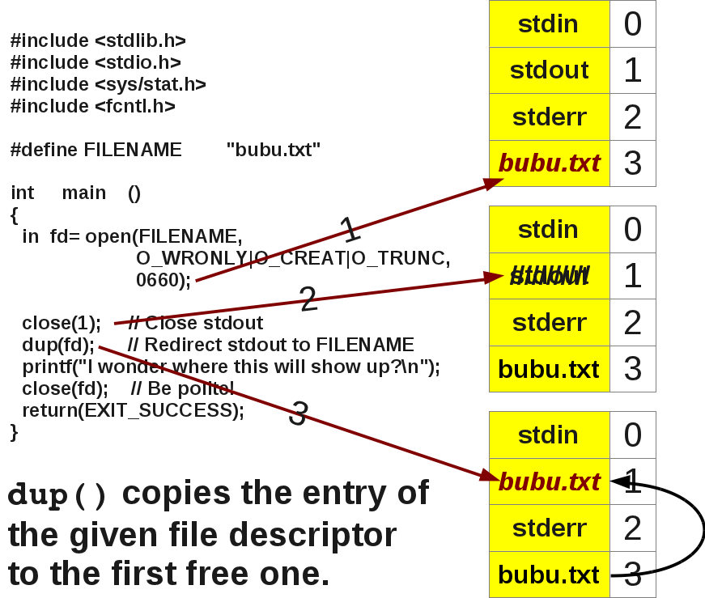
dup()

Slide 28
IPC with pipes
#include <stdlib.h>
#include <stdio.h>
#include <ctype.h>
#include <sys/stat.h>
#include <fcntl.h>
#include <string.h>
int main ()
{
int parentToChild[2];
int childToParent[2];
if ((pipe(parentToChild) < 0)
||(pipe(childToParent)< 0))
{
fprintf(stderr,
"Can't make pipes\n");
return(EXIT_FAILURE);
}
int pid = fork();
if (pid < 0)
{
fprintf(stderr,"Too many processes Ace!\n");
return(EXIT_FAILURE);
}
else
if (pid == 0)
{
// Baby's case
close(0); // Close "stdin"
dup(parentToChild[0]);
close(1); // Close "stdout"
dup(childToParent[1]);
// . . . continued

Slide 29
IPC with pipes, cont'd
{
// Mama's case
while (1)
{
char buffer[10];
fgets(buffer,10,stdin);
write
(parentToChild[1],
buffer,
10);
read
(childToParent[0],
buffer,
10);
printf(buffer);
}
}
return(EXIT_SUCCESS);
}
// Baby's case, continued
while (1)
{
char buffer[10];
int i,numRead;
numRead =
read(0,buffer,10);
for (i=0; i<numRead; i++)
buffer[i] =
toupper(buffer[i]);
write(1,buffer,numRead);
}
}
else

Slide 30
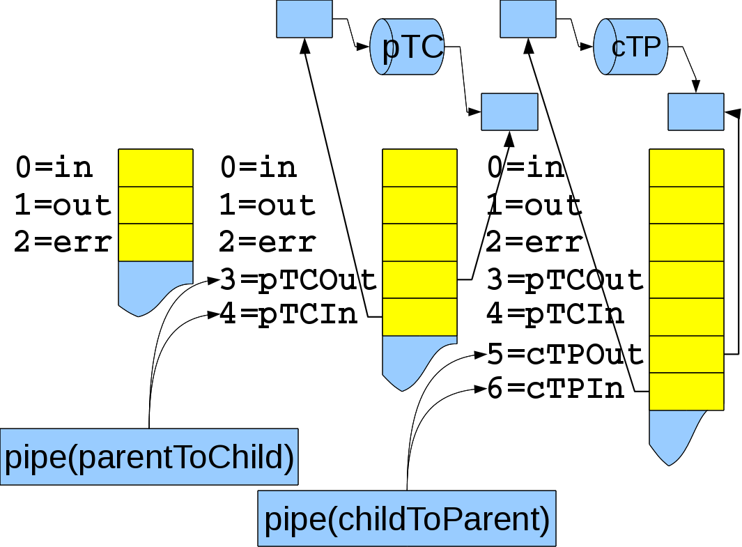
dup() and pipe(), 1

Slide 31
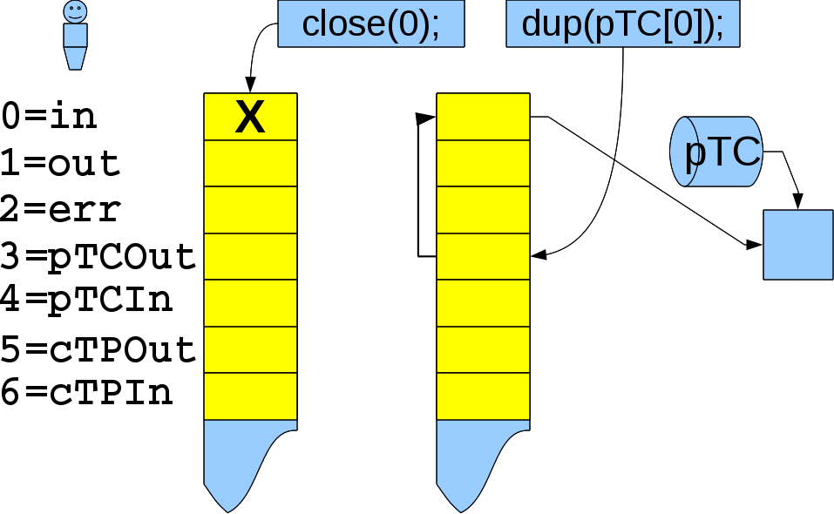
dup() and pipe(), 2

Slide 32
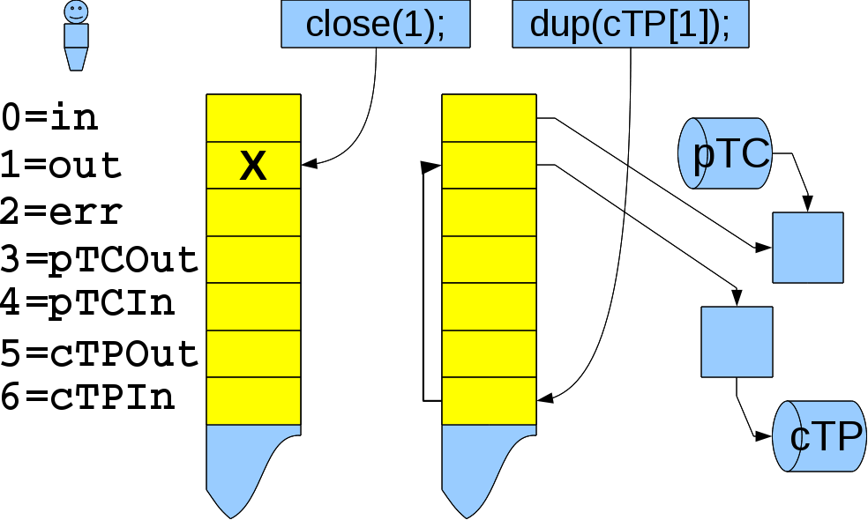
dup() and pipe(), 3

Slide 33
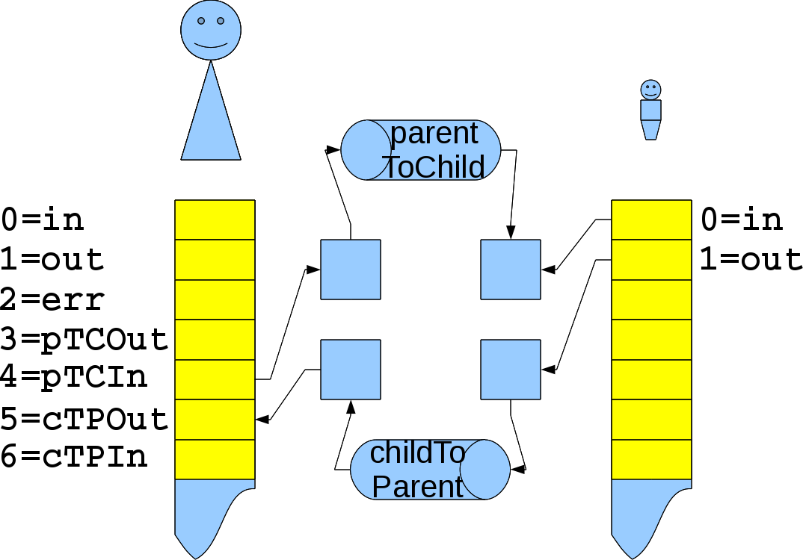
dup() and pipe(), 4

Slide 34

Sockets
Hey! Moving bytes to/from a file descriptor is such a grand idea that we can use it to move bytes to/from another process
Further, the process could be here (on the same machine)
. . . . . . . . . . . . . . . . . . . . . . . . . . . . . . . . . . . . . . . . . . . . . . . . . . . . . . . . . . . . . . . . or way over here (another machine across the Internet)
We call this sockets!

Slide 35
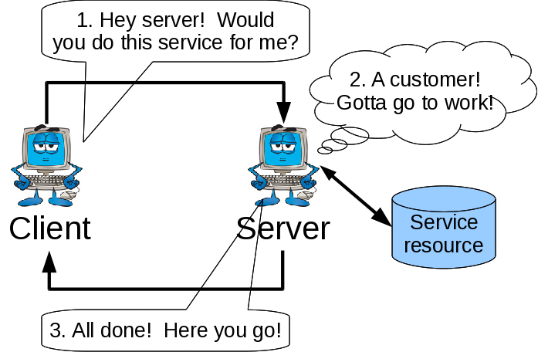
The client-server computing model
1. Client asks server for a service
2. Server does service
3. Server returns result to client
Examples: ssh, sftp, http, etc.

Slide 36
Processes talking to each other on different computers
Identify service by IP address and port
IP address: Which computer?
Humans like strings: “www.depaul.edu”
Computers like numbers: 75.102.246.202
DNS: Domain Name Service
Given name get number (or vice versa)
Computers refer to themselves by the “loopback address”
127.0.0.1 (integers)
localhost or localhost.localdomain (string)

Slide 37
Ports:
Ports: Which service on the given computer?
Can range from 0 . . . 65535?
Common ones:
20 (ftp data), 21 (ftp control)
22 (ssh), 23 (telnet <-- DO NOT USE TO LOG IN!)
37 (time)
80 (www/http)

Slide 38
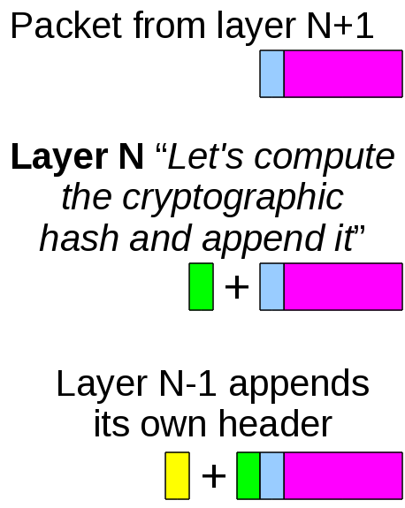
Packets (or datagrams)
Any communication is split up into manageable chunks (“packets”) that are sent individually.
These chunks get routing, checksum, cryptographic, etc. info added to them

Slide 39
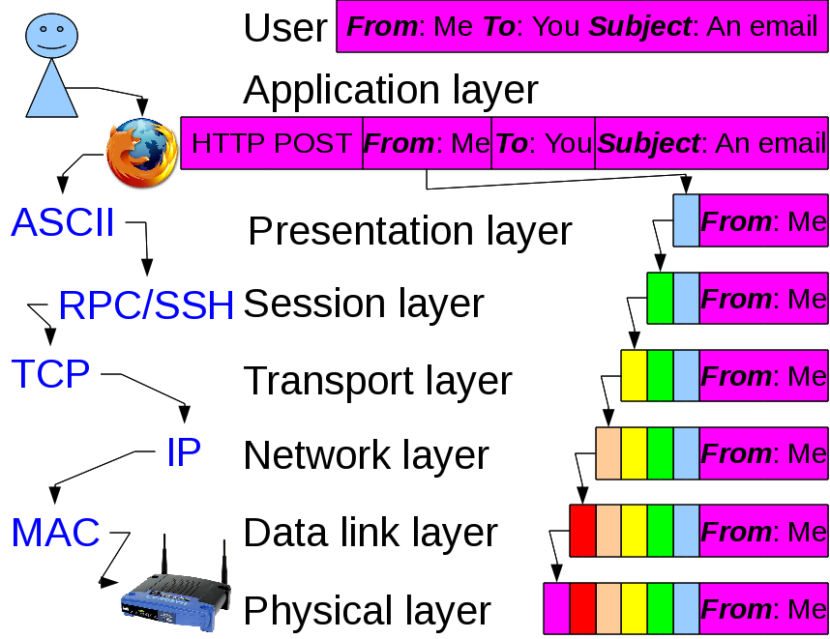
So I know with whom I wanna talk, how do I communicate? (1)

Slide 40
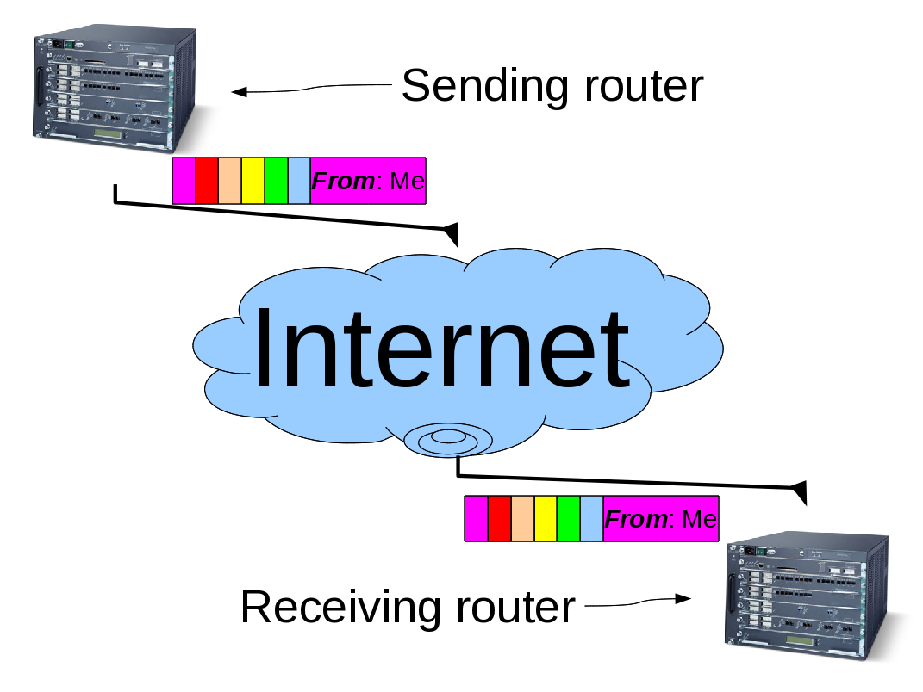
So I know with whom I wanna talk, how do I communicate? (2)

Slide 41
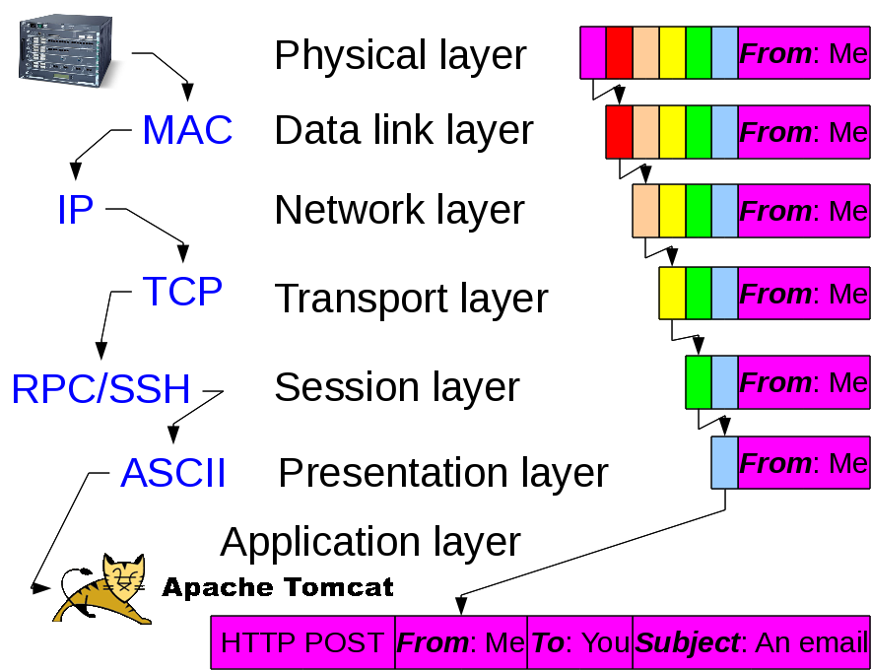
So I know with whom I wanna talk, how do I communicate? (3)

Slide 42
Tell me more about packets being sent over the 'net!
Two common networking protocols:
UDP: User Datagram Protocol
Fast! Unreliable!
“Just send the packets! Missed the last one? Don't worry, here's another!”
Question: When would you use this?
TCP: Transmission Control Protocol
Slower! Transmission is verified!
“Just a received a packet. Slow down! Let's make sure it hasn't been corrupted and that I have them all.”
Question: When would you use this?

Slide 43

Sockets!
Question: Cool deal! How do I program it?
Answer: With sockets, silly!
Socket communication
Done with read() and write() (just like for files)
Both have their own <address,port> pair
Socket provides non-transient 2-way communication link

Slide 44
Server Side:
#include <sys/socket.h>//For socket()
#include <netinet/in.h>//For sockaddr_in and htons()
#include <netdb.h> //For getaddrinfo()
#include <errno.h> //For errno var
#include <sys/stat.h> //For open(), read(),write()
#include <fcntl.h> // and close()
socket(): Ask OS for a socket
bind(): Bind socket and port together
listen(): Tell how many clients may queue
accept(): Wait until a client connects
write(): Write to client/server
read(): Read from client/server
close(): Close socket with client/server.

Slide 45
Client Side:
#include <sys/socket.h>//For socket()
#include <netinet/in.h>//For sockaddr_in and htons()
#include <netdb.h> //For getaddrinfo()
#include <errno.h> //For errno var
#include <sys/stat.h> //For open(), read(),write()
#include <fcntl.h> // and close()
getaddrinfo(): Find server's IP address
socket(): Ask OS for a socket
connect(): Attempt to connect to server
write(): Write to server
read(): Read from server
close(): Close socket with server.

Slide 46
socket()
// Create a socket
int socketDescriptor =
socket(AF_INET, // AF_INET domain
SOCK_STREAM, // Reliable TCP
0);
Returns
  A file descriptor that the server uses to see if a client has connected, or,
  -1 on error
There's also SOCK_DGRAM for UDP
Last parameter type if used for SOCK_RAW

Slide 47
bind()
// Bind socket to port
// We'll fill in this datastruct
struct sockaddr_in socketInfo;
// Fill socketInfo with 0's
memset(&socketInfo,'\0',sizeof(socketInfo));
// Use std TCP/IP
socketInfo.sin_family = AF_INET;
// Tell port in network endian with htons()
socketInfo.sin_port = htons(portNumber);
// (1) Allow connections from myself only:
struct in_addr addr;
if (inet_aton("127.0.0.1",&addr)==0) exit(EXIT_FAILURE);
socketInfo.sin_addr.s_addr = addr.s_addr;
// or (2) Allow machine to connect to this service
socketInfo.sin_addr.s_addr = INADDR_ANY;
// Try to bind socket with port and other specifications
int status = bind(socketDescriptor, // from socket()
(struct sockaddr*)&socketInfo,
sizeof(socketInfo));
status == -1 on error

Slide 48
What are those structs?
typedef uint32_t in_addr_t;
struct in_addr
{
in_addr_t s_addr;
};
struct sockaddr_in
{
sa_family_t sin_family; // addr family: AF_INET
in_port_t sin_port; // port (in network
// byte order)
struct in_addr sin_addr; // internet addr
};

Slide 49
listen()
// Tell OS how many clients may queue up for this server
int status =
listen(socketDescriptor,
maxNumPendingClients);
(Almost) ready to listen to port!
5 is a good default for maxNumPendingClients.
If status==-1 then error

Slide 50
accept()
// Accept connection to client
int clientDescriptor =
accept(socketDescriptor,NULL,NULL);
Wait (by default) for someone to actual connect
Returns
  a file descriptor for talking with one particular client, or
  -1 for error
connectionDescriptor for talking with that one client (there may be others for other clients)
socketDescriptor is for listening to socket.

Slide 51
Your turn!
Question: Hey! How is the server supposed to do two (or more!) things at once?
How do we get the server to both:
wait for another client to connect by listening to socketDescriptor, and
handle the current client(s) request by talking on clientDescriptor?

Slide 52
Do you speak BIG or little Endian?
Now that we're talking . . . we'd better use same endian!
// Host to network long (ie. 32-bit)
uint32_t htonl(uint32_t hostlong);
// Host to network short (ie. 16-bit)
uint16_t htons(uint16_t hostshort);
// Network to host long (ie. 32-bit)
uint32_t ntohl(uint32_t netlong);
// Network to host short (ie. 16-bit)
uint16_t ntohs(uint16_t netshort);

Slide 53
Your turn again!
Write a server program that
waits for a client to connect
for any connected client it read()s characters and write()s the toupper() of them.

Slide 54
Client-side time!

Slide 55
getaddrinfo()
// Get info on server (the “hostName”)
int getaddrinfo
(const char* hostName, // e.g. "www.depaul.edu"
const char* service, // e.g. "ftp"
const struct addrinfo* hints,
struct addrinfo** resultPtr);
// Also: getnameinfo()
Gets info on host given integers
Sets resultPtr to datastructure with info on host hostName
  hostName/service effective tell host:port
  returns integer: 0 == success, 0 != error.

Slide 56
Another strange struct!
struct addrinfo
{
int ai_flags; // Used in hints
int ai_family; // AF_INET, AF_INET6
// or AF_UNSPEC for
// IPv4,IPv6 or both
int ai_socktype; // SOCK_STREAM
// or SOCK_DGRAM
int ai_protocol; // 0 = any protocol
socklen_t ai_addrlen; // Len of next field
struct sockaddr *ai_addr; // (See prev slide)
char *ai_canonname;// Official hostname
struct addrinfo *ai_next; // For linked list
};

Slide 57
getaddrinfo() (derived from wikipedia example)
#include <stdio.h>
#include <stdlib.h>
#include <string.h>
#include <ctype.h>
#include <netdb.h>
#include <netinet/in.h>
#include <sys/socket.h>
#ifndef NI_MAXHOST
#define NI_MAXHOST 1025
#endif
#define LINE_LEN 256
#define SERVICE_ADDR_SEP_STR "://"
#define SERVICE_ADDR_SEP_STR_LEN \
(sizeof(SERVICE_ADDR_SEP_STR)-1)

Slide 58
getaddrinfo() (derived from wikipedia example)
char* enterUrlName (char* urlName,
int urlNameLen
)
{
printf("\n"
"URL "
"(e.g. ftp://ctilinux1.cstcis.cti.depaul.edu)"
" or a blank line to stop\n"
": "
);
fgets(urlName,urlNameLen,stdin);
char* cPtr = strchr(urlName,'\n');
if (cPtr != NULL)
*cPtr = '\0';
return(urlName);
}

Slide 59
getaddrinfo() (derived from wikipedia example)
void parse (char* serviceName,
int serviceNameLen,
char* addrName,
int addrNameLen,
const char* urlName
)
{
const char* cPtr;
for (cPtr = urlName; isspace(*cPtr); cPtr++);
const char* sepPtr = strstr(cPtr,SERVICE_ADDR_SEP_STR);
if (sepPtr == NULL)
{
strncpy(serviceName,"",serviceNameLen);
strncpy(addrName,cPtr,addrNameLen);
}
else
{
int numServiceChars = sepPtr-cPtr;
strncpy(serviceName,cPtr,numServiceChars);
serviceName[numServiceChars] = '\0';
strncpy(addrName,sepPtr+SERVICE_ADDR_SEP_STR_LEN,addrNameLen);
}
}

Slide 60
getaddrinfo() (derived from wikipedia example)
void describe (const char* serviceName,
const char* addrName
)
{
struct addrinfo* hostPtr;
struct addrinfo* run;
int status = getaddrinfo
(addrName,
(serviceName[0] == '\0')
? NULL
: serviceName,
NULL,
&hostPtr
);
if (status != 0)
{
fprintf(stderr,gai_strerror(status));
return;
}

Slide 61
getaddrinfo() (derived from wikipedia example)
for (run = hostPtr; run != NULL; run = run->ai_next)
{
char hostname[NI_MAXHOST] = "";
int error = getnameinfo
(run->ai_addr,
run->ai_addrlen,
hostname, NI_MAXHOST, NULL, 0, 0);
if (error != 0)
{
fprintf(stderr, "error in getnameinfo: %s\n",
gai_strerror(error)
);
continue;
}
if (*hostname == '\0')
printf("%-32s:",run->ai_canonname);
else
printf("%-32s:", hostname);

Slide 62
getaddrinfo() (derived from wikipedia example)
switch (run->ai_family)
{
case AF_INET : printf(" (IPv4,"); break;
case AF_INET6 : printf(" (IPv6,"); break;
case AF_UNSPEC : printf(" (IPv4 & IPv6,"); break;
case AF_UNIX : printf(" (local Unix,"); break;
case AF_IPX : printf(" (Novell,"); break;
case AF_APPLETALK:printf(" (Appletalk,"); break;
case AF_PACKET: printf(" (Lo-level packet,"); break;
default : printf(" (Unknown family?,");
}
switch (run->ai_socktype)
{
case SOCK_STREAM :printf(" TCP)\n"); break;
case SOCK_DGRAM : printf(" UDP)\n"); break;
case SOCK_SEQPACKET:printf(" sequenced, reliable)\n"); break;
case SOCK_RAW : printf(" raw network protocol)\n"); break;
case SOCK_RDM : printf(" reliable w/o ordering)\n"); break;
default : printf(" unknown protocol?)\n");
}
}
}

Slide 63
getaddrinfo() (derived from wikipedia example)
int main ()
{
char urlName[LINE_LEN];
while ( *enterUrlName(urlName,LINE_LEN) != '\0' )
{
char serviceName[LINE_LEN];
char addressName[LINE_LEN];
parse(serviceName,LINE_LEN,addressName,LINE_LEN,urlName);
describe(serviceName,addressName);
}
return(EXIT_SUCCESS);
}

Slide 64
connect()
// Connect to server
sockaddr_in server;
// Clear server datastruct
memset(&server, 0, sizeof(server));
// Use TCP/IP
server.sin_family = AF_INET;
// Tell port # in proper network byte order
server.sin_port = htons(portNumber);
// Copy connectivity info from info on server ("hostPtr")
server.sin_addr.s_addr =
((struct sockaddr_in*)hostPtr->ai_addr)->sin_addr.s_addr;
int status = connect(socketDescriptor,&server,sizeof(server));
-1 means error

Slide 65
read(), write() and close()
As previously stated:
// Read from file/socket
// numRead==0 means "EndOfFile", numRead==-1 means "error"
int numRead =
read(connectDescriptor,bufferAddress,bufferLen);
int numRead =
recv(connectDescriptor,bufferAddress,bufferLen,int flags);
// Write to file/socket: numWritten == -1 means "error"
int numWritten =
write(connectDescriptor,bufferAddress,bufferLen);
int numWritten =
send(connectDescriptor,bufferAddress,bufferLen,int flags);
// Close connection: status == -1 means "error"
int status = close(descriptor);

Slide 66
But sometimes you don't want to wait for socket input
int recv(int connectDescriptor,void* bufferPtr, int bufferLen, int flags)
Reads up to bufferLen bytes into the buffer pointed to by bufferPtr from file descriptor connectDescriptor. flags tells how to read, where MSG_DONTWAIT means "non-blocking".
Returns number of bytes read, or returns -1 and sets global var errno to EAGAIN if the flag was MSG_DONTWAIT and there was nothing to read.

Slide 67
Short counts with recv()
Short counts occur during:
  Encounter End of file (EOF) when reading file (expected)
  Reading text from terminal (also expected)
  Reading from network or pipes if get interrupted by catching any sort of signal (an annoyance!)
  Question: Did the fact that read() or recv() returned something mean that it got something, or that it was interrupted?
Oh no! Can nothing save us?!?!

Slide 68
Robust I/O Package to the rescue!
/* From authors' thread-safe, buffered I/O package. Same interface as read() */
ssize_t rio_readn(int fd, void *usrbuf, size_t n)
{
size_t nleft = n;
ssize_t nread;
char* bufp = usrbuf;
while (nleft > 0) {
if ((nread = read(fd, bufp, nleft)) < 0) {
if (errno==EINTR) /* Interrupted by sig handlr rtn? */
nread = 0; /* Yes: Call read() again */
else
return -1; /* No: Have some other error */
}
else if (nread == 0)/* Have EOF? */
break; /* Yes: Just quit loop */
nleft -= nread; /* Else that many fewer chars to get*/
bufp += nread; /* Advance in buffer to read more */
}
return (n - nleft); /* For non errors return val >= 0 */
}

Slide 69
Your turn!
Write a client program that:
  Connects with the server
  Asks the user for text
  Sends the text to the server
  Gets the response back from the server and prints it

Slide 70
Next time
ncurses cursor control

