Slide 1

Final Projects & Presentations Final Projects & Presentations TA Session 6 Spring 2026 Graph Neural Networks Claudio Bustamante

Slide 2
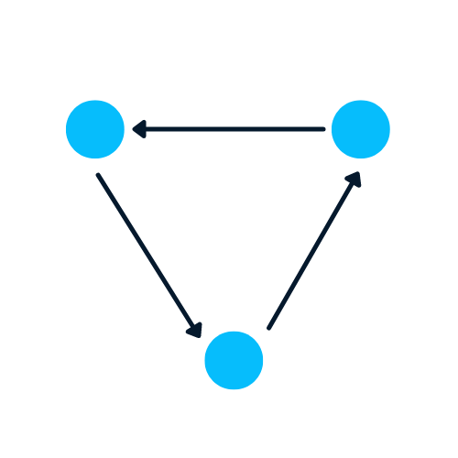
Graph Neural Networks, including what GNNs are, the different types of graph neural networks, and what they're used What is a Graph? A Graph is the type of data structure that contains nodes and edges. A node can be a person, place, or thing, and the edges define the relationship between nodes. The edges can be directed and undirected based on directional dependencies. In the example below, the blue circles are nodes, and the arrows are edges. The direction of edges defines dependencies between two nodes.
GNN

Slide 3
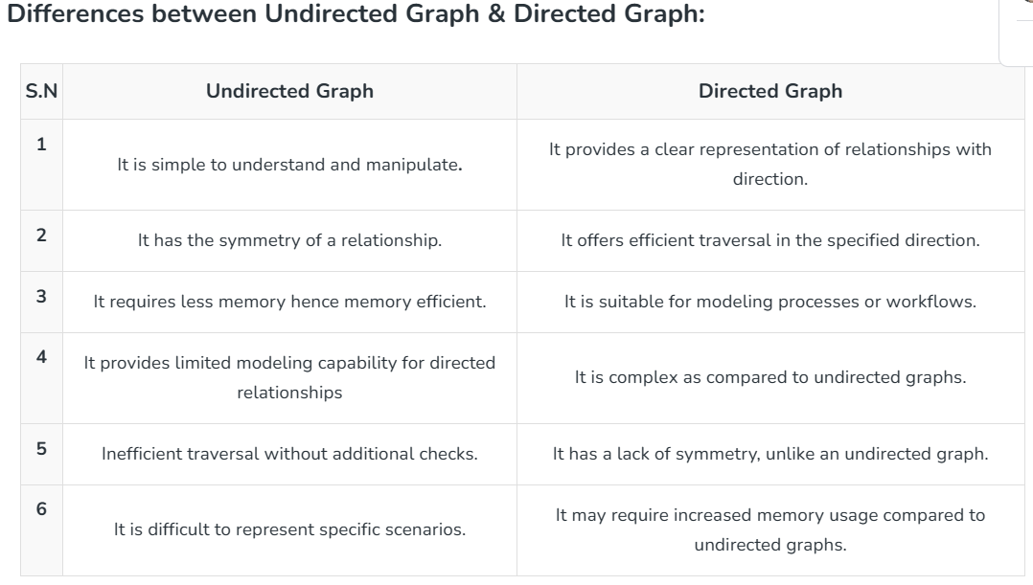
Undirected vs. Directed Graphs An undirected graph is a graph where the edges do not have a specific direction, and it is bidirectional in nature it does not have a parent-child relation concept as there is no particular direction. A directed graph is a graph that is unidirectional in this the edges have a specific direction, and the edges have directions specified with them also a directed graph can contain cycles.
Graph Theory

Slide 4
Undirected Graphs: A graph in which edges have no direction, i.e., the edges do not have arrows indicating the direction of traversal. Example: A social network graph where friendships are not directional. Directed Graphs: A graph in which edges have a direction, i.e., the edges have arrows indicating the direction of traversal. Example: A web page graph where links between pages are directional. Weighted Graphs: A graph in which edges have weights or costs associated with them. Example: A road network graph where the weights can represent the distance between two cities. Unweighted Graphs: A graph in which edges have no weights or costs associated with them. Example: A social network graph where the edges represent friendships. Complete Graphs: A graph in which each vertex is connected to every other vertex. Example: Trees: A connected graph with no cycles. Example: A tree where each person is connected to their parents. Sparse Graphs: A graph with relatively few edges compared to the number of vertices. Example: A chemical reaction graph where each vertex represents a chemical compound, and each edge represents a reaction between two compounds.
Graph Theory

Slide 5
What is a Graph Neural Network (GNN)? Graph Neural Networks are special types of neural networks capable of working with a graph data structure. They are highly influenced by Convolutional Neural Networks (CNNs) and graph embedding. GNNs are used in predicting nodes, edges, and graph-based tasks. CNNs are used for image classification. Similarly, GNNs are applied to graph structure (grid of pixels) to predict a class. Recurrence Neural Networks are used in text classification. Similarly, GNNs are applied to graph structures where every word is a node in a sentence. A Comprehensive Introduction to Graph Neural Networks (GNNs) | DataCamp The coding examples are influenced by Pytorch geometric documentation.
GNN
The Cora dataset has 2708 nodes, 10,556 edges, 1433 features, and 7 classes. The first object has 2708 train, validation, and test masks. We will use these masks to train and evaluate the model.
Lab7_2024 PyG Documentation — pytorch_geometric documentation – takes longer to run

Slide 6
Traditional graph analysis methods requires using searching algorithms, clustering spanning tree algorithms and so on. A major downside to using these methods for analysis of graph data is that you require a prior knowledge of the graph to be able to apply these algorithms. Based on the structure of the graph data, traditional machine learning system will not be able to properly interpret the graph data and thus the advent of the Graph Neural Network (GNN). Graph neural network is a domain of deep learning that is mostly concerned with deep learning operations on graph datasets. Application of Machine learning in Graphs - Protein folding for drug analysis - Recommender systems - Drug side effect prediction - Traffic predictions - Drug discovery - Molecule generation - Physics simulation
GNN

Slide 7
There are several types of neural networks, and most of them have some variation of Convolutional Neural Networks. In this section, we will be learning about the most popular GNNs. Graph Convolutional Networks (GCNs) are similar to traditional CNNs. It learns features by inspecting neighboring nodes. GNNs aggregate node vectors, pass the result to the dense layer, and apply non-linearity using the activation function. In short, it consists of Graph convolution, linear layer, and non-learner activation function. There are two major types of GCNs: Spatial Convolutional Networks and Spectral Convolutional Networks. Graph Auto-Encoder Networks learn graph representation using an encoder and attempt to reconstruct input graphs using a decoder. The encoder and decoders are joined by a bottleneck layer. They are commonly used in link prediction as Auto-Encoders are good at dealing with class balance. Recurrent Graph Neural Networks(RGNNs) learn the best diffusion pattern, and they can handle multi-relational graphs where a single node has multiple relations. This type of graph neural network uses regularizers to boost smoothness and eliminate over-parameterization. RGNNs use less computation power to produce better results. They are used in generating text, machine translation, speech recognition, generating image descriptions, video tagging, and text summarization. Gated Graph Neural Networks (GGNNs) are better than the RGNNs in performing tasks with long-term dependencies. Gated Graph Neural Networks improve Recurrent Graph Neural Networks by adding a node, edge, and time gates on long-term dependencies. Similar to Gated Recurrent Units (GRUs), the gates are used to remember and forget information in different states.
Types of Graph Neural Networks

Slide 8
Permutation invariance is a property of a mathematical function or algorithm that remains unchanged even when the order of its inputs is altered. In other words, if we feed the function the same set of values but in a different order, the output remains the same. This property is particularly important in machine learning and data science because the order of input features can significantly affect the outcome of a model. Permutation equivariance is the property of a function or model that responds to permutations of input elements by producing correspondingly permuted outputs.
What is Permutation invariance and equivariance
The f() is permutation invariant if the average weight is same for original and permuted graph. Homework question.

Slide 9
Message passing is the core mechanism enabling Graph Neural Networks to learn from graph-structured data by having nodes iteratively exchange information with their neighbor’s. The process involves three steps: - Computing messages from neighboring nodes, - Aggregating these messages through operations like summation or attention, and - Updating each node’s representation by combining the aggregated information with its current features. Through multiple iterations, nodes can capture increasingly complex patterns from both local neighborhoods and distant parts of the graph.
Message Passing

Slide 10
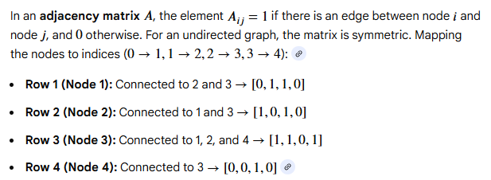
import networkx as nx # Create a graph G = nx.Graph() # Add node 1 with attribute color='blue' G.add_nodes_from([(1, {"color": "blue"})]) # Verify the node attributes print(G.nodes[1]) # Output: {'color': 'blue'}
Example (Graphs can be presented by adjacency matrices)
The adjacency matrix for an undirected graph is a symmetric matrix
The adjacency matrix for a directed graph is not symmetric.

Slide 11
GNN Cheatsheet — pytorch_geometric documentation (pytorch-geometric.readthedocs.io) GNN-Tutorial/GNN-tutorial-solution.ipynb at master · sw-gong/GNN-Tutorial · GitHub Hands-on Graph Neural Networks for Social Network Using PyTorch | by Awadelrahman M. A. Ahmed | Medium What is the difference between an undirected and a directed Graph? – GeeksforGeeks Drawing — NetworkX 3.2.1 documentation Introduction to Graph Neural Network with Pytorch | Kaggle Understanding Message Passing in Graph Neural Networks | by Rajeev Chandran | Medium
References

Slide 12
Lab2025 - NetworkX - This guide can help you start working with NetworkX. Petersen graph – Wikipedia Lab 6 Shortest Path - NetworkX — NetworkX documentation / GitHub - networkx/networkx: Network Analysis in Python Lab7_2024 PyG Documentation — pytorch_geometric documentation – takes longer to run Chapter 18 – part 1 Chapter 18 – part 2 Both files were uploaded
Lab examples

Slide 13

P1 and P2 A permutation matrix is a square binary matrix with exactly one '1' in each row and column, and '0's elsewhere, used to rearrange (permute) the rows or columns of another matrix via multiplication # Original adjacency matrix nx.adjacency_matrix # Permutation matrix P for relabeling nodes (1,2,3,4,5) to (5,1,3,2,4) # Draw the graph # Compute the adjacency matrix of the permuted graph #perform matric multiplications P_t = P.t() A_perm_step1 = torch.matmul(P, A_orig) A_perm = torch.matmul(A_perm_step1, P_t) # Check if the permuted adjacency matrix is identical to the original print(torch.equal(A_perm, A_orig))
HW 7 - HINTS

Slide 14
P3 //assign weights G_orig.edges[edge]['weight'] = TBD G.edges[e]['weight'] = (i-j)**2 //calculate average weight return np.mean(weights) P4 - create six small graphs - possible atoms # Creating graphs with randomly assigned atom types atoms = ['C', 'O', 'N'] # Atom types atom_to_color = {'C':'gray', 'O':'red', 'N':'blue'} print("atom to color mapping:", atom_to_color) - You are not asked to train the network. You are demonstrating that you can feed a GNN with batches of graphs.
HW 7

Slide 15
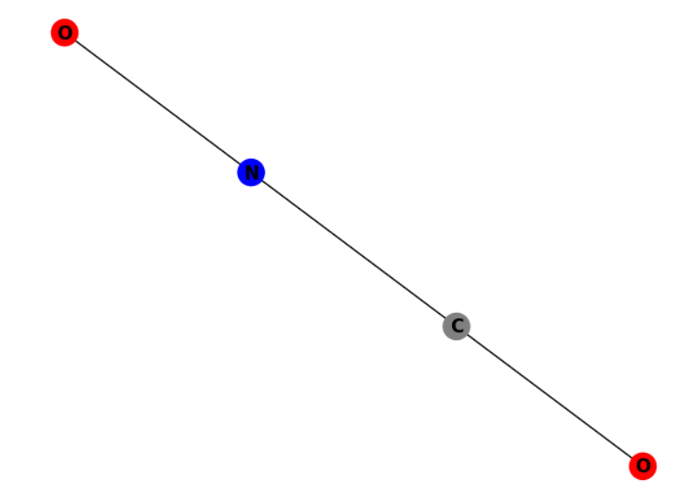
# Creating graphs with randomly assigned atom types atoms = ['C', 'O', 'N'] # Atom types atom_to_color = {'C':'gray', 'O':'red', 'N':'blue'} print("atom to color mapping:", atom_to_color) # Create one-hot encoding to identify all atoms: mapping_dict = {'C': 0, 'O': 1, 'N': 2} Next, we create 6 graphs with 4,4,5,5,6,6 nodes using the atoms feature we defined above G1
HW 7
CNO2

