Slide 1

CSCI-E104 Advanced Deep Learning
Lab 05: Stable Diffusion
Lakshmi Umarale

Slide 2

CSCI-E104, 02-28-2026
Lab Objectives …
1
Stable Diffusion Notebook Review
2
Homework Review
Page ▪ 2
Notes:
2

Slide 3
What is Stable Diffusion?
Stable Diffusion is a Latent Diffusion Model capable of generating high-resolution images and art forms from text and image prompts. It originally launched in 2022.
Instead of operating in the high-dimensional image space, it first compresses the image into the latent space. The latent space is 48 times smaller, so it reaps the benefit of crunching a lot fewer numbers. That’s why it’s a lot faster.

Slide 4
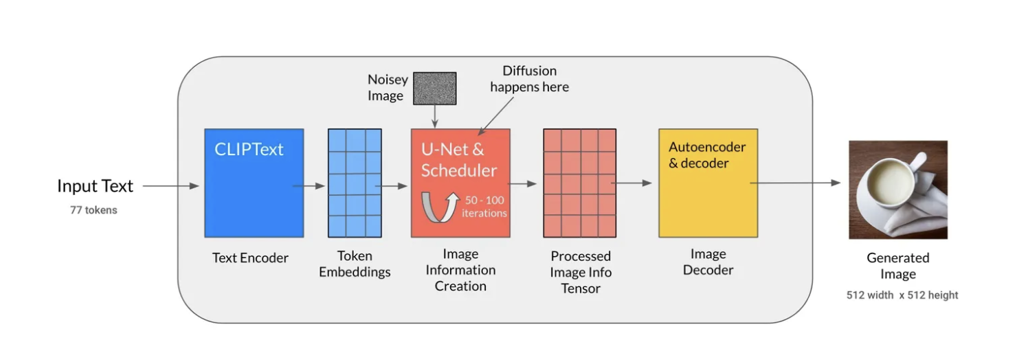
Architecture of Stable Diffusion
There are three main components in latent diffusion-
1. Autoencoder (Variational AutoEncoder) - converts the image into a low dimensional latent representation to serve as an input to the U-Net model, the decoder transforms the latent representation back into an image.
2. U-Net – The encoder compresses an image into a lower-resolution image, while the decoder decodes this lower-resolution image
3. An optional text encoder - is responsible for transforming the text input prompt into an embedding space that the U-Net can understand.

Slide 5
What can Stable Diffusion do?
Its capabilities include text-to-image, image-to-image, graphic artwork, image editing, and video creation, etc.
Text-to-image generation
This is the most common way people use Stable Diffusion. Stable Diffusion generates an image using a textual prompt.
Image-to-image generation
Using an input image and text prompt, you can create images based on an input image. A typical case would be to use a sketch and a suitable prompt.

Slide 6
Homework Review
Please refer to Canvas

Slide 7
Resources
https://guides.library.harvard.edu/hks/science_technology_policy
Besides the above, here are some other links of interest ( and many many more) where you get a free subscription through Harvard Key:
OReilley Learning Platform: https://learning-oreilly-com.ezp-prod1.hul.harvard.edu/home/
Harvard Business Review : https://library.harvard.edu/services-tools/harvard-business-review
Gartner: https://huit.harvard.edu/tools-and-services#g
NYT: https://library.harvard.edu/services-tools/new-york-times
WSJ: https://library.harvard.edu/services-tools/wall-street-journal
Washington Post https://library.harvard.edu/services-tools/washington-post

Slide 8
References
Lecture Notes – All lecture notes are very comprehensive, you will find all your homework answers in them
Jonathan Ho, Ajay Jain, Pieter Abbeel, “Denoising Diffusion Probabilistic
Models”, 2020
Alec Radford, Jong Wook Kim, Chris Hallacy, Aditya Ramesh, Gabriel Goh, Sandhini Agarwal, Girish Sastry, Amanda Askell, Pamela Mishkin, Jack Clark, Gretchen Krueger, Ilya Sutskever,”Learning Transferable Visual Models From Natural Language Supervision”, 2021
[3] Robin Rombach and Andreas Blattmann and Dominik Lorenz and Patrick Esser and Björn Ommer, “High-Resolution Image Synthesis with Latent Diffusion Models”, arXiv:2112.10752, 2021,
Richard Zhang, Phillip Isola, Alexei A. Efros, Eli Shechtman, Oliver Wang, “The Unreasonable Effectiveness of Deep Features as a Perceptual Metric”, CVPR, 2018
Patrick Esser, Robin Rombach, Björn Ommer, “Taming transformers for high- resolution image synthesis”, CVPR, 2020
Some of the images in this lecture come from J. Alammar’s blog post: • https://jalammar.github.io/illustrated-stable-diffusion/

