Slide 1

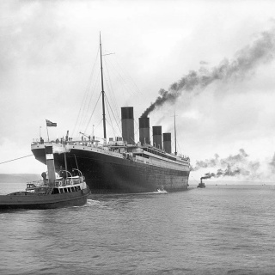
Practical Lab Activity – Data Cleaning with Titanic Dataset
Hands-on Data Preprocessing for Machine Learning
BY DR TAIWO AYODELE

Slide 2


Why Data Cleaning Matters
Essential for Reliable Analysis
Data cleaning is the foundation of any successful machine learning project. Messy or incomplete data can lead to misleading results and poor models.
Real-World Impact
From predicting survival rates to informing safety measures, clean data ensures trustworthy insights.

Slide 3

Learning Outcomes
By the End of This Lab
Understand the role of data cleaning in machine learning.
Apply Python to identify and handle missing or inconsistent data.
Prepare the Titanic dataset for analysis and modelling.
Document your cleaning decisions clearly.

Slide 4
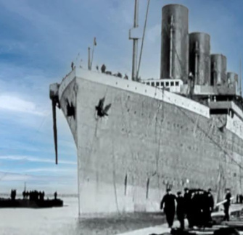
Meet the Titanic Dataset
A Classic Dataset
The Titanic dataset contains information about passengers aboard the Titanic, including:
Age, gender, ticket class
Survival status
Fare paid, port of embarkation
It's widely used to teach data science and machine learning.

Slide 5
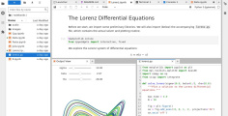


Resources You'll Need
Python Environment
Jupyter Notebook or any Python IDE for running your code.
Titanic Dataset
CSV file containing passenger information for the Titanic.
Internet Access
To look up documentation and best practices as needed.

Slide 6
Lab Activity Roadmap
Step 1
Exploration
Investigate the dataset's structure and spot issues.
Step 3
Documentation
Record and justify your cleaning decisions.
Start
Dataset Loading
Import the Titanic dataset into your Python environment.
Step 2
Cleaning
Apply techniques to tidy up the data for analysis.
End
Saving
Export the cleaned dataset for future use.

Slide 7
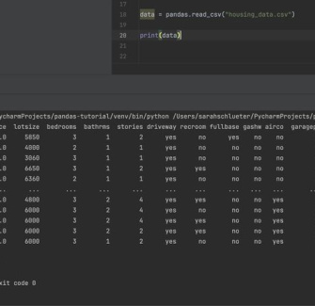
Step 1: Load the Dataset
Getting Started in Python
Use Pandas to load the Titanic CSV file:
This command displays the first few rows so you can preview the data.

Slide 8

Fill in the blanks ​🧩​
To begin, we need to ____ the Titanic dataset using the ____ library, then display the first few ____ to preview the data.
Word bank ​🏦​
rows, load, numpy, columns, pandas, save
Answers on the next slide...

Slide 9
Fill in the blanks ​🧩​
​✅​
To begin, we need to load the Titanic dataset using the pandas library, then display the first few rows to preview the data.
Word bank ​🏦​
rows, load, numpy, columns, pandas, save

Slide 10
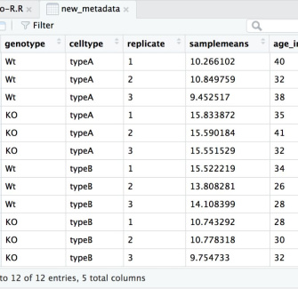
Step 2: Explore the Data
Understanding the Structure
Use to see column types and non-null counts.
Use for summary statistics.
Look for columns that might be irrelevant or problematic.
This initial exploration is key for planning your cleaning steps.

Slide 11
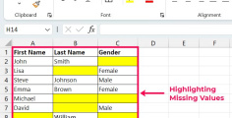
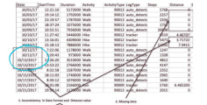
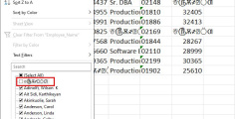
Identifying Missing Data
1
2
3
Null Values
Pandas shows missing values as NaN. Use to count them.
Inconsistent Entries
Look for strange or inconsistent values (e.g., 'Unknown', 0 for age).
Column Relevance
Some columns may not be useful for analysis (e.g., ticket numbers).

Slide 12

Spotting Data Issues
Question 1:
Which Pandas function is used to identify and count missing values (NaN) in a dataset?
Question 2:
Besides NaN, what other types of 'inconsistent entries' should you look out for when exploring a dataset like the Titanic one?
Question 3:
Explain why a column like 'Ticket Number' might be considered 'irrelevant' for a survival prediction model on the Titanic dataset.
Answers on the next slide...

Slide 13
Spotting Data Issues
​✅​
Answer 1:
The `.isnull().sum()` function in Pandas is used to identify and count missing values.
Answer 2:
You should look out for strange values like 'Unknown' or '0' for age, which might not be NaN but still represent missing or irrelevant data.
Answer 3:
A 'Ticket Number' column might be irrelevant because it often contains unique identifiers that don't directly contribute to predicting survival and could add noise to the model.

Slide 14
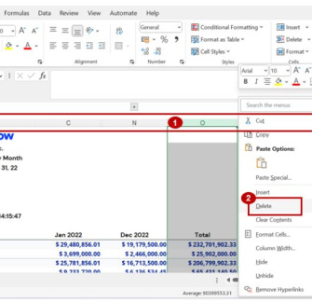
Step 3: Drop Irrelevant Columns
Streamlining Your Data
Columns like 'PassengerId', 'Ticket', or 'Cabin' may not help with survival prediction. Remove them using:
Always consider why you are dropping each column.

Slide 15
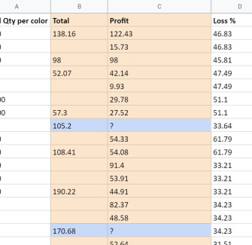
Step 4: Handle Missing Values
Two Main Approaches
Remove rows with missing data (if few and not critical).
Fill missing values using methods like mean, median, or mode.
Example:

Slide 16
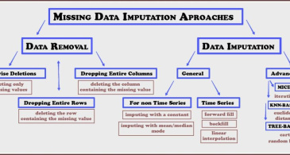
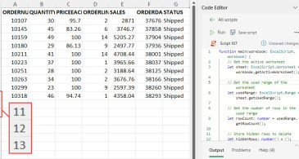
Filling vs Dropping
Filling Values
Keeps more data but may introduce bias. Use for columns like 'Age' or 'Fare'.
Dropping Rows
Removes incomplete entries. Use when missingness is minimal or random.

Slide 17

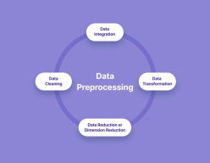
Discuss! ​🤷‍♀️​ ​💁‍♂️​ ​💬​
Missing Values Dilemma
We've explored two primary ways to handle missing values: filling them or dropping rows. When deciding which approach to take, what key factors would influence your choice for a dataset like the Titanic survival data?

Slide 18
Discuss! ​🤷‍♀️​ ​💁‍♂️​ ​💬​
​✅​
You might have said...
I would consider how many missing values there are; if it's only a few, dropping rows might be okay, but if there are lots, filling them keeps more useful data.
I'd think about the importance of the column with missing data; for something critical like 'Age', filling might be better than losing many rows.
The nature of the missing data is important; if it's 'missing at random', filling with a mean or median could be suitable, but if there's a pattern, dropping might be safer.

Slide 19
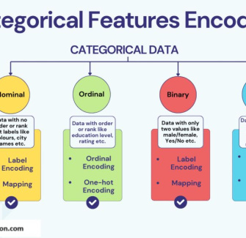
Step 5: Encode Categorical Variables
Preparing Data for Modelling
Machine learning models need numbers, not text. Convert columns like 'Sex' and 'Embarked' using encoding:
Or use for one-hot encoding.

Slide 20

Documenting Your Decisions
1
State the Problem
Clearly describe what issue you found (e.g., missing 'Age' values).
2
Explain Your Action
Write what you did (e.g., filled with median) and why.
3
Reflect on Impact
Consider how your choices affect analysis and results.

Slide 21

Step 6: Save the Cleaned Dataset
Ready for Analysis
Export your cleaned data for use in future projects:
This file is now ready for modelling and deeper analysis.

Slide 22

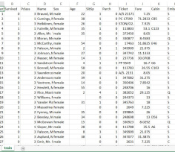
Clean & Justify Titanic Data
Now it's your turn! Apply all the data cleaning steps we've covered—loading, exploring, dropping irrelevant columns, handling missing values, and encoding categorical variables—to the original Titanic dataset.
Once complete, submit your cleaned dataset file along with a short justification document (1-2 paragraphs) explaining the decisions you made for each cleaning step.

Slide 23

Summary & Next Steps
You Have Learned
Data cleaning's importance in ML
Python for missing data (identify, drop, fill, encode)
Value of documenting work
Next Steps
Model/analyze your cleaned Titanic dataset. Apply these skills to other real-world datasets.

