Slide 1




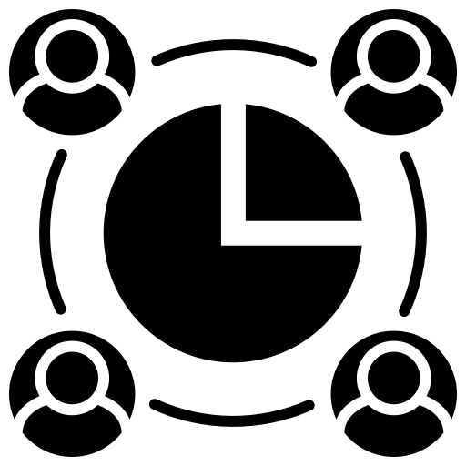






DEATHS DASHBOARD
CURRENT_WORLD_POPULATION
DEATHS
MONTHS
DAILY
YEARLY
PIE CHART OF CAUSES
PROBLEMS
DAYS
DEATH CAUSES
SOCIAL DEATHS
DEATHS DISEASES
UNDER-FIVE VS. DEATHS RATES

