Slide 1

Round-Robin Cellular Network: Performance Evaluation Through Discrete Event Simulation
Project Title: Round-Robin Cellular Network
Course: Performance Evaluation of Computer Systems and Networks
Author: Ayoub El Ourrak
Academic Year: 2024/2025

Slide 2
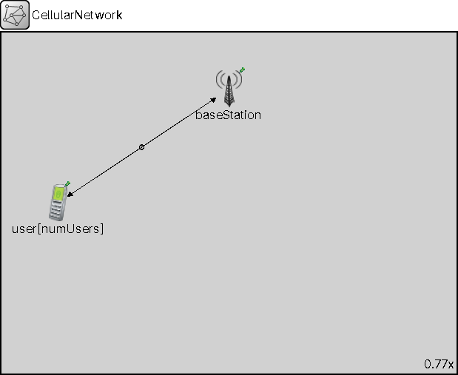
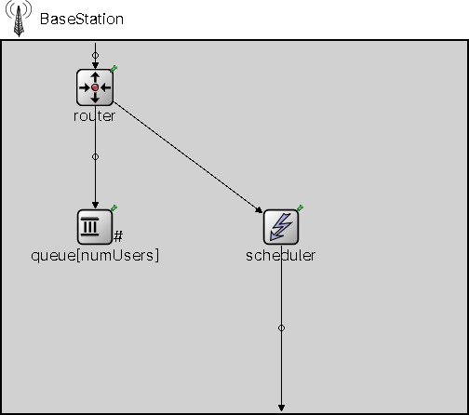
System Architecture
Cellular network with n=10 users
25 Resource Blocks per frame, 1ms TTI
CQI feedback mechanism (1-15 scale)
Round-Robin scheduling policy
FIFO queues per user
Notes:
Our system models a single-cell cellular network serving 10 users. The key factor is the realistic modeling of Channel Quality Indicators, which determine how many bytes can be packed into each Resource Block. Users report their CQI every millisecond, and the base station uses Round-Robin scheduling to fairly allocate the 25 available RBs. Each user has a dedicated FIFO queue, ensuring packet ordering. The CQI values range from 1 to 15, with capacity varying from 3 to 93 bytes per RB.

Slide 3
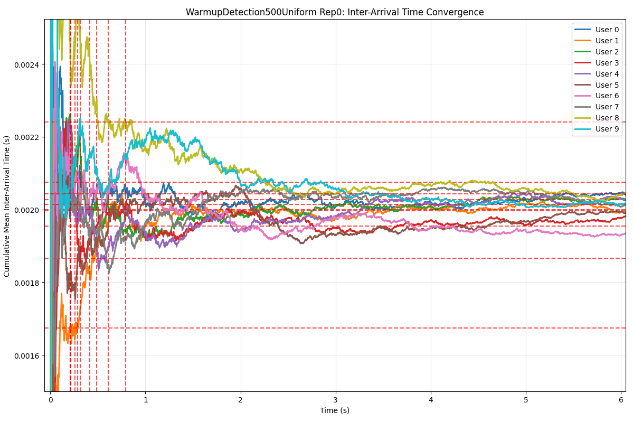
Warm-up Analysis
Challenge: Eliminate transient effects for unbiased statistics
Method: Cumulative mean analysis of inter-arrival times
Convergence criterion: Coefficient of Variation < 2%
Result: 5-second warm-up period (conservative choice)
Notes:
Determining the proper warm-up period is critical for obtaining unbiased steady-state statistics. We employed the cumulative mean method, tracking when system metrics stabilize. The graph shows inter-arrival times converging within 1 second for most scenarios, but we conservatively chose 5 seconds to ensure all transient effects are eliminated across all load conditions.

Slide 4
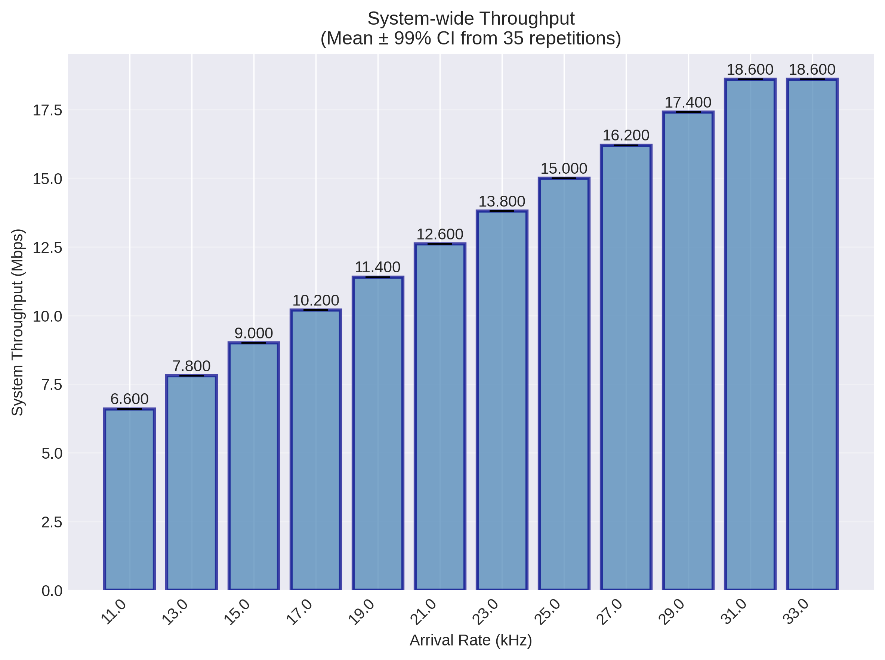
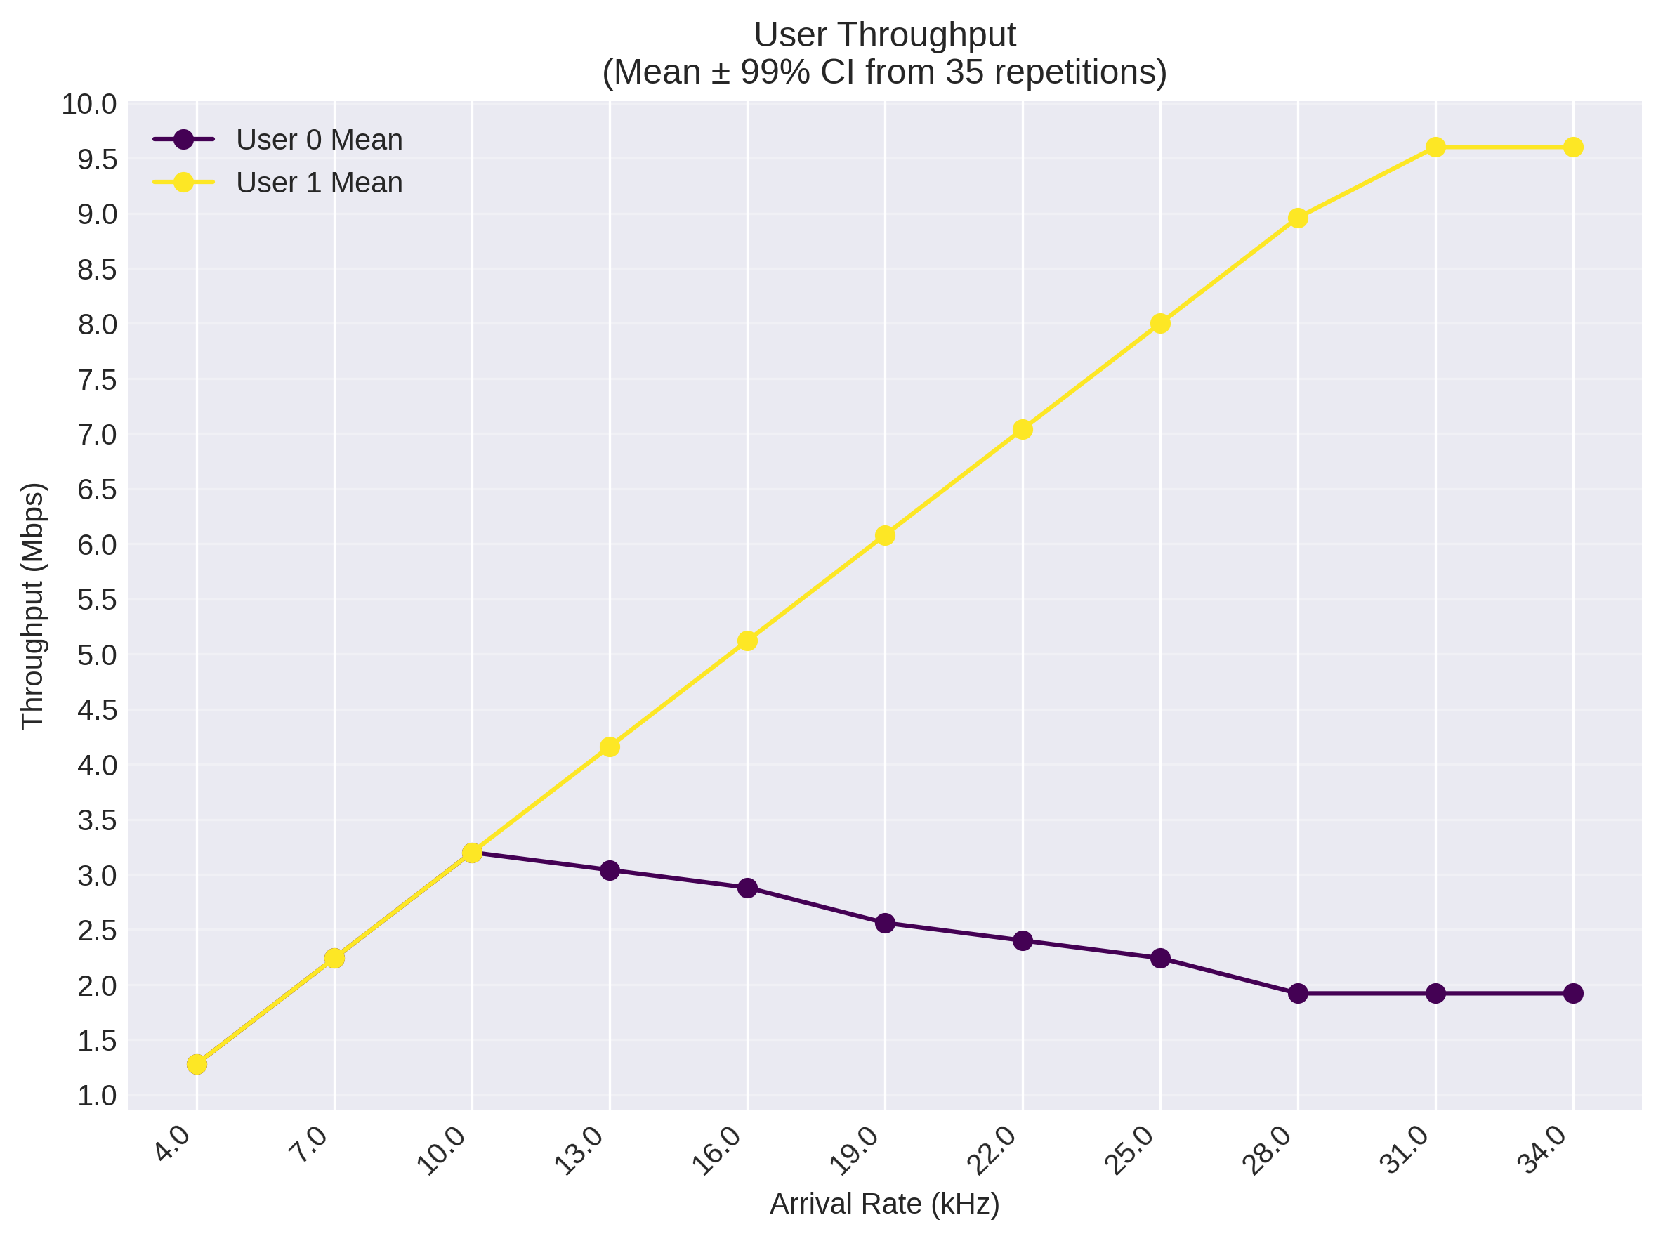
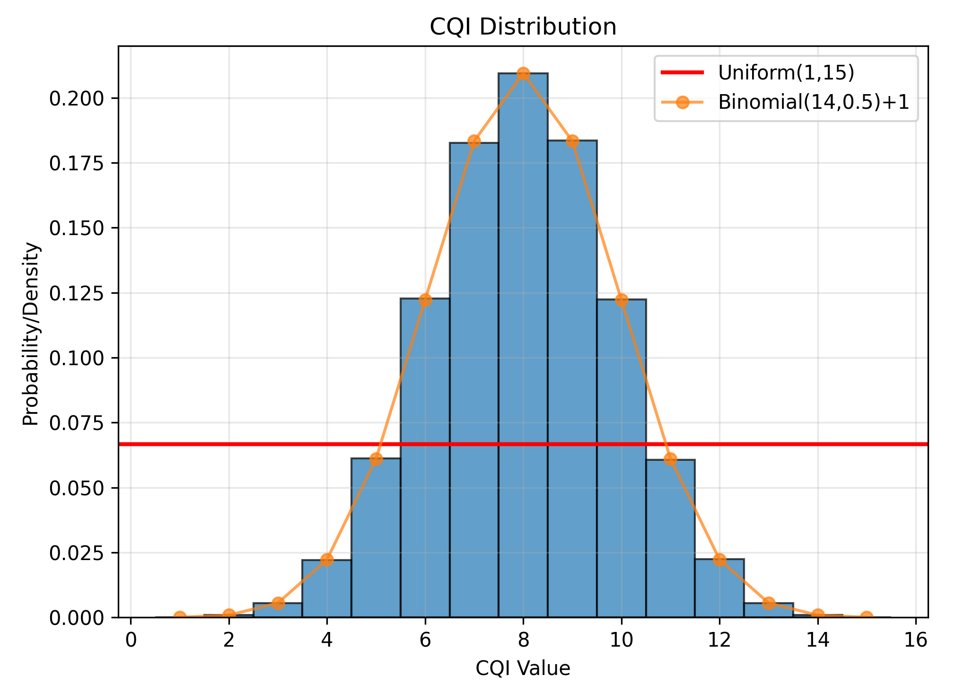
Validation Methodology
5 validation tests with increasing complexity
Theoretical calculations vs. simulation results
Single user baseline (Test 1)
Multi-user fairness verification (Tests 2 & 5)
Statistical distribution validation (Tests 3 & 4)
Notes:
Validation is crucial for simulation credibility. We designed five tests progressively verifying different aspects. Test 1 confirms basic throughput calculations - a single user with CQI 15 achieves exactly 18.6 Mbps as predicted. Test 2 validates multi-user scheduling with different CQIs, showing how capacity differences affect throughput and saturation. Tests 3 and 4 verify our random distributions - exponential arrivals, uniform packets, and both uniform and binomial CQI models. Test 5 confirms perfect Round-Robin fairness with 10 identical users.

Slide 5
Two Realistic Scenarios: Mobile vs. Stationary Users
Scenario 1: Uniform CQI - mobile users in urban environment
All users: CQI uniform [1,15]
Models high mobility scenarios
Scenario 2: Binomial CQI - stationary users with location-based quality
Group 1 (users 0-2): p=0.8 (near base station)
Group 2 (users 3-6): p=0.5 (mid-cell)
Group 3 (users 7-9): p=0.2 (cell edge)
Notes:
We evaluate two scenarios representing different real-world deployments. Scenario 1 models mobile users experiencing all channel conditions equally - like vehicles or pedestrians moving through an urban cell. All users have identical statistical behavior with uniform CQI distribution. Scenario 2 models stationary users where location determines average channel quality. We use binomial distributions with different parameters: high p-value for users near the base station, medium for typical users, and low for cell-edge users. This creates a heterogeneous environment to test Round-Robin fairness under diverse conditions.

Slide 6
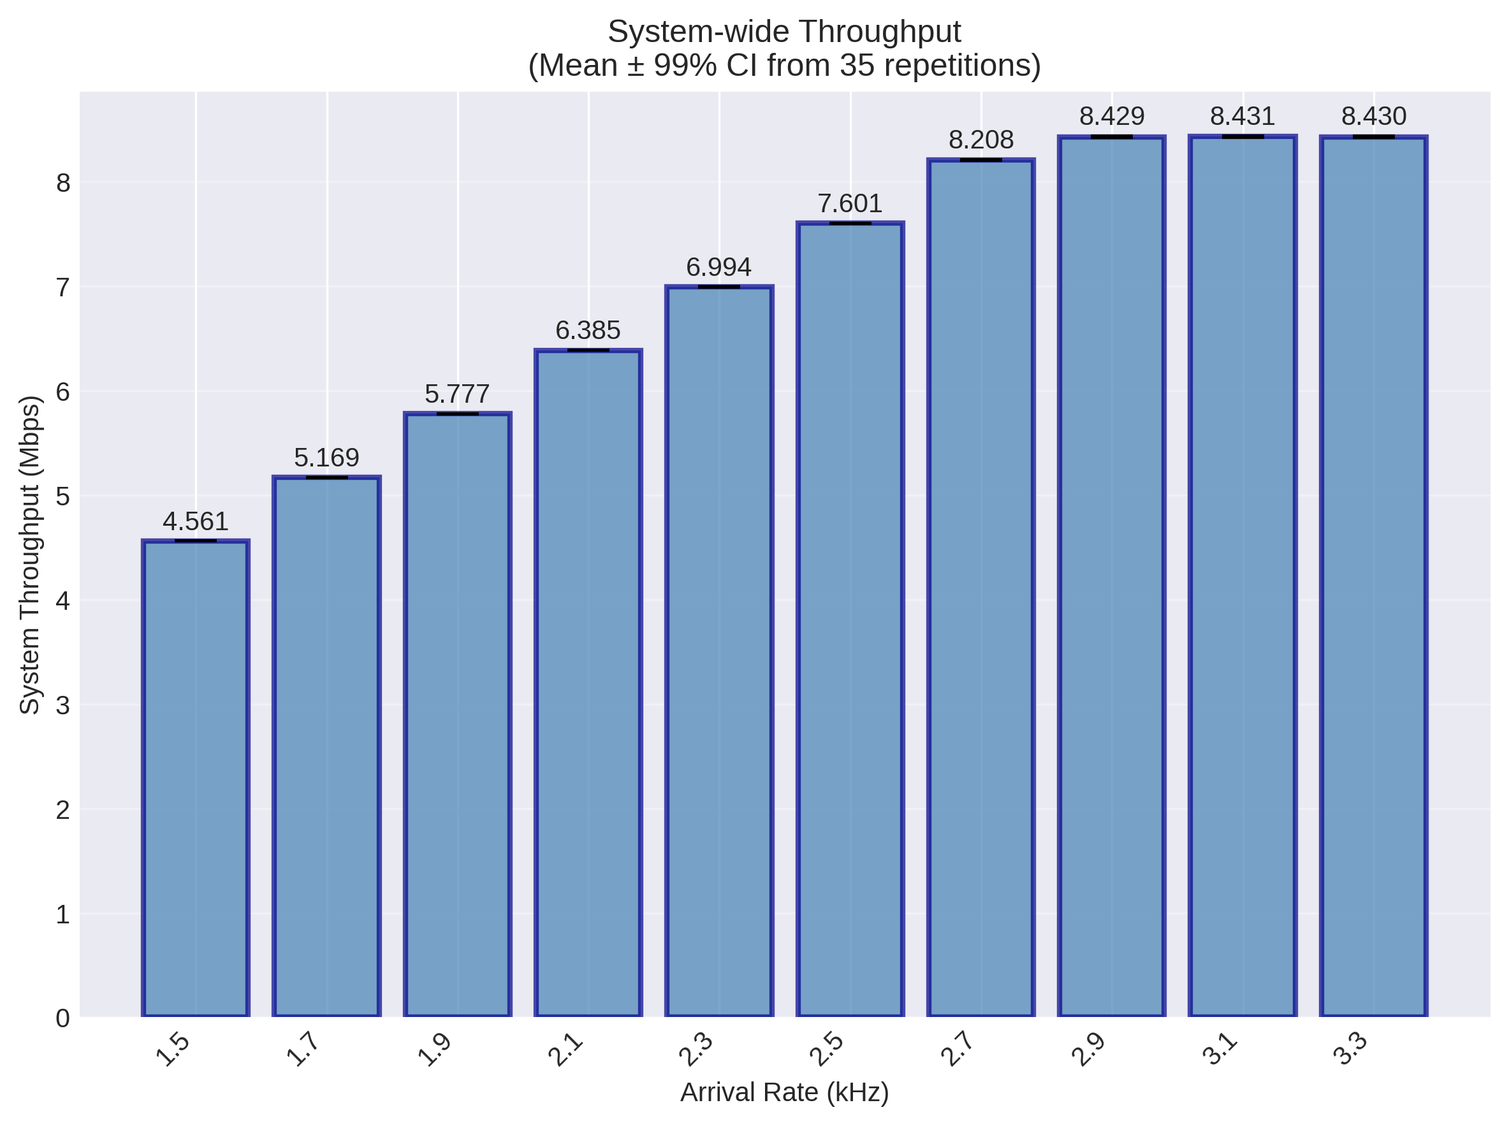
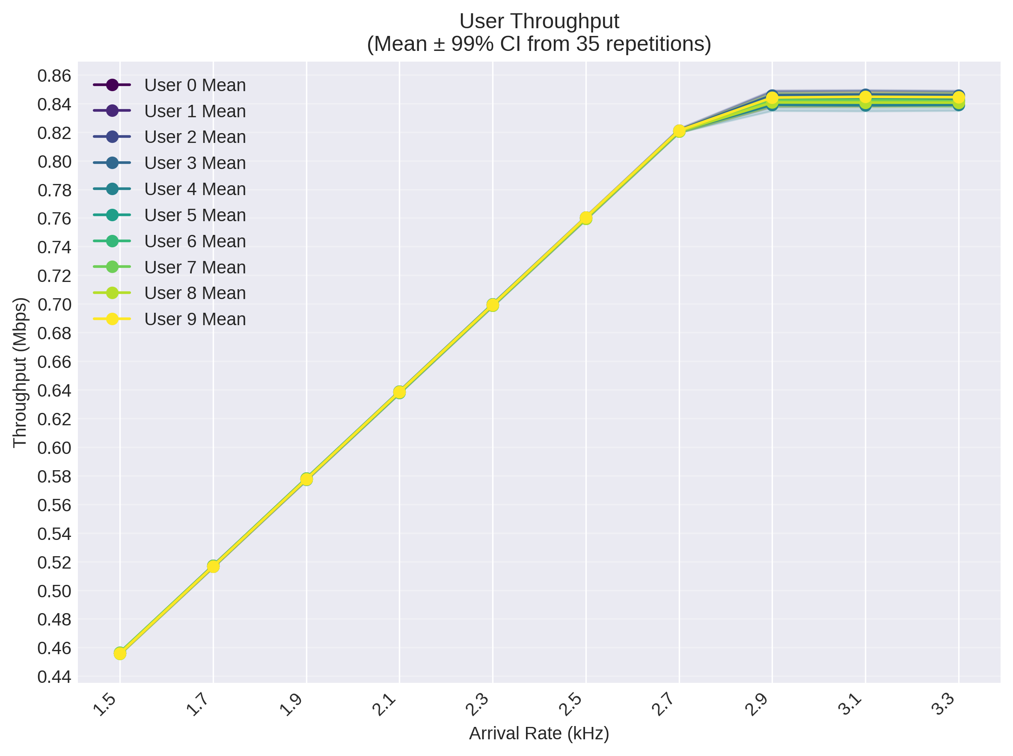
Uniform CQI Results: Perfect Fairness Under Homogeneous Conditions
System saturation at 8.428 Mbps (λ ≈ 2.9 kHz/user)
Perfect fairness: all users achieve ~0.84 Mbps at saturation
Linear throughput growth in low-load region
Statistical multiplexing gain from variable packet sizes
Notes:
Scenario 1 demonstrates Round-Robin's strength with homogeneous users. The system achieves 8.428 Mbps total throughput, higher than our validation baseline due to statistical multiplexing - variable packet sizes allow better RB packing. All 10 users achieve nearly identical throughput, confirming perfect fairness. The linear growth region extends to about 2.7 kHz per user, then gradually transitions to saturation. The 99% confidence intervals are extremely tight, showing consistent behavior across 20 replications. This represents the ideal case for Round-Robin scheduling.

Slide 7
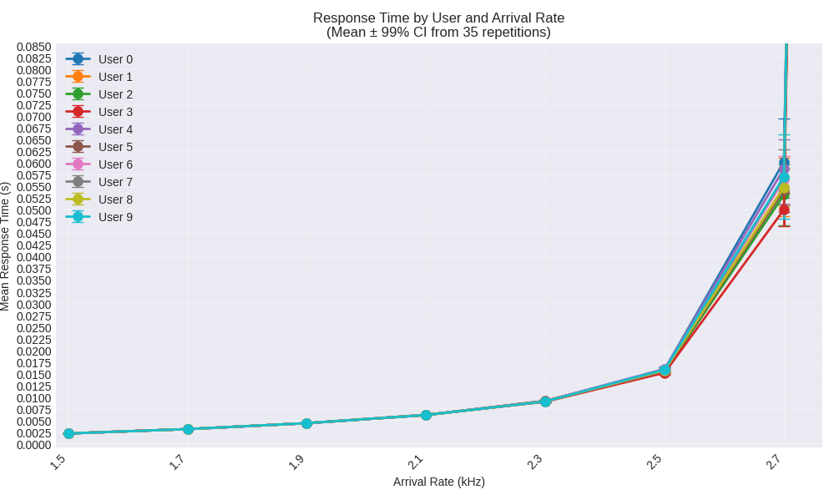
Response Time Behavior: From Milliseconds to Congestion
Low load (< 2.0 kHz): Response time < 5ms
Medium load (2.0-2.7 kHz): Gradual increase to 60ms
Near saturation: Exponential growth to >1 second
All users experience identical delay patterns
Notes:
Response time analysis reveals three distinct regions. At low loads, packets experience minimal delay - under 5 milliseconds, essentially just the scheduling delay. As load increases, queueing effects emerge, with response times reaching 60ms. The knee of the curve appears around 2.7 kHz, where queues begin building rapidly. At saturation, response times exceed 1 second as queues grow without bound.

Slide 8
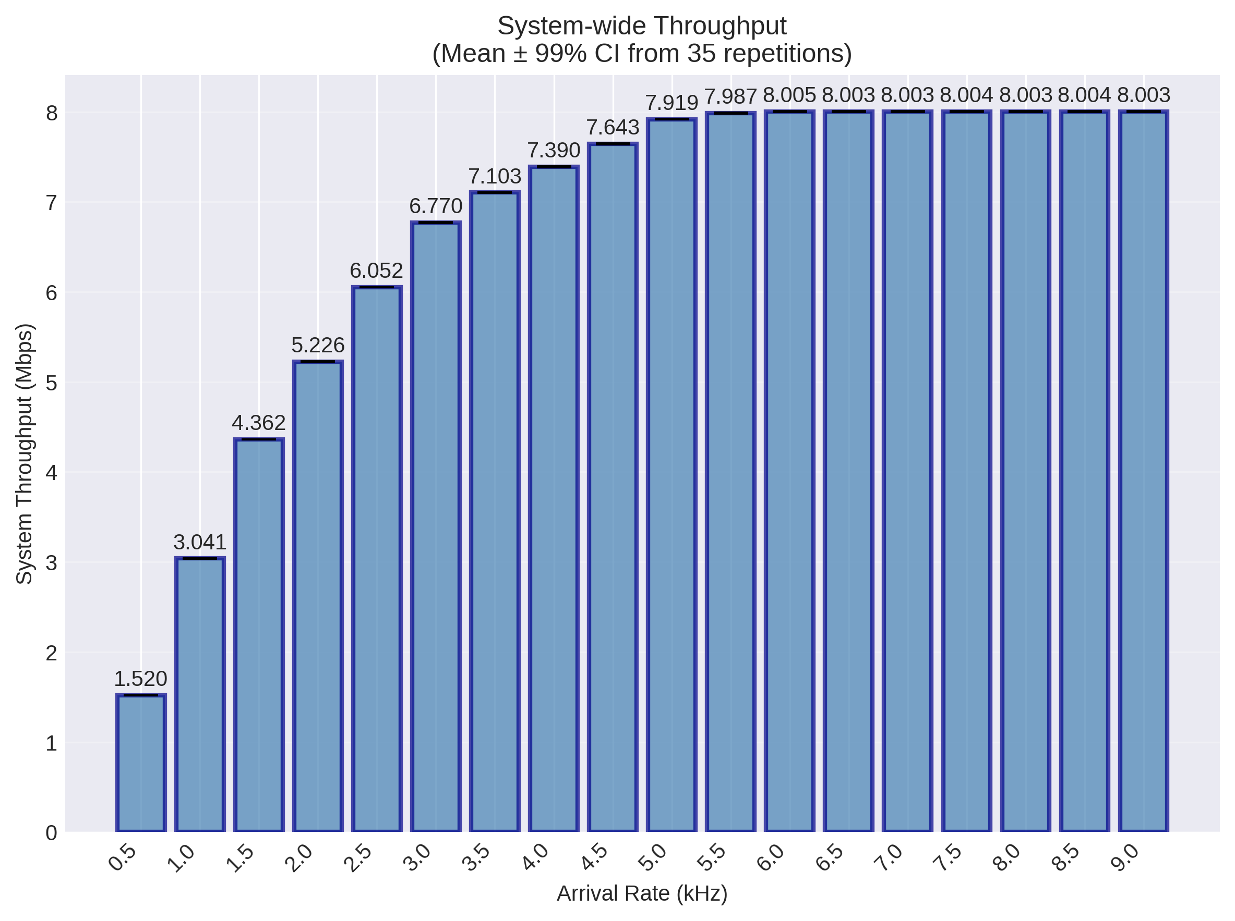
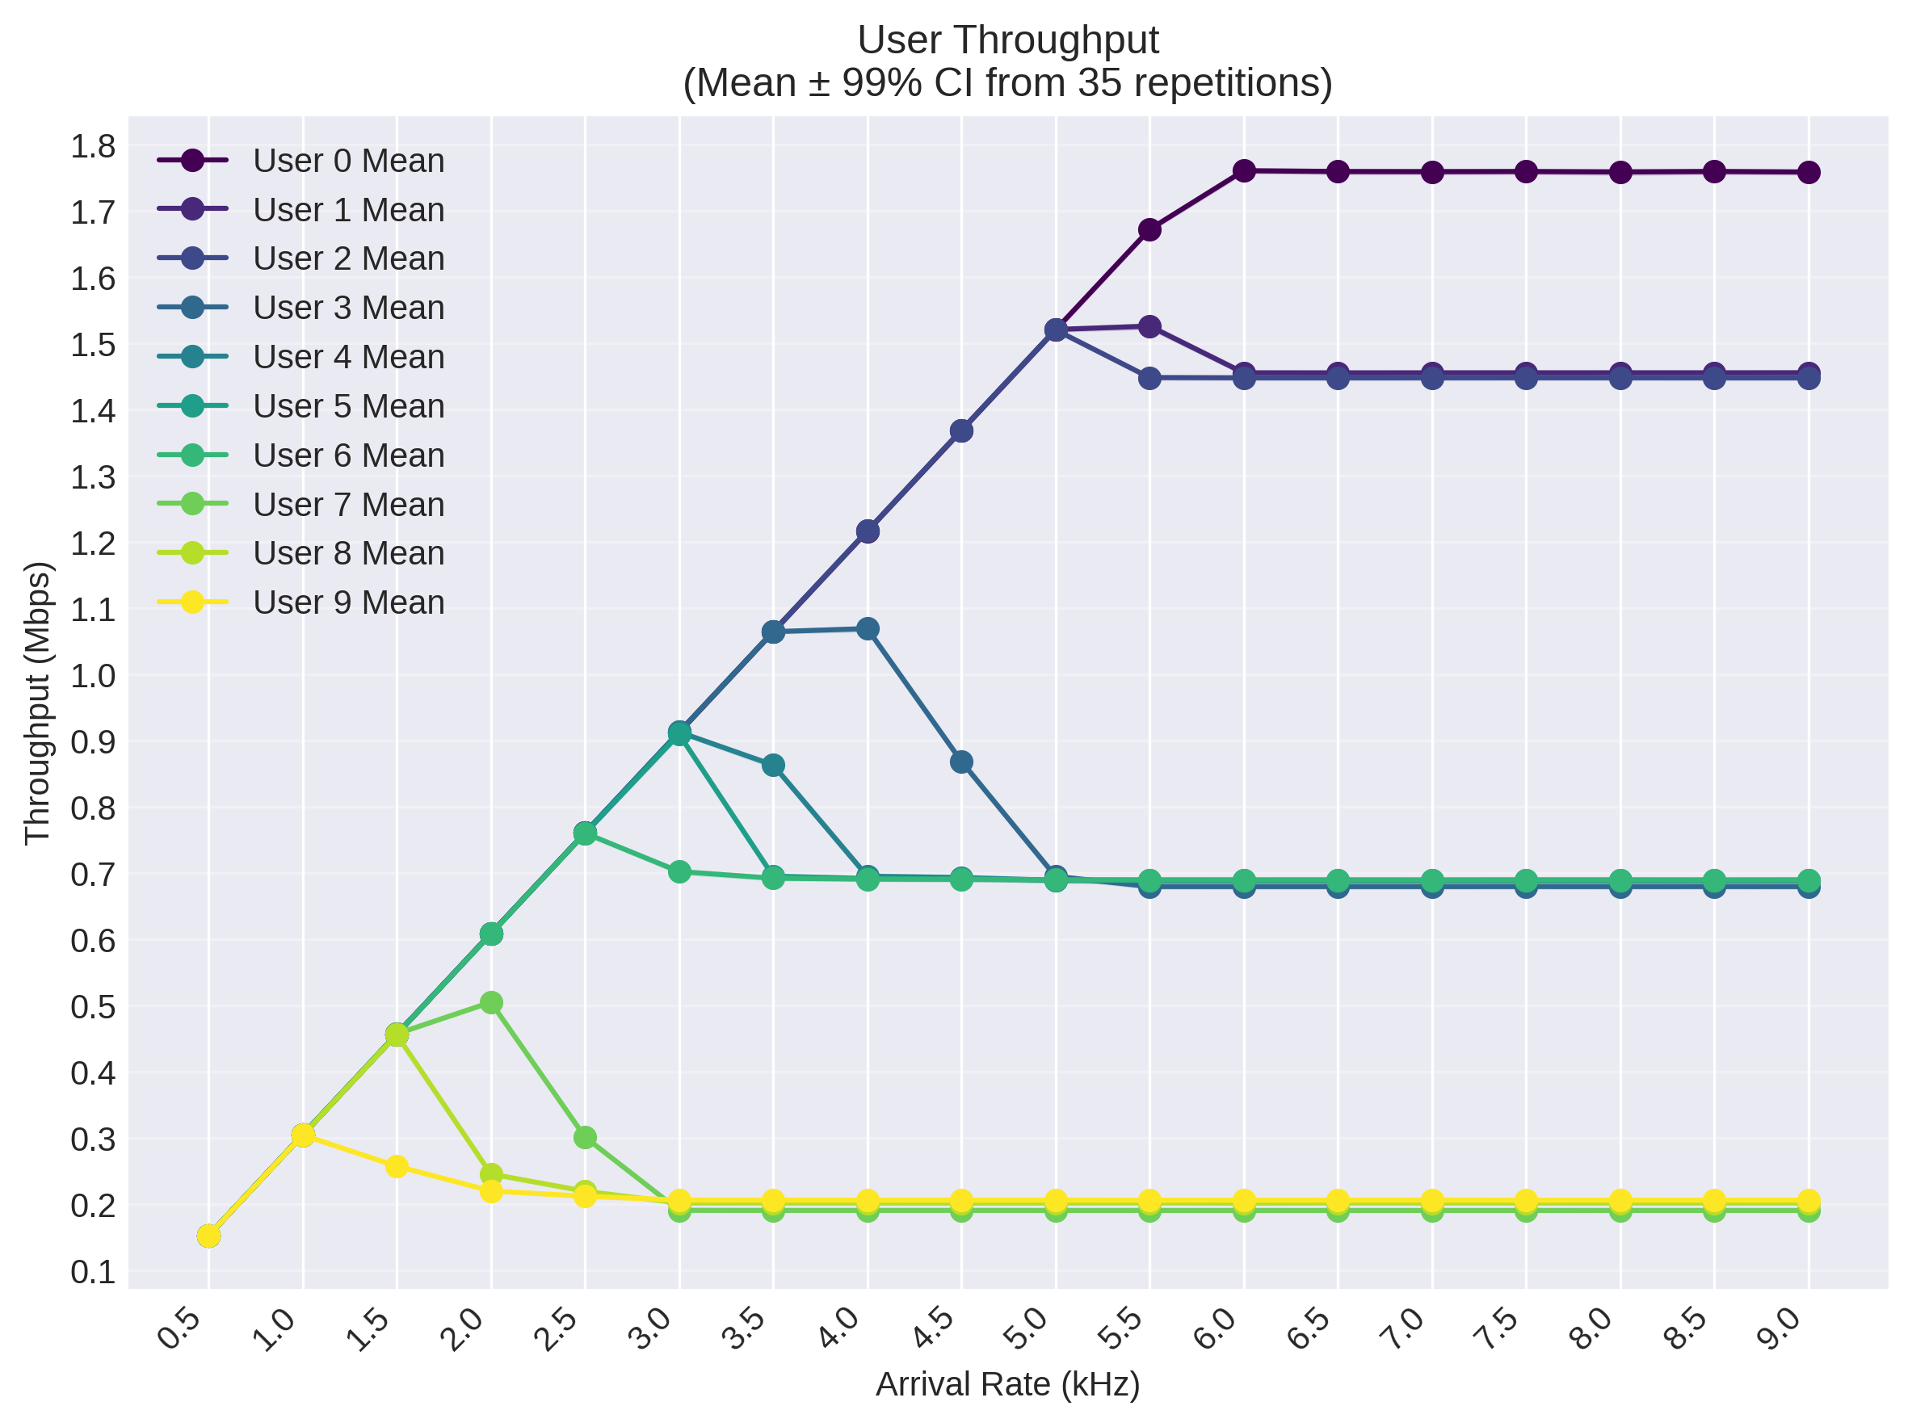
Binomial CQI Impact: When Location Matters
Three distinct saturation points by user group:
Good channel (p=0.8): ~1.45 Mbps at 5-6 kHz
Medium channel (p=0.5): ~0.68 Mbps at 3-4 kHz
Poor channel (p=0.2): ~0.20 Mbps at 2-3 kHz
User index bias within groups
Resource "stealing" effect at high loads
Notes:
Scenario 2 reveals fascinating behavior with heterogeneous users. The three groups saturate at dramatically different points based on their average CQI. Good-channel users achieve 7x the throughput of poor-channel users. Interestingly, we observe user index bias within groups - User 3 (first medium user after good users) maintains higher throughput longer than User 6, due to Round-Robin ordering interactions. At high loads, good-channel users benefit from poor-channel users' inability to fill frames efficiently. User 0 particularly benefits, achieving higher throughput than its group peers by utilizing User 9's unused resources.

Slide 9
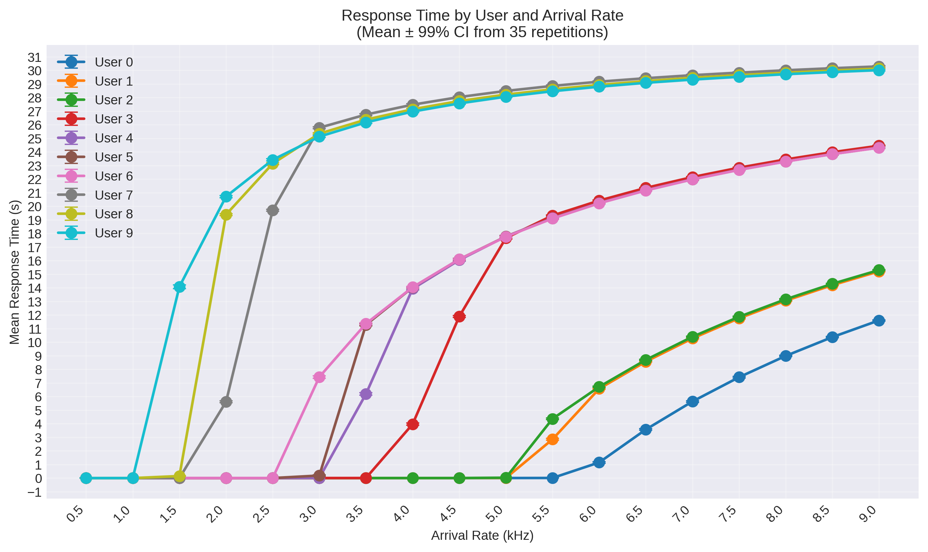
Response Time Behavior
Good-channel users: Maintain low delays until 5 kHz
Medium-channel users: Moderate delays starting at 3 kHz
Poor-channel users: High delays even at moderate loads

Slide 10
Round-Robin Performance: Fairness vs. Efficiency Trade-offs
Fairness Achievement: Perfect with homogeneous users, challenged with heterogeneous CQIs
Efficiency: 8.4 Mbps with uniform CQI, 8.0 Mbps with binomial (5% loss)
Critical Observations:
Statistical multiplexing improves efficiency
User ordering affects individual performance
Poor-channel users limit system capacity
Response time degrades rapidly near saturation
Notes:
Our study reveals Round-Robin's fundamental trade-off between fairness and efficiency. With homogeneous users, it achieves perfect fairness while maintaining high efficiency through statistical multiplexing. However, with heterogeneous channels, strict fairness comes at a cost - poor-channel users consume many RBs for minimal data, reducing overall efficiency by 5%. The user ordering bias is an unexpected finding, showing that even "fair" algorithms can have subtle inequalities. For delay-sensitive applications, operating below saturation load is crucial as response times increase dramatically beyond that point.

