Slide 1
Compilation
How GCC Compilers our c code?

Slide 2
What is compilation a compilers
deferens between interpreters and compilers
The 4 different steps of compilation ( GCC ):
The preprocessing
The compiling
The assembling
The linking

Slide 3
Compilation is the process of turning human readable code ( A programing language e.g. C ) into binary code that the computer can understand using a special program called Compiler

Slide 4
What’s a Compiler?
Compiler is a program that take our source code as an input and translate it into a machine code

Slide 5
Deferens between interpreters and compilers:
An interpreter translate our source code line by line
A Compiler translate all of our source code
Interpreted Languages :
Python
JavaScript
PHP
Compiled Languages:
C++
Java
C#

Slide 6
The 4 different steps of compilation ( GCC ):
The preprocessing
The compiling
The assembling
The linking

Slide 7
The preprocessing

Slide 8
This step:
get rid of all comments
Include all header files “.h”
Replace all macros with there value
gcc -E main.c

Slide 9
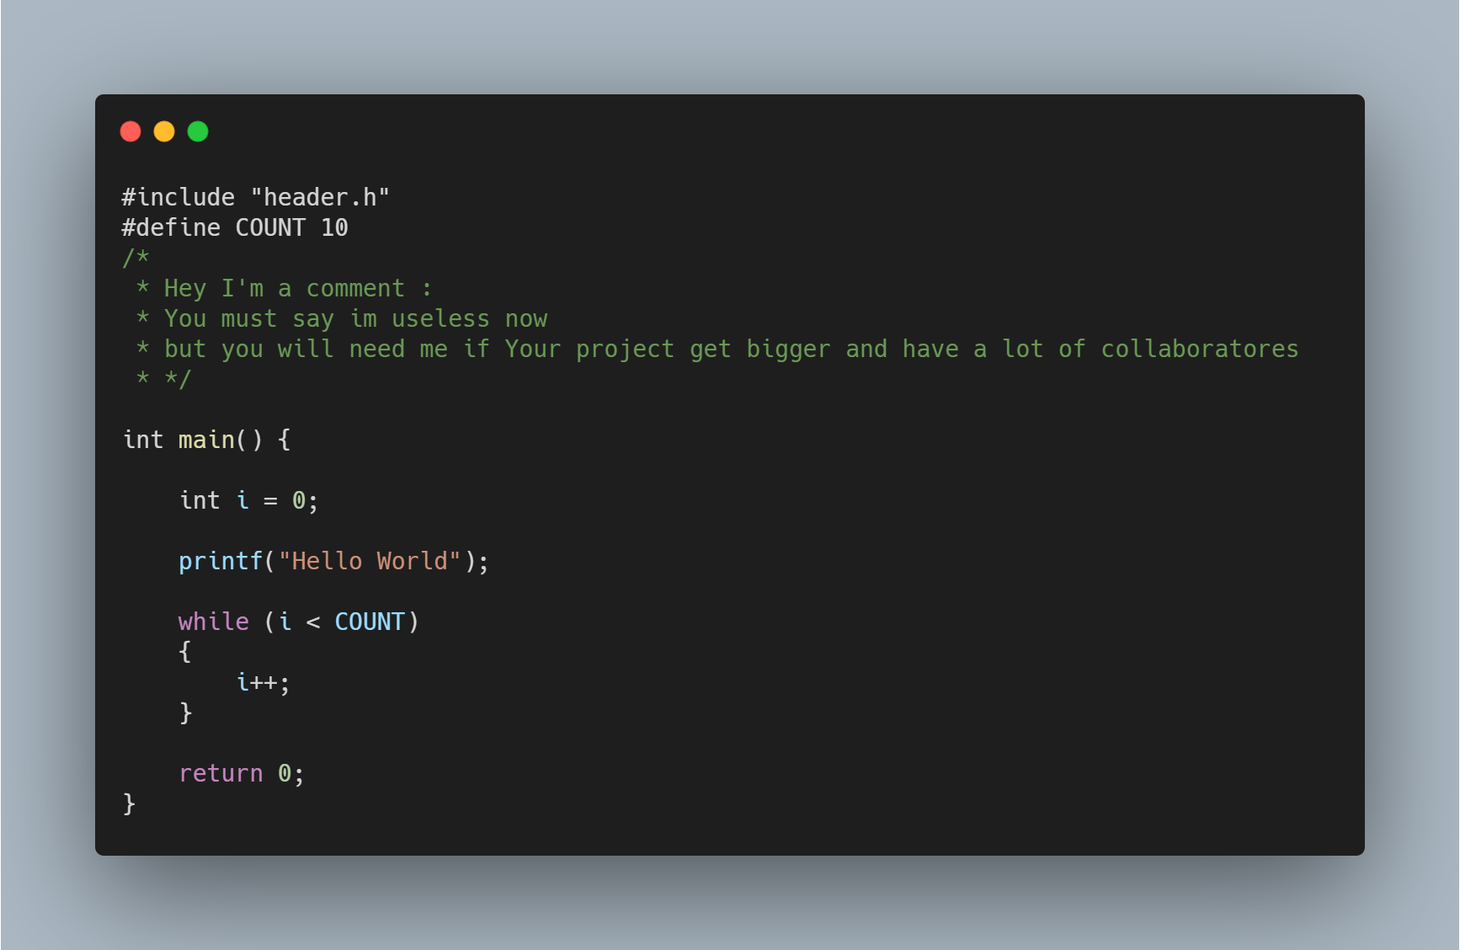

Slide 10
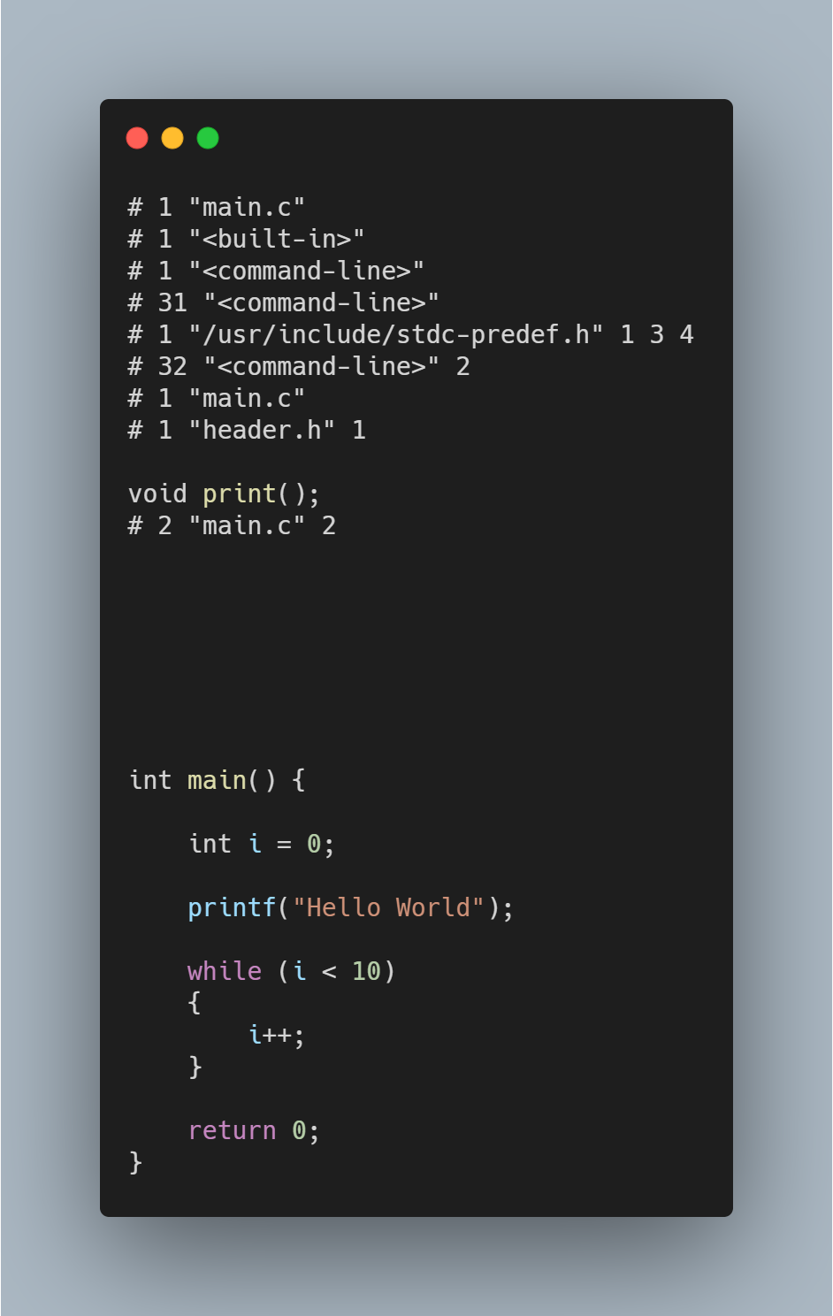

Slide 11
The compiler

Slide 12
This step:
Take our code (the preprocessed code) and generate a IR ( Intermediate representation )
gcc -S main.c

Slide 14
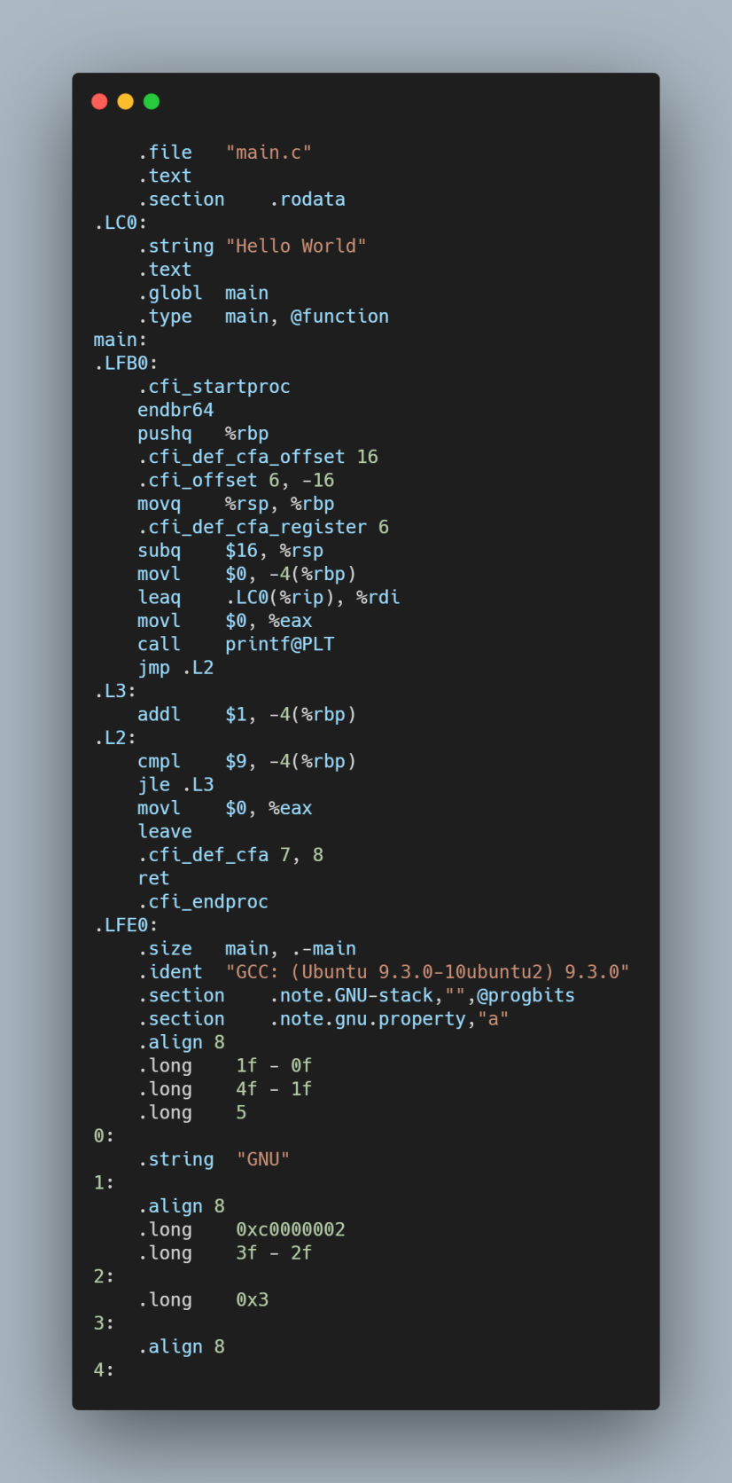

Slide 15
The assembler

Slide 16
This step:
Take our IR and turn it into binary
gcc -c main.c

Slide 17
The linker

Slide 18
This step:
Link function calls with there definition
gcc -c main.c

