Slide 1
Survival-Guided Matrix Factorization Identifies Reproducible Prognostic Programs in Pancreatic Cancer
Amber M. Young
Department of Biostatistics | University of North Carolina at Chapel Hill
R package: github.com/ayoung31/DeSurv

Slide 2
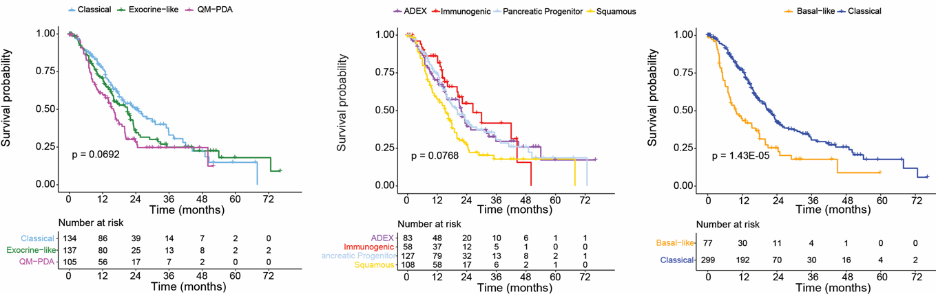
The Problem: Dominant biological structure ≠ Prognosis
Standard NMF minimizes reconstruction error — but dominant signals are often not prognostic
Bulk tumor expression is a mixture: malignant cells, fibroblasts, immune infiltrate
Standard NMF minimizes reconstruction error → captures dominant expression signals
Dominant signals ≈ tissue composition / tumor purity → often outcome-neutral
Standard workflow: discover gene programs unsupervised, then evaluate clinical relevance retrospectively
In PDAC specifically:
Exocrine cell signal reflects tumor purity.
Prognostically neutral.
Why not just use single-cell data?
Bulk expression is primary source of large, clinically annotated cohorts for survival analysis
Clinical relevance still evaluated retrospectively in bulk

Slide 3
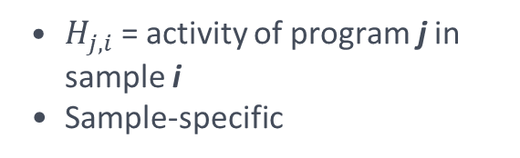
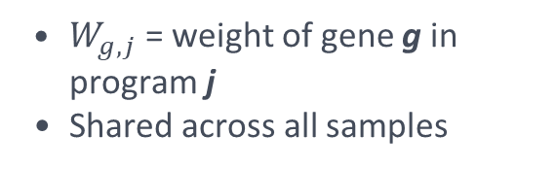

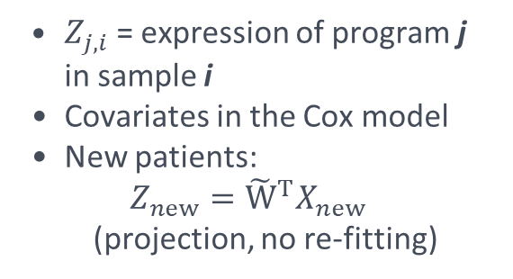
NMF Background
Nonnegative Matrix Factorization — additive, interpretable decomposition
X ≈ W · H
(p × n) = (p × k) × (k × n) W, H ≥ 0
p = genes, n = samples, k = latent factors
W — Gene Programs (p × k)
Top genes in W – program identity
Z = Wᵀ X — Program Scores (k × n)
$W_{g,j}$ = weight of gene g in program j
Shared across all samples
Top genes are program specific
Large weights in one program and small weights in others
Rank:
$$W_{gj} − \max_{r≠j}W_{gr}$$
$Z_{j,i}$ = expression of program j in sample i
Covariates in the Cox model
New patients:
$$Z_{new}={\tilde{W}}^{T}X_{new}$$ (projection, no re-fitting)
H — Sample Loadings (k × n)
$H_{j,i}$ = activity of program j in sample i
Sample-specific
Objective mismatch:
NMF Minimizes: ‖ X − WH ‖² (reconstruction error) Downstream evaluation: survival prediction (c-index)
3

Slide 4
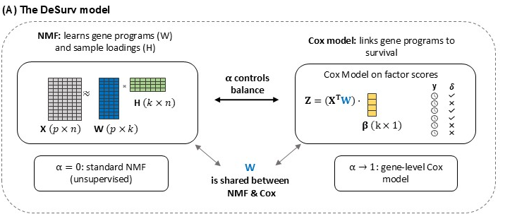

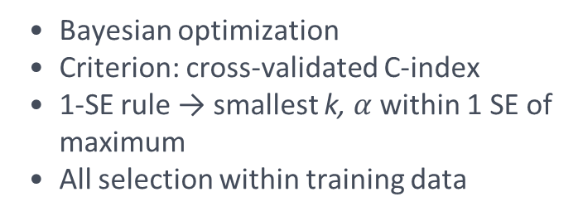
DeSurv: Survival-Supervised Deconvolution
Joint NMF + Cox proportional hazards — α controls supervision strength
1. Joint objective:
2. Model selection
Bayesian optimization
Criterion: cross-validated C-index
1-SE rule → smallest k, $α$ within 1 SE of maximum
All selection within training data
ℒ(W, H, β) = (1 − α) · $ℒ_{NMF}$(W, H) − α · $ℒ_{Cox}$(W, β)
3. Out-of-sample scoring
W fixed at training time
New patients:
$$Z_{new}={\tilde{W}}^{T}X_{new}$$
No re-optimization
Risk score = $Z_{new}\hat{β}$ (linear predictor)

Slide 5
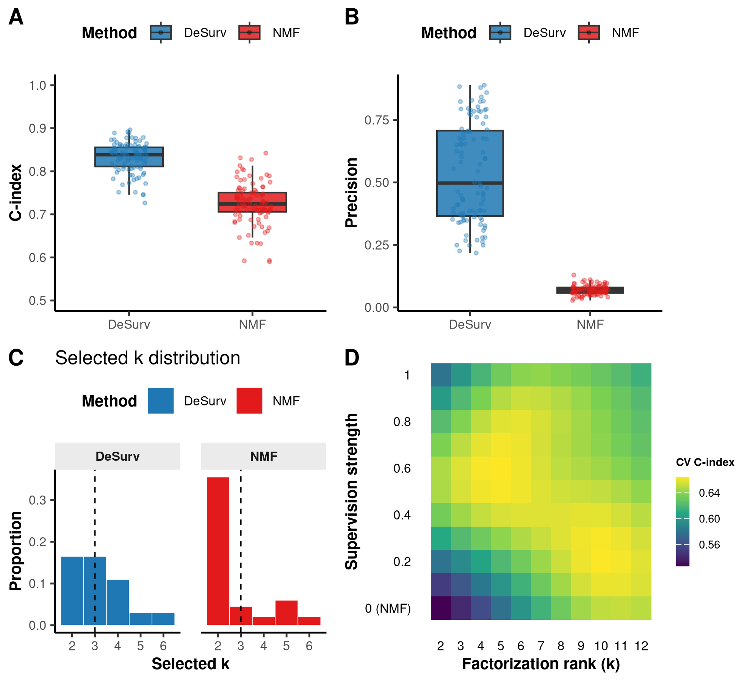
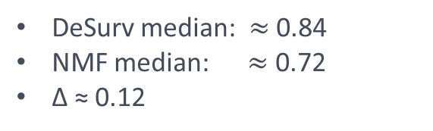
Simulation: DeSurv Wins When Expression Dominance ≠ Prognosis
100 replicates | p = 3,000 genes, n = 200 samples, true k = 3 | both methods tuned by BO over CV C-index
Primary scenario: prognostic genes are sparse compared to outcome-neutral background genes.
β = (2, 0, 0) → only factor 1 drives survival.
C-index (test set)
Gene Program Precision
DeSurv median: $≈$ 0.84 NMF median: $≈$ 0.72 Δ ≈ 0.12
Fraction of top genes in learned factor overlapping the true prognostic program
NMF: near zero
DeSurv: substantially higher
Benefit beyond prediction
NMF achieves moderate c-index despite failing to find prognostic programs
Benefit of DeSurv extends beyond prediction – prognostic program recovery

Slide 6
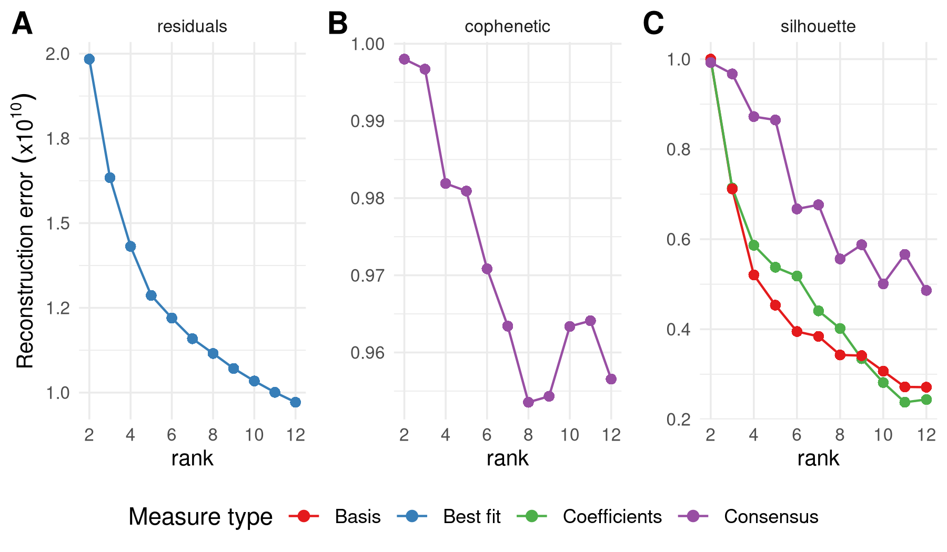
Model Selection in PDAC: BO + 1-SE Rule
Training cohorts: TCGA-PAAD + CPTAC-3
Standard NMF rank selection in PDAC:
DeSurv: BO over CV C-index
Reconstruction residuals: elbow around k=5
Cophenetic correlation: drops afer k=3
Silhouette score: inconsistent
→ No single k clearly indicated
Bayesian optimization explores (k, α, λ, …)
Objective = cross-validated C-index
GP-predicted mean C-index over k × α grid
1-SE rule: smallest k within 1 SE of max
→
PDAC result: k = 3, α ≈ 0.37 (CV C-index = 0.63)

Slide 7
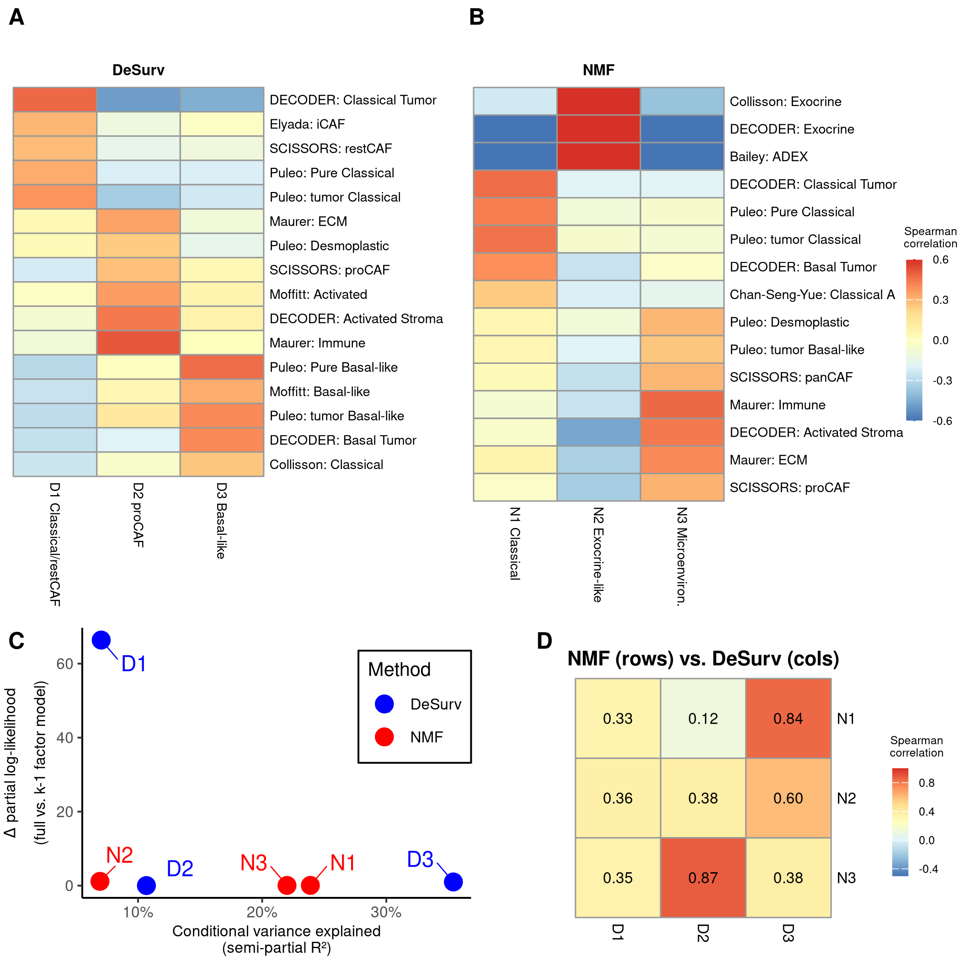
PDAC Factor Structure: DeSurv vs. Standard NMF (both at k = 3)
Gene program identity measured by Spearman correlation to established PDAC reference signatures
Standard NMF (k = 3)
DeSurv (k = 3, α = 0.37)
Exocrine
Classical +
restCAF
Classical
proCAF
Microenvironment
Dominant tissue types
Established prognostic programming
Basal-like

Slide 8
Variance vs. Survival Contribution in PDAC
Semi-partial R² (expression variance) vs. ΔCox log-likelihood (survival contribution per factor)
Key findings:
NMF factors primarily explain dominant expression patterns
ΔCox ≈ 0 (no survival contribution)
DeSurv most prognostic factor (D1):
Low variance <10%
ΔCox >> 0 (all survival signal here)
All NMF factors: negligible ΔCox despite spanning range of variance
→ Dominance and prognosis diverge in PDAC

Slide 9
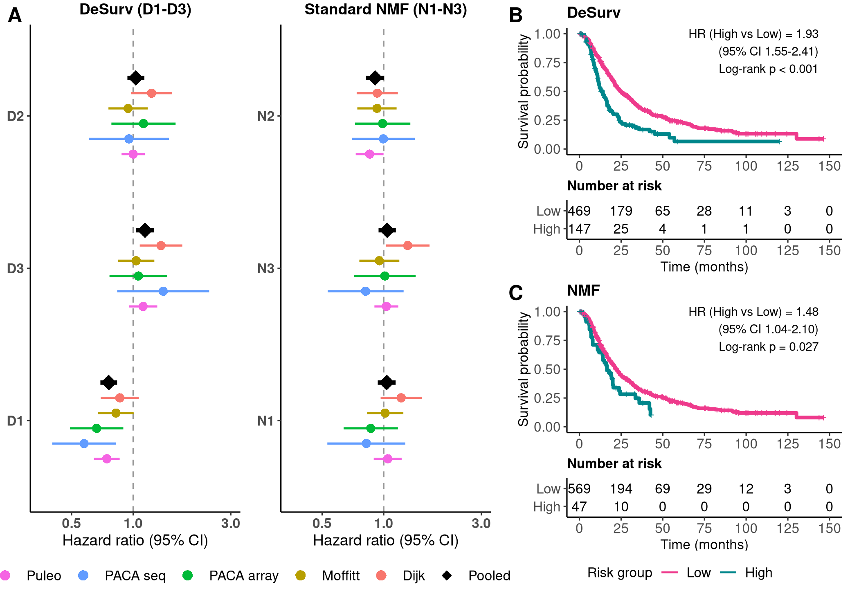
External Validation: 5 Independent PDAC Cohorts
Scored by projection only — no retraining, no access to validation survival data during training
Validation cohorts:
Puleo (array)
Moffitt (GEO array)
PACA-AU (RNA-seq)
PACA-AU (array)
Dijk (array)
Pooled HR per SD (DeSurv D1):
HR = 0.76 (95% CI 0.69 – 0.84) P < 0.001 (stratified Cox)
Standard NMF at same rank (k = 3):
Weaker pooled effect Inconsistent effect direction within programs

Slide 10
Kaplan–Meier Curves: Pooled External Validation
Risk groups dichotomized at cross-validated cutpoint learned from training data
DeSurv
Standard NMF (k = 3)
DeSurv: clearer risk stratification with better-separated survival curves

Slide 11
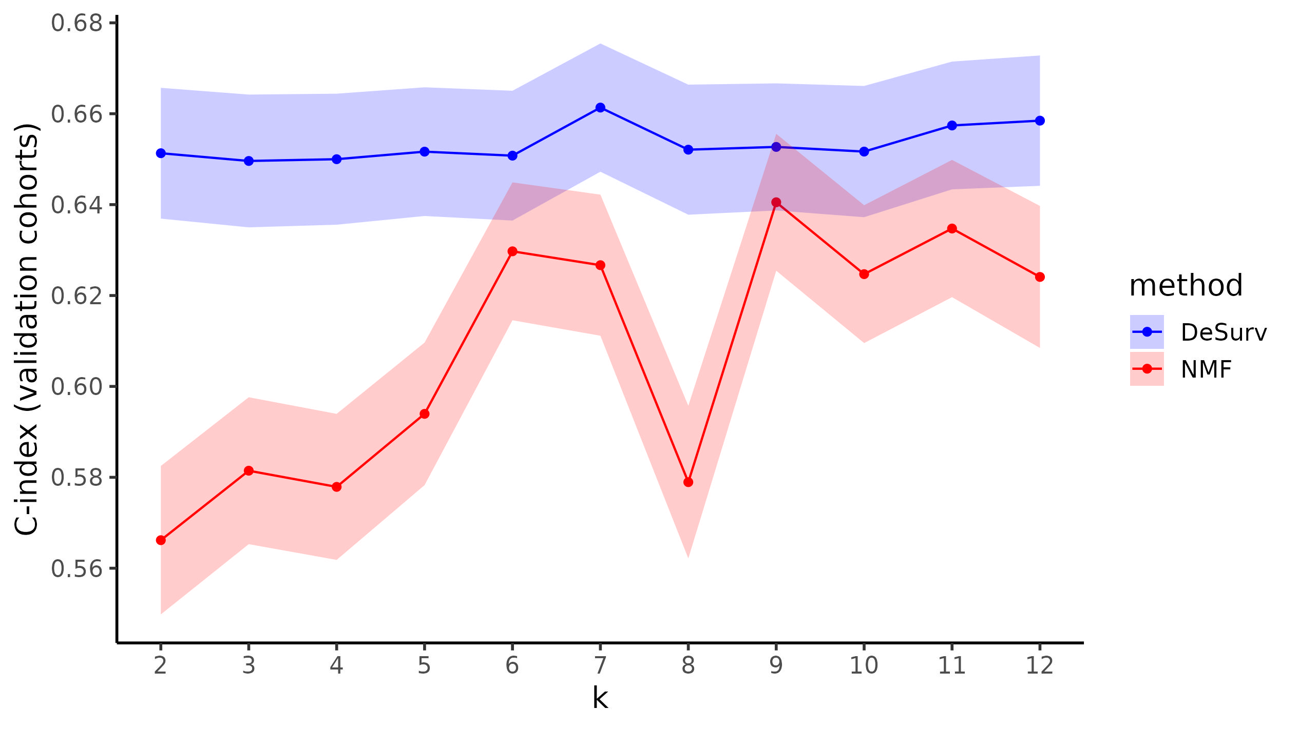
DeSurv is robust to k selection
Sensitivity analysis: grid search over k and alpha, fixing other parameters
Across k:
DeSurv: Supervision creates broad concordance plateau
NMF: concordance mostly increases with k → needs large k to approach DeSurv performance

Slide 12

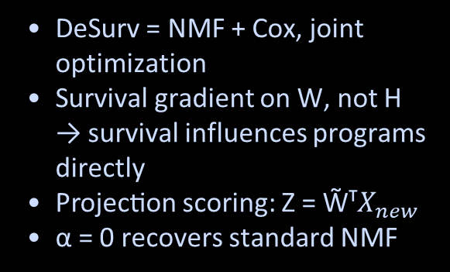
Summary
Methodological
Empirical
Biological
DeSurv = NMF + Cox, joint optimization
Survival gradient on W, not H → survival influences programs directly
Projection scoring: Z = W̃ᵀ$X_{new}$
α = 0 recovers standard NMF
Simulations: advantage when dominant programs ≠ prognosis
DeSurv programs generalize across 5 independent cohorts
D1 = classical tumor + restCAF stroma coupling
NMF N2 = exocrine purity signal (not prognostic)
Tumor purity dominates variance
Aligning the factorization objective with the clinical question—during discovery, not just evaluation— yields more transportable prognostic signatures with fewer, biologically interpretable factors.
Extensions to single-cell
NMF often used in scRNA-seq to understand cell states
As annotated cohort sizes increase for this technology, this represents a natural extension for DeSurv
R package: github.com/ayoung31/DeSurv | Paper code: github.com/ayoung31/DeSurv-paper

Slide 13





Acknowledgements
Biostatistics UNC:
Dr. Naim Rashid (Advisor)
Dr. Didong Li (Advisor)
Yeh Lab:
Dr. Jen Jen Yeh
Dr. Laura Peng
Stony Brook:
Dr. Alisa Yurovsky
Funding:
U01 CA274298
P50 CA257911
T32 CA106209

Slide 14
BACKUP SLIDES
Supplementary material and additional details

Slide 15
Algorithm Details
Alternating optimization — converges to stationary point under mild conditions
Initialize W, H using consensus across multiple random starts
Alternating updates:
Update H: fix W, β → minimize ℒ_NMF (ℓ₂ penalty)
Update W: fix H, β → minimize joint objective (survival gradient here)
Update β: fix W, H → maximize ℒ_Cox (elastic-net penalized Cox)
Repeat until convergence (relative objective change < ε)
Multiple initializations → select best by training C-index
W truncated to BO-selected n_top = 270 genes per factor (PDAC)
Convergence: stationary point guaranteed (SI Appendix)

Slide 16
Dataset Details
Training and external validation cohorts
Role
Cohort
Platform
n
Source
Training
TCGA-PAAD
RNA-seq
144
GDC / TCGA
Training
CPTAC-3
RNA-seq
129
GDC / CPTAC
Validation
Puleo et al.
Microarray
288
ArrayExpress E-MTAB-6134
Validation
Moffitt et al.
Microarray
123
GEO GSE71729
Validation
PACA-AU (array)
Microarray
63
ICGC / EGA
Validation
PACA-AU (seq)
RNA-seq
52
ICGC / EGA
Validation
Dijk et al.
RNA-seq
90
ArrayExpress E-MTAB-6830
Preprocessing: log₂(TPM+1) → within-sample rank transform (preserves nonneg). Gene selection: top 1,970 genes by mean expression + variance (intersection across training cohorts).

Slide 17
W-Matrix Correspondence Between Methods
Spearman rank correlation of gene loadings (all genes) between DeSurv and NMF factors
Interpretation:
N1 (classical) ↔ D3 (basal-like): strong positive correlation
N3 (mixed microenvironment) ↔ D2 (proCAF): strong positive correlation
D1 (most prognostic): weak, uniform correlation with ALL NMF factors
→ D1's tumor-stroma coupling does not exist in the NMF solution
N2 (exocrine): moderate positive correlation with D3 (Basal-like) → exocrine signal suppressed by DeSurv
Two methods share some biology but differ on: exocrine suppression & tumor-stroma coupling

