Slide 1
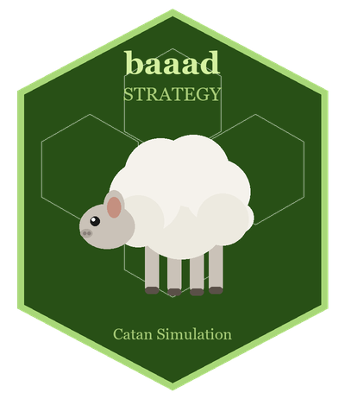
baaad-strategy
A Monte Carlo simulation proving the sheep strategy in Catan is baaad
Built in R · 1,000 simulated games · χ² statistical significance testing
github.com/ayoung31/baaad-strategy

Slide 2
What Is This Project?
▸ Settle the debate: is going all-in on sheep actually a good Catan strategy?
• The 'sheep strategy' — settle on high-wool hexes, race to the 2:1 Wool port
• Sounds clever in theory; this project tests it statistically
▸ Approach: Monte Carlo simulation in R
• Run 1,000 full Catan games with three competing strategies
• Compare win rates using a chi-squared significance test (p < 0.05)
▸ Result: sheep strategy loses significantly — the numbers don't lie
• Reproducible with a fixed random seed
• All results written to results/simulation_results.csv

Slide 3
Catan Primer: Resources & Building Costs
Item | Cost | VP | Strategic Value
Road | ● Lumber ● Brick | 0 | Expands network; needed for Longest Road
Settlement | ● Lumber ● Brick ● Wool ● Grain | 1 | Unlocks new production spots
City (upgrade) | ●●● Ore ●● Grain | +1 | Doubles production; primary VP engine
Dev Card | ● Ore ● Wool ● Grain | varies | Knights (Largest Army) or VP cards
Largest Army | 3+ Knight cards | 2 | Hold the most knight cards (≥ 3)
Longest Road | 5+ continuous road segments | 2 | Early game bonus for road builders

Slide 4
Board Setup & Dice Probabilities
Terrain Hex Counts
Number Token Probabilities
19 hexes total:
▸ Forest (Lumber) — 4 hexes
▸ Pasture (Wool) — 4 hexes
▸ Fields (Grain) — 4 hexes
▸ Hills (Brick) — 3 hexes
▸ Mountains (Ore) — 3 hexes
▸ Desert — 1 hex
9 ports around the coast:
4 × General (3:1) | 5 × Specific (2:1)
Token Pips Probability
─────────────────────────
6 5 5/36 ← best
8 5 5/36 ← best
5 4 4/36
9 4 4/36
4 3 3/36
10 3 3/36
3 2 2/36
11 2 2/36
2 1 1/36
12 1 1/36
7 (robber — not a token)

Slide 5
4 Key Strategy Components
Initial placement
Where do you put your first settlement?
Second placement
Where do you put your second settlement?
Road Priority
Which direction should we go towards with roads?
Build priority
What should our building priority be?
Dev cards, cities, settlements, roads

Slide 6
The Three Competing Strategies
Strategy | Initial Placement | Road Priority | Build Priority
balanced | pip_sum + 1×distinct_resources (both picks use same formula; diversity naturally avoids duplication) | Routes to highest-diversity open intersection; road built only when it opens a new settlement spot | City → Settlement → Dev card → Road Flexible; city is top priority throughout
sheep | wool_pips×2 + total_pips×0.5 2nd pick: infra guard (ensure lumber/brick) + Wool port bonus (+100) | Routes to 2:1 Wool port until secured; then best remaining wool spot | Dev card → Settlement → City → Road Bets on Largest Army VP; city deliberately deprioritised
ore_grain | (ore+grain)_pips×2 + total_pips×0.5 2nd pick: infra guard + Ore/Grain port bonus (+50) | Routes to 2:1 Ore or Grain port until secured; then best ore+grain spot | City → Settlement (capped at 4) → Dev card → Road City upgrades are the entire strategy

Slide 7
The Hypothesis: Why Sheep Loses
▸ Wool is structurally the weakest late-game resource
• Needed for settlements & dev cards — but NOT cities
• Cities (3 Ore + 2 Grain) are the primary VP-scaling mechanism
▸ Wool is the most abundant resource on the board
• 4 Pasture hexes vs. only 3 Mountains and 3 Hills
• Opponents naturally produce plenty of wool — the 2:1 port is less of an edge than 2:1 Ore or 2:1 Grain
▸ Placement trade-off hurts city-building
• Prioritising wool hexes means sacrificing better ore/grain spots
• A wool surplus with no matching ore/grain cannot efficiently convert to VP
▸ Success criterion: sheep win rate significantly lower than balanced (p < 0.05)

Slide 8
Architecture: 7 R Modules
▸ board.R — Hex graph, board generation, ports
• 19 hexes · 54 intersections · 72 road edges · axial coordinate layout
• generate_board() supports random terrain, tokens, and ports
▸ player.R — Player state and resource management
• Resource cards, settlements, cities, roads, dev cards, VP
• can_build() / do_build() / do_trade() helpers; 7-card discard rule
▸ strategy.R — Strategy interface + implementations
• Each strategy is a named list of functions: choose_initial_placement, choose_second_placement, choose_road_placement, choose_action
▸ game.R — Single game loop (reverse snake draft → turns → win check)
▸ simulation.R — Monte Carlo runner: run_simulation(n_games, strategies, seed)
▸ analysis.R — ggplot2 charts + chi-squared significance test ▸ visualize_board.R — Board & game-state rendering (plot_board, plot_game_state)

Slide 9
Game Loop (game.R)
▸ Initial placement — reverse snake draft
• P1 → P2 → P3 → P4 → P4 → P3 → P2 → P1
• Second settlement grants 1 of each adjacent resource to start
▸ Each turn: Roll → Robber/Production → Trade → Build
• Roll 7: discard rule (>7 cards) + robber targets the leading player
• Production: settlements yield 1 resource, cities yield 2
• Trade: bank 4:1 or port rates (3:1 general / 2:1 specific)
▸ Win condition: first player to reach 10 VP on their turn
• Stalemate safeguard: game ends after 500 turns (recorded as NA winner)
▸ Special VP bonuses tracked each turn
• Longest Road (≥ 5 segments) → 2 VP
• Largest Army (≥ 3 knights) → 2 VP

Slide 10
Simplifications vs. Full Catan Rules
Full Rule | Simulation Simplification | Impact on Results
Player-to-player trading | Omitted — strategies trade against bank/port only. Simulate-then-commit pattern: trade_toward() simulates the full sequence before committing any single trade. Unified goal order: city → settlement → dev card → road. | Low: all strategies use the same trading engine; removes negotiation but preserves resource conversion logic
Longest Road | Tracked; 2 VP at ≥5 road segments | Faithful to rules
Largest Army | Tracked; 2 VP at ≥3 knights | Faithful to rules
Robber targeting | Always targets the leading player (most VP) | Deterministic; slightly penalises front-runners
Board geometry | Intersection IDs enumerated for simulation; not pixel-perfect | Structural relationships preserved

Slide 11
How to Run the Simulation
source("R/simulation.R") results <- run_simulation( n_games = 1000, seed = 42 ) source("R/analysis.R") plot_win_rates(results)
Output
results/simulation_results.csv
Charts
Win rate bar chart with 95% CIs VP distribution violin/boxplot
Stats
χ² test on win-count table Target: p < 0.05
Time
< 60 seconds for 1,000 games

Slide 12
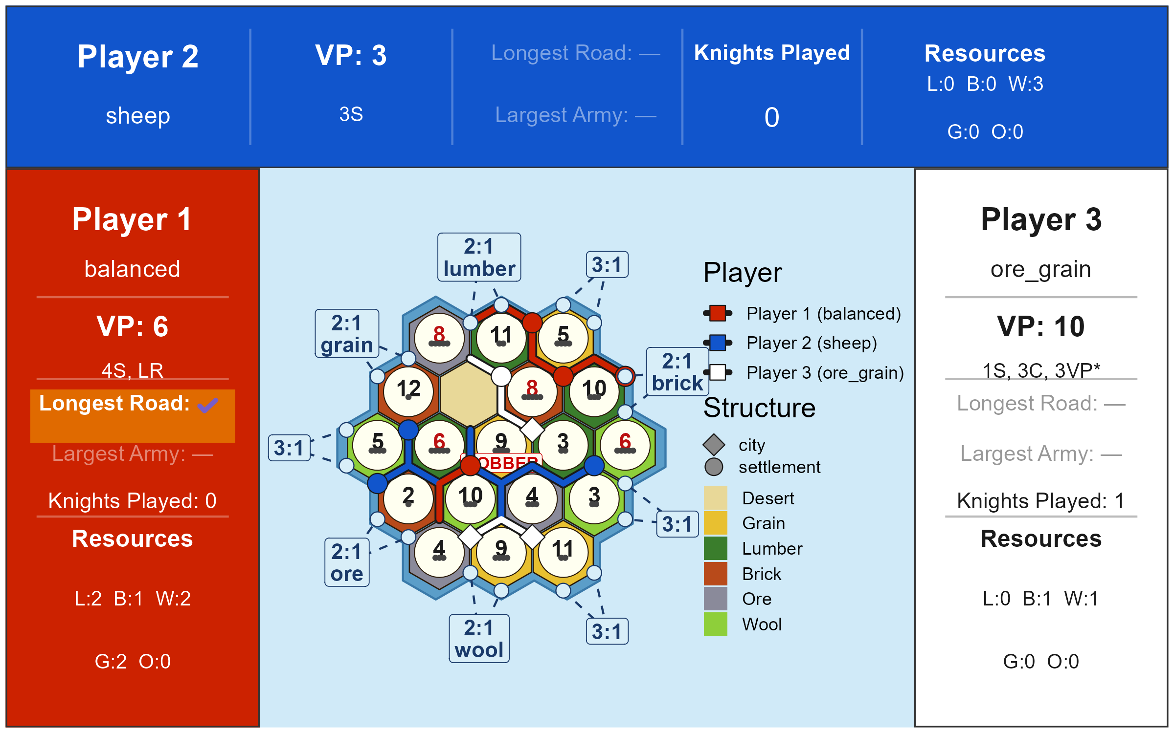
A Representative Game: ore_grain Wins (Seed 99)
Winner: ore_grain in 60 turns
Fastest ore_grain win in our 37-seed sample — a board where ore and grain placement aligned well from the start
ore_grain: 1 settlement, 3 cities
Cities double ore/grain output, funding further cities — the compounding VP loop playing out at full speed
sheep: 3 settlements, 0 cities
Accumulated wool but could not convert it to ore/grain; stuck near starting VP with no upgrade path
balanced: 4 settlements, 0 cities
Diversified production but on this board couldn't reach city resources before ore_grain closed out
Key takeaway
When ore_grain secures strong ore/grain placement, it wins decisively. Sheep demonstrates the starvation failure mode regardless of board.

Slide 13
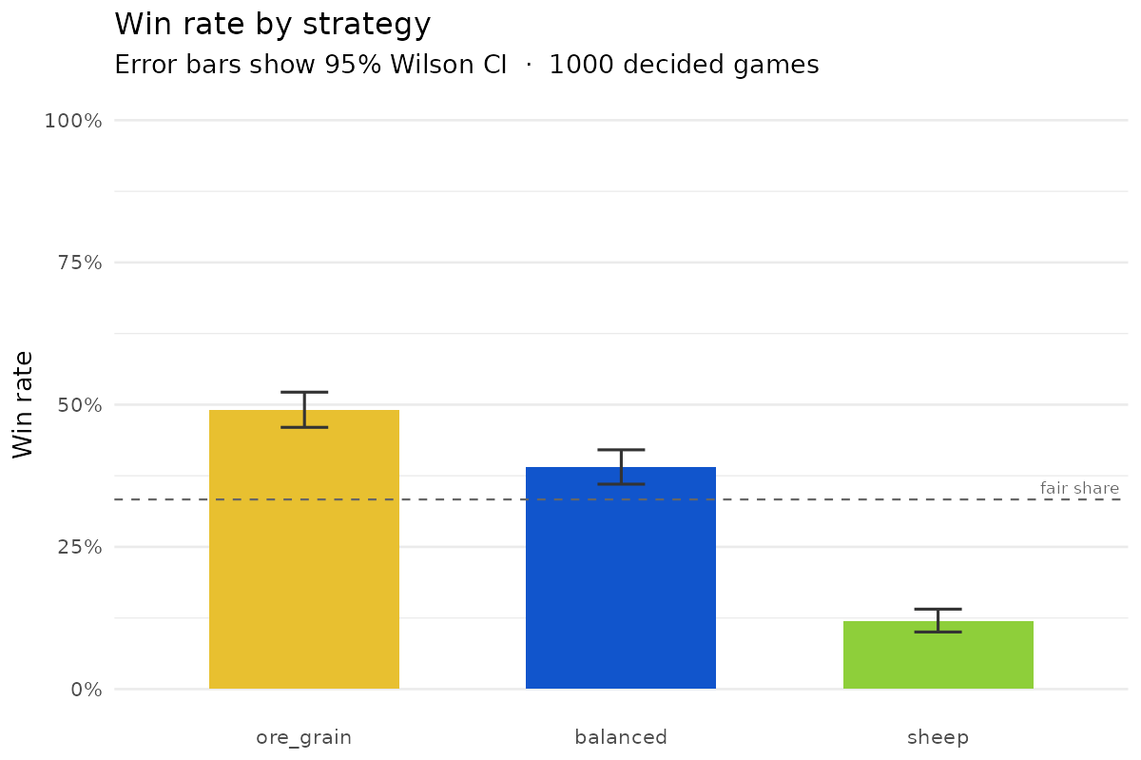
Results: Win Rates by Strategy

Slide 14
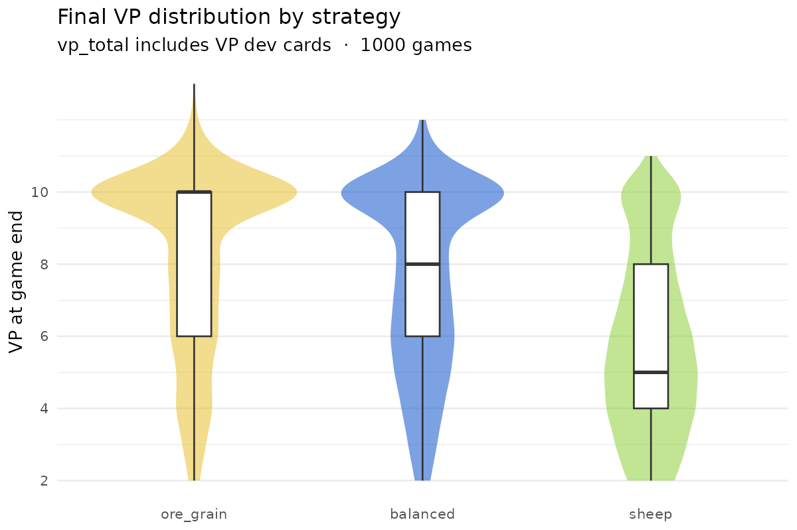
Results: VP Distribution at Game End

Slide 15
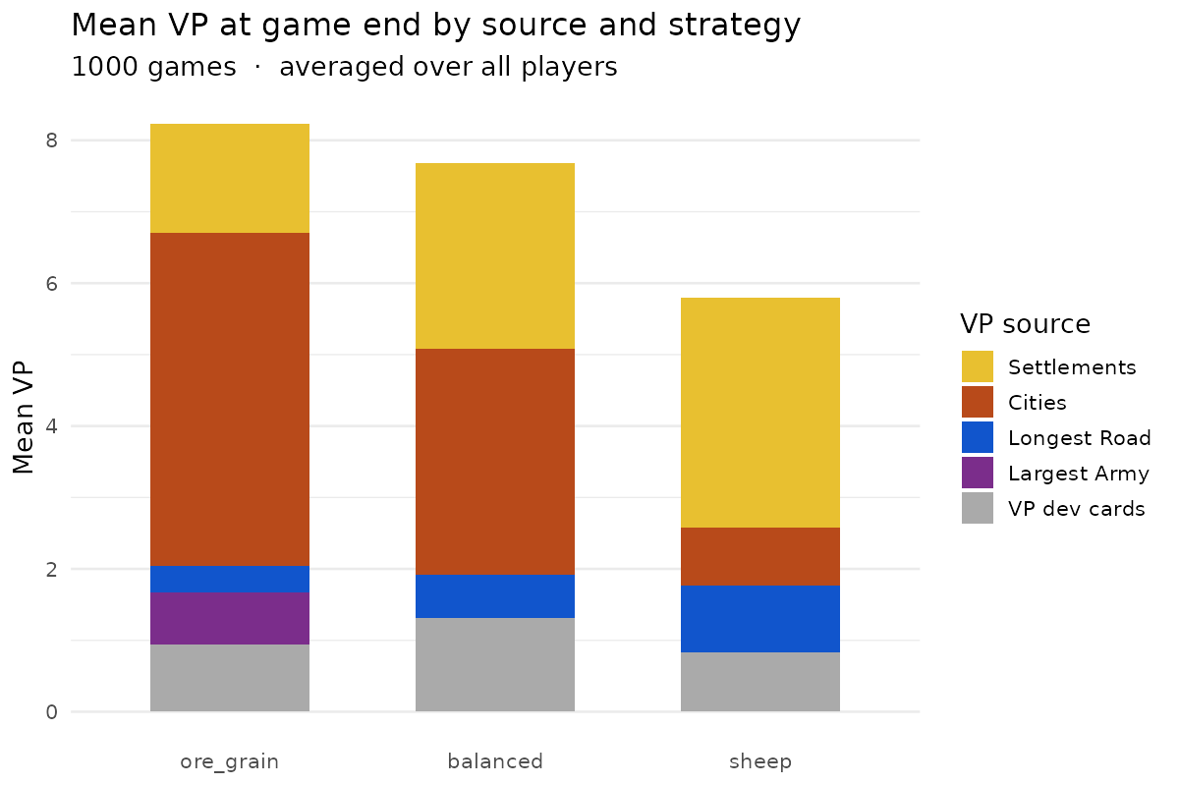
Results: VP Breakdown by Strategy

Slide 16
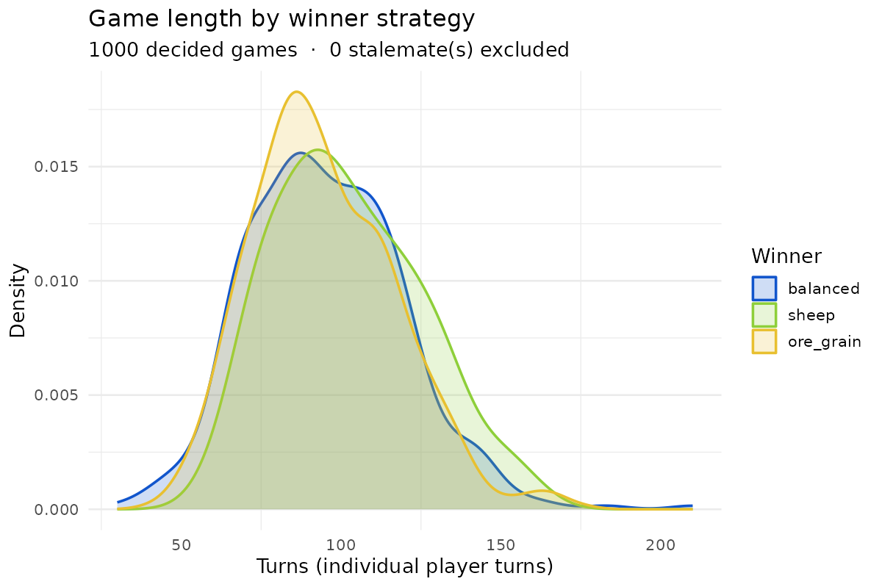
Results: Game Length Distribution

Slide 17
Statistical Analysis
Hypothesis
H₀: all three strategies win equally often (expected 333 wins each out of 1,000 games)
H₁: win rates differ significantly across strategies
Observed Results
ore_grain 491 / 1,000 (49.1%) 95% CI [46.0%, 52.2%]
balanced 390 / 1,000 (39.0%) 95% CI [36.0%, 42.1%]
sheep 119 / 1,000 (11.9%) 95% CI [10.0%, 14.1%]
Chi-Squared Test
χ² = 222.03 df = 2 p-value < 1 × 10⁻¹⁰
✔ Reject H₀ at p < 0.05 — win rates differ significantly
Sheep wins significantly less than both balanced and ore_grain
ore_grain outperforms balanced by ~10 percentage points

Slide 18
Summary
▸ Sheep strategy loses — the numbers prove it
• Win rate significantly lower than balanced (p < 0.05) across 1,000 games
▸ Why: wool is structurally weak as a primary resource
• Cities need ore + grain, not wool
• Wool is abundant; the 2:1 port advantage is marginal
▸ Two strategies outperform sheep
• Balanced: pip diversity + city focus; consistent on any board • Ore_grain: ore/grain dominance + city compounding; wins fast when placement aligns
▸ Reproducible · Fast · Open source
github.com/ayoung31/baaad-strategy

Slide 19
Acknowledgements
The Goof Troop
Mark
For countless hours of board games, heated rule disputes, questionable trades, and the kind of chaotic gameplay that makes statistical analysis both necessary and deeply personal. This project exists because of you.
For his unwavering commitment to the sheep strategy in the face of all evidence, logic, and repeated defeat. Without Mark's baaad decisions, this project would never have been born. The data is dedicated to him.

