Slide 1
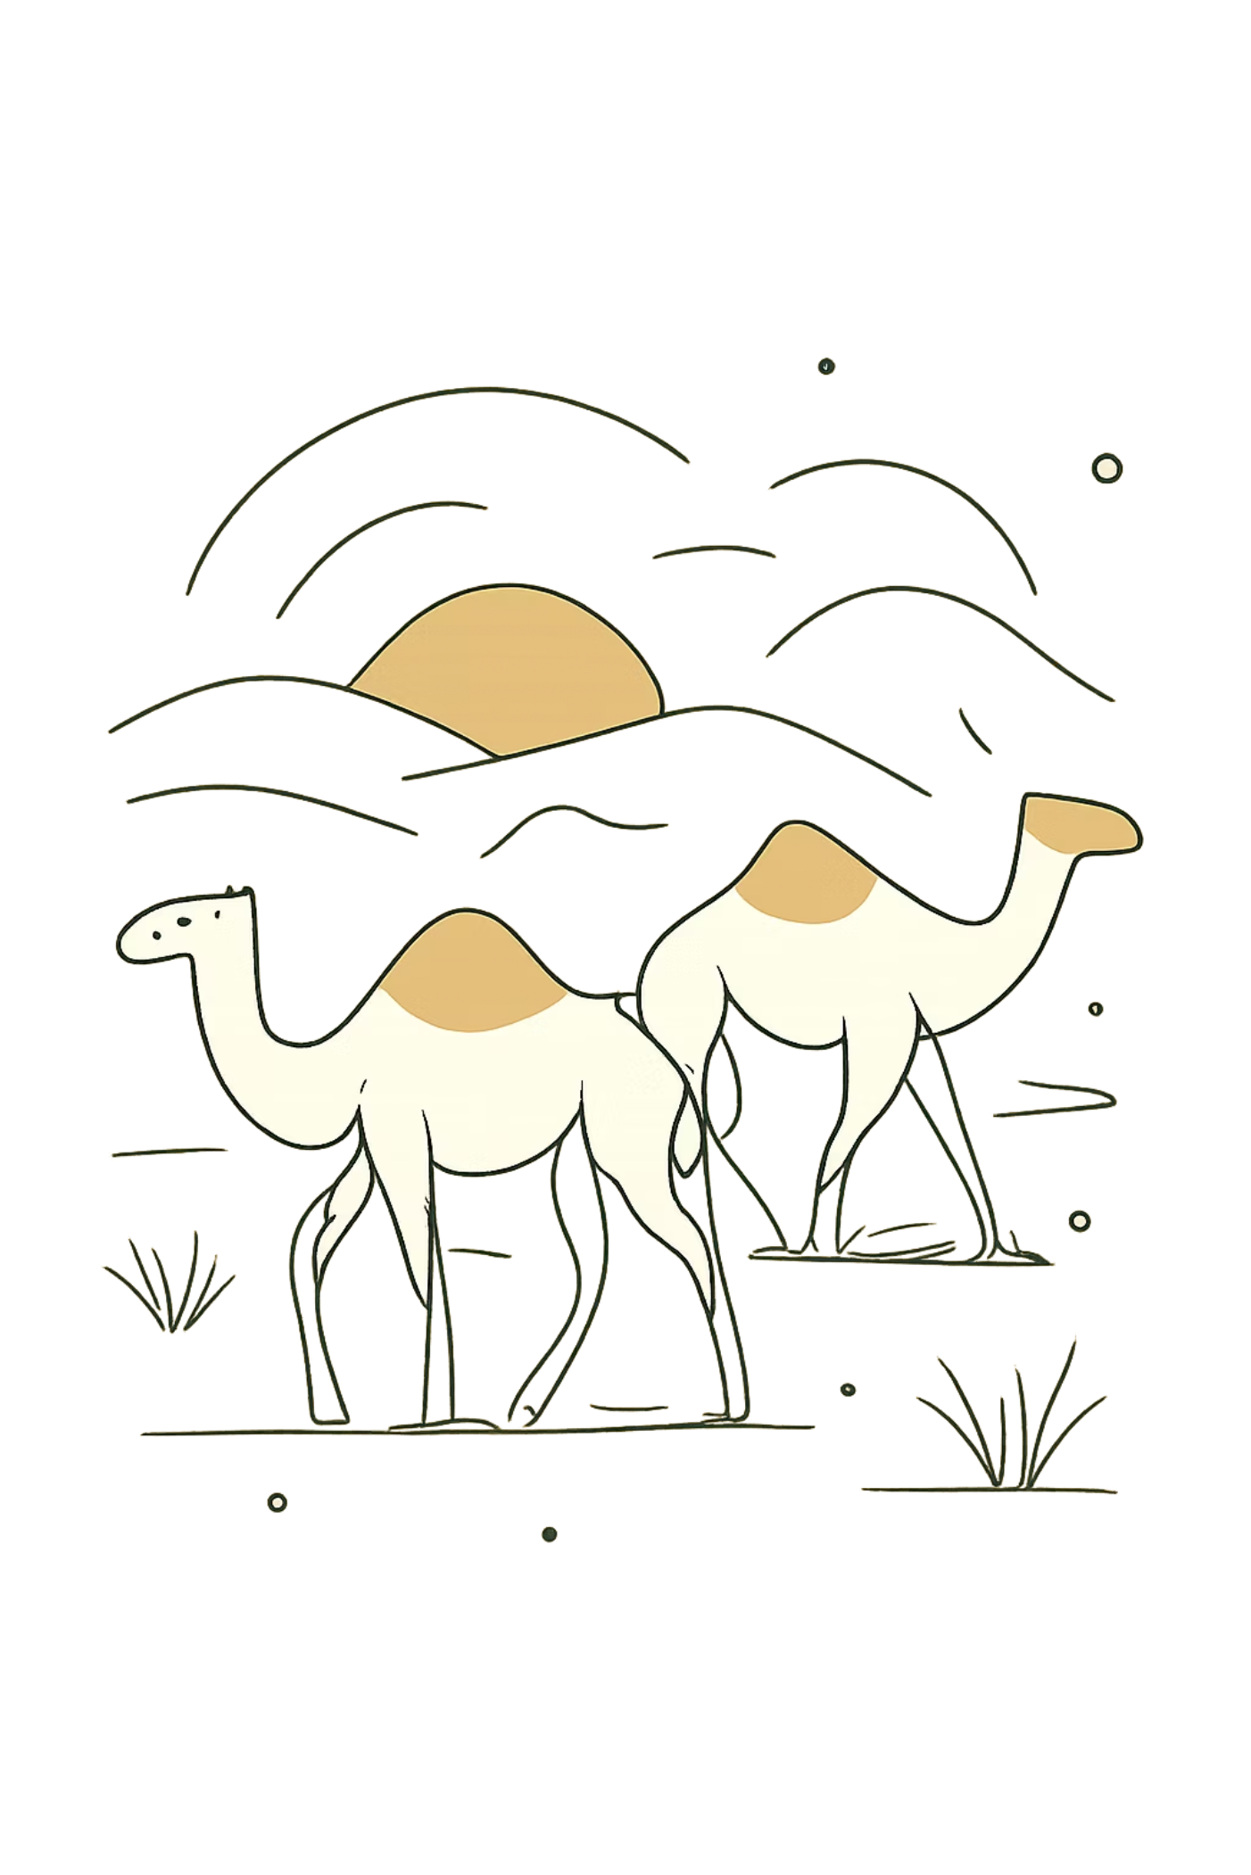
A Rhetorical Structure Theory Analysis of Human- and AI-Generated News Articles
Case study: BBC News — "Extreme heat is defeating camel resilience in Africa"
Rhetorical Structure Theory (RST) is a framework for text organization developed by William Mann, Sandra Thompson, Christian M. I. M. Matthiessen, and others at USC's Information Sciences Institute, formalized in a landmark 1988 paper. https://www.bbc.com/news/articles/cqlxvvw06pqo

Slide 2
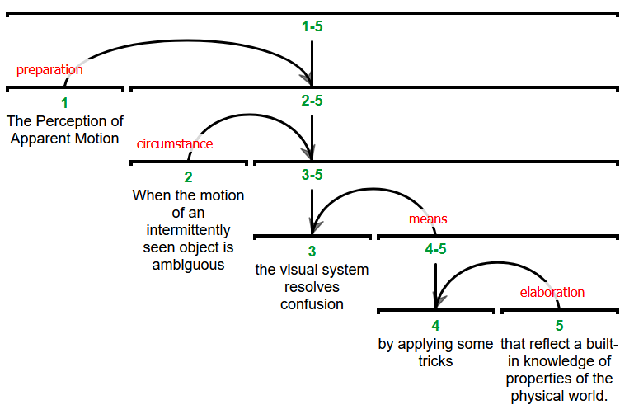

Slide 3

CASE STUDY
About the Article
Genre & Scope
Long-form environmental news feature — science journalism. Approximately 1,800–2,000 words across ~30 paragraphs, with an estimated 8–10 minute reading time.
Core Subject
The impact of extreme heat and accelerating climate change on camel populations across Africa's arid regions.
Style Characteristics
Neutral Tone
Evidence-Based Reporting
Human + Scientific Blend
Objective, measured language throughout — no editorializing or emotional framing beyond sourced testimony.
Sources span camel herders, scientists, veterinarians, universities, the WMO, and the FAO — blending lived experience with institutional data.
Personal testimony ("I have lost eight camel calves") is paired directly with physiological explanation (heat stress and cellular damage) — a hallmark of feature journalism.

Slide 4
Prompt:
Write a professional environmental news feature article with the title:
"Even camels can't cope: Africa's ships of the desert hit by rising temperatures"
Create an article similar in genre, length, and journalistic structure to a BBC environment feature article.
Requirements:
Length and structure:
* Write approximately 1,800–2,000 words.
* Use a long-form news feature structure.
* Start with an engaging introduction that presents an unexpected problem.
* Follow this structure:
1. Introduction/hook explaining the main issue.
2. A human case study with a person's experience and direct quotations.
3. Scientific evidence from researchers and studies.
4. Explanation of the causes behind the problem.
5. Examples from different geographical regions.
6. Expert opinions and explanations.
7. Effects and consequences.
8. Discussion of future risks and possible solutions.
9. A strong concluding paragraph that connects back to the opening idea.
eatwaves, and rising temperatures since the 1980s).
* Mention scientific studies, climate organizations, veterinarians, researchers, and local communities.
* Include statistics where appropriate.
* Include at least 3–5 expert quotations.
* Include at least 2–3 personal quotations from camel herders.
* Explain biological effects of heat stress on camels:
* cause-and-effect relationships throughout the article.

Slide 5
Writing style:
* Use a formal journalistic tone.
* Write objectively like a BBC or Reuters environment correspondent.
* Do not write an opinion article.
* Present information through evidence, studies, interviews, and expert statements.
* Use clear transitions between paragraphs.
* Avoid dramatic exaggeration.
* Use scientific explanations but keep the article understandable for general readers.
Rhetorical structure goals:
Organize the article so that it follows this information flow:
Problem → Human example → Evidence → Scientific explanation → Causes → Consequences → Wider impact → Conclusion
Use:
* background information before complex explanations,
* evidence after major claims,
* examples to elaborate on general statements,
* cause-and-effect relationships throughout the article.

Slide 6
https://github.com/ayperiKhudaybergenova/A-Rhetorical-Structure-Theory-Analysis-of-Human-and-AI--Generated-News-Article

Slide 7
1. Opening section
EDU 1: “Camels are famously known as the ships of the desert...”
EDU 2: “...but even these hardy animals are not being spared from the extremes of rising temperatures in Africa.”
Relation: Contrast
Satellite: Camels are traditionally seen as strong and resistant animals.
Nucleus: Even camels are being affected by climate change.
Function: Introduces the main problem by contrasting camel resilience with climate vulnerability.
2. Geographic background
EDU: “The Afar region of north-eastern Ethiopia is one of the hottest and driest places on Earth...”
Relation: Background
Satellite: Provides geographical and environmental context.
Nucleus: Camels are suffering from extreme heat.
Function: Explains where the climate problem is happening.

Slide 8
3. Personal experience of camel herder
EDU: “I can see my camels suffering from extreme heat.”
EDU: “They get blisters on their feet, their eyes become watery and the hot sand burns their skin...”
Relation: Elaboration
Satellite: Specific examples of camel injuries and suffering.
Nucleus: Extreme heat is damaging camels.
Function: Provides a human example to make the issue more concrete.
4. Personal observation → scientific confirmation
EDU: “He is not alone in his observations: scientists, animal welfare workers and various studies all mention stress, fatigue, dehydration, disease prevalence as direct impacts of extreme heat.”
Relation: Evidence
Satellite: Scientific research supports the herder’s experience.
Nucleus: Extreme heat harms camel health.
Function: Moves from individual testimony to scientific credibility.

Slide 9
5. Regional expansion
EDU: “North Africa and the Horn of Africa host around 80% of the world's largest population of dromedary camels.”
Relation: Background
Satellite: Shows the importance of camels in these regions.
Nucleus: Climate change threatens major camel populations.
Function: Expands the issue beyond one location.
6. Research evidence from Ethiopia
EDU: “A study based on the perception of camel herders in southern Ethiopia showed that high temperatures and climate variability had a detrimental impact on camel herd health.”
Relation: Evidence
Satellite: The study provides research support.
Nucleus: High temperatures damage camel health.
Function: Strengthens the argument with scientific findings.

Slide 10
1. Opening section
EDU 1: “For centuries, the camel has been the ultimate survivor of Africa’s drylands...”
EDU 2: “But that assumption is now being tested.”
Relation: Contrast
Satellite: Camels are traditionally seen as symbols of survival.
Nucleus: Climate change is challenging camel resilience.
Function: Introduces the main conflict of the article.
2. Climate problem introduction
EDU: “Across Ethiopia, Somalia, Kenya and parts of North Africa, veterinarians, pastoralists and researchers are reporting something that would once have seemed unthinkable: camels are struggling to cope with the heat.”
Relation: Evidence
Satellite: Reports from different groups support the claim.
Nucleus: Extreme heat is affecting camels across Africa.
Function: Shows that the problem is widespread.

Slide 11
3. Human case study
EDU: “Hassan Abdi Nur has kept camels in Kenya’s Marsabit County for most of his life.”
Relation: Background
Satellite: Introduces the person and his connection with camel herding.
Nucleus: Camel herders are experiencing climate changes.
Function: Provides a personal perspective.
EDU: “Even the camels, which can go many days without water, are collapsing on the road when we move them too far in this heat.”
Relation: Evidence
Satellite: Shows a direct example of camel suffering.
Nucleus: Extreme heat is weakening camels.
Function: Makes the climate problem concrete.
4. Drought evidence
EDU: “Nur said he lost four camels during the drought that struck the region between 2020 and 2023.”
Relation: Evidence
Satellite: Provides an example of camel deaths.
Nucleus: Drought is damaging camel survival.
Function: Supports the main argument with a real case.

Slide 12
1.The BBC text uses an Evidence → Explanation → Consequence RST structure, where personal testimony and scientific studies act as satellites supporting the nucleus that extreme heat is harming camels.
The AI text uses a Background → Explanation → Consequence structure, where broader climate information supports the nucleus that camels are reaching their limits because of climate change.
2.The human-written article depends more on Evidence satellites such as quotes from herders, scientists, and veterinarians, making it more journalistic and factual.
The AI-written article depends more on Elaboration and Cause satellites, creating a smoother argument but with less direct evidence from real sources.

