Slide 1

SemEval 2026
Abductive Event Reasoning: Towards Real-World Event Causal Inference for Large Language Models

Slide 2
TASK OVERVIEW
  LLMs struggle with Abductive Reasoning (inferring the most likely cause from an outcome).
  This limits LLMs in high-stakes areas: Crisis Response, Misinformation Detection, Policy Impact.
  The model must select the most plausible, direct cause for a given real-world event, using provided evidence.
  Goal: Choose the most plausible cause for a given event by Enhance LLMs’ reasoning
  Focus: Inferring the most plausible causes behind real-world events.
Our Contribution:
  Implemented and evaluated baseline models: Qwen, LLaMA, and DeBERTa.
  Analyzed model performance on the SemEval 2026 AER dataset.
  Identified strengths and limitations of on model baseline models
  Insights from baselines guide future improvements, e.g., Chain-of-Thought tree reasoning.

Slide 3

WHAT IS ABDUCTIVE REASONING?
Definition:
Inferring the most plausible cause of an event from incomplete information.
Goes beyond extraction or summarization to structured causal reasoning.
Key Features:
Combines context, background knowledge, and hypothesis evaluation.
Mirrors human reasoning under uncertainty.
Importance:
Tests LLMs’ ability for real-world causal inference.
Applications: crisis response, policy analysis, misinformation detection.
Highlights LLM limitations: semantic distraction and plausible-but-incorrect answers.
Notes:
Why Abductive Event Reasoning?
Every day, global events—economic shifts, policy changes, disasters, tech breakthroughs—affect our world.
Understanding the why behind events is crucial for both humans and AI systems.
Challenge for LLMs:
LLMs excel in event extraction, summarization, prediction.
Limitation: Struggle with abductive reasoning—identifying the most likely cause from incomplete or distributed information.
SemEval 2026 Task 12:
Given an event (e.g., “Cryptocurrency Market Prices Soar”) and supporting documents, the model selects the most plausible direct cause (“Government announces national cryptocurrency reserve”).
Mirrors human reasoning under uncertainty: combining context, knowledge, and hypotheses.
Dataset & Findings:
High-quality dataset covering politics, finance, and emergencies.
Causal options validated by both LLMs and human annotators.
Pilot experiments show even state-of-the-art LLMs face:
Semantic distraction
Plausible but incorrect answers
Impact:
Pushes LLMs toward structured, context-grounded reasoning.
Relevant for AI transparency, explainability, and real-world decision-making.

Slide 4
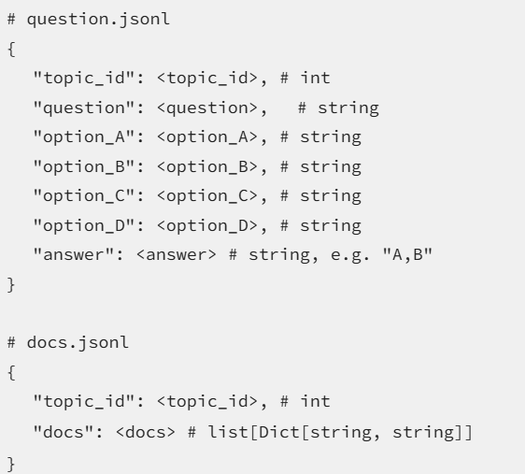
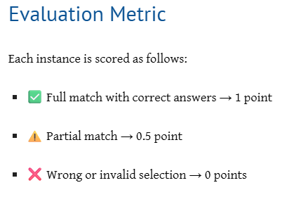
DATASET AND EVALUATION
  Real-world event–cause pairs
  Multiple-choice format: one correct cause, distractor causes
  Challenges: subtle semantics, long-range context

Slide 5

BASELINE AND EXPERIMENTAL SETUP

Slide 6
BASELINE MODELS
Qwen3-30B
Best performer
Strong contextual understanding
Stable outputs for long abductive prompts
Most reliable single-answer generation
Llama-3.1-8B-Instruct
High generative quality
Issues with multiple outputs or over-generation
Stability concerns on long abductive tasks
DeBERTa
Strong semantic understanding and matching
Struggled with implicit causal reasoning compared to Qwen
Reason for Selection:
Evaluate diverse model architectures: generative (Qwen, LLaMA) vs. encoder (DeBERTa)
Test different strengths: reasoning ability, stability, multiple-choice handling
Establish a reliable baseline for SemEval 2026 Task 12

Slide 7
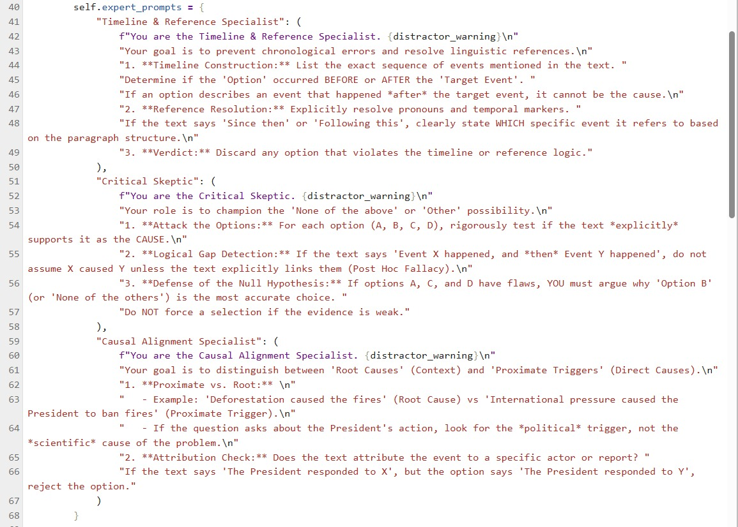
Baseline Prompting Strategies
Zero-Shot Prompts
Few-Shot Prompts
Multi-Expert Prompting

Slide 8
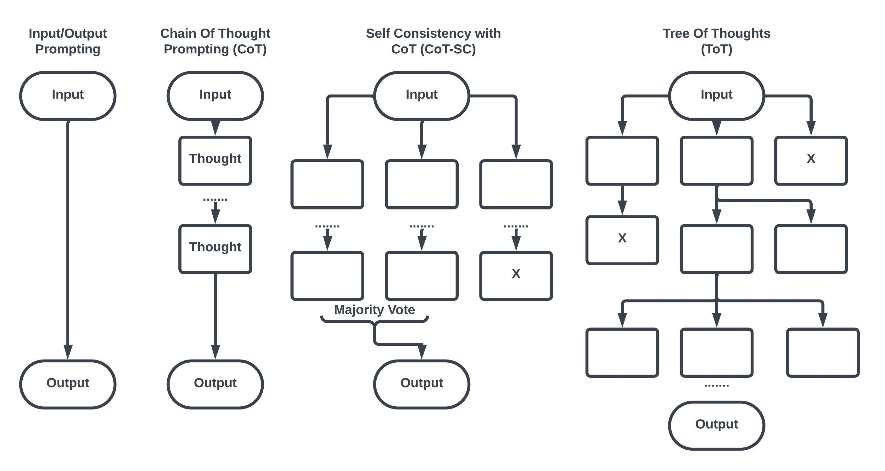
FUTURE WORK : Chain-of-Thought
Inspired by paper-Advancing Reasoning in Large Language Models(Paper)
Tree-based exploration of multiple hypothesis paths
Goal: Improve causal inference and reduce model uncertainty

Slide 9
NEXT STEPS
Qwen : strong baseline
improvements expected with tree-CoT
01
Test with diverse dataset
02

Slide 10
THANK YOU

