Slide 1
Fast API
Post: Create ; Get: Read ; Put: Update ; Delete
https://www.restapitutorial.com/lessons/httpmethods.html
How to quickly create key CRUD operations
@app.api_route(“flux, methods=[‘GET’, ‘POST’, ‘PUT’, ‘DELETE’])
def handle_strat_collection(strat_collection: StratCollection):
logging.debug(strat_collection) # do something with data
return {
“strat_collection”: strat_collection.as_dict()
}
http status code
200 OK
201 Created
400 Bad Request
404 Not found

Slide 2
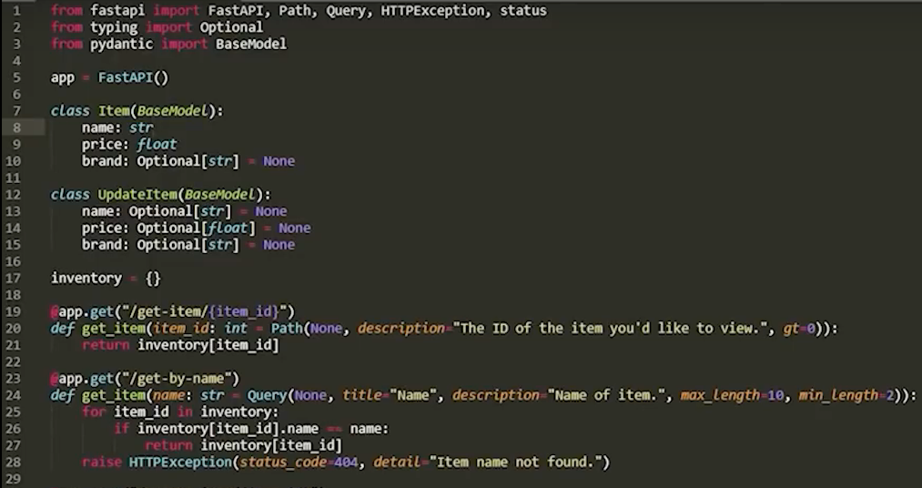

Slide 3
