Slide 1
Understanding the Dynamics of Housing Prices
Saadman Chowdhury, Brandon Kokin, Ayrat Aymetov

Slide 2
Motivation and Overview
Housing prices reflect both structural attributes and location effects
Understanding price drivers is critical for buyers, sellers, and investors
This project combines explanatory and predictive modeling approaches
Methods used: - ANOVA and OLS regression - Logistic regression - Bootstrap inference

Slide 3
Research Objectives
Identify key factors influencing housing prices
Quantify neighborhood effects beyond structural characteristics
Classify homes as selling above or below expected value
Assess model uncertainty using nonparametric bootstrap methods

Slide 4
Dataset Overview
Ames Housing dataset (De Cock, 2011)
2,930 residential property sales in Ames, Iowa
82 variables:
  Nominal, ordinal, discrete, and continuous features
Rich representation of housing structure and neighborhood context

Slide 5
Data Preparation and Modeling Framework
Primary drivers: Neighborhood, Overall quality, Living area
Secondary drivers: Basement area, Garage capacity, Architectural style
Responses:
  log(SalePrice) — explanatory modeling
  AboveExpected — classification

Slide 6
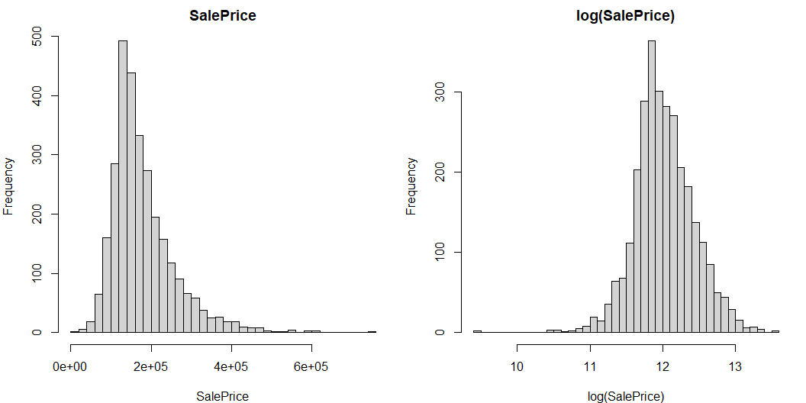
Why log(SalePrice)?
Raw SalePrice distribution is strongly right-skewed
Variance increases with price, violating OLS assumptions
Log transformation stabilizes variance and improves normality

Slide 7
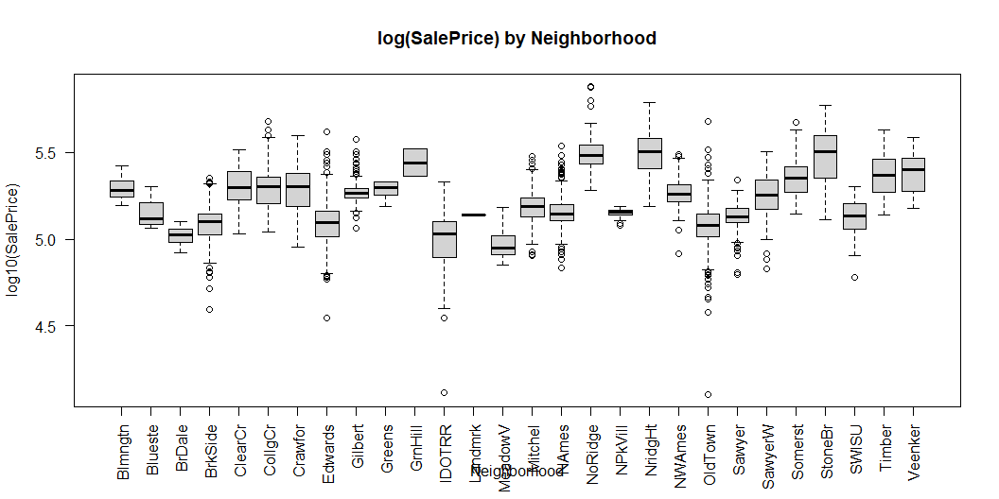
Neighborhood Effects: ANOVA
One-way ANOVA confirms significant price differences across neighborhoods
Strong evidence of spatial heterogeneity
Differences persist even before controlling for structure

Slide 8
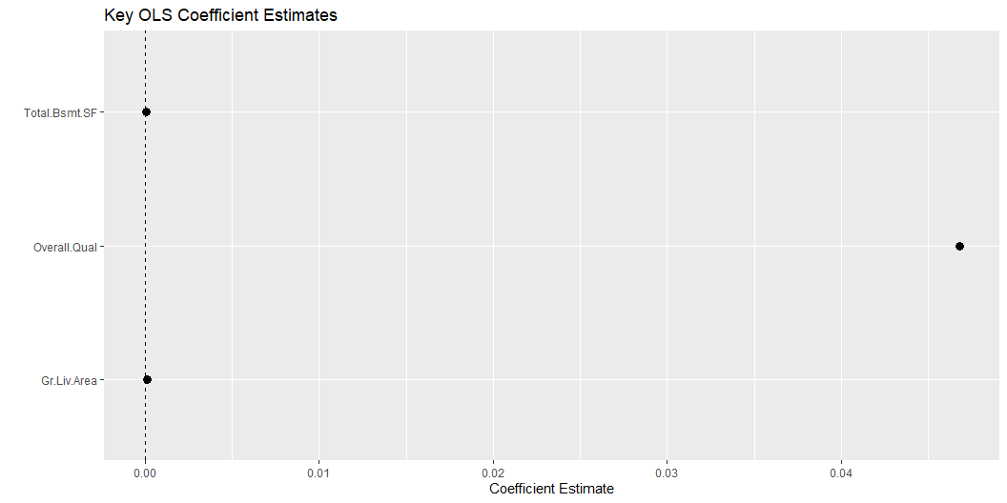
Baseline OLS Model Results
OLS explains a large share of price variation (Adjusted R² ≈ 0.84)
Dominant predictors:
  Overall quality
  Above-ground living area
  Neighborhood
Effects persist after controlling for structure

Slide 9
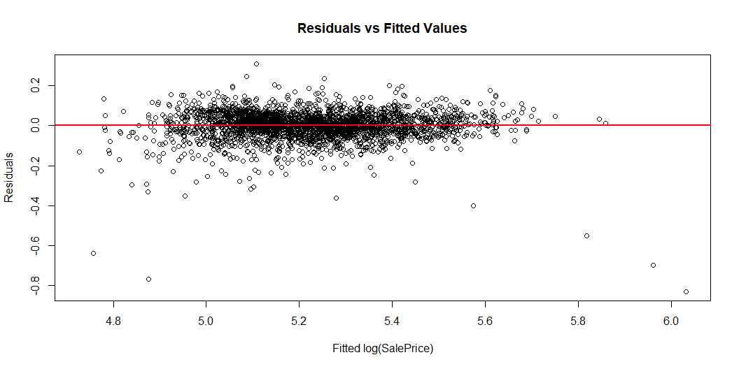
OLS Diagnostics
Linearity assumption appears reasonable
No strong evidence of heteroscedasticity after log transformation
No single observation unduly influences results

Slide 10
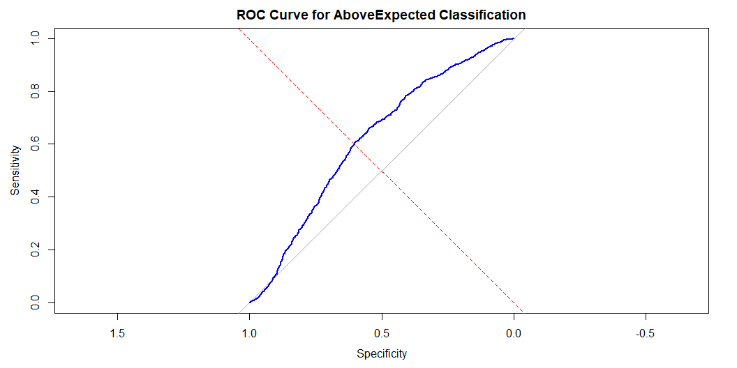
Predicting Above-Expected Sales
Define AboveExpected relative to OLS-predicted price
Logistic regression estimates probability of selling above expected value
Residual-based outcome introduces inherent noise

Slide 11
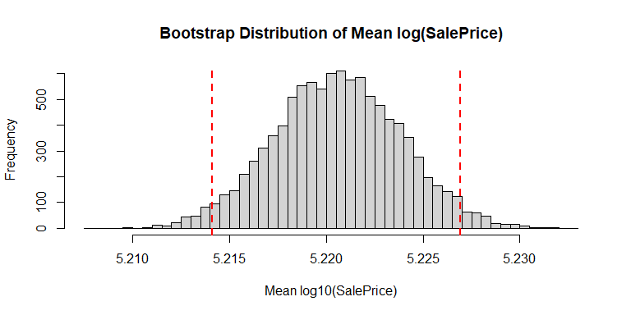
Bootstrap Inference & Key Takeaways
OLS performs well for explanation
Classification highlights market noise
Bootstrap provides robust uncertainty quantification

