Slide 1

Money Classification
Ayşe Rabia Soylu
152120181044
Pattern Recognition Final Project

Slide 2
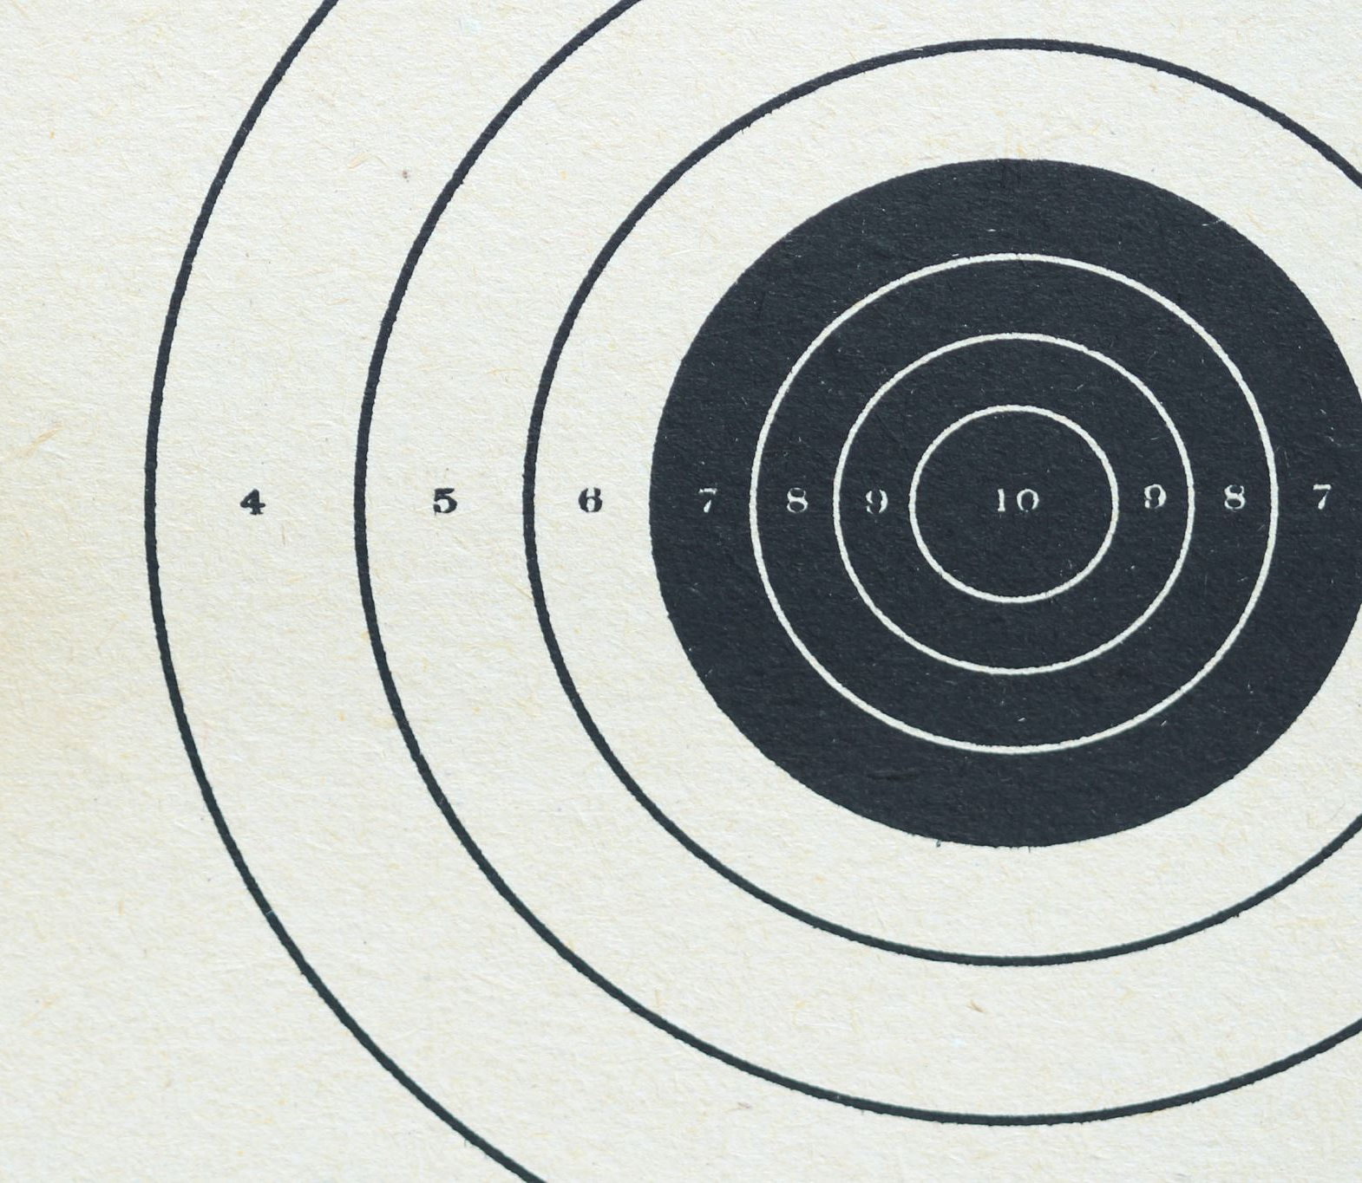
AIM
Creating a Turkish Curreny Classification Model
Analyzing the importance of features when classifying curency

Slide 3
Dataset
12 different class #of Total Images: 444
Train dataset: 12 * 25 (Image per for class) = 300
Test dataset: 12 * 12 (Image per class) = 144
Both front and back of coins and banknotes
Images rotated around its axis by 90 degrees
Images on white background
Mirror reflections of Images

Slide 4

Feature Extraction
Color Features
Shape Features
Edge Features
SIFT Features

Slide 5
Color Features | Shape Features | Edge Features | SIFT
RGB to HSV H: Hue Color of Pixel [0, 179] S: Saturation How gray a color is [0, 255] V: Vue How dark or light the color is [0, 255] The color histogram is calculated in the HSV space and reduced to one dimension. | Canny Edge Detection + Only external lines (RETR_EXTERNAL) + Simple lines (CHAIN_APPROX_SIMPLE) The number of outermost contours is extracted as features. | Canny Edge Detection Edge features are extracted as a one-dimensional array to represent the image. | Pattern and Texture Detection Scale-invariant Defines feature points for feature extraction and creates descriptive vectors using pixel intensities around these points.

Slide 6
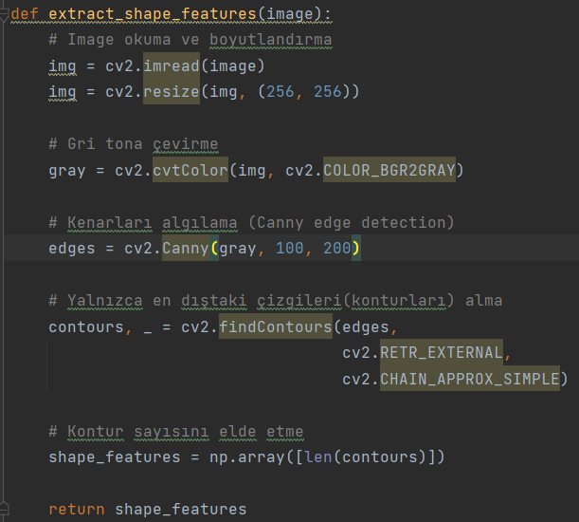
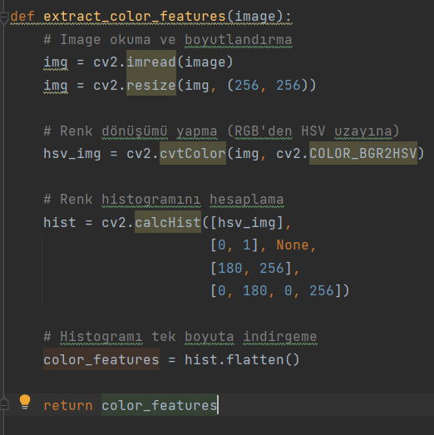
Feature Extraction Codes

Slide 7
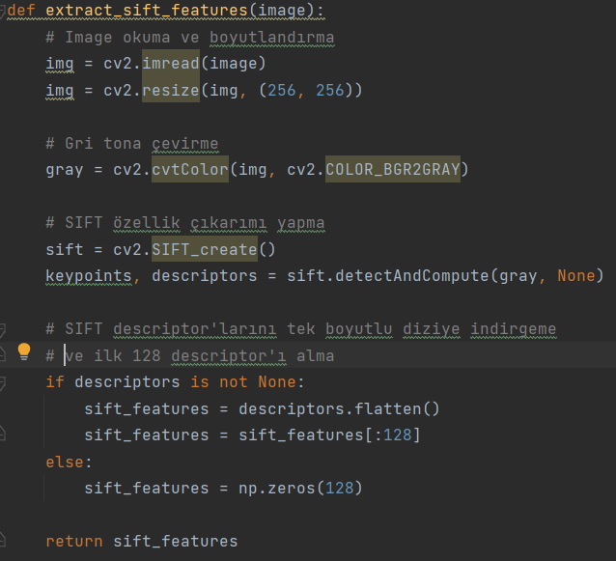
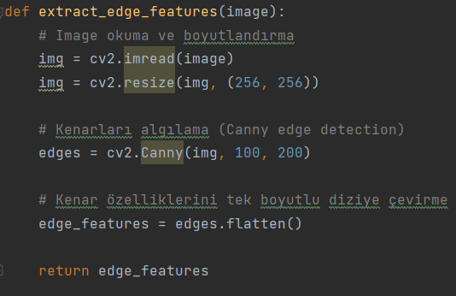
Feature Extraction Codes

Slide 8
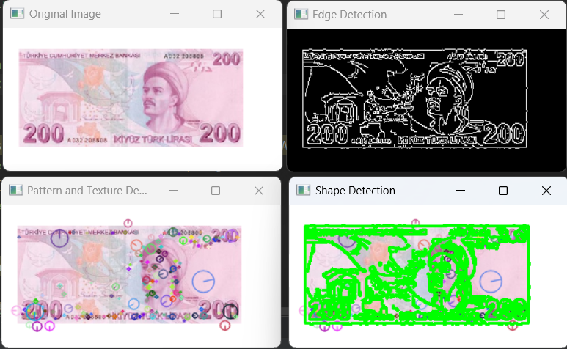

Slide 9

Classifier
KNN with 3 neighbor

Slide 10
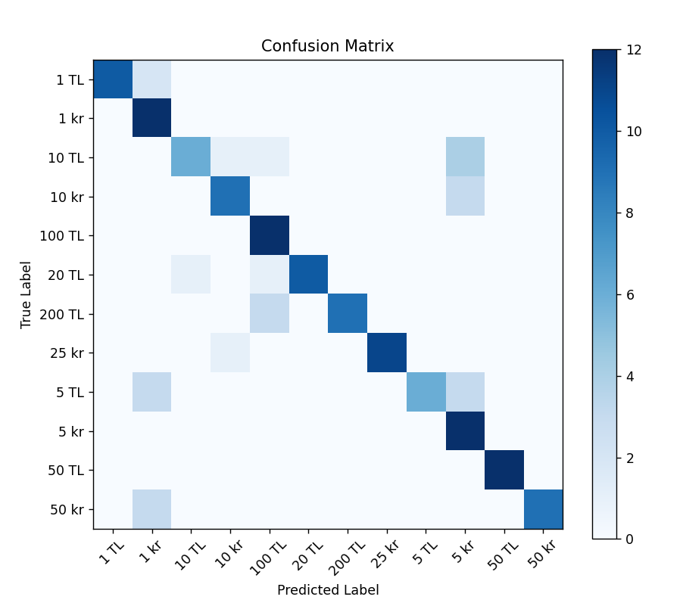
Highest TP’s
1 kr
100 TL
5 kr
50 TL
Lowest TP’s
10 TL
5 TL
10 kr
50 kr

Slide 11
Performance Metrics
Accuracy: 0.8194444444444444
F-Score: 0.8211093450935797
Recall: 0.8194444444444445
Precision: 0.8772217978100332

Slide 12

Importance of Features
Feature: Edge Features Importance: 0.25
Feature: SIFT Features Importance: 0.25
Feature: Shape Features Importance: 0.25
Feature: Color Features Importance: 0.25

