Slide 1

Stock Price Analysis for –AMZN & FB
Designed and Developed by –
Nidhi Thakur – Programmer Analyst, BA
George N – Project Specialist
Vaibhav Jain – Programmer Analyst
Jasgeet Kaur – Programmer Analyst
Pooja Ayre – Project Architect; Project POC

Slide 2
OVERVIEW
How to Scan & Parse News from a given website
Track and Store parsed news
How to pull historic data for stock symbols
Volume and Close Price Analysis
Stock Recommendation

Slide 3
SCAN & PARSE
STEP 1 - REQUIREMENT
STEP 2 – DEFINING FUNCTION
STEP 3 – CREATING A CSV FILE
https://www.prnewswire.com/news-releases/news-releases-list/
Libraries Used –
BeautifulSoup, it is a python library that is used for web scraping purposes to pull the data out of HTML and XML files.
Function call to parse through the webpage and scan for required fields.
Exporting the dynamically retrieved data into columns and storing as a CSV file.

Slide 4
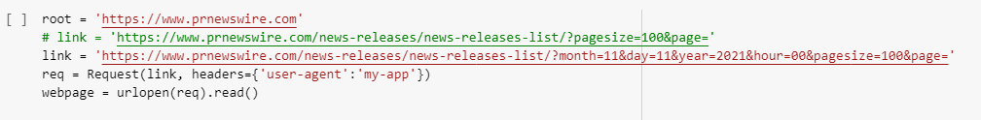
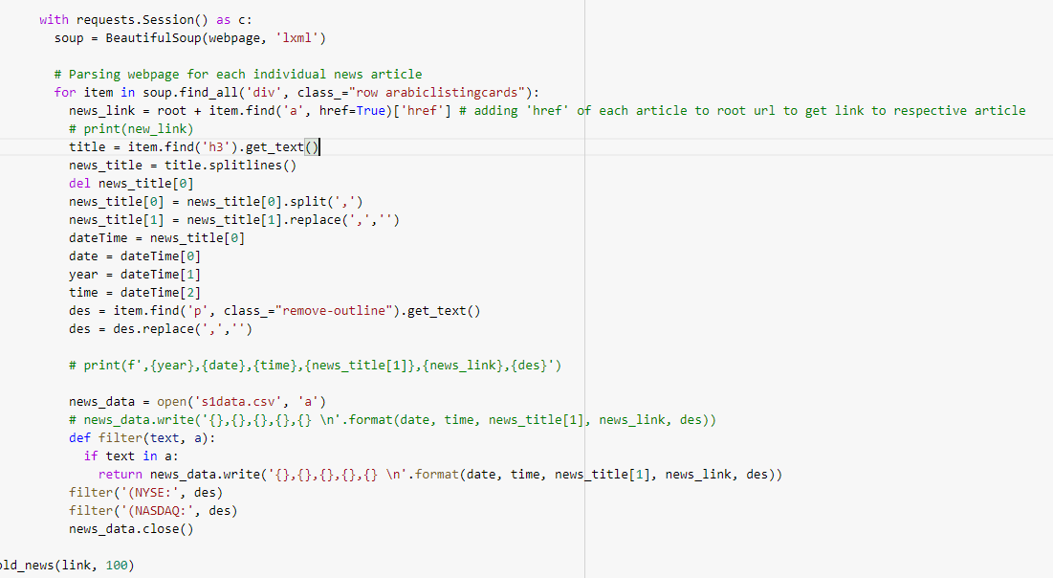
SCAN & PARSE

Slide 5

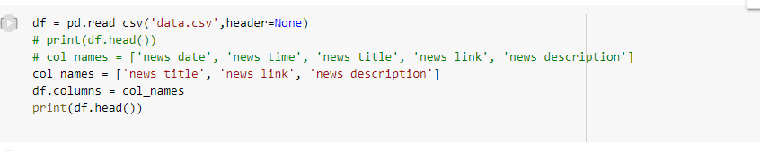
TRACK/STORE/SEARCH – SYMBOL EXTRACTION
Importing Csv file as a panda data frame
Installing libraries(re & fuzzywuzzy) for symbol extraction
Extraction through direct symbol
Extraction through the name of the company
Searching through the News_Title
Storing Extracted Symbols

Slide 6
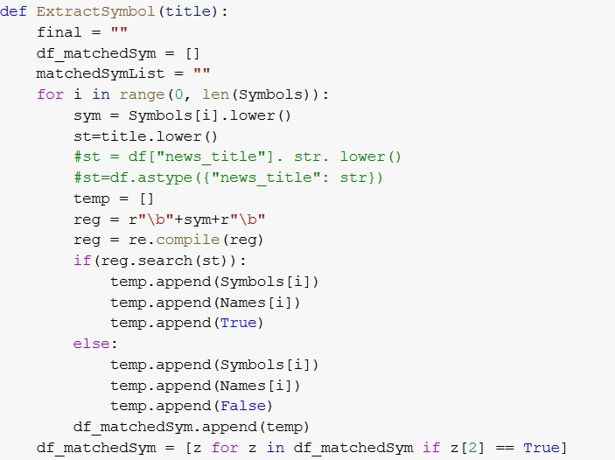
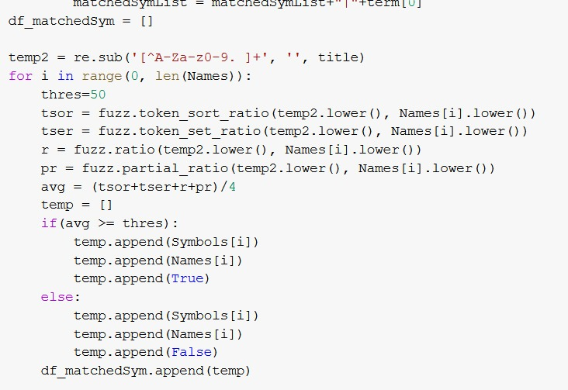
TRACK/STORE/SEARCH – SYMBOL EXTRACTION

Slide 7
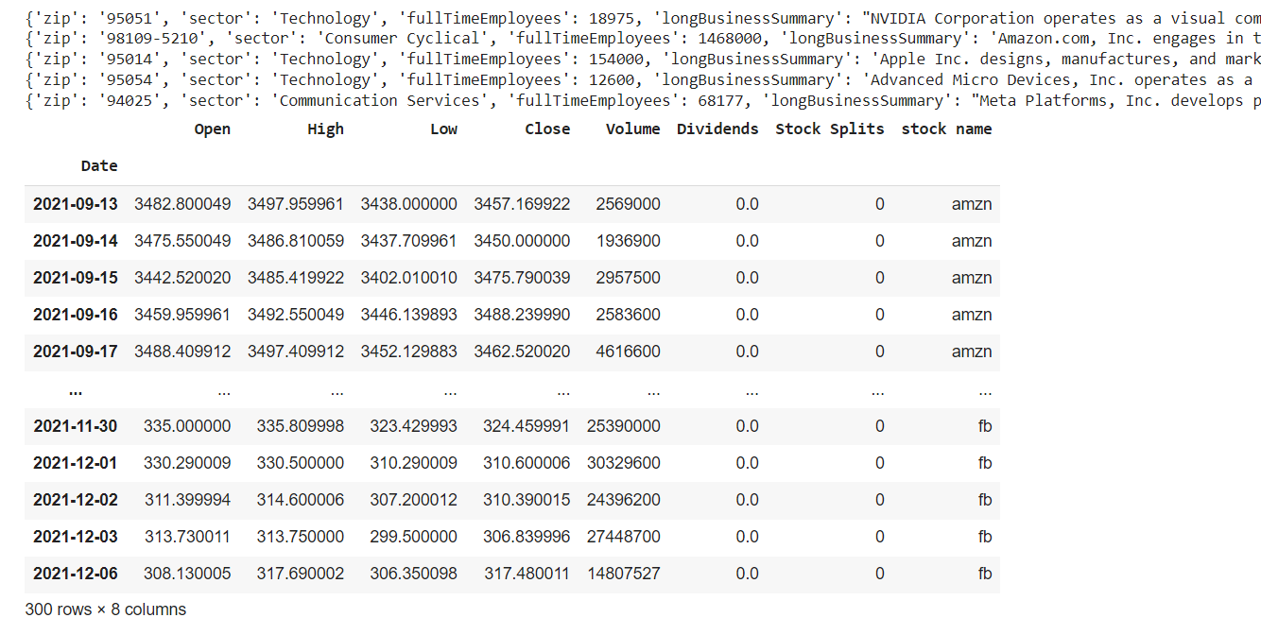
HISTORIC STOCK PRICE AND VOLUME
What is Yahoo Finance API
Why should I use Yahoo Finance API
How to access Yahoo Finance API through python
How to download historic data using yfinance

Slide 8
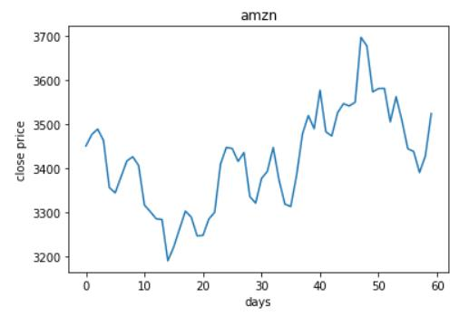
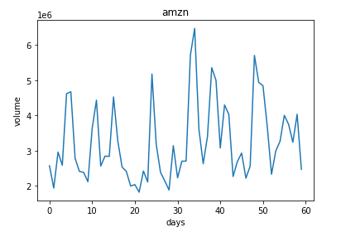
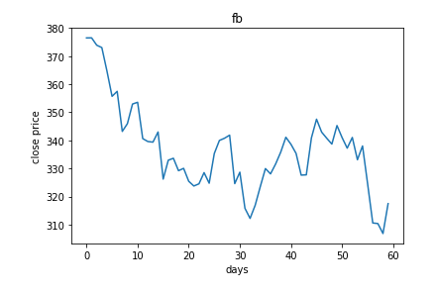
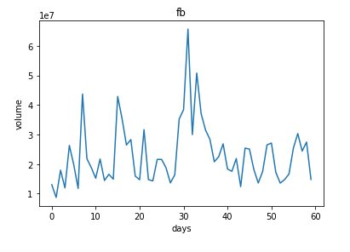
STATISTICAL ANALYSIS – VOUME & CLOSE PRICE

Slide 9
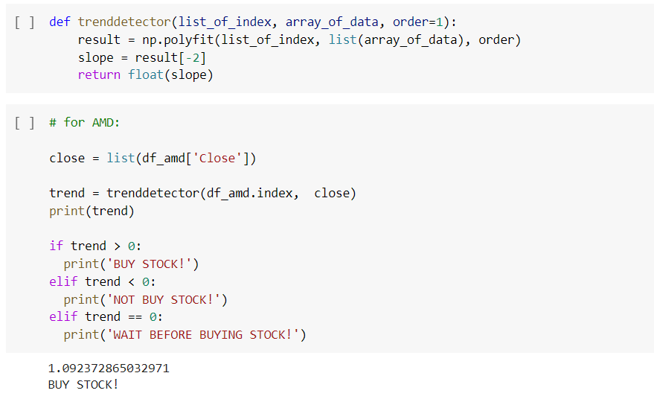
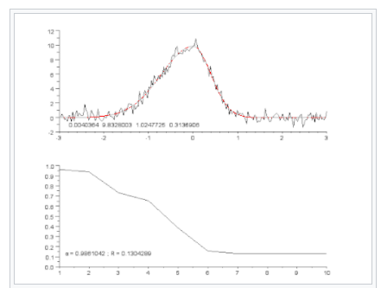
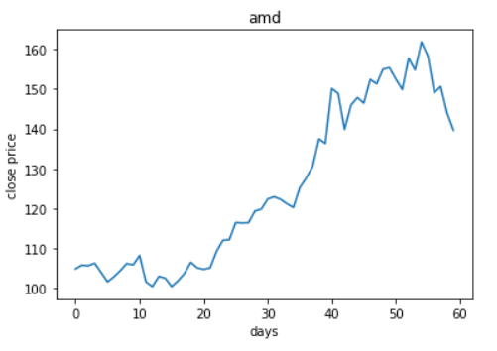
SUMMARY & RECOMMENDATION

Slide 10

THANK YOU

