Slide 1
Looking for best place to open a new bakery in Guadalajara, based on users ranking
Ayrton Mondragon
April 18, 2019

Slide 2
Introduction
  - Guadalajara has been growing fast in the last few years
  - A lot of people is looking for new places to hang out
  - Bakeries are very popular now, and people likes those places to spend time with family and friends.
  - Looking for the best place to open a bakery based on users raking in Foursquare API

Slide 3
Data Acquisition and Cleaning
  - Zip codes scrapped from https://codigo-postal.co/en-us/mexico/jalisco/guadalajara/
  - Latitude and longitude of each zip codes has been retrieved from http://codigo-postal.es.mapawi.com/mexico
  - Dropped columns with same information for all neighborhoods
  - Venue data retrieved from https://api.foursquare.com/v2/venues/explore?&client_id={}&client_secret={}&v={}&ll={},{}&radius={}&limit={}
  - 147 Unique venue categories retrieved

Slide 4
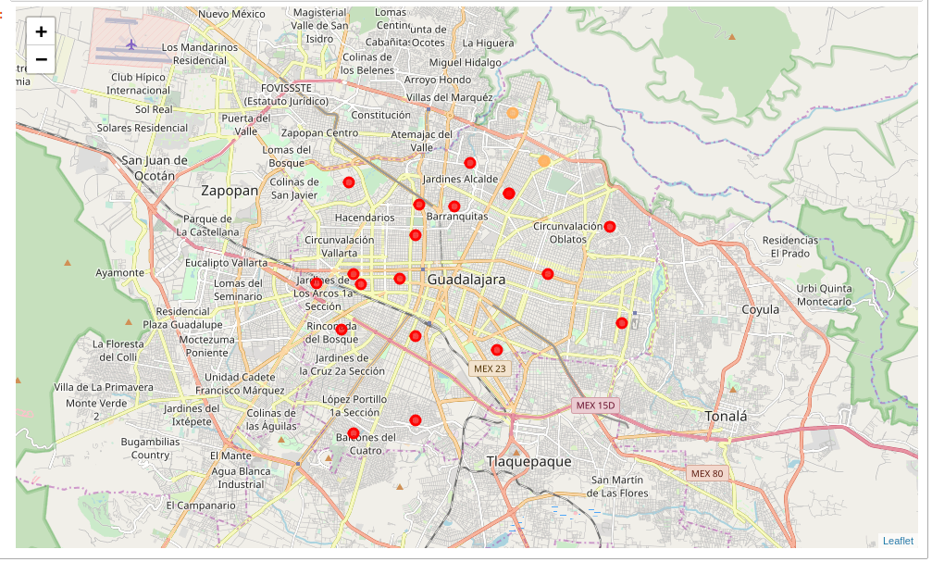
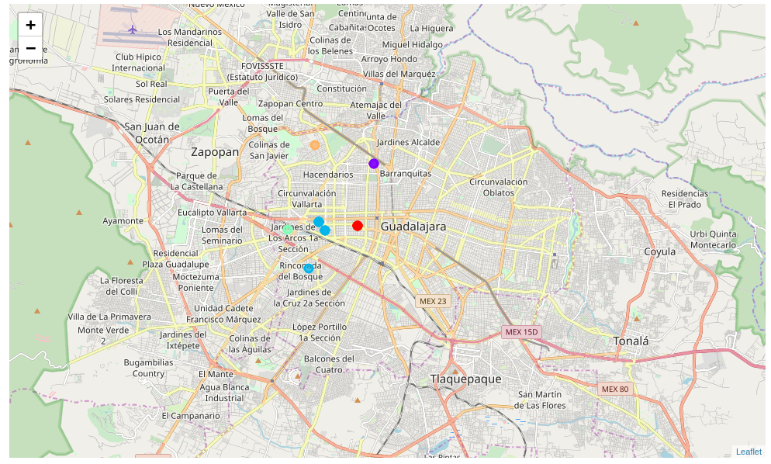
Modeling
  - Two clusters created, one with all venue categories and the other one with bakeries, coffee shops and desert shops only
  - Both models with 5 clusters
  - Clusters displayed on map

Slide 5
Conclusion
  - Using all venue categories didn’t showed up a lot information about neighborhoods that could give us an insight to take a decision.
- With the filtered data we got a better insight and concluding that around Colonia Barrera and Colonia Arcos Vallare are the best location to open a new bakery.

