Slide 1
Looking for best place to open a new bakery in Guadalajara, based on users ranking
Ayrton Mondragon
April 18, 2019

Slide 2
Introduction
- Guadalajara has been growing fast in the last few years
- A lot of people is looking for new places to hang out
- Bakeries are very popular now, and people likes those places to spend time with family and friends.
- Looking for the best place to open a bakery based on users raking in Foursquare API

Slide 3
Data Acquisition and Cleaning
- Zip codes scrapped from https://codigo-postal.co/en-us/mexico/jalisco/guadalajara/
- Latitude and longitude of each zip codes has been retrieved from http://codigo-postal.es.mapawi.com/mexico
- Dropped columns with same information for all neighborhoods
- Venue data retrieved from https://api.foursquare.com/v2/venues/explore?&client_id={}&client_secret={}&v={}&ll={},{}&radius={}&limit={}
- 147 Unique venue categories retrieved

Slide 4
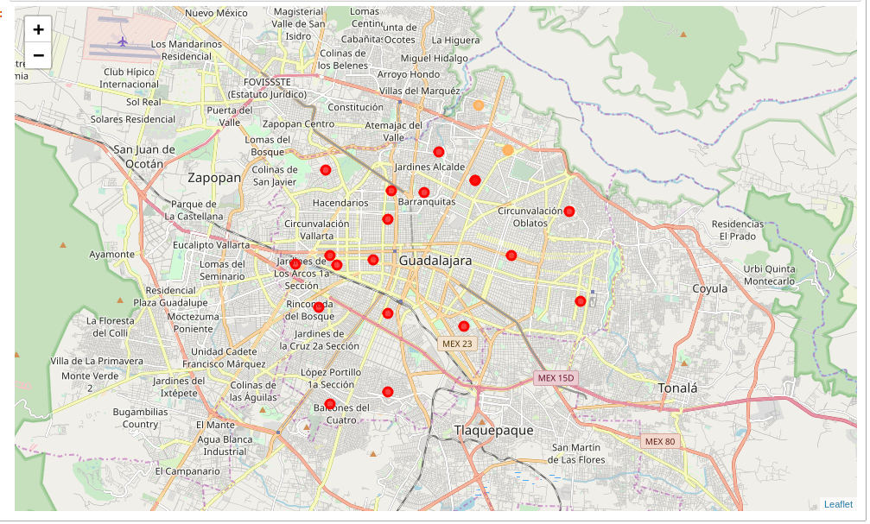
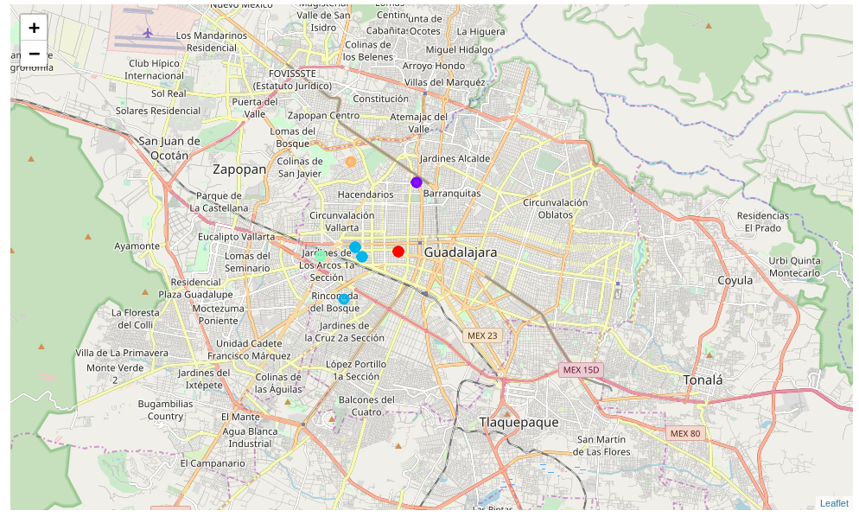
Modeling
- Two clusters created, one with all venue categories and the other one with bakeries, coffee shops and desert shops only
- Both models with 5 clusters
- Clusters displayed on map

Slide 5
Conclusion
- Using all venue categories didn’t showed up a lot information about neighborhoods that could give us an insight to take a decision.
- With the filtered data we got a better insight and concluding that around Colonia Barrera and Colonia Arcos Vallare are the best location to open a new bakery.

